Slide 1



Extracting Secret Keys from a Device's Power LED Using COTS Video Cameras
Ben Nassi
Real World Crypto’24

Slide 2
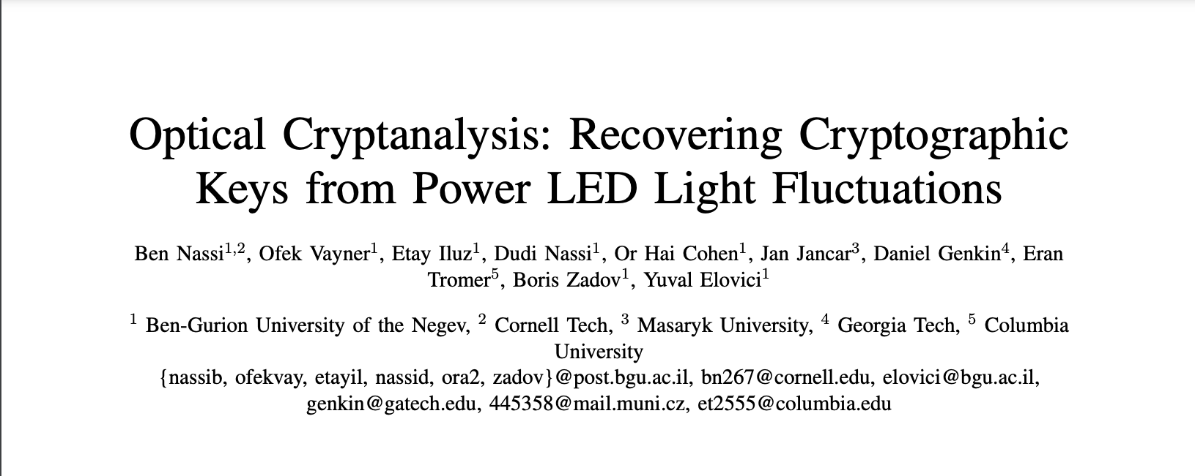
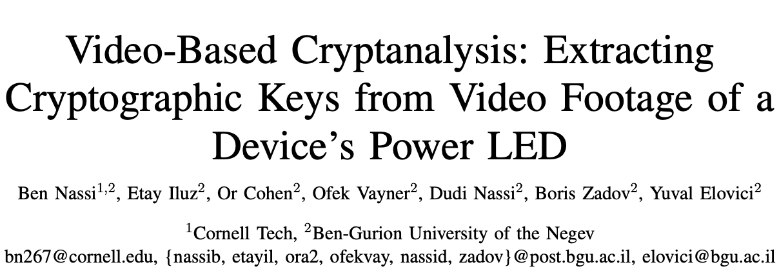
About This Talk
CCS’23
SP’24

Slide 3
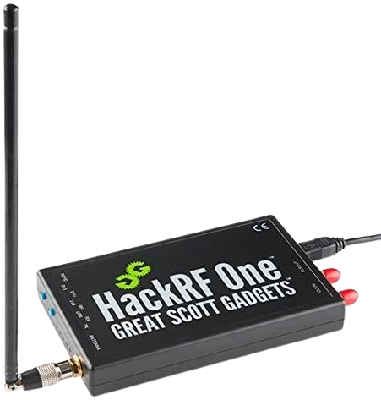
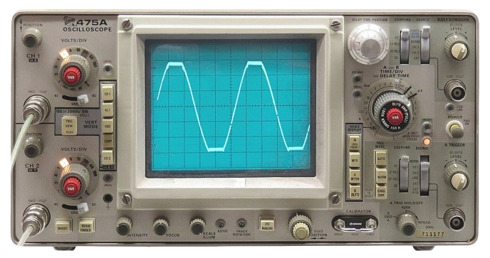
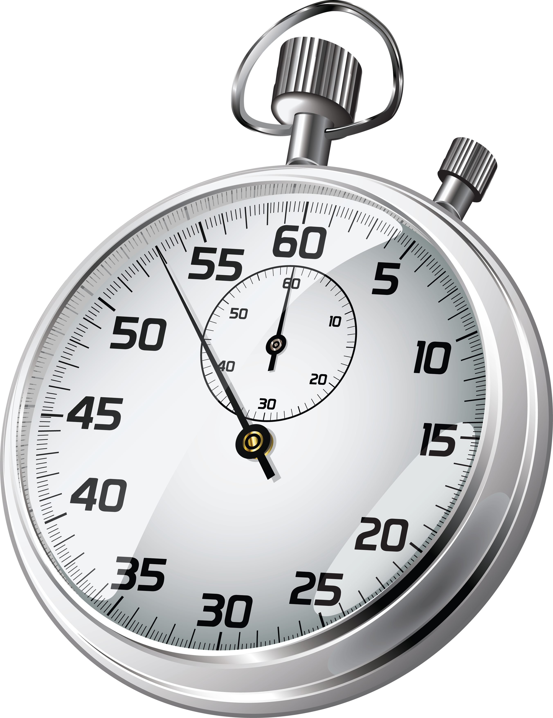
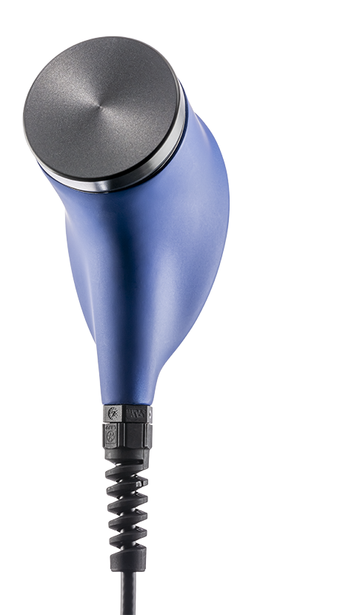

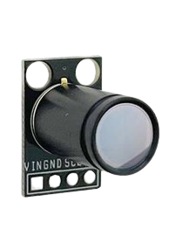
Cryptanalytic Side-Channel Attacks
EMR Leakage (01)
Agrawal, Dakshi, et al.
The EM sid—channel (s).
Power Leakage (99)
Paul Kocher, Joshua Jae, and Benjamin Jun
Differential Power Analysis
Acoustic Leakage (14)
Local Timing
Leakage (96)
Genkin, D., Shamir, A., & Tromer, E.
RSA key extraction via low-bandwidth acoustic cryptanalysis.
Kocher, Paul C.
Timing attacks on implementations of
Diffie-Hellman, RSA, DSS, and other systems.
Remote Timing
Leakage (05)
Optical Leakage (08)
Ferrigno, Julie, and M. Hlaváč.
When AES blinks: introducing optical side channel.
Brumley, D., & Boneh, D.
Remote timing attacks are practical.

Slide 4
Cryptanalytic Side-Channel Attacks
EMR Leakage (01)
Agrawal, Dakshi, et al.
The EM sid—channel (s).
Power Leakage (99)
Paul Kocher, Joshua Jae, and Benjamin Jun
Differential Power Analysis
Acoustic Leakage (14)
Local Timing
Leakage (96)
Genkin, D., Shamir, A., & Tromer, E.
RSA key extraction via low-bandwidth acoustic cryptanalysis.
Kocher, Paul C.
Timing attacks on implementations of
Diffie-Hellman, RSA, DSS, and other systems.
Remote Timing
Leakage (05)
Optical Leakage (08)
Over the last 28 years, research highlighted the fact that high end sensors (e.g., scopes, RF scanners, ultrasonic microphones) can be utilized to perform cryptanalysis by exploiting various channels (EMR, acoustic, etc).
Ferrigno, Julie, and M. Hlaváč.
When AES blinks: introducing optical side channel.
Brumley, D., & Boneh, D.
Remote timing attacks are practical.

Slide 5
Open Questions
Open question#1: can we apply cryptanalytic optical attacks to recover secret keys from commercial shielded devices running commonly used cryptographic libraries?
Yes.
By obtaining optical traces from a device’s power LED (Optical Cryptanalysis, CCS’23).
Open question#2: can we apply cryptanalytic side-channel attacks to recover secret keys with COTS devices instead of high-end sensors (scopes, RF scanners, SDR, ultrasonic microphones)?
Yes.
By recording the device’s power LED with a standard video camera and exploiting the rolling-shutter functionality
(Video-based Cryptanalysis, SP’24).

Slide 6
Optical Cryptanalysis (CCS’23)

Slide 7
Optical Cryptanalysis (CCS’23)
How did you think about the idea to recover secret keys from a device’s power LED?

Slide 8
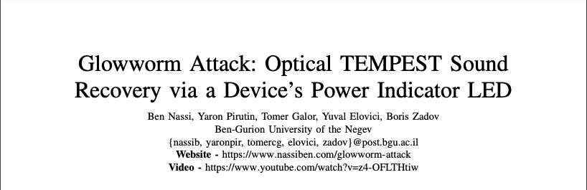
Glowworm Attack (CCS’21)

Slide 9
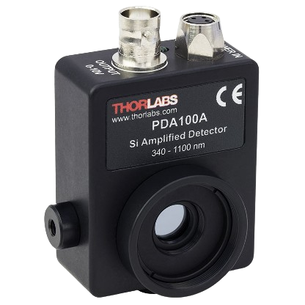
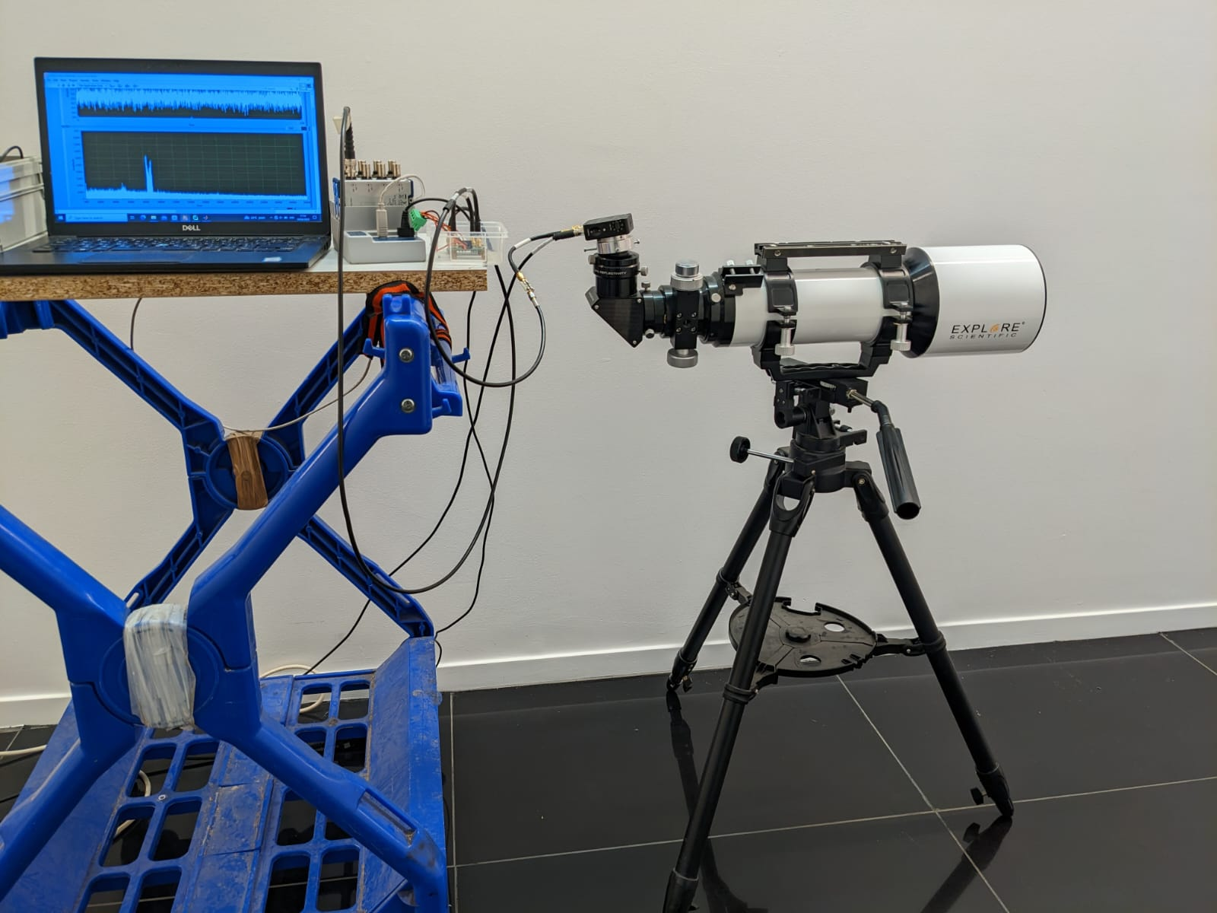
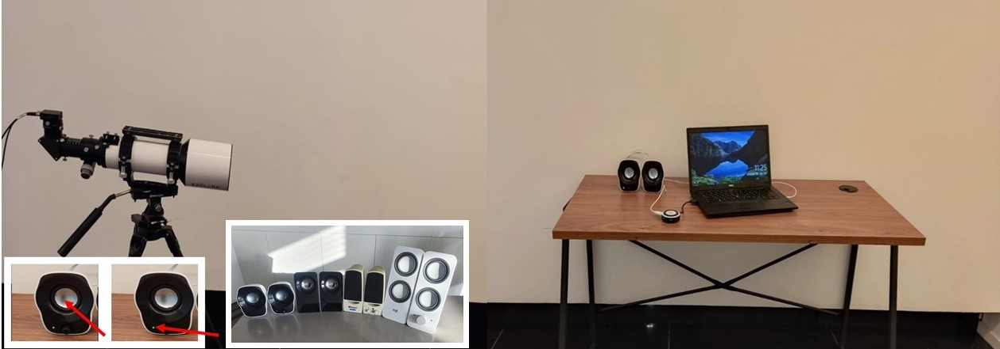
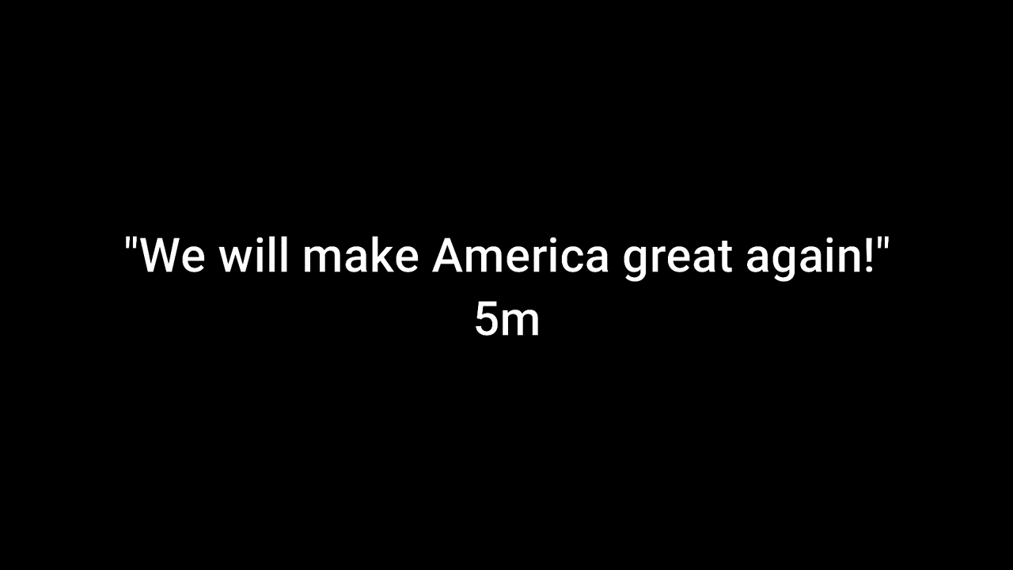
Glowworm Attack (CCS’21)
        Speech recovery using a photodiode
        Analyzing a speaker’s power LED intensity when speech is played
        Speech recovered from 35 meters
The photodiode
used

Slide 10
Glowworm Attack (CCS’21)
Why can the intensity of a speaker’s power LED be used to recover speech?

Slide 11
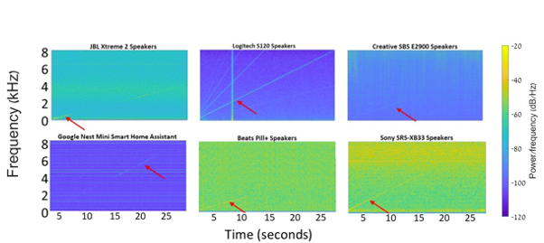
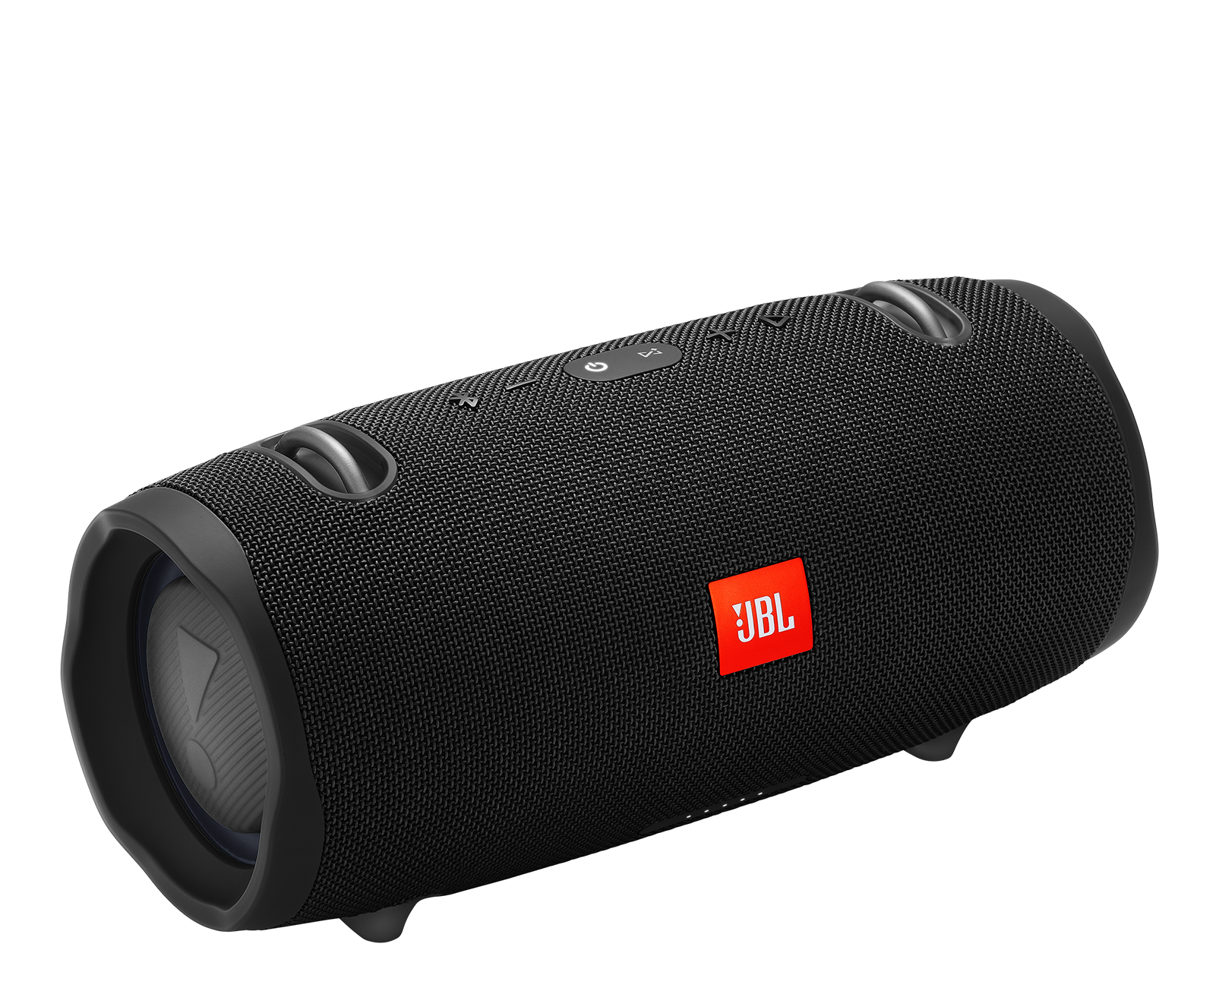
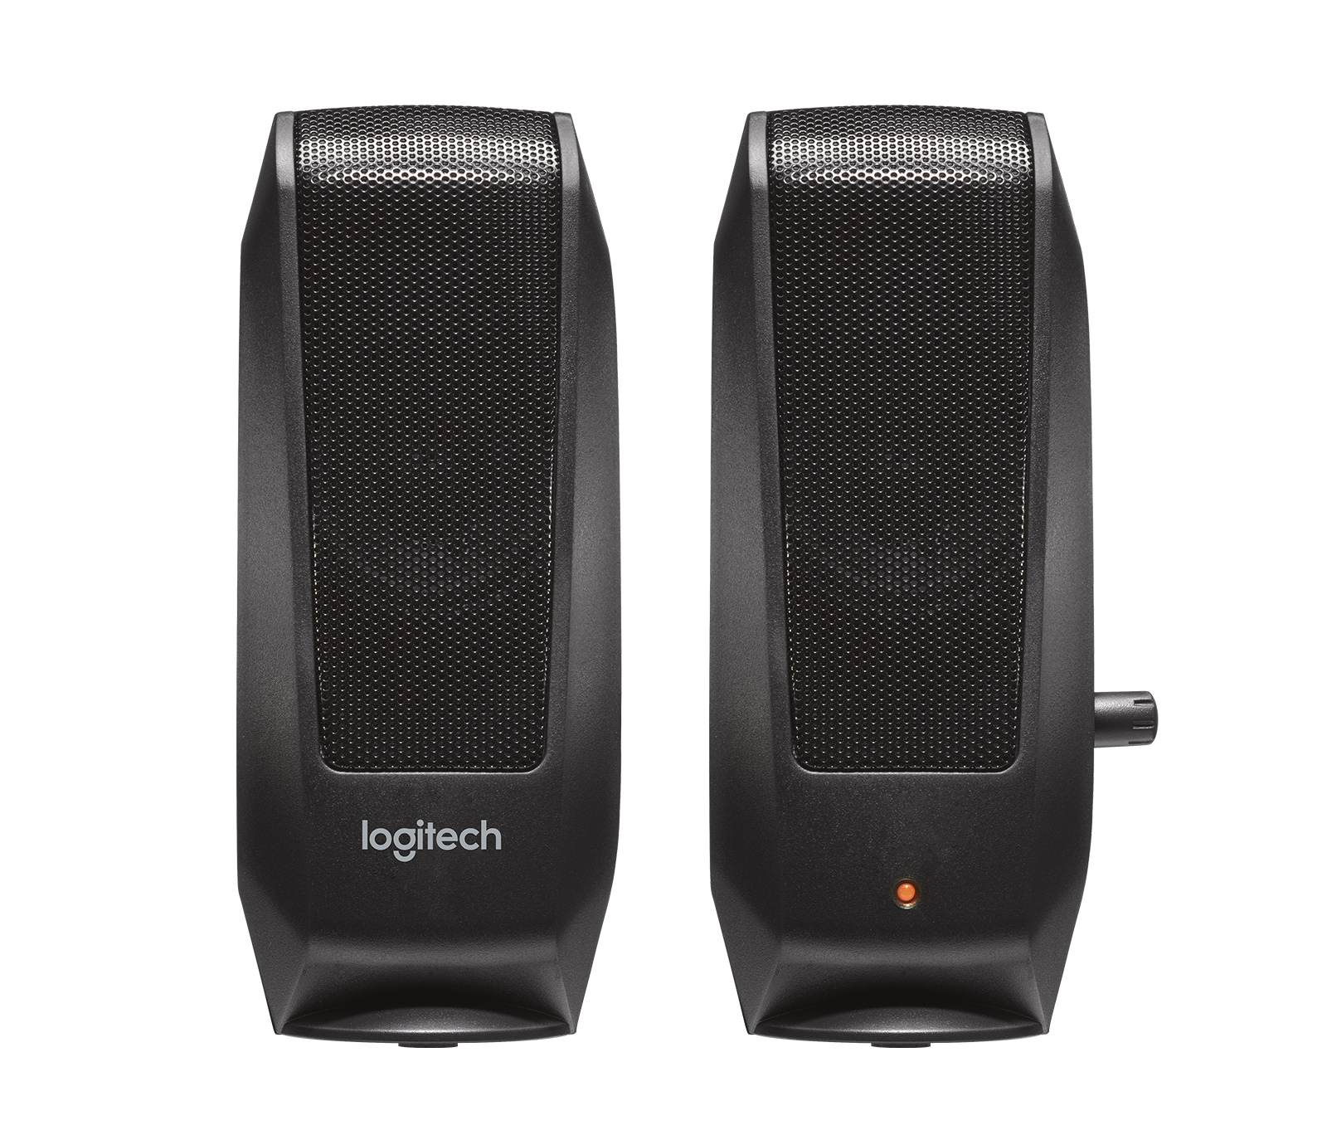
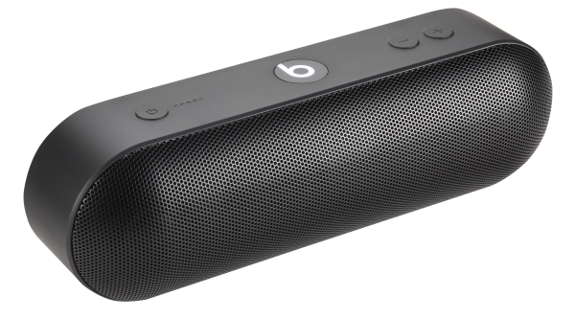
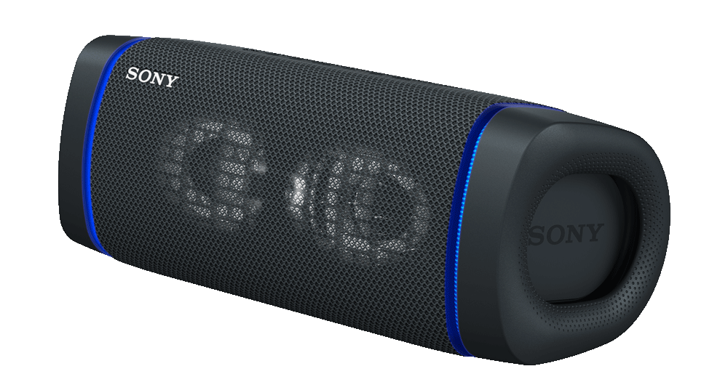
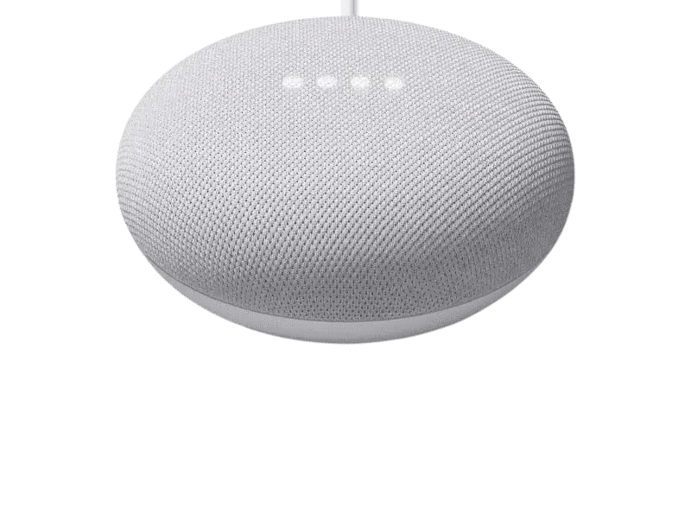
Glowworm Attack (CCS’21)
Why can the intensity of a speaker’s power LED be used to recover speech?
The intensity of speakers’ power LED corelates with the speakers’ power consumption which correlates with the audio played by the speakers

Slide 12
Glowworm Attack (CCS’21)
Why can the intensity of a speaker’s power LED be used to recover speech?
The intensity of speakers’ power LED corelates with the speakers’ power consumption which correlates with the audio played by the speakers
The intensity of a device’s power LED reflects the device’s power consumption.

Slide 13
Glowworm Attack (CCS’21)
Why?
In some electrical circuits, the integrated power LED is connected directly to the power line, and dedicated means of decoupling the optical and power correlation are either:
not integrated into the circuits
or are integrated into the circuits but ineffective.

Slide 14
Glowworm Attack (CCS’21)
Why?
In some electrical circuits, the integrated power LED is connected directly to the power line, and dedicated means of decoupling the optical and power correlation are either:
not integrated into the circuits
or are integrated into the circuits but ineffective.
As a result, the power consumption of the device (power supply to the integrated power LED) correlates with the intensity of the LED.

Slide 15
Glowworm Attack (CCS’21)
Why?
In some electrical circuits, the integrated power LED is connected directly to the power line, and dedicated means of decoupling the optical and power correlation are either:
not integrated into the circuits
or are integrated into the circuits but ineffective.
As a result, the power consumption of the device (power supply to the integrated power LED) correlates with the intensity of the LED.
With that in mind, I wanted to demonstrate an optical cryptanalytic side-channel attack using optical traces obtained from a device’s power LED.

Slide 16
Optical Cryptanalysis (CCS’23)
Objective – performing cryptanalysis by obtaining optical traces using a photodiode from a device’s power LED.

Slide 17
Optical Cryptanalysis (CCS’23)
Can we detect the beginning and the end of cryptographic operations performed by the device?

Slide 18
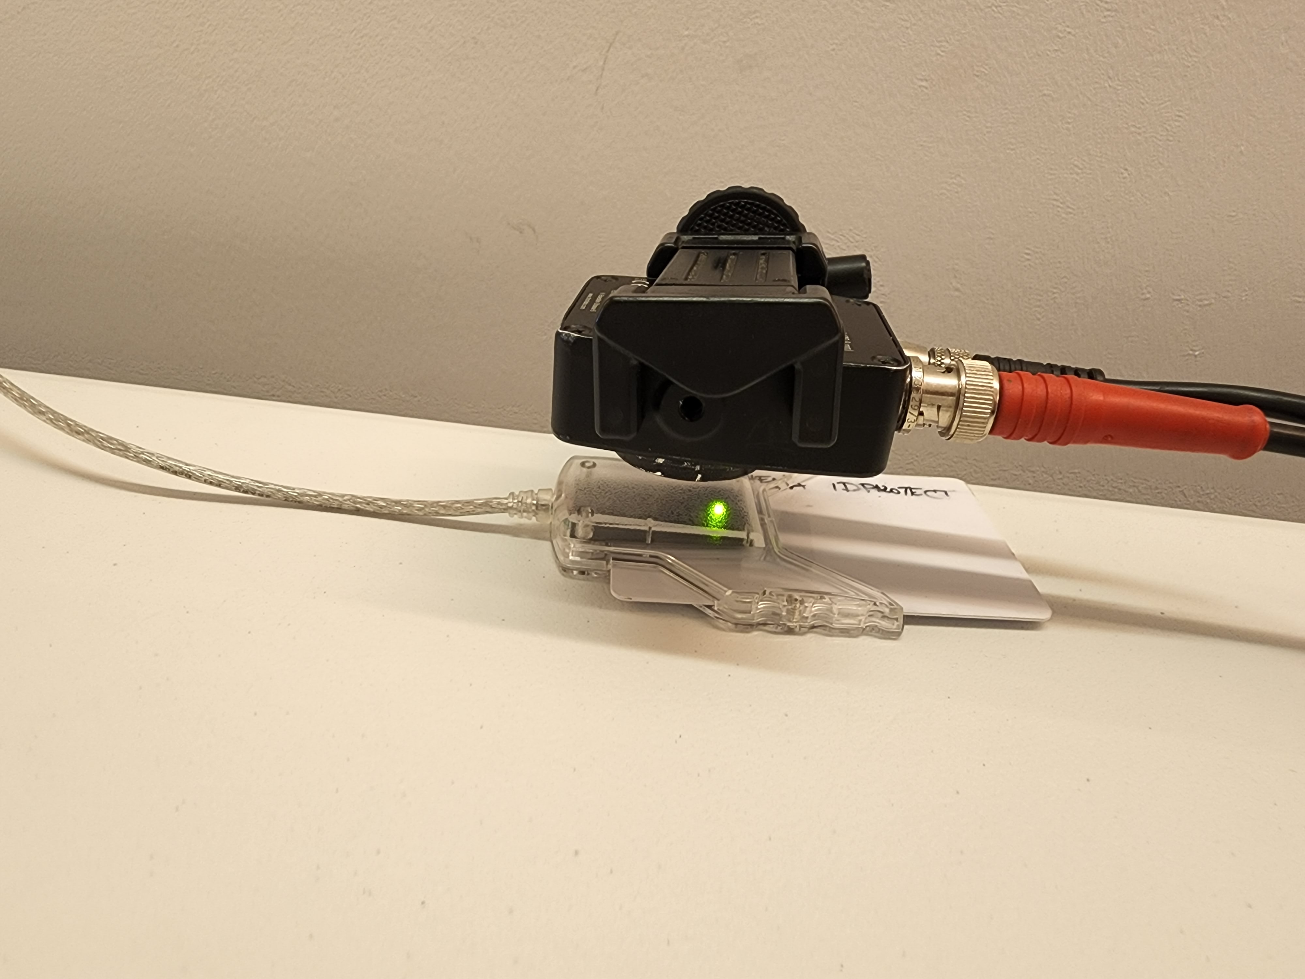
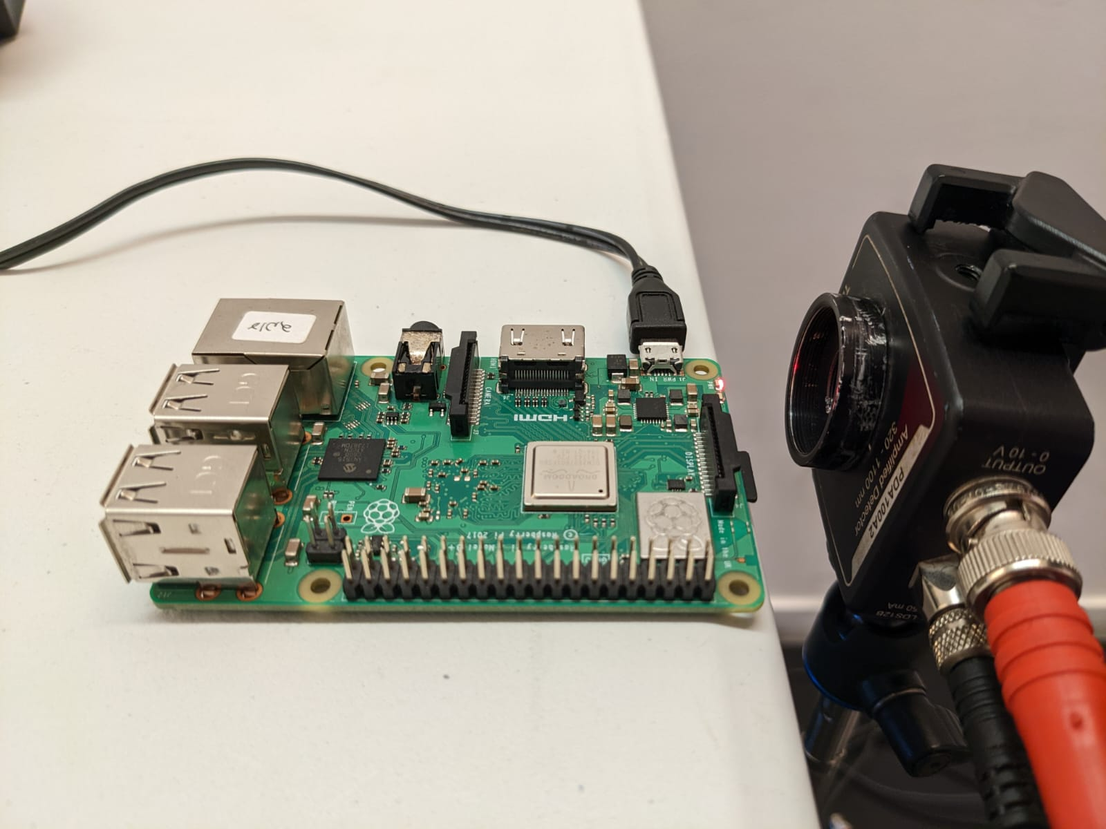
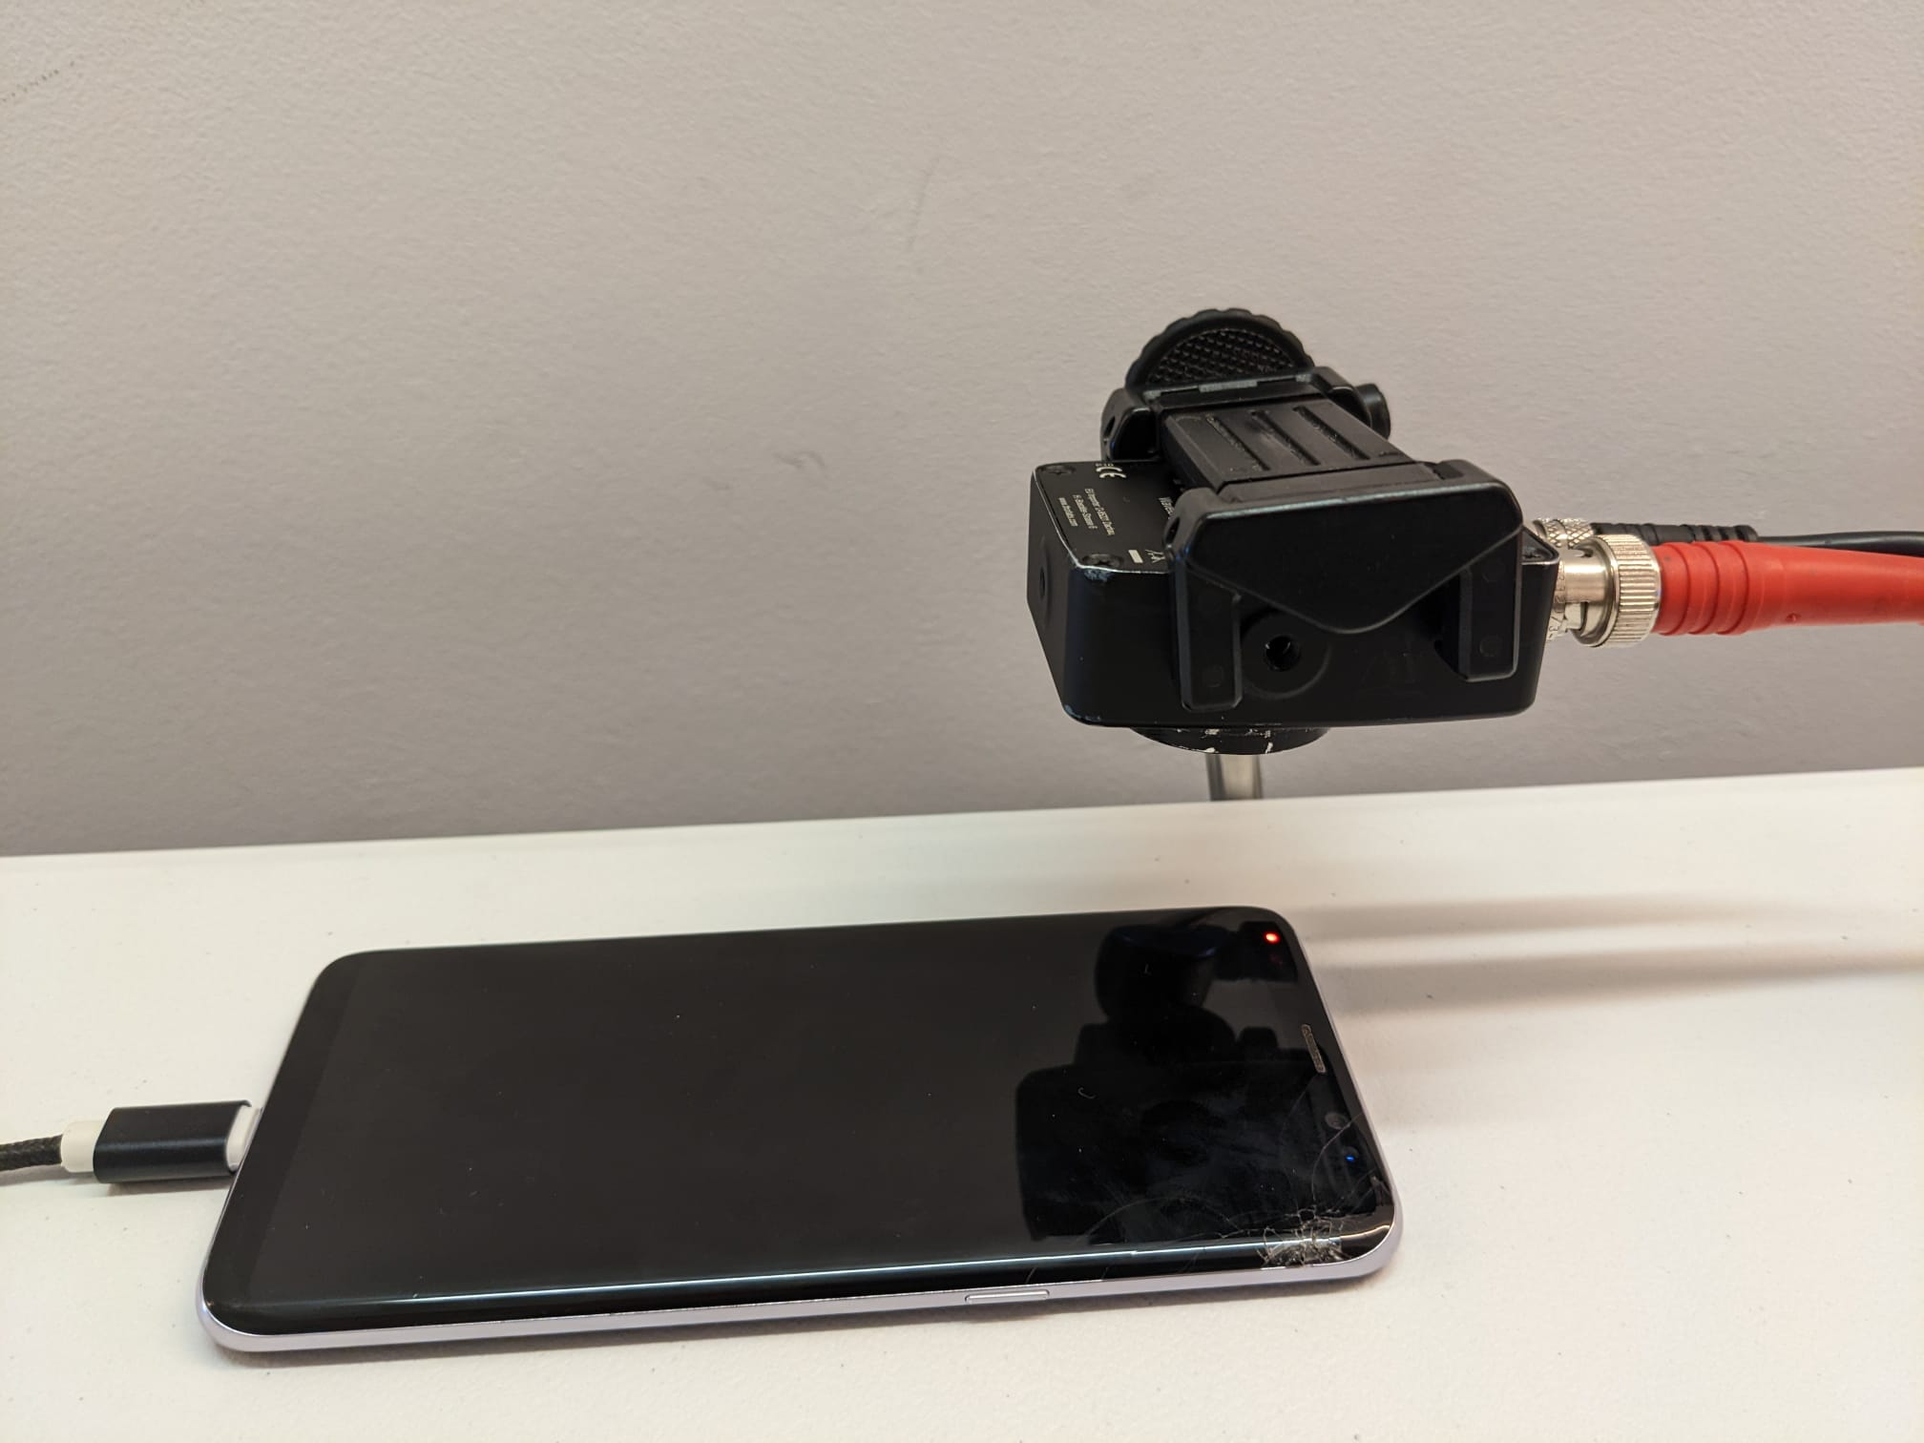
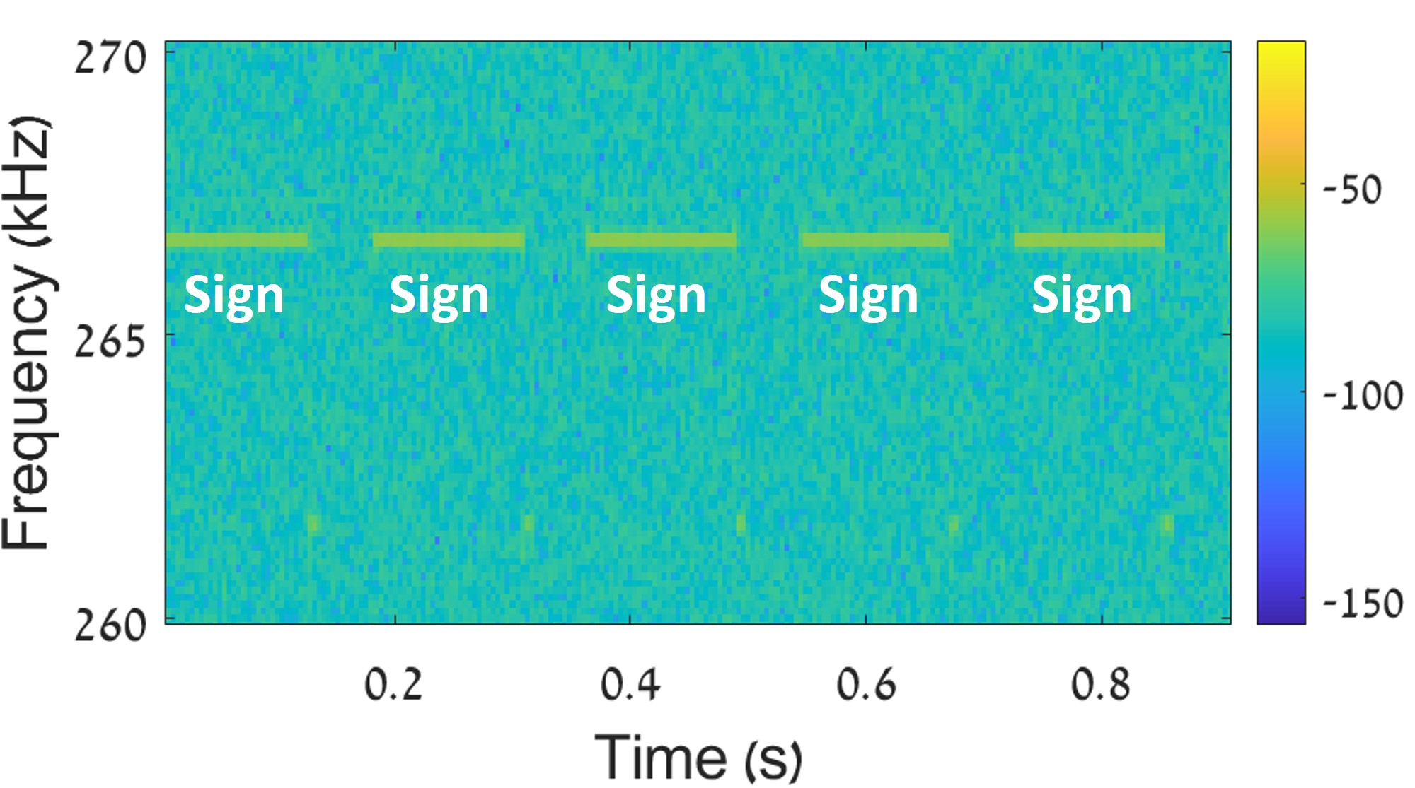
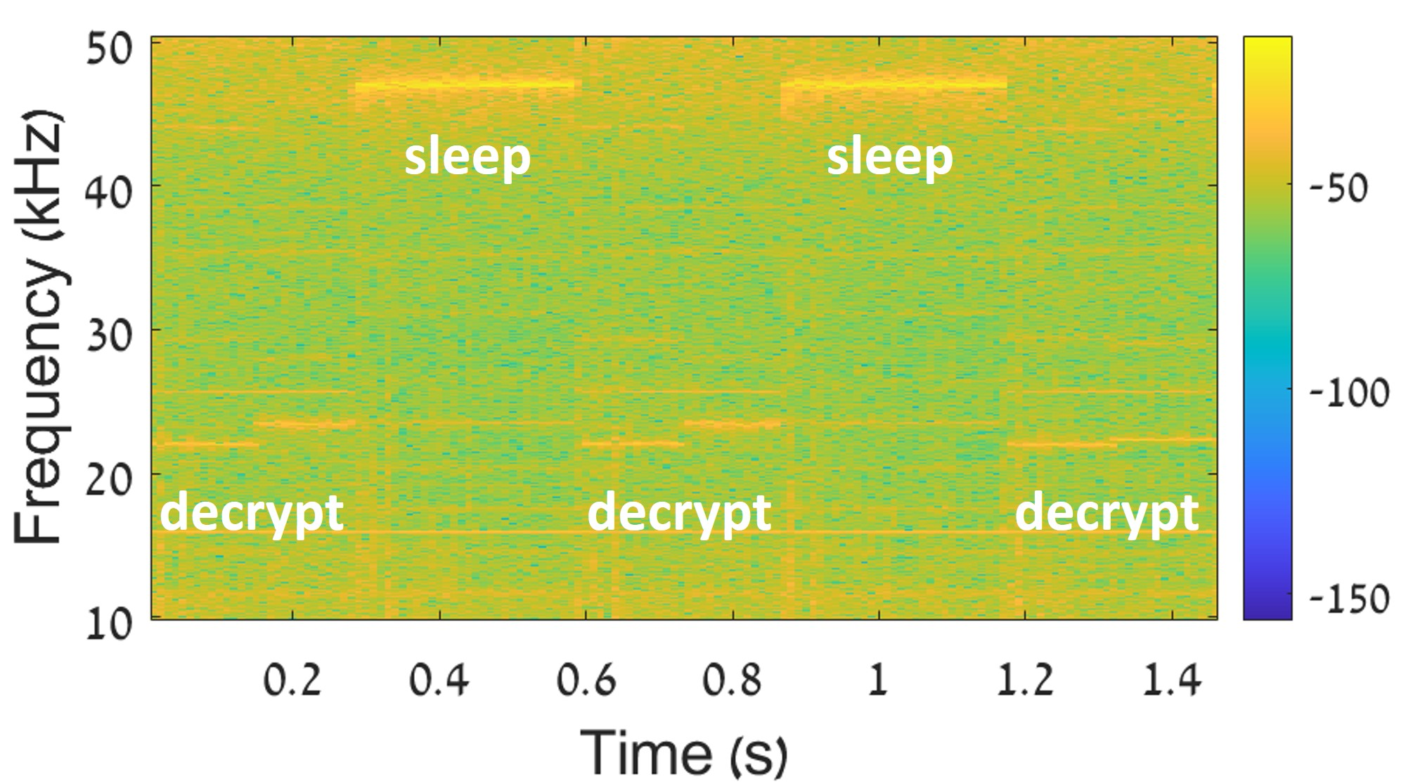
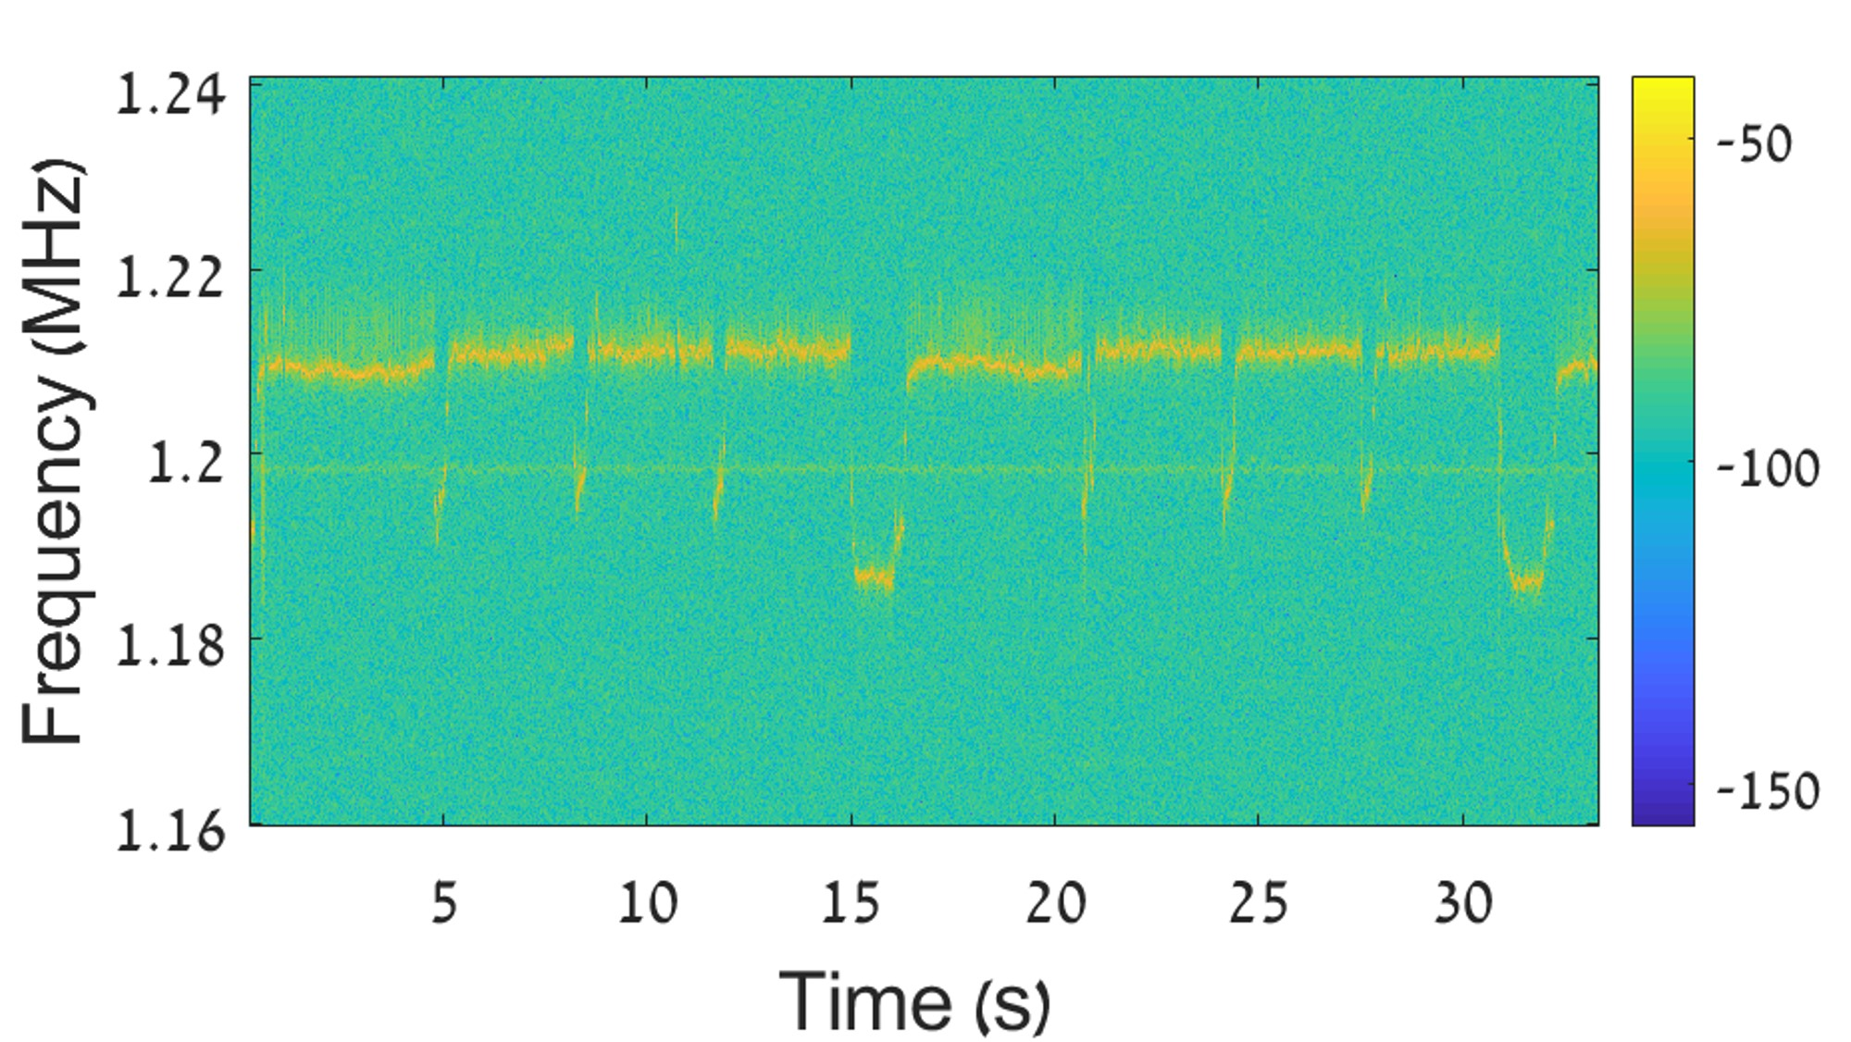
Optical Cryptanalysis (CCS’23)
Can we detect the beginning and the end of cryptographic operations performed by the device?
ECDSA signs (smartcard)
RSA decryptions (GnuPG on RP)
SIKE operations (PQCrypto-SIDH 3.4 on Samsung S8)
The beginning and the end of cryptographic operations can be spotted in optical traces obtained from power LED of various devices.

Slide 19
Optical Cryptanalysis (CCS’23)
Can we detect the beginning and the end of cryptographic operations performed by the device?
ECDSA signs (smartcard)
RSA decryptions (GnuPG on RP)
SIKE operations (PQCrypto-SIDH 3.4 on Samsung S8)
We can use optical traces to perform cryptanalytic attacks against COTS shielded devices running commonly used cryptographic libraries

Slide 20
Optical Cryptanalysis
GnuPG 4096 bit
Acoustic Cryptanalysis RSA Key
We recovered a 4096-bit RSA key from the power LED of RP by replicating the 2014 Acoustic Cryptanalysis attack.

Slide 21
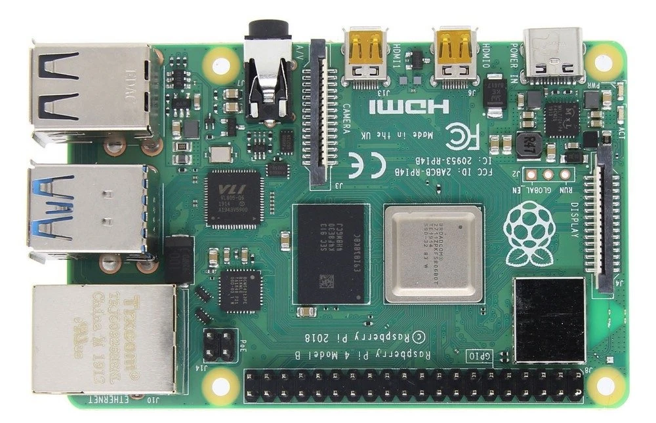
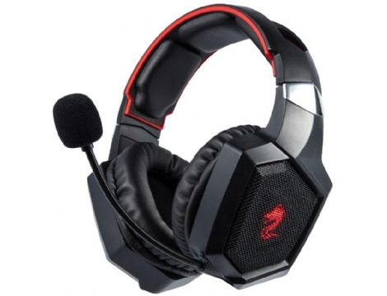
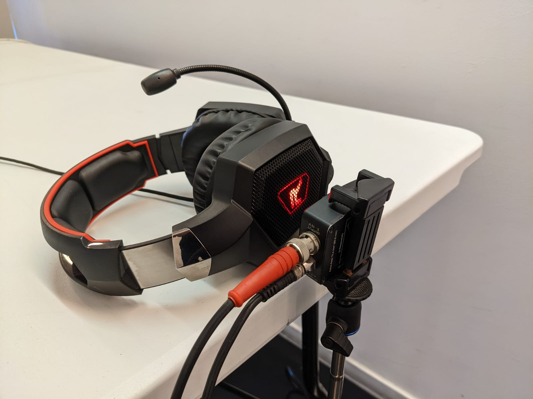
Optical Cryptanalysis
GnuPG 4096 bit
Acoustic Cryptanalysis RSA Key
Libgcrypt 256-bit 256-bit 256-bit
Minerva (2020) ECDSA key ECDSA key ECDSA key
We recovered a 256-bit ECDSA key from the power LED of various devices (RP, connected headphones, of smartcard reader) by replicating the 2020 Minerva attack.

Slide 22
Optical Cryptanalysis
GnuPG 4096 bit
Acoustic Cryptanalysis RSA Key
Libgcrypt 256-bit 256-bit 256-bit
Minerva (2020) ECDSA key ECDSA key ECDSA key
PQCrypto-SIDH 378-bit
HertzBleed SIKE key
We recovered a 378-bit SIKE key from the power LED of Samsung Galaxy S8 by replicating the 2022 HertzBleed attack.

Slide 23
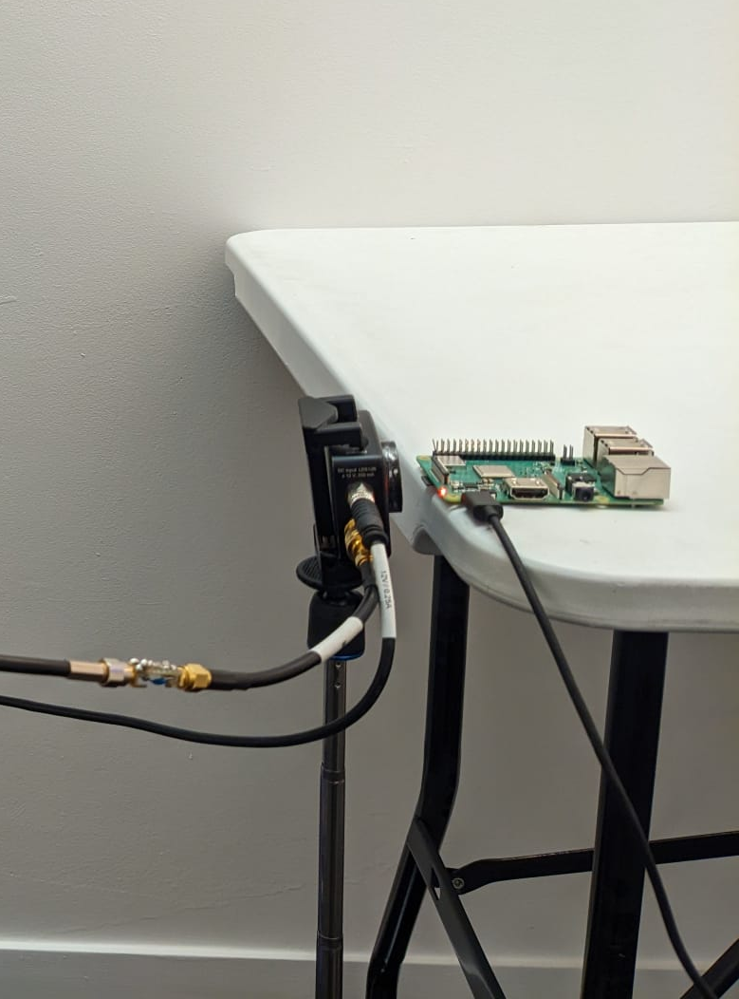
Limitations
Primary disadvantage: Photodiodes are not commonly used sensors, and attackers must connect them to a dedicated ADC in order to obtain optical measurements.

Slide 24
Limitations
Solution: Let’s perform cryptanalysis by using ubiquitous video cameras (instead of photodiodes).

Slide 25
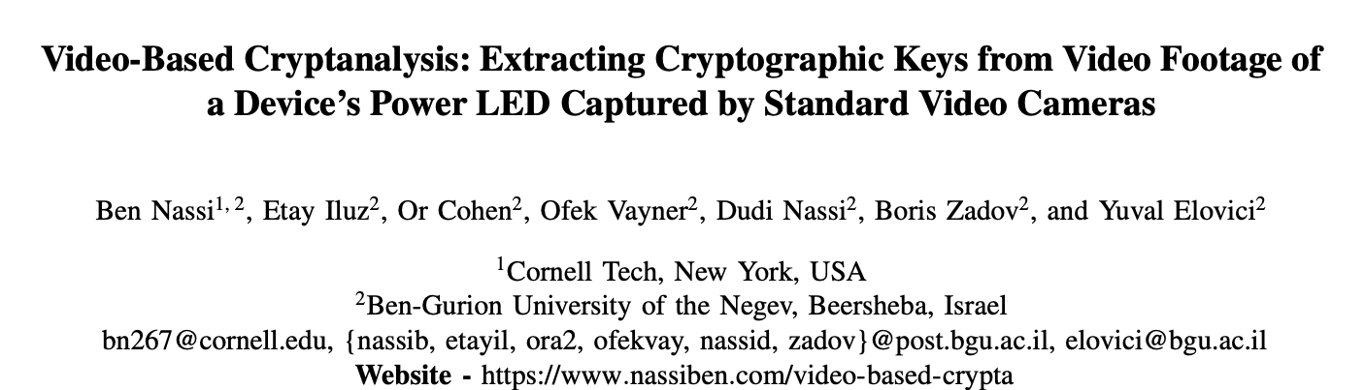
Video-based Cryptanalysis (SP’24)

Slide 26
Video-based Cryptanalysis (SP’24)
Objective – performing cryptanalysis by recording a device’s power LED using COTS video camera.

Slide 27
Video-based Cryptanalysis - Challenges
Objective – performing cryptanalysis by recording a device’s power LED using COTS video camera.
So far, we’ve used photodiodes, which are analog sensors that can be sampled at a few GHz.

Slide 28
Video-based Cryptanalysis - Challenges
Objective – performing cryptanalysis by recording a device’s power LED using COTS video camera.
So far, we’ve used photodiodes, which are analog sensors that can be sampled at a few GHz.
Video cameras can record 60 or 120 frames per second.

Slide 29
Video-based Cryptanalysis - Challenges
Objective – performing cryptanalysis by recording a device’s power LED using COTS video camera.
So far, we’ve used photodiodes, which are analog sensors that can be sampled at a few GHz.
Video cameras can record 60 or 120 frames per second.
A sampling rate of 60 frames per second is not sufficient to perform cryptanalysis.

Slide 30
Video-based Cryptanalysis - Challenges
Objective – performing cryptanalysis by recording a device’s power LED using COTS video camera.
So far, we’ve used photodiodes, which are analog sensors that can be sampled at a few GHz.
Video cameras can record 60 or 120 frames per second.
A sampling rate of 60 frames per second is not sufficient to perform cryptanalysis.
Or is it?

Slide 31

Rolling Shutter
99% of video cameras use a rolling shutter to record a video.
        A single picture is the result of multiple snapshots taken at different times by the video camera.
        A video camera uses a rolling shutter to scan an object vertically or horizontally and combines the scanned pieces into a single frame.

Slide 32
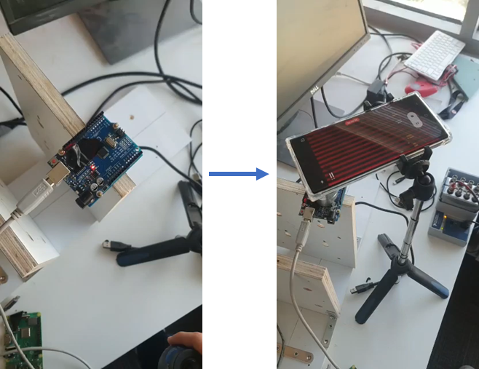
Rolling Shutter
Experiment
We programmed an Arduino to turn its power LED on and off in 4 kHz.

Slide 33
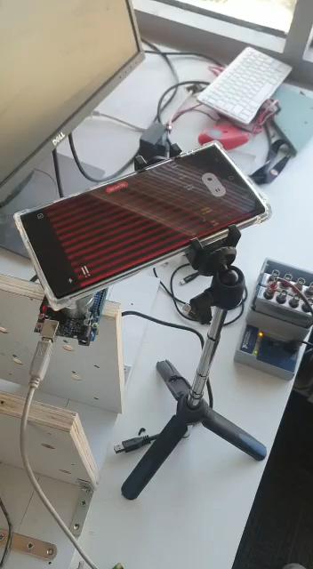

Rolling Shutter
Experiment
We programmed an Arduino to turn its power LED on and off in 4 kHz.
An extra lens was used to direct the camera of a Samsung Galaxy S22 Ultra to the Arudino’s power LED, so that the view of the LED fills the entire frame.
The result

Slide 34
Rolling Shutter
Experiment
We programmed an Arduino to turn its power LED on and off in 4 kHz.
An extra lens was used to direct the camera of a Samsung Galaxy S22 Ultra to the Arudino’s power LED, so that the view of the LED fills the entire frame.
By filling the frame with the view of the LED, we exploit a video camera’s rolling shutter to increase the number of measurements obtained at different times.
The result

Slide 35
Rolling Shutter
Experiment
We programmed an Arduino to turn its power LED on and off in 4 kHz.
An extra lens was used to direct the camera of a Samsung Galaxy S22 Ultra to the Arudino’s power LED, so that the view of the LED fills the entire frame.
By filling the frame with the view of the LED, we exploit a video camera’s rolling shutter to increase the number of measurements obtained at different times.
The result
This allows us to detect the 4 kHz flicker even with 60 frames

Slide 36
Rolling Shutter
Experiment
We programmed an Arduino to turn its power LED on and off in 4 kHz.
An extra lens was used to direct the camera of a Samsung Galaxy S22 Ultra to the Arudino’s power LED, so that the view of the LED fills the entire frame.
Theoretically, by exploiting a video camera’s rolling shutter, we can increase the sampling rate by three orders of magnitude: from the FPS rate (60 measurements per second) to the rolling shutter rate (60K).
The result

Slide 37
Rolling Shutter
Experiment
We programmed an Arduino to turn its power LED on and off in 4 kHz.
An extra lens was used to direct the camera of a Samsung Galaxy S22 Ultra to the Arudino’s power LED, so that the view of the LED fills the entire frame.
Now, let’s discuss the ECDSA key recovery.
The result

Slide 38
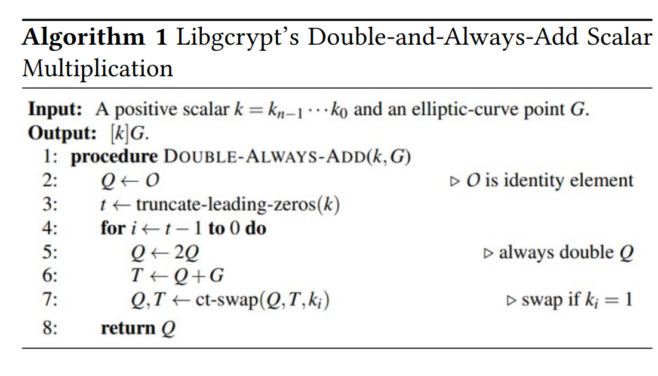

Recovering ECDSA Keys
Signatures +
Signing time of a
set of ECDSA signatures
Minerva Attack
Black Box
ECDSA Key
0xD10B…..0F, 143.2 ms
………………………..
……………………….
……………………
…………………
……………..
.
Information on the nonces
Hidden Number Problem (Boneh et al.)
Closest Vector Problem
Lattice Reduction &
Babai’s Nearest
Plane Algorithm
Private
instance
Transform
Solvable
Minerva recovers ECSDSA key from a set of ECDSA signatures with associated signing times

Slide 39
Recovering ECDSA Keys
Signatures +
Signing time of a
set of ECDSA signatures
Minerva Attack
Black Box
ECDSA Key
0xD10B…..0F, 143.2 ms
………………………..
……………………….
……………………
…………………
……………..
.
Information on the nonces
Hidden Number Problem (Boneh et al.)
Closest Vector Problem
Lattice Reduction &
Babai’s Nearest
Plane Algorithm
Private
instance
Transform
Solvable
How can the ECDSA signing time of a signature be estimated from a video?

Slide 40
Recovering ECDSA Keys
16 meters
Objective: Recovering a 256-bit ECDSA key from a smartcard using video footage
of the power LED of the smartcard reader obtained by an Internet-connected video-camera.

Slide 41
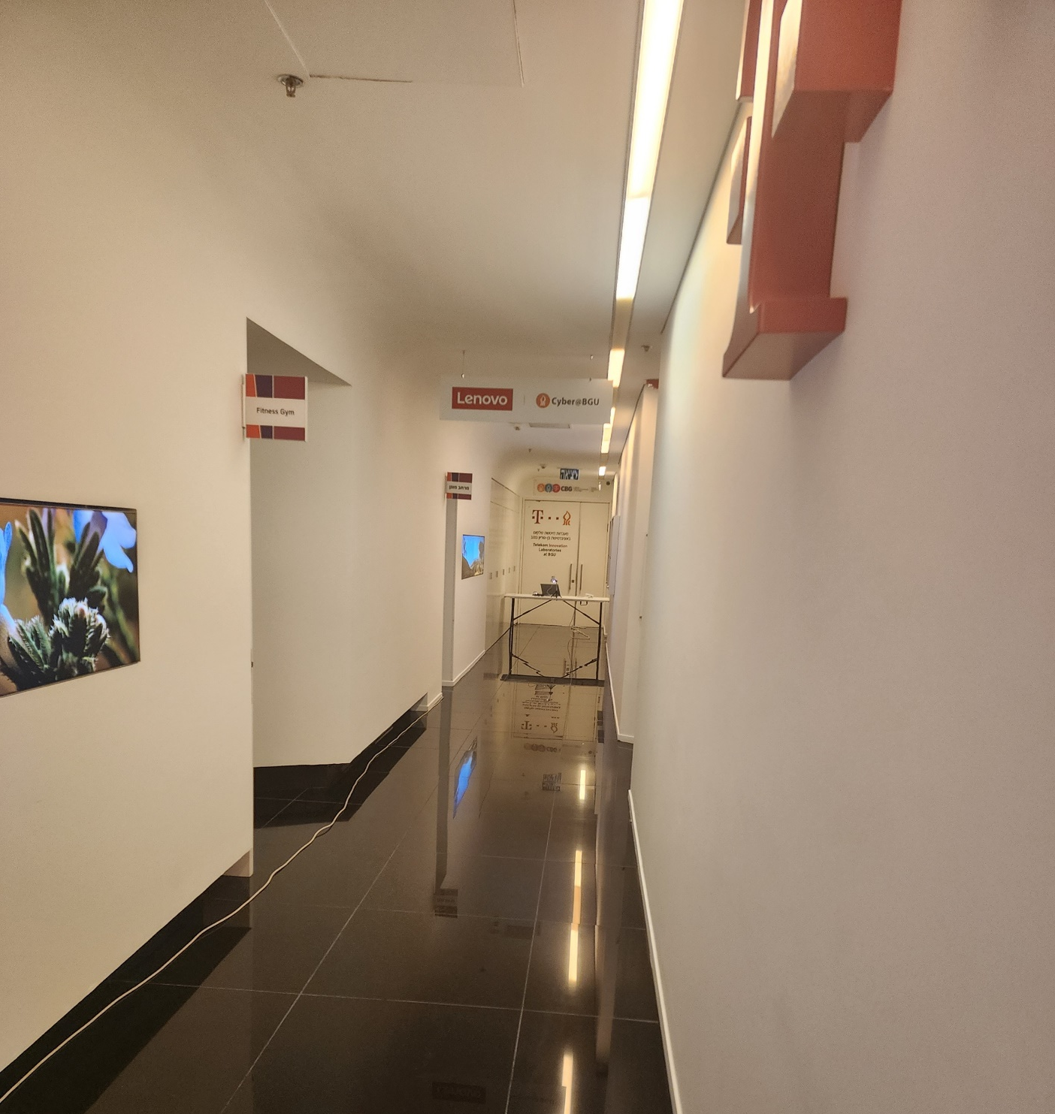
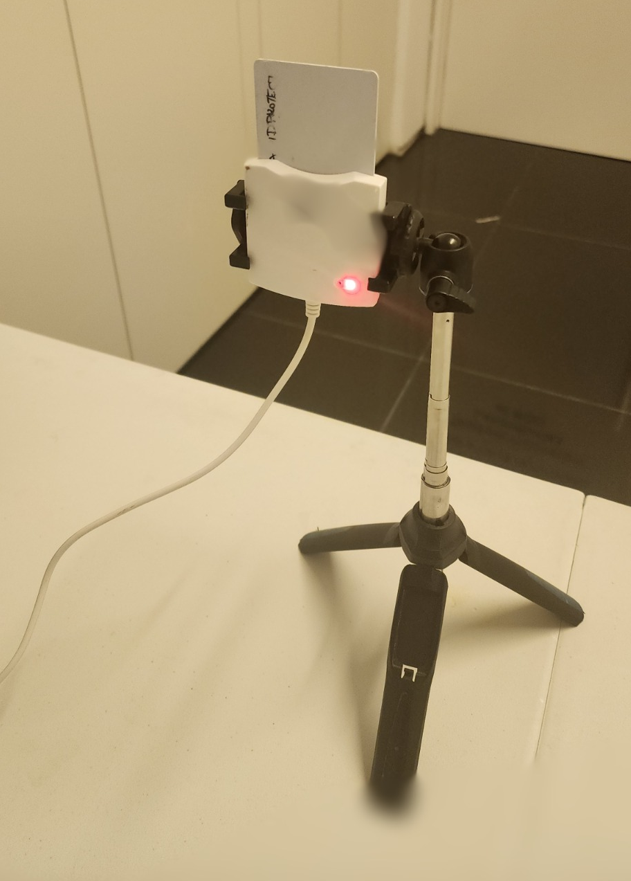
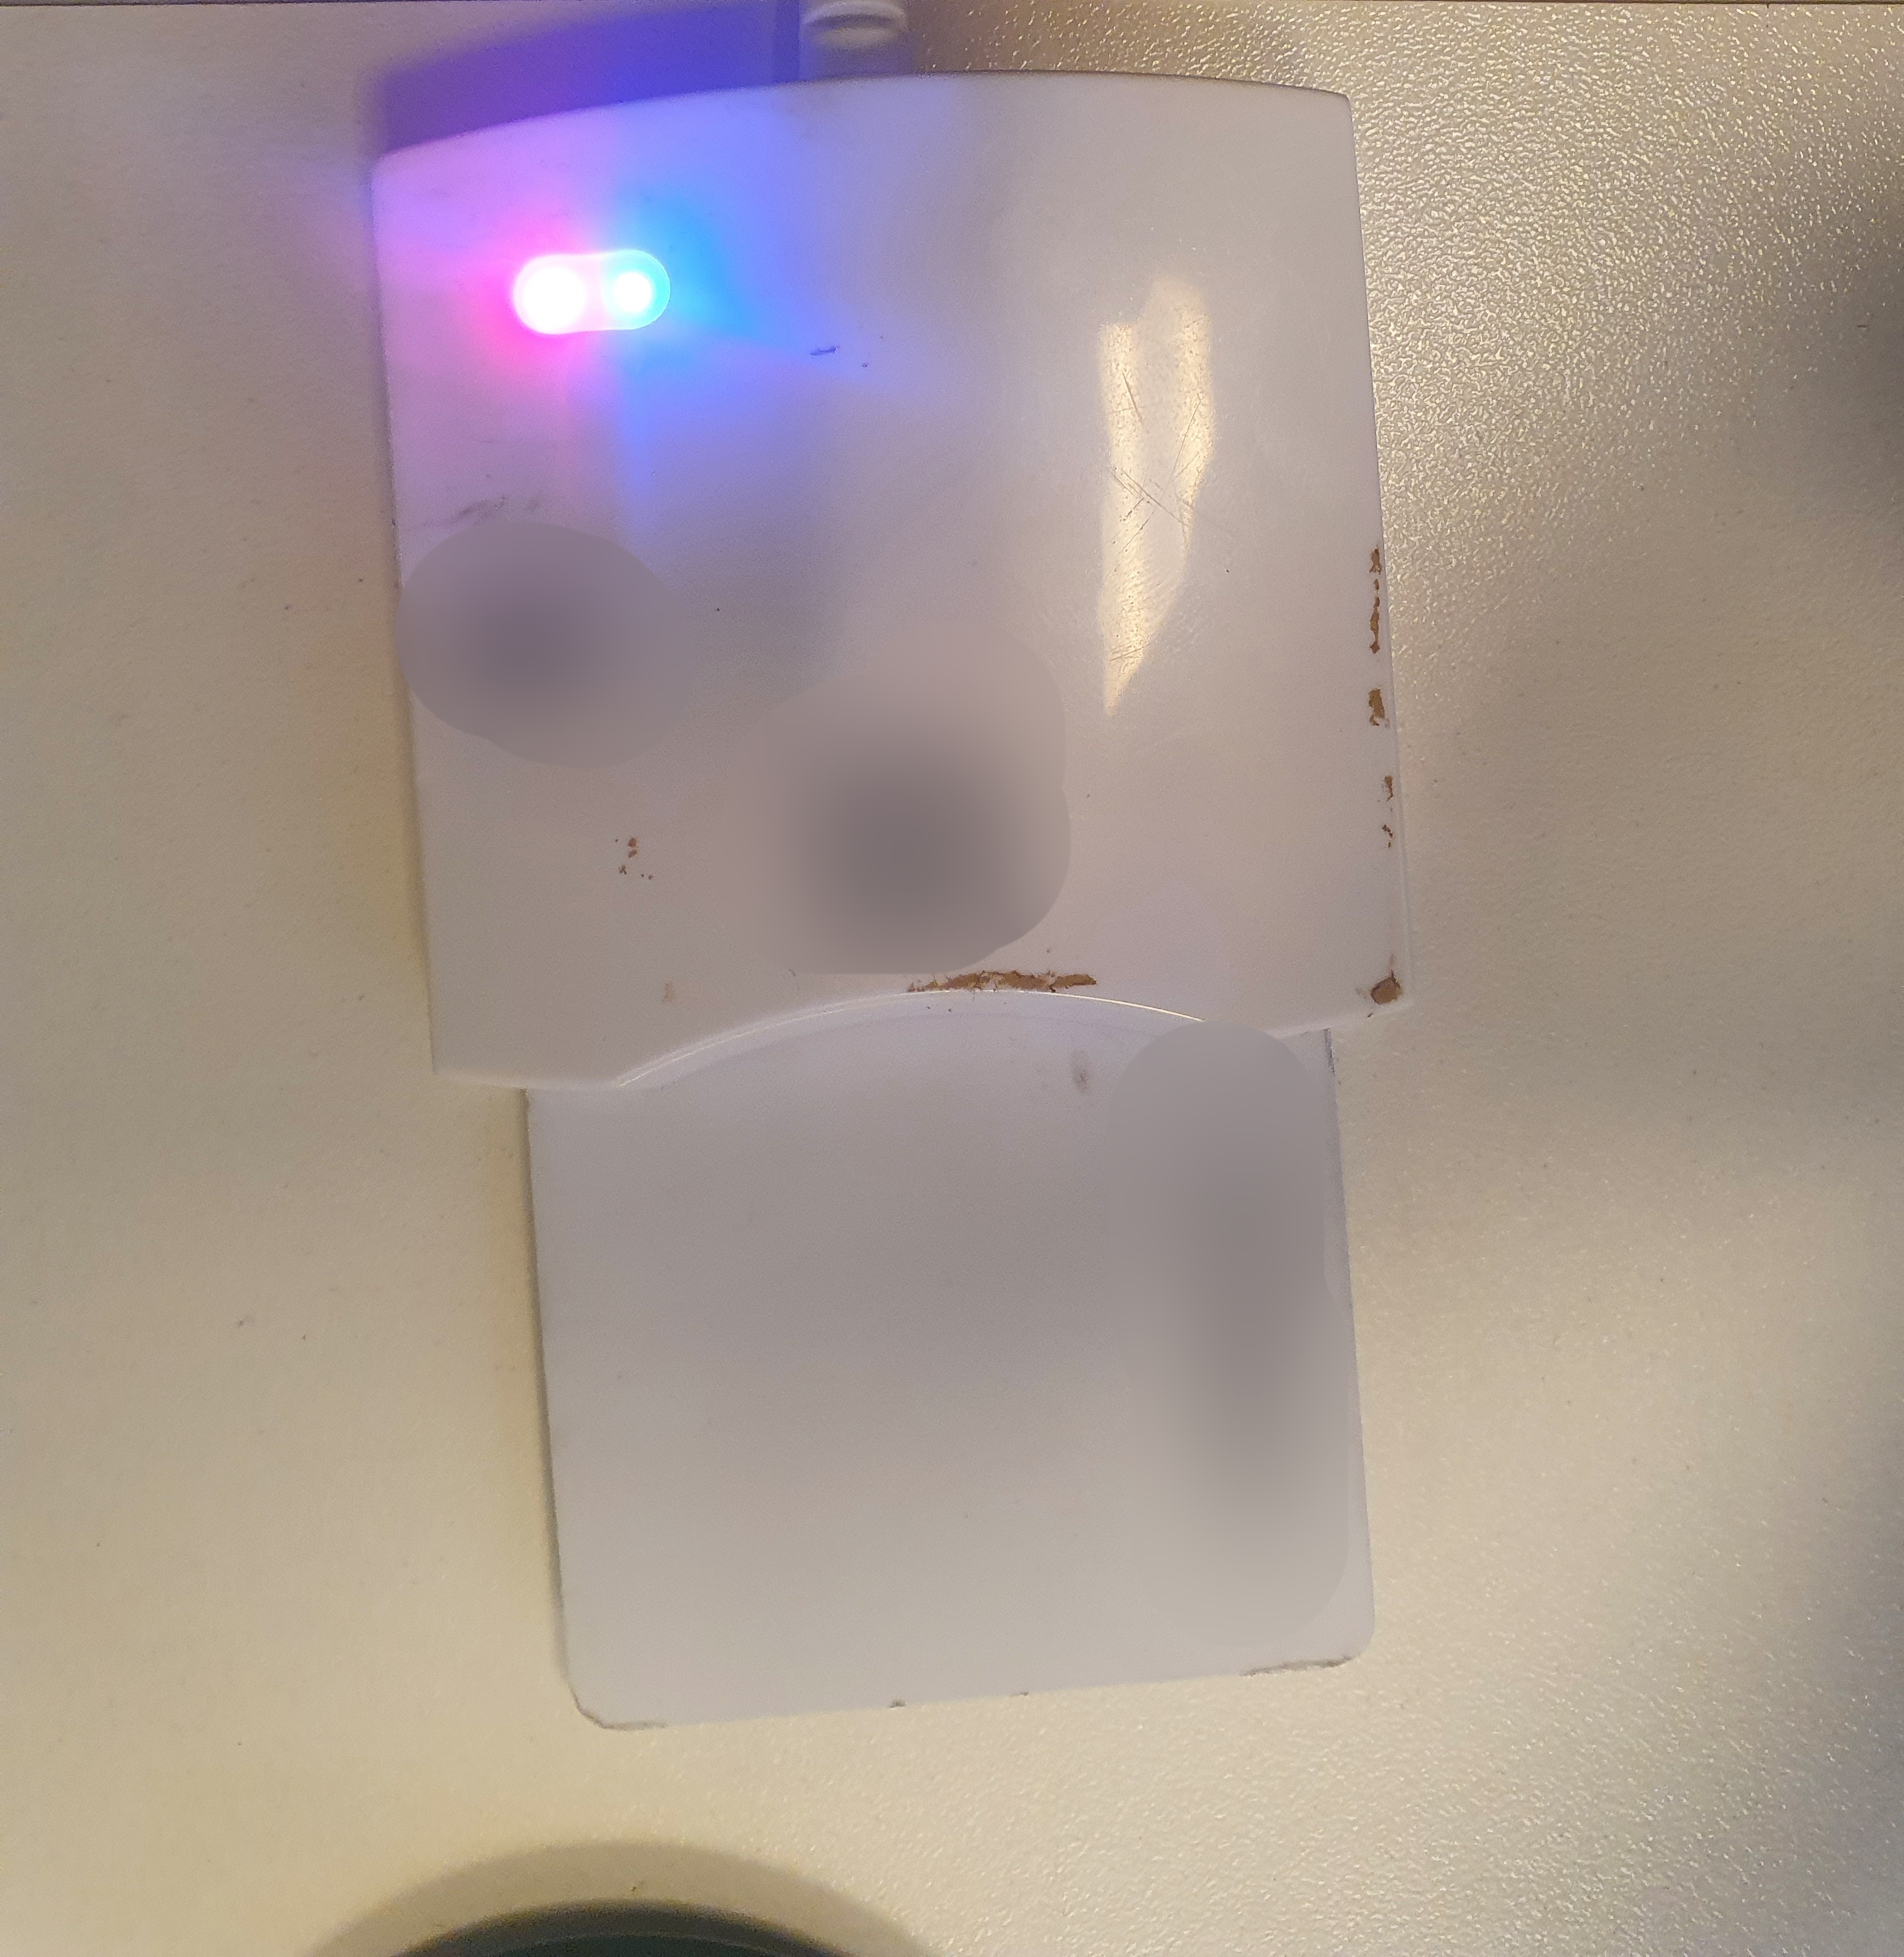
Recovering ECDSA Keys
Right LED
On (Blue) = idle
Off = ECDSA Sign

Slide 42
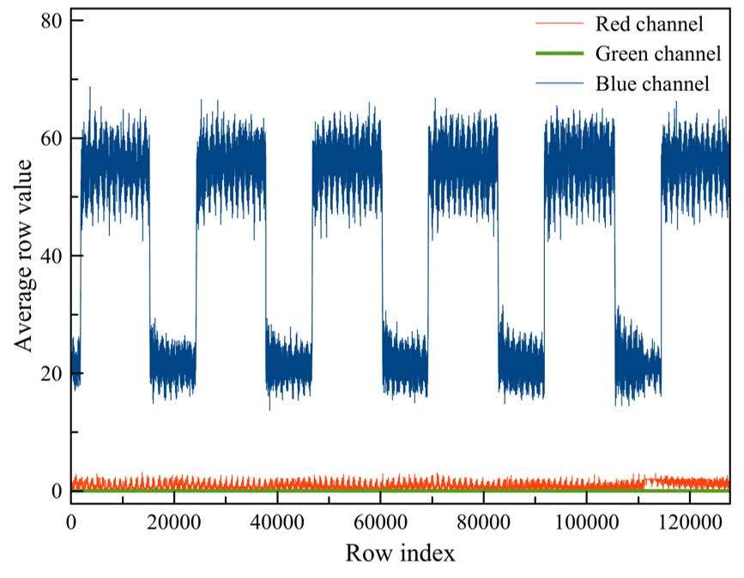
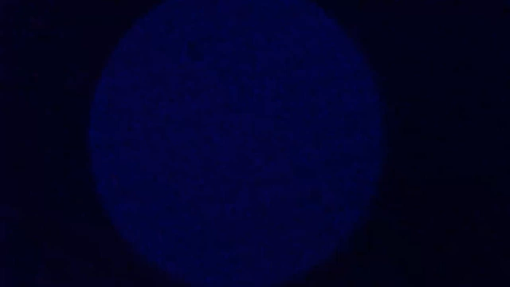
Recovering ECDSA Keys

Slide 43
Recovering ECDSA Keys
By averaging each row in a frame to a single value and arranging them in a time series, we can distinguish between sign operations (the power LED is off) and idle operations (the color of the power LED is blue) based on the blue channel.
But how can we calculate the signing time?

Slide 44
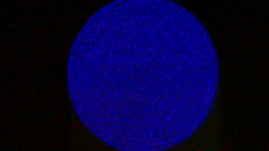
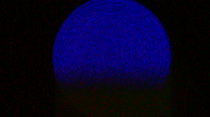
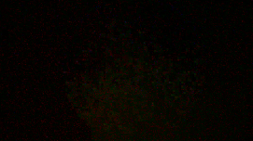
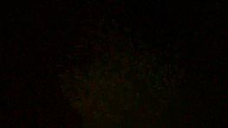
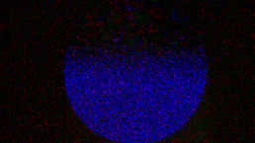
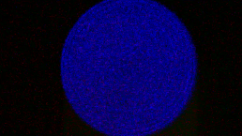
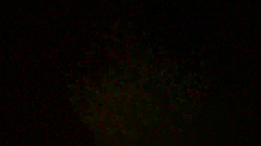




Recovering ECDSA Keys
Calculating the ECDSA signing time
We extracted the series of frames associated with each signature from the video.
$$F_{start}$$
$$F_{start+1}$$
Time
$$F_{end−1}$$
$$F_{end}$$

Slide 45


Recovering ECDSA Keys
Calculating the ECDSA signing time
We extracted the series of frames associated with each signature from the video.
We kept series that contained the indication of the switch between the beginning and the end of signing, i.e. that the beginning and the end of the signing were captured in the frames (we filtered series in which one of the indications is missing).
Beginning of the sign operation
End of the sign operation
The operation started during the transition/dead time
Missing indication
for the beginning
of sign operation
The operation ended during the transition/dead time
$$F_{start}$$
$$F_{start+1}$$
Time
$$F_{end−1}$$
$$F_{end}$$
Missing indication
for the end
of sign operation

Slide 46








Recovering ECDSA Keys
Calculating the ECDSA signing time
We extracted the series of frames associated with each signature from the video.
We filtered any series that started/ended during the transition time.
We calculated $T_{1}$ = the execution time of all of the frames ($F_{start+1} ….F_{end+1}$).
We calculated $T_{2}$= the execution time of the first frame in which the color changed ($F_{start}$).
We calculated $T_{3}$= the execution time of the last frame in which the color changed ($F_{end}$).
Sign time = $T_{1}+T_{2}+T_{3}$.
$$T_{2}$$
$$T_{1}$$
$$T_{3}$$
$$F_{start}$$
$$F_{start+1}$$
Time
$$F_{end−1}$$
$$F_{end}$$

Slide 47
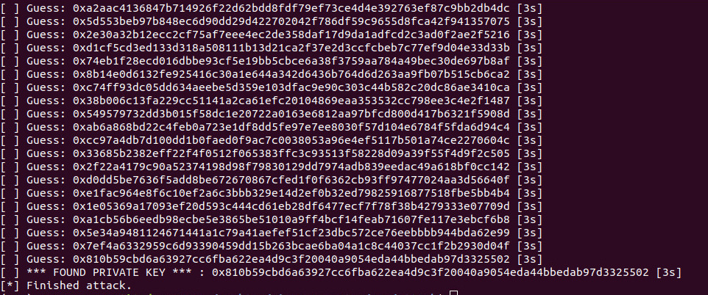
Recovering ECDSA Keys
Running the Minerva script
16 meters
We recovered a 256-bit ECDSA key from video footage obtained by an Internet-connected video camera located 16 meters away from the smartcard.

Slide 48
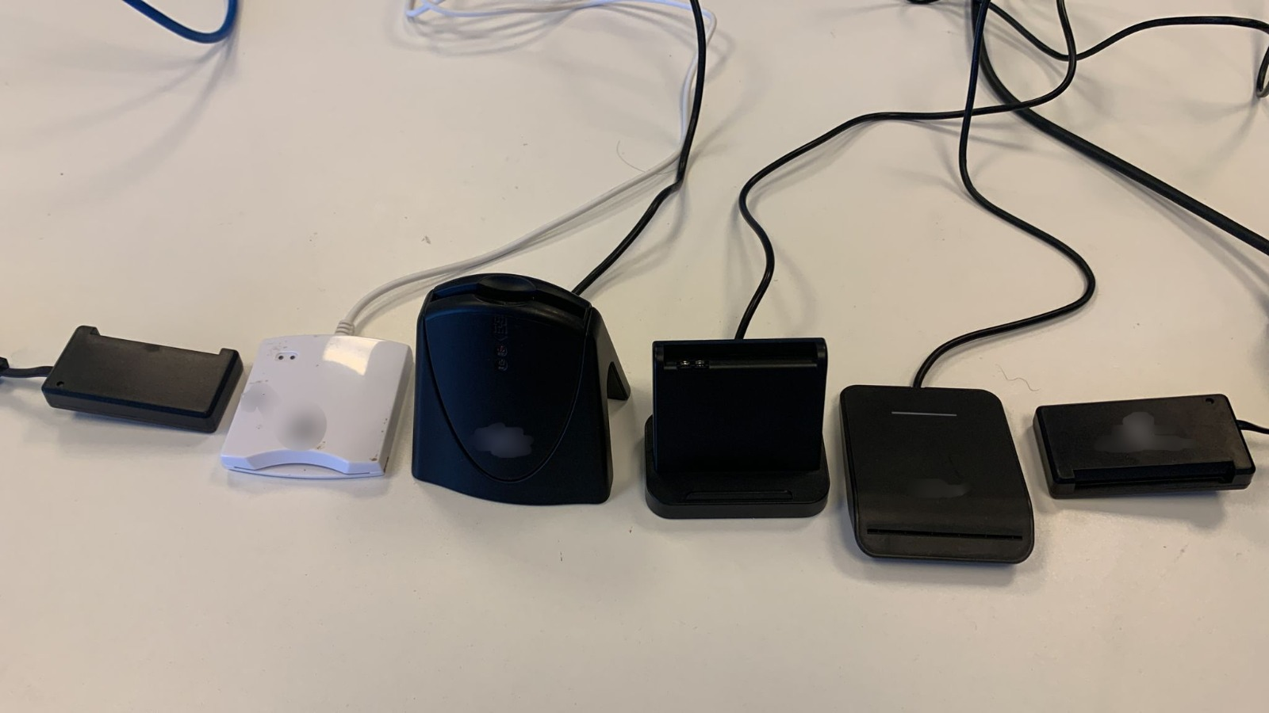
Recovering ECDSA Keys
We recovered ECDSA keys from six different models of smartcard readers that we purchased on Amazon.

Slide 49
Recovering ECDSA Keys
Now let’s discuss recovering a SIKE key

Slide 50
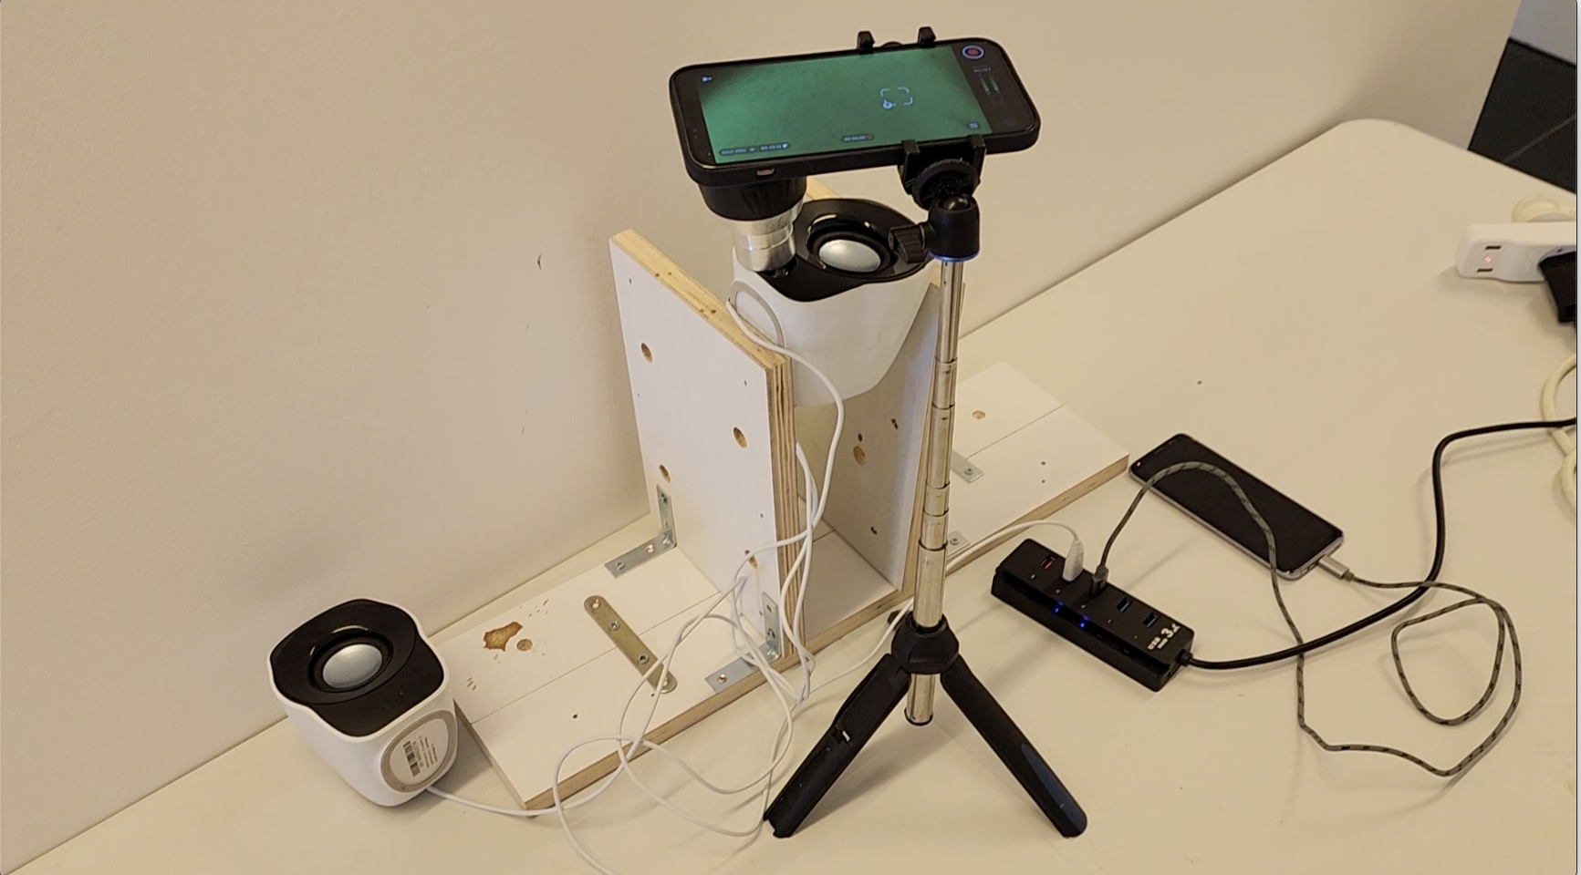
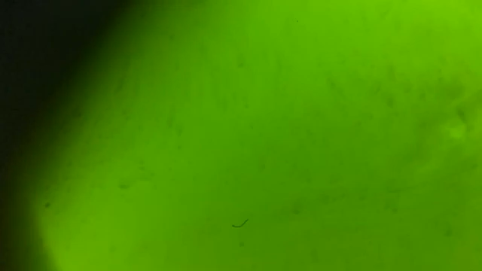
Recovering SIKE Keys
iPhone 13
Pro Max
Logitech USB
Speakers
Samsung
Galaxy S8
USB Hub
We also recovered a 378-bit SIKE key from a Samsung Galaxy S8 using video footage of the power LED of Logitech Z120 USB speakers that were connected to the same USB hub used to charge the Galaxy S8 via an iPhone 13 Pro Max.

Slide 51
Takeaways
The potential of the attack is actually greater than shown in this work. Professional video cameras could be utilized by attackers to recover secret keys (instead of the COTS video cameras we have used).
We expect the exposure of video based cryptanalysis will increase in time. More and more limited functional IoT devices which continually deployed every day will meet improved video cameras (following Moore’s Law).
Even after three decades of experience and understanding in side-channel cryptanalysis, building resilient and leakage free devices remains a great challenge.

Slide 52










Q&A
Thank you for attending this talk.

