Slide 1
Towards Robust FHE for the Real World
Christian Knabenhans ^{(EPFL)}, Alexander Viand ^{(Intel Labs)}, Anwar Hithnawi ^{(ETH)}

Slide 2
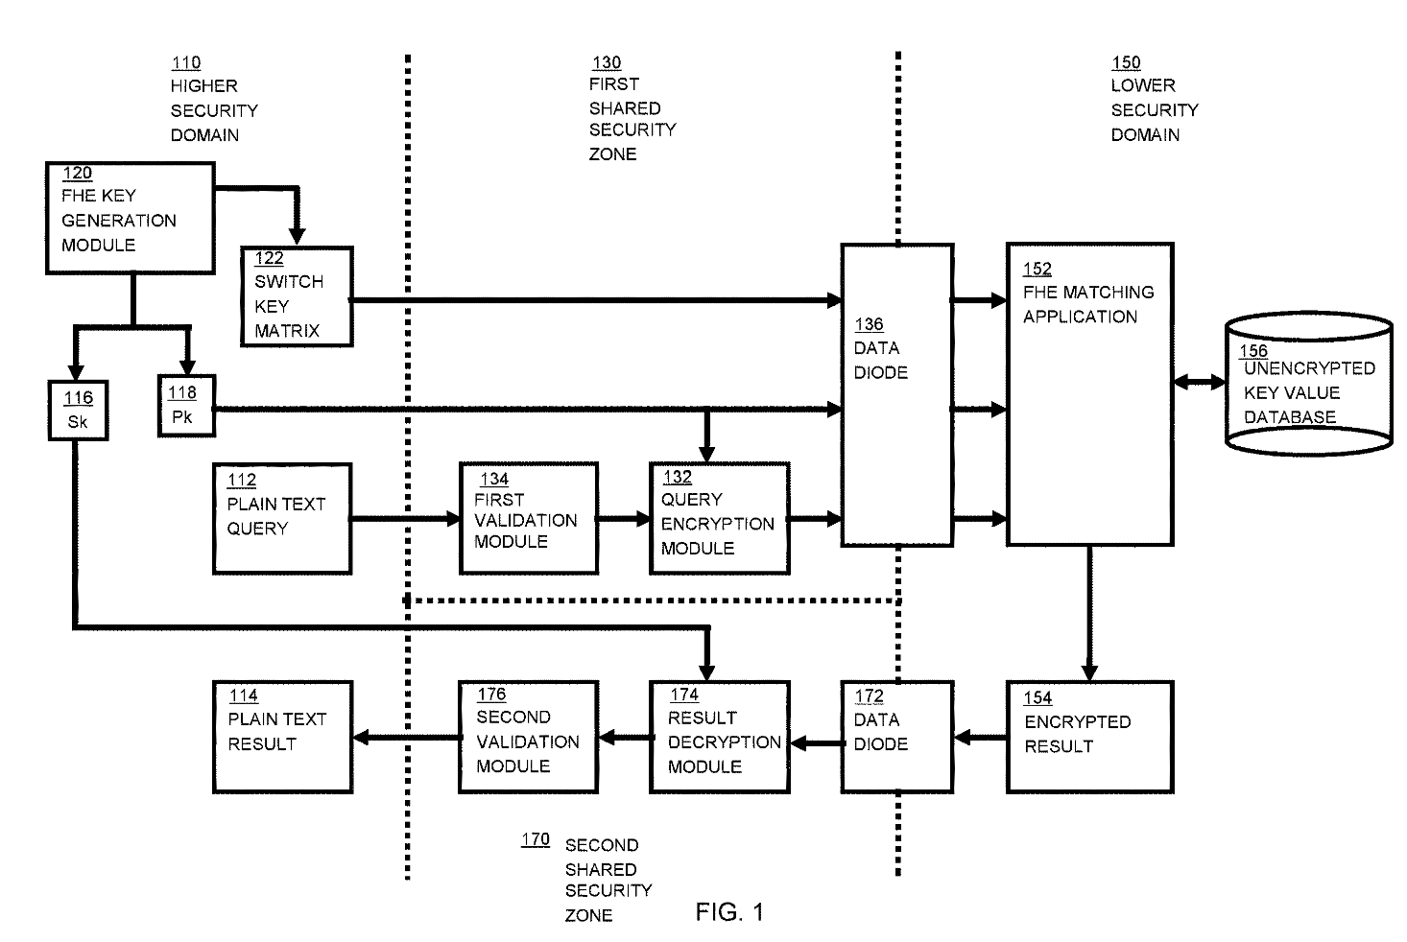
FHE in the real world
in theory
in practice
X
Eval
Y
Enc
Dec
x
y
From US Patent 11487894B2 “Performing Secure Queries from a Higher Security Domain of Information in a Lower Security Domain”, 2022, IBM
Notes:
Fully Homorphic Encryption, often called the holy grail of modern crypto, is an encryption scheme that allows the evaluation of arbitrary functions over encrypted data.
So in theory, we add an Evaluation algorithm to the usual Encryption/Decryption algorithms.
- However in practice, deploying FHE in the real world presents a number of challenges that are still unsolved.
In particular, for interesting real-world applications, FHE is often only a part of the overall protocol, which leads to limitations such as performance, usability, key management, and integrity, which is what I want to focus on in this talk.

Slide 3
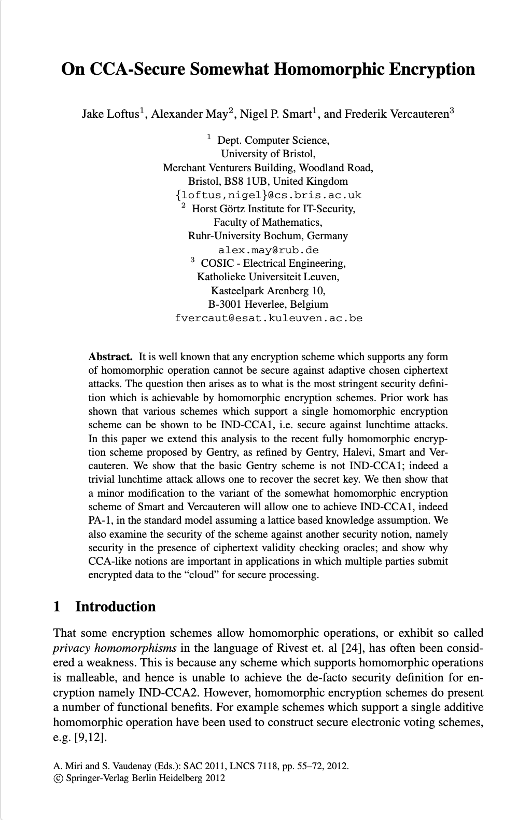
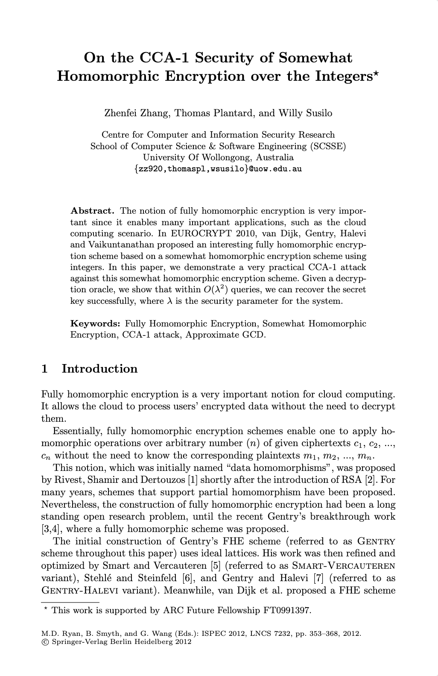
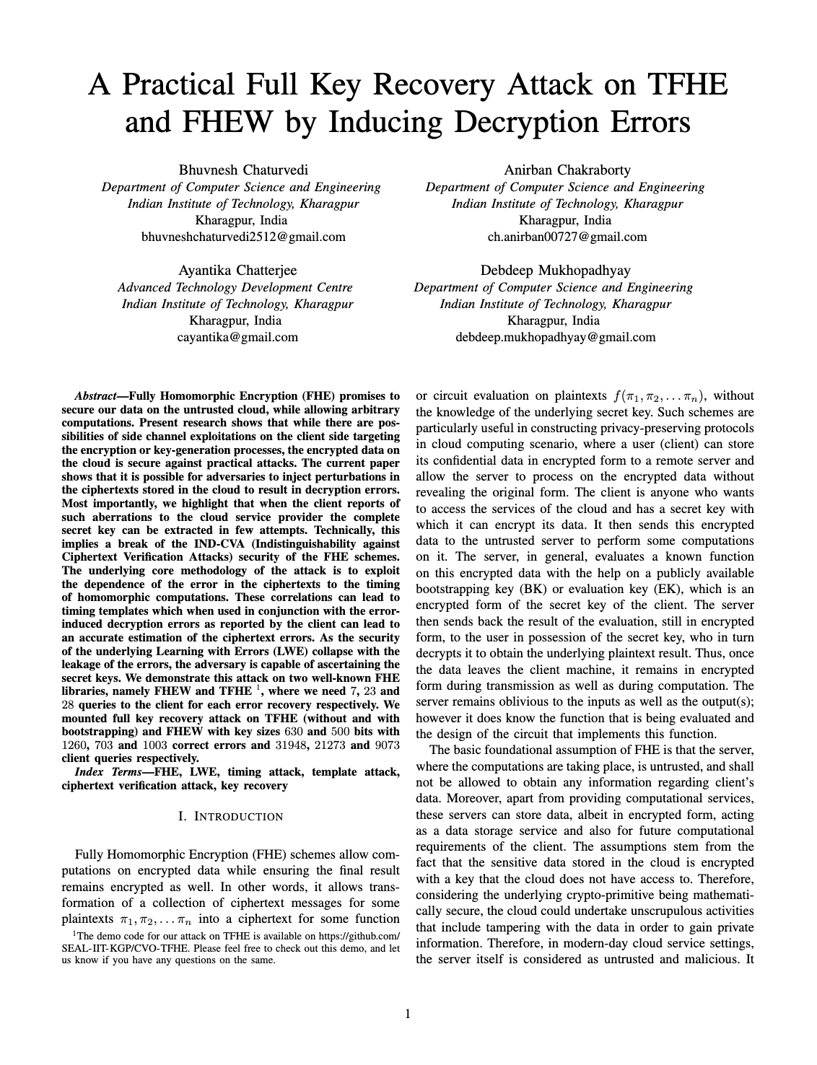
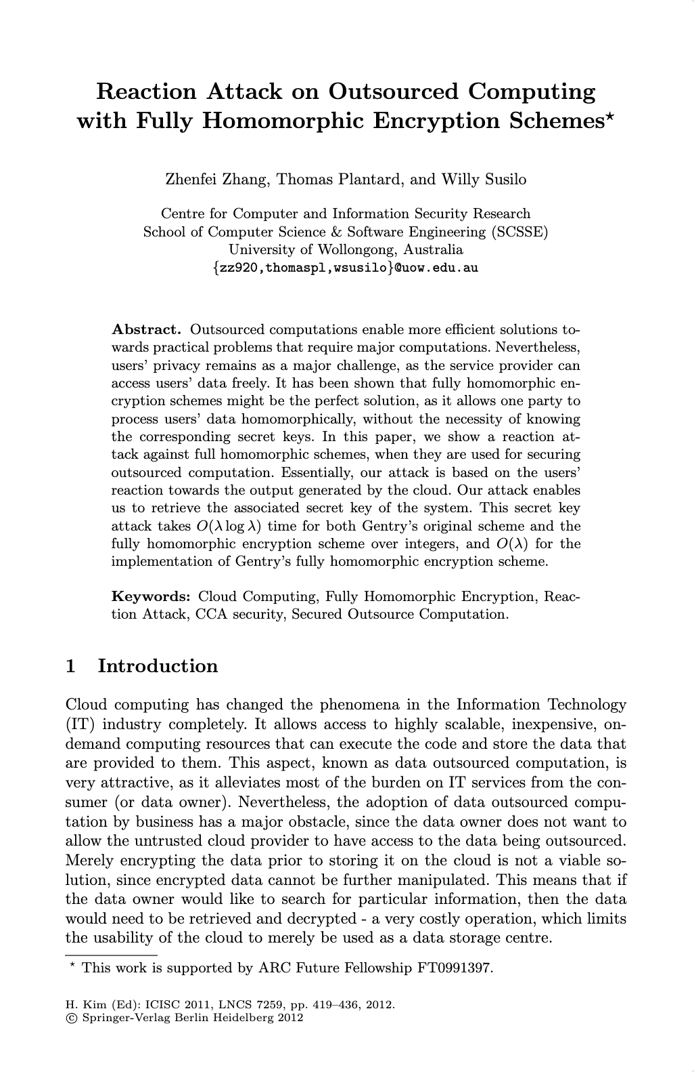
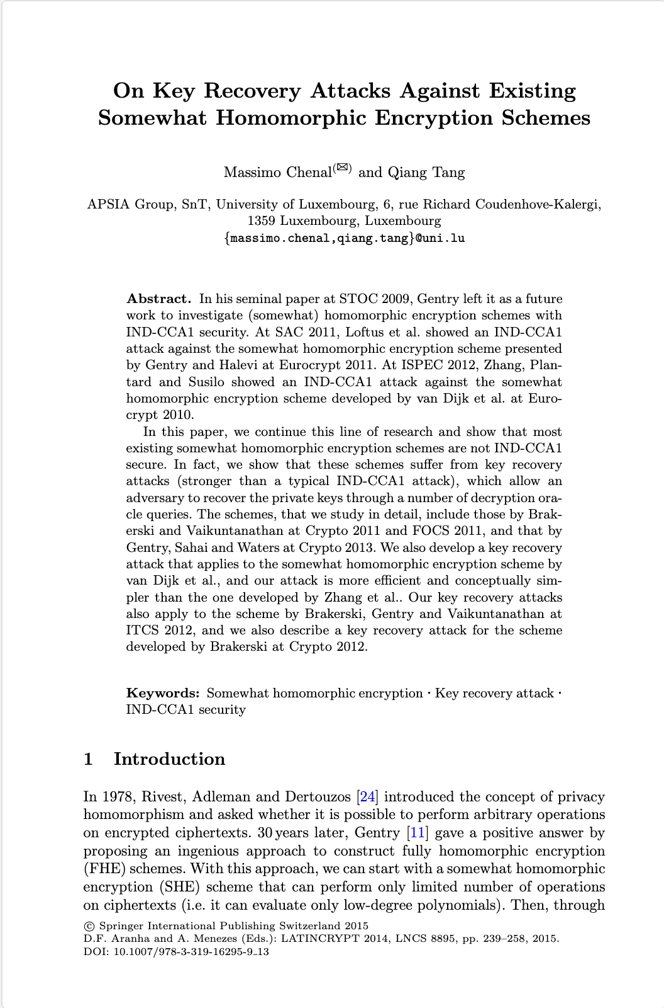
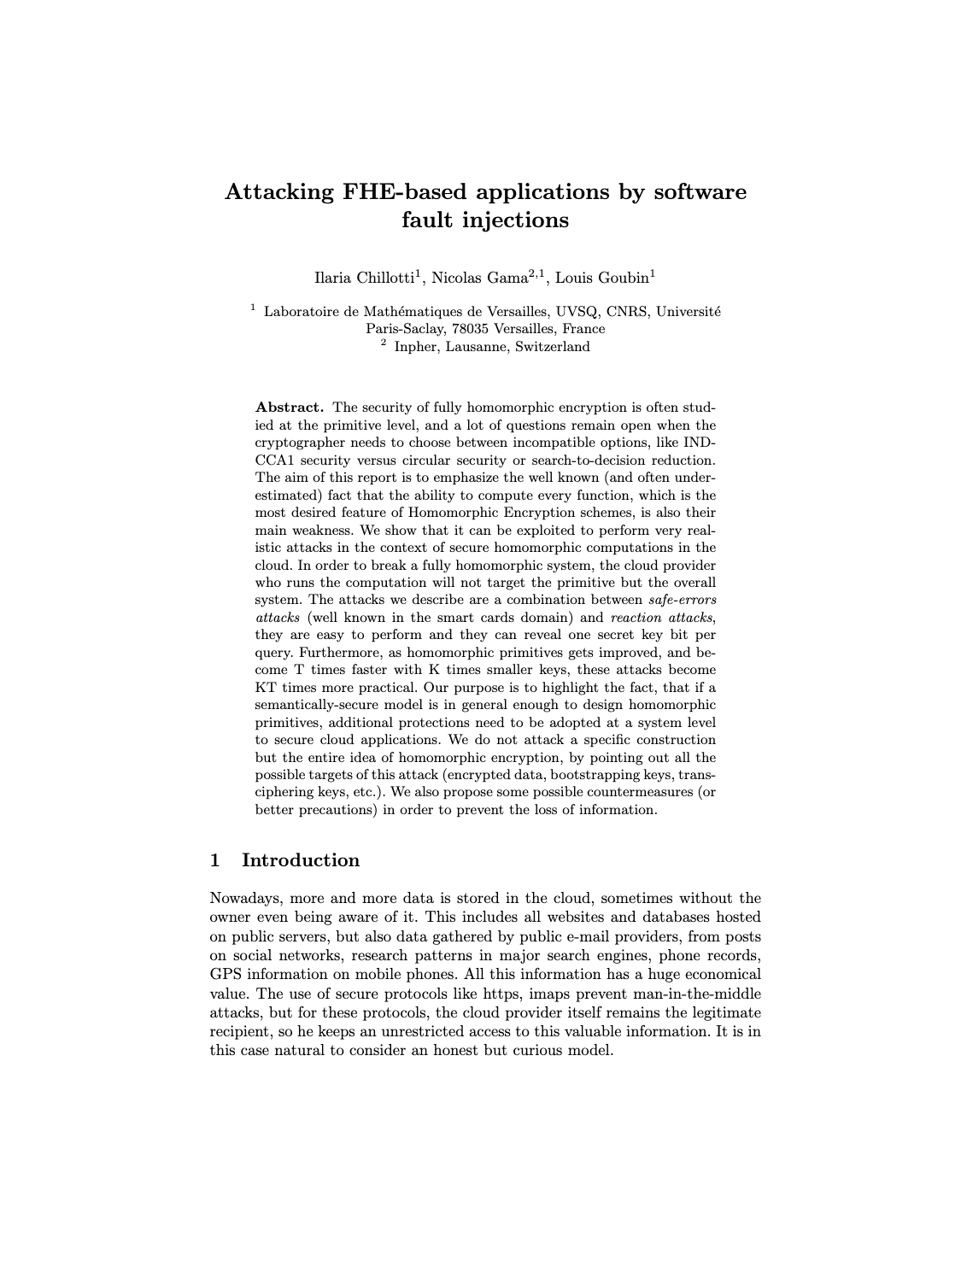
FHE in the real world is brittle
enc_{s}(x) = (-a, as + tx + e)
c = (c₀, c₁)
c = (1, 0)
dec_{s}(c) = round(c₀s+c₁)
dec_{s}(c) = round(1s+0) = s
partial oracle
Key Recovery
(decryption, validity, format, etc.)
Attack extends to weaker oracles and fine-grained corruption of ciphertexts
[ZTS11] Reaction Attack on Outsourced Computing with Fully Homomorphic Encryption Schemes, Z. Zhang, T. Plantard, and W. Susilo, ICISC 2011
[LMSV11] On CCA-Secure Somewhat Homomorphic Encryption, J. Loftus, A. May, N. P. Smart, and F. Vercauteren, Selected Areas in Cryptography 2012
[CT14] On Key Recovery Attacks Against Existing Somewhat Homomorphic Encryption Schemes, M. Chenal and Q. Tang, LATINCRYPT 2014
[CGG16] Attacking FHE-based applications by software fault injections, I. Chillotti, N. Gama, and L. Goubin, ia.cr/2016/1164
[CCCM22] A Practical Full Key Recovery Attack on TFHE and FHEW by Inducing Decryption Errors, B. Chaturvedi et al, ia.cr/2022/1563
Notes:
Because FHE is a very brittle encryption scheme, and it has a tendency to break catastrophically in real-world adversarial environments.
….
More formally, all the state-of-the-art FHE schemes barely achieves IND-CPA, and often don’t even achieve a slighty stronger notion called IND-CPA-D, and are very vulnerable to these kinds of key recovery attacks.
- Add more integrity to
What we want instead: a TEE
Bring back later, with proofs attached and showing that we fix it
Full key recovery attack
Integrity implies KR /

Slide 4
An old problem, finally relevant
An old problem
An old problem, but not the main problem…
… until now:
Hardware accelerators with 10⁴× speedup for FHE
DPRIVE
ISO standard on FHE schemes and applications
WD 18033-8
NIST call for multi-party threshold schemes
IR8214C
HEIR
Compilers and unified intermediate representation
Growing community of practitioners
[ZTS11] Reaction Attack on Outsourced Computing with Fully Homomorphic Encryption Schemes, Z. Zhang, T. Plantard, and W. Susilo, ICISC 2011
[LMSV11] On CCA-Secure Somewhat Homomorphic Encryption, J. Loftus, A. May, N. P. Smart, and F. Vercauteren, Selected Areas in Cryptography 2012
[CT14] On Key Recovery Attacks Against Existing Somewhat Homomorphic Encryption Schemes, M. Chenal and Q. Tang, LATINCRYPT 2014
[CGG16] Attacking FHE-based applications by software fault injections, I. Chillotti, N. Gama, and L. Goubin, ia.cr/2016/1164
[CCCM22] A Practical Full Key Recovery Attack on TFHE and FHEW by Inducing Decryption Errors, B. Chaturvedi et al, ia.cr/2022/1563
Notes:
And this is not a new insight, this has been known for at least a decade, only a few years after Gentry’s seminal work. And in fact, there are even discussions of this in the original paper that introduced the idea of “privacy homomorphisms” by Rivest, Adelman and Dertouzos back in 1978.
However, it was never really the main problem of FHE,
So why am I talking about this at Real World Crypto 2024?
- Because in the coming years, we are expecting a number of FHE milestones:
- 2024: DPRIVE accelerators
- 2025: ISO standard
- 2026: NIST threshold crypto
- Compilers
- Community
Let’s talk about robust FHE for the real world…

Slide 5
Real-world FHE deployments
Notes:
…., and I want to motivate that the key recovery attack that I showed 2 slides ago is actually a real concern.
So let’s dive in and focus on a few deployment and trust topologies from real-world examples:

Slide 6
Deployments – Outsourcing
Private Information
Retrieval as a Service
enc(x)
enc(f(x))
enc(x)
enc(f(x, ))
Computation
Outsourcing
Storage
Outsourcing
Notes:
- The canonical setting for FHE (ever since the 1978 “Privacy Homomorphisms” paper) is computation outsourcing: computationally weak client delegates work to a more powerful server.
- This is also the setting that is mostly used in the literature on FHE integrity, but it is actually not very deployed in practice, simply because it is very hard to find a setting where outsourcing computation using FHE is better than simply computing locally on unencrypted data. x
- A related deployment pattern is the one of storage outsourcing, where the server holds a public, unencrypted database, and the client receives the encrypted result of some function f applied to its input and this database. In particular, we see this type of deployment for Private Information Retrieval protocols.
- Clear possibility of reaction oracle; malicious server is less clear, it could be somewhat trusted in some deployments.

Slide 7
Deployments – 2-Party Computation
y
Microsoft Edge
password monitor
Cordong-I COVID
tracing app
Beomdong-I restraining
order enforcement app
enc(x)
enc(f(x, y))
enc(x)
enc(f(x, y))
y
Server-driven
2PC
Client-driven
2PC
Notes:
However, when things start getting really interesting is when FHE is used for 2-party computations, which can be either server-driven, for example in the private set intersection protocol used in the Microsoft Edge password monitor,
- or client-driven, as in the Korean Cording-I and Beomdong-I apps.
And you can see how the brittleness of FHE becomes very problematic in these deployment settings, which very naturally have untrusted parties (e.g., client devices) and a chock-full with reaction oracles.

Slide 8
Deployments – Multi-Party Computation
enc(x)
privacy-preserving
ML training
encrypted
blockchains
enc(x)
enc(y)
enc(f(x))
enc(f(x,y))
Multi-Party Computation
Multi-Party Computation
Notes:
And finally, FHE is also very useful for generic multi-party computation with limited bandwidth requirements, for example for
- machine learning training,
- or for private blockchains.

Slide 9
Cryptographic Integrity for FHE
Who computes?
X
Eval
Y
Enc
Dec
x
y
Who gives inputs?
Who receives outputs?

Slide 10
Building blocks for robust FHE
X
Eval
Y
Encryption Integrity
- Linear operation
- Ensure smallness of secret
- Ensure property of message (e.g., format)
Decryption Integrity
- Non-linear rounding op.
- Ensure smallness of secret
- Ensure property of ciphertext (e.g., origin)
Enc
Dec
x
y
Other mechanisms
- Differential privacy for IND-CPA^{D}
- Noise flooding for circuit privacy

Slide 11
Integrity of Encryption & Decryption
slow, memory-intensive
generic SNARKs
[DPLS18]
[BCOS20]
Lattice-based proofs
[Yan+19]
[ENS20]
[LNS21a]
[BLNS21]
[Cha+23]
[BLS19]
[ALS20]
[LNS20]
[LNS21b]
[LNP22]
[LNSW13]
[LLNW18]
[Beu20]
Stern-style proofs
slow, large proofs
BGV11
DM14
CGGI16
Gentry09
B/FV12
CKKS16

Slide 12
Building blocks for robust FHE
Computation Integrity
If input encrypts x, output encrypts f(x)
Output is valid ciphertext
- Non-linear operations
- Very large design space
X
Eval
Y
Encryption Integrity
- Linear operation
- Ensure smallness of secret
- Ensure property of message (e.g., format)
Decryption Integrity
- Non-linear rounding op.
- Ensure smallness of secret
- Ensure property of ciphertext (e.g., origin)
Enc
Dec
x
y
Other mechanisms
- DP for IND-CPA^{D}
- Noise flooding for circuit privacy
Notes:
So what remains is computation integrity, which is also arguably the most needed in practice.
- What do we mean by computation integrity: 2 things
=>
- Non-linear operations & very large design space

Slide 13
How (not) to do Proof-of-Computation
…
f₁(x)
f_{n}(x)
x
x
x
f(x)
Replication
Hardware Attestation
Practicality | Performance overhead, Single-input computations only | Excludes HW necessary for fast FHE (GPU, TPU, FPGA, ASIC)
Trust | Hard to achieve distributed trust | Hard to find independent trusted HW vendor / service provider
Notes:
Before adressing the "crypto" in real-world crypto, let's first discard some of the straightforwards approaches to address this problem,
Outro: need crypto solution together with FHE.

Slide 14
Proof-of-Computation
2-level HE only
Encrypt-then-MAC
[FGP14]
restricted FHE ops
[LDPW14]
[LWZ18]
Encrypt-and-MAC
Compute-then-Prove
[GGP10]
[FNP20]
[BCFK21]
[GNSV21]
[GW13]
[CF13]
[CKPH22]
MAC-then-Encrypt
single-input computation only
BGV11
DM14
CGGI16
Gentry09
B/FV12
CKKS16
Notes:
Encrypt-then-MAC: requires the MAC to be fully homomorphic and be able to match all FHE operations (including ciphertext maintenance) in lockstep. In practice the constructions only support very limited homomorphism (e.g., degree-2)
Encrypt-and-MAC: same restriction as for Encrypt-then-MAC, but additionally require the MAC to hide its input, which is even trickier to achieve. Again, severely limited in practice.
MAC-then-Encrypt:

Slide 15
Cryptographic proofs of computation for FHE

Slide 16
circomlib-fhe: FHE arithmetization in high-level DSL
B/FV
BGV
CKKS
FHEW
TFHE

Slide 17
zkOpenFHE: an extensible benchmark framework for FHE+ZKP
id
ZKP witness
x5 = FHE.mul(x0, x1)
v5 = ZKP.extended_witness(mul, v0, v1)
c5 = ZKP.add_constraints(mul, c0, c1)
…
pi = ZKP.prove(v0, …, vy, c0, …, cy)
B/FV
BGV
CKKS
ZKP constraint
x₀
FHEW
×
TFHE
x₅
x₁
+
x₈
x₉
x₂
×
×
y
x₆
x₃
x₇
x₄
BS

Slide 18
Where are we today?
Efficiency (higher is better)
semi-honest FHE
nanoHE
tinyHE
FHE
Expressivity (higher is better)
linear regression, naïve matrix-vector mult
logistic regression,
small ML inference
ML inference, ML training, etc.

Slide 19
Challenge #1: arithmetization
FHE
ZKP
x₁
nanoHE
Single (big!) parameter set for all circuits ($q≈2^{254}$)
Levelled HE with severe depth limitations
→ Linear regression, non-optimized matrix-vector mult
x₂
×
+
A
z
B
z
C
z
x₃
×
y
○
=
×
x₄
x₅
Prover 580 – 1200 s
Verifier 2 ms – 2 s
R1CS
(or AIR, CCS, etc.)
c × 2 × 5 × 16384 × a ≈ 16 ×10⁶ constraints
elems
coeffs
ctxts (≈ 10)
RNS limbs
arithmetization
overhead (≈ 10)

Slide 20
Challenge #2: algebra mismatch
FHE
ZKP
$$ℤ_{Q_{i}∙P}^{N}$$
INTT
$$𝓡_{Q_{i}∙P}$$
eval
NTT
tinyHE
Per-application choice of parameters
Limited levelled HE with depth limitations
→ Logistic regressions
extend
reduce
$$ℤ_{Q_{i}}^{N}$$
INTT
$$𝓡_{Q_{i}}$$
$$𝔽$$
NTT
eval
Prover 1 – 2 h
Verifier 2 ms – 12 s
$$ℤ_{Q_{L}}^{N}$$
$$𝓡_{Q_{L}}$$
emulation overhead (∝ ${log \left|𝔽\right|}/{log q}$ ≈ 20)
eval
c × 2 × 5 × 8192 × a × e ≈ 160×10⁶ constraints
NTT
elems
coeffs
ctxts (≈ 10)
embed
arithmetization
overhead (≈ 10)
RNS limbs
$$ℤ_{t}^{N}$$
$$𝓡_{t}$$
encode

Slide 21
Challenge #3: rotations & maintenance
FHE
ZKP
rotation
Generic FHE
Per-application choice of parameters
Arbitrary-depth computations
→ ML inference, Private Set Intersection, etc.
x₁
x₁
relinearization
×
x₂
×
x₂
A
z
B
z
C
z
+
x₃
x₃
y
×
×
y
×
x₄
x₄
○
=
x₅
mod-switching
x₅
BS
BS
Prover 150 – 300 h
Verifier 2 ms – 25 min
bootstrapping
bootstrapping
emulation overhead (∝ ${\left|𝔽\right|}/q$ ≈ 20)
c × 2 × 5 × 8192 × a × e × m ≈ 16 ×10⁹ constraints
elems
coeffs
ctxts (≈ 10)
RNS limbs
arithmetization
overhead (≈ 10)
maintenance (≈ 100)

Slide 22
Other challenges
Application Logic
FHE
Other
Crypto
ZKP
Heterogeneous Accelerator Hardware

Slide 23
What’s next?

Slide 24
What’s next?
crypto-TEE:
private & verifiable computation
private & verifiable special-purpose computation
private & verifiable single-input computation
FHE: private computation

Slide 25
A wishlist
lattice-ring-friendly, flexible, post-quantum, doubly-efficient, (zero-knowledge) proof systems running on heteregeneous FHE-accelerating hardware
Notes:
lattice-ring-friendly: since we want to prove statement about ring element
flexible: in the sense that they don’t restrict the computations that can be performed
post-quantum, because the security of our FHE scheme may now depend on the soundness of the proof system
oubly-efficient: efficient to prove and efficient to verify
running on FHE hardware: we want to leverage the heterogeneous HW that has been used to accelerate FHE to run the integrity part as well

Slide 26
Towards robust FHE for the real world
Christian Knabenhans^{(EPFL)} Alexander Viand^{(Intel Labs)} Anwar Hithnawi^{(ETH)}
zkFHE.github.io

