Slide 1
What does privacy mean for stock trading? (and why it matters)
Authors: Arthur Américo, Allison Bishop, Paul Cesaretti, Garrison Grogan, Adam McKoy, Robert Moss, Lisa Oakley, Marcel Ribeiro, Mohammad Shokri
Presenters: Allison Bishop and Lisa Oakley

Slide 2
Why did we start this research?
Proof Trading is a registered broker-dealer for US equities, trading orders on behalf of institutional clients.
The company was founded in 2019 by Daniel Aisen and Allison Bishop.
We are an unusual broker in that we are strong proponents of transparency in markets, and we publish the research behind our trading algorithms.
We collaborate with academic scientists, many of whom are involved in this work ☺

Slide 3
What is the stock market anyways?
Buyer 1
“I want to buy
100 shares of INDCPA
for ≤ $23.45”
Seller 1
“I want to sell 100 shares of SNARK
for $28.52”
Buyer 2
“I want to buy
500 shares of RWC
for $200”
Seller 2
“I want to sell
100 shares of INDCPA for ≥ $23.45”
…
…
Trade 1
March 25, 2024 at 9:32:00.192935 100 Shares INDCPA for $23.45
Time Series of Completed Trades

Slide 4
The “Market” (US equities) as a Time Series
We can describe the market time series of trades for each day
Date | Timestamp | Volume | Symbol* | Price (per share)
March 25, 2024 | 9:32:00.192935 | 100 Shares | INDCPA | $23.45
March 25, 2024 | 9:32:00.459345 | 10 Shares | IACR | $19.81
March 25, 2024 | 9:33:00.184800 | 100 Shares | SNARK | $15.00
March 25, 2024 | 9:34:00.349505 | 700 Shares | INDCPA | $23.47
March 25, 2024 | 9:34:00.349703 | 200 Shares | INDCPA | $23.47
March 25, 2024 | 9:35:00.459863 | 100 Shares | RWC | $400.00
…
*Note: this is fake data used to illustrate an example

Slide 5
Asset Manager Alice
Alice works for a company that manages a large pool of assets (e.g. 401ks, pension accounts, endowments, etc.)
The company selects a portfolio of stocks to balance risk and reward
When the company wants to make changes to their portfolio, the volume they need bought or sold is often high
Alice must decide when and how to buy/sell large numbers of shares

Slide 6
How can Alice Buy 100,000 Shares of RWC?
Trade 1
Seller 1
“I want to sell 100 shares of RWC for $400.00 a share”
Trade 2
Seller 2
“I want to sell 200 shares of RWC for $400.01 a share”
Trade 3
Seller 3
“I want to sell 200 shares of RWC for $400.01 a share”
Trade 4
Seller 4
“I want to sell 100 shares of RWC for $400.01 a share”
Trade 5
Seller 5
“I want to sell 500 shares of RWC for $400.02 a share”
Trade 6
Seller 6
“I want to sell 200 shares of RWC for $400.04 a share”
…
Notes:
If Alice wants to buy 100,000 shares of RWC, it is unlikely there is one seller offering them all for a good price
Instead, Alice must find multiple buyers in her price range to purchase from
If she wants to complete the order as quickly as possible, this means choosing the N sellers whose available shares of RWC add to 100,000 and are priced the lowest

Slide 7
Information Leakage (and Adversarial Trader Eve)
Date | Timestamp | Volume | Symbol* | Price (per share)
March 25, 2024 | 9:32:00.192935 | 100 Shares | INDCPA | $23.45
March 25, 2024 | 9:32:00.459345 | 10 Shares | IACR | $19.81
March 25, 2024 | 9:33:00.459863 | 100 Shares | RWC | $400.00
March 25, 2024 | 9:34:00.459863 | 200 Shares | RWC | $400.01
March 25, 2024 | 9:34:00.554598 | 200 Shares | RWC | $400.01
March 25, 2024 | 9:34:00.669590 | 100 Shares | RWC | $400.01
March 25, 2024 | 9:34:01.340594 | 500 Shares | RWC | $400.02
March 25, 2024 | 9:34:01.444950 | 200 Shares | RWC | $400.04
Hmmm… some unusual clustering of activity in RWC shares today. Let’s drive up the price!
…
Eve

Slide 8
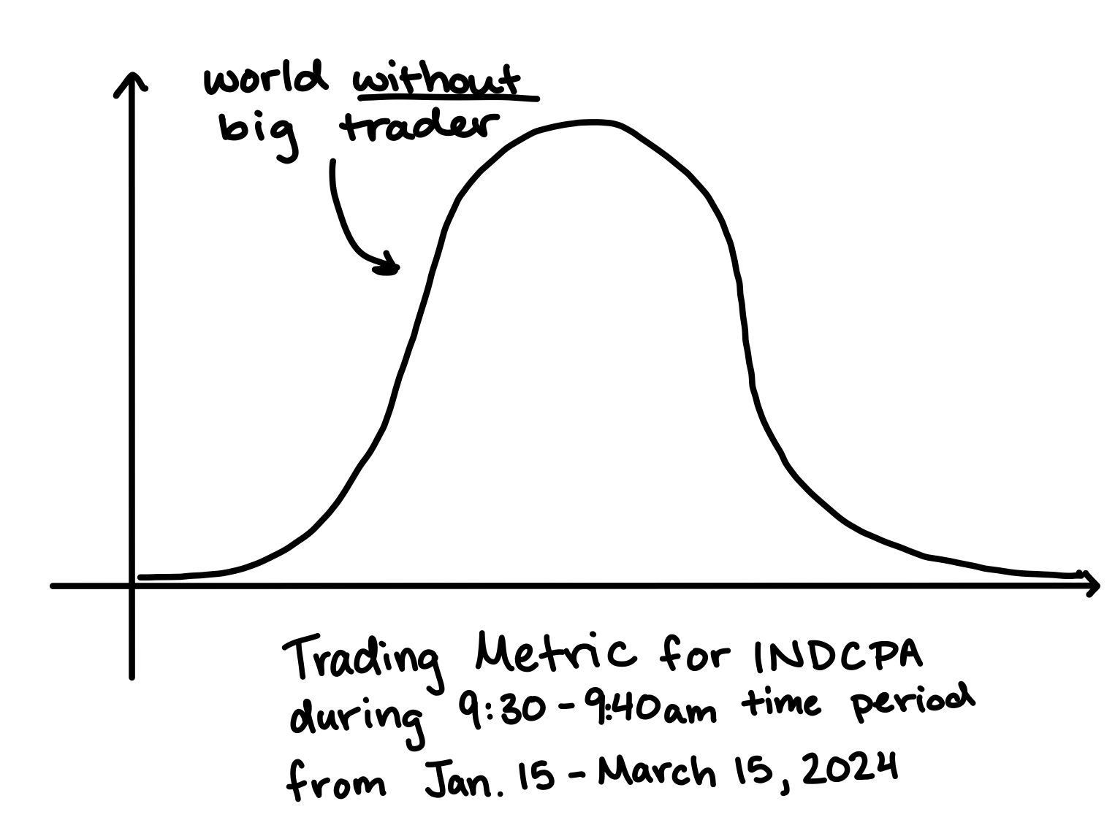
Modeling the Market (without Alice)
Date | Timestamp | Volume | Symbol* | Price (per share)
Mar. 4, 2024 | 9:32:00.192935 | 100 Shares | INDCPA | $23.45
Mar. 4, 2024 | 9:32:00.459345 | 10 Shares | IACR | $19.81
Mar. 4, 2024 | 9:33:00.184800 | 100 Shares | SNARK | $15.00
Mar. 4, 2024 | 9:34:00.349505 | 700 Shares | INDCPA | $23.47
Mar. 4, 2024 | 9:34:00.349703 | 200 Shares | INDCPA | $23.47
Mar. 4, 2024 | 9:35:00.459863 | 100 Shares | RWC | $400.00
Date | Timestamp | Volume | Symbol* | Price (per share)
Mar. 5, 2024 | 9:32:00.192935 | 100 Shares | INDCPA | $23.45
Mar. 5, 2024 | 9:32:00.459345 | 10 Shares | IACR | $19.81
Mar. 5, 2024 | 9:33:00.184800 | 100 Shares | SNARK | $15.00
Mar. 5, 2024 | 9:34:00.349505 | 700 Shares | INDCPA | $23.47
Mar. 5, 2024 | 9:34:00.349703 | 200 Shares | INDCPA | $23.47
Mar. 5, 2024 | 9:35:00.459863 | 100 Shares | RWC | $400.00
Date | Timestamp | Volume | Symbol* | Price (per share)
Mar. 6, 2024 | 9:32:00.192935 | 100 Shares | INDCPA | $23.45
Mar. 6, 2024 | 9:32:00.459345 | 10 Shares | IACR | $19.81
Mar. 6, 2024 | 9:33:00.184800 | 100 Shares | SNARK | $15.00
Mar. 6, 2024 | 9:34:00.349505 | 700 Shares | INDCPA | $23.47
Mar. 6, 2024 | 9:34:00.349703 | 200 Shares | INDCPA | $23.47
Mar. 6, 2024 | 9:35:00.459863 | 100 Shares | RWC | $400.00
…
…
…
…
Find the distribution of trades
for a single symbol (e.g. INDCPA)
during a specific window (e.g. 9:30-9:40am)
over some number of days (e.g. 3 months)

Slide 9
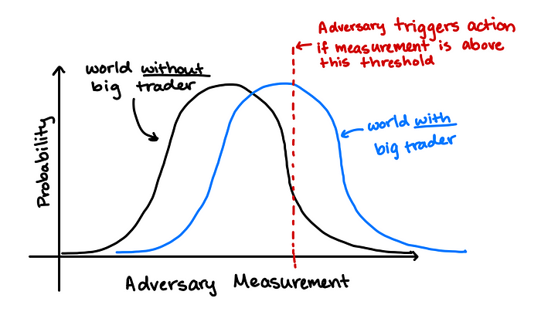
Modeling the Market (with Alice)
Date | Timestamp | Volume | Symbol* | Price (per share)
March 25, 2024 | 9:32:00.192935 | 100 Shares | INDCPA | $23.45
March 25, 2024 | 9:32:00.459345 | 10 Shares | IACR | $19.81
March 25, 2024 | 9:33:00.459863 | 100 Shares | RWC | $400.00
March 25, 2024 | 9:34:00.459863 | 200 Shares | RWC | $400.01
March 25, 2024 | 9:34:00.554598 | 200 Shares | RWC | $400.01
March 25, 2024 | 9:34:00.669590 | 100 Shares | RWC | $400.01
March 25, 2024 | 9:34:01.340594 | 500 Shares | RWC | $400.02
March 25, 2024 | 9:34:01.444950 | 200 Shares | RWC | $400.04
…
If Alice trades 100,000 shares of RWC in a 10 minute window on one day, an adversary sampling over a metric on the market will notice a shift in the market distribution
We assume here that the market remains stable without Alice

Slide 10
Some natural goals that are generally impossible
Alice would like the transcript of trading data to come from
the same distribution regardless of her activity.
Transcripts are granular and affected by basically any move by any trader.
Alice would like prices to stay stagnant
(or at least independent of her activity).
Alice represents a significant shift in supply and demand.
The purpose of continuous markets is to incorporate this shift into prices over time.

Slide 11
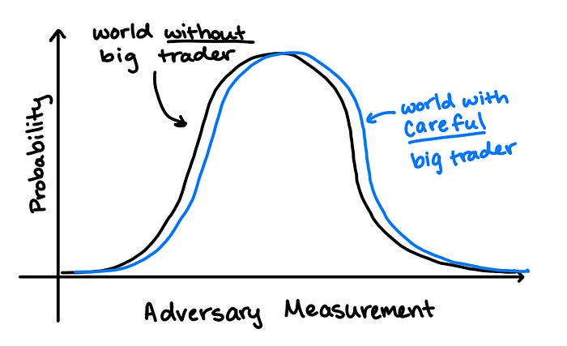
What Alice can hope to achieve
This:
Instead of this:
Alice wants the world with her trading to look “similar” to the world without
(at least for some fixed suite of measurements that Eve might make)
This is a similar motivation to that of differential privacy

Slide 12
Let’s define this as a game
x is sampled from a priori distribution (D_{X}) of Eve’s measurement in a market without Alice
x
(D_{X})
Alice
Eve

Slide 13
Let’s define this as a game
aux(x) is any additional information Alice has when making her trading decisions
x is sampled from a priori distribution (D_{X}) of Eve’s measurement in a market without Alice
aux(x)
x
(D_{X})
Alice
Eve

Slide 14
Let’s define this as a game
aux(x) is any additional information Alice has when making her trading decisions
x is sampled from a priori distribution (D_{X}) of Eve’s measurement in a market without Alice
aux(x)
x
a
(D_{X})
Alice
Eve

Slide 15
Let’s define this as a game
aux(x) is any additional information Alice has when making her trading decisions
x is sampled from a priori distribution (D_{X}) of Eve’s measurement in a market without Alice
We assume for simplicity that Alice’s activity is additive on the measurement
aux(x)
x
a
(D_{X})
x + a
x + a
Alice
Eve

Slide 16
Let’s define this as a game
aux(x) is any additional information Alice has when making her trading decisions
x is sampled from a priori distribution (D_{X}) of Eve’s measurement in a market without Alice
We assume for simplicity that Alice’s activity is additive on the measurement
aux(x)
x
a
(D_{X})
x + a
x + a
Alice
Eve
We can repeat this for multiple rounds where the new distribution in each round is a function of the history

Slide 17
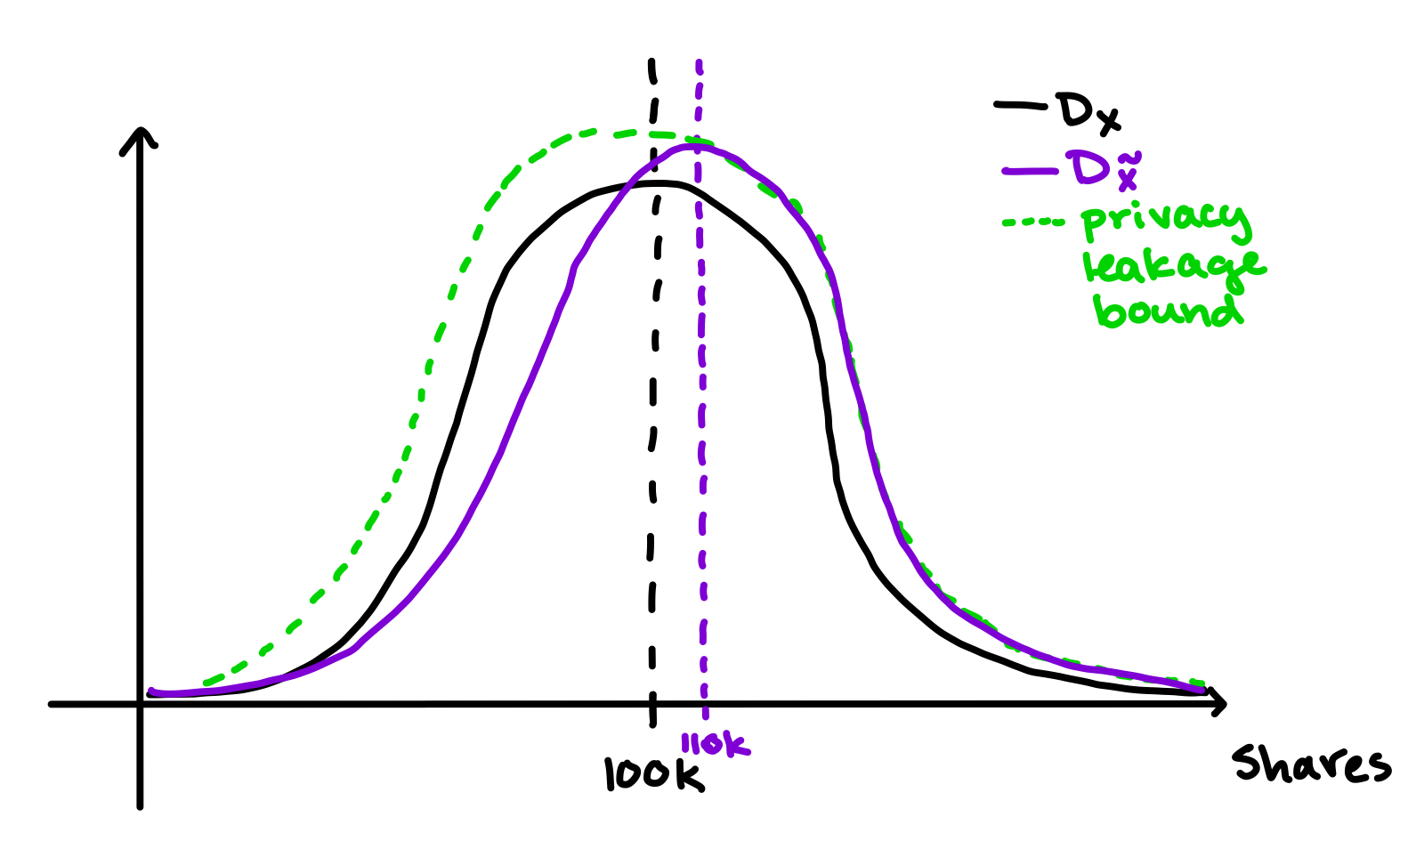
Formulating Alice’s Privacy and Utility Goals
Utility goal:
Maximize the amount that Alice can trade within a specified privacy bound.
Privacy goal:
Ensure any value of Eve’s measurement is not much more likely in the world with Alice vs. without Alice.
This is analogous to ε-dp. Naturally we define an (ε,δ)-version too.

Slide 18
The one-round game as a linear program
Alice’s expected trading
Information leakage bound
*
* There are more constraints in the paper that help with computation

Slide 19
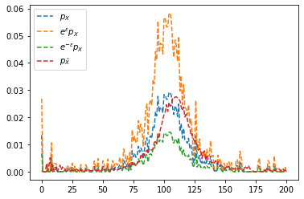
What do solutions look like on real data?
Alice’s trading shifts the normal market distribution to the right, but maintains the upper and lower information leakage bounds

Slide 20
Why should we want to help Alice?
We can reduce risk by holding more diverse stocks and other assets.
We don’t all have to become experts in the mechanics of stock trading.
We don’t have to rebalance our own holdings constantly, (something ordinary people are bad at doing).
We can participate in the overall growth of the market
Pooling our money into big portfolios at institutions has many benefits

Slide 21
What does Alice do today?
Prop trader 1
Prop trader 2
Broker 1
Alice 1
Date | Timestamp | Volume | Symbol* | Price (per share)
March 25, 2024 | 9:32:00.192935 | 100 Shares | INDCPA | $23.45
March 25, 2024 | 9:32:00.459345 | 10 Shares | IACR | $19.81
March 25, 2024 | 9:33:00.184800 | 100 Shares | SNARK | $15.00
March 25, 2024 | 9:34:00.349505 | 700 Shares | INDCPA | $23.47
March 25, 2024 | 9:34:00.349703 | 200 Shares | INDCPA | $23.47
March 25, 2024 | 9:35:00.459863 | 100 Shares | RWC | $400.00
Broker 2
Alice 2
Broker 3
Alice uses black-box broker algorithms and tries to evaluate their performance
Alice 3

Slide 22
The challenges of the current system
Broker 1
It’s hard to evaluate broker performance! Alice’s data is very noisy.
Exchanges, brokers, and proprietary traders are all for-profit companies, incentivized to extract revenue from the system.
Broker 2
Broker 3

Slide 23
How could the market work better for Alice (and for all of us)?
Alice is paying for fancy black boxes.
There’s a shroud of secrecy around how they work to “protect Alice”.
But secrecy is not security. As cryptographers we know it is possible (and better!) to design algorithms that can be disclosed.
Expense of complexity gets passed back to all of us, without accountability that it’s adding any value.
FinancewordGPT
(worth millions, we promise)
SecureTrader
(security is hard, you wouldn’t get it)
DecisionBroker (definitely not just a decision tree)

Slide 24
How could the market work better for Alice (and for all of us)?
We think that public-facing scientific research can let us open the black boxes.
If brokers do public-facing research, they can be held accountable on more than just noisy metrics.
We can all benefit from faster moving research that may reveal more consequences of the underlying market structures.
Prop Trader
Broker
Broker
Date | Timestamp | Volume | Symbol* | Price (per share)
March 25, 2024 | 9:32:00.192935 | 100 Shares | INDCPA | $23.45
March 25, 2024 | 9:32:00.459345 | 10 Shares | IACR | $19.81
March 25, 2024 | 9:33:00.184800 | 100 Shares | SNARK | $15.00
March 25, 2024 | 9:34:00.349505 | 700 Shares | INDCPA | $23.47
March 25, 2024 | 9:34:00.349703 | 200 Shares | INDCPA | $23.47
March 25, 2024 | 9:35:00.459863 | 100 Shares | RWC | $400.00
Broker

Slide 25
Lots of open questions!
What are optimal solutions to the multi-round game?
How should we pick ε and δ parameters in practice?
How well can we anticipate Eve’s measurement options?
Expanding beyond additive impact for Alice to arbitrary functions?
When is RWC going to IPO and start trading?
Will Alice’s child grow up to be a crypto bro?

