Slide 1

Terrapin Attack: Breaking SSH Channel Integrity By Sequence Number Manipulation
Full paper at 33rd USENIX Security Symposium!
Fabian Bäumer, Marcus Brinkmann, Jörg Schwenk | IACR RWC 2024

Slide 2








SSH Is Often Used for High Privilege Server Access
Attacker
HTTP
Server
TLS
IMAP
SSH
TLS
SSH
root@Server
User
SMTP
Admin
TLS

Slide 3

SSH Is Split Into Separate Layers
SSH Connection Protocol
SSH Authentication Protocol
SSH Transport Layer Protocol (TLP)
TCP / IP

Slide 4
The SSH TLP Has Four Major Security Goals
Confidentiality
Integrity
Server Authentication
Authenticity
Our Finding: SSH fails to protect the integrity of the secure channel under certain conditions

Slide 5

SSH Adopted Various Authenticated Encryption Modes Over The Years
2013
ChaCha20-Poly1305
2012
CBC-EtM
CTR-EtM
(Encrypt-then-MAC)
2007
GCM
2003
CTR-EaM
1997
CBC-EaM
(Encrypt-and-MAC)

Slide 6
SSH TLP Has Been Proven Secure
Security of the handshake
    Williams (IMACC 2011): SSH handshake with DH key exchange
    Bergsma et al. (CCS 2014): Multi-ciphersuite security
Security of the secure channel
    Bellare et al. (CCS 2002): Encrypt-and-MAC
    Paterson, Watson (EUROCRYPT 2010): Encrypt-and-MAC with CTR-Mode
    Albrecht et al. (CCS 2016): Encrypt-then-MAC, AES-GCM, ChaCha20-Poly1305
But what about the combination of the handshake and secure channel?

Slide 7
SSH TLP: Protocol Version Exchange
Client
Server
SSH-2.0-PuTTY-Release-0.80
SSH-2.0-OpenSSH_9.6p1

Slide 8
SSH TLP: Algorithm Negotiation
Client
Server
SSH-2.0-PuTTY-Release-0.80
SSH-2.0-OpenSSH_9.6p1
KexInit: $n_{S}, algorithm_lists$
KexInit: $n_{C}, algorithm_lists$

Slide 9
SSH TLP: (DH) Key Exchange
Client
Server
Protocol Version Exchange
KexInit: $n_{s}, algorithm_lists$
KexInit: $n_{c}, algorithm_lists$
KexDhInit: $g^{x}$
KexDhReply: $g^{y}, {pk}_{S}, sig$

Slide 10
SSH TLP: Activating the Secure Channel
Client
Server
Protocol Version Exchange
KexInit: $n_{s}, algorithm_lists$
KexInit: $n_{c}, algorithm_lists$
KexDhInit: $g^{x}$
KexDhReply: $g^{y}, {pk}_{S}, sig$
NewKeys
NewKeys

Slide 11
SSH TLP: Requesting Another Service
Client
Server
Protocol Version Exchange
KexInit: $n_{s}, algorithm_lists$
KexInit: $n_{c}, algorithm_lists$
KexDhInit: $g^{x}$
KexDhReply: $g^{y}, {pk}_{S}, sig$
NewKeys
NewKeys
ExtInfo
ServiceRequest: ssh-userauth
ServiceAccept: ssh-userauth

Slide 12
SSH Uses Implicit Sequence Numbers
Client
Server
Snd
Rcv
Protocol Version Exchange
Snd
Rcv
0
0
0
0
KexInit: $n_{s}, algorithm_lists$
0
1
KexInit: $n_{c}, algorithm_lists$
1
0
1
1
KexDhInit: $g^{x}$
1
1
2
1
KexDhReply: $g^{y}, {pk}_{S}, sig$
1
2
2
2
NewKeys
2
2
2
3
NewKeys
3
2
3
3
ExtInfo
3
3
3
4
ServiceRequest: ssh-userauth
4
3
4
4
ServiceAccept: ssh-userauth
4
4

Slide 13
SSH Allows for Optional Messages in Handshakes
Observation: Optional messages during the handshake are not protected by the server‘s signature
Client
Server
Snd
Rcv
Protocol Version Exchange
Snd
Rcv
0
0
Algorithm Negotiation
0
0
1
1
Ignore
1
1
1
2
KexDhInit: $g^{x}$
2
1
2
2
KexDhReply: $g^{y}, {pk}_{S}, sig$
2
2
2
3
NewKeys
3
2
2
4
NewKeys
4
2
3
4
ExtInfo
4
3
3
5
ServiceRequest: ssh-userauth
5
3
4
5
ServiceAccept: ssh-userauth
5
4

Slide 14
SSH Allows for Optional Messages in Handshakes
Client
MitM
Server
Snd
Rcv
Protocol Version Exchange
Snd
Rcv
0
0
Algorithm Negotiation
0
0
1
1
Ignore
1
1
1
2
KexDhInit: $g^{x}$
2
1
2
2
KexDhReply: $g^{y}, {pk}_{S}, sig$
2
2
2
3
NewKeys
3
2
2
4
NewKeys
4
2
3
4
ExtInfo
4
3
3
5
ServiceRequest: ssh-userauth
5
3
4
5
ServiceAccept: ssh-userauth
5
4

Slide 15
MitM Attackers Can Inject Messages Into Handshake…
Client
MitM
Server
Snd
Rcv
Protocol Version Exchange
Snd
Rcv
Snd counter is not being incremented as message is now being injected by a MitM
0
0
Algorithm Negotiation
0
0
1
1
Ignore
1
1
1
2
KexDhInit: $g^{x}$
1
1
2
2
KexDhReply: $g^{y}, {pk}_{S}, sig$
1
2
2
3
NewKeys
2
2
2
4
NewKeys
3
2
3
4
ExtInfo
3
3
3
5
ServiceRequest: ssh-userauth
4
3
4
5
ServiceAccept: ssh-userauth
4
4

Slide 16
… And Drop Messages Inside The Secure Channel
Client
MitM
Server
Snd
Rcv
Protocol Version Exchange
Snd
Rcv
0
0
Algorithm Negotiation
0
0
1
1
Ignore
1
1
1
2
KexDhInit: $g^{x}$
1
1
By dropping the first message inside the secure channel sent by the server, sequence numbers realign.
2
2
KexDhReply: $g^{y}, {pk}_{S}, sig$
1
2
2
3
NewKeys
2
2
2
4
NewKeys
3
2
3
4
ExtInfo
3
3
3
4
ServiceRequest: ssh-userauth
4
3
4
4
ServiceAccept: ssh-userauth
4
4

Slide 17
The ExtInfo Message Contains Extensions as Key-Value Pairs
server-sig-algs
List of public key algorithms for user authentication
ping@openssh.com
Like Heartbeat extension in TLS
Other Extensions
Not considered because no security impact
Enables RSA-SHA2 support
Can be used to obscure keystroke timings

Slide 18
Implementation Bugs Can Escalate Impact
AsyncSSH Client
MitM
Server
Snd
Rcv
Protocol Version Exchange
Snd
Rcv
0
0
Algorithm Negotiation
0
0
1
1
ExtInfo
1
1
1
2
KexDhInit: $g^{x}$
1
1
2
2
KexDhReply: $g^{y}, {pk}_{S}, sig$
1
2
But wait, there‘s more!
See our paper for a more sophisticated attack targeting user authentication.
2
3
NewKeys
2
2
2
4
NewKeys
3
2
3
4
ExtInfo
3
3
3
4
ServiceRequest: ssh-userauth
3
3
4
4
ServiceAccept: ssh-userauth
4
4

Slide 19
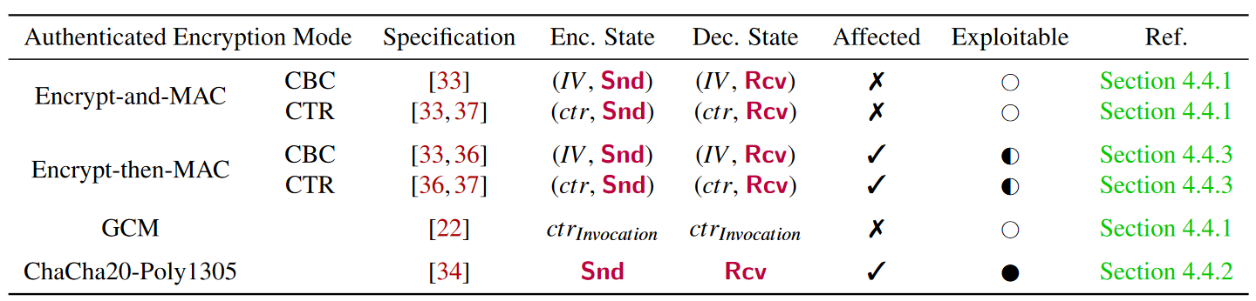
Successful Prefix Truncation Depends on Authenticated Encryption Mode

Slide 20

CBC-EtM Allows Probabilistic Truncation Attacks
packet_length
encrypted packet
mac
${MAC}_{K_{Int}}(sqn$ || $packet_length \text{||} encrypted_packet$) $=mac ?$
packet_length
encrypted packet
${Decrypt}_{K_{Enc}}(encrypted_packet$)
packet_length
padding_length
payload
padding

Slide 21











CBC-EtM Allows Probabilistic Truncation Attacks
$$c_{1}$$
$$c_{2}$$
$$c_{3}$$
$$c_{4}$$
$${Decrypt}_{K_{Enc}}$$
$${Decrypt}_{K_{Enc}}$$
$${Decrypt}_{K_{Enc}}$$
$${Decrypt}_{K_{Enc}}$$
$$IV$$
$$m_{1}$$
$$m_{2}$$
$$m_{3}$$
$$m_{4}$$

Slide 22


CBC-EtM Allows Probabilistic Truncation Attacks
$$c_{3}$$
$$c_{4}$$
$$IV$$
$${Decrypt}_{K_{Enc}}$$
$${Decrypt}_{K_{Enc}}$$
$$m_{3}^{′}$$
$$m_{4}$$

Slide 23





The Attack’s Success Depends on How Peers Handle The Corrupt Message Block
$$m_{3}^{′}$$
$$m_{3}^{′}$$
$$m_{3}^{′}$$
OR
OR
Our experimental verification yielded success probabilities from 0.0003 – 0.8383 for the extension downgrade
Invalid format
Message accepted
Message type unknown
Connection terminated
Connection continues
Respond with Unimplemented and continue

Slide 24
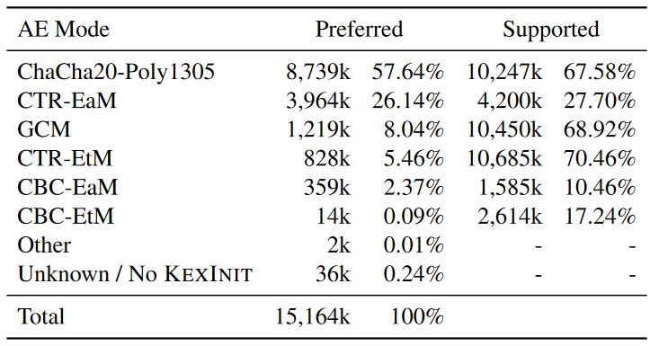
ChaCha20-Poly1305 And EtM Are Popular

Slide 25




Mitigating Our Attack Is Difficult
Countermeasure | Our Suggestion | “Strict KEX” (OpenSSH)
Reset sequence numbers at key installation
Authenticate the entire handshake transcript (hash)
Harden handshake to disallow unexpected messages
  > 30 vendors support “strict kex”
  ~ 8 million servers offer “strict kex”

Slide 26

Lessons Learned
Terrapin is a novel cryptographic attack targeting SSH channel integrity
    Can be exploited in practice to downgrade the connection‘s security
    May lead to more severe vulnerabilities if combined with state machine flaws
  Affected modes of encryption (% Supported):
    ChaCha20-Poly1305 (67.58%)
    CBC-EtM (17.24%)
    CTR-EtM (70.46%)
  All these modes have been proven secure in previous works
    Proofs hold when “strict kex” countermeasure applied

Slide 27

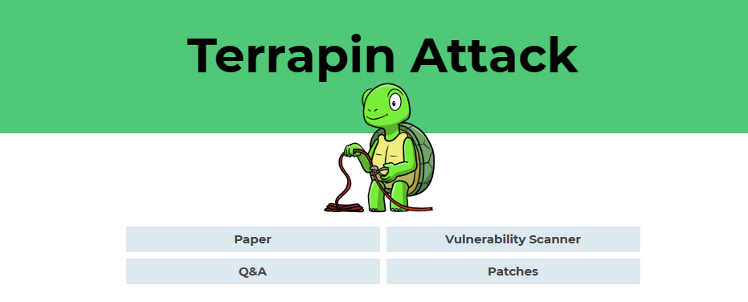
Thanks! Questions?
https://terrapin-attack.com/
E-Mail: fabian.baeumer@rub.de
X (formerly Twitter): @TrueSkrillor
Mastodon: @Skrillor@infosec.exchange

Slide 28
Backup Slides

Slide 29

SSH Got More Complex Over The Years
CBC-EaM
1997
Encrypt-and-MAC (EaM)
CTR-EaM
2003
AE Construction
CBC-EtM
2012
Encrypt-then-MAC (EtM)
Encryption Modes
CTR-EtM
2012
ChaCha20-Poly1305
2013
AEAD
AES-GCM
2007

Slide 30



CBC/CTR-EaM Is Not Affected By Our Attacks
encrypted packet
mac
$${Decrypt}_{K_{Enc}}$$
packet_length
encrypted packet (without first block)
mac
$${Decrypt}_{K_{Enc}}$$
packet_length
padding_length
payload
padding
mac
${MAC}_{K_{Int}}(sqn$ || $unencrypted_packet$) $=mac ?$

Slide 31
AES-GCM Does Not Use Sequence Numbers
(compressed) payload
Padding
packet_length
padding_length
payload
padding
Plaintext
AAD
Nonce
4 bytes
8 bytes
$${Encrypt}_{K_{Enc}}$$
fixed
invocation_ctr
Initialized by key exchange
packet_length
encrypted packet
tag

Slide 32



ChaCha20-Poly1305 Allows Perfect Prefix Truncation
$K_{Enc}=K_{2}||$ $K_{1}$
enc. length
encrypted packet
tag
$${ChaCha20}_{K_{1}}$$
packet_length
encrypted packet
tag
AAD
Nonce
8 Byte
$${ChaCha20Poly1305}_{K_{2}}$$
sequence_number
packet_length
padding_length
payload
padding

Slide 33
The Practical Impact of Our Attack Varies
Truncating ExtInfo After Handshake (Extension Downgrade Attack)
    Impact varies depending on extensions sent by server / recognized by client
      Stripping server-sig-algs can disable RSA-SHA2 support at the client
    Works against all compliant SSH implementations
Malicious ExtInfo (Rogue Extension Negotiation Attack)
    Impact limited by supported extensions
    Limited to non-compliant SSH implementations accepting ExtInfo before NewKeys

Slide 34
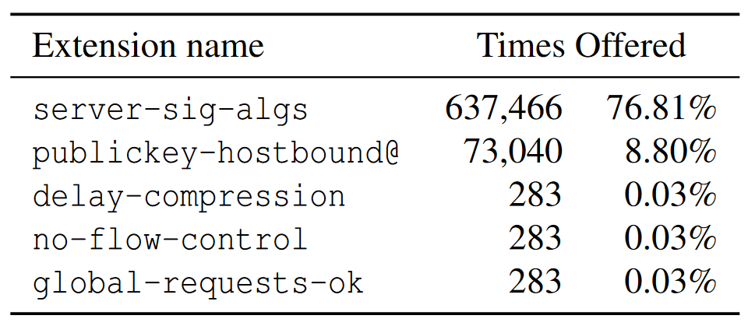
Server-Sig-Algs Is The Most Common Server-Side SSH Extension

Slide 35
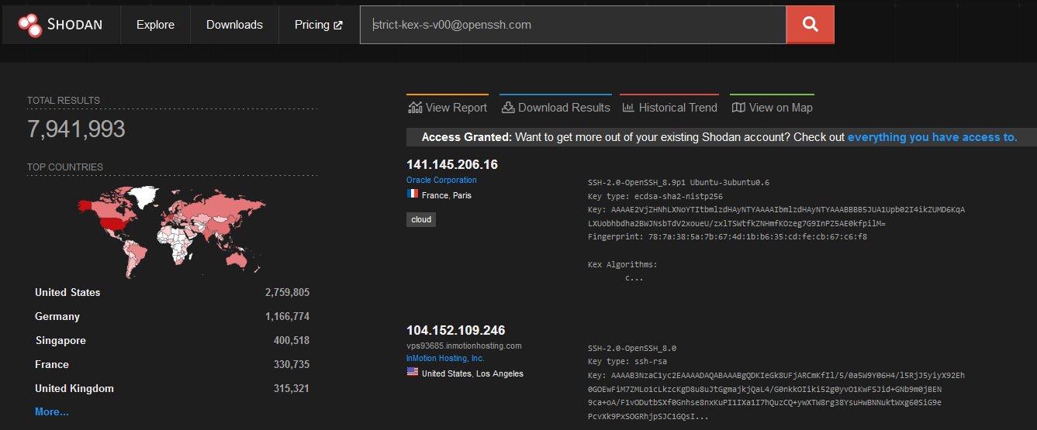
Today: Almost 8 million servers ship „strict kex“

Slide 36
We Contacted ~ 30 Vendors During Disclosure
October 2023
Initial contact with OpenSSH and AsyncSSH
November 2023
AsyncSSH published patch to fix implementation bugs
Initial contact with 29 additional vendors of SSH implementations
December 2023
Public Disclosure
  Thanks to all involved parties for the flawless responsible disclosure process!

