Slide 1
Checking Passwords on Leaky Computers: A Side Channel Analysis of Chrome’s Password Leak Detection Protocol
Andrew Kwong, Walter Wang, Jason Kim, Jonathan Berger, Daniel Genkin, Eyal Ronen, Hovav Shacham, Riad Wahby, Yuval Yarom
Notes:
Hello, everyone. My name is Walter. I will talk about our paper. Checking Passwords on Leaky Computers: A Side Channel Analysis of Chrome’s Password Leak Detection Protocol.

Slide 2
Why Check for Compromised Passwords?
6.9%
Credential Stuffing
Notes:
So let’s start with the motivation why we need to check leaked passwords?
It’s well known that people tend to reuse passwords across services. So, If an adversary compromises user’s passwords in one service,
They can perform a credential stuffing attack, which will lead to further compromise of user’s accounts.
It is estimated that 6.9 percent of credentials are still valid on some service, even after being compromised.
This number, 6.9 percent, may seem small. But we will realize it's still a serious real world problem
if we look at the current large scale of leaked passwords,
and the severe damage to both users accounts and online service providers

Slide 3
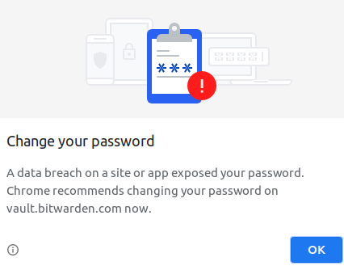
Chrome’s Password Checkup – USENIX Sec. 2019 & RWC 2020
Enabled by Default!
Notes:
As a countermeasure to this, Google devised their own protocol which they call password leak detection,
and they presented this work at Real World Crypto 2020.
Currently, this protocol is built into Chrome browser and it’s enabled by default.
Whenever a user logs into a website,
Chrome will engage with Google’s server to determine if the password is in the database of compromised passwords.
If it is, the browser will show a pop-up to the user, urging them to change their password.

Slide 4
Chrome’s Password Leak Detection
Memory-hard Hashing
Hash-to-curve
Private Set Intersection
Is Password Leak Detection secure against side-channel attacks?
No!
Notes:
While services that alert the user of compromised passwords are not unheard of, Google’s protocol is notable in that it preserves privacy in both directions, assuming both client and server may be malicious.
Therefore, the server shouldn’t know anything about the client’s credentials.
In addition, having a database of leaked passwords is great for a dictionary attack…
So the client shouldn’t know anything about the server’s database either.
To accomplish this, the protocol employs some cryptographic primitives that haven’t seen as much scrutiny in hardware security as some others have seen.
This brings us to the key question of our paper: is Password Leak Detection secure against side-channel attacks?
Obviously, the answer is no, and that’s why I’m presenting today.

Slide 5
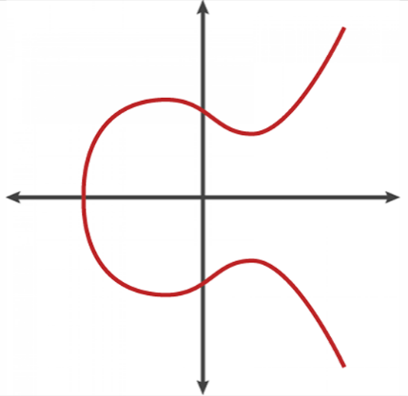
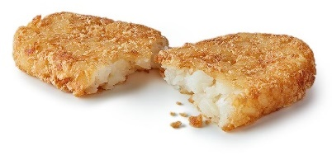
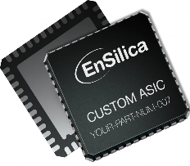
The Protocol in a Nutshell
*PSI: Private Set Intersection
$$Q$$
PSI Step 4:
Unblind with Mod. Inv.
Memory-hard Hashing: Scrypt
PSI Step 1: Hash-to-curve
$${(Q^{ab})}^{a^{−1}}=Q^{b}$$
$$Q^{b}∈\{Q_{1}^{b},Q_{2}^{b},…,Q_{n}^{b}\}$$
?
$$a$$
$${(Q^{a})}^{b}=Q^{ab}$$
$$b$$
$$\{Q_{1}^{b},Q_{2}^{b},…,Q_{n}^{b}\}$$
PSI Step 2:
Blind with Scalar Multiplication
$$Q^{a}$$
PSI Step 3:
Server Computation
Notes:
Let me introduce Google’s protocol, first.
I believe no one here is willing to give our password to the server in plaintext. So Chrome takes the user’s password and hashes it, which I’ll show with a hash brown. Here, it uses Scrypt, a maximally memory-hard hash function.
This means the cost of running Scrypt repeatedly scales dominantly with computer memory rather than CPU cycles, and it’s a countermeasure against brute-forcing the hash function with custom ASICs.
Second, to determine if the user’s password is in Google’s database of leaked ones while preserving privacy, we need something called private set intersection, or PSI, which I’ll start introducing.
So we want the server to be able to perform computations on the password hash, even when it’s blinded, or encrypted. To achieve this, Chrome will map the hash to a point on an elliptic curve; let’s call it Q. This is the first step of PSI.
This alone is not enough for preserving privacy, so we will blind the point before sending it to the server.
Chrome, as the client, randomly generates a one time blinding factor, let’s call it A. It performs blinding with modular exponentiation, by raising Q to the power of A. That is what gets sent to the server.
The server, receiving the blinded point, will use its private blinding factor B to blind the point Q to the power of A again. Let’s call the output Q to the power of A B, or Q AB.
In addition, the server will provide a set of points, lets say Q_1 to Q_n, corresponding to n compromised passwords, all blinded with server’s blinding factor B. After that, the server will send the Q AB and the set back to the client.
This brings us to the last step. Chrome first calculates the modular inverse of A, and uses it to unblind Q AB from the server’s response, yielding Q to the power of B. This is the previous point Q, corresponding to user’s credential, now only blinded with server’s blinding factor B.
Finally, Chrome can check whether Q to the power of B is in the set sent from the server. If it is, this means the credential is compromised and the browser will prompt the user to change their password.

Slide 6
The Protocol in a Nutshell
*PSI: Private Set Intersection
$$Q$$
PSI Step 4:
Unblind with Mod. Inv.
Memory-hard Hashing: Scrypt
PSI Step 1: Hash-to-curve
$${(Q^{ab})}^{a^{−1}}=Q^{b}$$
Notes:
For the rest of the talk, we’ll focus on the three parts on the top half of this slide, namely scrypt, hash-to-curve, and unblinding with modular inversion.

Slide 7
Let the Attacks Begin!
*PSI: Private Set Intersection
$$Q$$
PSI Step 4:
Unblind with Mod. Inv.
Memory-hard Hashing: Scrypt
PSI Step 1: Hash-to-curve
$${(Q^{ab})}^{a^{−1}}=Q^{b}$$
Native Adversary
Notes:
We will present three attacks under three different threat models.
First, let’s consider the simplest threat model of a native adversary, where the adversary’s application and Chrome run on the same target system, and therefore CPU. In this scenario, we can go after Scrypt.

Slide 8
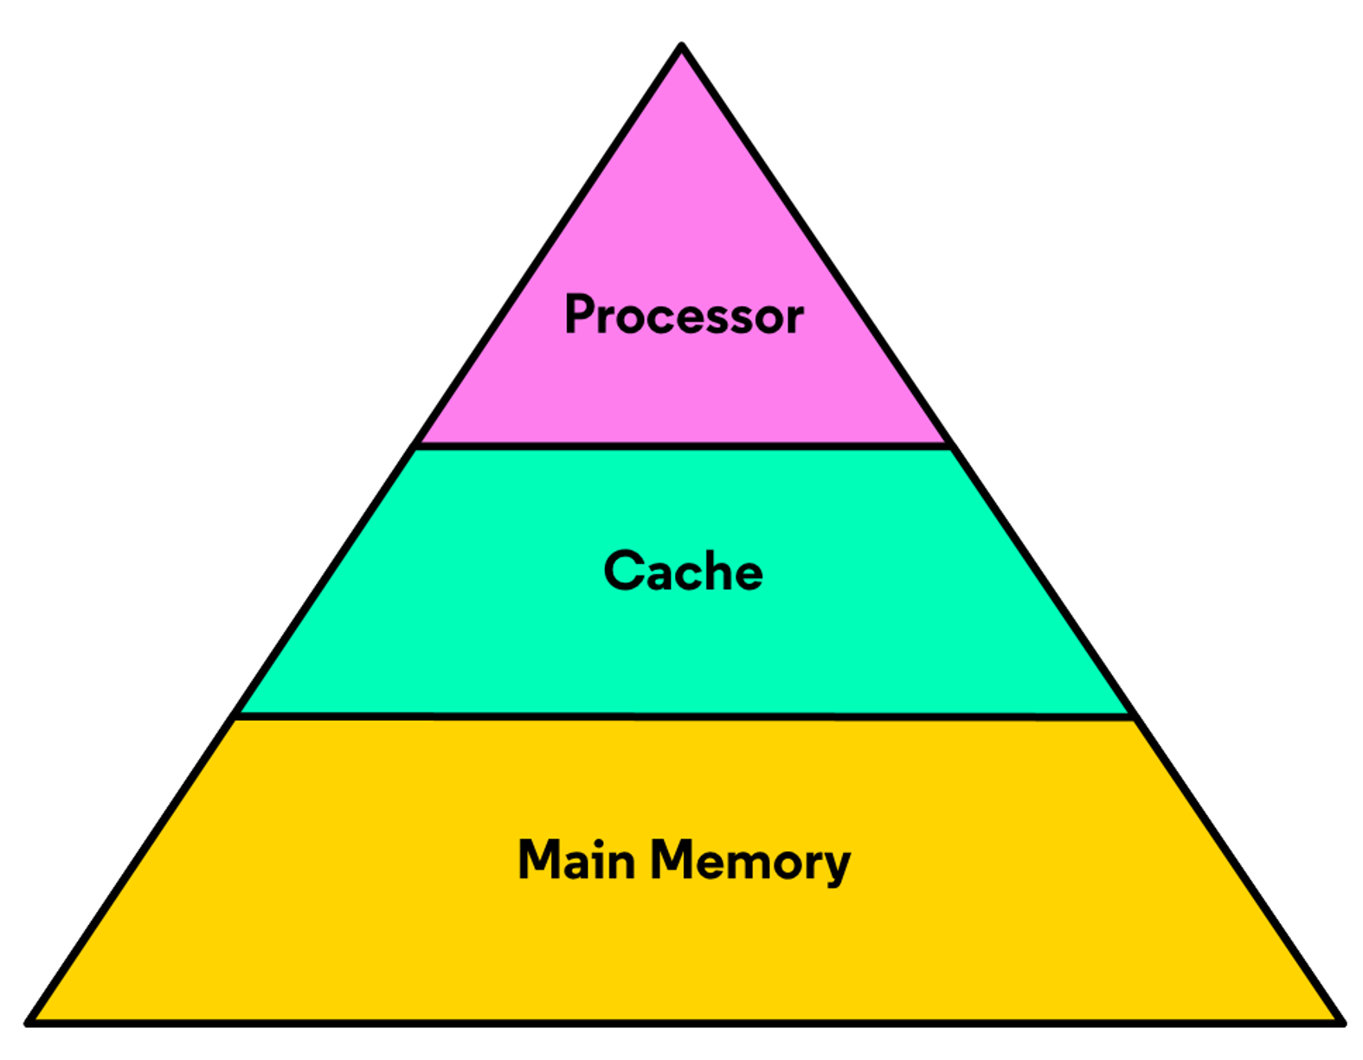
Attacking Input-dependent Memory Accesses
function scrypt(inp)
X = init(inp)
for i = 0 to N–1
j = int(X)
temp = X ^ V[j]
X = mix(temp)
Fast!
Slow…
Array V
14M
rockyou.txt
hunter2
80% Exact Match Using 5 Traces
qwerty
5 sec.
123456
Notes:
Here’s the pseudocode of Scrypt, where we observe it makes accesses into a big array in memory called V.
We can visualize this as a heatmap of V, where the red elements were accessed and the white elements were not.
This access pattern is determined by the input to Scrypt, that is, the user’s credentials. Now, I will explain why this is problematic from a side-channel perspective.
To bridge the gap in latency between the CPU core and main memory, CPUs store recently accessed data in small caches, making access to them fast. For data that hasn’t been accessed recently, they need to be loaded from main memory, which is slow.
With that knowledge, we now can have an adversary who sits and times the access to elements in V.
The red elements are quickly loaded from cache to the adversary,
But the white elements are slowly loaded from main memory.
Using this timing difference, the adversary can reconstruct a trace of this heatmap!
This gives way to a dictionary attack, where we start with over 14 million real passwords from the RockYou breach. We run Scrypt on each password to reconstruct a heatmap trace, and we save into a dictionary pairs of password and trace.
When we measure a trace of an unknown password like adversary’s copy, we search each entry in the dictionary for a match.
Using 5 such measurements that take about 5 seconds total, we show that the adversary can guess the correct password on the very first attempt 80% of the time

Slide 9
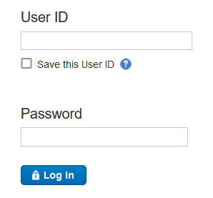
What About Browser-based Adversaries?
*PSI: Private Set Intersection
$$Q$$
PSI Step 4:
Unblind with Mod. Inv.
Memory-hard Hashing: Scrypt
PSI Step 1: Hash-to-curve
$${(Q^{ab})}^{a^{−1}}=Q^{b}$$
Native Adversary
Browser Adversary
Notes:
Now, native adversaries are cool, but who runs untrusted binaries on their machine naively?
Furthermore, people are more and more relying on web browsers for their daily tasks, such as social media, email, and online banking.
In response to that, we present our second threat model and attack. Let’s move on to a browser adversary.
This threat model is much more dangerous, because all the target needs to do is have the adversary’s webpage open on one tab, and their bank account login page open on another tab of the same browser.
This time, we’ll go after Chrome’s hash-to-curve algorithm, which we need for the server to compute on blinded data.

Slide 10
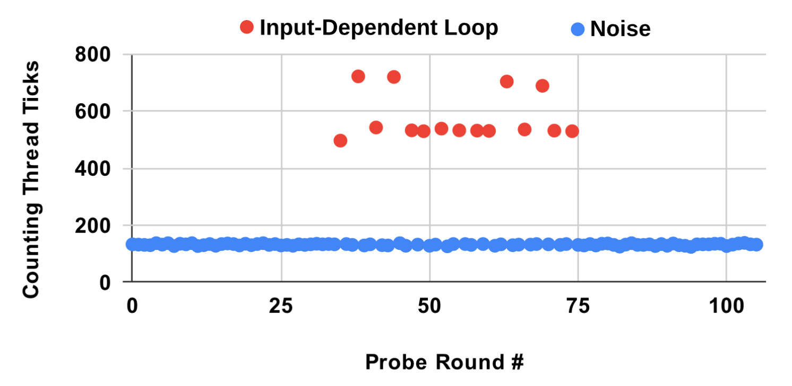
Attacking Input-dependent Loop Iterations
function hash2curve(hash)
point = RandomOracleSHA256(hash)
while !OnCurve(point) do
point = RandomOracleSHA256(point)
…
(hunter2, 3)
14M
(12345678, 4)
rockyou.txt
(qwerty, 10)
Offline: Make Dictionary
66% Recovery
5 Traces
5 sec.
Notes:
To map the password hash to a point on an elliptic curve, we observe that the hash-to-curve pseudocode iterates over a while-loop. However, it simply tries mapping over and over again until it finds a point on the curve. Therefore, the number of iterations is input-dependent. From before, you might see where this is going, namely that any secret-dependent program behavior is a red flag.
In a similar manner to before, using the timing difference between cache and memory, we can determine how many times this loop executed. In this graph, we observe a red timing spike whenever the loop runs.
Therefore, we can measure the duration of when we see these spikes to determine how many loop iterations occurred.
This lets us construct a dictionary offline where each entry consists of a pair of password and number of loop iterations it takes. Compared to the native adversary, this dictionary provides less uniquely identifying information. However, certain passwords like the one in red have a very high iteration count, which lets the adversary identify that password.
We demonstrated this attack in the Chrome browser, and we were able to retrieve some passwords with 66% success rate after performing 5 measurements that took 5 seconds total.

Slide 11
What About Browser-based Adversaries?
*PSI: Private Set Intersection
$$Q$$
PSI Step 4:
Unblind with Mod. Inv.
Memory-hard Hashing: Scrypt
PSI Step 1: Hash-to-curve
$${(Q^{ab})}^{a^{−1}}=Q^{b}$$
Native Adversary
Native + Server Adversary
Browser Adversary
Notes:
So far, we’ve been considering threat models where the adversary is co-located on the client’s machine.
What if the adversary runs the server, too? Recall that Google’s password leak detection protocol guarantees that the server cannot see the client’s hashed password, in case it is malicious.
Our third attack goes after the unblinding part, which involves modular inversion. We show that if the adversary has native code execution capabilities *and* runs the server, then they can violate Google’s guarantee.

Slide 12
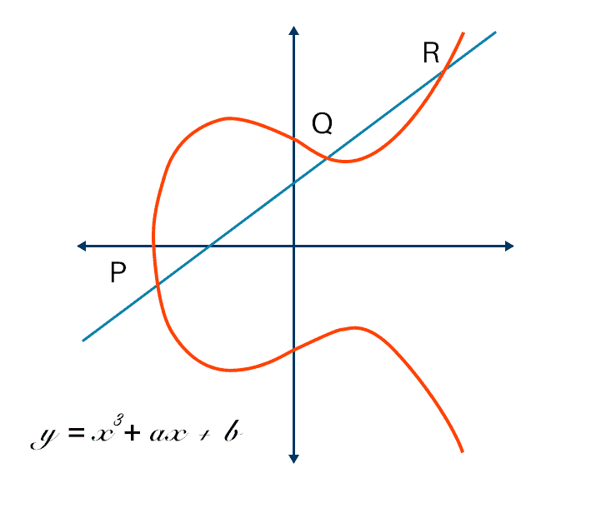
Leaking the Blinded Point
$$Q^{a}$$
$${(Q^{ab})}^{a^{−1}}=Q^{b}$$
$$Q^{ab}$$
$$\{Q_{1}^{b}, …,Q_{n}^{b}\}$$
$$Q$$
$$a^{−1}$$
BEEA
$$a^{−1}$$
34 ms
hunter2 → (-1, 7)
$${(Q^{a})}^{a^{−1}}=Q$$
qwerty → (5, 0)
14M
abc123 → (-2, -8)
Notes:
It’s been several slides since the protocol overview, so let’s talk blinding again. So far, we’re at a point where the user’s password has been hashed and mapped to a point on a curve. Let’s call that point Q. We can’t send Q to the potentially malicious server because everything so far has been deterministic, allowing for a dictionary attack.
So, we need to blind Q. Chrome, as the client, will randomly generate a blinding factor A. Then, we can send Q to the A to the server.
The server, will blind the Q to the power of A again with its own blinding factor B. Also, it will prepare a set of points mapped from leaked passwords, and send Q AB and the set to the client.
So for Chrome to check whether the password is leaked, it needs to unblind Q AB by calculating the modular inverse of the blinding factor A.
Now, the attack begins: from the server side, the adversary has Q to the power A, sent by the client.
On the client side, unfortunately, Chrome uses the binary extended Euclidean algorithm or BEEA when computing the modular inverse, which is not constant-time. This leaks the modular inverse of the blinding factor A on the side-channel floor to an adversary.
So, now, the attacker has the blinded point Q A and the unblinding factor A inverse,
They can directly calculate the point Q, which is deterministic for each password!
This is bad, because the adversary can now build a dictionary that maps passwords to coordinates, and figure out what the client’s password is.
Indeed, we were able to recover the blinding factor and the password completely in just 34 milliseconds.

Slide 13
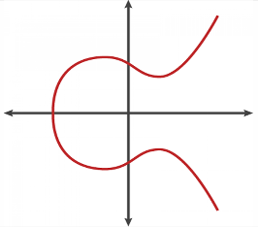
The Final Picture
Scrypt
Native
Argon2
$$Q$$
Constant-time
Hash-to-curve
Browser
Constant-time
Modular Inversion
Using BEEA
Native + Server
foo = arr[secret];
Thank you for listening!
Constant-time Implementations!
Walter Wang
walwan@gatech.edu
Check our paper in USENIX Sec. 23'
for details
Performance
Memory-
hardness
Input-
Obliviousness
Notes:
So, let’s talk about the big picture now. We noticed that Chrome had a new protocol for checking for credential stuffing attacks that used some new cryptography whose side-channel resistance had not been studied well. What's our findings?
Well, we ended up breaking the protocol in three places,
under three different threat models. In all attacks, the Password Leak Detection protocol can disclose a user’s password to the adversary!
This happened because the algorithms are not input-oblivious in their execution. This leaves traces in the CPU’s cache, which is shared across security domains such as processes and websites. These traces can be measured by an adversary co-located on the same system, in both native and browser environments. If the adversary runs the server too, then the landscape is looking even worse.
So, we emphasize the need for constant-time implementations in Chrome’s Password Leak Detection.
In response to our work, Google proposed to replace scrypt with argon2, change hash-to-curve to be constant time, and replace BEEA with a constant-time modular inversion algorithm.
More broadly, given our attacks on script and hash-to-curve, its natural to wonder if there are existing hash algorithms that are more suitable for password checkup, with regards to trade offs between performance, memory hardness, and input obliviousness. It could be interesting to augment existing algorithms, or even designing new ones, that are more desirable for password leak detection.
And that brings an end to my talk. My name is Walter, thank you very much for listening, and I would be happy to answer any questions.

