Slide 1
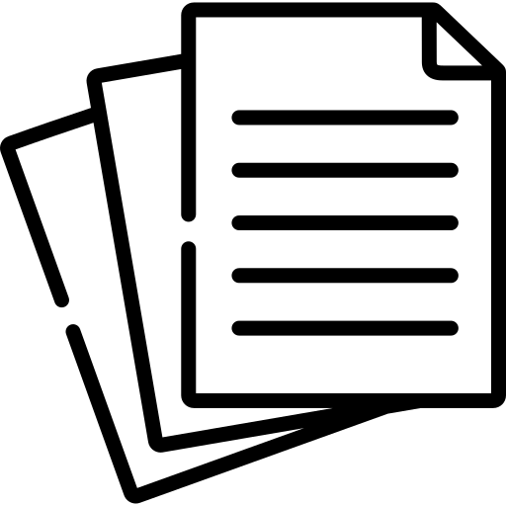
zk-creds Flexible Anonymous Credentials from zkSNARKs and Existing Identity Infrastructure
Michael Rosenberg
University of Maryland
micro@umd.edu
Jacob White
Purdue University
white570@purdue.edu
Christina Garman
Purdue University
clg@purdue.edu
Ian Miers
University of Maryland
imiers@umd.edu
https://ia.cr/2022/878
https://github.com/rozbb/zkcreds-rs

Slide 2
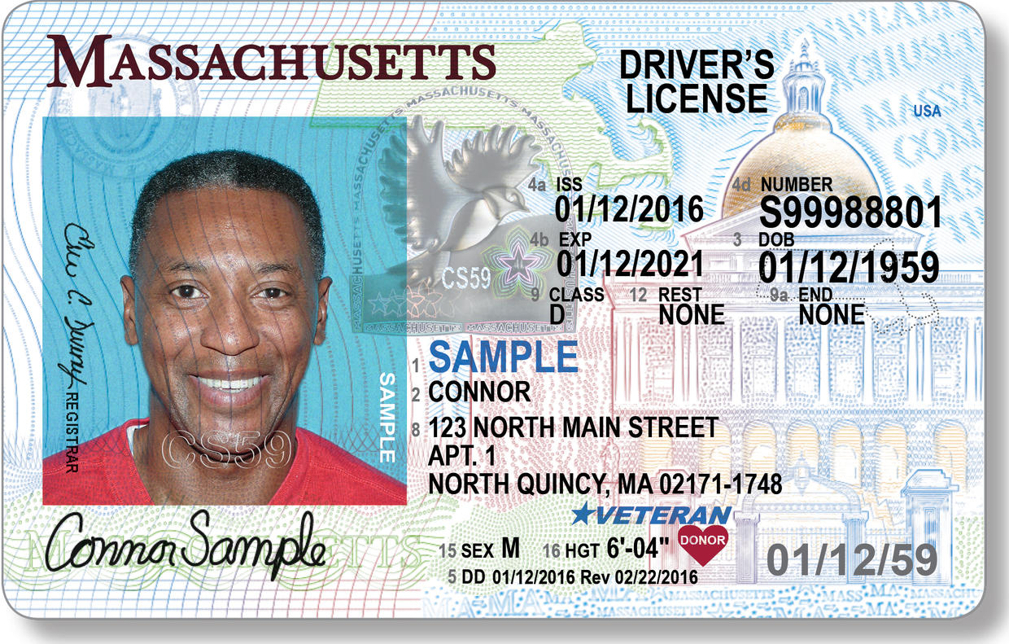
Anonymous Credentials
Prove something about yourself ("I'm over 18"),
without revealing anything else (name, address, etc.)
Notes:
What the hell is an anonymous credential
We can think of this as a redacted state license issued by e.g. the DMV

Slide 3
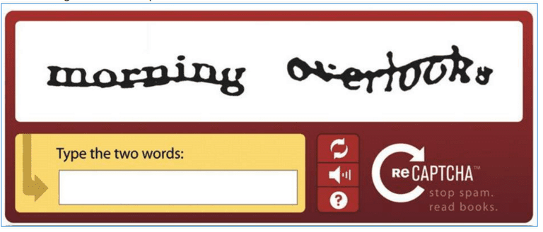
Anonymous Credentials
Example 1
Serving age-restricted video using photo ID or a credit card
Example 2
Preventing spam / DoS using PrivacyPass-like tokens
Notes:
We will motivate anonymous credentials with 2 example use cases
We sites need to know you're over 18 , but you don't want them to learn every video you look at. E.g., YouTube, pornhub etc".
Transition: A question you might have is: is this a new idea?

Slide 4
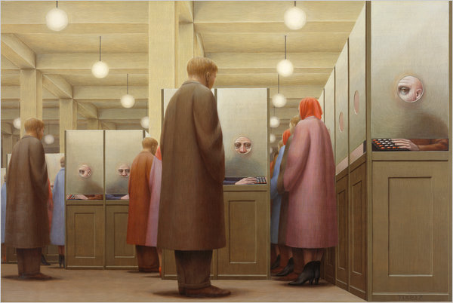
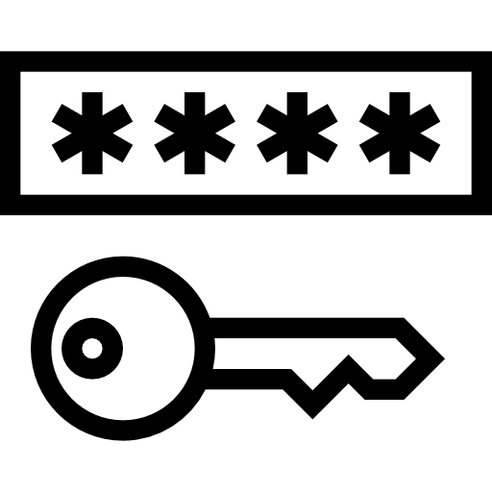
Anonymous Credentials
Lots of anonymous credential schemes exist [Cha85, CL01, CL03, CL04, CHK+06, BCKL08, CG08, BL13, GGM14, CDHK15, SAB+19]
But each:
Requires the gov. to issue new exotic credentials
Requires you to hire a cryptographer to design a custom protocol for each new use case
Government Bureau, George Tooker, 1956
Notes:
The DMV definitely won't
And the other issue is that they're inflexible. new ID source? new use case? requires new blind signature schemes or new sigma protocols
transition: We fix these issues with zk-creds
TODO: More citations.

Slide 5
zk-creds
A practical system must:
Support existing identity documents
Not require new trusted parties for issuance
Be easily programmable for new use cases
zk-creds uses SNARKs to get all of these
Notes:
Documents which already come with an amount of trust. Issued by govts
We don't want to invent sweeping new trust assumptions. This should be relatively conservative
Without hiring a cryptographer. We shouldn't have to invent new cryptography every time

Slide 6
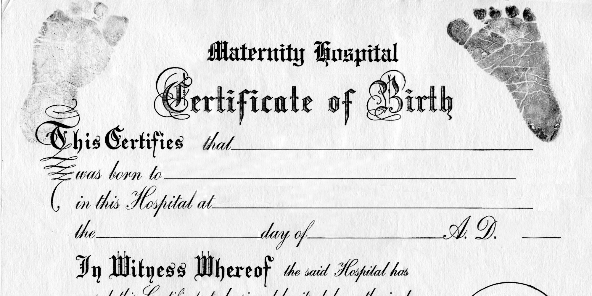
Supporting existing identity documents
Showing age requires gov. ID
Existing creds schemes assume that the gov. will issue your cred.
Observation: some gov. IDs have non-anonymous digital IDs inside the chip.
Furthermore, these IDs are signed by the gov. itself
Idea
Let's bootstrap an anonymous system on top of this non-anonymous one
Notes:
Showing age requires govt. ID
Why do we wanna support existing identity documents?
Simple: the government determines lots of things about you. For example your age
Existing anon creds schemes will stop right there

Slide 7
Supporting existing identity documents
Problem
Credential schemes are broader than just what's in 1 doc
With SNARKs, we take a passport and prove the age is >18.
This works for anything with a signature in it.
"Doc X has age > 18, and X is signed by the US State Dept. pubkey"
π
Notes:
Problem: This doesn't work with many schemes.
Some require a PRF key, or a captcha, or additional info not from a passport, like privacy pass or other identity sources
So we need a way to issue our credentials.
BUT...transition
TODO: split into 2 slides. imagine a conversation. how would this split.

Slide 8
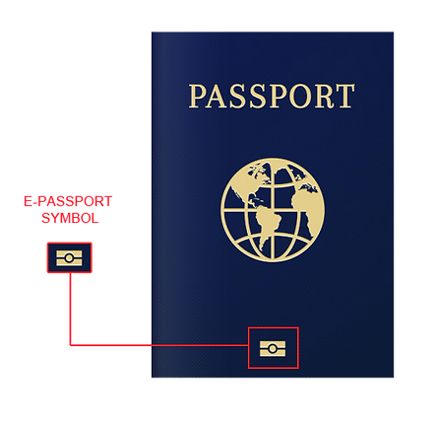
What if we could just use existing identity documents?
Problem
Credential schemes are more than one doc
You need other fields and keys
Some gov identity documents are digitally signed
Signatures are not anonymous
We can fix this with a zk proof!
Prove an ID is signed by the gov
Make statements about the identity
"Doc X is signed by the US State Dept. pubkey
AND X.age > 18"
π
Notes:
We can basically wrap everything in a ZKP
So we're done, right?
Problem: This doesn't work with many schemes.
Some require a PRF key, or a captcha, or additional info not from a passport, like privacy pass or other identity sources
So we need a way to issue our credentials.
BUT...transition
TODO: split into 2 slides. imagine a conversation. how would this split.

Slide 9
Supporting existing identity documents
Problem
Credential schemes are more than one doc
You need other fields and keys
Use zero-knowledge proofs (zkSNARKs) to:
Prove an ID is signed by the gov.
Make statements about the identity
Privacy ✅ Authenticity ✅
"Doc X is signed by the US State Dept. pubkey
AND X.age > 18"
π
Notes:
We can basically wrap everything in a ZKP
So we're done, right?
Problem: This doesn't work with many schemes.
Some require a PRF key, or a captcha, or additional info not from a passport, like privacy pass or other identity sources
So we need a way to issue our credentials.
BUT...transition
TODO: split into 2 slides. imagine a conversation. how would this split.

Slide 10
zk-creds
A practical system must:
Support existing identity documents
Not require new trusted parties for issuance
Be easily programmable for new use cases
Notes:
BUT...we can't set up a new trusted party for the reasons we already spoke about.

Slide 11
(Issuing) Anonymous credentials
The usual flow
Problem
We want fewer, not more, trusted third parties
Request issue
Issue
"I know a signature on a doc such that..."
π
Show
Notes:
Here's roughly what existing anonymous credential schemes do for issuance
Issuer signs blindly
Of course this has a trusted issuer to do issuance
TODO: Crisp it up

Slide 12
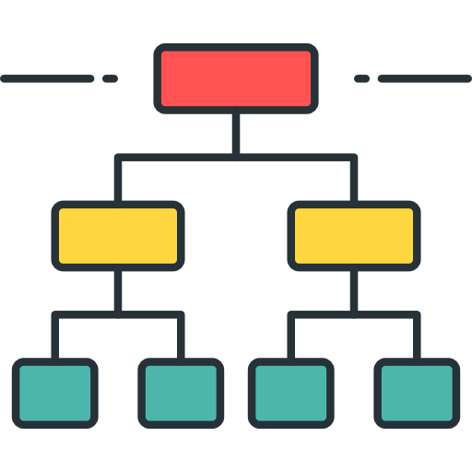
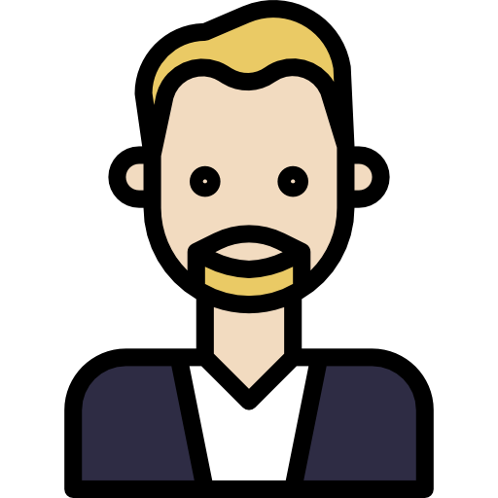
(Issuing) Anonymous credentials
The zk-creds flow
Replace signature with proof of list membership + use SNARKs:
Issuance list
What does this buy us?
What does this cost us?
Request issue
"I know a leaf in this tree such that..."
π
Show
Anonymous credentials
The zk-creds flow
Notes:
So how do we fix this?
Instead of signing the cred, just put it in a list
So instead of signing, we have a list you just put it in
BUT WHY is that useful? We still have to maintain a list!

Slide 13
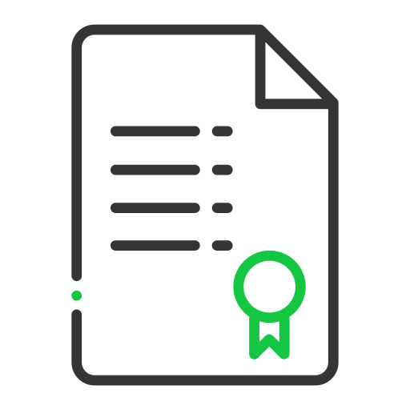
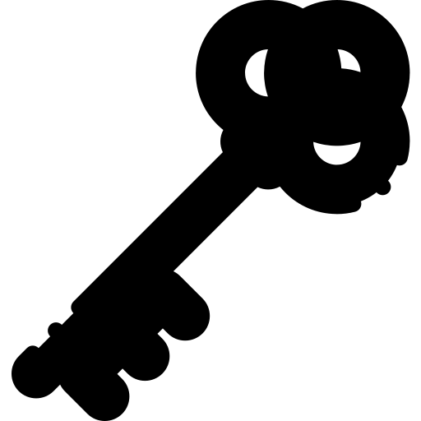
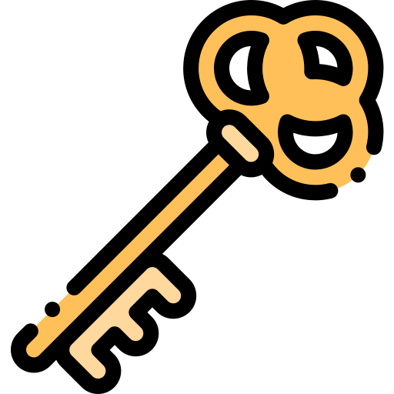
zk-creds Protocol diagram
TODO: Replace sig w/ merkle tree. and that's the ONLY change
TODO: slide after this motivating zk supporting documentation
[
[
[
[
[
[
[
[
π
[
Request issue
TODO: add arrow from this pi to tree
π
[
Show
Notes:
Need an idea of issuance. Don't worry we won't reinvent the wheel

Slide 14
zk-creds Extending flexibility
TODO: kill this. read previous slide
An issuer checks multiple documents, called zk-supporting documentation, and issues a credential.
[
commit
[
Previously: issuance is a signature
π
[
Now: issuance is inclusion in a Merkle tree
π
[
[
[

Slide 15
zk-creds When to issue, when to reject
To get an issued credential, a user might need to give extra information.
This is called zk-supporting documentation
To request issuance in zk-creds, provide:
A credential
zk-supporting docs
A proof it's all correct
[
[
[
π
Notes:
What does this buy us?
Well with signatures, the signer can sign at any time.
With the list, you can include a proof of why that thing should be there.
This list is now a publicly auditable issuing mechanism. It can be run by one person or by consensus, or anything in between.
key point: removed signing authority and transitioned to something transparent
TODO: Make the merkle tree more transparent
TODO: Delete all subheadings
TODO: also maybe note that pi is flexible. maybe on another slide.

Slide 16
Transparent issuance
Previously: issuer could privately sign whatever they wanted
With a public list: we can see every issued cred
Replace list of IDs with commitments to IDs
We can now use zk-supporting documents to justify why it was issued
Issuance is now publicly auditable but private
Bonus: more ways to issue (threshold permissions, Byzantine consensus, blockchain, etc.)
Issuance list
commitment
commitment
π
π
Notes:
In short, it makes issuance transparent
Malicious signer. Not just a problem, but an undetectable problem
This list is now a publicly auditable issuing mechanism. It can be run by one person or by consensus, or anything in between.
key point: removed signing authority and transitioned to something transparent
Transition: This process doesn't compromise on privacy either
TODO: also maybe note that pi is flexible. maybe on another slide.

Slide 17
Transparent issuance
[
commit
[
Everything is still private
Issuance happens on commitments of IDs, not IDs themselves
Zero-knowledge proofs during issuance and show means nothing extra is revealed
Issuance list
[
[
π
π
Notes:
Transition: we've addressed issuance. now we want to make sure you can actually use these credentials once they're issued
TODO: also maybe note that pi is flexible. maybe on another slide.

Slide 18
zk-creds
A practical system must:
Support existing identity documents
Not require new trusted parties for issuance
Be easily programmable for new use cases

Slide 19
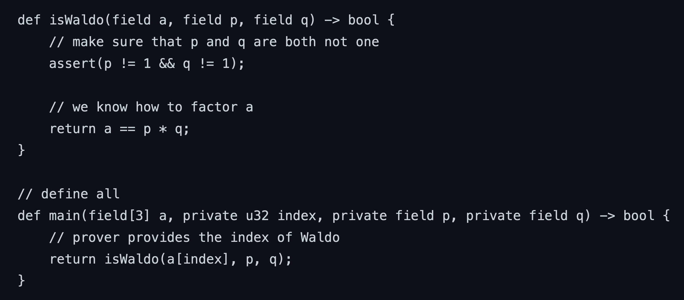
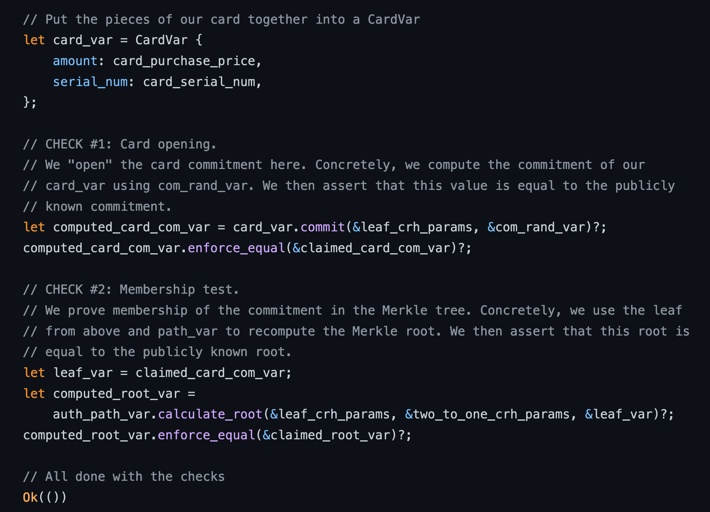
Flexibility
zokrates
π
can be an arbitrary statement
Show
arkworks
Huge ecosystem for SNARKs
Can write complex statements without highly specialized skills
We implemented this
Notes:
made it so Show is a general-purpose snark
This has a few benefits.
First, there's a lot of SNARK tooling out there. There's DSL, and frameworks for C++, Rust, and Java
Second, this tooling makes it so that you don't have to be a cryptographer
We've written out some examples that demonstrate this

Slide 20
Using flexibility
Optimization
A new cryptographic technique that lets you reuse and link gadgets together
Gadgets:
Expiry The credential hasn't expired
Linkable Show I'm the same person as before
Rate limiting I haven't used my credential too many times
Clone resistance If I reused my credential too many times, you can deanonymize me
We build all these with just a few lines of arkworks code.
π_{bul}
π_{gadg1}
π_{gadg2}
π_{gadg3}
Notes:
We defined some fundamental buildling blocks for show proofs we call gadgets
and implemented them
Clone resistance is exactly what we need for our youtube example
Transition: recapping...

Slide 21
Composing documents
Another bonus: the proofs can be anything, both for show and zk-supporting docs
Allows us to combine information both:
For issuing credentials with zk-supporting documentation
And satisfying access policies which need multiple credentials (e.g., identity and residency)
Bank Statement
π
π
Notes:
In short, it makes issuance transparent
Malicious signer. Not just a problem, but an undetectable problem
This list is now a publicly auditable issuing mechanism. It can be run by one person or by consensus, or anything in between.
key point: removed signing authority and transitioned to something transparent
TODO: also maybe note that pi is flexible. maybe on another slide.

Slide 22
zk-creds
A practical system must:
Support existing identity documents
Not require new trusted parties for issuance
Be easily programmable for new use cases
Notes:
We built a system that can bootstrap off of existing identity
Ensures public auditability of all issuance
And can be reprogrammed for new, possibly unintended or unexpected use cases
Great.
How fast is it?
Near the human perception limit of what counts as instantaneous
We'll see that in a sec

Slide 23
Experiments
Microbenchmarks Benchmarked bulletin membership + 1 gadget
Case study Wrote an Android app that dumps passports. Wrote a SNARK for US passport validity. Benchmarked proofs.
Show < 300ms
Proofs ~1KiB
Verify < 10ms
Takeaway
Fast enough to run on your phone in the real world
Notes:
We wrote up the gadgets in arkworks
Also wrote up end-to-end examples like walking into a bar and showing your age and face
Did this with an Android app that reads a US passport and dumps it to JSON that we then use for proofs
Benchmarked on desktop computer
Memory usage: 824MB

Slide 24
Extensions & future work
TODO: pare down or delete. top priority is point #1. And: this is very flesible. you can swap out the SNARK scheme, the statements, the identity types, etc.
More identity sources No limits on what we can use. DKIM to prove email ownership. DECO/TLSNotary to prove web account ownership.
More show statements Prove you live in a specific voting district. Even if expensive, you only prove once.
Faster primitives New ZK crypto is coming out all the time

Slide 25
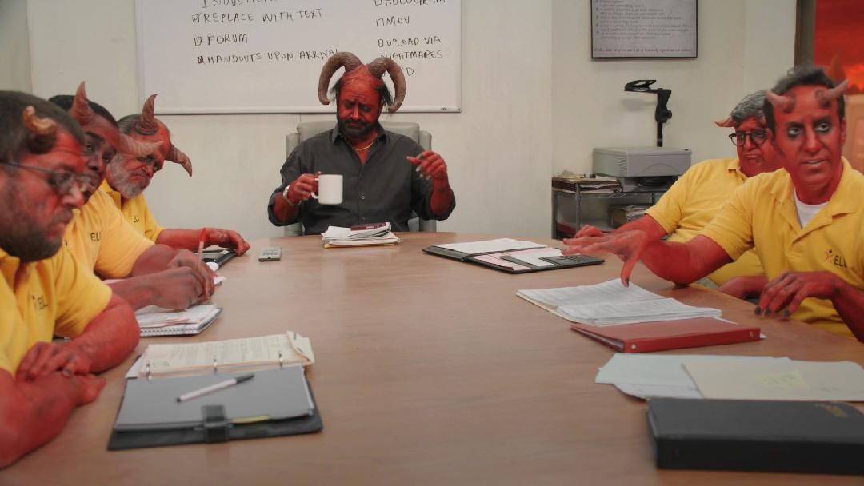
Conclusion
Show < 300ms
Proofs ~1KiB
Verify < 10ms
We built a fast, flexible anonymous credentials scheme.
Any part can be swapped out (hash, proof system, tree/sig)
This is all possible due to general purpose zkSNARKs
Notes:
w/o having to, like the bard Orpheus refusing to accept the sudden and untimely passing of his wife Eurydice, go down to the DMV

Slide 26
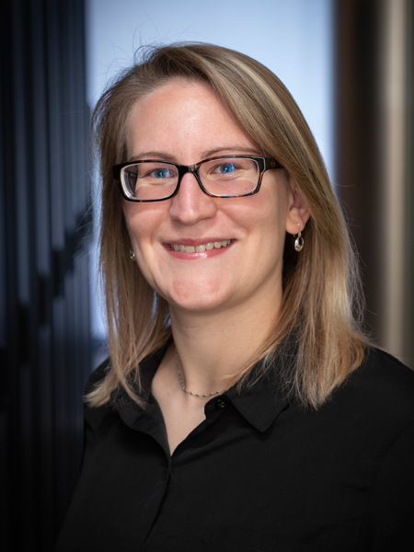
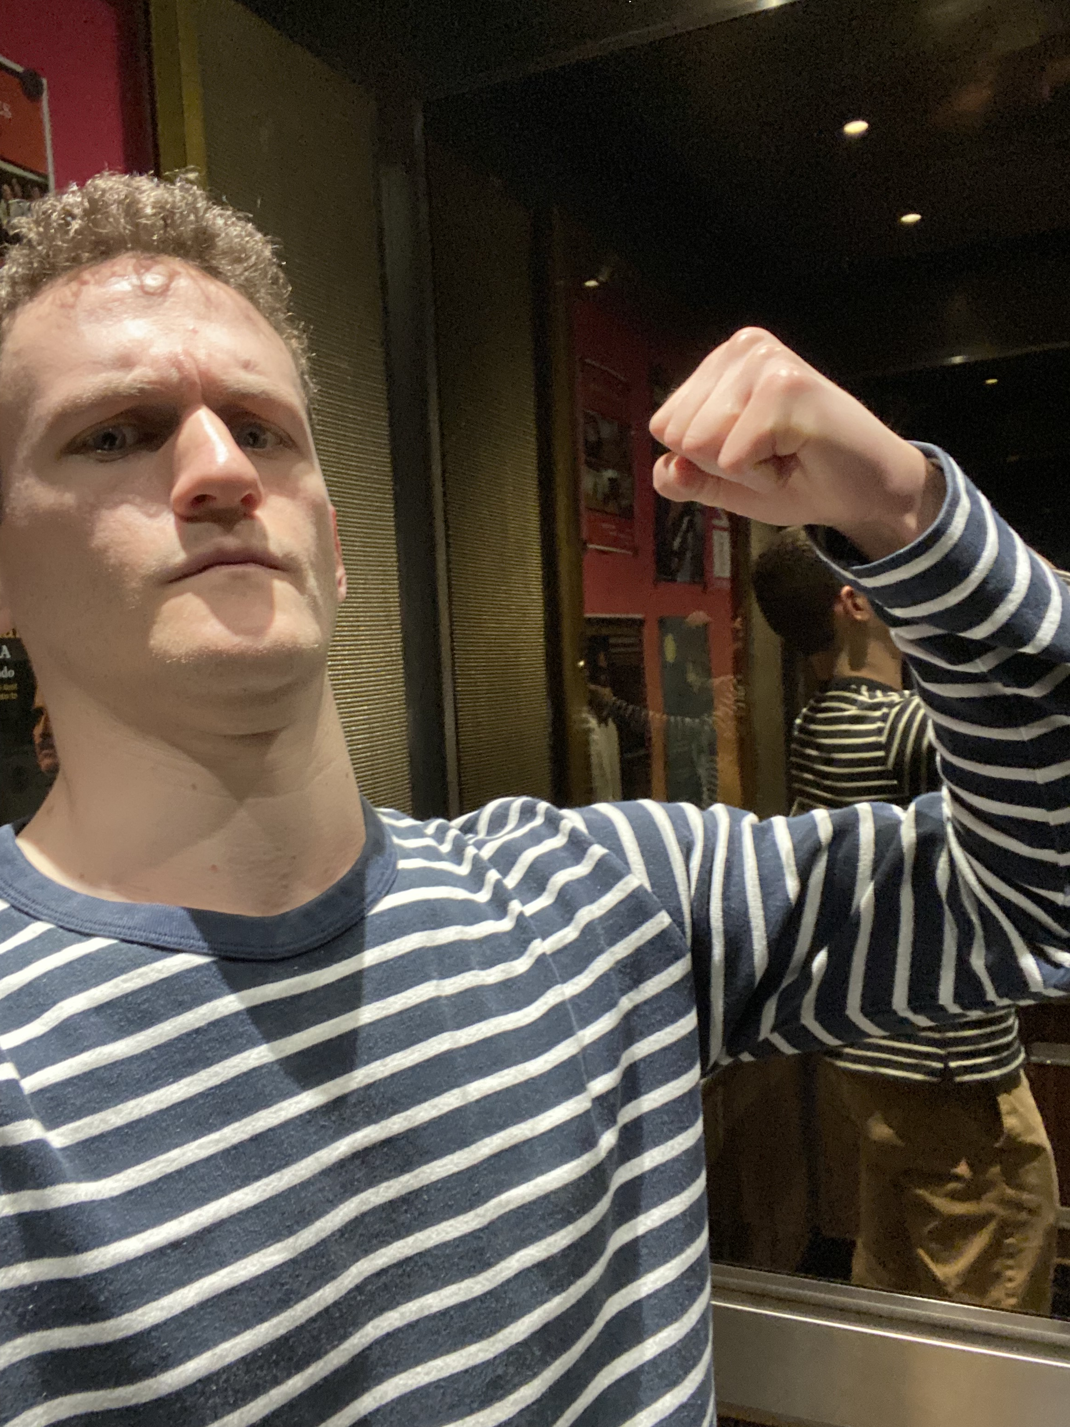
Questions?
zk-creds Flexible Anonymous Credentials from zkSNARKs and Existing Identity Infrastructure
Support for existing identity documents
No new trusted parties
Programmable w/o needing cryptographers
https://ia.cr/2022/878
https://github.com/rozbb/zkcreds-rs
Images from flaticon.com

Slide 27
How do you revoke credentials?
We can remove credentials from the issuance list
Only requires a mechanism for learning we need to revoke
Easy in some cases
Harder in others
Issuance list
Government Bureau, George Tooker, 1956

Slide 28
zk-creds show
TODO: one big bulletin board
Show: User proves
That their cred is on the bulletin board
Any other statements that the service provider asks for
Service provider verifies the proofs wrt the bulletin board
Bonus feature
Hidden issuer
π_{bul}
π_{stmt1}
π_{stmt2}
π_{stmt3}
Notes:
This indeed is what we want
arbitrary statements
no need to enumerate statements ahead of time
Bonus:
we actually support multiple issuers, and the user proves that they are on one of multipole possible bulletin boards

Slide 29
Prelims: zkSNARKs
New
Zero-knowledge Succinct Noninteractive ARgument of Knowledge:
Can prove "I know x such that P(x, aux)" where aux is public
That proof π is the same size no matter how complicated P is
Verify(π, aux) is constant time*
Example: Unlinkable signatures
"I know σ such that SigVerif_{pk}(σ, m)"
LinkG16 extends Groth16. Lets you package and repackage multiple proofs:
π₁
π₂
π₃
π'₂

Slide 30
Terminology
Service Provider
Credential
User
Issuer

Slide 31
Our contribution
zk-creds lets users:
Bootstrap digital credentials from existing identity infrastructure (e.g., passports) in a publicly auditable way.
Prove arbitrary statements about credentials, even statements that weren't imagined when they were issued (e.g., ID + vaccine card)

Slide 32
Terminology (cont.)
Issue
[
Show
Notes:
Issuance:
For now, can think of it as a signature or blind signature.
The issuer signs the thing, but doesn't necessarily see its contents

Slide 33
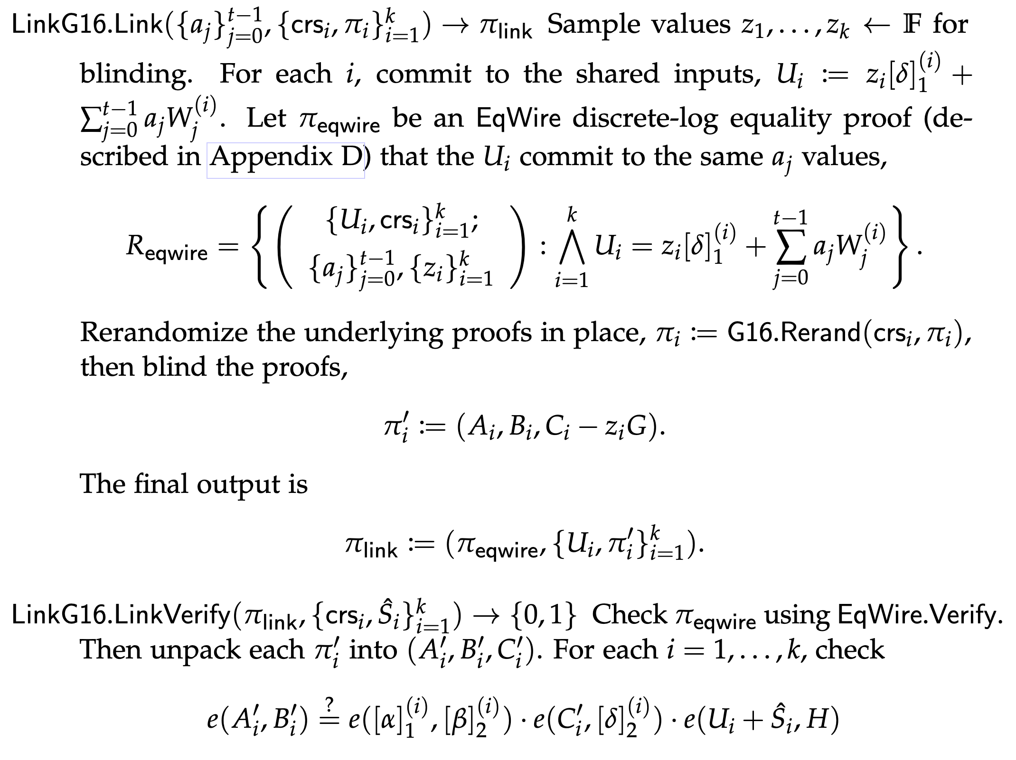
LinkG16
todo: flesh out. include merkle forest optims
text
Notes:
Clone resistance is exactly what we need for our youtube example

