Slide 1
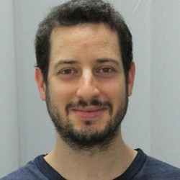
Reclaiming our passwords: Protecting End-to-End Encryption from a Malicious Zoom Server
Cas Cremers
Eyal Ronen
Mang Zhao
CISPA Helmholtz Center for
Information Security, Germany
cremers@cispa.de
Tel Aviv University, Israel
er@eyalro.net
CISPA Helmholtz Center for
Information Security, Germany
mang.zhao@cispa.de
Notes:
Hello everyone! I am Mang Zhao from CISPA.
In this talk, I will present our recent work on Zoom, suggesting reclaiming our passwords for protecting our End-to-End Encryption from a Malicious Zoom Server.
This is the joint work my co-authors Cas Cremers and Eyal Ronen.

Slide 2
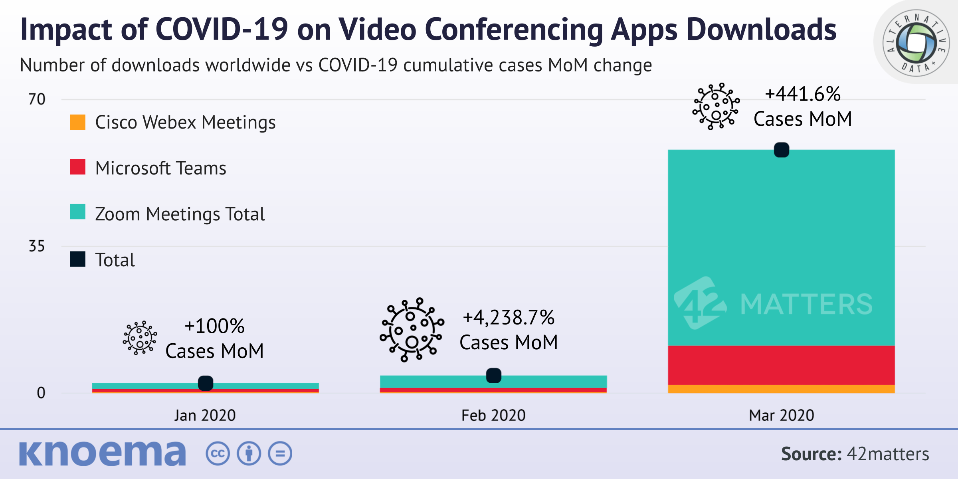
Video Conferencing Apps Are Popular
Notes:
Starting from Covid-19 pandemic, video conferencing apps have become more and more popular in helping people maintain long-distance business and social connections.
Some real-world applications are Webex by Cisco, Microsoft Teams, and Zoom.

Slide 3
The Most Popular Video Conferencing App: Zoom
350 million daily meeting participants* (2023).
*: Data from https://earthweb.com/zoom-statistics/, Winner icons created by Freepik - Flaticon
Notes:
Among them, Zoom is the most popular one.
Even in the post-covid era, Zoom still has plenty of daily users.

Slide 4
How People Meet in Zoom
Notes:
Zoom is a video-conferencing platform that allows a group of people to meet in a virtual room.

Slide 5
How People Meet in Zoom
Notes:
In every group meeting, there is always a party who is responsible for scheduling this event. We call this party “leader”.
[1']

Slide 6
How People Meet in Zoom
Notes:
When the group meeting is scheduled, some other parties can then join the same group meeting room.
We call them participants.

Slide 7
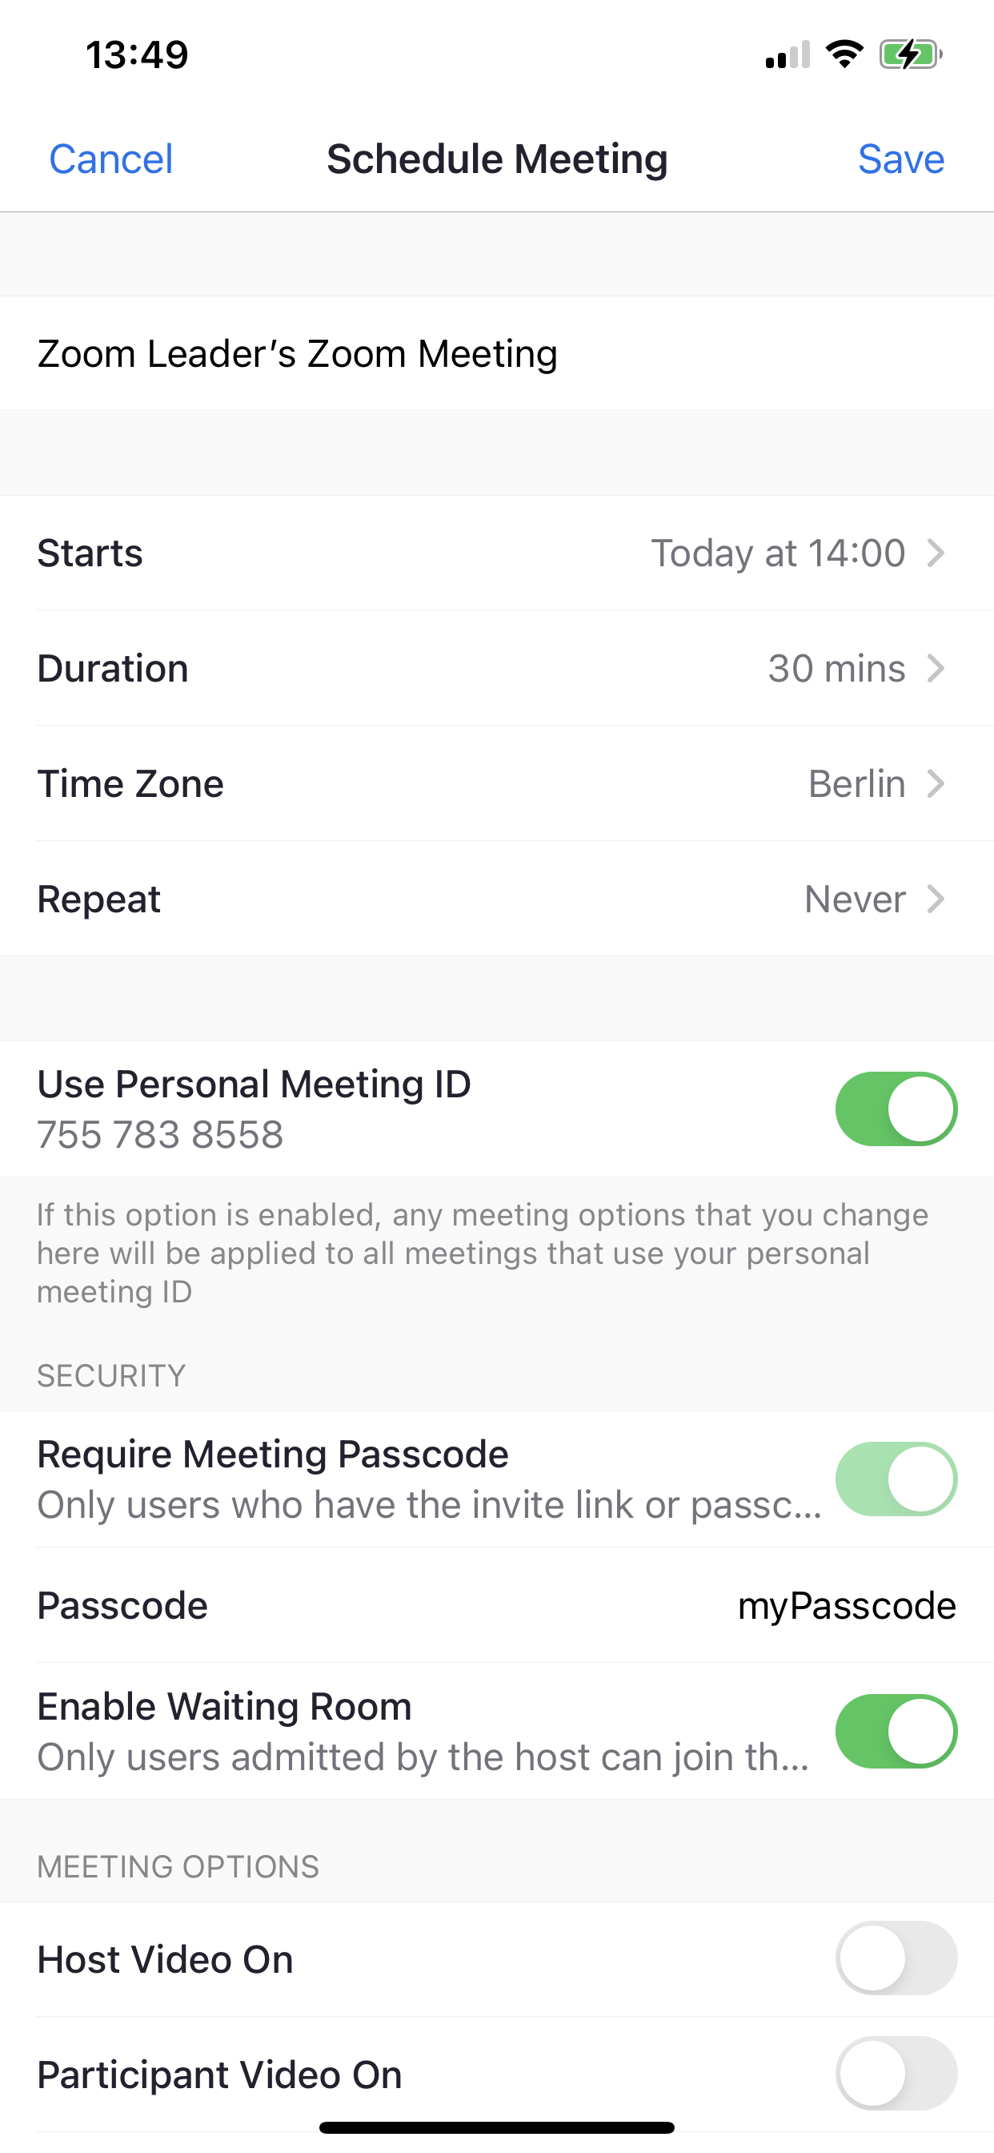
How People Meet in Zoom
passcode $pc$
Notes:
When scheduling a group meeting, as you might know if you have tried in Zoom, the leader needs to pick a group meeting ID and a passcode pc, followed by sending them to the Zoom server.

Slide 8
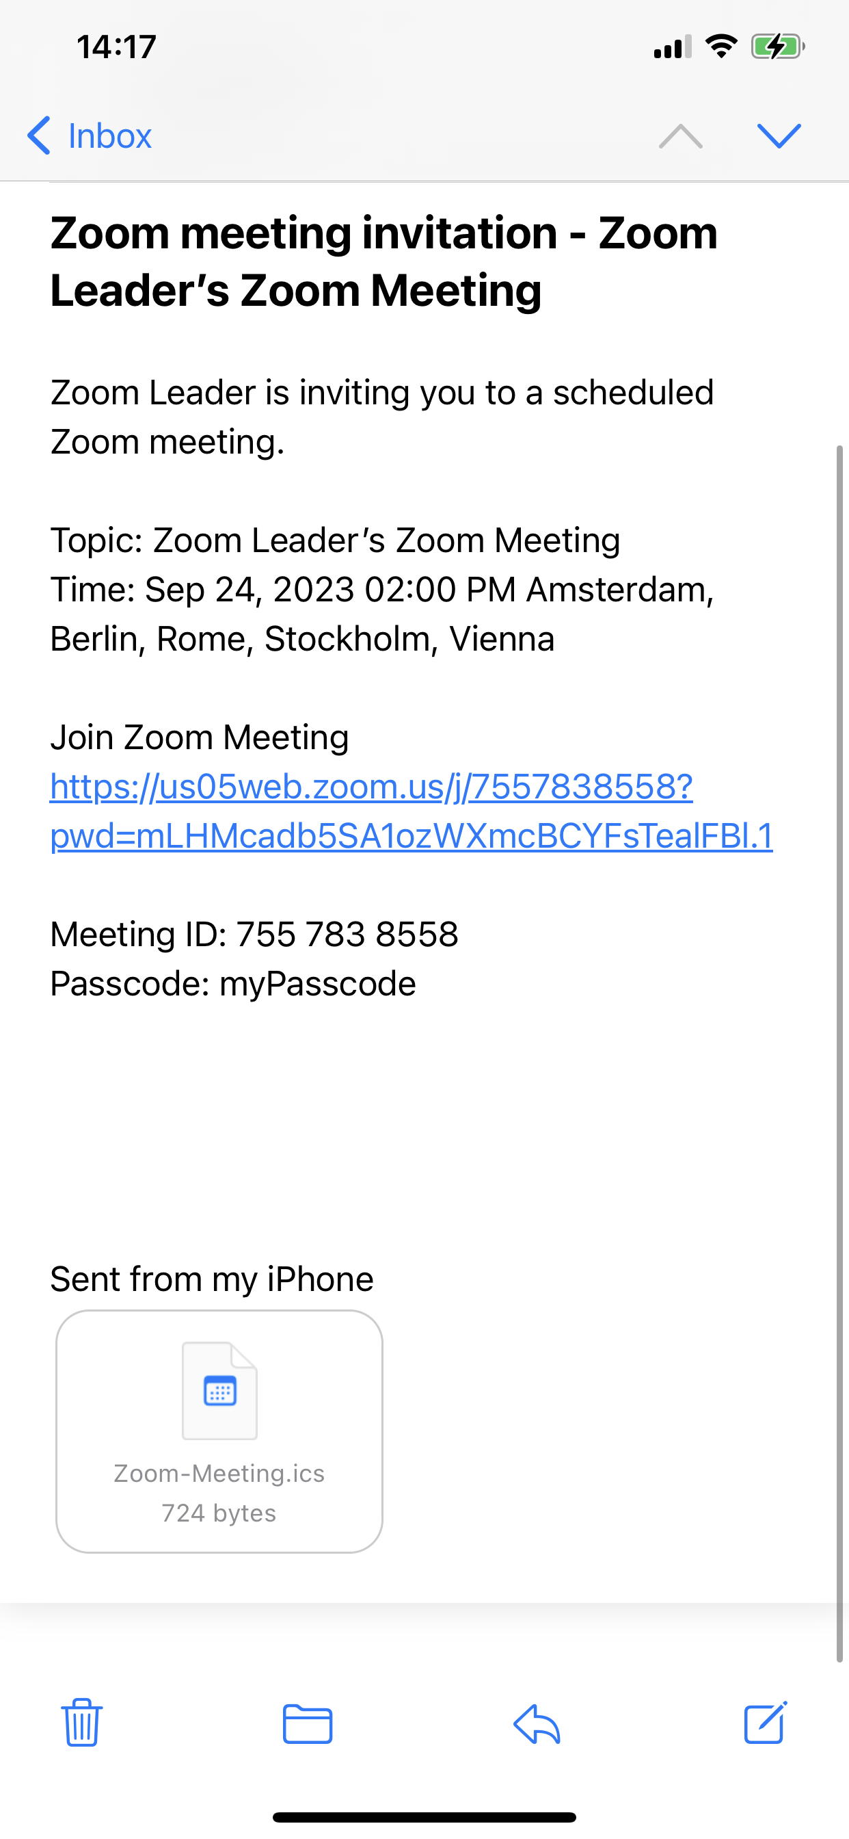
How People Meet in Zoom
passcode $pc$
passcode $pc$ (out-of-band)
Notes:
At the same time, the leader also sends both the meeting ID and the passcode to all invited participants over some out-of-band channels, for example, by Email.

Slide 9
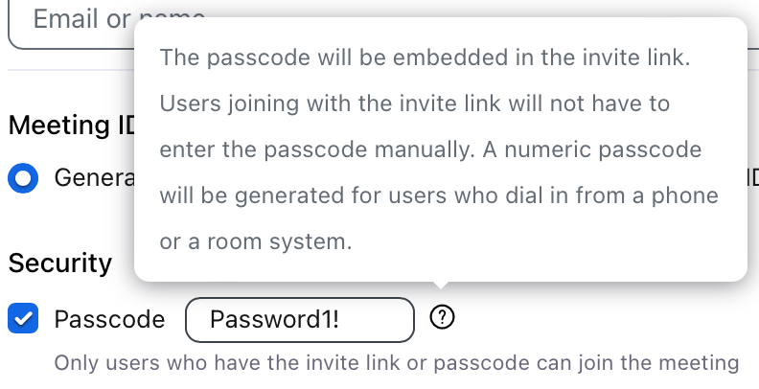
How People Meet in Zoom
passcode $pc$
passcode $pc$’
passcode $pc$ (out-of-band)
Notes:
Finally, the participants can join the desired group meeting room by using the received passcode.
Of course, people can also instead simply click the invite link, where the passcode is embedded.

Slide 10
How People Meet in Zoom
passcode $pc$
passcode $pc$’
participant’s pk, if $pc=pc′$
leader’s pk, if $pc=pc′$
passcode $pc$ (out-of-band)
Notes:
If the passcode sent by this participant matches the one scheduled by the leader, the Zoom server will send the leader’s public keys to the participant, and the participant’s public keys to the leader.

Slide 11
How People Meet in Zoom
passcode $pc$
passcode $pc$’
participant’s pk, if $pc=pc′$
leader’s pk, if $pc=pc′$
passcode $pc$ (out-of-band)
Talk in the meeting room
Notes:
Afterwards, the leader and the participants can freely talk inside the group meeting room.

Slide 12
Zoom Supports Two Encryptions
passcode $pc$
passcode $pc$’
participant’s pk, if $pc=pc′$
leader’s pk, if $pc=pc′$
passcode $pc$ (out-of-band)
Talk in the meeting room
Notes:
Zoom supports two different encryptions to protect the security of the group communication.

Slide 13
Zoom Supports Two Encryptions
passcode $pc$
passcode $pc$’
participant’s pk, if $pc=pc′$
leader’s pk, if $pc=pc′$
passcode $pc$ (out-of-band)
Talk in the meeting room
Goal: defend third-party attackers
=> Zoom Server knows all content in this meeting
Notes:
The first one is the enhanced encryption, which aims to defend third-party attackers.
With this encryption, the Zoom server can obtain all keys for encryption and decryption, and therefore also knows all messages in this group meeting.

Slide 14
Zoom Supports Two Encryptions
passcode $pc$
passcode $pc$’
participant’s pk, if $pc=pc′$
leader’s pk, if $pc=pc′$
passcode $pc$ (out-of-band)
Talk in the meeting room
Goal: defend third-party attackers
=> Zoom Server knows all content in this meeting
Goal: defend third-party attackers and a malicious Zoom server
Question: Is Zoom E2EE Really So Secure?
Note: We analyzed version 4.0 (Released on 18.Nov.2022) [Zoom-WP]
Notes:
The second one is the end-to-end encryption, which aims to defend not only third-party attackers but also a malicious Zoom server.
As Zoom claimed, by end-to-end encryption, "No one else can obtain your encryption key, not even Zoom”.
[3']

Slide 15
Zoom Supports Two Encryptions
passcode $pc$
passcode $pc$’
participant’s pk, if $pc=pc′$
leader’s pk, if $pc=pc′$
passcode $pc$ (out-of-band)
Talk in the meeting room
Goal: defend third-party attackers
=> Zoom Server knows all content in this meeting
Goal: defend third-party attackers and a malicious Zoom server
Question: Is Zoom E2EE Really So Secure?
Note: We analyzed version 4.0 (Released on 18.Nov.2022) [Zoom-WP]
Notes:
Now, a natural question arises: is Zoom’s end-to-end encryption really so secure?
In this work, we analyzed the security of Zoom’s End-to-End Encryption, following Zoom’s white paper version 4.0.

Slide 16
Related Works
Concurrent Work on Zoom’s E2EE Security [DJKM23]:
Proved security of Zoom (Client v5.12), assuming a trusted PKI infrastructure
Zoom realizes trusted PKI by:
(Still) developing Zoom Transparency Tree (ZTT) for honest key distribution
(Now) suggesting every group member to read a key-related security code
passcode $pc$
passcode $pc$’
participant’s pk, if $pc=pc′$
leader’s pk, if $pc=pc′$
passcode $pc$ (out-of-band)
Talk in the meeting room
Notes:
Related to Zoom’s security analysis, a concurrent work [DJKM23] proved Zoom’s end-to-end security but under the assumption that Zoom can offer a trusted PKI infrastructure.

Slide 17
Related Works
Concurrent Work on Zoom’s E2EE Security [DJKM23]:
Proved security of Zoom (Client v5.12), assuming a trusted PKI infrastructure
the current underlying PKI is also operated by Zoom => Is it reliable?
passcode $pc$
passcode $pc$’
participant’s pk, if $pc=pc′$
leader’s pk, if $pc=pc′$
passcode $pc$ (out-of-band)
Talk in the meeting room
Notes:
However, the current PKI underlying Zoom is also operated by Zoom.
If the Zoom server might be malicious, how could we trust this PKI?

Slide 18
Related Works
Concurrent Work on Zoom’s E2EE Security [DJKM23]:
Proved security of Zoom (Client v5.12), assuming a trusted PKI infrastructure
the current underlying PKI is also operated by Zoom => Is it reliable?
Zoom is developing Zoom Transparency Tree (ZTT) to realize trusted PKI
passcode $pc$
passcode $pc$’
participant’s pk, if $pc=pc′$
leader’s pk, if $pc=pc′$
passcode $pc$ (out-of-band)
Talk in the meeting room
Notes:
Now, Zoom is also developing a new mechanism called Zoom Transparency Tree ZTT to realize trusted PKI.

Slide 19
Related Works
Concurrent Work on Zoom’s E2EE Security [DJKM23]:
Proved security of Zoom (Client v5.12), assuming a trusted PKI infrastructure
the current underlying PKI is also operated by Zoom => Is it reliable?
Zoom is developing Zoom Transparency Tree (ZTT) to realize trusted PKI
=> A malicious server can still inject an uninvited malicious participant!
passcode $pc$
passcode $pc$’
participant’s pk, if $pc=pc′$
leader’s pk, if $pc=pc′$
passcode $pc$ (out-of-band)
Talk in the meeting room
Notes:
However, note that Zoom server knows passcodes of every group meetings.
A malicious Zoom server can easily inject an uninvited malicious participant into any group meeting.
We will see a feasible attack example later.

Slide 20
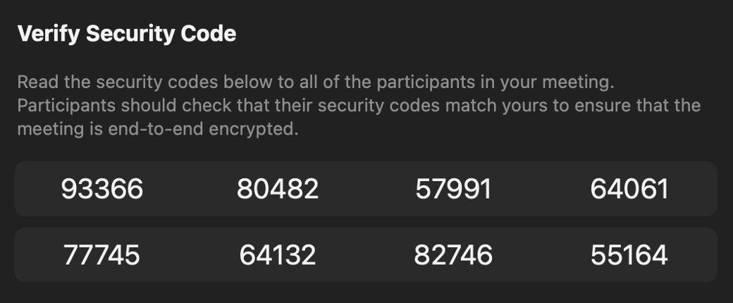
Related Works
Zoom suggests:
group members to read a security code that is
related to leader’s public keys
Notes:
Besides, Zoom also suggests every group members to read and compare a security code that is related to the leader’s public keys at the beginning of every group meeting.
This mechanism can prevent man-in-the-middle attack and also potentially provide member identification by voice.

Slide 21
Related Works
Zoom suggests:
group members to read a security code that is
related to leader’s public keys
VOICE-ZEUS Attack against Zoom [AS23]:
Proposed a novel voice impersonation attack: Recorded voice of a victim can be used to generate an artificial voice that reads new security codes
“To mitigate these risks, stronger security measures are necessary during the group authentication ceremony in Zoom” [AS23]
Notes:
However, a recent work [AS23] proposed a novel voice impersonation attack: recorded voice of a victim can be reused to generate an artificial voice that reads new security codes.
The authors in [AS23] stressed that “to mitigate these risks, stronger security measures are necessary during the group authentication ceremony in Zoom.”

Slide 22
Related Works
Zoom suggests:
group members to read a security code that is
related to leader’s public keys
VOICE-ZEUS Attack against Zoom [AS23]:
Proposed a novel voice impersonation attack: Recorded voice of a victim can be used to generate an artificial voice that reads new security codes
Conclusion: Zoom is conjectured to be insecure against (fully) malicious servers
“To mitigate these risks, stronger security measures are necessary during the group authentication ceremony in Zoom” [AS23]
Notes:
So, following the intuition above, we can conjecture that Zoom is insecure against malicious servers.

Slide 23
Main Contribution and Outline
Our main contribution is:
to improve Zoom’s security against malicious servers
achieved by reusing passcodes in a better way!
passcode $pc$
passcode $pc$’
participant’s pk, if $pc=pc′$
leader’s pk, if $pc=pc′$
passcode $pc$ (out-of-band)
Talk in the meeting room
Notes:
In this work, our main contribution is to improve Zoom’s security against malicious servers.
And our methodology is to reuse Zoom's passcodes in a better way, without introducing any new security element or mechanism.

Slide 24
Main Contribution and Outline
Our main contribution is:
to improve Zoom’s security against malicious servers
achieved by reusing passcodes in a better way!
Q&A Outline:
Q1. What does Zoom E2EE look like?
Q2. Is Zoom E2EE as secure as claimed?
Q3. How does our solution reuse passcodes?
Q4. How is our solution provably secure against (fully) malicious servers?
Notes:
In the rest of this talk. We will focus on 4 questions:
What does Zoom end-to-end encryption look like? Is Zoom’s end-to-end encryption as secure as claimed?
How does our solution reuse passcodes?
and how is our solution provably secure against fully malicious servers?
Now, let’s start to answer the first question, What does Zoom's end-to-end encryption look like? [6]

Slide 25
Q1. What does Zoom E2EE look like?
generate state
generate state
Sign Up
$$m_{SignUp}^{A}$$
$$m_{SignUp}^{B}$$
Notes:
The Zoom's End-to-End Encryption protocol has six phases. For simple presentation, we call the leader Alice and any participant Bob.
In the first sign up phase, both Alice and Bob need to generate their local states, followed by sending a public message to the server.
We denote these messages by m-SignUp-A or B.

Slide 26
Q1. What does Zoom E2EE look like?
generate state
generate state
Sign Up
$$m_{SignUp}^{A}$$
$$m_{SignUp}^{B}$$
pick group id $gid$
passcode $pc$
receive group id $gid$
passcode $pc$
Group
Schedule
$$gid, pc$$
store $pc^{gid}$
$gid, pc$ (out-of-band)
Notes:
In the second group schedule phase, the leader Alice needs to pick a group id gid and a passcode pc.
As we have introduced, Alice will send both gid and pc to the server, the server will store the passcode.
At the same time, Alice also sends both group id and passcode to Bob over some out-of-band channels, for exmaple, email.
Bob receives them by checking his email box.

Slide 27
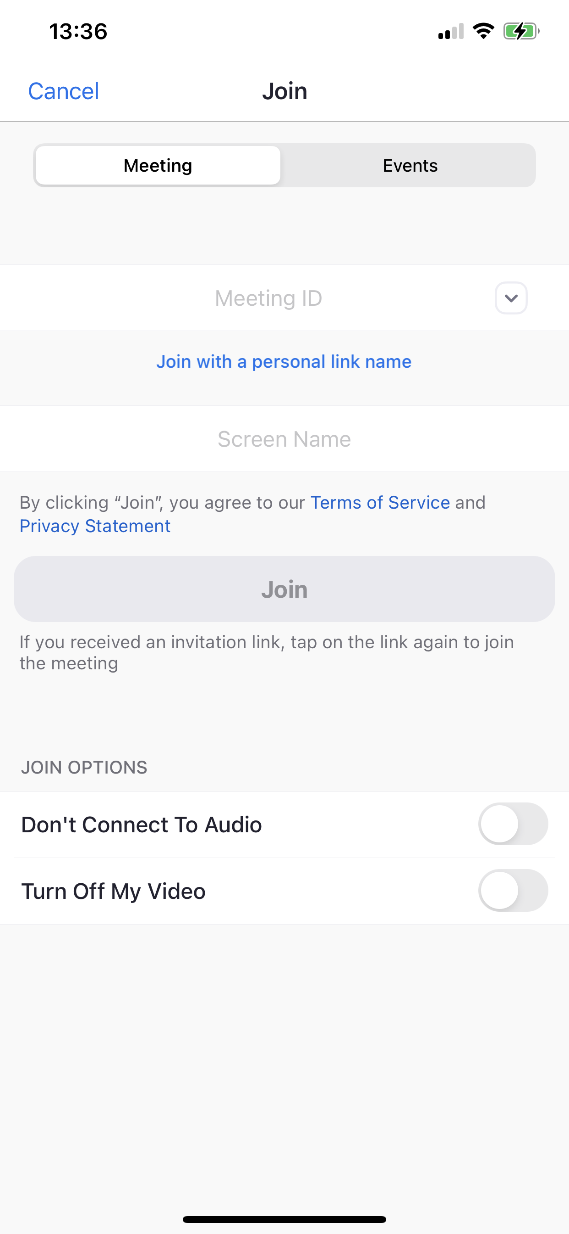
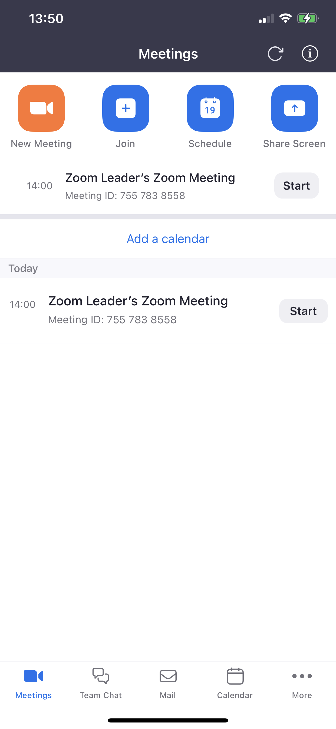
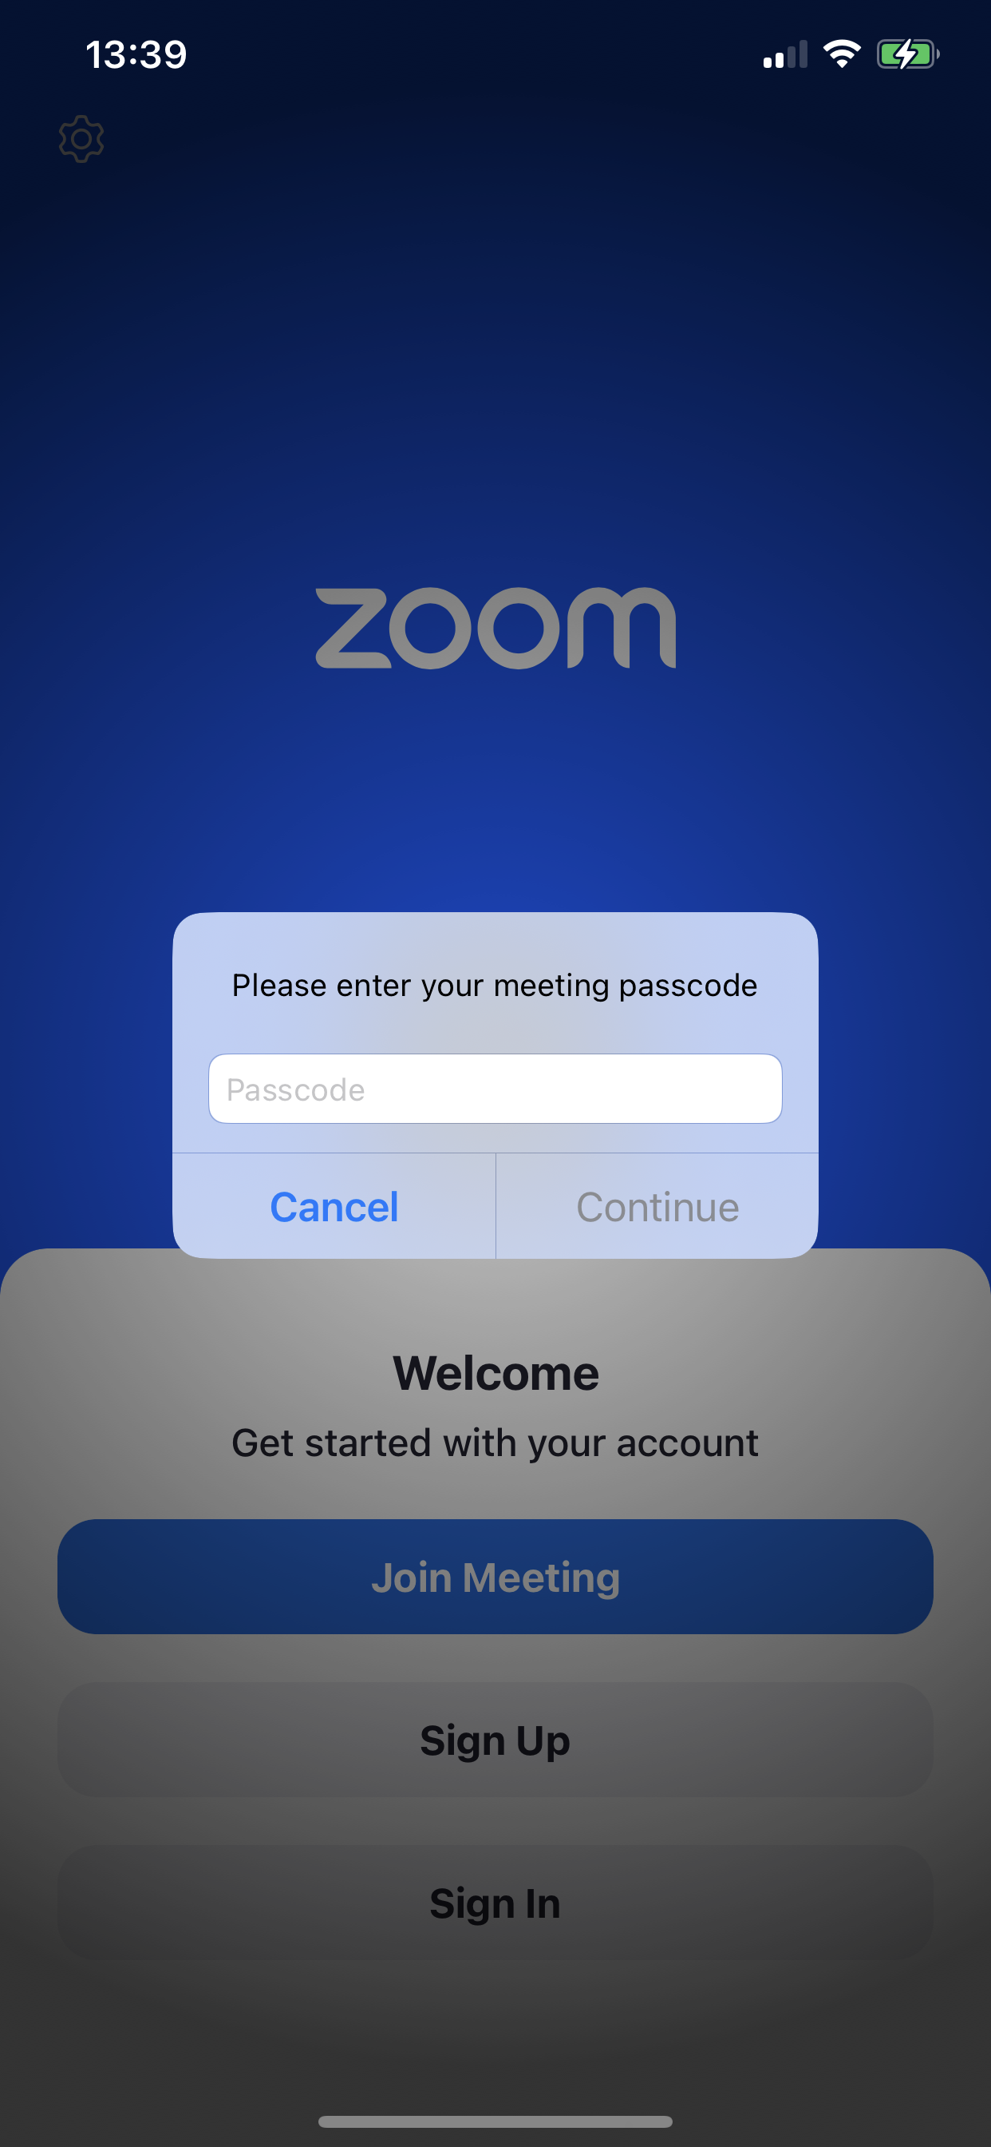
Q1. What does Zoom E2EE look like?
generate state
generate state
Sign Up
$$m_{SignUp}^{A}$$
$$m_{SignUp}^{B}$$
pick group id $gid$
passcode $pc$
receive group id $gid$
passcode $pc$
Group
Schedule
$$gid, pc$$
store $pc^{gid}$
$gid, pc$ (out-of-band)
generate per-group state
sample group key $gk$
generate per-group state
Register
$$gid, pc,m_{Reg}^{A},…$$
$$gid, pc,m_{Reg}^{B},…$$
check $pc=pc^{gid}$
Notes:
When the group is scheduled, Alice can register by clicking the start button and Bob can register by entering the group id and the passcode.
In this phase, both Alice and Bob generate a per-group state. The leader additionally samples a group key gk.
Then, both Alice and Bob send the group id gid, the passcode pc, and some messages to the server. We denote these messages by m-reg-A or B.
The server checks whether the passcodes are correct.

Slide 28
Q1. What does Zoom E2EE look like?
generate state
generate state
Sign Up
$$m_{SignUp}^{A}$$
$$m_{SignUp}^{B}$$
pick group id $gid$
passcode $pc$
receive group id $gid$
passcode $pc$
Group
Schedule
$$gid, pc$$
store $pc^{gid}$
$gid, pc$ (out-of-band)
generate per-group state
sample group key $gk$
generate per-group state
Register
$$gid, pc,m_{Reg}^{A},…$$
$$gid, pc,m_{Reg}^{B},…$$
check $pc=pc^{gid}$
$$m_{SignUp}^{B},m_{Reg}^{B}$$
$$m_{SignUp}^{A},m_{Reg}^{A}$$
Participant
Join
verify $m_{Reg}^{B}$ using $m_{SignUp}^{B}$
encrypt $gk$ using $m_{Reg}^{B}$
verify $m_{Reg}^{A}$ using $m_{SignUp}^{A}$
decrypt $gk$ using $m_{Reg}^{A}$
$$c$$
Notes:
If the passcodes are correct, then the Zoom server will forward the partner’s both sign-up and register messages to Alice and Bob.
Both Alice and Bob will verify the partner’s register-message by using the partner’s sign-up message.
Afterwards, Alice encrypts the current group key using her local per-group state and Bob’s register-message.
When receiving the ciphertext c, Bob recovers the group key by using his per-group state and Alice’s register-message.

Slide 29
Q1. What does Zoom E2EE look like?
generate state
generate state
Sign Up
$$m_{SignUp}^{A}$$
$$m_{SignUp}^{B}$$
pick group id $gid$
passcode $pc$
receive group id $gid$
passcode $pc$
Group
Schedule
$$gid, pc$$
store $pc^{gid}$
$gid, pc$ (out-of-band)
generate per-group state
sample group key $gk$
generate per-group state
Register
$$gid, pc,m_{Reg}^{A},…$$
$$gid, pc,m_{Reg}^{B},…$$
check $pc=pc^{gid}$
$$m_{SignUp}^{B},m_{Reg}^{B}$$
$$m_{SignUp}^{A},m_{Reg}^{A}$$
Participant
Join
verify $m_{Reg}^{B}$ using $m_{SignUp}^{B}$
encrypt $gk$ using $m_{Reg}^{B}$
verify $m_{Reg}^{A}$ using $m_{SignUp}^{A}$
decrypt $gk$ using $m_{Reg}^{A}$
$$c$$
sample new group key $gk$
encrypt $gk$ using $m_{Reg}^{B}$
decrypt $gk$ using $m_{Reg}^{A}$
update $gk$
Key
Rotation
$$c$$
Notes:
Now, Alice and Bob can talk in the group meeting. The message, video, and audio all are end-to-end encrypted by using the group key gk.
To provide strong security, Zoom further rotates the group keys every certain minutes.
In the fifth key rotation phase, Alice samples a new group key and encrypts it.Bob recovers the new group key and updates it locally.
The encryption and decryption in this phase are identical to the ones in the Participant Join phase.

Slide 30
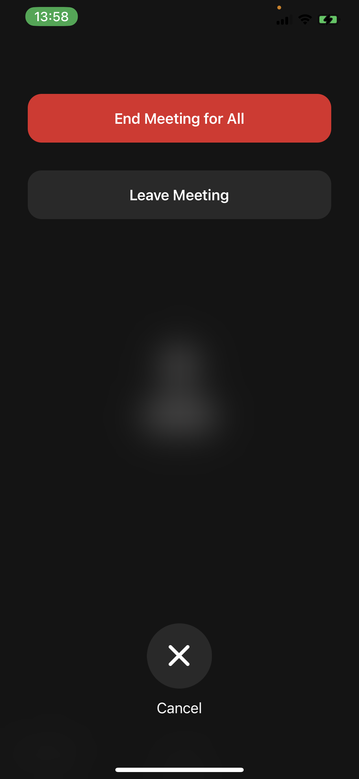
Q1. What does Zoom E2EE look like?
generate state
generate state
Sign Up
$$m_{SignUp}^{A}$$
$$m_{SignUp}^{B}$$
pick group id $gid$
passcode $pc$
receive group id $gid$
passcode $pc$
Group
Schedule
$$gid, pc$$
store $pc^{gid}$
$gid, pc$ (out-of-band)
generate per-group state
sample group key $gk$
generate per-group state
Register
$$gid, pc,m_{Reg}^{A},…$$
$$gid, pc,m_{Reg}^{B},…$$
check $pc=pc^{gid}$
$$m_{SignUp}^{B},m_{Reg}^{B}$$
$$m_{SignUp}^{A},m_{Reg}^{A}$$
Participant
Join
verify $m_{Reg}^{B}$ using $m_{SignUp}^{B}$
encrypt $gk$ using $m_{Reg}^{B}$
verify $m_{Reg}^{A}$ using $m_{SignUp}^{A}$
decrypt $gk$ using $m_{Reg}^{A}$
$$c$$
sample new group key $gk$
encrypt $gk$ using $m_{Reg}^{B}$
decrypt $gk$ using $m_{Reg}^{A}$
update $gk$
Key
Rotation
$$c$$
Member
Leave
erase per-group state about $gid$
erase per-group state about $gid$
Notes:
In the final Member-Leave phase, if any member wants to leave the group, he or she must erase their local per-group states. [9']

Slide 31
Q2. Is Zoom E2EE as secure as claimed?
generate state
generate state
Sign Up
$$m_{SignUp}^{A}$$
$$m_{SignUp}^{B}$$
pick group id $gid$
passcode $pc$
receive group id $gid$
passcode $pc$
Group
Schedule
$$gid, pc$$
store $pc^{gid}$
$gid, pc$ (out-of-band)
generate per-group state
sample group key $gk$
generate per-group state
Register
$$gid, pc,m_{Reg}^{A},…$$
$$gid, pc,m_{Reg}^{B},…$$
check $pc=pc^{gid}$
$$m_{SignUp}^{B},m_{Reg}^{B}$$
$$m_{SignUp}^{A},m_{Reg}^{A}$$
Participant
Join
verify $m_{Reg}^{B}$ using $m_{SignUp}^{B}$
encrypt $gk$ using $m_{Reg}^{B}$
verify $m_{Reg}^{A}$ using $m_{SignUp}^{A}$
decrypt $gk$ using $m_{Reg}^{A}$
$$c$$
sample new group key $gk$
encrypt $gk$ using $m_{Reg}^{B}$
decrypt $gk$ using $m_{Reg}^{A}$
update $gk$
Key
Rotation
$$c$$
Member
Leave
erase per-group state about $gid$
erase per-group state about $gid$
Notes:
Now, we have seen Zoom’s end-to-end encryption workflow.
Let’s continue to answer our second question: Is Zoom really as secure as claimed?
The answer is very tricky. Consider attackers with very strong capabilities that can corrupt group members' states and interfere with the message transmission.

Slide 32
Q2. Is Zoom E2EE as secure as claimed? Yes, for PKI-security!
generate state
generate state
Sign Up
$$m_{SignUp}^{A}$$
$$m_{SignUp}^{B}$$
pick group id $gid$
passcode $pc$
receive group id $gid$
passcode $pc$
Group
Schedule
$$gid, pc$$
store $pc^{gid}$
$gid, pc$ (out-of-band)
generate per-group state
sample group key $gk$
generate per-group state
Register
$$gid, pc,m_{Reg}^{A},…$$
$$gid, pc,m_{Reg}^{B},…$$
check $pc=pc^{gid}$
$$m_{SignUp}^{B},m_{Reg}^{B}$$
$$m_{SignUp}^{A},m_{Reg}^{A}$$
Participant
Join
verify $m_{Reg}^{B}$ using $m_{SignUp}^{B}$
encrypt $gk$ using $m_{Reg}^{B}$
verify $m_{Reg}^{A}$ using $m_{SignUp}^{A}$
decrypt $gk$ using $m_{Reg}^{A}$
$$c$$
sample new group key $gk$
encrypt $gk$ using $m_{Reg}^{B}$
decrypt $gk$ using $m_{Reg}^{A}$
update $gk$
Key
Rotation
$$c$$
Member
Leave
erase per-group state about $gid$
erase per-group state about $gid$
Notes:
Similar to the concurrent works, we proved that assuming the honest distribution of sign-up messages within the group,

Slide 33
Q2. Is Zoom E2EE as secure as claimed? Yes, for PKI-security!
generate state
generate state
Sign Up
$$m_{SignUp}^{A}$$
$$m_{SignUp}^{B}$$
pick group id $gid$
passcode $pc$
receive group id $gid$
passcode $pc$
Group
Schedule
$$gid, pc$$
store $pc^{gid}$
$gid, pc$ (out-of-band)
generate per-group state
sample group key $gk$
generate per-group state
Register
$$gid, pc,m_{Reg}^{A},…$$
$$gid, pc,m_{Reg}^{B},…$$
check $pc=pc^{gid}$
$$m_{SignUp}^{B},m_{Reg}^{B}$$
$$m_{SignUp}^{A},m_{Reg}^{A}$$
Participant
Join
verify $m_{Reg}^{B}$ using $m_{SignUp}^{B}$
encrypt $gk$ using $m_{Reg}^{B}$
verify $m_{Reg}^{A}$ using $m_{SignUp}^{A}$
decrypt $gk$ using $m_{Reg}^{A}$
$$c$$
sample new group key $gk$
encrypt $gk$ using $m_{Reg}^{B}$
decrypt $gk$ using $m_{Reg}^{A}$
update $gk$
Key
Rotation
$$c$$
Member
Leave
erase per-group state about $gid$
erase per-group state about $gid$
Notes:
if every group member’s states including the group keys keep confidential until they leave the group, as we highlight with green color in this figure, then as claimed by Zoom, no one outside the group can obtain encryptions keys, not even Zoom.
We call this security notion PKI-security.
However, note that the sign-up message distribution is also operated by the Zoom server in practice.

Slide 34
NO End-to-End Security If Zoom Server is Malicious
generate state
generate state
Sign Up
$$m_{SignUp}^{A}$$
$$m_{SignUp}^{Z}$$
pick group id $gid$
passcode $pc$
receive group id $gid$
passcode $pc$
Group
Schedule
$$gid, pc$$
store $pc^{gid}$
$gid, pc$ (out-of-band)
generate per-group state
sample group key $gk$
generate per-group state
Register
$$gid, pc,m_{Reg}^{A},…$$
$$gid, pc′,m_{Reg}^{Z},…$$
check $pc=pc^{gid}$
$$m_{SignUp}^{Z},m_{Reg}^{Z}$$
$$m_{SignUp}^{A},m_{Reg}^{A}$$
Participant
Join
verify $m_{Reg}^{Z}$ using $m_{SignUp}^{Z}$
encrypt $gk$ using $m_{Reg}^{Z}$
verify $m_{Reg}^{A}$ using $m_{SignUp}^{A}$
decrypt $gk$ using $m_{Reg}^{A}$
$$c$$
sample new group key $gk$
encrypt $gk$ using $m_{Reg}^{Z}$
decrypt $gk$ using $m_{Reg}^{A}$
update $gk$
Key
Rotation
$$c$$
Member
Leave
erase per-group state about $gid$
erase per-group state about $gid$
Notes:
We find that, as we conjectured before, if the Zoom server is malicious, then the server can easily forge sign-up and register messages as we highlight with red color in this figure, to inject any uninvited malicious member into any group.
The reason behind is that the server knows the passcode and is responsible for the access control management and the sign-up message distribution.
In this case, the leader will send every group key to this malicious participant and all messages in this group meeting will be then leaked.

Slide 35
Our Solution: Password-Protected (PP) Transformation
Goals:
Generality: Improve the security of any Zoom-like protocol
No Additional Security Elements: by using passcodes in a better way.
To achieve this, we need two primitives: PAKE and AEAD.
Notes:
To prevent this attack, we proposed our solution, password-protected transformation – PP transformation.
The goal of our PP transformation is to improve the security of any Zoom-like protocol by using passcodes in a better way.
Our PP Transformation employs two primitives: PAKE and AEAD.

Slide 36
Our Solution: Password-Protected (PP) Transformation
Goals:
Generality: Improve the security of any Zoom-like protocol
No Additional Security Elements: by using passcodes in a better way.
To achieve this, we need two primitives: PAKE and AEAD.
Password-Authenticated Key Exchange (PAKE)
Exchange high-entropy keys $k$ by using a shared low-entropy password $pw$
2-round Instantiations: CPace [HL19] or SPAKE2 [AP05]
$$pw$$
…
…
$$pw$$
$$k_{A}$$
$$k_{B}$$
Notes:
The first one, Password-Authenticated Key Exchange PAKE, allows two parties to exchange high-entropy keys by using a shared low-entropy password.
PAKE is an interactive protocol that often needs several back-and-forth rounds.
A crucial feature of PAKE is that without knowing the password in advance, attackers cannot obtain any information about the exchanged keys.
Two popular 2-round instantiations are CPace and SPAKE2.

Slide 37
Our Solution: Password-Protected (PP) Transformation
Authenticated Encryption with Associated Data (AEAD)
three security requirements:
Instantiations: CAU-C4 and CAU-SIV-C4 [BH22]
Privacy [R02]
Integrity [R02]
FROB [CDJZ23]
$c_{1}$ or $c_{2}$?
$$c, n,h$$
$$⊥≠Dec\left(k_{1},n_{1},h_{1},c\right)$$
$$⊥≠Dec\left(k_{2},n_{2},h_{2},c\right)$$
$$h_{1}≠h_{2}$$
$$c_{1}←Enc(k,n,h,m)$$
$$⊥←Dec(k,n,h,c)$$
random $c_{2}$
Notes:
The second one, authenticated encryption with associated data AEAD, is a variant of symmetric key encryption.
We require AEAD to satisfy three security properties: the conventional privacy, which prevents attackers from knowing any information about the encrypted message;
the conventional integrity, which prevents attackers from forging a new ciphertext,
and a full robustness FROB security that prevents attackers from finding a ciphertext that can be decrypted using two different associated data. Two available instantiations are CAU-C4 and CAU-SIV-C4.

Slide 38
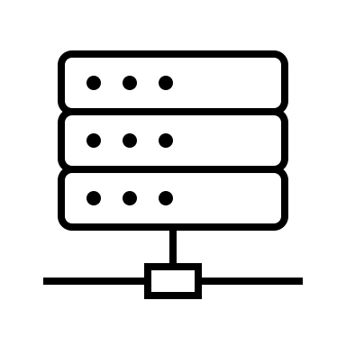
Q3. How does our solution reuse passcodes?
Additional
Execution
Additional
Execution
Sign Up
1. original execution
1. original execution
Group
Schedule
1. original execution
1. original execution
1. original execution
1. original execution
Register
Participant
Join
2. Compute original output $c$
3. original execution
1. Compute original output $c$
Key
Rotation
2. original execution
Member
Leave
1. original execution
1. original execution
Notes:
[13'] To answer our third question, how does our solution reuse passcodes, let’s see how our PP transformation applies to any Zoom-like protocol in three steps.

Slide 39
Q3. How does our solution reuse passcodes?
Additional
Execution
Additional
Execution
Sign Up
1. original execution
1. original execution
Group
Schedule
1. original execution
1. original execution
2. pick password $pw$
$pw$ (out-of-band)
2. receive password $pw$
1. original execution
1. original execution
Register
Participant
Join
2. Compute original output $c$
3. original execution
1. Compute original output $c$
Key
Rotation
2. original execution
Member
Leave
1. original execution
1. original execution
Notes:
First, in the group schedule phase, the leader Alice picks a password pw and sends it only to the invited participant Bob over some out-of-band channels.
In particular, this means that the server has no idea about this password.

Slide 40
Q3. How does our solution reuse passcodes?
Additional
Execution
Additional
Execution
Sign Up
1. original execution
1. original execution
Group
Schedule
1. original execution
1. original execution
2. pick password $pw$
$pw$ (out-of-band)
2. receive password $pw$
1. original execution
1. original execution
Register
$$c_{PAKE}$$
2. Run $PAKE(pw)$
$$c_{PAKE}$$
1. Run $PAKE(pw)$ and outputting $k_{A}$
…
1. Run $PAKE(pw)$ and outputting $k_{B}$
Participant
Join
2. Compute original output $c$
3. original execution
1. Compute original output $c$
Key
Rotation
2. original execution
Member
Leave
1. original execution
1. original execution
Notes:
Second, in the Register and Participant Join phase, Alice and Bob run the PAKE protocol and obtain a symmetric key.

Slide 41
Q3. How does our solution reuse passcodes?
Additional
Execution
Additional
Execution
Sign Up
1. original execution
1. original execution
Group
Schedule
1. original execution
1. original execution
2. pick password $pw$
$pw$ (out-of-band)
2. receive password $pw$
1. original execution
1. original execution
Register
$$c_{PAKE}$$
2. Run $PAKE(pw)$
$$c_{PAKE}$$
1. Run $PAKE(pw)$ and outputting $k_{A}$
…
1. Run $PAKE(pw)$ and outputting $k_{B}$
Participant
Join
2. Compute original output $c$
3. $c_{PP}←Enc(k_{A},n,m_{SignUp}^{A}∥m_{SignUp}^{B},c)$
$$n,c_{PP}$$
2. $c←Dec(k_{B},n,m_{SignUp}^{A}∥m_{SignUp}^{B},c_{PP})$
3. original execution
1. Compute original output $c$
Key
Rotation
2. $c_{PP}←Enc(k_{A},n,m_{SignUp}^{A}∥m_{SignUp}^{B},c)$
$$n,c_{PP}$$
1. $c←Dec(k_{B},n,m_{SignUp}^{A}∥m_{SignUp}^{B},c_{PP})$
2. original execution
Member
Leave
1. original execution
1. original execution
Notes:
Finally, in the Participant Join and Key Rotation phases, Alice encrypts the original output by using AEAD, with the symmetric key output by PAKE, a random nonce, and an associated data that consists of both parties’ sign-up messages.

Slide 42
Q4. How is our solution provably secure against (fully) malicious servers?
Additional
Execution
Additional
Execution
Sign Up
1. original execution
1. original execution
Group
Schedule
1. original execution
1. original execution
2. pick password $pw$
$pw$ (out-of-band)
2. receive password $pw$
1. original execution
1. original execution
Register
$$c_{PAKE}$$
2. Run $PAKE(pw)$
$$c_{PAKE}$$
1. Run $PAKE(pw)$ and outputting $k_{A}$
…
1. Run $PAKE(pw)$ and outputting $k_{B}$
Participant
Join
2. Compute original output $c$
3. $c_{PP}←Enc(k_{A},n,m_{SignUp}^{A}∥m_{SignUp}^{B},c)$
$$n,c_{PP}$$
2. $c←Dec(k_{B},n,m_{SignUp}^{A}∥m_{SignUp}^{B},c_{PP})$
3. original execution
1. Compute original output $c$
Key
Rotation
2. $c_{PP}←Enc(k_{A},n,m_{SignUp}^{A}∥m_{SignUp}^{B},c)$
$$n,c_{PP}$$
1. $c←Dec(k_{B},n,m_{SignUp}^{A}∥m_{SignUp}^{B},c_{PP})$
2. original execution
Member
Leave
1. original execution
1. original execution
Notes:
This is our PP transformation.
To answer our four and final question, how is our solution provably secure against fully malicious servers, I will introduce some simple security intuition behind.

Slide 43
Security Intuition: $k_{A}$ and $k_{B}$ are random
Additional
Execution
Additional
Execution
Sign Up
1. original execution
1. original execution
Group
Schedule
1. original execution
1. original execution
2. pick password $pw$
$pw$ (out-of-band)
2. receive password $pw$
1. original execution
1. original execution
Register
$$c_{PAKE}$$
2. Run $PAKE(pw)$
$$c_{PAKE}$$
1. Run $PAKE(pw)$ and outputting $k_{A}$
…
1. Run $PAKE(pw)$ and outputting $k_{B}$
Participant
Join
2. Compute original output $c$
3. $c_{PP}←Enc(k_{A},n,m_{SignUp}^{A}∥m_{SignUp}^{B},c)$
$$n,c_{PP}$$
2. $c←Dec(k_{B},n,m_{SignUp}^{A}∥m_{SignUp}^{B},c_{PP})$
3. original execution
1. Compute original output $c$
Key
Rotation
2. $c_{PP}←Enc(k_{A},n,m_{SignUp}^{A}∥m_{SignUp}^{B},c)$
$$n,c_{PP}$$
1. $c←Dec(k_{B},n,m_{SignUp}^{A}∥m_{SignUp}^{B},c_{PP})$
2. original execution
Member
Leave
1. original execution
1. original execution
Notes:
First, due to the security of PAKE, we know both Alice and Bob’s PAKE keys are random and secure.

Slide 44
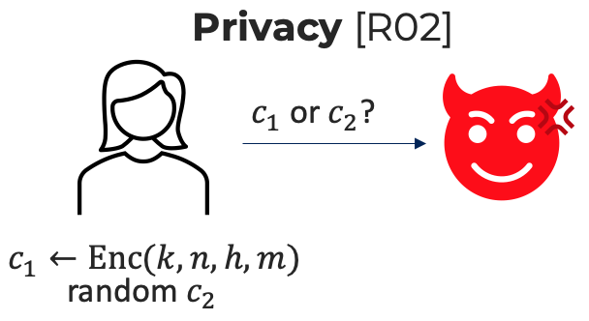
Security Intuition: Leader leaks no Information
Additional
Execution
Additional
Execution
Sign Up
1. original execution
1. original execution
Group
Schedule
1. original execution
1. original execution
2. pick password $pw$
$pw$ (out-of-band)
2. receive password $pw$
1. original execution
1. original execution
Register
$$c_{PAKE}$$
2. Run $PAKE(pw)$
$$c_{PAKE}$$
1. Run $PAKE(pw)$ and outputting $k_{A}$
…
1. Run $PAKE(pw)$ and outputting $k_{B}$
Participant
Join
2. Compute original output $c$
3. $c_{PP}←Enc(k_{A},n,m_{SignUp}^{A}∥m_{SignUp}^{B},c)$
$$n,c_{PP}$$
2. $c←Dec(k_{B},n,m_{SignUp}^{A}∥m_{SignUp}^{B},c_{PP})$
3. original execution
1. Compute original output $c$
Key
Rotation
2. $c_{PP}←Enc(k_{A},n,m_{SignUp}^{A}∥m_{SignUp}^{B},c)$
$$n,c_{PP}$$
1. $c←Dec(k_{B},n,m_{SignUp}^{A}∥m_{SignUp}^{B},c_{PP})$
2. original execution
Member
Leave
1. original execution
1. original execution
Notes:
Second, due to the privacy of AEAD, we know that attackers cannot obtain any information about the group key from the leader.

Slide 45
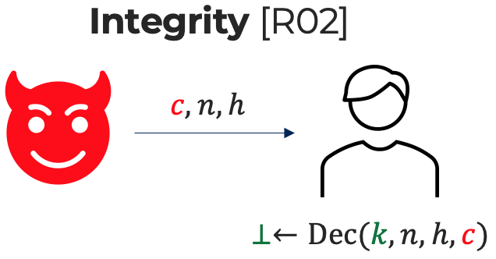
Security Intuition: Participant leaks no Information
Additional
Execution
Additional
Execution
Sign Up
1. original execution
Group
Schedule
1. original execution
2. pick password $pw$
$pw$ (out-of-band)
1. original execution
1. original execution
Register
$$c_{PAKE}$$
2. Run $PAKE(pw)$
$$c_{PAKE}$$
1. Run $PAKE(pw)$ and outputting $k_{A}$
…
1. Run $PAKE(pw)$ and outputting $k_{B}$
Participant
Join
2. Compute original output $c$
3. $c_{PP}←Enc(k_{A},n,m_{SignUp}^{A}∥m_{SignUp}^{B},c)$
$$n,c_{PP}$$
2. $c←Dec(k_{B},n,m_{SignUp}^{A}∥m_{SignUp}^{B},c_{PP})$
3. original execution
1. Compute original output $c$
Key
Rotation
2. $c_{PP}←Enc(k_{A},n,m_{SignUp}^{A}∥m_{SignUp}^{B},c)$
$$n,c_{PP}$$
1. $c←Dec(k_{B},n,m_{SignUp}^{A}∥m_{SignUp}^{B},c_{PP})$
2. original execution
Member
Leave
1. original execution
1. original execution
Notes:
Third, due to the integrity of AEAD, we know that the attackers cannot forge any new AEAD ciphertext towards participant Bob.
This means, Alice and Bob agree on the same AEAD ciphertext.

Slide 46
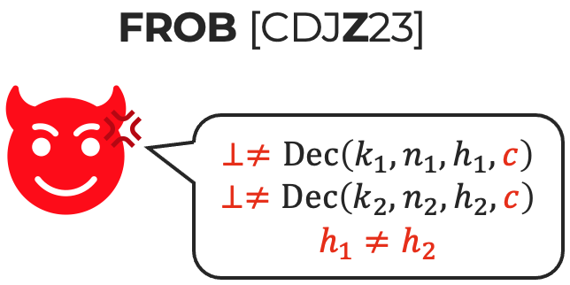
Security Intuition: Participant leaks no Information
Additional
Execution
Additional
Execution
Sign Up
1. original execution
Group
Schedule
1. original execution
2. pick password $pw$
$pw$ (out-of-band)
1. original execution
1. original execution
Register
$$c_{PAKE}$$
2. Run $PAKE(pw)$
$$c_{PAKE}$$
1. Run $PAKE(pw)$ and outputting $k_{A}$
…
1. Run $PAKE(pw)$ and outputting $k_{B}$
Participant
Join
2. Compute original output $c$
3. $c_{PP}←Enc(k_{A},n,m_{SignUp}^{A}∥m_{SignUp}^{B},c)$
$$n,c_{PP}$$
2. $c←Dec(k_{B},n,m_{SignUp}^{A}∥m_{SignUp}^{B},c_{PP})$
3. original execution
1. Compute original output $c$
Key
Rotation
2. $c_{PP}←Enc(k_{A},n,m_{SignUp}^{A}∥m_{SignUp}^{B},c)$
$$n,c_{PP}$$
1. $c←Dec(k_{B},n,m_{SignUp}^{A}∥m_{SignUp}^{B},c_{PP})$
2. original execution
Member
Leave
1. original execution
1. original execution
Notes:
Finally, due to the FROB security of AEAD, we know that both the leader Alice and the participant Bob must agree on the same sign-up messages with each other.
If the attacker cannot break the PKI-security of the original Zoom-like protocol assuming a trusted PKI, then this attacker cannot break the same security of the new protocol even against a fully malicious server neither, as long as the password in this group is not leaked.

Slide 47
Apply PP Transformation to Zoom: Obtain ZoomPAKE
$$m_{SignUp}^{A}$$
$$m_{SignUp}^{B}$$
generate state
Sign Up
generate state
pick group id $gid$, password $pw$
receive group id $gid$, password $pw$
Group
Schedule
$$gid, pc$$
store $pc^{gid}$
$gid, pw$ (out-of-band)
generate per-group state, sample group key $gk$
generate per-group state, run $PAKE(pw)$
Register
$$gid, pc,m_{Reg}^{A},…$$
check $pc=pc^{gid}$
$$gid, pc,m_{Reg}^{B},c_{PAKE}…$$
$$m_{SignUp}^{B},m_{Reg}^{B},c_{PAKE}$$
$$m_{SignUp}^{A},m_{Reg}^{A}$$
run $PAKE(pw)$ for $k_{A}$
verify $m_{Reg}^{B}$ using $m_{SignUp}^{B}$
encrypt $gk$ using $m_{Reg}^{B}$ for $c$
$c_{PP}←Enc(k_{A},n,m_{SignUp}^{A}∥m_{SignUp}^{B},c)$
run $PAKE(pw)$ for $k_{B}$
$c←Dec(k_{B},n,m_{SignUp}^{A}∥m_{SignUp}^{B},c_{PP})$
verify $m_{Reg}^{A}$ using $m_{SignUp}^{A}$
decrypt $c$ using $m_{Reg}^{A}$ for $gk$
Participant
Join
$$n,c_{PP},c_{PAKE}^{′}$$
sample new group key $gk$
encrypt $gk$ using $m_{Reg}^{B}$ for $c$
$c_{PP}←Enc(k_{A},n,m_{SignUp}^{A}∥m_{SignUp}^{B},c)$
$c←Dec(k_{B},n,m_{SignUp}^{A}∥m_{SignUp}^{B},c_{PP})$
decrypt $c$ using $m_{Reg}^{A}$ for $gk$
update $gk$
Key
Rotation
$$n,c_{PP}$$
Member
Leave
erase per-group state about $gid$
erase per-group state about $gid$
Notes:
[15'] Then by applying our PP transformation to Zoom and instantiating PAKE with 2-round constructions, like CPace and SPAKE2, we obtain our new protocol, called ZoomPAKE.
Combining all results in this talk, our new ZoomPAKE protocol satisfies provable security against fully malicious servers by using Zoom’s passcode in a better way, notably without adding any additional communication round.

Slide 48
References
[Zoom-WP]: J. Blum et al. “Zoom end-to-end encryption whitepaper”. https://github.com/zoom/zoom-e2e-whitepaper Version 4.0 (Released on 18.11.2022).
[HL19]: B. Haase and B. Labrique, “AuCPace: Efficient verifier-based PAKE protocol tailored for the IIoT”. In TCHES 2019.
[AP05]: M. Abdalla and D. Pointcheval, “Simple password-based encrypted key exchange protocols”. In CT-RSA 2005.
[R02]: P. Rogaway. “Authenticated-Encryption with Associated-Data”. In ACM CCS 2002.
[CDJZ23]: C. Cremers et al. "Automated Analysis of Protocols that use Authenticated Encryption: How Subtle AEAD Differences can impact Protocol Security." In USENIX Security 2023.
[BH22]: M. Bellare and V. Tung Hoang. "Efficient schemes for committing authenticated encryption”. In Eurocrypt 2022.
[DJKM23]: Y. Dodis et al., “End-to-End Encrypted Zoom Meetings: Proving Security and Strengthening Liveness”. In Eurocrypt 2023.
[AS23]: M. Alatawi and N. Saxena, “VOICE-ZEUS: Impersonating Zoom's E2EE-Protected Static Media and Textual Communications via Simple Voice Manipulations”. arXiv preprint arXiv:2310.13894.
Notes:
Here are the references in this talk.

Slide 49
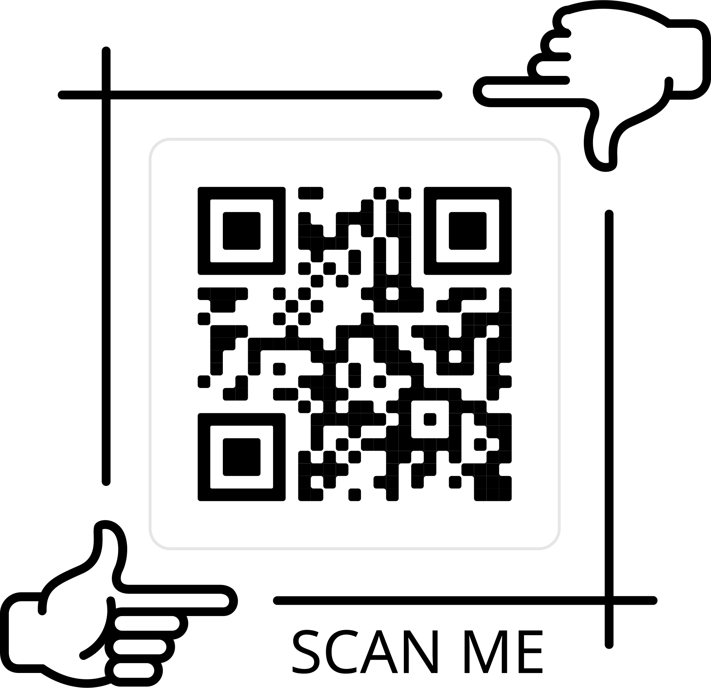
Thanks for Your Attention!
Advertisement
I am looking for a postdoc position or a short-term research visit
Analysis Target | Goal | Solution Methodology | Solution Benefit
Zoom E2EE (Whitepaper version 4.0) | Improve Zoom’s security against malicious servers | New PP Transformation | Generic Provable security against malicious servers ZoomPAKE: Add no communication round ZoomPAKE: Add no security element/mechanism
Mang Zhao
PhD Recipient (since last week) CISPA Helmholtz Center for Information Security, Germany
4 IEEE S&P, 1 Usenix Security
Email: mang.zhao@cispa.de
Web: https://mang-zhao.github.io/
49
Notes:
In the end, I would like to conclude this talk by a short summary. Our work analyzed Zoom’s end-to-end encryption following its white-paper version 4.0. In order to improve Zoom’s security against malicious servers, we propose our new PP transformation.
Our generic PP transformation can be applied to any Zoom-like protocol and achieves provable security against malicious servers. By applying PP Transformation to Zoom with 2-round PAKE, our new ZoomPAKE protocol adds neither any additional communication round nor any additional security element or mechanism.

Slide 50
Thanks for Your Attention!
Advertisement
I am looking for a postdoc position or a short-term research visit
Analysis Target | Goal | Solution Methodology | Solution Benefit
Zoom E2EE (Whitepaper version 4.0) | Improve Zoom’s security against malicious servers | New PP Transformation | Generic Provable security against malicious servers ZoomPAKE: Add no communication round ZoomPAKE: Add no security element/mechanism
Full Version: https://eprint.iacr.org/2023/1243
This work has been accepted by IEEE S&P 2024
Original Title: Multi-Stage Group Key Distribution and PAKEs: Securing Zoom Groups against Malicious Servers without New Security Elements
Mang Zhao
PhD Recipient (since last week) CISPA Helmholtz Center for Information Security, Germany
4 IEEE S&P, 1 Usenix Security
Email: mang.zhao@cispa.de
Web: https://mang-zhao.github.io/
50
Cas Cremers
Eyal Ronen
Mang Zhao
Notes:
This work has been accepted by IEEE S&P 2024. And the full version of this paper is available at IACR eprint.
That is all of my talk. Thanks for your attention. If you have any questions, please feel free to ask.

Slide 51
Thanks for Your Attention!
Advertisement
I am looking for a postdoc position or a short-term research visit
We provide one of the first formal analysis of Zoom protocol (version 4.0), proving its end-to-end security (assuming honest server for public keys distribution).
We show how real-world attacks manifest Zoom-like protocols and notably how malicious zoom servers can manipulate groups.
We develop a solution to generically improve the security of Zoom-like protocols against malicious servers, without introducing new security elements.
Full Version: https://eprint.iacr.org/2023/1243
This paper has been accepted by IEEE S&P 2024
Original Title: Multi-Stage Group Key Distribution and PAKEs: Securing Zoom Groups against Malicious Servers without New Security Elements
Mang Zhao
Ph.D Candidate CISPA Helmholtz Center for Information Security, Germany
4 IEEE S&P, 1 Usenix Security
Email: mang.zhao@cispa.de
Web: https://mang-zhao.github.io/
51
Notes:
Thanks for your attention. If you have any questions, please feel free to ask.

Slide 52
Thanks for Your Attention!
We provide one of the first formal analysis of Zoom protocol (version 4.0), proving its end-to-end security (assuming honest server for public keys distribution).
We show how real-world attacks manifest Zoom-like protocols and notably how malicious zoom servers can manipulate groups.
We develop a solution to generically improve the security of Zoom-like protocols against malicious servers, without introducing new security elements.
Full Version: https://eprint.iacr.org/2023/1243
This paper has been accepted by IEEE S&P 2024
Original Title: Multi-Stage Group Key Distribution and PAKEs: Securing Zoom Groups against Malicious Servers without New Security Elements
Notes:
That is all of my talk. Thanks for your attention. If you have any questions, please feel free to ask.

Slide 53
Zoom End-to-End Encryption Workflow
generate state
generate state
Sign Up
$$m_{SignUp}^{A}$$
$$m_{SignUp}^{B}$$
pick group id $gid$
passcode $pc$
receive group id $gid$
passcode $pc$
Group
Schedule
$$gid, pc$$
store $pc^{gid}$
$gid, pc$ (out-of-band)
generate per-group state
sample group key $gk$
generate per-group state
Register
$$gid, pc,m_{Reg}^{A},…$$
$$gid, pc,m_{Reg}^{B},…$$
check $pc=pc^{gid}$
$$m_{SignUp}^{B},m_{Reg}^{B}$$
$$m_{SignUp}^{A},m_{Reg}^{A}$$
Participant
Join
verify $m_{Reg}^{B}$ using $m_{SignUp}^{B}$
encrypt $gk$ using $m_{Reg}^{B}$
verify $m_{Reg}^{A}$ using $m_{SignUp}^{A}$
decrypt $gk$ using $m_{Reg}^{A}$
$$c$$
sample new group key $gk$
encrypt $gk$ using $m_{Reg}^{B}$
decrypt $gk$ using $m_{Reg}^{A}$
update $gk$
Key
Rotation
$$c$$
Member
Leave
erase per-group state about $gid$
erase per-group state about $gid$
Notes:
To answer this question, we need to look at the underlying workflow of Zoom meeting.
From a syntax level, we decompose the Zoom protocol into six phases.
Below, I will introduce them one by one.
In the following slides, we call the leader Alice and the participant Bob.

Slide 54
Our Solution: Password-Protected (PP) Transformation
Additional
Execution
Additional
Execution
Sign Up
1. original execution
1. original execution
Group
Schedule
1. original execution
1. original execution
2. pick password $pw$
$pw$ (out-of-band)
2. receive password $pw$
1. original execution
1. original execution
Register
$$c_{PAKE}$$
2. Run $PAKE(pw)$
$$c_{PAKE}$$
1. Run $PAKE(pw)$ until outputting $k_{A}$
…
1. Run $PAKE(pw)$ until outputting $k_{B}$
Participant
Join
2. Compute original output $c$
3. $c_{PP}←Enc(k_{A},n,m_{SignUp}^{A}∥m_{SignUp}^{B},c)$
$$n,c_{PP}$$
2. $c←Dec(k_{B},n,m_{SignUp}^{A}∥m_{SignUp}^{B},c_{PP})$
3. original execution
1. Compute original output $c$
Key
Rotation
2.$c_{PP}←Enc(k_{A},n,m_{SignUp}^{A}∥m_{SignUp}^{B},c)$
$$n,c_{PP}$$
1.$c←Dec(k_{B},n,m_{SignUp}^{A}∥m_{SignUp}^{B},c_{PP})$
2. original execution
Member
Leave
1. original execution
1. original execution
Notes:
Our PP transformation transforms any Zoom-like protocol as in this figure.
There are mainly three steps.

Slide 55
Our Solution: Password-Protected (PP) Transformation
Additional
Execution
Additional
Execution
Sign Up
1. original execution
1. original execution
Group
Schedule
1. original execution
1. original execution
2. pick password $pw$
$pw$ (out-of-band)
2. receive password $pw$
1. original execution
1. original execution
Register
$$c_{PAKE}$$
2. Run $PAKE(pw)$
$$c_{PAKE}$$
1. Run $PAKE(pw)$ until outputting $k_{A}$
…
1. Run $PAKE(pw)$ until outputting $k_{B}$
Participant
Join
2. Compute original output $c$
3. $c_{PP}←Enc(k_{A},n,m_{SignUp}^{A}∥m_{SignUp}^{B},c)$
$$n,c_{PP}$$
2. $c←Dec(k_{B},n,m_{SignUp}^{A}∥m_{SignUp}^{B},c_{PP})$
3. original execution
1. Compute original output $c$
Key
Rotation
2.$c_{PP}←Enc(k_{A},n,m_{SignUp}^{A}∥m_{SignUp}^{B},c)$
$$n,c_{PP}$$
1.$c←Dec(k_{B},n,m_{SignUp}^{A}∥m_{SignUp}^{B},c_{PP})$
2. original execution
Member
Leave
1. original execution
1. original execution
Notes:
First, in the group schedule phase, the leader Alice picks a password and sends it to the participant Bob over some out-of-band channels.
Namely, the server has no idea about the password.

Slide 56
Our Solution: Password-Protected (PP) Transformation
Additional
Execution
Additional
Execution
Sign Up
1. original execution
1. original execution
Group
Schedule
1. original execution
1. original execution
2. pick password $pw$
$pw$ (out-of-band)
2. receive password $pw$
1. original execution
1. original execution
Register
$$c_{PAKE}$$
2. Run $PAKE(pw)$
$$c_{PAKE}$$
1. Run $PAKE(pw)$ until outputting $k_{A}$
…
1. Run $PAKE(pw)$ until outputting $k_{B}$
Participant
Join
2. Compute original output $c$
3. $c_{PP}←Enc(k_{A},n,m_{SignUp}^{A}∥m_{SignUp}^{B},c)$
$$n,c_{PP}$$
2. $c←Dec(k_{B},n,m_{SignUp}^{A}∥m_{SignUp}^{B},c_{PP})$
3. original execution
1. Compute original output $c$
Key
Rotation
2.$c_{PP}←Enc(k_{A},n,m_{SignUp}^{A}∥m_{SignUp}^{B},c)$
$$n,c_{PP}$$
1.$c←Dec(k_{B},n,m_{SignUp}^{A}∥m_{SignUp}^{B},c_{PP})$
2. original execution
Member
Leave
1. original execution
1. original execution
Notes:
Second, in the Register and Participant Join phase, Alice and Bob run the PAKE protocol until they both obtain a symmetric key.

Slide 57
Our Solution: Password-Protected (PP) Transformation
Additional
Execution
Additional
Execution
Sign Up
1. original execution
1. original execution
Group
Schedule
1. original execution
1. original execution
2. pick password $pw$
$pw$ (out-of-band)
2. receive password $pw$
1. original execution
1. original execution
Register
$$c_{PAKE}$$
2. Run $PAKE(pw)$
$$c_{PAKE}$$
1. Run $PAKE(pw)$ until outputting $k_{A}$
…
1. Run $PAKE(pw)$ until outputting $k_{B}$
Participant
Join
2. Compute original output $c$
3. $c_{PP}←Enc(k_{A},n,m_{SignUp}^{A}∥m_{SignUp}^{B},c)$
$$n,c_{PP}$$
2. $c←Dec(k_{B},n,m_{SignUp}^{A}∥m_{SignUp}^{B},c_{PP})$
3. original execution
1. Compute original output $c$
Key
Rotation
2.$c_{PP}←Enc(k_{A},n,m_{SignUp}^{A}∥m_{SignUp}^{B},c)$
$$n,c_{PP}$$
1.$c←Dec(k_{B},n,m_{SignUp}^{A}∥m_{SignUp}^{B},c_{PP})$
2. original execution
Member
Leave
1. original execution
1. original execution
Notes:
Finally, in the Participant Join and Key Rotation phases, Alice encrypts the original output by using AEAD, with the symmetric key output by PAKE, a random nonce, and a header that consists of both parties’ sign-up messages.

Slide 58
Our Solution: Password-Protected (PP) Transformation
Authenticated Encryption with Associated Data (AEAD)
has five components
(1) key $k$ (2) nonce (= number used only once) $n$
(3) associated data / header $h$. (4) message $m$ (5) ciphertext $c$
three security requirements:
Instantiations: CAU-C4 and CAU-SIV-C4 [BH22]
Privacy [R02]
Integrity [R02]
h-FROB [CDJZ23]
$c_{1}$ or $c_{2}$?
$$c, n,h$$
$$⊥≠Dec\left(k_{1},n_{1},h_{1},c\right)$$
$$⊥≠Dec\left(k_{2},n_{2},h_{2},c\right)$$
$$h_{1}≠h_{2}$$
$$c_{1}←Enc(k,n,h,m)$$
$$⊥←Dec(k,n,h,c)$$
random $c_{2}$
Notes:
The second one is AEAD. We have talked about it before.
We need AEAD to satisfy conventional privacy and integrity, and additionally the h-FROB security.
Recall that h-FROB means that no attackers can find a ciphertext that can be decrypted using different headers.

Slide 59
ZoomPAKE: Applying PP Transformation to Zoom
$$m_{SignUp}^{A}$$
$$m_{SignUp}^{B}$$
generate state
Sign Up
generate state
pick group id $gid$, passcode $pc$, password $pw$
receive group id $gid$, passcode $pc$, password $pw$
Group
Schedule
$$gid, pc$$
store $pc^{gid}$
$gid, pc, pw$ (out-of-band)
generate per-group state, sample group key $gk$
generate per-group state, run $PAKE(pw)$
Register
$$gid, pc,m_{Reg}^{A},…$$
check $pc=pc^{gid}$
$$gid, pc,m_{Reg}^{B},c_{PAKE}…$$
$$m_{SignUp}^{B},m_{Reg}^{B},c_{PAKE}$$
$$m_{SignUp}^{A},m_{Reg}^{A}$$
run $PAKE(pw)$ for $k_{A}$
verify $m_{Reg}^{B}$ using $m_{SignUp}^{B}$
encrypt $gk$ using $m_{Reg}^{B}$ for $c$
$c_{PP}←Enc(k_{A},n,m_{SignUp}^{A}∥m_{SignUp}^{B},c)$
run $PAKE(pw)$ for $k_{B}$
$c←Dec(k_{B},n,m_{SignUp}^{A}∥m_{SignUp}^{B},c_{PP})$
verify $m_{Reg}^{A}$ using $m_{SignUp}^{A}$
decrypt $c$ using $m_{Reg}^{A}$ for $gk$
Participant
Join
$$n,c_{PP},c_{PAKE}^{′}$$
sample new group key $gk$
encrypt $gk$ using $m_{Reg}^{B}$ for $c$
$c_{PP}←Enc(k_{A},n,m_{SignUp}^{A}∥m_{SignUp}^{B},c)$
$c←Dec(k_{B},n,m_{SignUp}^{A}∥m_{SignUp}^{B},c_{PP})$
decrypt $c$ using $m_{Reg}^{A}$ for $gk$
update $gk$
Key
Rotation
$$n,c_{PP}$$
Member
Leave
erase per-group state about $gid$
erase per-group state about $gid$

Slide 60
ZoomPAKE reuses Password in Zoom
$$m_{SignUp}^{A}$$
$$m_{SignUp}^{B}$$
generate state
Sign Up
generate state
pick group id $gid$, passcode $pc$, password $pw$
receive group id $gid$, passcode $pc$, password $pw$
Group
Schedule
$$gid, pc$$
store $pc^{gid}$
$gid, pc, pw$ (out-of-band)
generate per-group state, sample group key $gk$
generate per-group state, run $PAKE(pw)$
Register
$$gid, pc,m_{Reg}^{A},…$$
check $pc=pc^{gid}$
$$gid, pc,m_{Reg}^{B},c_{PAKE}…$$
$$m_{SignUp}^{B},m_{Reg}^{B},c_{PAKE}$$
$$m_{SignUp}^{A},m_{Reg}^{A}$$
run $PAKE(pw)$ for $k_{A}$
verify $m_{Reg}^{B}$ using $m_{SignUp}^{B}$
encrypt $gk$ using $m_{Reg}^{B}$ for $c$
$c_{PP}←Enc(k_{A},n,m_{SignUp}^{A}∥m_{SignUp}^{B},c)$
run $PAKE(pw)$ for $k_{B}$
$c←Dec(k_{B},n,m_{SignUp}^{A}∥m_{SignUp}^{B},c_{PP})$
verify $m_{Reg}^{A}$ using $m_{SignUp}^{A}$
decrypt $c$ using $m_{Reg}^{A}$ for $gk$
Participant
Join
$$n,c_{PP},c_{PAKE}^{′}$$
sample new group key $gk$
encrypt $gk$ using $m_{Reg}^{B}$ for $c$
$c_{PP}←Enc(k_{A},n,m_{SignUp}^{A}∥m_{SignUp}^{B},c)$
$c←Dec(k_{B},n,m_{SignUp}^{A}∥m_{SignUp}^{B},c_{PP})$
decrypt $c$ using $m_{Reg}^{A}$ for $gk$
update $gk$
Key
Rotation
$$n,c_{PP}$$
Member
Leave
erase per-group state about $gid$
erase per-group state about $gid$
Notes:
Note that the passcode in Zoom does not provide any security benefit. We can simply remove it.
Then, compared with the original Zoom protocol, the new ZoomPAKE protocol provably satisfies the full end-to-end security without adding any new security element.

Slide 61
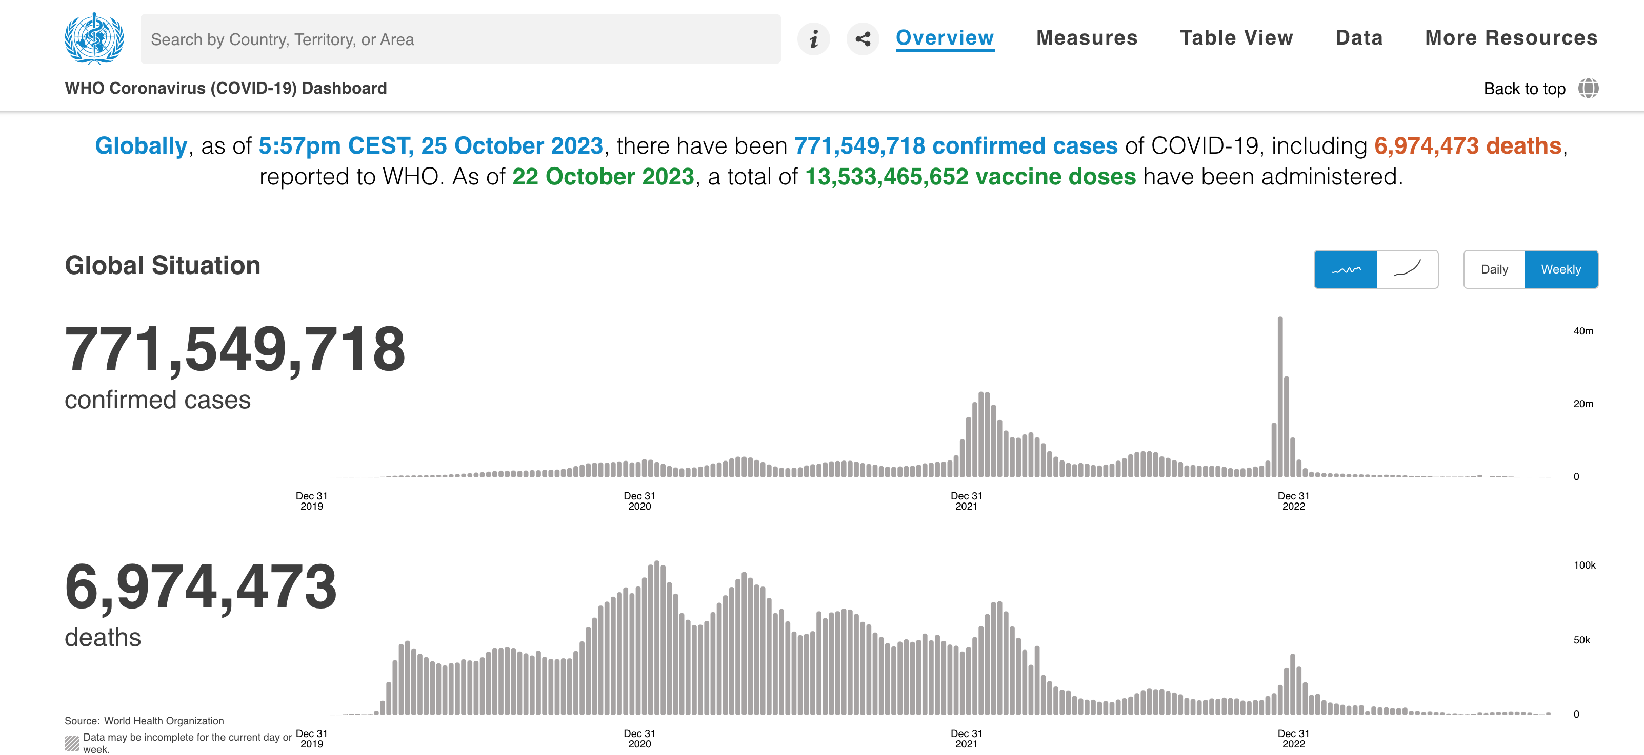
Covid-19 Pandemic Has Changed Our Lives
Figure Sources
Left: WHO Coronavirus (COVID-19) Dashboard
Right: IAB-Forum
Notes:
During the past few years, we experienced a catastrophe – the covid 19 pandemic.
During this period, our lives have been much changed: many people stop working offline but instead start to work from home.
[remove this]

Slide 62
Related Works
Concurrent Work on Zoom’s E2EE Security [DJKM23]:
Proved security of Zoom (Client v5.12), assuming a trusted PKI infrastructure
Zoom realizes a trusted PKI by:
(Still) developing Zoom Transparency Tree (ZTT) for honest key distribution
(Now) suggesting every group member to read a key-related security code
passcode $pc$
passcode $pc$’
participant’s pk, if $pc=pc′$
leader’s pk, if $pc=pc′$
passcode $pc$ (out-of-band)
Talk in the meeting room
Notes:
Fortunately, Zoom is trying to realize a trusted PKI by two approaches.
The first approach called Zoom Transparency Tree ZTT is still under development. ZTT is expected to allow group members’ public keys to be honestly distributed within every group meeting.

Slide 63
Related Works
Concurrent Work on Zoom’s E2EE Security [DJKM23]:
Proved security of Zoom (Client v5.12), assuming a trusted PKI infrastructure
Zoom realizes a trusted PKI by:
(Still) developing Zoom Transparency Tree (ZTT) for honest key distribution
(Now) suggesting every group member to read a key-related security code
passcode $pc$
passcode $pc$’
participant’s pk, if $pc=pc′$
leader’s pk, if $pc=pc′$
passcode $pc$ (out-of-band)
Talk in the meeting room
Notes:
The second approach is to ask every group member to read a public-key-related security code after joining every group meeting.
By checking whether the security code being read matches the one appears on the screen, every group member can verify each others’ public keys.
However, on one hand, this approach will cost much time, especially in some large group.
When any party joins the group after this security-code verification, all parties have to re-do this verification again.
[turn around Zoom PKI, first voice then ZTT]

Slide 64
Related Works
VOICE-ZEUS Attack against Zoom [AS23]:
Proposed a novel voice impersonation attack: Recorded voice of a victim can be used to generate an artificial voice that reads fake security codes
“To mitigate these risks, stronger security measures are necessary during the group authentication ceremony in Zoom” [AS23]
passcode $pc$
passcode $pc$’
participant’s pk, if $pc=pc′$
leader’s pk, if $pc=pc′$
passcode $pc$ (out-of-band)
Talk in the meeting room
Notes:
On the other hand, a recent work [AS23] proposed a novel voice impersonation attack: recorded voice of a victim can be reused to generate an artificial voice that reads fake security codes.
The authors in [AS23] stressed that “to mitigate these risks, stronger security measures are necessary during the group authentication ceremony in Zoom.”

Slide 65
Q1. What does Zoom E2EE look like?
generate state
generate state
Sign Up
$$m_{SignUp}^{A}$$
$$m_{SignUp}^{B}$$
pick group id $gid$
passcode $pc$
receive group id $gid$
passcode $pc$
Group
Schedule
$$gid, pc$$
store $pc^{gid}$
$gid, pc$ (out-of-band)
generate per-group state
sample group key $gk$
generate per-group state
Register
$$gid, pc,m_{Reg}^{A},…$$
$$gid, pc,m_{Reg}^{B},…$$
check $pc=pc^{gid}$
$$m_{SignUp}^{B},m_{Reg}^{B}$$
$$m_{SignUp}^{A},m_{Reg}^{A}$$
Participant
Join
verify $m_{Reg}^{B}$ using $m_{SignUp}^{B}$
encrypt $gk$ using $m_{Reg}^{B}$
verify $m_{Reg}^{A}$ using $m_{SignUp}^{A}$
decrypt $gk$ using $m_{Reg}^{A}$
$$c$$
sample new group key $gk$
encrypt $gk$ using $m_{Reg}^{B}$
decrypt $gk$ using $m_{Reg}^{A}$
update $gk$
Key
Rotation
$$c$$
Member
Leave
erase per-group state about $gid$
erase per-group state about $gid$
Notes:
In the final Member-Leave phase, if any member wants to leave the group, he or she must erase their local per-group states. [9'30'']
[lowest 10% space]

Slide 66
Apply PP Transformation to Zoom: Remove Passcode
$$m_{SignUp}^{A}$$
$$m_{SignUp}^{B}$$
generate state
Sign Up
generate state
pick group id $gid$, passcode $pc$, password $pw$
receive group id $gid$, passcode $pc$, password $pw$
Group
Schedule
$$gid, pc$$
store $pc^{gid}$
$gid, pc, pw$ (out-of-band)
generate per-group state, sample group key $gk$
generate per-group state, run $PAKE(pw)$
Register
$$gid, pc,m_{Reg}^{A},…$$
check $pc=pc^{gid}$
$$gid, pc,m_{Reg}^{B},c_{PAKE}…$$
$$m_{SignUp}^{B},m_{Reg}^{B},c_{PAKE}$$
$$m_{SignUp}^{A},m_{Reg}^{A}$$
run $PAKE(pw)$ for $k_{A}$
verify $m_{Reg}^{B}$ using $m_{SignUp}^{B}$
encrypt $gk$ using $m_{Reg}^{B}$ for $c$
$c_{PP}←Enc(k_{A},n,m_{SignUp}^{A}∥m_{SignUp}^{B},c)$
run $PAKE(pw)$ for $k_{B}$
$c←Dec(k_{B},n,m_{SignUp}^{A}∥m_{SignUp}^{B},c_{PP})$
verify $m_{Reg}^{A}$ using $m_{SignUp}^{A}$
decrypt $c$ using $m_{Reg}^{A}$ for $gk$
Participant
Join
$$n,c,c_{PAKE}^{′}$$
sample new group key $gk$
encrypt $gk$ using $m_{Reg}^{B}$ for $c$
$c_{PP}←Enc(k_{A},n,m_{SignUp}^{A}∥m_{SignUp}^{B},c)$
$c←Dec(k_{B},n,m_{SignUp}^{A}∥m_{SignUp}^{B},c_{PP})$
decrypt $c$ using $m_{Reg}^{A}$ for $gk$
update $gk$
Key
Rotation
$$n,c$$
Member
Leave
erase per-group state about $gid$
erase per-group state about $gid$
Notes:
Finally, I would like to demonstrate how to apply our PP transformation to Zoom via an intermediate protocol in two steps.
First, note that the passcode in Zoom does not provide any security benefit.
If we choose the underlying passcodes to be a zero-bit or empty string, then the new intermediate protocol is still PKI-secure.
[reuse psscode, not replace, not ]

Slide 67
Comparison with Concurrent Work [DJKM23]
 | Zoom E2EE Security Analysis |  |  | Solution Methodology | Solution Benefit
 | Target | Assumption | Vulnerability
Our Work | whitepaper version 4.0 | trusted PKI | insecurity against malicious servers | new PP Transformation by using password | Generality: apply to any Zoom-like protocol Stronger provable security for invited participants against malicious servers By instantiating 2-round PAKE, ZoomPAKE needs no additional communication round Compared with Zoom, ZoomPAKE does not add any security element/mechanism
[DJKM23] | client version 5.12, including “leader-change” and ”liveness” | trusted PKI | degradation of liveness during leader changes
Notes:
Compared with the concurrent work [DJKM23], they analyzed Zoom’s security following the client version 5.12, and captures some advanced features, like leader-change and liveness.
They proved Zoom’s security also assuming a trusted PKI and disclosed Zoom’s degradation of liveness during leader changes.

Slide 68
Comparison with Concurrent Work [DJKM23]
 | Zoom E2EE Security Analysis |  |  | Solution Methodology | Solution Benefit
 | Target | Assumption | Vulnerability
Our Work | whitepaper version 4.0 | trusted PKI | insecurity against malicious servers | new PP Transformation by using password | Generality: apply to any Zoom-like protocol Stronger provable security for invited participants against malicious servers By instantiating 2-round PAKE, ZoomPAKE needs no additional communication round Compared with Zoom, ZoomPAKE does not add any security element/mechanism
[DJKM23] | client version 5.12, including “leader-change” and ”liveness” | trusted PKI | degradation of liveness during leader changes | new time-based credential for group key update | Generality: apply to any LL-CGKA protocol Better liveness by leveraging pre-existing clock synchronicity Worst-case liveness: same as current Zoom
Notes:
To solve this, they propose a new time-based credential that can be used for group key update.
Their solution is generic and can applied to any so-called Leader-based Continuous Group Key Agreement protocol.
Moreover, their solution achieves better liveness by leveraging pre-existing clock synchronicity and preserves the current Zoom’s liveness in the worst case.
[less text here]
[upper/lower case]
[less related work]
[DJKM23 focus on liveness]

Slide 69
Summary: ZoomPAKE Reuses Password in a Better Way!
 | Zoom E2EE Security Analysis |  |  | Solution Methodology | Solution Benefit
 | Target | Assumption | Vulnerability
Our Work | whitepaper version 4.0 | trusted PKI | insecurity against malicious servers | new PP Transformation by using password | Generality: apply to any Zoom-like protocol Stronger provable security for invited participants against malicious servers By instantiating 2-round PAKE, ZoomPAKE needs no additional communication round Compared with Zoom, ZoomPAKE does not add any security element/mechanism
Notes:
We propose our optimization, a new PP transformation by using passwords in a better way.
Our solution is generic and can be applied to any Zoom-like protocol to obtain stronger security for invited pariticpants against malicious servers.
When applying to Zoom, our new ZoomPAKE protocol adds neither any additional communication round if the underlying PAKE is 2-round, nor any additional security element or mechanism.

Slide 70
Summary: ZoomPAKE Reuses Password in a Better Way!
Analysis Target | Goal | Solution Methodology | Solution Benefit
Zoom E2EE in Whitepaper version 4.0 | Improve Zoom’s security against malicious servers | New PP Transformation | Generic Provable security against malicious servers ZoomPAKE: Add no communication round ZoomPAKE: Add no security element/mechanism
Notes:
In the end, I would like to conclude this talk by a short summary.
Our work analyzed Zoom’s end-to-end encryption following its white-paper version 4.0.
We proved Zoom’s security assuming a trusted PKI and uncovered its insecurity against malicious servers.

Slide 71
Q3. How does our solution reuse passcodes?
Additional
Execution
Additional
Execution
Sign Up
1. original execution
1. original execution
Group
Schedule
1. original execution
1. original execution
1. original execution
1. original execution
Register
Participant
Join
2. Compute original output $c$
3. original execution
1. Compute original output $c$
Key
Rotation
2. original execution
Member
Leave
1. original execution
1. original execution
Notes:
To answer our third question, how does our solution reuse passcodes, let’s see how our PP transformation applies to any Zoom-like protocol in three steps.

Slide 72
Q3. How does our solution reuse passcodes?
Additional
Execution
Additional
Execution
Sign Up
1. original execution
1. original execution
Group
Schedule
1. original execution
1. original execution
2. pick password $pw$
$pw$ (out-of-band)
2. receive password $pw$
1. original execution
1. original execution
Register
Participant
Join
2. Compute original output $c$
3. original execution
1. Compute original output $c$
Key
Rotation
2. original execution
Member
Leave
1. original execution
1. original execution
Notes:
First, in the group schedule phase, the leader Alice picks a password pw and sends it only to the invited participant Bob over some out-of-band channels.
In particular, this means that the server has no idea about this password.

Slide 73
Q3. How does our solution reuse passcodes?
Additional
Execution
Additional
Execution
Sign Up
1. original execution
1. original execution
Group
Schedule
1. original execution
1. original execution
2. pick password $pw$
$pw$ (out-of-band)
2. receive password $pw$
1. original execution
1. original execution
Register
$$c_{PAKE}$$
2. Run $PAKE(pw)$
$$c_{PAKE}$$
1. Run $PAKE(pw)$ and outputting $k_{A}$
…
1. Run $PAKE(pw)$ and outputting $k_{B}$
Participant
Join
2. Compute original output $c$
3. original execution
1. Compute original output $c$
Key
Rotation
2. original execution
Member
Leave
1. original execution
1. original execution
Notes:
Second, in the Register and Participant Join phase, Alice and Bob run the PAKE protocol and they both obtain a symmetric key.

Slide 74
Q3. How does our solution reuse passcodes?
Additional
Execution
Additional
Execution
Sign Up
1. original execution
1. original execution
Group
Schedule
1. original execution
1. original execution
2. pick password $pw$
$pw$ (out-of-band)
2. receive password $pw$
1. original execution
1. original execution
Register
$$c_{PAKE}$$
2. Run $PAKE(pw)$
$$c_{PAKE}$$
1. Run $PAKE(pw)$ and outputting $k_{A}$
…
1. Run $PAKE(pw)$ and outputting $k_{B}$
Participant
Join
2. Compute original output $c$
3. $c_{PP}←Enc(k_{A},n,m_{SignUp}^{A}∥m_{SignUp}^{B},c)$
$$n,c_{PP}$$
2. $c←Dec(k_{B},n,m_{SignUp}^{A}∥m_{SignUp}^{B},c_{PP})$
3. original execution
1. Compute original output $c$
Key
Rotation
2.$c_{PP}←Enc(k_{A},n,m_{SignUp}^{A}∥m_{SignUp}^{B},c)$
$$n,c_{PP}$$
1.$c←Dec(k_{B},n,m_{SignUp}^{A}∥m_{SignUp}^{B},c_{PP})$
2. original execution
Member
Leave
1. original execution
1. original execution
Notes:
Finally, in the Participant Join and Key Rotation phases, Alice encrypts the original output by using AEAD, with the symmetric key output by PAKE, a random nonce, and an associated data that consists of both parties’ sign-up messages.

Slide 75
Q4. How is our solution provably secure against (fully) malicious servers?
Additional
Execution
Additional
Execution
Sign Up
1. original execution
1. original execution
Group
Schedule
1. original execution
1. original execution
2. pick password $pw$
$pw$ (out-of-band)
2. receive password $pw$
1. original execution
1. original execution
Register
$$c_{PAKE}$$
2. Run $PAKE(pw)$
$$c_{PAKE}$$
1. Run $PAKE(pw)$ and outputting $k_{A}$
…
1. Run $PAKE(pw)$ and outputting $k_{B}$
Participant
Join
2. Compute original output $c$
3. $c_{PP}←Enc(k_{A},n,m_{SignUp}^{A}∥m_{SignUp}^{B},c)$
$$n,c_{PP}$$
2. $c←Dec(k_{B},n,m_{SignUp}^{A}∥m_{SignUp}^{B},c_{PP})$
3. original execution
1. Compute original output $c$
Key
Rotation
2.$c_{PP}←Enc(k_{A},n,m_{SignUp}^{A}∥m_{SignUp}^{B},c)$
$$n,c_{PP}$$
1.$c←Dec(k_{B},n,m_{SignUp}^{A}∥m_{SignUp}^{B},c_{PP})$
2. original execution
Member
Leave
1. original execution
1. original execution
Notes:
This is our PP transformation. To answer our four and final question, how is our solution provably secure against fully malicious servers, I will introduce some simple security intuition behind.

Slide 76
Security Intuition: $k_{A}$ and $k_{B}$ are random
Additional
Execution
Additional
Execution
Sign Up
1. original execution
1. original execution
Group
Schedule
1. original execution
1. original execution
2. pick password $pw$
$pw$ (out-of-band)
2. receive password $pw$
1. original execution
1. original execution
Register
$$c_{PAKE}$$
2. Run $PAKE(pw)$
$$c_{PAKE}$$
1. Run $PAKE(pw)$ and outputting $k_{A}$
…
1. Run $PAKE(pw)$ and outputting $k_{B}$
Participant
Join
2. Compute original output $c$
3. $c_{PP}←Enc(k_{A},n,m_{SignUp}^{A}∥m_{SignUp}^{B},c)$
$$n,c_{PP}$$
2. $c←Dec(k_{B},n,m_{SignUp}^{A}∥m_{SignUp}^{B},c_{PP})$
3. original execution
1. Compute original output $c$
Key
Rotation
2.$c_{PP}←Enc(k_{A},n,m_{SignUp}^{A}∥m_{SignUp}^{B},c)$
$$n,c_{PP}$$
1.$c←Dec(k_{B},n,m_{SignUp}^{A}∥m_{SignUp}^{B},c_{PP})$
2. original execution
Member
Leave
1. original execution
1. original execution
Notes:
First, due to the security of PAKE, we know both Alice and Bob’s PAKE keys are random, either same random or independently random.
[TODO: point boxes to texts]

Slide 77
Security Intuition: Leader leaks no Information
Additional
Execution
Additional
Execution
Sign Up
1. original execution
1. original execution
Group
Schedule
1. original execution
1. original execution
2. pick password $pw$
$pw$ (out-of-band)
2. receive password $pw$
1. original execution
1. original execution
Register
$$c_{PAKE}$$
2. Run $PAKE(pw)$
$$c_{PAKE}$$
1. Run $PAKE(pw)$ until outputting $k_{A}$
…
1. Run $PAKE(pw)$ until outputting $k_{B}$
Participant
Join
2. Compute original output $c$
3. $c_{PP}←Enc(k_{A},n,m_{SignUp}^{A}∥m_{SignUp}^{B},c)$
$$n,c_{PP}$$
2. $c←Dec(k_{B},n,m_{SignUp}^{A}∥m_{SignUp}^{B},c_{PP})$
3. original execution
1. Compute original output $c$
Key
Rotation
2.$c_{PP}←Enc(k_{A},n,m_{SignUp}^{A}∥m_{SignUp}^{B},c)$
$$n,c_{PP}$$
1.$c←Dec(k_{B},n,m_{SignUp}^{A}∥m_{SignUp}^{B},c_{PP})$
2. original execution
Member
Leave
1. original execution
1. original execution
Notes:
Second, due to the privacy of AEAD, we know that attackers cannot obtain any information about the group key from the leader.

Slide 78
Security Intuition: Participant leaks no Information
Additional
Execution
Additional
Execution
Sign Up
1. original execution
1. original execution
Group
Schedule
1. original execution
1. original execution
2. pick password $pw$
$pw$ (out-of-band)
2. receive password $pw$
1. original execution
1. original execution
Register
$$c_{PAKE}$$
2. Run $PAKE(pw)$
$$c_{PAKE}$$
1. Run $PAKE(pw)$ until outputting $k_{A}$
…
1. Run $PAKE(pw)$ until outputting $k_{B}$
Participant
Join
2. Compute original output $c$
3. $c_{PP}←Enc(k_{A},n,m_{SignUp}^{A}∥m_{SignUp}^{B},c)$
$$n,c_{PP}$$
2. $c←Dec(k_{B},n,m_{SignUp}^{A}∥m_{SignUp}^{B},c_{PP})$
3. original execution
1. Compute original output $c$
Key
Rotation
2.$c_{PP}←Enc(k_{A},n,m_{SignUp}^{A}∥m_{SignUp}^{B},c)$
$$n,c_{PP}$$
1.$c←Dec(k_{B},n,m_{SignUp}^{A}∥m_{SignUp}^{B},c_{PP})$
2. original execution
Member
Leave
1. original execution
1. original execution
Notes:
Due to the integrity of AEAD, we know that the attackers cannot forge any new AEAD ciphertext on behalf of the participant Bob.
This means, Alice and Bob agree on the same AEAD ciphertext.

Slide 79
Security Intuition: Participant leaks no Information
Additional
Execution
Additional
Execution
Sign Up
1. original execution
1. original execution
Group
Schedule
1. original execution
1. original execution
2. pick password $pw$
$pw$ (out-of-band)
2. receive password $pw$
1. original execution
1. original execution
Register
$$c_{PAKE}$$
2. Run $PAKE(pw)$
$$c_{PAKE}$$
1. Run $PAKE(pw)$ until outputting $k_{A}$
…
1. Run $PAKE(pw)$ until outputting $k_{B}$
Participant
Join
2. Compute original output $c$
3. $c_{PP}←Enc(k_{A},n,m_{SignUp}^{A}∥m_{SignUp}^{B},c)$
$$n,c_{PP}$$
2. $c←Dec(k_{B},n,m_{SignUp}^{A}∥m_{SignUp}^{B},c_{PP})$
3. original execution
1. Compute original output $c$
Key
Rotation
2.$c_{PP}←Enc(k_{A},n,m_{SignUp}^{A}∥m_{SignUp}^{B},c)$
$$n,c_{PP}$$
1.$c←Dec(k_{B},n,m_{SignUp}^{A}∥m_{SignUp}^{B},c_{PP})$
2. original execution
Member
Leave
1. original execution
1. original execution
Notes:
Due to the h-FROB security of AEAD, we know that both the leader Alice and the participant Bob must agree on the same sign-up messages that are distributed at the sign-up phase.
If the attacker cannot break the PKI-security of the original Zoom-like protocol assuming a trusted PKI, then this attacker cannot break the same security of the new protocol even against a fully malicious server neither, as long as the password for this group is not leaked.
[TODO: too long time for this slide]
[TODO: highlight change, by boxes, arrow]

Slide 80
Related Works
Concurrent Work on Zoom’s E2EE Security [DJKM23]:
Proved security of Zoom (Client v5.12), assuming a trusted PKI infrastructure
Zoom realizes a trusted PKI by:
implementing an internal PKI operated by Zoom => However, is it reliable?
suggesting leader to read a public key related security code
=> However, who uses it in practice?
passcode $pc$
passcode $pc$’
participant’s pk, if $pc=pc′$
leader’s pk, if $pc=pc′$
passcode $pc$ (out-of-band)
Talk in the meeting room
Notes:
However, who uses it in practice?
On one hand, this approach will cost much time, especially in some large group.

Slide 81
Related Works
VOICE-ZEUS Attack against Zoom [AS23]:
Proposed a novel voice impersonation attack: Recorded voice of a victim can be used to generate an artificial voice that reads fake security codes
“To mitigate these risks, stronger security measures are necessary during the group authentication ceremony in Zoom” [AS23]
passcode $pc$
passcode $pc$’
participant’s pk, if $pc=pc′$
leader’s pk, if $pc=pc′$
passcode $pc$ (out-of-band)
Talk in the meeting room
Notes:
On the other hand, a recent work [AS23] proposed a novel voice impersonation attack: recorded voice of a victim can be reused to generate an artificial voice that reads fake security codes.
The authors in [AS23] stressed that “to mitigate these risks, stronger security measures are necessary during the group authentication ceremony in Zoom.”

Slide 82
Related Works
Concurrent Work on Zoom’s E2EE Security [DJKM23]:
Proved security of Zoom (Client v5.12), assuming a trusted PKI infrastructure
Zoom realizes a trusted PKI by:
implementing an internal PKI operated by Zoom
passcode $pc$
passcode $pc$’
participant’s pk, if $pc=pc′$
leader’s pk, if $pc=pc′$
passcode $pc$ (out-of-band)
Talk in the meeting room
Notes:
Currently, Zoom is trying to realize a trusted PKI by two approaches.
First, Zoom implements an internal PKI that is operated by Zoom.

Slide 83
Related Works
Concurrent Work on Zoom’s E2EE Security [DJKM23]:
Proved security of Zoom (Client v5.12), assuming a trusted PKI infrastructure
Zoom realizes a trusted PKI by:
implementing an internal PKI operated by Zoom => However, is it reliable?
passcode $pc$
passcode $pc$’
participant’s pk, if $pc=pc′$
leader’s pk, if $pc=pc′$
passcode $pc$ (out-of-band)
Talk in the meeting room
Notes:
However, if the Zoom server might be malicious, how could we trust the PKI operated by Zoom?

Slide 84
Related Works
Concurrent Work on Zoom’s E2EE Security [DJKM23]:
Proved security of Zoom (Client v5.12), assuming a trusted PKI infrastructure
Zoom realizes a trusted PKI by:
implementing an internal PKI operated by Zoom => However, is it reliable?
asking leader to read a public key related security code to prevent MitM attack
passcode $pc$
passcode $pc$’
participant’s pk, if $pc=pc′$
leader’s pk, if $pc=pc′$
passcode $pc$ (out-of-band)
Talk in the meeting room
Notes:
The second approach is to ask every group leader to read a public-key-related security code at the beginning of every group meeting.
By checking whether the security code being read matches the one appears on the screen, every group member can verify the leader’s public keys and prevent man-in-the-middle attack.

Slide 85
Related Works
Concurrent Work on Zoom’s E2EE Security [DJKM23]:
Proved security of Zoom (Client v5.12), assuming a trusted PKI infrastructure
Zoom realizes a trusted PKI by:
implementing an internal PKI operated by Zoom => However, is it reliable?
asking leader to read a public key related security code to prevent MitM attack
=> However, who uses it in practice?
passcode $pc$
passcode $pc$’
participant’s pk, if $pc=pc′$
leader’s pk, if $pc=pc′$
passcode $pc$ (out-of-band)
Talk in the meeting room
Notes:
However, who uses it in practice?

