Slide 1
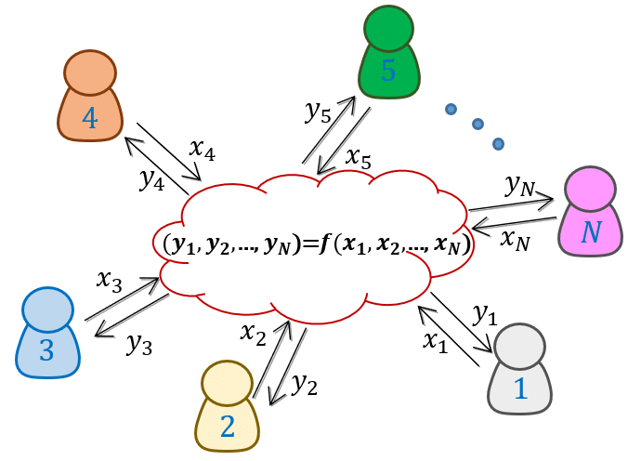
Advanced FHE Protocols for the Blockchain
RWC, Toronto, 2024
Authors:
M. Dahl, C. Danjou, D. Demmler, P. Ivanov, M. Joye, B. Libert, D. Rotaru, N. Smart, L. Thibault
Nigel Smart
Professor : COSIC, KU Leuven
Chief Academic Officer: Zama
@SmartCryptology
@SmartCryptology.bsky.social

Slide 2
What is FHE?
An encryption scheme which allows one to compute an encryption of the output of any function of the underlying plaintexts.
Given Enc(m₁), … Enc(m_{n}) one can compute
Enc(F(m₁,…m_{n}))
for any function F
Only the person holding the decryption key can obtain the output F(m₁,…m_{n})
2
ZAMA
2
COSIC

Slide 3
What is MPC?
Allows n parties to compute a known function on their private data
Privacy: Only what can be deduced from the output is revealed
Correctness: If all parties behave then the correct output is obtained
Robustness: Even if bad parties deviate from the protocol then the honest parties receive the correct output
3
ZAMA
COSIC

Slide 4
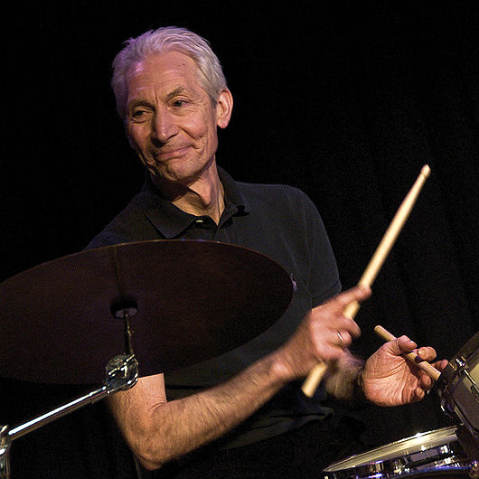
Gentry’s FHE-Based MPC Protocol
4
ZAMA
4
COSIC

Slide 5
Gentry’s FHE-Based MPC Protocol (Setup)
SK_{A}
PK
SK_{B}
PK
PK
Threshold Key Generation
SK_{C}
PK
SK_{D}
PK
5
ZAMA
5
COSIC

Slide 6
Gentry’s FHE-Based MPC Protocol (Input)
PK
ct_{A} = Enc(PK, m_{A})
SK_{A}
PK
ct_{B} = Enc(PK, m_{B})
SK_{B}
PK
ct_{C} = Enc(PK, m_{C})
SK_{C}
ct_{D} = Enc(PK, m_{D})
PK
PK
SK_{D}
6
ZAMA
6
COSIC

Slide 7
Gentry’s FHE-Based MPC Protocol (Evaluation)
PK
SK_{A}
PK
SK_{B}
ct_{F} = F(ct_{A}, ct_{B}, ct_{C}, ct_{D})
PK
SK_{C}
PK
PK
SK_{D}
7
ZAMA
7
COSIC

Slide 8
Gentry’s FHE-Based MPC Protocol (Output)
PK
SK_{A}
PK
SK_{B}
F
ct_{F}
Threshold Decryption
PK
SK_{C}
PK
PK
The parties obtain F = F(m_{A}, m_{B}, m_{C}, m_{D})
SK_{D}
8
ZAMA
8
COSIC

Slide 9
Gentry’s FHE-Based MPC Protocol
Low round complexity (Two)
Communication complexity is function independent
It only depends on input/output size
Only passively secure
There are loads of attack vectors
Our goal is to remove these attack vectors without increasing cost too much
Map it into a block chain scenario
9
ZAMA
9
COSIC

Slide 10
USERS
VALIDATORS
THRESHOLD DECRYPTION NODES
The Threshold Decryption Nodes are “Help”-er Nodes
10
ZAMA
10
COSIC

Slide 11
PK
PK
PK
PK
PK
PK
PK
PK
Threshold Key Generation
SK_{J}
SK_{P}
SK_{G}
SK_{R}
11
ZAMA
11
COSIC

Slide 12
PK
ct_{A} = Enc(PK, m_{A})
PK
PK
ct_{B} = Enc(PK, m_{B})
PK
PK
ct_{C} = Enc(PK, m_{C})
PK
PK
ct_{D} = Enc(PK, m_{D})
SK_{J}
SK_{P}
SK_{G}
SK_{R}
12
ZAMA
12
COSIC

Slide 13
PK
PK
ct_{F} = F(ct_{A}, ct_{B}, ct_{C}, ct_{D})
PK
PK
ct_{F} = F(ct_{A}, ct_{B}, ct_{C}, ct_{D})
PK
PK
PK
ct_{F} = F(ct_{A}, ct_{B}, ct_{C}, ct_{D})
SK_{J}
SK_{P}
SK_{G}
SK_{R}
13
ZAMA
13
COSIC

Slide 14
PK
PK
F
PK
F
PK
PK
F
F
ct_{F}
PK
PK
F
Threshold Decryption
SK_{J}
SK_{P}
SK_{G}
SK_{R}
14
ZAMA
14
COSIC

Slide 15
Gentry’s Protocol Bad Cloud Attack…..
PK
SK_{A}
PK
SK_{B}
ct_{F} = G(ct_{A}, ct_{B}, ct_{C}, ct_{D})
PK
The cloud could compute the wrong function.
It could even just compute
G = ct_{A}
Resulting in everyone learning Alice’s input
SK_{C}
PK
PK
SK_{D}
15
ZAMA
15
COSIC

Slide 16
PK
PK
ct_{F} = F(ct_{A}, ct_{B}, ct_{C}, ct_{D})
PK
PK
ct_{G} = G(ct_{A}, ct_{B}, ct_{C}, ct_{D})
PK
If we assume an honest majority of validators we can detect invalid function evaluation in the blockchain setting by simply taking the majority outcome
PK
PK
ct_{F} = F(ct_{A}, ct_{B}, ct_{C}, ct_{D})
SK_{J}
SK_{P}
SK_{G}
SK_{R}
16
ZAMA
16
COSIC

Slide 17
Independence of Inputs
MPC protocols require that all parties have independent inputs
You cannot make your input a function of the input of another party
Related to this is the need to ensure the simulator can extract the dishonest parties inputs
This is often the main technical issue in protocol design
Vital for practical security, and theoretical security proofs
Classic technique to get this is to prove in zero-knowledge that you know the thing which you are secretly transferring into the protocol
17
ZAMA
17
COSIC

Slide 18
PK
ct_{A} = Enc(PK, m_{A})
PK
A bad sender could just copy another person’s ciphertext over.
Hard to detect as FHE ciphertexts are re-randomizable
- Just add an encryption of zero
If an election this would result in the winner most probably being Alice’s input
Thus Bob/Angus learns who Alice voted for.
PK
ct_{A}
PK
PK
ct_{C} = Enc(PK, m_{C})
PK
PK
ct_{D} = Enc(PK, m_{D})
SK_{J}
SK_{P}
SK_{G}
SK_{R}
18
ZAMA
18
COSIC

Slide 19
PK
ct_{A} , π_{A}, Sig
PK
PK
Add a proof of knowledge of the plaintext
Bind this to the sender by making them sign the whole package
ct_{B} , π_{B}, Sig
PK
PK
ct_{C} , π_{C}, Sig
PK
PK
ct_{D} , π_{D}, Sig
SK_{J}
SK_{P}
SK_{G}
SK_{R}
19
ZAMA
19
COSIC

Slide 20
Proof of Plaintext Not Enough
LWE ciphertexts are not like ElGamal ones.
In ElGamal every “ciphertext” (pair of elements) is an encryption of something
(c₁, c₂) = (g^{k}, m*h^{k})
In LWE every “ciphertext” (pair of elements) may not be a valid encryption
(c₁, c₂) = (a, a*s + e + Δ*m)
e must be small
Indeed distinguishing a valid ciphertext from random junk IS the LWE problem
20
ZAMA
20
COSIC

Slide 21
Proof of Plaintext Not Enough
(c₁, c₂) = (a, a*s + e + Δ*m)
If e is too big then the attacker can result in garbage being output from the computation
Breaks robustness
Provides a denial of service attack
If e is only slightly too big then whether this happens depends on other parties inputs AND the secret key
Can lead to selective failure attacks
We need to ensure that the encryptor does the correct thing during encryption
Fast prover, PQ-Secure, Large Proofs using MPC-in-the-Head: FMRV22
Slow prover, classically secure, small proofs using vector-commitments: Lib24
21
ZAMA
21
COSIC

Slide 22
PK
PK
An adversarial decryptor could lead to incorrect decryption
PK
An adversarial decryptor could lead to leakage of secret key information
PK
PK
An adversarial decryptor could lead to denial of service attacks
F
ct_{F}
PK
PK
Threshold Decryption
SK_{J}
SK_{P}
SK_{G}
SK_{R}
22
ZAMA
22
COSIC

Slide 23
PK
PK
PK
DDE+23 provide a robust threshold decryption protocol for FHE schemes
Theoretically could get this with t<n/2
Efficiently we can get this with t<n/3
PK
PK
F
ct_{F}
PK
PK
Threshold Decryption
SK_{J}
SK_{P}
SK_{G}
SK_{R}
23
ZAMA
23
COSIC

Slide 24
Security Proof
To define security we need to introduce a god like character…
The adversary interacts with a simulation of the real world parties.
The simulator has access to an ideal functionality, the god like character, which is secure “by definition”
If the adversary cannot tell it is working in a simulation with god, then the protocol is secure.
Proof follows basic idea of SPDZ Offline Proof [Crypto 2012]
Simulation needs access to the honest parties inputs (so it can simulate)
This is obtained in the simulation via the ideal key gen functionality
In the proof of correctness of the simulation this is obtained by rewinding the ZKPoKs
Key point is the simulation does not rewind, only the proof of the simulation does
See Sma23 for details
24
ZAMA
24
COSIC

Slide 25
Reading
FMRV22: Thibauld Feneuil, Jules Maire, Matthieu Rivain, and Damien Vergnaud. Zero-knowledge protocols for the subset sum problem from MPC-in-the-head with rejection. ASIACRYPT 2022
Lib24: Benoit Libert. Vector commitments with proofs of smallness: Short range proofs and more. PKC 2024
Sma23: Nigel P. Smart. Practical and Efficient FHE-Based MPC. IMACC 2023:
DDD+23: Morten Dahl et al. fhEVM: Confidential EVM Smart Contracts using Fully Homomorphic Encryption
https://github.com/zama-ai/fhevm/blob/main/fhevm-whitepaper.pdf
DDE+23: Morten Dahl et al. Noah's Ark: Efficient Threshold-FHE Using Noise Flooding. WAHC@CCS 2023:
25
ZAMA
25
COSIC

Slide 26
Questions?
26
ZAMA
26
COSIC

