Slide 1
A High-Performance Enterprise System for Key Management
Sergey Banshats
Gleb Keselman
Olla Nasirov
Alon Rosen
Yaron Sheffer
Margarita Vald
Intuit Inc.
Intuit Inc.
Intuit Inc.
Bocconi University and Reichman University
Intuit Inc.
Intuit Inc.

Slide 2
Common protection practices:
Protect, using encryption, data at rest and at transit

Slide 3
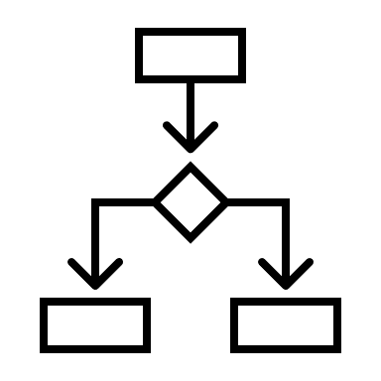
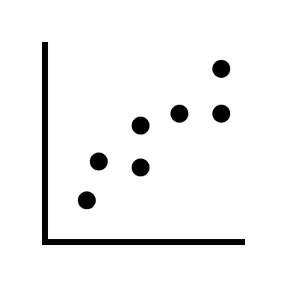
Enterprise Architecture
Data Lake
(AES-encrypted)
Key management: Generation, storage, usage
Access control: Authorization, authentication
APP
Data producers
Data consumers

Slide 4
Key Management Practices
Small blast radius: each key encrypts no more than X data.
Scalability: manage a small number of keys for rapidly-growing amounts of data.
In the past key management was handled by humans. Today services handle keys (and services are mapped to teams for ownership purposes).
Construct a key management service based on key derivation:
Manage only the root keys, and derive keys on demand from the root keys.
Key Management Service
derive
Client Enc/Dec

Slide 5
Our Results
IDPS: A multi-tenant service for key management and protection of data at rest:
Based on a new key derivation protocol
Security in the two-server model:
Root keys never exposed on any machine
Lightweight servers: with a single purpose
Performant:
4K-25K TPS for derivation requests
Latency of derive: ~6.85ms for end-to-end 0.01ms for computation in server
Scalable:
300 data producers
3K data consumers
40K root keys
serving ~300M derive/day

Slide 6
IDPS
Key Management System

Slide 7
Multi-Tenant Architecture
System security requirements:
Client cannot derive keys w/o servers
(non-colluding) Servers cannot learn the derived keys
Data Producer Manager (DPMngr)
Key Manager (KMngr)
Derive key with servers
Client1
Clientk
Enc/Dec
Enc/Dec

Slide 8
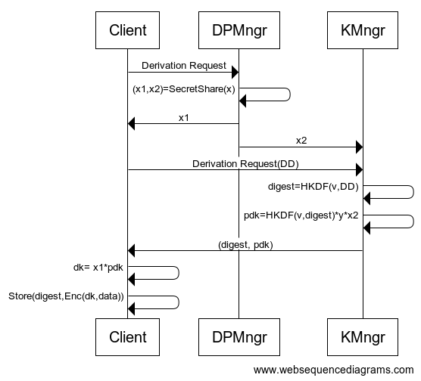
Key Derivation for Encryption – From Derivation Data DD
y←$ v←$
DD, data
x←$
rootkey= x*y mod p
All arithmetic is mod p
Used to re-derive key for decryption
(digest, ctxt)
dk=HKDF(v,digest)*rootkey
(digest_2, ctxt_2)
(digest_k, ctxt_k)
ctxt=

Slide 9
Key Derivation for Encryption – From Derivation Data DD
y←$ v←$
x←$
rootkey= x*y mod p
All arithmetic is mod p
(digest, ctxt)
dk=HKDF(v,digest)*rootkey
(digest_2, ctxt_2)
(digest_k, ctxt_k)
**x2 relayed securely via client and cached

Slide 10
Request Rate vs. Latency
Notes:
sample day Dec 28th

Slide 11
Daily Usage During Peak Season

Slide 12
An In-House Solution as a Security Enabler

Slide 13
Why In-House Solution?
Ownership
Strategic
Flexible
Cost
Who should own the keys to the castle (data)?
Deep understanding that leads to problem-solving
(e.g., encryption proxy)
Can be fine-tuned to our exact needs
More affordable than the alternatives

Slide 14
Encryption Proxy
Use case: Encrypt, company-wide, an additional type of data.
Data Lake
APP
Data producers

Slide 15
Encryption Proxy
Use case: Encrypt, company-wide, an additional type of data.
Data Lake
Unlimited blast radius
Encryption Proxy
APP
Data producers

Slide 16
Encryption Proxy
Use case: Encrypt, company-wide, an additional type of data.
Data Lake
Modify protocol to derive “encrypt only” keys
Encryption Proxy
APP
Data producers

Slide 17
Summary
Company-wide key management system:
Multi-tenant architecture
Based on a new key derivation protocol: Secure in the 2-server model
Performant and scalable
Enabler for better security
Next to come: Post-Quantum secure IDPS

Slide 18
Questions?

