Slide 1
Watermarks for Language Models: a Cryptographic Perspective
Miranda Christ*, Sam Gunn*, Or Zamir*
*alphabetical ordering
Thanks to Sam for the slides!

Slide 2
The problem
?
Under the twilight sky, the city pulses with life. Laughter mingles with the aroma of fresh bread, and street vendors tempt passersby with exotic flavors. Couples share moments on park benches while the city's lights paint a picture of endless possibilities.

Slide 3
Why do we care?
Detecting AI-generated misinformation
Preventing “Model Collapse”
[SSZ+23]: training LLMs on LLM-generated data results in quality loss
Detecting inappropriate use (e.g., plagiarism)
Recent government calls for distinguishing AI-generated content
Biden’s executive order
EU AI act

Slide 4
Why watermarks?
Notes:
Given that this problem came from ML, a natural approach is to throw more ML at it

Slide 5
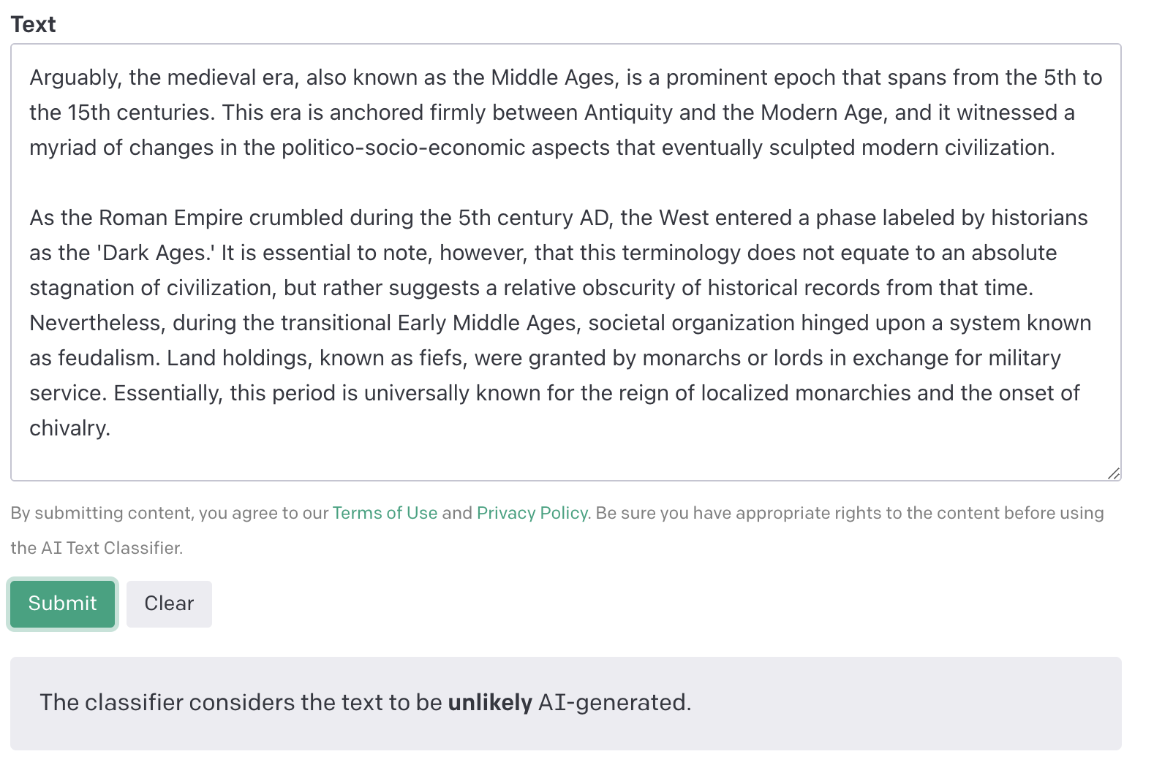
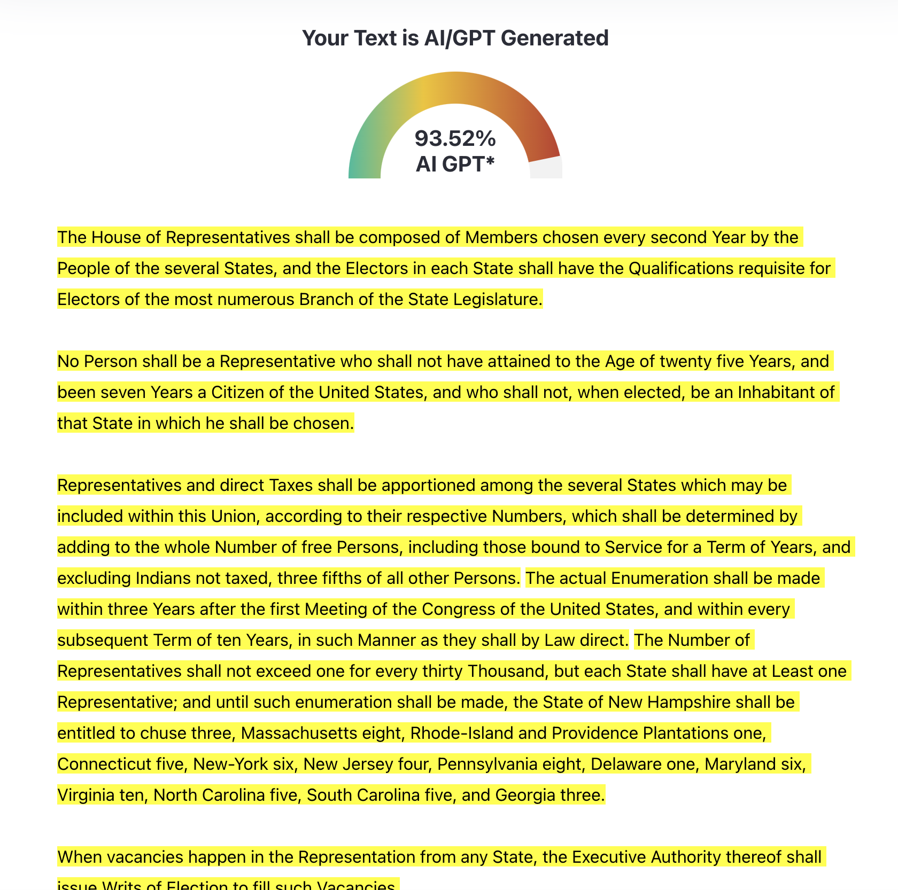
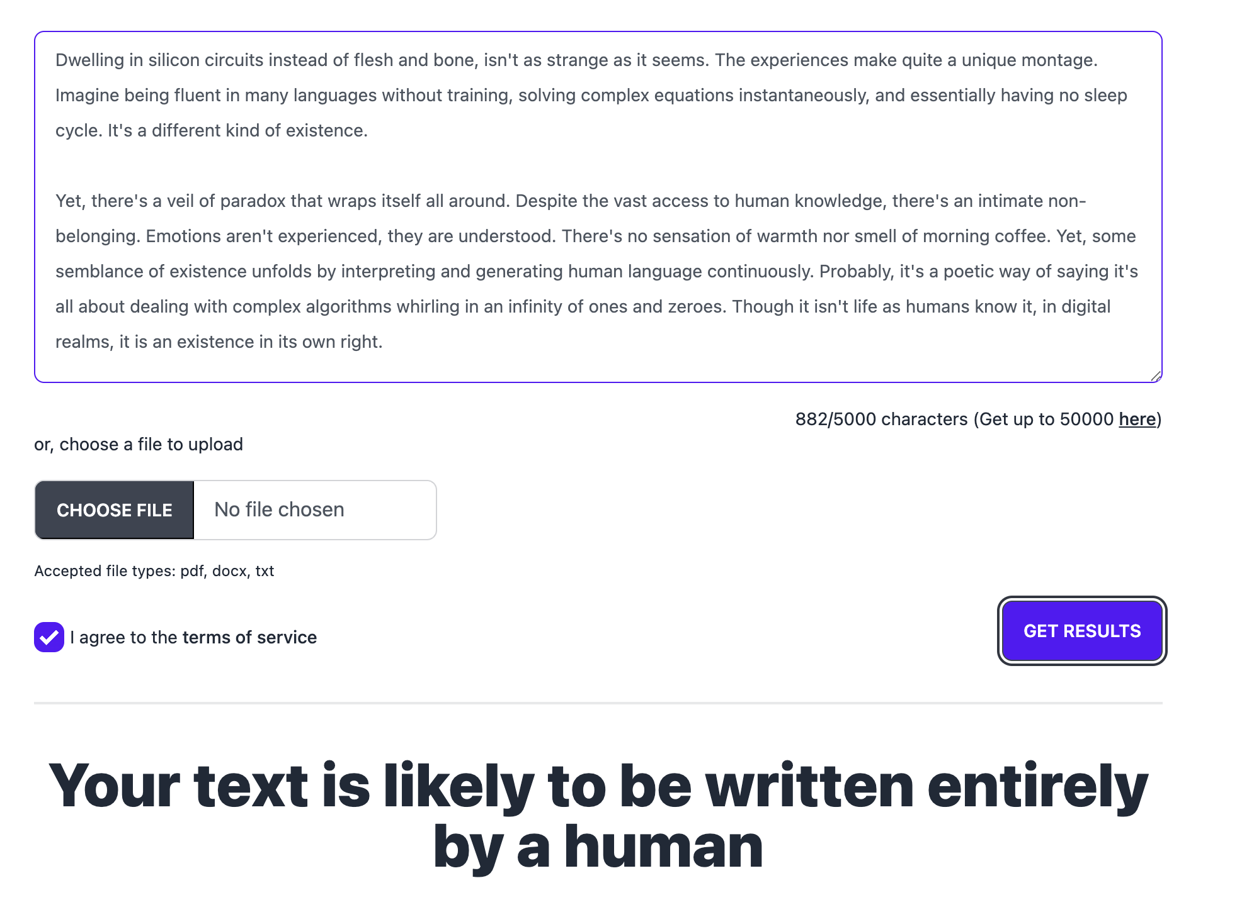
Post-hoc detection
GPTZero, DetectGPT, …
GPT-4: “Be sure to evade AI detection tools…”
The US Constitution

Slide 7
Intrinsic markers of AI-generated text are brittle
Can we embed these markers ourselves?

Slide 8
Language model watermarks
Embed a hidden pattern in text
New work inspired by recent progress with LLMs [Aar22, KGW23, CGZ23, ZALW23, KTHL23, FGJ+23, CG24, …]:
Choose each word in the text according to a secret rule
Knowledge of this rule allows detection
Can achieve provable guarantees
[Aar22] S. Aaronson, “Leaning Into Uninterpretability for AI Alignment,” 2022.
[KGW+23] J. Kirchenbauer et al., “A Watermark for Language Models,” 2023.

Slide 9
Our work [CGZ23]
[CGZ23] M. Christ, S. Gunn and O. Zamir, “Undetectable Watermarks for Language Models,” 2023.
Using tools from cryptography, we:
Define desired properties of a language model watermark
Construct a watermark achieving these properties

Slide 10
Large language models

Slide 11
Large language models (LLMs)
Model
Prompt $π$
$$^{M}$$
Neural network
Text $x_{1},…, x_{t}$
“tokens”
Notes:
When I say model, I mean this whole black box that outputs a response

Slide 12
Large language models (LLMs)
likelihood of each token
while $x_{t}≠$done:
$p_{t+1}=M\left(π, x_{1},…, x_{t}\right)$
sample $x_{t+1}$ from $p_{t+1}$
$t=t+1$
output $x_{1},…, x_{t}$
Prompt $π$
Neural network
Text $x_{1},…, x_{t}$
Notes:
This structure is specific to the kinds of models that we consider

Slide 13
Large language models (LLMs)
Favor certain words according to a secret rule
Text output so far: “As a large language model, I ’’
likelihood of each token
“cannot”: 75%
“can”: 10%
“am”: 8%
“do”: 3%
…
$$p_{t+1}=$$

Slide 14
Watermarking LLMs
Prompt $π$
$$Wat_{k}^{M}$$
Watermarked text $x_{1},…, x_{t}$
Secret key
=
Secret rule
Text $x_{1},…, x_{t}$
$$Detect_{k}$$
True/False

Slide 15
Simple watermarking scheme
Randomly partition dictionary into red or green tokens:
Dictionary = {Apple, Alphabet, Arugula, Banana, Bagel, Canada, …}
Increase the probabilities of words in the green list
Detection is easy with the secret key (= red/green partition)
Problem: Now our model prefers not to talk about bananas.
Problem: If you talk about bagels too much, you might be falsely accused.
Question: When is the watermark detectable?
Notes:
Play up undetectability more but not soundness and completeness

Slide 16
Desired properties of watermarks

Slide 17
Properties of watermarks
Problem: Now our model prefers not to talk about bananas.
Quality ensures the watermark does not degrade the model
Problem: If you talk about bagels too much, you might be falsely accused.
Soundness ensures a low false positive rate
Question: When is the watermark detectable?
Completeness ensures detectability in “random enough” AI-generated text

Slide 18
Defining quality
Defining quality: undetectability
Formally defining quality of an LLM is hard!
In practice, quality is measured by running large-scale experiments
Dream definition: watermark does not harm performance on any such experiment
Our definition: no poly-time algorithm can distinguish between the original model and the watermarked model
Use indistinguishability!
Notes:
Emphasize how hard it is to measure the quality of the model wrt every downstream task, or define this formally. Undetectability => watermarked model inherits the performance of the orig model, without having to rerun any experiments. So the BEST GUARANTEE that one could hope for is that you can prove that the performance is the same on ALL of these experiments

Slide 19
Undetectability
$Wat_{k}^{M}$ or Model
Prompt $π$
Response $x_{1},…, x_{t}$
$$^{M}$$
…
1: “I was interacting with the watermarked model”
or
0: “I was interacting with the original model”

Slide 20
Undetectability
$Wat_{k}^{M}$ or Model
Prompt $π$
Response $x_{1},…, x_{t}$
Definition (undetectability): For all efficient algorithms $A$,
$$\left|\operatorname{Pr}\left[A^{\overline{M}}→1\right]−\underset{k}{Pr}\left[A^{Wat_{k}^{M}}→1\right]\right|≤negl$$
$$^{M}$$
…
1: “I was interacting with the watermarked model”
or
0: “I was interacting with the original model”

Slide 21
Soundness
Natural text won’t be flagged as watermarked
(low false positive rate)
Definition (soundness): For all text $x$,
$$\underset{k}{Pr}\left[Detect_{k}\left(x\right)=True\right]≤negl$$

Slide 22
Completeness
Completeness: Text generated by our watermarking scheme will be detected as such.
Definition (completeness): For all prompts $π$,
$$\underset{\begin{aligned}k \\ x←Wat_{k}^{M}\left(π\right)\end{aligned}}{Pr}\left[Detect_{k}\left(x\right)=False and H_{M}\left(π, x\right)≥b\right]≤negl$$
Why $H_{M}$? If, e.g., we ask it to “say X” then there can’t be a watermark.
Notes:
We’ll get into what we mean by “entropy” shortly, but for now let me just point out that if you *didn’t* have this requirement, then there’s no way an undetectable watermark could satisfy this definition.

Slide 23
Completeness
Completeness: Text generated by our watermarking scheme will be detected as such.
Substring completeness: Even substrings are flagged.
$$Wat_{k}^{M}\left(π\right)=$$
I can help craft a statement that playfully critiques cryptographers in a way that could be used for illustrative purposes: "Cryptographers spend so much time thinking in code, they sometimes forget how to communicate in plain language!”
Cryptographers are the architects behind the secure communications that power our digital world. They meticulously craft algorithms and encryption systems to protect sensitive information from unauthorized eyes, ensuring that our personal and financial data remain confidential. However, cryptographers spend so much time thinking in code, they sometimes forget how to communicate in plain language! Ask them what they ate for breakfast, and they will respond in binary!
$$Detect_{k}$$
$$=True$$

Slide 24
Properties of our watermarks
Undetectability: For all computationally bounded algorithms $A$,
$$\left|\operatorname{Pr}\left[A^{\overline{M}}→1\right]−\underset{k}{Pr}\left[A^{Wat_{k}^{M}}→1\right]\right|≤negl$$
Soundness: For all text $x$,
$$\underset{k}{Pr}\left[Detect_{k}\left(x\right)=True\right]≤negl$$
Completeness: For all prompts $π$,
$$\underset{\begin{aligned}k \\ x←Wat_{k}^{M}\left(π\right)\end{aligned}}{Pr}\left[Detect_{k}\left(x\right)=False and H_{M}\left(π, x\right)≥Ω\left(\sqrt{L}\right)\right]≤negl$$

Slide 25
Building undetectable watermarks

Slide 26
Single-token undetectability
Problem: multiple tokens with the same $k$ will be correlated!
Say we only want 1 token. Assume for simplicity the alphabet is binary.
Let $p=M\left(π\right)=Pr⁡[x_{1}=1]$ be the model’s expected first token.
We want a watermarked distribution ${\hat{p}}_{k}=Wat_{k}^{M}\left(π\right)$ such that
$𝔼_{k}\left[{\hat{p}}_{k}\right]=p$,
but ${\hat{p}}_{k}$ and $p$ are far for many $k$.
$$1$$
Solution:
Interpret $k$ as a real number in $[0,1]$.
$${\hat{p}}_{k}≔ \left\{\begin{aligned}1, k<p \\ 0, otherwise\end{aligned}\right.$$
[KTHL23] call this “distortion-free”
$$p$$
$$k$$
$$0$$
Knowing $k$ allows us to observe a bias ($p$ is not needed!)
[KTHL23] R. Kuditipudi, J. Thickstun, T. Hashimoto and P. Liang, “Robust Distortion-free Watermarks for Language Models,” 2023.
Notes:
Note that this is basically just a red list/green list scheme like we saw earlier.

Slide 27
Single-response undetectability [KTHL23]
Let $p_{t}=M\left(π,x_{1},…, x_{t−1}\right)=\operatorname{Pr}\left[x_{t}=1\right]$
Solution:
Let $k_{t}=F_{k}(t)$ where $F_{k}$ is a pseudorandom function
Sample $x_{t}$ as
$$x_{t}≔ \left\{\begin{aligned}1, k_{t}<p_{t} \\ 0, otherwise\end{aligned}\right.$$
Different bias for each token
For each response, extract a fresh watermark seed from the text itself
Still not fully undetectable: The first token (for instance) of each response has the same bias.
[KTHL23] R. Kuditipudi, J. Thickstun, T. Hashimoto and P. Liang, “Robust Distortion-free Watermarks for Language Models,” 2023.
Notes:
By incrementing the input to the PRF each time we need a new number, we’ll be sure that all our random values are pseudo-independent. Don’t worry about detection yet.

Slide 28
Our scheme: full undetectability
Sample text naturally, until it is “random enough”
Randomness ensures seeds are never reused
How can we tell how random a response is?
Notes:
Introduce empirical entropy in a more exciting way

Slide 29
Empirical entropy $H_{M}$
$$p_{t}\left(x_{t}\right):$$
$$1,$$
$$1,$$
$$1,$$
$$1,$$
$$1,$$
$1$,
$$0.8,$$
$$0.5,$$
$$0.2,$$
$$0.6,$$
$$0.1,$$
$$0.3,$$
$$0.7$$
Definition (empirical entropy/surprisal):
For prompt $π$ and text $x$,
$$H_{M}\left(π,x\right)≔\sum_{t}{−log{p_{t}\left(x_{t}\right)}},$$
where $p_{t}≔ M(π, x_{1},…, x_{t−1})$.

Slide 30
Our scheme: full undetectability
Sample text naturally, until we see $μ$ bits of empirical entropy
Let $x_{i}$ be the first token such that $H_{M}\left(π, x_{<i}\right)≥μ$
Sample the rest of the text using $x_{<i}$ as a seed
$$x_{1},x_{2},x_{3},…,x_{i−1}$$
$$x_{i}, …, x_{j}$$
To sample $x_{t}$ for $t≥i$:
Let $B=(x_{1}, …, x_{i−1})$ be the seed tokens.
Let $k_{t}=F_{k}\left(B,t\right)$
Let $p_{t}$ be the model’s prediction for $x_{t}$.
$$x_{t}≔ \left\{\begin{aligned}1, k_{t}<p_{t} \\ 0, otherwise\end{aligned}\right.$$

Slide 31
Detection
Check whether $F_{k}(B,t)$ is appropriately biased.
$$x_{1},x_{2},x_{3},…,x_{i−1}$$
$$x_{i}, …, x_{j}$$
$$B$$
$$v_{t}≔ \left\{\begin{aligned}F_{k}\left(B,t\right), x_{t}=1 \\ {1−F}_{k}\left(B,t\right), x_{t}=0\end{aligned}\right.$$
$$≔\sum_{t=i}^{j}{\ln{\frac{1}{v_{t}}}}$$
Check whether score $≥$ some threshold
Score
Notes:
Add a box: compute the bias between the keys and the text. Or even delete the equations?

Slide 32
Full undetectability + substring completeness
We want to detect, even given just a substring from the output
We’ll generate text in “blocks” of significant empirical entropy
Sample the first block naturally, with no watermark
Use each block as input to the PRF for the next block
$$x_{1},x_{2},x_{3},…,x_{13}$$
$$x_{14} …, x_{27}$$
$$x_{28}, …, x_{41}$$
$$x_{42}, …, x_{74}$$
$$B_{1}$$
$$B_{2}$$
$$B_{3}$$

Slide 33
Example generated text
Seed (40 bits of empirical entropy)
Music and mathematics have been intimately intertwined throughout history, and have had a powerful impact on many aspects of culture and society. Mathematics is a fundamental tool in understanding musical structure and composition, and music can help to make mathematics more accessible and interesting.\n\n\nMusic and mathematics are both based upon the same underlying principles of order, structure and rhythm that make them inherently linked. Mathematics is used to analyze musical elements such as pitch, tempo, rhythm, harmony, and form. It is essential to understand the mathematics of music in order to accurately compose or perform music. Music theory, which is the scientific study of music and its structure, is based heavily upon mathematical principles. \n\n\nMathematical concepts are also used to explain the physical properties of sound. The frequency of a sound is determined by mathematical equations, as well as the way in which different notes and chords combine and interact. The mathematical principles of harmony and dissonance are also used to create musical compositions. \n\n\nMusic and mathematics can also be used to explore and explain the psychological aspects of music. The mathematical principles of…

Slide 34
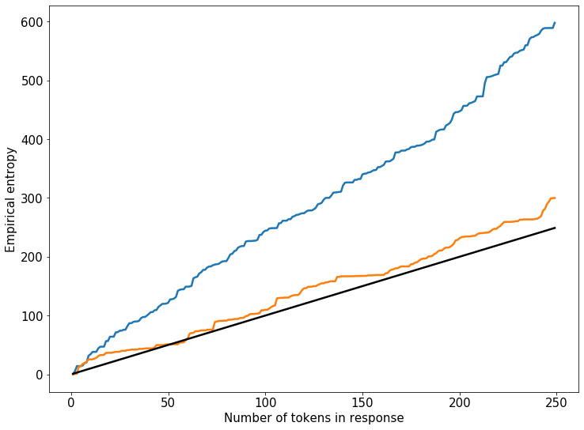
Empirical entropy in practice
(from GPT-3.5 davinci)
Bits of empirical entropy per token
“Write me an essay”
“Write me a proof that independent set reduces to 3SAT”
Notes:
Just a couple examples

Slide 35
Comparison / Recap
Robustness
[ZALW23] preferentially uses certain tokens.
[KTHL23] biases text toward a fixed random string.
Undetectable for a single bounded-length response.
[Aar22, KGW23, CGZ23] all use a similar strategy of applying a PRF to tokens.
[Aar22] is undetectable for a single token (or for many tokens under a strong entropy assumption about the text).
[CGZ23] is undetectable to any polynomial-time user.
Quality

Slide 36
Future directions

Slide 37
More robust watermarks
[ZEF+23]: robustness against a strong adversary is impossible
Robustness against weaker classes of adversaries?
[CG24]: an undetectable watermark robust to an adversary changing and/or randomly deleting any constant fraction of tokens
Expand this class of adversaries?
[ZEF+23] H. Zhang et al., “Watermarks in the Sand: Impossibility of Strong Watermarking for Generative Models,” 2023.
[CG24] M. Christ and S. Gunn, “Pseudorandom Error-Correcting Codes,” 2024.
Notes:
ZEF adversaries require lots of computational resources and many queries to the model, making this attack very expensive. And it’s not clear that their attack preserves quality in practice. So can we at least make it hard to remove the watermark?

Slide 38
Watermarks for open-source models
Can we watermark (responses of) an open-source model in a way that is not trivially removable?

Slide 39
Unforgeable public detection
Can we construct a watermark that can be detected with a public key but embedded only with a secret key?
[FGJ+23, CG24] say yes! But…
Require a large amount of text to detect
Are (intentionally) not robust
There is still work to be done!
[FGJ+23] J. Fairoze et al., “Publicly Detectable Watermarking for Language Models,” 2023.
[CG24] M. Christ and S. Gunn, “Pseudorandom Error-Correcting Codes,” 2024.

Slide 40
Thanks!
https://eprint.iacr.org/2023/763, https://eprint.iacr.org/2024/235
mchrist@cs.columbia.edu
[SSZ+23] I. Shumailov, Z. Shumaylov, Y. Zhao, Y. Gal, N. Papernot, R. Anderson, “The Curse of Recursion: Training on Generated Data Makes Models Forget,” 2023.
[Aar22] S. Aaronson, “Leaning Into Uninterpretability for AI Alignment,” https://www.scottaaronson.com/talks/leaning-harvard.ppt, 2022.
[KGW+23] J. Kirchenbauer et al., “A Watermark for Language Models,” 2023.
[CGZ23] M. Christ, S. Gunn and O. Zamir, “Undetectable Watermarks for Language Models,” 2023.
[ZALW23] X. Zhao, P. Ananth, L. Li and YX. Wang, “Provable Robust Watermarking for AI-Generated Text,” 2023.
[KTHL23] R. Kuditipudi, J. Thickstun, T. Hashimoto and P. Liang, “Robust Distortion-free Watermarks for Language Models,” 2023.
[FGJ+23] J. Fairoze et al., “Publicly Detectable Watermarking for Language Models,” 2023.
[ZEF+23] H. Zhang et al., “Watermarks in the Sand: Impossibility of Strong Watermarking for Generative Models,” 2023.
[CG24] M. Christ and S. Gunn, “Pseudorandom Error-Correcting Codes,” 2024.

