Slide 1

Multi-Authority FE with Bounded Collusions from Standard Assumptions
Rishab Goyal Saikumar Yadugiri

Slide 2



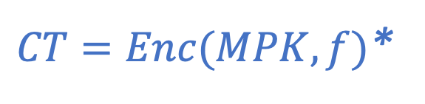
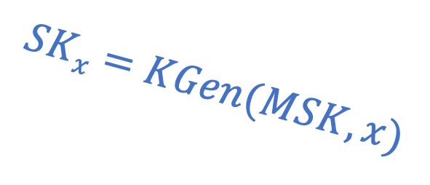




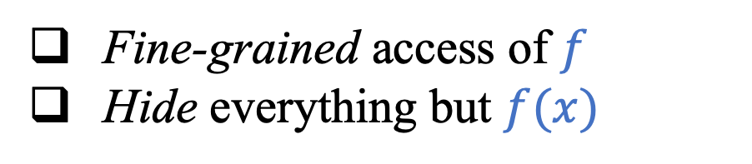
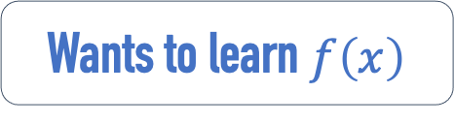
Functional Encryption [Sahai-Waters05 ……]
Fine-grained access of $f$
Hide everything but $f(x)$
$$MSK$$
$$SKx=KGen(MSK, x)$$
Wants to learn $f\left(x\right)$
$$MPK$$
$CT=Enc(MPK, f)$*
$$f$$
$$x$$
*Ciphertext-policy FE

Slide 3



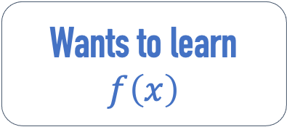


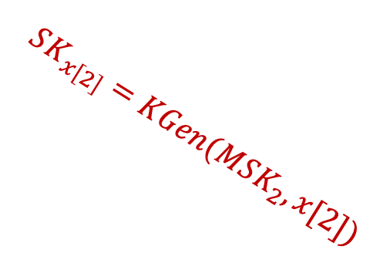

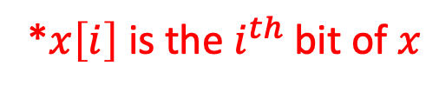



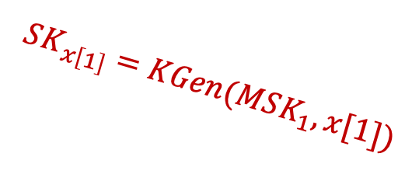
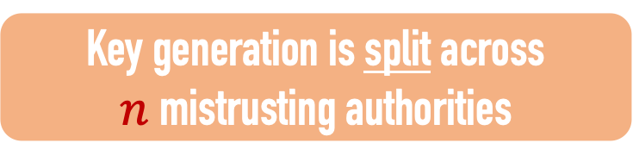

Multi-Authority FE
[Chase07, Chase-Chow09, Lewko-Waters11, Brakerski-Chandran-Goyal-Jain-Sahai-Segev17]
*$x\left[i\right]$ is the $i^{th}$bit of $x$
$$⋯⋯$$
$$MSK_{1}$$
$$MSK_{2}$$
$$MSK_{n}$$
Key generation is split across
$n$ mistrusting authorities
$$SK_{x\left[n\right]}$$
$$SK_{x\left[1\right]}=KGen(MSK_{1}, x[1])$$
$$SK_{x\left[2\right]}=KGen(MSK_{2}, x[2])$$
$${\left\{MPK_{i}\right\}}_{i}$$
$$CT=Enc({\left\{MPK_{i}\right\}}_{i}, f)$$
$$f$$
Wants to learn $f\left(x\right)$

Slide 4

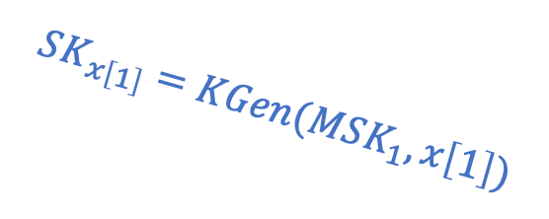




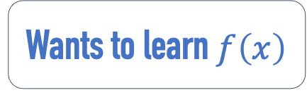
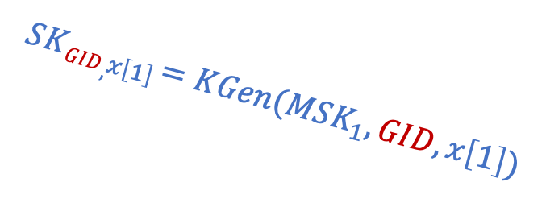
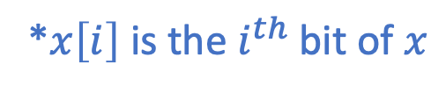





Adding GIDs
[Chase07, …]
*$x\left[i\right]$ is the $i^{th}$bit of $x$
$$⋯⋯$$
$$MSK_{1}$$
$$MSK_{2}$$
$$MSK_{n}$$
$$SK_{x\left[2\right]}$$
$$S{KGID,}_{x\left[2\right]}$$
$$SK_{x\left[n\right]}$$
$$S{KGID,}_{x\left[n\right]}$$
$$SK_{x\left[1\right]}=KGen(MSK_{1}, x\left[1\right])$$
$$S{KGID,}_{x\left[1\right]}=KGen(MSK_{1}, GID,x\left[1\right])$$
$$GID$$
$${\left\{MPK_{i}\right\}}_{i}$$
$$CT=Enc({\left\{MPK_{i}\right\}}_{i}, f)$$
$$f$$
Wants to learn $f\left(x\right)$

Slide 5
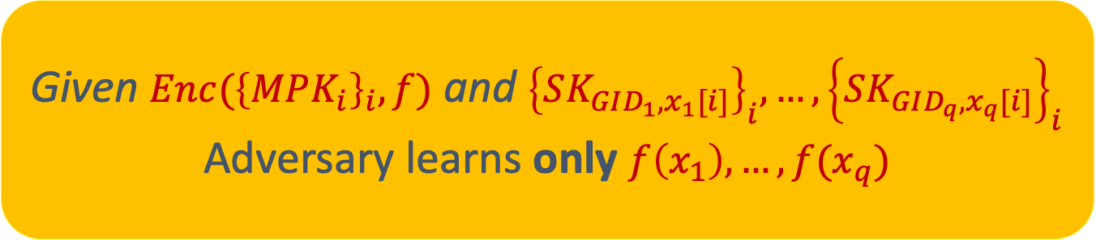
Multi-Authority FE: Security
[Chase07, …, Brakerski-Chandran-Goyal-Jain-Sahai-Segev17]
INTUITION
Given $Enc({\left\{MPK_{i}\right\}}_{i}, f)$ and ${\left\{SK_{GID_{1},x_{1}[i]}\right\}}_{i},…,{\left\{SK_{GID_{q},x_{q}[i]}\right\}}_{i}$
Adversary learns only $f\left(x_{1}\right), …,f(x_{q})$
Bounded Collusion Model
Secure as long as < Q collusions

Slide 6

Landscape
From sub-exponential $i𝒪$ for general circuits [Brakerski-Chandran-Goyal-Jain-Sahai-Segev17]
We don’t how to MAFE with bounded collusions from simpler assumptions
Brakerski et al. proved it gives obfuscation …even in the bounded collusion model
Why?

Slide 7
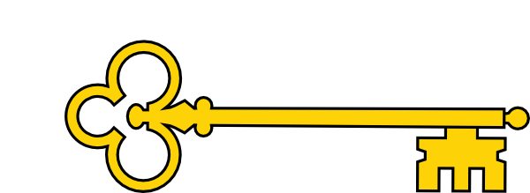

Multi-Authority FE: Gives iO/VBB
[Brakerski-Chandran-Goyal-Jain-Sahai-Segev17]
$$⋯⋯$$
NOT BOUNDED COLLUSION MODEL !!!
(GID, 0)
(GID, 0)
(GID, 0)
(GID, 1)
(GID, 1)
(GID, 1)
To obfuscate:
  -- Encrypt f under MPK₁ … MPK_{n}
  -- Generate SK_{GID,i,0} and SK_{GID,i,1} from every MSK_{i}
  -- Set CT along with all {SK_{GID,i,b}}_{i,b} as obfuscation
  -- To evaluate, Dec({SK_{GID,i,x[i]}}_{i}, CT)
Need security when two keys for same GID corrupted
The point for GIDs was to ensure only one “full” key can ever be formed by combining all partial keys from different authorities.

Slide 8
Question under consideration!
Is MAFE with bounded key corruptions and semi-honest authorities enough for obfuscation?
Or, can we design MAFE with semi-honest authorities for non-trivial classes from “simple assumptions”?

Slide 9
Our Results
In this talk…
Theorem 1: 2/3-authority MAFE with bounded collusions from poly-hard assumptions
Theorem 2 (Bootstrapping Theorem 1): Constant authority MAFE with bounded collusions from poly-hard assumptions
Theorem 3: Polynomial authority MAFE with bounded collusions from sub-exponential (vanilla) public-key encryption + ROM
1. 1-GID MAFE
2. Compiler to handle Q-GID collusions
NO RANDOM ORACLES NEEDED!

Slide 10

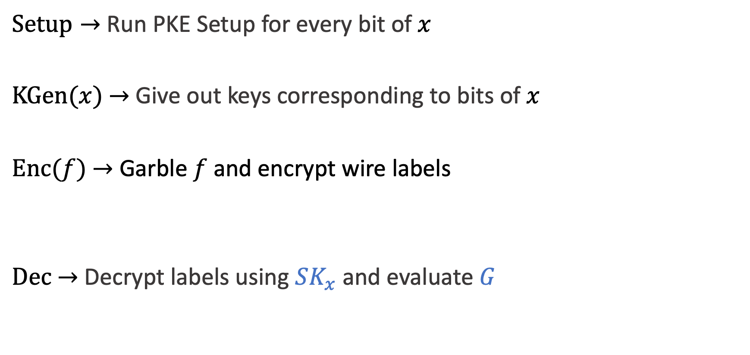
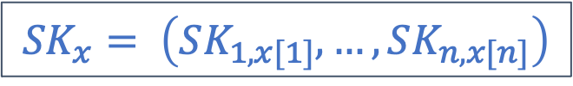
1-Collusion FE from PKE
[Sahai-Seyalioglu10]
$Setup→$ Run PKE Setup for every bit of $x$
$KGen(x)$ $→$ Give out keys corresponding to bits of $x$
$Enc(f)$ $→$ Garble $f$ and encrypt wire labels
$Dec$ $→$ Decrypt labels using $SK_{x}$ and evaluate $G$
$$\left(PK_{i, b}, SK_{i, b}\right)←PKE.Setup$$
Can distribute this
$${SK}_{x}= \left(SK_{1, x[1]}, …,SK_{n, x[n]}\right)$$
Can distribute this
$\left(G, lab_{i,b}\right)←Garble\left(f\right)$ & ${CT}_{i, b} ←PKE.Enc(PK_{i, b},lab_{i,b})$

Slide 11



1-GID Multi-Authority FE
$AuthSetup(i)→$ Run PKE Setup for $i^{th}$ bit
$KGen(x\left[i\right])$ $→$ Give out key corresponding to $i^{th}$ bit of $x$
$Setup→$ Run PKE Setup for every bit of $x$
$KGen(x)$ $→$ Give out keys corresponding to bits of $x$
$Enc(f)$ $→$ Garble $f$ and encrypt wire labels
$Dec$ $→$ Decrypt labels using $SK_{x}$ and evaluate $G$
$$\left(PK_{i, b}, SK_{i, b}\right)←PKE.Setup$$
$${SK}_{x}= \left(SK_{1, x[1]}, …,SK_{n, x[n]}\right)$$
$$SK_{i, x[i]}$$
$\left(G, lab_{i,b}\right)←Garble\left(f\right)$ & ${CT}_{i, b} ←PKE.Enc(PK_{i, b},lab_{i,b})$

Slide 12
Main step: Handling large collusion Q
Natural starting point
  Single-authority FE compiler [Gorbunov-Vaikuntanathan-Wee12]
PLAN. Try to use similar collusion bound amplification techniques.

Slide 13
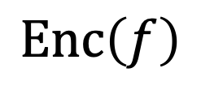
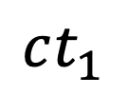

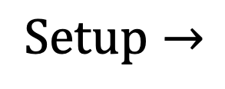

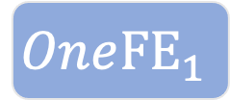

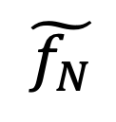
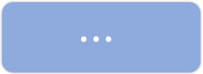

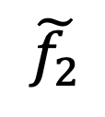
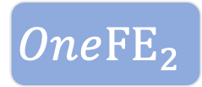
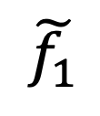

Reviewing GVW
$$N=poly(Q)$$
$$Setup→$$
$$One{FE}_{1}$$
$$One{FE}_{2}$$
$$⋯$$
$$One{FE}_{N}$$
$$\tilde{f_{1}}$$
$$\tilde{f_{2}}$$
$$⋯$$
$$\tilde{f_{N}}$$
Special Threshold
Secret Sharing
OneFE Encryption
$$Enc\left(f\right)$$
$$ct_{1}$$
$$ct_{2}$$
$$ct_{N}$$

Slide 14

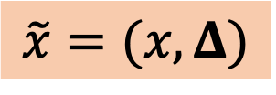
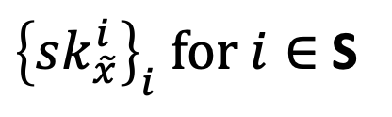


Reviewing GVW
$$N=poly(Q)$$
$$Setup→$$
$$One{FE}_{1}$$
$$One{FE}_{2}$$
$$⋯$$
$$One{FE}_{N}$$
$$⋯$$
OneFE Key Generation
$$KGen\left(x\right)→$$
${\left\{sk_{\tilde{x}}^{i}\right\}}_{i} for i∈$ S
Select random subset S
$$\tilde{x}=(x, Δ)$$
Each key has random subset of OneFE keys for special encoding $\tilde{x}$
$$Enc\left(f\right)→$$
$$ct_{1}$$
$$ct_{2}$$
$$ct_{N}$$

Slide 15
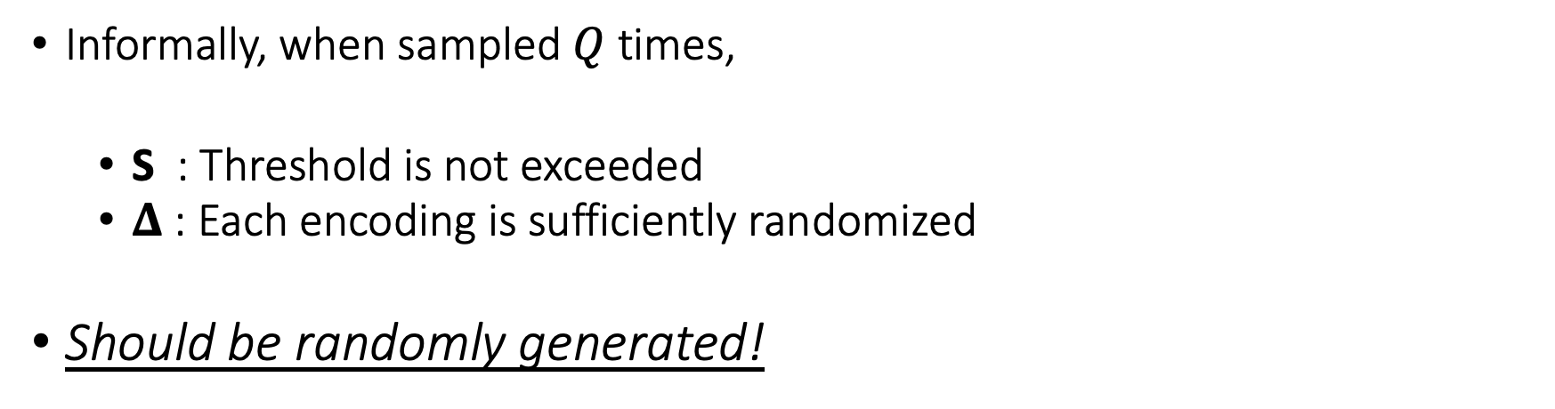
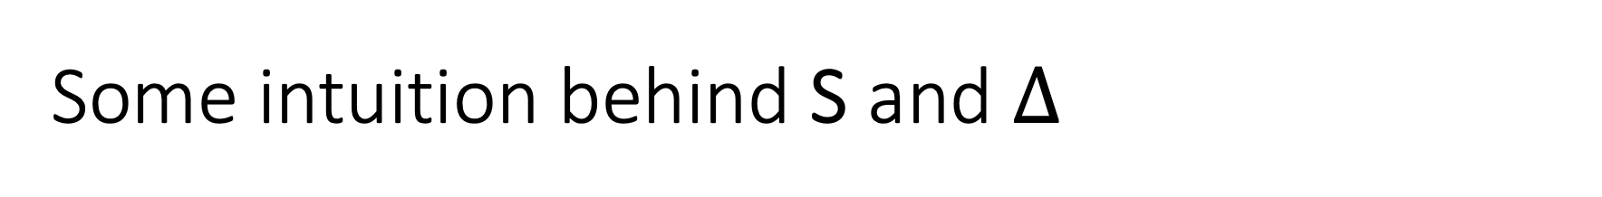
Some intuition behind S and $Δ$
Informally, when sampled $Q$ times,
  S : Threshold is not exceeded
  $Δ$ : Each encoding is sufficiently randomized
Should be randomly generated!

Slide 16
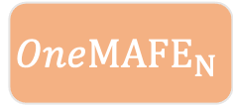

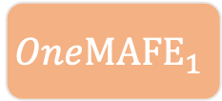
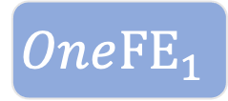
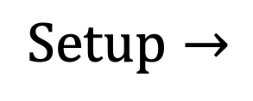
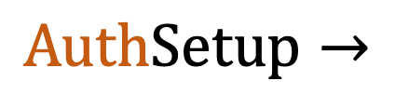
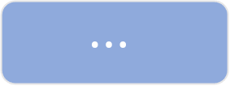
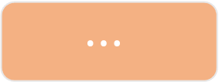
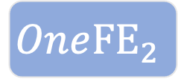
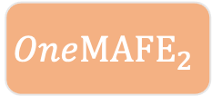
Let’s just generalize it!
$$Setup→$$
$$One{FE}_{1}$$
$$One{FE}_{2}$$
$$⋯$$
$$One{FE}_{N}$$
$$AuthSetup→$$
$$One{MAFE}_{1}$$
$$One{MAFE}_{2}$$
$$⋯$$
$$One{MAFE}_{N}$$
$$\tilde{f_{1}}$$
$$\tilde{f_{2}}$$
$$⋯$$
$$\tilde{f_{N}}$$
Special-Sharing
OneMAFE Encryption
OneFE Encryption
$$Enc\left(f\right)$$
$$ct_{1}$$
$$ct_{2}$$
$$ct_{N}$$

Slide 17


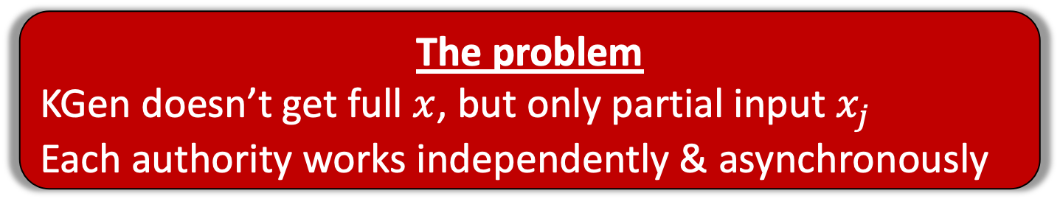

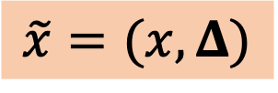
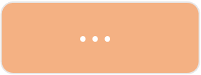


Collusion Amplification in MAFE
$$AuthSetup→$$
$$One{MAFE}_{1}$$
$$One{MAFE}_{2}$$
$$⋯$$
$$One{MAFE}_{N}$$
The problem
KGen doesn’t get full $x$, but only partial input $x_{j}$
Each authority works independently & asynchronously
$$⋯$$
OneFE Key Generation
OneMAFE Key Generation
$$KGen\left(x\right)→$$
${\left\{sk_{\tilde{x}}^{i}\right\}}_{i} for i∈$ S
$$\tilde{x}=(x, Δ)$$
$$KGen\left(GID, x_{j}\right)→$$
Both S and $Δ$ have to be randomly sampled!

Slide 18




Looking more closely…
The problem is even the attacker learns K!
Thus, although $\text{S}, Δ$ are (pseudo)random, this breaks the statistical arguments/lemmas essential for security.
Authorities should be able to select S and $Δ$ asynchronously
  Must be identical for any given GID (recall GID fixes a user)
  Must be randomly selected for every GID
Let us just use a PRF?
$$\left(\text{S}, Δ\right)={PRF}_{K}(GID)$$
Where is K?
K could be thought as global CRS.
E.g., XORing every user’s individual key $K= ⊕_{i}K_{i}$.
IMP: Every authority knows this at key generation.

Slide 19



Solution: NIKE
Hiding set selection via computational hardness
The problem is even the attacker learns K!
Thus, although $\text{S}, Δ$ are (pseudo)random, this breaks the statistical arguments/lemmas essential for security.
$$K←NIKE\left(Auth_{1},⋯, Auth_{n}\right)$$
Then just use PRF to sample $S, Δ$.
$$\left(\text{S}, Δ\right)={PRF}_{K}(GID)$$
Now each authority obtains $K$, but not the adversary.

Slide 20
Our Results
Theorem 1: 2/3-authority MAFE from poly-hard assumptions
Theorem 2 (Bootstrapping Theorem 1): Constant authority MAFE with bounded collusions from poly-hard assumptions
Theorem 3: Polynomial authority MAFE with bounded collusions from sub-exponential (vanilla) public-key encryption + ROM

Slide 21
Open Problems
Corruptible Authorities
👿

