Slide 1



Hamming Weight Proofs of Proximity with One-Sided Error
Gal Arnon Shany Ben-David Eylon Yogev
Notes:
Say thank you at the beginning, and repeat the name and paper name
Talk fluently
Make more focus on succinctness and
Add 3 minutes to the introduction
Look at the audience most of the time
Export pdf
Take a clicker

Slide 2





Motivating Example
$${v∈Ham}_{0.95}$$
$$v$$
1 | 1 | 1 | 1 | 0 | 1 | 1 | 1 | 0 | 1 | 1 | 1 | 1 | 1 | 1
$350\sim$ million uses
Notes:
We start with an example
In 2022, Elon Musk initiated the process of acquiring Twitter. However, Musk later revoked his offer, claiming that a significant portion of the users were spambots. This sparked a major dispute. Twitter was arguing that this was a false claim, and tried to force Musk into the deal.
To resolve this, Musk wanted to verify that 95% of Twitter's users are real. We can represent the user as a bit vector v, where 1 indicates a real user and 0 a spambot. Back than Twitter had 350 million users, so the vector v is huge.
Naively, Musk could verify that 95% of the users are real by directly counting real users, but this would be very costly, potentially requiring expensive individual checks, maybe even a private investigator to verify that a single user is real, and for such a massive dataset this is impractical. Musk could check a small number of users, but not more than that.
This problem comes down to designing a proof system in which Twitter can prove to Musk that the vector v has Hamming weight approximately 0.95, allowing Musk to check only a small number users. Now let’s see what are the properties required from the proof system.

Slide 3




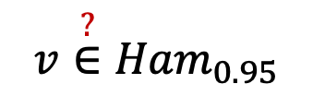

Framing Free
$${v\overset{?}{∈}Ham}_{0.95}$$
$$r$$
Prover
Verifier
$$Π$$
$$v$$
1 | 1 | 1 | 1 | 0 | 1 | 1 | 1 | 0 | 1 | 1 | 1 | 1 | 1 | 1
$350\sim$ million uses
Notes:
We want framing free system. We want perfect completeness. Why is that? Even if we had a proof system with exponentially small error, Musk could deliberately choose randomness that make the proof fail. If Musk presents this failure as evidence in court, it could frame Twitter, despite its honesty.
To make sure that Twitter will be willing to post proof, we must have perfect completeness.
Next we define Hamming weight proof of proximity with perfect completeness.

Slide 4


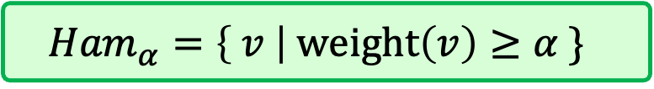


Hamming Weight Proofs of Proximity
$${Ham}_{α}=\left\{ v \right| weight\left(v\right)≥α \}$$
$$v$$
1 | 1 | 1 | 0 | 0 | 1 | 1 | 1 | 1 | 0 | 1 | 1 | 1 | 1 | 1
Prover
Verifier
.
.
.
$$0/1$$
Perfect Completeness: If $v∈{Ham}_{α}$then $\underset{r}{Pr}\left[<P,V>\left(v\right)=1\right]=1$
Soundness: If $weight\left(v\right)=α−δ$then $\underset{r}{Pr}\left[<\tilde{P},V>\left(v\right)=1\right]≤ε$
Notes:
We define ${Ham}_{α}$ to be the language of all the bit vectors with Hamming weight at least alpha, where a vector has Hamming weight alpha if an alpha fraction of the elements in the vector have the value 1.
In this setting, we think of the vector as huge, and each query to the input vector is expensive. The prover and verifier interact, and the verifier, given its randomness, reads a small number of bits from the vector and decides whether to accept or reject.
And the properties that we require from such a system are: 1. perfect completeness. This is the framing free property that we just talked about. The verifier always accepts the proof. We say that the proof system is perfectly complete if for a vector with hamming weight >= alpha, the verifier accepts with probability 1. and for soundness, ……..
This was a general definition of Hamming weight proof of proximity. Next we describe the specific models that we studies

Slide 5
Hamming Weight Proofs of Proximity
A systematic study of
Hamming weight proof of proximity
Focusing on practically efficient prover
IOP of proximity
PCP of proximity
MA of proximity
Notes:
In this work we perform a systematic study of hamming weight proof of proximity, with a focus on practically efficient prover. So in each one of our results the prover is very efficient.
In all of the models, the verifier reads only a small number of bits from the vector.
In the IOP model, the prover and verifier interact, and the verifier is restricted to read only a small number of bits from the prover messages.
In the PCP model, there is no interaction. The prover generates the proof, and the verifier is restricted to reads only a small number of bits from the proof.
In the MA model, again, there is no interaction, only a single prover message, the difference is that here the verifier reads the entire message.
For each model we provides a different upper and lower bounds.
We provide results on three models, IOP,PCP, and MA of proximity. In each one of the models, the verifier reads only a small number of bits from the input vector.

Slide 6
Results

Slide 7

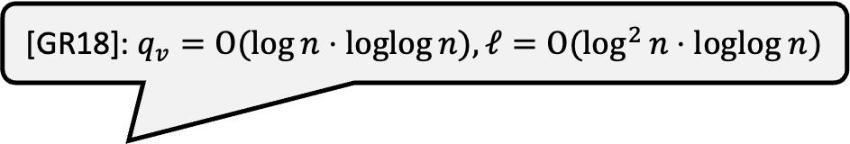
Our Results – MA
[GR18]: $q_{v}=O(\log{n}⋅loglog{n}), ℓ=O(\log^{2}{n}⋅loglog n)$
MA: we give a proximity protocol with $q_{v}=O({\log{n}})$ and $ℓ=O(\log^{2}{n})$
Lower bound: Any perfectly complete IP of proximity for ${Ham}_{α}:$
$$ℓ=Ω\left(\log{n}−\log{q_{v}}\right)$$
Corollary: For input query $q_{v}=√n$ the proof length is:
$$ℓ=Ω\left(\log{n}\right)$$
$n$- input size; $ℓ$ - proof length; $q_{v}$ - input query complexity
Notes:
We give an MA proximity protocol where the verifier read logn bits from the vector, and the proof length is $\log^{2}{n}$, where $n$ refers to the input vecotr size.
Compared to previous work we improve by a loglogn factor
We provide a lower bound that applies to IP with any nuber of rounds. We show that any perfectly complete interactive proof of proximity for the hamming weight problem must have proof length that is logn over $q_{v}$, where $q_{v}$ is the number of queries that the verifier makes.
This bound gives us the following corollary. If the verifier makes even sqrtn queries to the vector, the proof length must be logn.
So even if we allow interaction, and even if the verifier reads many many bits from the input vector, the proof length has to be at least logarithmic in the vector size.
This means that our MA protocol has a proof length that is optimal up to a $\log{n}$ factor

Slide 8
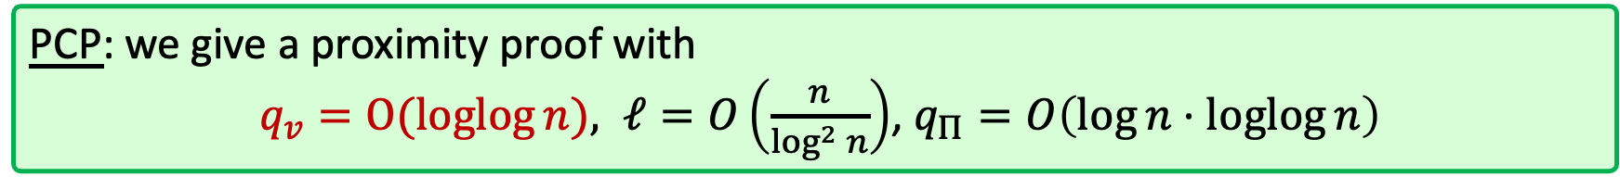

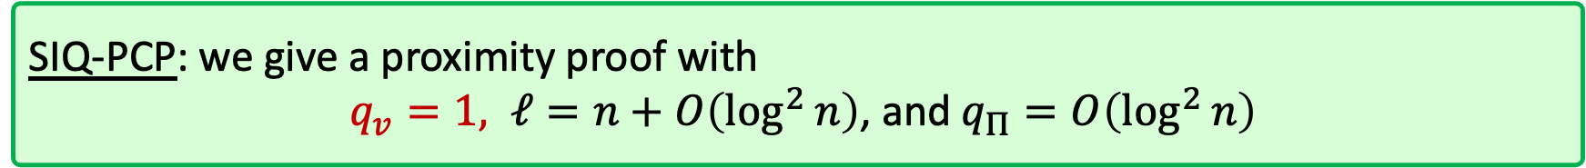
Our Results - PCP
PCP: we give a proximity proof with
$q_{v}=O(loglog{n}), ℓ=O\left(\frac{n}{\log^{2}{n}}\right)$, $q_{Π}=O\left(\log{n}⋅\operatorname{loglog}{n}\right)$
SIQ - Single Input Query
SIQ-PCP: we give a proximity proof with
$q_{v}=1, ℓ=n+O\left(\log^{2}{n}\right)$, and $q_{Π}=O\left(\log^{2}{n}\right)$
Lower bound: For any $α∈\left(0.5, 0.77\right),$every perfectly complete SIQ-PCP of proximity for ${Ham}_{α}$ has proof length $Ω(n)$
$n$- input size; $ℓ$ - proof length; $q_{v}$ - input query complexity; $q_{Π}$ - proof query complexity
Notes:
Our PCP protocol has O(loglogn) input query complexity, the proof length is $O\left(\frac{n}{\log^{2}{n}}\right)$ which is sublinear in n, and the proof query complexity is O(lognloglogn).
Focusing on the input query complexity, this is a logarithmic improvement compared to the MA results.
As a next step, we try to optimize the input query complexity and have a single input query. We define a PCP with a single input query as SIQ PCP. We construct SIQ-PCP with proof length that is $n+O\left(\log^{2}{n}\right)$, and $O\left(\log^{2}{n}\right)$ proof query complexity
To complete the study of the SIQ PCP model, we show that the linear proof length is inherent. More formally, we show that for some range of alphas, every perfectly complete SIQ-PCP for ${Ham}_{α}$ must have proof length that is at least linear in n.
So if we want to optimize the query complexity, we need a proof length that is proportional to the vector size, and that means that our SIQ-PCP construction acheives optimal proof length
The verifier queries the input logn times
the proof length is subliner
and the verifier makes slightly more thatn logn queries to the proof intself.
What if we want the verifier to do only a signle inpur query ?
we show that this is tight. we give lower bound that for a wide range of alphas.....

Slide 9
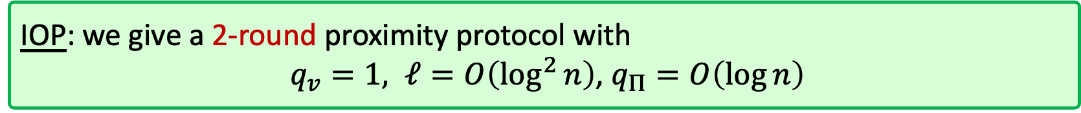
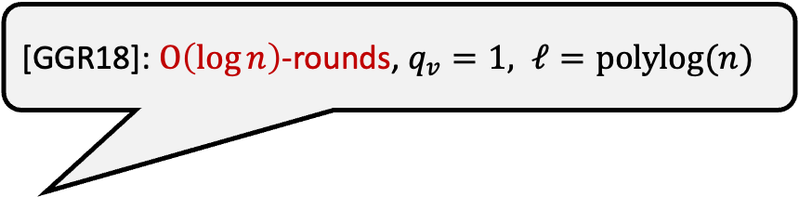
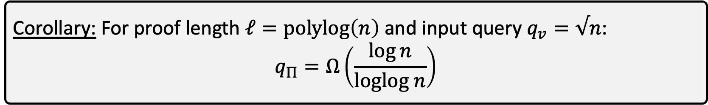
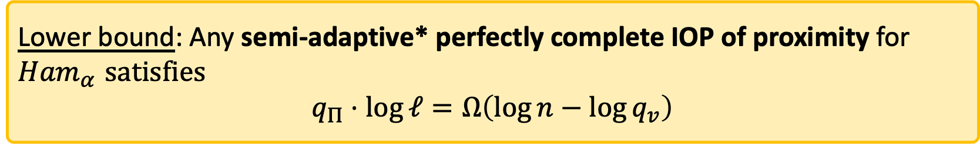
Our Results - IOP
[GGR18]: $O\left(\log{n}\right)$-rounds, $q_{v}=1, ℓ=polylog(n)$
IOP: we give a 2-round proximity protocol with
$q_{v}=1, ℓ=O\left(\log^{2}{n}\right)$, $q_{Π}=O\left(\log{n}\right)$
Lower bound: Any semi-adaptive* perfectly complete IOP of proximity for ${Ham}_{α}$ satisfies
$$q_{Π}⋅\log{ℓ}=Ω\left(\log{n}−\log{q_{v}}\right)$$
Corollary: For proof length $ℓ=polylog\left(n\right)$and input query $q_{v}=√n$:
$$q_{Π}=Ω\left(\frac{\log{n}}{loglog n}\right)$$
$n$- input size; $ℓ$ - proof length; $q_{v}$ - input query complexity; $q_{Π}$ - proof query complexity
Notes:
Moving on to the IOP setting, we give a 2-round proximity protocol with a single input query, $O\left(\log^{2}{n}\right)$ proof length, and $O\left(\log{n}\right)$ proof query complexity.
Goldreich Gur and Rothblum constrcuted an IP protocol, with O(logn) rounds,…. So here we prove in all parameters.
For the IOP setting we provide the following lower bound: any semi-adaptive perfectly complete IOP for the hamming weight problem satisfies the following equation.
Where semi-adaptive IOP protocols is a IOP protocol that is stronger that non-adaptive and weaker than adaptive.
This bound gives us the following corollary: For any constant epsilon, any semi-adaptive IOP of proximity with proof length $polylog\left(n\right)$and $n^{ε}$input query complexity, which means that the verifier reads many bits from the input query complexity, the query complexity is omega of logn over loglogn
We talked about PCP MA and which are non interactive
and finally we show the power of interaction.
We show an IOP with a single input query that still has communiction complexity that is.....
any semi adaptive ..... where the verifier even makes sqrt n queries to the input, still needs to make slightly less than.....
Connect to next slide

Slide 10
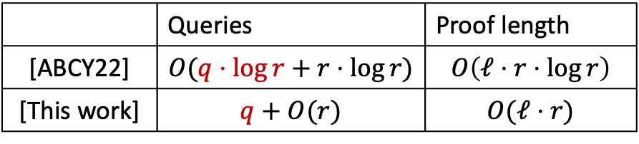
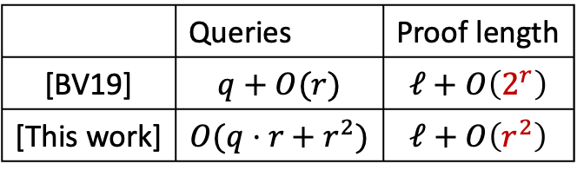
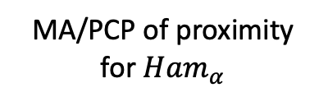

Additional Applications
PCP with imperfect completeness
MA/PCP of proximity for ${Ham}_{α}$
PCP with perfect completeness
 | Queries | Proof length
[BV19] | $$q+O(r)$$ | $$ℓ+O\left(2^{r}\right)$$
[This work] | $$O(q⋅r+r^{2})$$ | $$ℓ+O\left(r^{2}\right)$$
$q$- query complexity; $ℓ$ - proof length; $r$ - randomness
IOP with imperfect completeness
IOP of proximity for ${Ham}_{α}$
IOP with perfect completeness
 | Queries | Proof length
[ABCY22] | $$O(q⋅\log{r}+r⋅\log{r})$$ | $$O\left(ℓ⋅r⋅\log{r}\right)$$
[This work] | $$q+O(r)$$ | $$O(ℓ⋅r)$$
$q$- query complexity; $ℓ$ - communication; $r$ - randomness
Notes:
Our results have an additional application
We show how to use Hamming weight of proximity protocols to transform PCP with Imperfect completeness to PCP with prefect completeness,
And IOP with imperfect completeness to IOP with perfect completeness
In the transformation we are able to to roughly maintain the query complexity and proof length of the protocols, and the cost of the transformation depends on the parameters that we achieve in our Hamming protocols.
As an additional application, we show that Hamming weight proof of proximity can be used to transform protocols with imperfect completeness to protocols with perfect completeness.
We first show a generic transformation that given any MA/PCP of proximity protocol for the Hamming weight problem we achieve PCP with perfect completeness. The overhead in the query complexity and proof length of the PCP protocol depends on the parameters of the Hamming weight protocol, and the better parameters we have in the Ham weight protocol, the better results we get in the transformation.
We also show a specific transformation from IOP with imperfect completeness to IOP with perfect completeness. And this transformation builds on the same techniques used in our IOP of proximity construction.
The transformation uses our results, and achieves good paramaters

Slide 11
PCP Construction
Notes:
a rough overview of our PCP construction

Slide 12

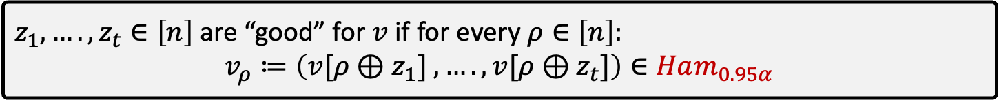






PCP Construction
Focus: 1. minimizing input query
2. sub-linear proof length
Good shifts: (à la [Lautemann 83])
:
$z_{1},….,z_{t}∈\left[n\right]$ are “good” for $v$ if for every $ρ∈\left[n\right]:$
$$v_{ρ}≔\left({v[ρ⊕z}_{1}] ,….,{v[ρ⊕z}_{t}]\right)∈Ham_{0.95α}$$
$$v$$
1 | 1 | 1 | 0 | 0 | 1 | 1 | 1 | 1 | 0 | 1 | 1 | 1 | 1 | 1
$$z_{1},…,z_{t}$$
$$v_{1}$$
1 | 0 | 1 | 1
. . .
$$v_{ρ}$$
1 | 1 | 0 | 1
. . .
$$v_{n}$$
1 | 0 | 1 | 1
$$t$$
$$v_{ρ}\left[i\right]=v[ρ⊕z_{i}]$$
Notes:
In this construction, our main goals are: (1) minimizing the input query complexity and (2) maintaining sublinear proof length.
We define good shifts as follows: shifts z1,…,zt are considered good for a vector v if, for every ρ, the shifted vector vρ​ has a Hamming weight at least say 0.95alpha
so the i-th element in $v_{ρ}$ is detemined by the shift z_i.

Slide 13


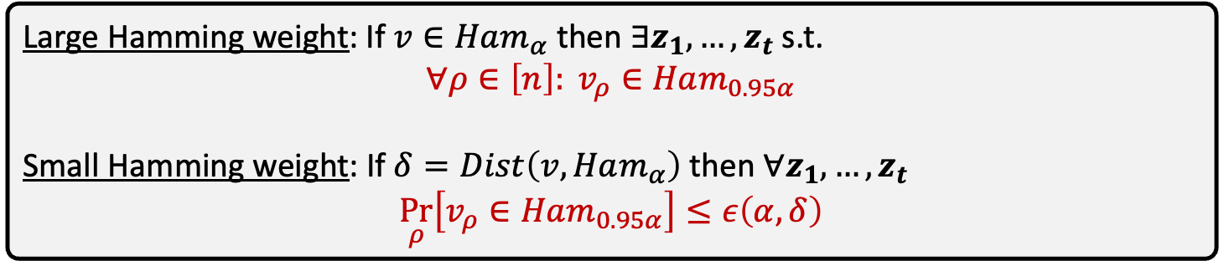
PCP Construction
Focus: 1. minimizing input query
2. sub-linear proof length
For $t= Θ(\log{n})$
Large Hamming weight: If $v∈Ham_{α}$ then $∃z_{1},…,z_{t}$ s.t.
$$∀ρ∈\left[n\right]: v_{ρ}∈Ham_{0.95α}$$
Small Hamming weight: If $δ=Dist\left(v,Ham_{α}\right)$ then $∀z_{1},…,z_{t}$
$$\underset{ρ}{Pr}\left[v_{ρ}∈Ham_{0.95α}\right]≤ε\left(α,δ\right)$$
$$v$$
1 | 1 | 1 | 0 | 0 | 1 | 1 | 1 | 1 | 0 | 1 | 1 | 1 | 1 | 1
$$z_{1},…,z_{t}$$
$$v_{1}$$
1 | 0 | 1 | 1
. . .
$$v_{ρ}$$
1 | 1 | 0 | 1
. . .
$$v_{n}$$
1 | 0 | 1 | 1
$$t$$

Slide 14
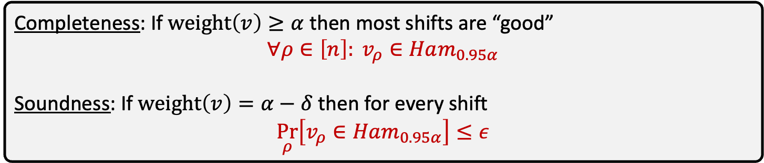
PCP Construction
Focus: 1. minimizing input query
2. sub-linear proof length
For $t= Θ(\log{n})$
Completeness: If $weight\left(v\right)≥α$ then most shifts are “good”
$$∀ρ∈\left[n\right]: v_{ρ}∈Ham_{0.95α}$$
Soundness: If $weight\left(v\right)=α−δ$ then for every shift
$$\underset{ρ}{Pr}\left[v_{ρ}∈Ham_{0.95α}\right]≤ε$$
$$v$$
1 | 1 | 1 | 0 | 0 | 1 | 1 | 1 | 1 | 0 | 1 | 1 | 1 | 1 | 1
$$z_{1},…,z_{t}$$
$$v_{1}$$
1 | 0 | 1 | 1
. . .
$$v_{ρ}$$
1 | 1 | 0 | 1
. . .
$$v_{n}$$
1 | 0 | 1 | 1
$$t$$
Notes:
Moving on, we show that for t that is equal theta logn, We get if the following properties.
For completeness, If the hamming weight of the vector v is at least alpha, than most shifts are “good”, which means that all the shifted vectors v_rho have a hamming weight of at least 0.95 alpha.
and for soundness, we show that for vector v with hamming weight alpha-delta, the probability over the choice of rho that the vector v_rho has hamming weight at least 0.95 alpha is bounded by some epsilon.
These properties naturally lead to construction.

Slide 15

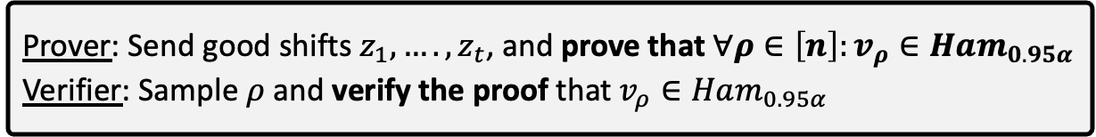
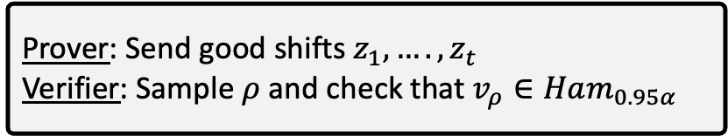
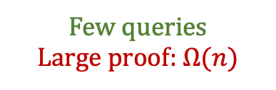
PCP Construction
Focus: 1. minimizing input query
2. sub-linear proof length
Attempt 1:
Prover: Send good shifts $z_{1},….,z_{t}$
Verifier: Sample $ρ$ and check that $v_{ρ}∈Ham_{0.95α}$
Too many queries
$t=Θ(\log{n})$
Attempt 2:
Prover: Send good shifts $z_{1},….,z_{t}$, and prove that $∀ρ∈\left[n\right]:v_{ρ}∈Ham_{0.95α}$
Verifier: Sample $ρ$ and verify the proof that $v_{ρ}∈Ham_{0.95α}$
Few queries
Large proof: $Ω(n)$
$$v$$
1 | 1 | 1 | 0 | 0 | 1 | 1 | 1 | 1 | 0 | 1 | 1 | 1 | 1 | 1
$$z_{1},…,z_{t}$$
$$v_{ρ}$$
1 | 1 | 0 | 1
$$t$$
Notes:
We define the prover to send good shifts
The verifier than samples rho, and checks that the hamming weight of the vector v_rho is large.
Since each element v_rho is defined by an element in v, this requires reading t elements from v, which is logn bits.
Which is too constly, and fails to address our first goal
So what can we do?
*Make the prover prove that the small vector vrho has large hamming weight, rather than proving on the large vefctor v. we make a recursice step here. This solves the query complexity, but what about the proof size? The prover needs to send a proof for each v_rho, so proof size is at least linear in n, and this fails to achieve our second goal.
so what can we do?

Slide 16





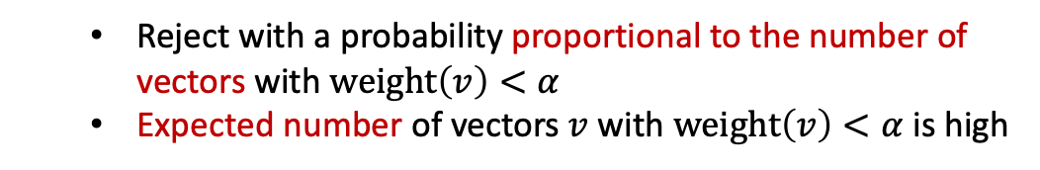
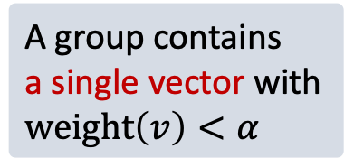
PCP Construction
Focus: 1. minimizing input query
2. sub-linear proof length
Prover: Send good shifts $z_{1},….,z_{t}$, and give proofs for large groups of $V_{j}∈ListHam_{0.95α}$
Verifier: Sample $j$ and verify that $V_{j}∈ListHam_{0.95α}$
Few queries
Small proof
Challenge:
Approach:
Soundness is
non-trivial!
A group contains
a single vector with $weight\left(v\right)<α$
  Reject with a probability proportional to the number of vectors with $weight\left(v\right)<α$
  Expected number of vectors $v$ with $weight\left(v\right)<α$ is high
$$v$$
$$v$$
1 | 1 | 1 | 0 | 0 | 1 | 1 | 1 | 1 | 0 | 1 | 1 | 1 | 1 | 1
1 | 1 | 1 | 0 | 0 | 1 | 1 | 1 | 1 | 0 | 1 | 1 | 1 | 1 | 1
$$z_{1},…,z_{t}$$
$$z_{1},…,z_{t}$$
$$v_{1}$$
$$V_{j}$$
$$v_{ρ}$$
1 | 1 | 0 | 1
1 | 1 | 0 | 1
$$v_{ρ}$$
$$v_{n′}$$
1 | 1 | 0 | 1
1 | 0 | 1 | 1
1 | 1 | 0 | 1
1 | 1 | 0 | 1
. . .
1 | 1 | 0 | 1
. . .
1 | 1 | 0 | 1
1 | 1 | 0 | 1
1 | 1 | 0 | 1
1 | 1 | 0 | 1
Notes:
We devide the vectors into large groups V_j, and the prover sends a proof for each group that all the vectors in the group have large hamming weight.
The verifier samples a group j, and verifies the proof.
This construction will have small query complexity and small proof length.
The idea is simple, but the challenge with this solution lies in its soundness.
What happens if we have a group V_j with only a single vector that has a small Hamming weight?
Catching such a case with high probability is very costly.
To address this, we reject Vj​ with a probability that is proportional to the number of vectors with small Hamming weight. Then, we prove that the expected number of vectors with small hamming weight in V_j is high.

Slide 17
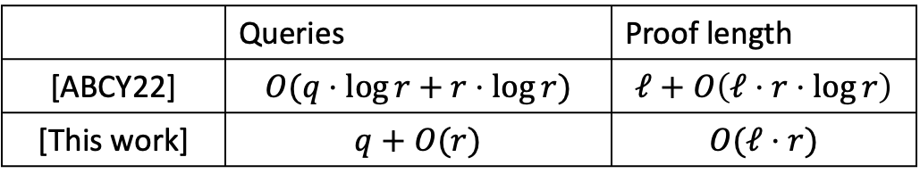

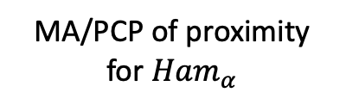
Additional Applications
PCP with imperfect completeness
MA/PCP of proximity for ${Ham}_{α}$
PCP with perfect completeness
 | Queries | Proof length
[BV19] | $$q+O(r)$$ | $$ℓ+O\left(2^{r}\right)$$
[This work] | $$O(q⋅r+r^{2})$$ | $$ℓ+O\left(r^{2}\right)$$
IOP with imperfect completeness
IOP with perfect completeness
 | Queries | Proof length
[ABCY22] | $$O(q⋅\log{r}+r⋅\log{r})$$ | $$ℓ+O\left(ℓ⋅r⋅\log{r}\right)$$
[This work] | $$q+O(r)$$ | $$O(ℓ⋅r)$$
Notes:
As an additional application we show that the Ham weight protocols can be used to transform PCP or IOP with imperfect completeness to perfectly complete protocols.
We first show that given any MA/PCP of proximity protocol to the Hamming weight problem we can get PCP with perfect completeness, and the better the Ham protocol, the better results we get in the transformation.
We also show a specific transformation from IOP with imperfect completeness to one with perfect completeness using the IOP of proximity protocol techniques we used in the paper.

Slide 18
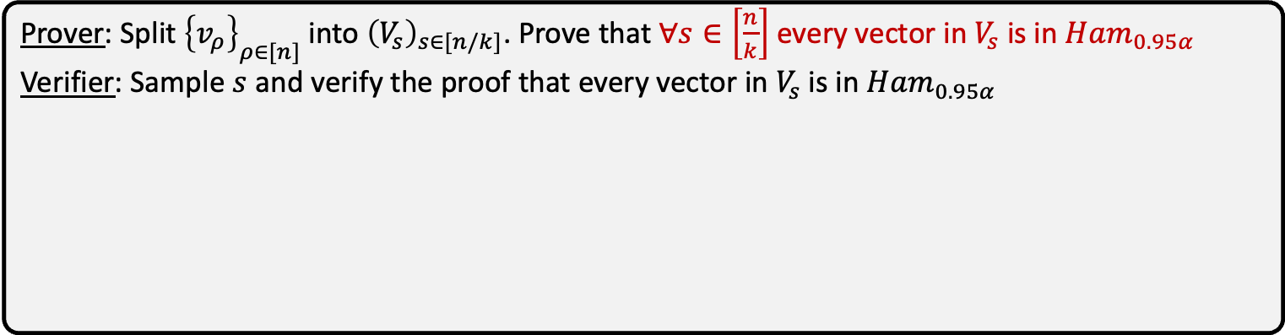
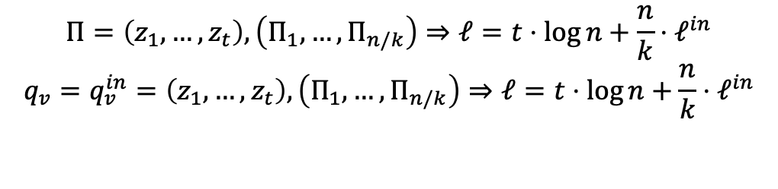
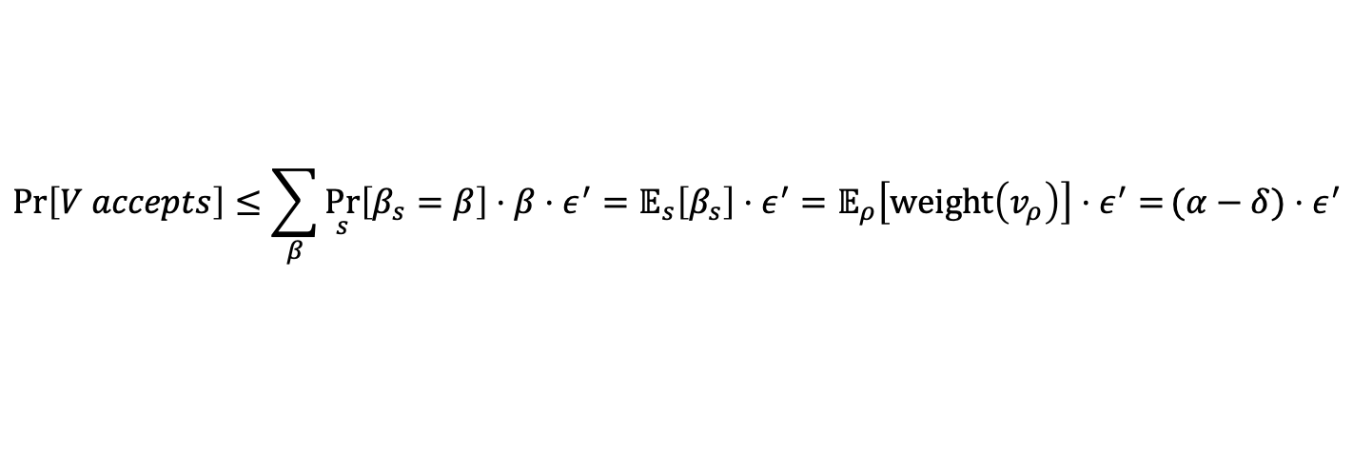
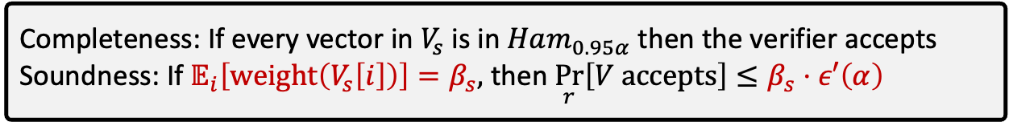
PCPP Construction
Focus: 1. minimizing input query
2. sub-linear proof length
Prover: Split ${\left\{v_{ρ}\right\}}_{ρ∈[n]}$into ${\left(V_{s}\right)}_{s∈[n/k]}$. Prove that $∀s∈\left[\frac{n}{k}\right]$every vector in $V_{s}$ is in $Ham_{0.95α}$
Verifier: Sample $s$ and verify the proof that every vector in $V_{s}$ is in $Ham_{0.95α}$
Inner protocol:
Completeness: If every vector in $V_{s}$ is in $Ham_{0.95α}$ then the verifier accepts
Soundness: If $𝔼_{i}\left[weight\left(V_{s}\left[i\right]\right)\right]=β_{s},$then$\underset{r}{Pr}\left[V accepts\right]≤β_{s}⋅ε′\left(α\right)$
$$\operatorname{Pr}\left[V accepts\right]≤\sum_{β}{\underset{s}{Pr}\left[β_{s}=β\right]⋅β⋅ε^{′}}=𝔼_{s}\left[β_{s}\right]⋅ε^{′}=𝔼_{ρ}\left[weight\left(v_{ρ}\right)\right]⋅ε^{′}=(α−δ)⋅ε^{′}$$
$$Π=\left(z_{1},…,z_{t}\right),\left(Π_{1},…,Π_{n/k}\right)⇒ℓ=t⋅\log{n}+\frac{n}{k}⋅ℓ^{in}$$
$$q_{v}=q_{v}^{in}=\left(z_{1},…,z_{t}\right),\left(Π_{1},…,Π_{n/k}\right)⇒ℓ=t⋅\log{n}+\frac{n}{k}⋅ℓ^{in}$$
Notes:
Our

Slide 19
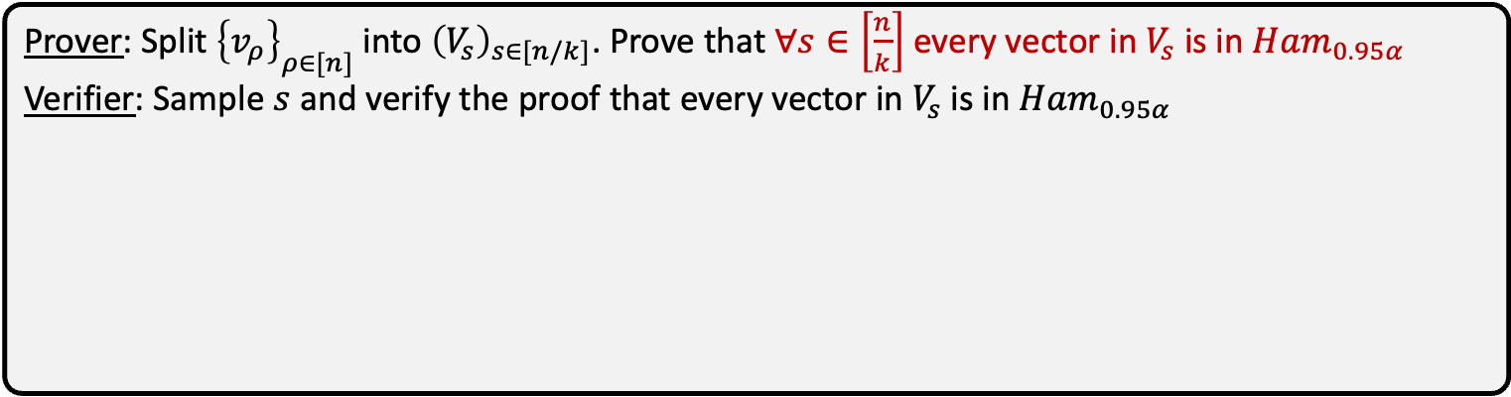
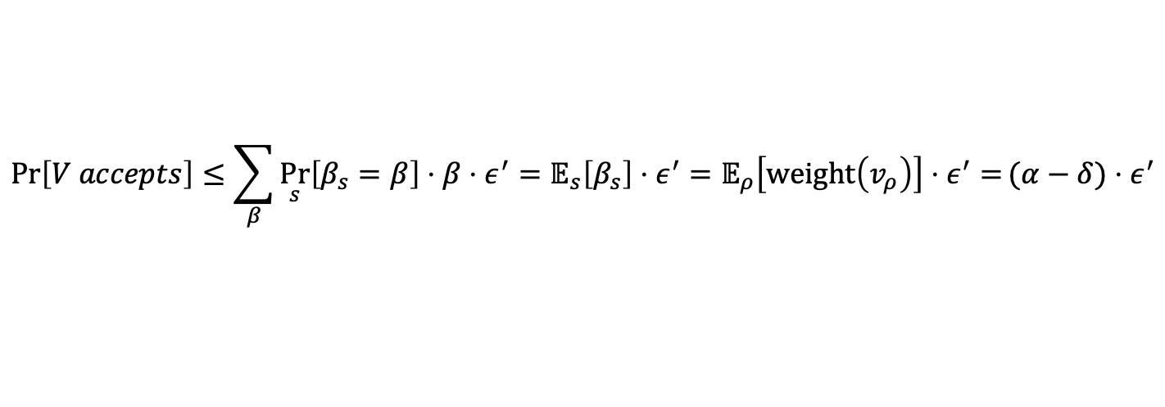
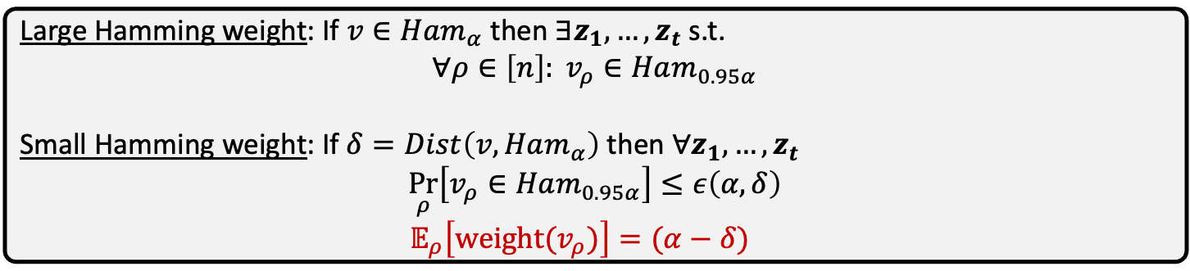
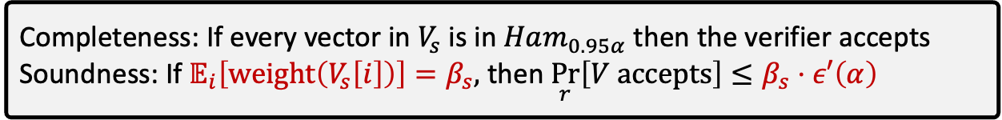
PCPP Construction
Focus: 1. minimizing input query
2. sub-linear proof length
Prover: Split ${\left\{v_{ρ}\right\}}_{ρ∈[n]}$into ${\left(V_{s}\right)}_{s∈[n/k]}$. Prove that $∀s∈\left[\frac{n}{k}\right]$every vector in $V_{s}$ is in $Ham_{0.95α}$
Verifier: Sample $s$ and verify the proof that every vector in $V_{s}$ is in $Ham_{0.95α}$
Inner protocol:
Completeness: If every vector in $V_{s}$ is in $Ham_{0.95α}$ then the verifier accepts
Soundness: If $𝔼_{i}\left[weight\left(V_{s}\left[i\right]\right)\right]=β_{s},$then$\underset{r}{Pr}\left[V accepts\right]≤β_{s}⋅ε′\left(α\right)$
$$\operatorname{Pr}\left[V accepts\right]≤\sum_{β}{\underset{s}{Pr}\left[β_{s}=β\right]⋅β⋅ε^{′}}=𝔼_{s}\left[β_{s}\right]⋅ε^{′}=𝔼_{ρ}\left[weight\left(v_{ρ}\right)\right]⋅ε^{′}=(α−δ)⋅ε^{′}$$
Good shifts:
Large Hamming weight: If $v∈Ham_{α}$ then $∃z_{1},…,z_{t}$ s.t.
$$∀ρ∈\left[n\right]: v_{ρ}∈Ham_{0.95α}$$
Small Hamming weight: If $δ=Dist\left(v,Ham_{α}\right)$ then $∀z_{1},…,z_{t}$
$$\underset{ρ}{Pr}\left[v_{ρ}∈Ham_{0.95α}\right]≤ε\left(α,δ\right)$$
$𝔼_{ρ}\left[weight(v_{ρ})\right]=(α−δ)$
Notes:
Our

Slide 20
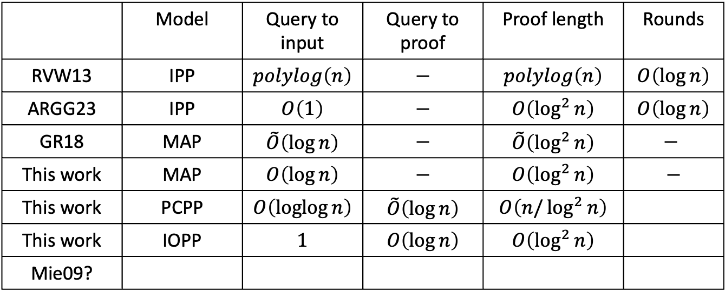
Previous Work
 | Model | Query to input | Query to proof | Proof length | Rounds
RVW13 | IPP | $$polylog\left(n\right)$$ | $$−$$ | $$polylog\left(n\right)$$ | $$O\left(\log{n}\right)$$
ARGG23 | IPP | $$O\left(1\right)$$ | $$−$$ | $$O\left(\log^{2}{n}\right)$$ | $$O\left(\log{n}\right)$$
GR18 | MAP | $$\tilde{O}\left(\log{n}\right)$$ | $$−$$ | $$\tilde{O}\left(\log^{2}{n}\right)$$ | $$−$$
This work | MAP | $$O\left(\log{n}\right)$$ | $$−$$ | $$O\left(\log^{2}{n}\right)$$ | $$−$$
This work | PCPP | $$O\left(\operatorname{loglog}{n}\right)$$ | $$\tilde{O}\left(\log{n}\right)$$ | $$O\left(n/\log^{2}{n}\right)$$
This work | IOPP | $$1$$ | $$O\left(\log{n}\right)$$ | $$O\left(\log^{2}{n}\right)$$
Mie09?

Slide 21


Hamming Weight Proofs of Proximity - MAP
$$v$$
Prover
Verifier
$$Π$$
Notes:
Exact hamming?

Slide 22

Hamming Weight Proofs of Proximity - PCPP
$$v$$
Prover
Verifier
$$Π$$
Notes:
Exact hamming?

Slide 23
Hamming Weight Proofs of Proximity - PCPP
$$v$$
 |  |  |  |  |  |  |  |  |  |  |  |  | 1
Prover
Verifier
$$Π$$
Notes:
Exact hamming?

Slide 24





Probabilistically Checkable Proofs (PCPs) - Completeness
$$ℛ∈NP$$
Prover: $\left(x,w\right)∈ℛ$
$$Π$$
Verifier: $x$
Completeness: $∀\left(x,w\right)∈ℛ$
$$\operatorname{Pr}{[V^{Π}\left(x\right)=1 | Π←P\left(x,w\right)]=1}$$

