Slide 1
Space-Lock Puzzles and
Verifiable Space-Hard Functions from Root-Finding in Sparse
Polynomials
Nico Döttling¹, Jesko Dujmovic¹², Antoine Joux¹
¹ CISPA, ² Saarland University
TCC 2024

Slide 2
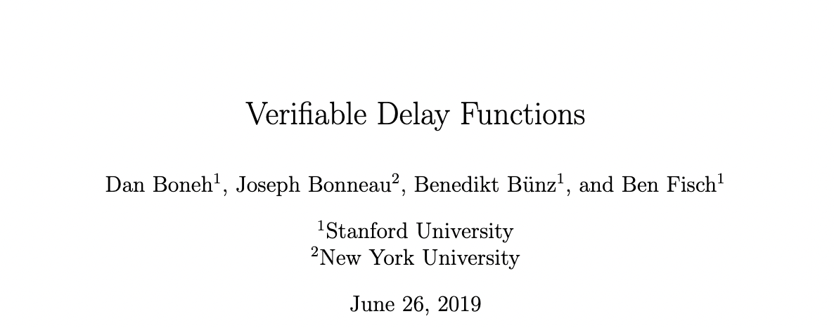
Verifiable Delay Function (VDF)
random x
y, π
f(T, x)
T
f(x) is a VDF if
y←f(x) takes a long time to compute
Produce a proof π that y=f(x)
π is fast to verify
“Verifiable Delay Functions” Boneh, Bonneau, Bünz, Fisch

Slide 3
Permutation Polynomials
Problems:
With enough parallel processors linear algebra is fast
Non-trivial high degree permutation polynomials with fast evaluation are hard to find
h(X) is a polynomial over finite field 𝔽
Permutation
High degree
Fast evaluation (e.g. sparse)
f(X)=h⁻¹(X) is a (weak) VDF
Easy to check y=h⁻¹(x) ↔ x=h(y)
Seems inherently sequential
Over $F_{p^{m}}$, where $q=p^{r}$ and $m<r$ and other
f(x) is a VDF if
y←f(x) takes a long time to compute
Produce a proof π that y=f(x)
π is fast to verify
h(X)=$\frac{(X^{q}-μX-μ)(X^{q}-μX+μ)^{q}+((X^{q}-μX+μ)^{2}+4μ^{2}X)^{(q+1)/2}}{2X^{q}}$
“Verifiable Delay Functions” Boneh, Bonneau, Bünz, Fisch; “Exceptional polynomials of affine type” Guralinck, Müller

Slide 4
Guralnik Müller
h(X)=$\frac{(X^{q}-μX-μ)(X^{q}-μX+μ)^{q}+((X^{q}-μX+μ)^{2}+4μ^{2}X)^{(q+1)/2}}{2X^{q}}$
Finding x s.t. h(x)=y is the same as finding root of h(X)-y
If $θ$ is the $q-1$st root of unity in the algebraic closure there are
$A,B,C,D$ in an extension of $F_{p^{m}}$ s.t.
$$\underset{i∈F_{q}}{∏}(h(X+iθ)-y)=X^{q^{3}}+AX^{q^{2}}+BX^{q}+CX+D$$
For any $x$ s.t. h($x$)=$y$ we get that $x^{q^{3}}+Ax^{q^{2}}+Bx^{q}+Cx+D=0$
Linear because $x↦x^{p}$ is an $F_{p}$ homomorphism
“Exceptional polynomials of affine type” Guralinck, Müller

Slide 5
How to Resolve Issues
Problems:
With enough parallel processors linear algebra is fast
Non-trivial high degree permutation polynomials with fast evaluation are hard to find
Solutions
Assume space hardness
Use less structured polynomials (not permutation)
random x
Is space-hardness reasonable?
f(S, x)
y, π
Any algorithm for finding the root of h(X)-y
treats h(X)-y it like a dense polynomial
S
Memory requirement grows with the degree

Slide 6
Sparse Polynomials in Verifiable Space-Hard Functions
Problem with h(X) no permutation:
For some y, there is no x s.t. h(x)=y
There are x₁≠x₂ s.t. h(x₁)=h(x₂)
Verify the computation of h⁻¹(y) to prove uniqueness w/ little verifier space
General-purpose SNARK works
We use the structure of h⁻¹ and ~polynomial commitments for a tailor made SNARK

Slide 7
Time-Lock Puzzles
z←Gen(T,m)
Sol(z)
T
m
“Time-lock puzzles and timed-release crypto” Rivest, Shamir, Wagner

Slide 8
Space-Lock Puzzles
z←Gen(S,m)
Sol(z)
S
m

Slide 9
Sparse Polynomials in Space-Lock Puzzles
Gen(m):
Sample sparse polynomial h(X) w\ random constant coefficient
Output z=h(X)-m
Sol(z):
Parse z as sparse polynomial g(X)
Compute roots {m₁,…,mₙ} of g(X)
Which m to output

Slide 10
Sparse Polynomials in Space-Lock Puzzles
Gen(m):
Sample sparse polynomial h(X) w\ random constant coefficient
Sample key k
c←Enc(k,m||0${}^{λ}$)
Output z=(h(X)-k, c)
Sol(z):
Parse z as sparse polynomial g(X) and ciphertext c
Compute roots {k₁,…,kₙ} of g(X)
For i in [n] m’ᵢ←Dec(kᵢ, c), if m’ᵢ=m||0${}^{λ}$ for some m output m

Slide 11
Space-Lock Puzzles and
Verifiable Space-Hard Functions from Root-Finding in
Sparse Polynomials
Thanks!

