Slide 1
Asynchronous Agreement on a Core Set in Constant Time and More Efficient Asynchronous VSS and MPC
Ittai Abraham Gilad Asharov Arpita Patra Gilad Stern

Slide 2
Network and Adversary Model
Fully connected network, $n$ parties
Asynchrony
Stronger adversarial model
Network-speed
Challenges: how long do we wait?
Adaptive malicious adversary
Optimal resilience ($n>3t$ for consensus, $n>4t$ for AVSS)
Perfect security
Analyzed in the UC framework

Slide 3
Asynchronous Multiparty Computation
{1,2,3$\}$
$$x_{1}$$
$${f(x_{1},…,x_{4})}_{ }$$
$$x_{1}$$
$$f$$
$$x_{4}$$
{1,2,4}
$$\{1,3,4\}$$
$$x_{2}$$
$$x_{4}$$
$${f(x_{1},…,x_{4})}_{ }$$
$${f(x_{1},…,x_{4})}_{ }$$
$$x_{2}$$
$$x_{3}$$
$${f(x_{1},…,x_{4})}_{ }$$
$$x_{3}$$

Slide 4
Agreement on a Core Set
State-of-the-art: BCG ‘93 and BKR ‘94
$O\left(n\right)$ binary agreements
$Ω(n^{7}\log{n})$ expected bits
$O(\log{n)}$ expected rounds
Our work:
1 multivalued agreement
$O(n^{4}\log{n)}$ expected bits
$O(1)$ expected rounds
$$×n^{3}$$
$$×\log{n}$$

Slide 5
Packed AVSS Intuition – Share
$$s_{1},…,s_{n}$$
Dealer
$$s_{1},…,s_{n}$$
Done
Done
Share
Done
Done

Slide 6
Packed AVSS Intuition - Reconstruct
$$s_{k}$$
$$s_{k}$$
Rec k
$$s_{k}$$
Rec k
$$s_{k}$$
$$s_{k}$$
Rec
$$s_{k}$$
Rec k
$$s_{k}$$
Rec k
$$s_{k}$$

Slide 7
Packed AVSS Improvements
State-of-the-art: Choudhury and Patra ’22
$O(n^{4}\log{n})$ bits for sharing $O(n)$ secrets
Our work:
$O\left(n^{3}\log{n}\right)$ bits for sharing $O\left(n\right)$ secrets
Can reconstruct sums/batches

Slide 8
Perfect AMPC Expected Complexity
$\tilde{O}(Cn^{6}+ACS)$ [BCG ‘93]
$\tilde{O}(Cn^{5}+ACS)$ [Srinathan, Rangen ‘00]
$\tilde{O}(Cn^{3}+ACS)$ [BH ‘07]
$\tilde{O}(Cn^{2}+ACS)$ [Patra, Choudhury, Rangan ‘10]
$\tilde{O}(Cn+ACS)$ [Abraham, Asharov, Patil, Patra ‘24]
All works with $Ω(D+\log{n})$ rounds
* $C$=num of mult., D=depth of circuit

Slide 9
AMPC Expected Complexity
Best prior [AAPP ‘24]:
expected $O\left(\left(Cn+Dn^{2}+n^{7}\right)\log{n}\right)$ bits, $O(D+\log{n})$ rounds
Our work:
expected $O\left(\left(Cn+Dn^{2}+n^{4}\right)\log{n}\right)$ bits, $O(D+1)$ rounds
State-of-the-art synchronous MPC [AAPP23]:
expected $O\left(\left(Cn+Dn^{2}+n^{4}\right)\log{n}\right)$ bits, $O(D)$ rounds
SotA Synchronous = SotA Asynchronous!
* $C$=num of mult., D=depth of circuit

Slide 10
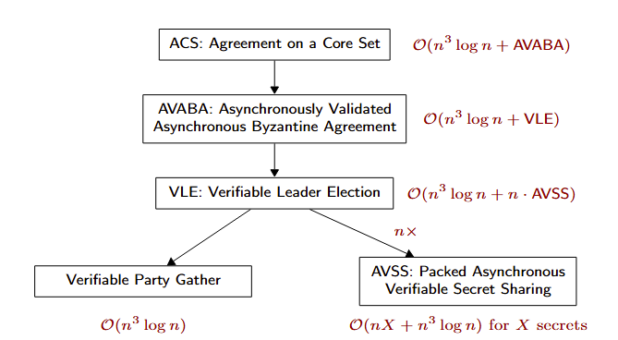
Asynchronously Validated Asynchronous Byzantine Agreement (AVABA)
Multivalued consensus
Based on No Waitin’ Hotstuff [AJMMS‘23]
Asynchronous external validity
Information-theoretic parallel of external validity
Similar to BKR’s dynamic predicate
Secure when $n>3t$ given leader-election

Slide 11
Thank You!

