Slide 1
Towards general-purpose program obfuscation via local mixing
Ran Canetti Claudio Chamon Eduardo Mucciolo Andrei Ruckenstein
BU CS BU Physics UCF Physics BU Physics
TCC’24 presentation

Slide 2
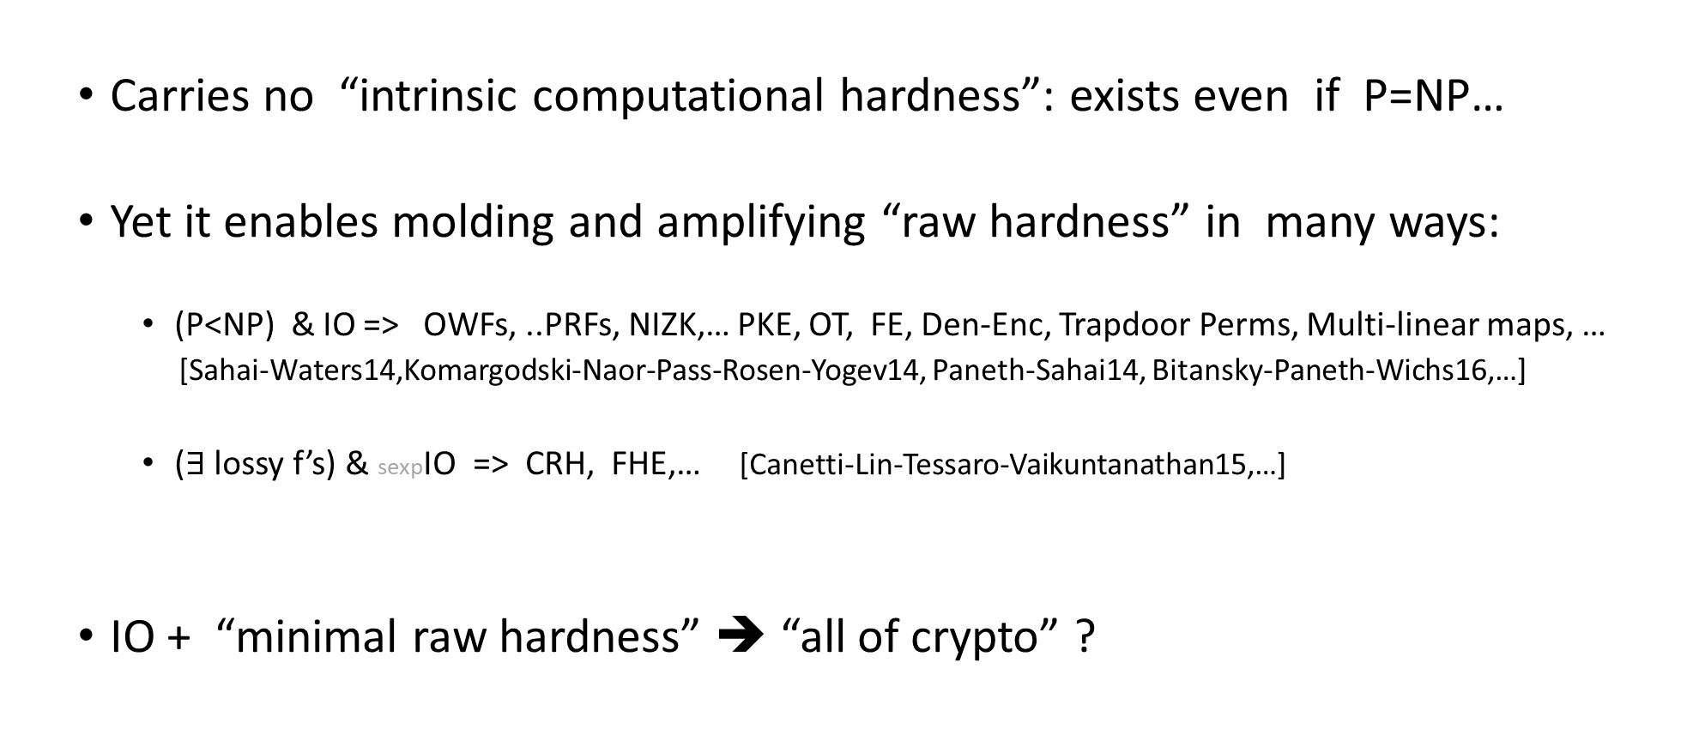
Indistinguishability Obfuscation is an intriguing beast…
[Barak-Goldreich-
Impagliazzo-Rudich-
Sahai-Vadhan-Yang01]
  Carries no “intrinsic computational hardness”: exists even if P=NP…
  Yet it enables molding and amplifying “raw hardness” in many ways:
    (P<NP) & IO => OWFs, ..PRFs, NIZK,… PKE, OT, FE, Den-Enc, Trapdoor Perms, Multi-linear maps, …
    [Sahai-Waters14,Komargodski-Naor-Pass-Rosen-Yogev14, Paneth-Sahai14, Bitansky-Paneth-Wichs16,…]
    ($∃$ lossy f’s) & sexpIO => CRH, FHE,… [Canetti-Lin-Tessaro-Vaikuntanathan15,…]
  IO + “minimal raw hardness” ➔ “all of crypto” ?

Slide 3
Constructing IO
  Known constructions are amazing feats
  [Garg-Gentry-Halevi-Raykova-Sahai-Waters13,…,Jain-Lin-Sahai20,21,…,Ragavan-Vafa-Vaikutanathan24]
  But:
    use highly structured primitives (Multi-linear maps, Evasive LWE, LPN, …)
    have high overhead
    are complex (“roundabout”?)

Slide 4
  Can IO be constructed “from first principles”?
    This work: an attempt at a “first principles” approach.

Slide 5
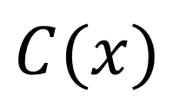

The basic idea: iteratively rerandomize small program segments.
For circuits:
$$x$$
$$C(x)$$
-Pick a circuit segment with O(1) gates
-Replace by a “sufficiently random” functionally equivalent circuit
-Repeat

Slide 6

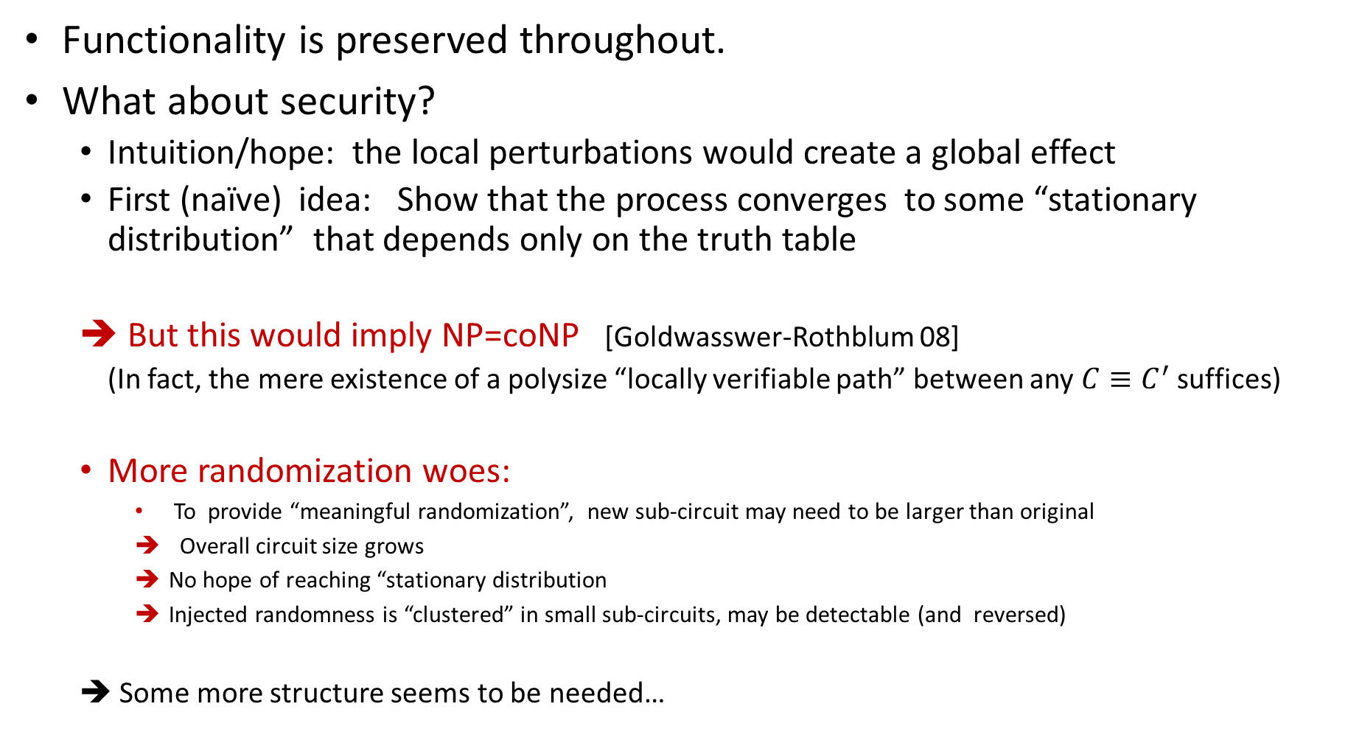

Towards analysis
$$x$$
$$C(x)$$
Functionality is preserved throughout.
What about security?
  Intuition/hope: the local perturbations would create a global effect
  First (naïve) idea: Show that the process converges to some “stationary distribution” that depends only on the truth table
  ➔ But this would imply NP=coNP [Goldwasswer-Rothblum 08]
  (In fact, the mere existence of a polysize “locally verifiable path” between any $C≡C^{′}$ suffices)
  More randomization woes:
    To provide “meaningful randomization”, new sub-circuit may need to be larger than original
    Overall circuit size grows
    No hope of reaching “stationary distribution
    Injected randomness is “clustered” in small sub-circuits, may be detectable (and reversed)
  ➔ Some more structure seems to be needed…

Slide 7
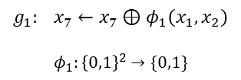


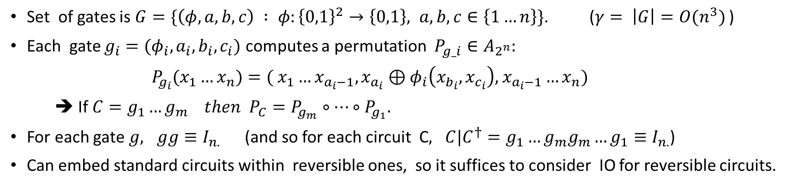





Reversible circuits to the rescue!
$x_{1}$
$x_{2}$
$$n$$
. . .
. . .
$x_{7}$
$$g_{1}$$
$$g_{2}$$
$$g_{m}$$
$$g_{1}: x_{7}←x_{7}⊕φ_{1}\left(x_{1},x_{2}\right)$$
$$φ_{1}:{\left\{0,1\right\}}^{2}→\{0,1\}$$
Set of gates is $G=\{\left(φ,a,b,c\right) : φ:{\left\{0,1\right\}}^{2}→\left\{0,1\right\}, a,b,c∈\left\{1…n\right\}\}$. ($γ= \left|G\right|=O(n^{3})$ )
Each gate $g_{i}=(φ_{i},a_{i}, b_{i}, c_{i})$ computes a permutation ${P_{g_i}∈A}_{2^{n}}:$
${P_{g_{i}}(x}_{1}…x_{n})=( x_{1}…x_{a_{i}−1},x_{a_{i}}⊕φ_{i}\left(x_{b_{i}},x_{c_{i}}\right),$ $x_{a_{i}−1}…x_{n})$
➔ If $C=g_{1}…g_{m} then$ $P_{C}=P_{g_{m}}∘…∘P_{g_{1}}.$
For each gate $g, gg≡I_{n.}$ (and so for each circuit C$, C|C^{†}=g_{1}…g_{m}g_{m}…g_{1}≡I_{n.}$)
Can embed standard circuits within reversible ones, so it suffices to consider IO for reversible circuits.

Slide 8


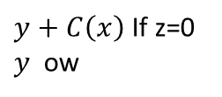
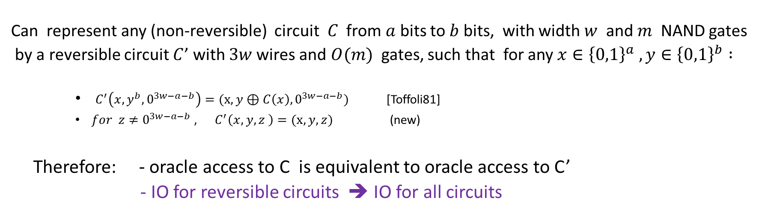





Can embed general circuits within reversible ones:
$$x$$
$$x$$
➔
$y+C\left(x\right)$If z=0
$y$ ow
$$x$$
$$C(x)$$
$$y$$
$$z$$
$$z$$
Can represent any (non-reversible) circuit $C$ from $a$ bits to $b$ bits, with width $w$ and $m$ NAND gates
by a reversible circuit $C$’ with $3w$wires and $O(m)$ gates, such that for any $x∈{\left\{0,1\right\}}^{a} ,y∈{\left\{0,1\right\}}^{b} :$
    $C^{′}\left(x,y^{b},0^{3w−a−b}\right)=(x,y⊕C\left(x\right),0^{3w−a−b})$ [Toffoli81]
    $for z≠0^{3w−a−b} , C^{′}\left(x,y,z \right)=(x,y,z)$ (new)
Therefore: - oracle access to C is equivalent to oracle access to C’
- IO for reversible circuits ➔ IO for all circuits

Slide 9
Why reversible circuits?
- The reversible model gives less protections than the standard circuit model:
- Information is never lost or duplicated (no “fanout”)
- All internal states are computable from the output
- Random reversible circuits have some appealing properties!

Slide 10
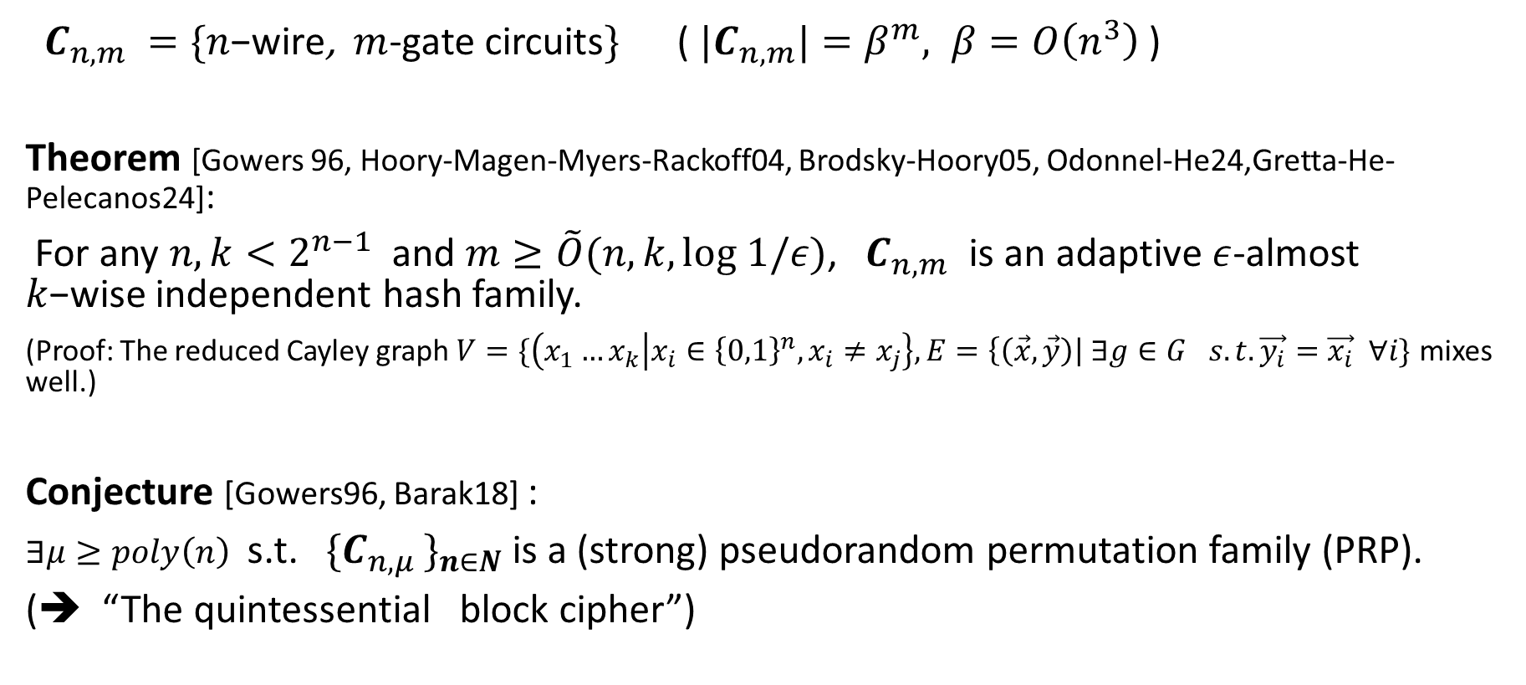
Property 1:
Random reversible circuits are almost k-wise independent
Pseudorandom
${ C}_{n,m }=\{n\text{−}\text{wire}$, $m$-gate circuits$\}$ ( ${|C}_{n,m}|=β^{m}, β=O\left(n^{3}\right)$ )
Theorem [Gowers 96, Hoory-Magen-Myers-Rackoff04, Brodsky-Hoory05, Odonnel-He24,Gretta-He-Pelecanos24]:
For any $n,k<2^{n−1}$ and $m≥\tilde{O}(n,k,log 1/ε)$,${ C}_{n,m }$is an adaptive $ε$-almost $k\text{−}\text{wise}$independent hash family.
(Proof: The reduced Cayley graph $V=\{\left(x_{1}…x_{k} | x_{i}∈{\left\{0,1\right\}}^{n},x_{i}≠x_{j}\right\}, E=\left\{\left(\vec{x},\vec{y}\right)\right| ∃g∈G_{}s.t. \vec{y_{i}}=\vec{x_{i}} ∀i\}$ mixes well.)
Conjecture [Gowers96, Barak18] :
$∃μ≥poly\left(n\right)$ s.t. ${ \{C}_{n,μ }\}_{n∈N}$ is a (strong) pseudorandom permutation family (PRP).
(➔ “The quintessential block cipher”)

Slide 11




Property 2:
“white box pseudorandomness” of reversible circuits
$C∈C_{n,m}$
$$\hat{C}←_{\$} E_{C,mμ}$$
$$≈_{c}$$
$$R←C_{n,μ} \hat{C}←_{\$} E_{R^{−1}C,(m−1)μ}$$
Split Circuit Pseudorandomness (SCP) assumption (simplified)

Slide 12
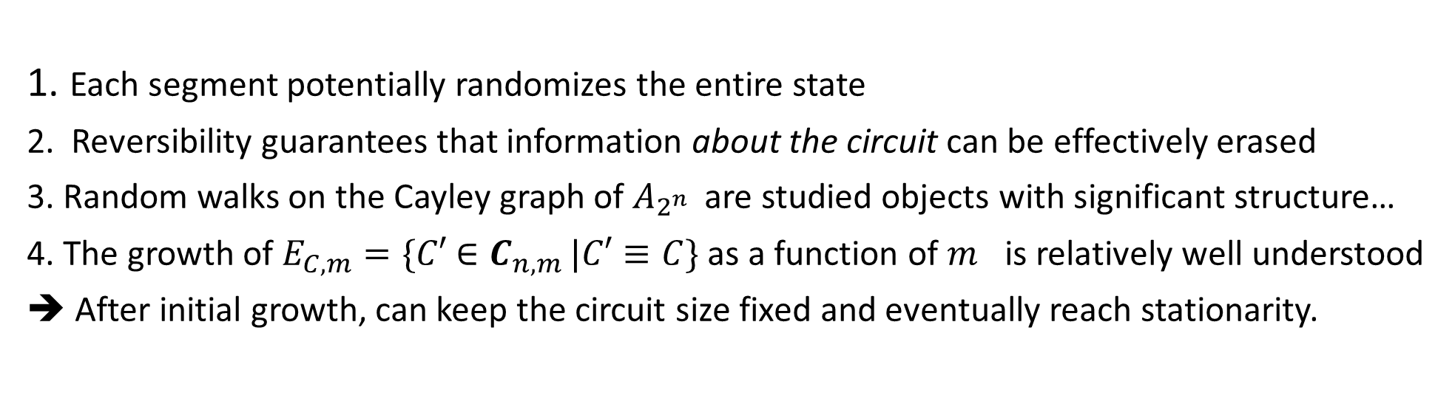


Property 3: Potential rerandomizability of RRC’s
$x_{1}$
$x_{2}$
$$n$$
. . .
. . .
$x_{7}$
$$g_{1}$$
$$g_{2}$$
$$g_{m}$$
1. Each segment potentially randomizes the entire state
2. Reversibility guarantees that information about the circuit can be effectively erased
3. Random walks on the Cayley graph of $A_{2^{n} }$ are studied objects with significant structure…
4. The growth of $E_{C,m}=\{C′$ $∈C_{n,m}$ $|C′≡C\}$ as a function of $m_{}$is relatively well understood
➔ After initial growth, can keep the circuit size fixed and eventually reach stationarity.

Slide 13

    The candidate construction: Outline
    Define and construct Random Circuit Obfuscators (RCOs) for random reversible circuits.
    Use RCOs for random $μ$-gate circuits to construct IO for all circuits.

Slide 14
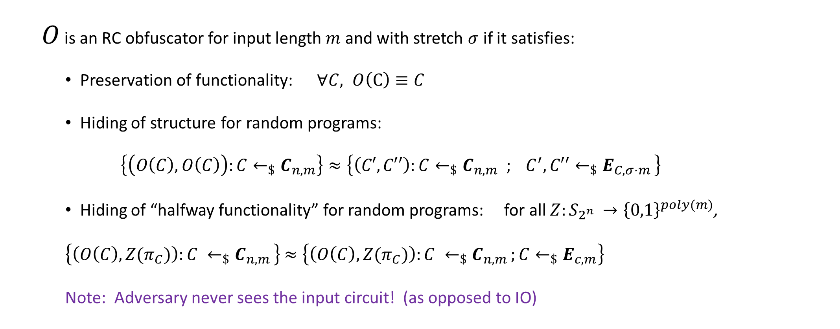
    Random Circuit Obfuscation (RCO)
  $O$ is an RC obfuscator for input length$m$and with stretch $σ$ if it satisfies:
    Preservation of functionality: $∀C, O\left(C\right)≡C$
    Hiding of structure for random programs:
    $$\left\{\left(O\left(C\right),O\left(C\right)\right):C←_{\$}C_{n,m}\right\}≈\left\{\left(C′,C′′\right):C←_{\$}C_{n,m}{ ; C}^{′},C′′←_{\$}E_{C,{σ⋅m}_{ }}\right\}$$
    Hiding of “halfway functionality” for random programs: for all $Z:S_{2^{n} }→{\left\{0,1\right\}}^{poly(m)}$,
    $\left\{\left(O\left(C\right), Z(π_{C})\right):C ←_{\$}C_{n,m }\right\}$ $≈\left\{\left(O\left(C\right),Z(π_{C})\right):C ←_{\$}C_{n,m };C←_{\$}E_{c,m}\right\}$
    Note: Adversary never sees the input circuit! (as opposed to IO)

Slide 15
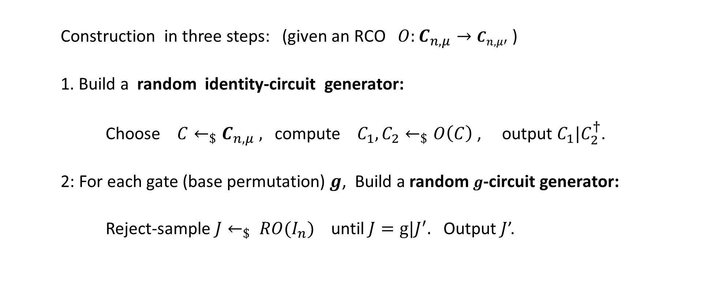
    From RCO for short circuits to IO for all circuits
    Construction in three steps: (given an RCO $O:C_{n,μ}→C_{n,μ′}$ )
    1. Build a random identity-circuit generator:
    Choose $C←_{\$}C_{n,μ} ,$ compute ${ C}_{1},C_{2}←_{\$}O\left(C\right)$ , output $C_{1}|C_{2}^{†}$.
    2: For each gate (base permutation) $g$, Build a random $g$-circuit generator:
    Reject-sample $J←_{\$} RO(I_{n})$ until $J=g|J^{′}.$ Output $J$’.

Slide 16









    From RCO for short circuits to IO for all circuits
    3. Given a circuit $C=g_{1}…g_{m}$:
    (a) Sample a random $g_{i }$-circuit for each $i:$
    …
    (b) Solder each two adjacent blocks:
  - Secure under the SCP assumption.
$$g_{1}$$
$$g_{2}$$
$$g_{m}$$
$$g_{i}$$
$g_{i+1}$
$$RCO$$

Slide 17
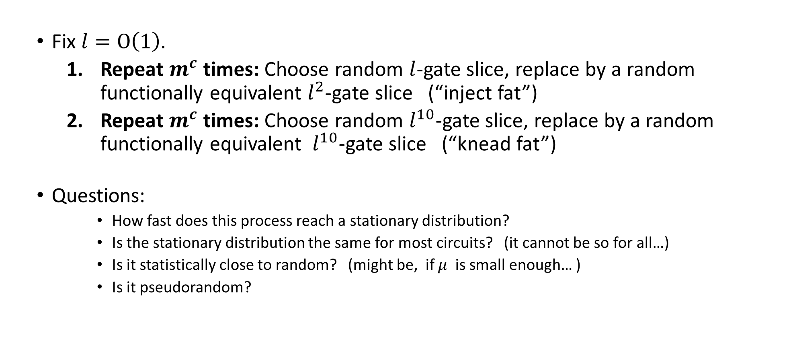
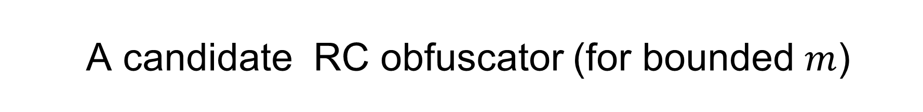
    A candidate RC obfuscator (for bounded $m$)
  Fix $l=O\left(1\right).$
    Repeat $m^{c}$ times: Choose random $l$-gate slice, replace by a random functionally equivalent $l^{2}$-gate slice (“inject fat”)
    Repeat $m^{c}$ times: Choose random $l^{10}$-gate slice, replace by a random functionally equivalent $l^{10}$-gate slice (“knead fat”)
  Questions:
      How fast does this process reach a stationary distribution?
      Is the stationary distribution the same for most circuits? (it cannot be so for all…)
      Is it statistically close to random? (might be, if $μ$ is small enough… )
      Is it pseudorandom?

Slide 18
Additional open questions / future directions
Can we use presentation theory to analyze local mixing?
  The word problem: How to generate /enumerate/ sample Identity circuits
  Sampling identity circuits seems closely related to randomizing a circuit
Better understand the black+white box pseudorandomness of RRC’s
  Connection between SCP and K-complexity? MCSP?
  Can we show that RRC’s are “universal PRPs”?
How about other animals in the crypto zoo?
  OWFs from RRC’s? CRHs from RRC’s? PKE? FHE?
  (Chamon-Mucciolo-Ruckenstein23 propose FHE candidates)
How about Quantum mixing of classical circuits?
- How about mixing of quantum circuits?

