Slide 1
Secret Sharing for High Slices
1
1
1
0
0
0
Amos Beimel*, Oriol Farràs**, Or Lasri*, Oded Nir
Ben-Gurion University of the Negev* Universitat Rovira i Virgili** Tel Aviv University
TCC 2024

Slide 2


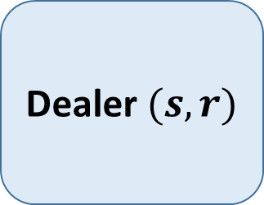






Secret Sharing Schemes [Shamir 79, Blakley 79, ItoSaiNish87]
$$n parties$$
A randomized dealer shares a secret $s$ by sending one message to every party.
$$s_{1}$$
$$s_{2}$$
Dealer $(s,r)$
$$s_{3}$$
$$s_{4}$$
$$s_{5}$$
$$s_{6}$$

Slide 3
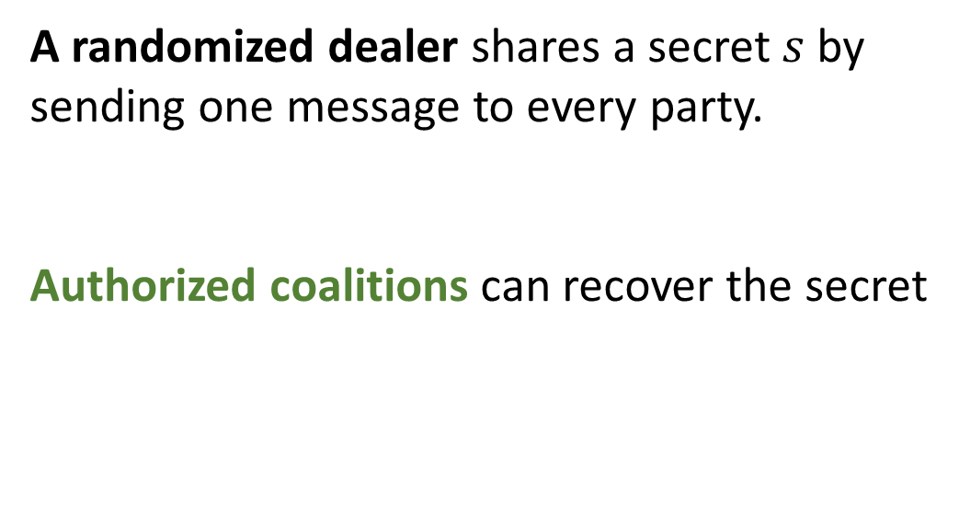
Secret Sharing Schemes [Shamir 79, Blakley 79, ItoSaiNish87]
$$n parties$$
A randomized dealer shares a secret $s$ by sending one message to every party.
Authorized coalitions can recover the secret
$$s_{1}$$
$$s_{2}$$
Dealer $(s,r)$
$$s_{3}$$
$$s_{4}$$
$$s_{5}$$
$$s_{6}$$

Slide 4
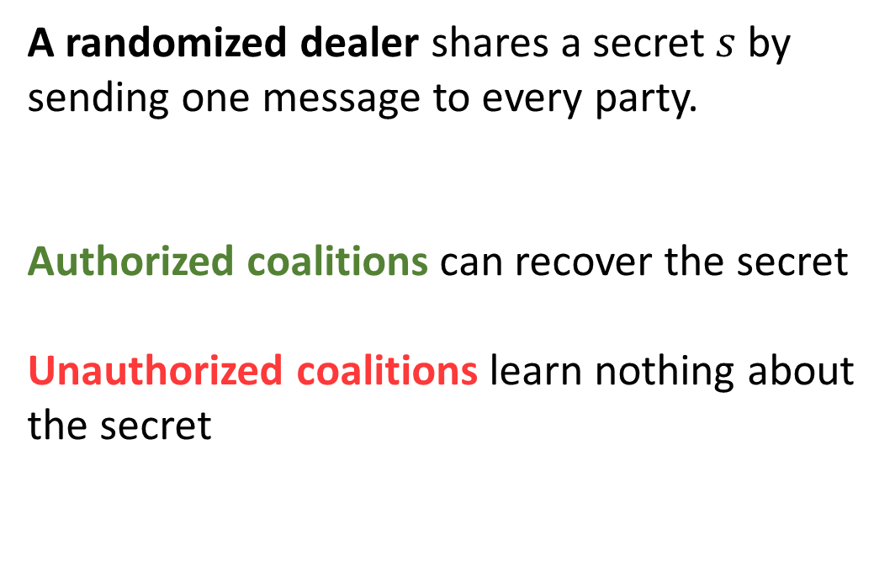
Secret Sharing Schemes [Shamir 79, Blakley 79, ItoSaiNish87]
$$n parties$$
A randomized dealer shares a secret $s$ by sending one message to every party.
Authorized coalitions can recover the secret
Unauthorized coalitions learn nothing about the secret
$$s_{1}$$
$$s_{2}$$
Dealer $(s,r)$
$$s_{3}$$
$$s_{4}$$
$$s_{5}$$
$$s_{6}$$

Slide 5
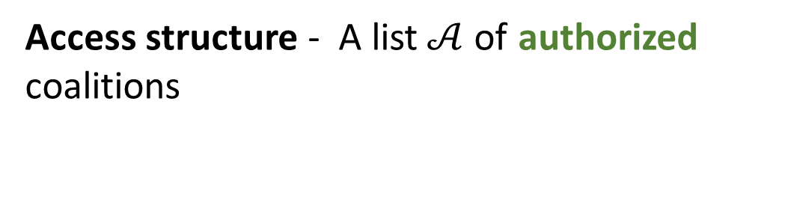
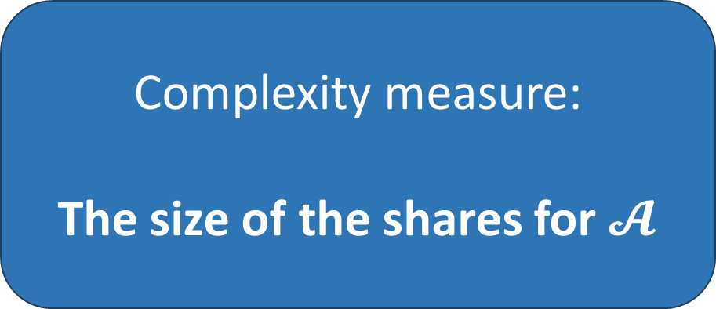
Secret Sharing Schemes [Shamir 79, Blakley 79, ItoSaiNish87]
$$n parties$$
Access structure - A list$𝒜$of authorized coalitions
$$s_{1}$$
$$s_{2}$$
Dealer $(s,r)$
Complexity measure:
The size of the shares for $𝓐$
$$s_{3}$$
$$s_{4}$$
$$s_{5}$$
$$s_{6}$$

Slide 6
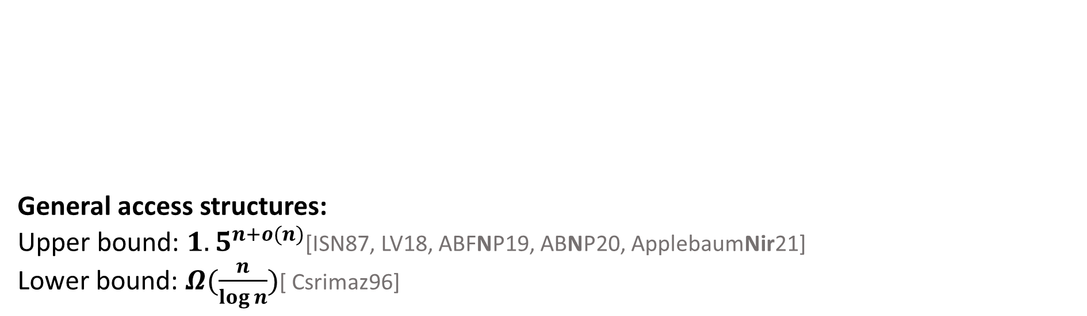
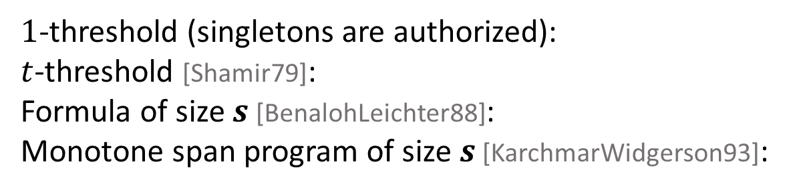
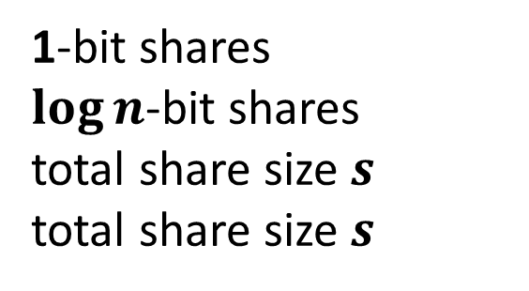
Different Share Size for Different Access Structures
Assume we deal with 1-bit secrets
General access structures:
Upper bound: ${1.5}^{n+o(n)}$[ISN87, LV18, ABFNP19, ABNP20, ApplebaumNir21]
Lower bound: $Ω(\frac{n}{\log{n}})$[ Csrimaz96]
$1$-threshold (singletons are authorized):
$t$-threshold [Shamir79]:
Formula of size $s$ [BenalohLeichter88]:
Monotone span program of size $s$ [KarchmarWidgerson93]:
1-bit shares
$\log{n}$-bit shares
total share size $s$
total share size $s$
Open Problems:
1. Share Size of General Access Structures?
2. Natural Access Structures with “Small” Shares?

Slide 7
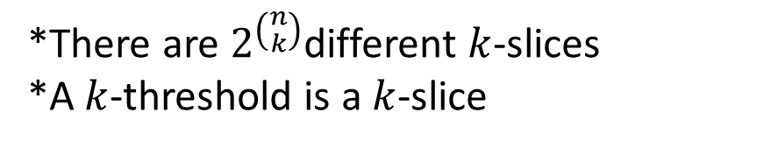
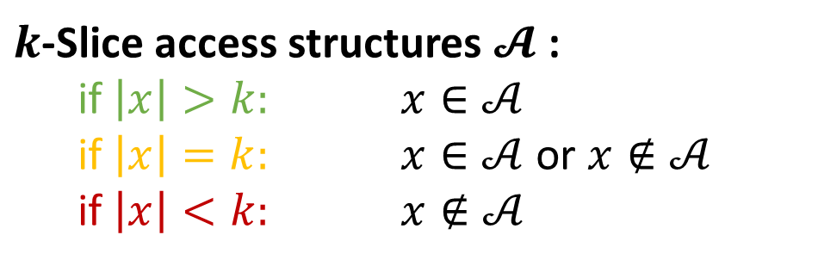



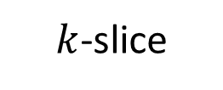
Slice Access Structures
set-size
$$n$$
1
$k$-Slice access structures $𝓐$:
  if $\left|x\right|>k:$ $x∈𝒜$
  if $\left|x\right|=k:$ $x∈𝒜$ or $x∉𝒜$
  if $\left|x\right|<k:$ $x∉𝒜$
$$k$$
0
*There are $2^{\left({n \atop k}\right)}$different $k$-slices
*A $k$-threshold is a $k$-slice
$$1$$
$k$-slice
The upper bound for general access structures is achieved by
composing slice access structures!
*Connections to ABE and symmetric PIR

Slide 8

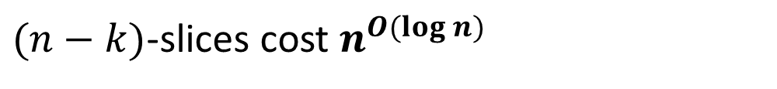
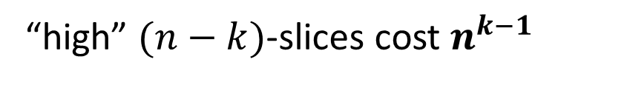
Share Size of Slice Access Structures
…, $2^{O\left(k\right)+\tilde{O}\left(\sqrt{k\log{n} }\right)}, \left({n−1 \atop k−1}\right)$
Share size for $k$-slices[LV18, AA18, ABFNP19]:
For $k=O(1):$
“low" $k$-slices cost $n^{o\left(1\right)}$
For $k=log n:$
$k$-slices cost $n^{O(\log{\log{n}}{)}}$
“high” $(n−k)$-slices cost $n^{k−1 }$
1
1
0
0
$(n−k)$-slices cost $n^{O(\log{n})}$
Improve schemes for high slices?
Asymmetry: Low slices are cheaper than high slices
Can it help realize larger families of access structures?

Slide 9
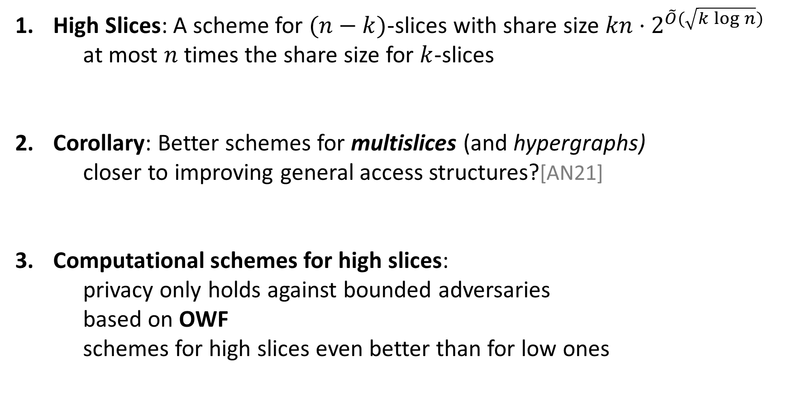
Our Results
1
High Slices: A scheme for $(n−k)$-slices with share size ${kn⋅2}^{\tilde{O}(\sqrt{k\log{n}})}$
at most $n$ times the share size for $k$-slices
Corollary: Better schemes for multislices (and hypergraphs)
closer to improving general access structures?[AN21]
Computational schemes for high slices:
  privacy only holds against bounded adversaries
  based on OWF
  schemes for high slices even better than for low ones
0
1
0
1
0

Slide 10
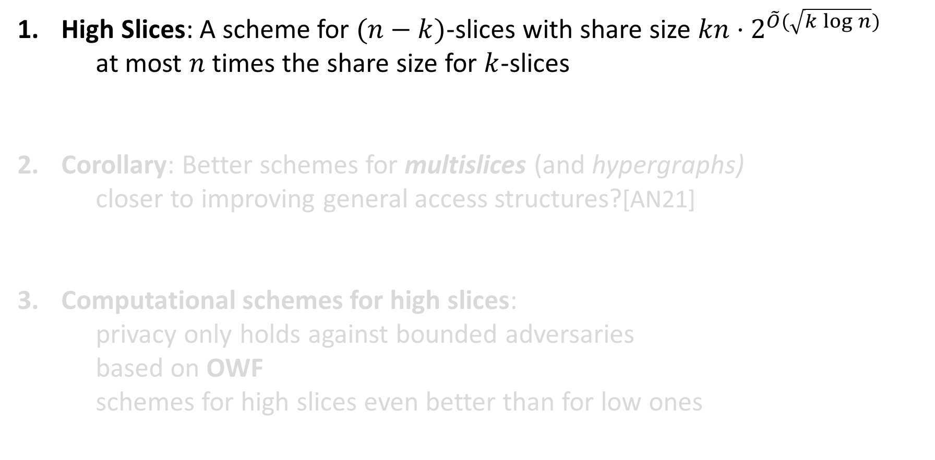
Our Results
1
High Slices: A scheme for $(n−k)$-slices with share size ${kn⋅2}^{\tilde{O}(\sqrt{k\log{n}})}$
at most $n$ times the share size for $k$-slices
Corollary: Better schemes for multislices (and hypergraphs)
closer to improving general access structures?[AN21]
Computational schemes for high slices:
  privacy only holds against bounded adversaries
  based on OWF
  schemes for high slices even better than for low ones
0
1
0
1
0

Slide 11





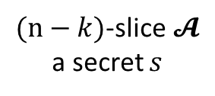
1. A Perfect (Simple) Scheme for High Slices
$(n−k)$-slice$𝓐$
a secret $s$
The scheme:
Denote by $𝓑$the $k$-slice that for every set $x$ of size $k$ satisfies$:$
$$x∈𝓑⟺\overline{x}∈𝓐$$
1
0
$$\overline{x}$$
$k$-slice $𝓑$
$(n−k)$-slice $𝓐$
$$x$$
Notes:
We have a more efficient construction

Slide 12
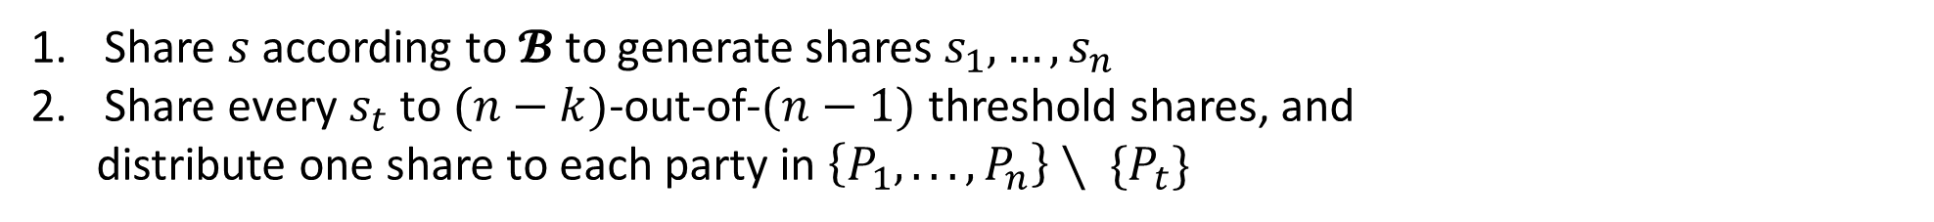

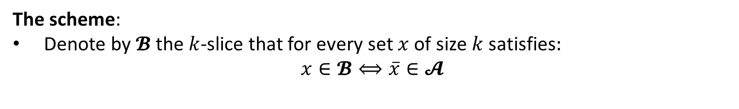
1. A Perfect (Simple) Scheme for High Slices
$(n−k)$-slice$𝓐$
a secret $s$
The scheme:
Denote by $𝓑$the $k$-slice that for every set $x$ of size $k$ satisfies$:$
$$x∈𝓑⟺\overline{x}∈𝓐$$
1
0
$$\overline{x}$$
$k$-slice $𝓑$
$$s_{1}$$
$(n−k)$-slice $𝓐$
$$x$$
Share $s$ according to $𝓑$ to generate shares $s_{1}, …,s_{n}$
Share every $s_{t}$ to $(n−k)$-out-of-$(n−1)$ threshold shares, and
distribute one share to each party in $\left\{P_{1}, . . . , P_{n}\right\}∖ \{P_{t}\}$

Slide 13



1. A Perfect (Simple) Scheme for High Slices
$(n−k)$-slice$𝓐$
a secret $s$
The scheme:
Denote by $𝓑$the $k$-slice that for every set $x$ of size $k$ satisfies$:$
$$x∈𝓑⟺\overline{x}∈𝓐$$
1
0
$$\overline{x}$$
$k$-slice $𝓑$
$$s_{1}$$
$$s_{2}$$
$(n−k)$-slice $𝓐$
$$x$$
Share $s$ according to $𝓑$ to generate shares $s_{1}, …,s_{n}$
Share every $s_{t}$ to $(n−k)$-out-of-$(n−1)$ threshold shares, and
distribute one share to each party in $\left\{P_{1}, . . . , P_{n}\right\}∖ \{P_{t}\}$

Slide 14
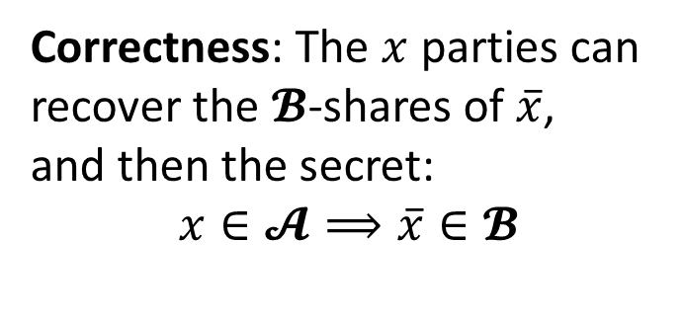
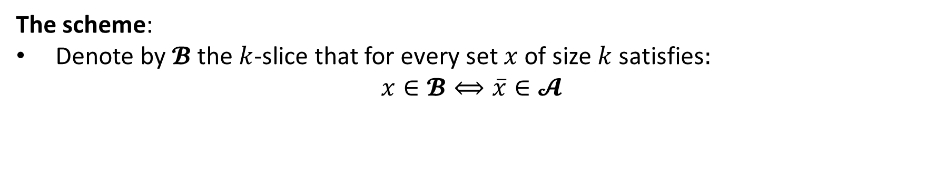


1. A Perfect (Simple) Scheme for High Slices
$(n−k)$-slice$𝓐$
a secret $s$
The scheme:
Denote by $𝓑$the $k$-slice that for every set $x$ of size $k$ satisfies$:$
$$x∈𝓑⟺\overline{x}∈𝓐$$
1
0
$$\overline{x}$$
$k$-slice $𝓑$
$$s_{1}$$
$$s_{2}$$
$$s_{3}$$
Correctness: The $x$ parties can recover the $𝓑$-shares of $\overline{x}$,
and then the secret:
$x∈𝓐⟹\overline{x}∈𝓑$
$(n−k)$-slice $𝓐$
$$x$$
Share $s$ according to $𝓑$ to generate shares $s_{1}, …,s_{n}$
Share every $s_{t}$ to $(n−k)$-out-of-$(n−1)$ threshold shares, and
distribute one share to each party in $\left\{P_{1}, . . . , P_{n}\right\}∖ \{P_{t}\}$

Slide 15

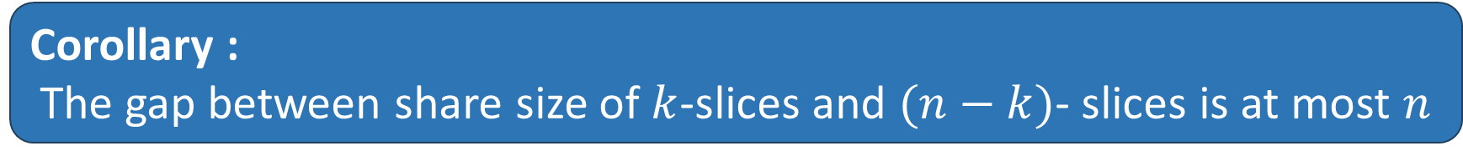
1. A Perfect (Simple) Scheme for High Slices
Share size of $k$-slices is $T\left(n\right)$
$$⇓$$
Share size of $(n−k)$-slices is $n⋅T\left(n\right)$
Corollary :
The gap between share size of $k$-slices and $(n−k)$- slices is at most $n$
1
1
Connections to duality and secret sharing[Csirmaz20, AN21, Bogdanov23]
Is there a gap between share sizes of dual access structures?
0
0

Slide 16
Open Questions
Better Perfect Schemes for General Access Structures?
  via more improvements to slices/multislices
Better Computational Schemes for More Access Structures from OWFs?
Duality and Secret Sharing
  More positive results?
  Separations?

Slide 18
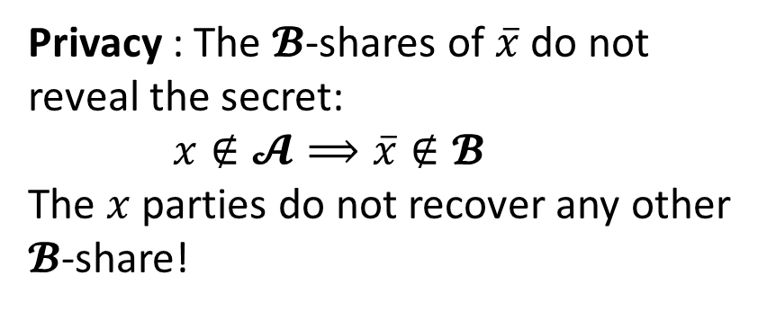
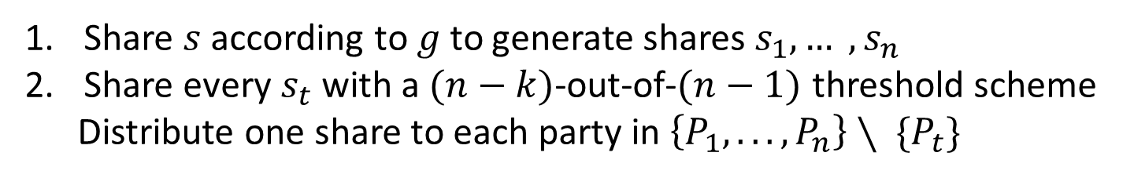
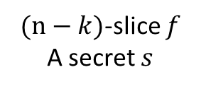

1. A Perfect (Simple) Scheme for High Slices
$(n−k)$-slice $f$
A secret $s$
The scheme:
Denote by $𝓑$the $k$-slice that for every set $x$ of size $k$ satisfies$:$
$$x∈𝓑⟺\overline{x}∈𝓐$$
1
0
$$\overline{x}$$
$k$-slice $𝓑$
Privacy : The $𝓑$-shares of $\overline{x}$do not reveal the secret:
$x∉𝓐⟹\overline{x}∉𝓑$
The $x$ parties do not recover any other $𝓑$-share!
$(n−k)$-slice $𝓐$
$$x$$
Share $s$ according to $g$ to generate shares $s_{1}, … ,s_{n}$
Share every $s_{t}$ with a $(n−k)$-out-of-$(n−1)$ threshold scheme
Distribute one share to each party in $\left\{P_{1}, . . . , P_{n}\right\}∖ \{P_{t}\}$

Slide 19

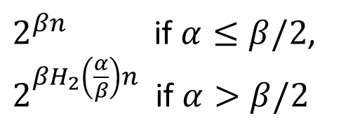
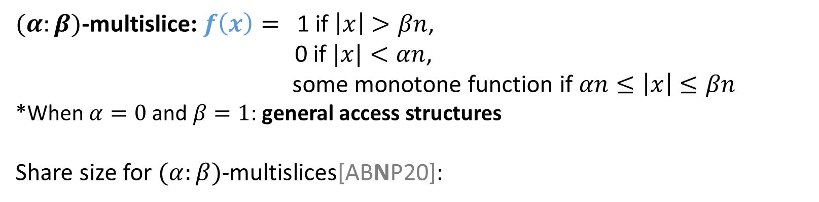
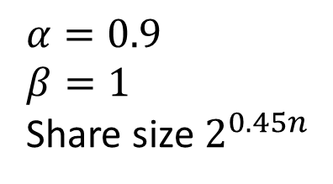
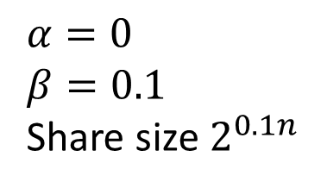

2. Schemes for MultiSlices
$(α:β)$-multislice: $f\left(x\right)=$ 1 if $\left|x\right|>βn$,
0 if $|x|<αn$,
some monotone function if $αn≤\left|x\right|≤βn$
*When $α=0$ and $β=1$: general access structures
Share size for $(α:β)$-multislices[ABNP20]:
1
$βn$-subsets
$αn$-subsets
0
$2^{βn}$ if $α≤β/2$,
$2^{{βH}_{2}\left(\frac{α}{β}\right)n}$ if $α>β/2$
1
0
$$α=0$$
$$β=0.1$$
Share size $2^{0.1n}$
$$α=0.9$$
$$β=1$$
Share size $2^{0.45n}$
To the Rescue: Schemes for high slices
Asymmetry: Low multislices are cheaper than high multislices

Slide 20



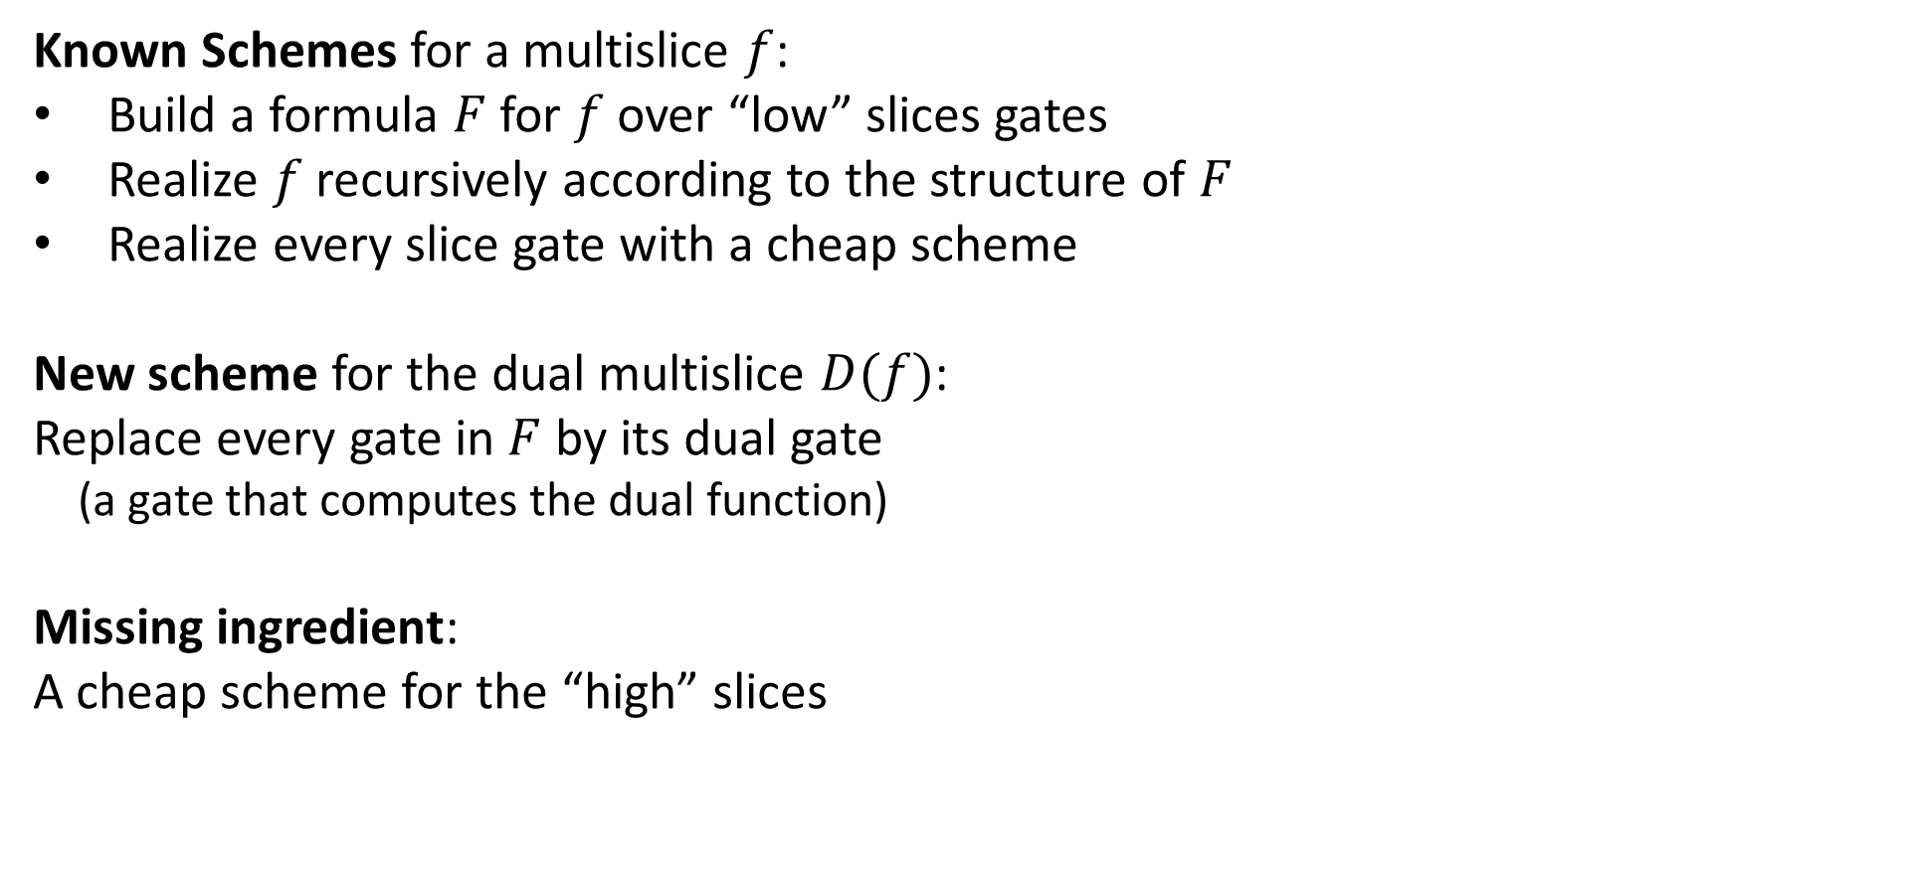












2. Schemes for MultiSlices
Known Schemes for a multislice $f$:
Build a formula $F$ for $f$over “low” slices gates
Realize $f$ recursively according to the structure of $F$
Realize every slice gate with a cheap scheme
New scheme for the dual multislice $D(f)$:
Replace every gate in $F$ by its dual gate
(a gate that computes the dual function)
Missing ingredient:
A cheap scheme for the “high” slices
$$f(x)$$
$$⋁$$
$$∧$$
$. . .$
$$∧$$
$. . .$
$$∧$$
$. . .$
$. . .$
$. . .$
$$⋁$$
$$⋁$$
$$⋁$$
$. . .$
$. . .$

Slide 21
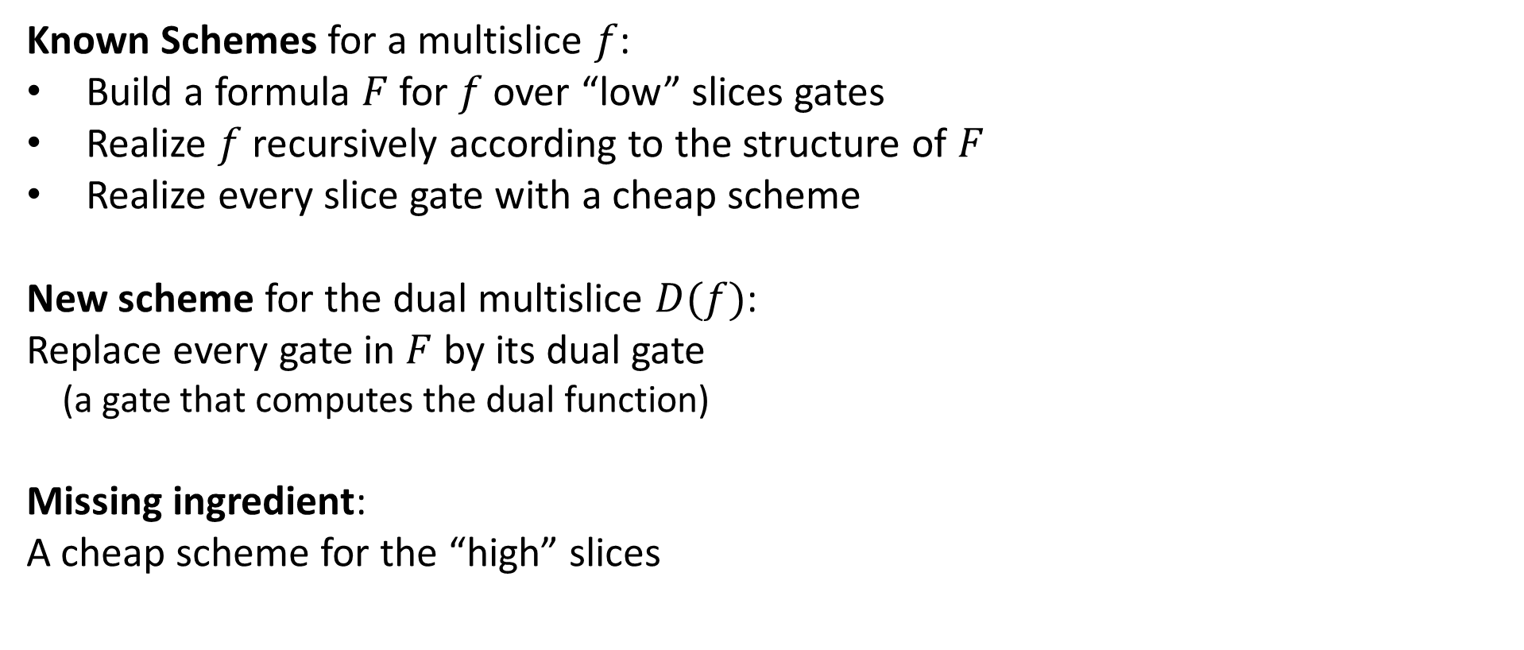

2. Schemes for MultiSlices
Known Schemes for a multislice $f$:
Build a formula $F$ for $f$over “low” slices gates
Realize $f$ recursively according to the structure of $F$
Realize every slice gate with a cheap scheme
New scheme for the dual multislice $D(f)$:
Replace every gate in $F$ by its dual gate
(a gate that computes the dual function)
Missing ingredient:
A cheap scheme for the “high” slices
Result: Same share size for $\left(α,β\right)$-multislices and
$\left(1−β,1−α\right)$-multislices
Solves an open problem from [AN21]

Slide 22

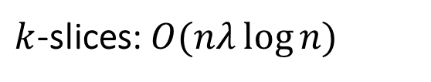
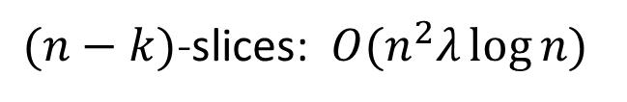
3. Computational Schemes for Slices
Computational schemes:
privacy only holds against bounded adversaries, based on OWF
Share size for $k$-slices[AK18, ABFNP19, ABIKLV23] (e.g., when $k$is constant):
Our result for $(n−k)$-slices: $O\left(λ\log{n}\right)$
$k$-slices:$O(nλ\log{n)}$
$(n−k)$-slices: $O(n^{2}λ\log{n)}$
1
1
0
0
Notes:
General expression: $min\left\{kn,2^{O\left(k\right)}\right\}⋅λ\log{n}$, we get n-k slices for $O\left(k^{2}λ\log{n}\right)$

Slide 23
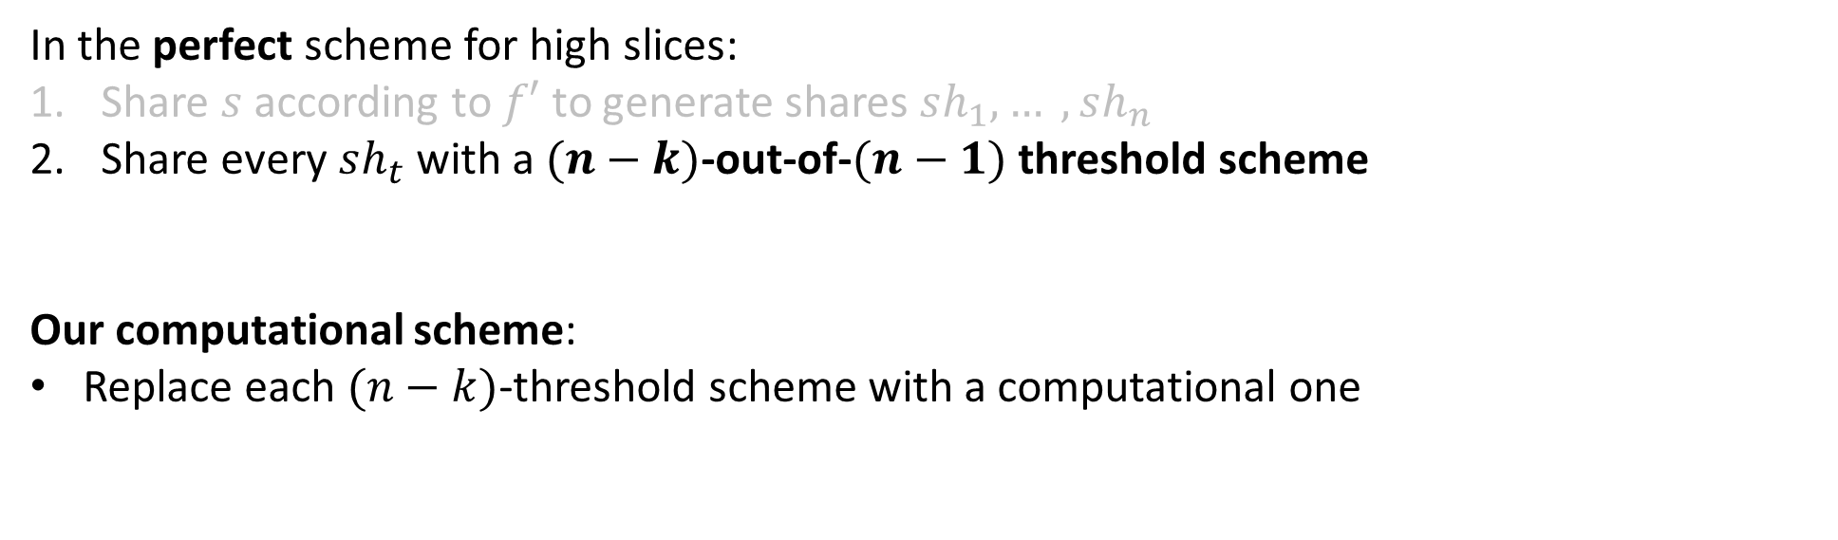
3. Computational Schemes for Slices
In the perfect scheme for high slices:
Share $s$ according to $f′$ to generate shares $sh_{1}, … ,sh_{n}$
Share every $sh_{t}$ with a $(n−k)$-out-of-$(n−1)$ threshold scheme
Our computational scheme:
Replace each $(n−k)$-threshold scheme with a computational one
Key idea: It is possible to run many high threshold (Shamir) schemes with a small overhead

