Slide 1
Rate-1 Zero-Knowledge Proofs from One-way Functions
Noor Athamnah, Eden Florentz – Konopnicki, Ron D. Rothblum

Slide 2
Communication complexity of zero-knowledge proofs:
How low can you go?

Slide 3
Zero-Knowledge Proofs
Succinct Zero-Knowledge
Introduced in 1982 [GMR]
Notes:
GMW = goldreich, micali, widgerson

Slide 4
Zero-Knowledge Proofs
Succinct Zero-Knowledge
Introduced in 1982 [GMR]
NP ⊆ZK in 1986 [GMW]
Notes:
GMW = goldreich, micali, widgerson

Slide 5
Zero-Knowledge Proofs
Succinct Zero-Knowledge
Introduced in 1982 [GMR]
NP ⊆ZK in 1986 [GMW]
Relies on one-way functions.

Slide 6
Zero-Knowledge Proofs
Succinct Zero-Knowledge
Introduced in 1982 [GMR]
NP ⊆ZK in 1986 [GMW]
Relies on one-way functions.
Through a zero-knowledge proof for 3-coloring
Notes:
Then through reduction to all NP

Slide 7
Zero-Knowledge Proofs
Succinct Zero-Knowledge
Introduced in 1982 [GMR]
NP ⊆ZK in 1986 [GMW]
Relies on one-way functions.
Through a zero-knowledge proof for 3-coloring
For a soundness error of $ε$, communication complexity is: $\text{poly}(λ)⋅|V|⋅|E|⋅log(1/ε)$
$λ$ security parameter

Slide 8
Zero-Knowledge Proofs
Succinct Zero-Knowledge
Introduced in 1982 [GMR]
NP ⊆ZK in 1986 [GMW]
Relies on one-way functions.
For general NP languages - polynomial in verification circuit.
Notes:
For general NP done through karp reduction to 3 coloring, then even more complexity complexity
NP witness here is just c|V|

Slide 9
Communication
Complexity
$n$ - input size
$m$ - witness size.
$λ$ - security parameter
Upper bound
$\text{p}\text{oly}$(verification circuit). [GMW]

Slide 10
Communication
Complexity
$n$ - input size
$m$ - witness size.
$λ$ - security parameter
Upper bound
$\text{poly}$(verification circuit). [GMW]
Lower bound
$m$ [GH98, GVW02]

Slide 11
Communication
Complexity
$n$ - input size
$m$ - witness size.
$λ$ - security parameter
Upper bound
$\text{poly}$(verification circuit). [GMW]
Lower bound
$m$ [GH98, GVW02]

Slide 12
Communication
Complexity
$n$ - input size
$m$ - witness size.
$λ$ - security parameter
Upper bound
Bounded Depth
$\text{poly}$(verification circuit).
Bounded Space
$\text{poly}(m)$ for large subclasses of NP [IKOS09, KR08, GKR15, RRR21, NR22, HVW23].
Lower bound
$$m$$

Slide 13
Communication
Complexity
$n$ - input size
$m$ - witness size.
$λ$ - security parameter
Bounded Depth
$\text{poly}$(verification circuit).
Bounded Space
Upper bound
$\text{poly}(m)$ for large subclasses of NP [IKOS09, KR08, GKR15, RRR21, NR22, HVW23].
Lower bound
$$m$$

Slide 14
Communication
Complexity
$n$ - input size
$m$ - witness size.
$λ$ - security parameter
$\text{poly}$(verification circuit).
Upper bound
$\text{poly}(m)$ *
$(1+γ)⋅m+n^{β}⋅\text{poly}(λ)$ (for a large subclass of NP) [NR22]
Lower bound
$$m$$
Notes:
Relies on a result for IOP’s - complex

Slide 15
Communication
Complexity
$n$ - input size
$m$ - witness size.
$λ$ - security parameter
$\text{poly}$(verification circuit).
$\text{poly}(m)$ *
Upper bound
$(1+γ)⋅m+n^{β}⋅\text{poly}(λ)$ (for a large subclass of NP) [NR22]
Lower bound
$$m$$

Slide 16
Communication
Complexity
$n$ - input size
$m$ - witness size.
$λ$ - security parameter
$\text{poly}$(verification circuit).
$\text{poly}(m)$ *
Upper bound
$(1+γ)⋅m+n^{β}⋅\text{poly}(λ)$ *
Lower bound
$$m$$
One-way function
Notes:
One way function is a necessary condition

Slide 17
Communication
Complexity
$n$ - input size
$m$ - witness size.
$λ$ - security parameter
$\text{poly}$(verification circuit).
$\text{poly}(m)$ *
Upper bound
$(1+γ)⋅m+n^{β}⋅\text{poly}(λ)$ *
Lower bound
$$m$$
Cryptographic
Assumption
One-way function

Slide 18
Communication
Complexity
$n$ - input size
$m$ - witness size.
$λ$ - security parameter
$\text{poly}$(verification circuit).
$\text{poly}(m)$ *
Upper bound
$(1+γ)⋅m+n^{β}⋅\text{poly}(λ)$ *
Lower bound
$$m$$
Cryptographic
Assumption
One-way function
FHE

Slide 19
Communication
Complexity
$n$ - input size
$m$ - witness size.
$λ$ - security parameter
$\text{poly}$(verification circuit).
$\text{poly}(m)$ *
Upper bound
$(1+γ)⋅m+n^{β}⋅\text{poly}(λ)$ *
Lower bound
$$m+\text{poly}(λ)$$ [GGI+15]
$$m$$
Cryptographic
Assumption
One-way function
FHE

Slide 20
Communication
Complexity
$n$ - input size
$m$ - witness size.
$λ$ - security parameter
$\text{poly}$(verification circuit).
$\text{poly}(m)$ *
Upper bound
$(1+γ)⋅m+n^{β}⋅\text{poly}(λ)$ *
New Result m+[…]
Lower bound
$$m+\text{poly}(λ)$$
$$m$$
Cryptographic
Assumption
One-way function
FHE

Slide 21
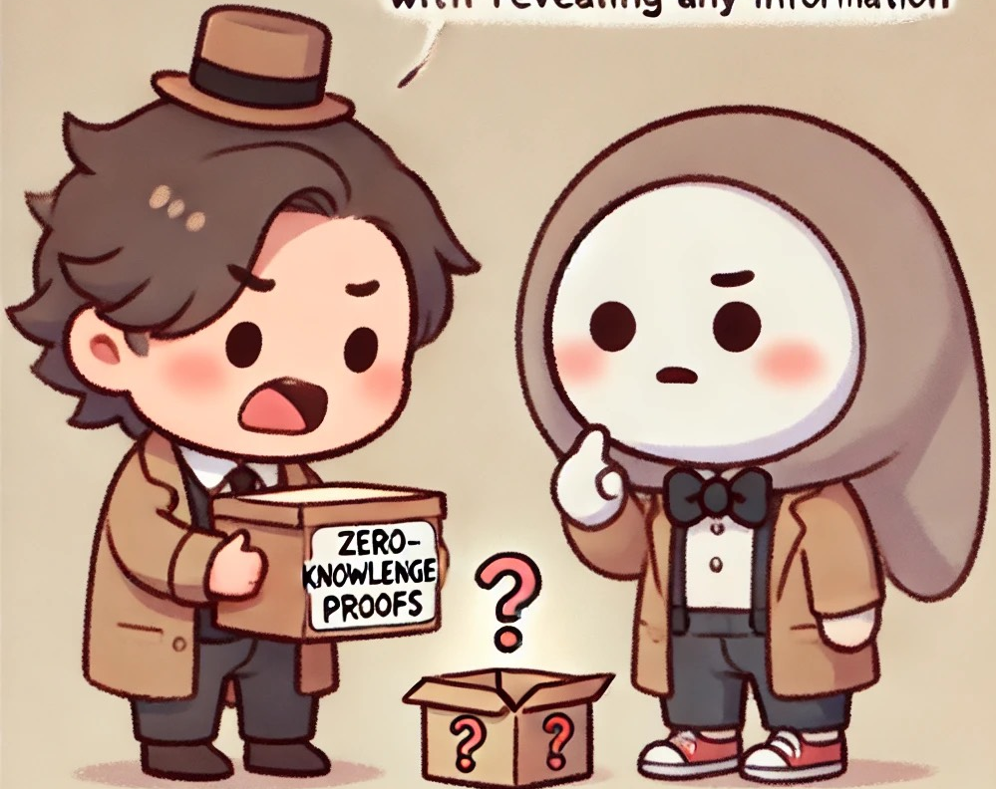
Main Results
You talk too much

Slide 22
Main Results
Assuming one-way functions.
Theorem 1+2: (Rate-1 Zero-knowledge for Bounded Depth/Space).
Theorem 3: (Black-Box Rate-1 Zero-knowledge for Bounded Depth).
Communication Complexity:
$$m+□$$

Slide 23
Main Results
$n$ - input size
$m$ - witness size.
$λ$ - security parameter
Theorem 1: (Rate-1 Zero-knowledge for Bounded Depth)
Assume: One-way functions exist.
Let $R$ be an NP relation that can be decided by a polynomial-size circuit with depth $D$.
Then, $R$ has a zero-knowledge proof with:
- communication complexity $m+\text{poly}(λ,log(m),D)$
- and soundness error $2^{−λ}$.
Notes:
Also P & V are efficient.
Soundness error - can’t amplify. (Lose hole point of additive)

Slide 24
Main Results
$n$ - input size
$m$ - witness size.
$λ$ - security parameter
Theorem 2: (Rate-1 Zero-knowledge for Bounded Space)
Assume: One-way functions exist.
Let $R$ be an NP relation that be decided by a polynomial-time and space $S$ algorithm.
Then for every $δ>0$, R has a zero-knowledge proof with:
- communication complexity $m+n^{δ}⋅\text{poly}(λ,S)$
- and soundness error $2^{−λ}$.
Notes:
Main difference is the inner protocol we will use
Also P & V are efficient.
Trade off - this has better round complexity

Slide 25
Main Results
$n$ - input size
$m$ - witness size.
$λ$ - security parameter
Theorem 3: (Black-Box Rate-1 Zero-knowledge for Bounded Depth)
Assume: One-way functions exist.
Let $R$ be an NP relation computed by circuit family C of size $S(n)$ and depth $D(n)$.
Then, for every $ε>0$, R has a zero-knowledge proof with:
- communication complexity $m+\text{poly}\left(\frac{1}{ε},λ,D,log(S)\right)$,
- soundness error $ε$
- and the prover and verifier make a black-box use of the one-way function.

Slide 26
Techniques
Theorems 1 & 2
Notes:
Based on idea for the result on FHE
Same technique first step then use something of the shelf

Slide 27
Key idea
$n$ - input size
$m$ - witness size.
$λ$ - security parameter
$$x,w$$
$$x$$
Prover
$$x\overset{?}{∈}L$$
Verifier

Slide 28
Key idea
$n$ - input size
$m$ - witness size.
$λ$ - security parameter
$$x,w$$
$$x$$
Prover
$$x\overset{?}{∈}L$$
Verifier
Want to prove $∃w:(x,w)∈R_{L}$
Notes:
Just sending w would do the job - but then no zk

Slide 29
Key idea
$n$ - input size
$m$ - witness size.
$λ$ - security parameter
$$x,w$$
$$x$$
Prover
$$x\overset{?}{∈}L$$
Verifier
Want to prove $∃w:(x,w)∈R_{L}$
$$G(s)$$
Generate random seed
$s∈\{0,1\}^{λ}$
$$G:\{0,1\}^{λ}→\{0,1\}^{m}$$
Notes:
G - PRG
Almost like random so V really still sees nothing

Slide 30
Key idea
$n$ - input size
$m$ - witness size.
$λ$ - security parameter
$$x,w$$
$$x$$
Prover
$$x\overset{?}{∈}L$$
Verifier
Want to prove $∃w:(x,w)∈R_{L}$
$$u=G(s)⊕w$$
Generate random seed
$s∈\{0,1\}^{λ}$
$$G:\{0,1\}^{λ}→\{0,1\}^{m}$$
Notes:
G - PRG
Almost like random so V really still sees nothing

Slide 31
Key idea
$n$ - input size
$m$ - witness size.
$λ$ - security parameter
$$x,w$$
$$x$$
Prover
$$x\overset{?}{∈}L$$
Verifier
Want to prove $∃w:\left(x,w\right)∈R_{L}$
$$u=G(s)⊕w$$
Generate random seed
$s∈\{0,1\}^{λ}$
Want to prove $∃s:(x,G(s)⊕u)∈R_{L}$

Slide 32
Key idea
$n$ - input size
$m$ - witness size.
$λ$ - security parameter
$$x,w$$
$$x$$
Prover
$$x\overset{?}{∈}L$$
Verifier
Want to prove $∃w:\left(x,w\right)∈R_{L}$
$$u=G(s)⊕w$$
Generate random seed
$s∈\{0,1\}^{λ}$
Want to prove $∃s:(x,G(s)⊕u)∈R_{L}$
$$R_{G}^{′}:=\left\{\left((x,u),s\right):(x,G(s)⊕u)∈R_{L}\right\}$$
$$\left((x,u),s\right)∈R_{G}^{′}⇒x∈L$$

Slide 33
Key idea
$n$ - input size
$m$ - witness size.
$λ$ - security parameter
$$x,w$$
$$x$$
Prover
$$x\overset{?}{∈}L$$
Verifier
$R$: $(x,w)∈R⇒x∈L$
$$u=G(s)⊕w$$
Generate random seed
$s∈\{0,1\}^{λ}$
$$R_{G}^{′}:=\left\{\left((x,u),s\right):(x,G(s)⊕u)∈R_{L}\right\}$$
Of-the-shelf zero knowledge proof for $R_{G}^{′}$

Slide 34
Key idea
$n$ - input size
$m$ - witness size.
$λ$ - security parameter
$$x,w$$
$$x$$
Prover
$$x\overset{?}{∈}L$$
Verifier
$R$: $(x,w)∈R⇒x∈L$
$$u=G(s)⊕w$$
Generate random seed
$s∈\{0,1\}^{λ}$
Bounded depth [GKR]
Bounded space [RRR]
+
PRG
$$R_{G}^{′}:=\left\{\left((x,u),s\right):(x,G(s)⊕u)∈R_{L}\right\}$$
$L_{G}^{′}$

Slide 35
Key idea
$n$ - input size
$m$ - witness size.
$λ$ - security parameter
$$x,w$$
$$x$$
Prover
$$x\overset{?}{∈}L$$
Verifier
$R$: $(x,w)∈R⇒x∈L$
$$u=G(s)⊕w$$
Generate random seed
$s∈\{0,1\}^{λ}$
Bounded depth [GKR]
Bounded space [RRR]
+
PRG
$$R_{G}^{′}:=\left\{\left((x,u),s\right):(x,G(s)⊕u)∈R_{L}\right\}$$
$L_{G}^{′}$
Notes:
Why not black box

Slide 36
Open Questions

Slide 37
Open Questions
Rate-1 zero-knowledge proof for all NP relations.
Negligible soundness error with black-box use of the one-way function.
Notes:
Has rate-1 for all NP from FHE, but now owf or even between
For neg, soundness there is O(|C|)+ stuff of IKOS09 - but not NP witness
Best for witness known is poly(m)+ stuff even for simple relations (NC)

