Slide 1
Compact Key Storage in the Standard Model
Yevgeniy Dodis Daniel Jost NYU NYU

Slide 2
CKS: Motivation
Cloud backup:
Users want security
But they also don’t want to lose their data
➔ Applications need to offer a secure backup solution

Slide 3
CKS: Motivation
Cloud backup:
Users want security
But they also don’t want to lose their data
➔ Applications need to offer a secure backup solution
Fine-grained E2E-security:
Applications offer end-to-end security
With forward-secrecy and post-compromise security
➔ Backup must preserve E2E-security

Slide 4
CKS: Motivation
Idea:
Many E2E-secure applications use a sequence of keys to encrypt the content
group chats
video calls
file sharing, …
Can we back up:
The original ciphertexts
The sequence of keys

Slide 5
CKS: Motivation
Idea:
Many E2E-secure applications use a sequence of keys to encrypt the content
group chats
video calls
file sharing, …
Can we back up:
The original ciphertexts
The sequence of keys
Compact Key Storage

Slide 6
CKS Requirements
Shared among all users of an E2E-secure application
Storage does not grow in number of users
Only minimal bandwidth overhead
Each user can retrieve the keys they knew
Forward secrecy (FS)
Post-compromise security (PCS)
Advanced functionality
Selective delegation
Selective erasure

Slide 7
CKS Functionality
$$ST_{1}$$
Upload
Only one party needs to upload information to the server
$$st_{1}$$
$$st_{1}$$
$$k_{1}$$

Slide 8
CKS Functionality
$$ST_{1}$$
$$st_{1}$$
$$st_{1}$$
$$k_{1}$$

Slide 9
CKS Functionality
$$ST_{1}$$
$$ST_{2}$$
Upload
Can recover $k_{1}$ and $k_{2}$
Can recover $k_{2}$ only
$$st_{2}$$
$$st_{2}$$
$$st_{1}$$
$$k_{1}$$
$$k_{2}$$

Slide 10
CKS Functionality
$$ST_{3}$$
Server state grows linear in number of keys
Upload
$$st_{3}$$
$$st_{3}$$
$$st_{2}$$
Parties’ states grow sub-linear in number of keys
$$k_{1}$$
$$k_{2}$$
$$k_{3}$$

Slide 11
CKS Functionality
$$ST_{4}$$
Upload
$$st_{4}$$
$$st_{3}$$
$$st_{3}$$
$$k_{1}$$
$$k_{2}$$
$$k_{3}$$
$$k_{4}$$

Slide 12
CKS Functionality
$$ST_{4}$$
Parties can selectively erase keys from local state
Erase $k_{3}$
$$st_{5}$$
$$st_{3}$$
$$st_{3}$$
$$k_{1}$$
$$k_{2}$$
$$k_{3}$$
$$k_{4}$$

Slide 13
CKS Security
Impossible
(Crypto’24)
Intuitive: pseudo-random keys
Keys indistinguishable from fresh random ones
given server state
and corrupted parties’ states
Weaker security: preservation security
Adding CKS does not harm security of E2E application
Impossible in standard-model
(this work)

Slide 14
Preservation Security
Crypto’24
“CKS-compatible” application
Must have sequence of secrets/keys…
Security must withstand testing of guesses for secrets
no issue for IND-CPA encryption, signatures, Signal, …
issue for One-time Pad
Preservation security:
Any CKS-compatible application must remain secure when the CKS scheme is applied

Slide 15
Preservation Security: Impossibility
Intuition:
Need to exclude “contrived” applications that are designed to break whenever CKS is added
Circumvented in idealized-model / ROM:
assume “fresh” ROM for CKS
…that is not accessible to the application

Slide 16
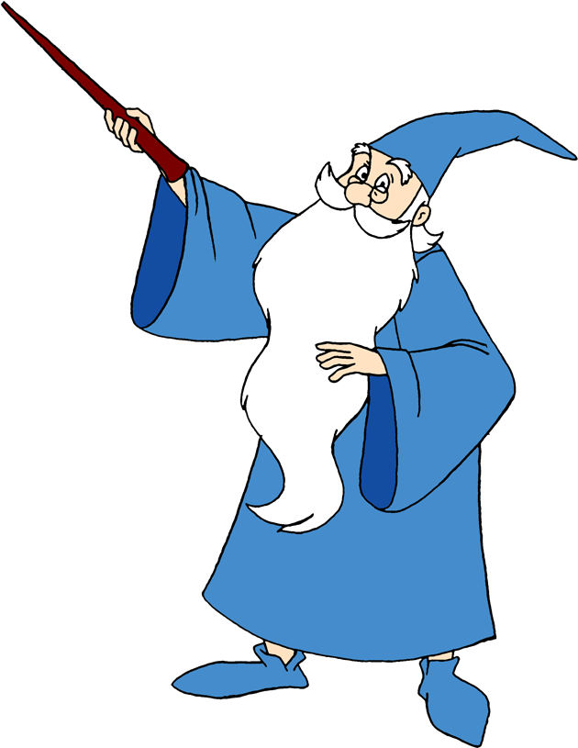
Samples keys $(k_{1},k_{2},…, k_{n})$
Runs CKS for a user appending $(k_{1},k_{2},…, k_{n})$
→ CKS state $st_{n}$
$$st_{n}$$
Test$(k_{i}^{′})$
$$k_{i}^{′}\overset{?}{=} k_{i}$$
Attacker wins iff
$∀i k_{i}=k_{i}^{′′}$
$$(k_{1}^{′′ },k_{2}^{′′ },…, k_{n}^{′′} )$$
Hard to win with non-negligible advantage
for any attacker!

Slide 17
$$st_{n}^{′}$$
Samples keys $(k_{1},k_{2},…, k_{n})$
Runs CKS for a user appending $(k_{1},k_{2},…, k_{n})$
→ CKS state $st_{n}$
CKS
$$ST_{n}$$
$$st_{n}$$
Test$(k_{i}^{′})$
$$k_{i}^{′}\overset{?}{=} k_{i}$$
Attacker wins iff
$∀i k_{i}=k_{i}^{′′}$
$$(k_{1}^{′′ },k_{2}^{′′ },…, k_{n}^{′′} )$$
Easy to win!
By CKS correctness, can be used to recover all keys from $ST_{n}$ even though outsourced by other party
$$st_{n}$$

Slide 18
CKS Security
Impossible
(Crypto’24)
Intuitive: pseudo-random keys
Keys indistinguishable from fresh random ones
given server state
and corrupted parties’ states
Weaker security: preservation security
Adding CKS does not harm security of E2E application
Weaker functionality:
Add key derivation step
Still useful for most applications
Impossible in standard-model
(this work)

Slide 19
Standard-model CKS
$$ST_{4}$$
$$st_{4}$$
$$st_{3}$$
$$st_{3}$$
$$k_{1}$$
$$k_{2}$$
$$k_{3}$$
$$k_{4}$$

Slide 20
Standard-model CKS
$$ST_{4}$$
Initially upload seeds
$$st_{4}$$
$$st_{3}$$
$$st_{3}$$
$$s_{1}$$
$$s_{2}$$
$$s_{3}$$
$$s_{4}$$
Later recover keys
$$k_{1}$$
$$k_{2}$$
$$k_{3}$$
$$k_{4}$$

Slide 21
Standard-model CKS
$$ST_{4}$$
Sufficient as long as:
E2E-secure application distributes seeds
Only uses derived keys to encrypt content
→ Applications designed with CKS is mind + many legacy applications with a key-derivation step
$$st_{4}$$
$$st_{3}$$
$$st_{3}$$
$$s_{1}$$
$$s_{2}$$
$$s_{3}$$
$$s_{4}$$
$$k_{1}$$
$$k_{2}$$
$$k_{3}$$
$$k_{4}$$

Slide 22
Schemes
Key ingredient: Trapdoor KDF

Slide 23
Schemes
Key ingredient: Trapdoor KDF
Trapdoor
Seed
State
Key

Slide 24
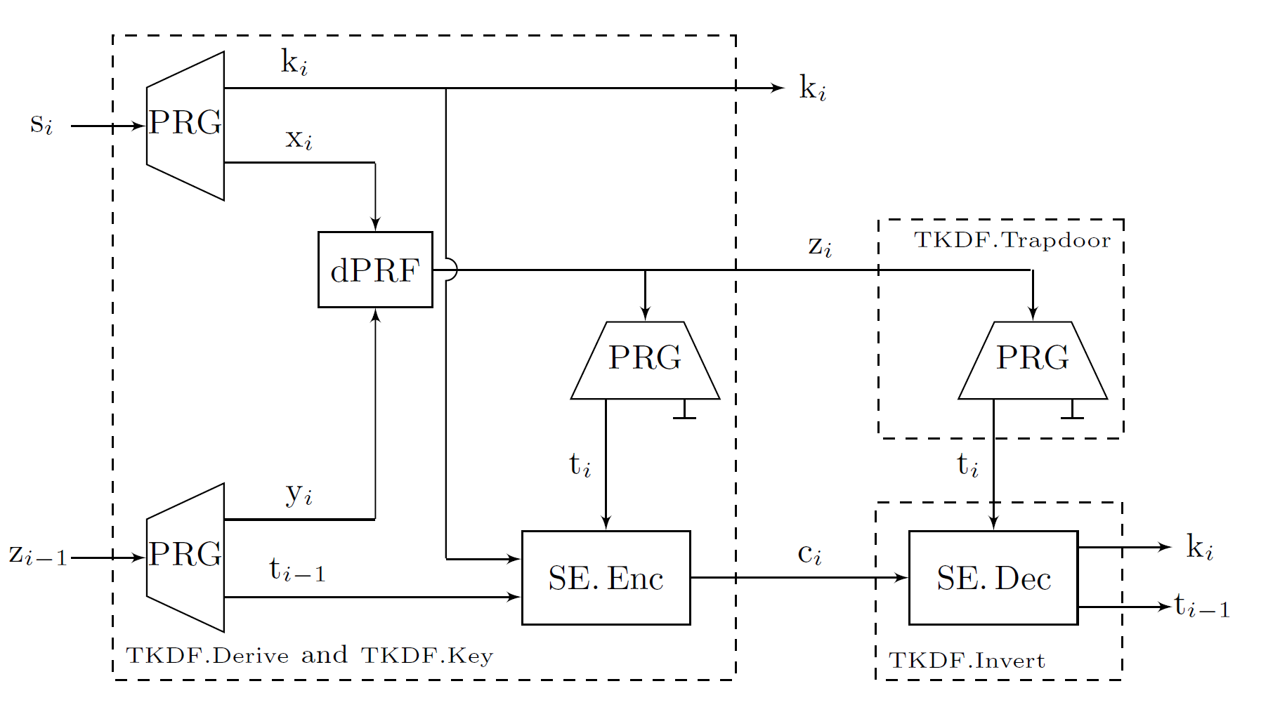
Trapdoor-KDF
Dual PRF
Determinisitic one-time secure

Slide 25
Trapdoor-KDF

Slide 26
All-or-nothing Scheme
$$s_{1}$$
$$s_{2}$$
$$s_{3}$$
Derive
Derive
Derive
$$z_{0}$$
$$z_{1}$$
$$z_{2}$$
$$z_{3}$$
$$c_{1}$$
$$c_{2}$$
$$c_{3}$$
Trapdoor
Trapdoor
Trapdoor
$$t_{0}$$
Invert
$$t_{1}$$
Invert
$$t_{2}$$
Invert
$$t_{3}$$
$$k_{1}$$
$$k_{2}$$
$$k_{3}$$

Slide 27
Interval Scheme
Derive
Result:
States can be combined according to any directed acyclic graph
Different trade-offs between functionality and complexity
Derive
Derive
Derive
Derive
Derive
Derive
Notes:
- Tags at leaves are some public constants. Either zero or hash of the epoch number…

Slide 28
Compact Key Storage
Questions
Crypto’24:
Dodis, Jost, Marcedone Compact Key Storage: A Modern Approach to Key Backup and Delegation

