Slide 1
Tighter Adaptive IBEs and VRFs: Revisiting Waters’ Artificial Abort
Goichiro Hanaoka
AIST
Shuichi Katsumata AIST and PQShield
Kei Kimura
Kyushu Univresity
Kaoru Takemure
AIST and PQShield
Shota Yamada
AIST
Notes:
Thank you for the introduction. I’m Kaoru. I’m going to talk about this paper. This is joint work with them.

Slide 2
Our Contributions
New Analysis for Partitioning based proof ⇒ Tighter Proof
2
Notes:
First, I’ll explain our contribution briefly.
Our main contribution is that we proposed new analysis for partitioning based proof which provide tighter reduction loss compared with existing analysis.

Slide 3
Our Contributions
New Analysis for Partitioning based proof ⇒ Tighter Proof
Improve reduction loss of Waters IBE[Wat05] and ABB IBE[ABB10]
Propose new partitioning function for ABB IBE achieving tighter reduction
Propose first VRF achieving sublinear vk and proof sizes under the standard d-LIN assumption
2
Notes:
By using our new analysis, we provide the following result.
The first contribution is that we improve the reduction loss of Waters IBE and ABB IBE.
The second contribution is that we propose new partitioning function for ABB IBE which can achieve tighter reduction.
The final contribution is that we propose first VRF with sublinear verification key size and proof size under standard d-LIN assumption.

Slide 4
Partitioning-based Reduction
3
Notes:
From here, I’ll talk about partitioning technique.

Slide 5






Decisional Security Model with Oracle
$$pub$$
Init: Generates $\left(pub,sec\right)$
Adversary $𝒜$
Challenger $C$
4
Notes:
In this work, we focus on the decisional security model with oracle queries, namely an adversary is allowed to access oracles to gain secret information. For example, the security models of IBE and VRF are included in this type of security model.
For the security game, in the initial phase, the challenger first generates public and secret information and gives public one to an adversary.

Slide 6

Decisional Security Model with Oracle
$$pub$$
Init: Generates $\left(pub,sec\right)$
Oracle Query
$$Q_{i}$$
Adversary $𝒜$
Challenger $C$
4
Notes:
Then, an adversary can make oracle queries Q_i to the oracle.

Slide 7


Decisional Security Model with Oracle
$$pub$$
Init: Generates $\left(pub,sec\right)$
Oracle Query
Answer using $sec$
$$Q_{i}$$
$$ans_{i}$$
Adversary $𝒜$
Challenger $C$
4
Notes:
Then the challenger generates answer by using secret information and returns it.

Slide 8
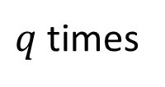
Decisional Security Model with Oracle
$$pub$$
Init: Generates $\left(pub,sec\right)$
Oracle Query
$q$ times
Answer using $sec$
$$Q_{i}$$
$$ans_{i}$$
Adversary $𝒜$
Challenger $C$
4
Notes:
Typically, A can make queries at most q times, where normally q is set to polynomial of security parameters.

Slide 9

Decisional Security Model with Oracle
$$pub$$
Init: Generates $\left(pub,sec\right)$
Oracle Query
$q$ times
Answer using $sec$
$$Q_{i}$$
$$ans_{i}$$
Adversary $𝒜$
$$Q^{∗}$$
Challenger $C$
Challenge Query
4
Notes:
Moreover, an adversary makes a challenge query Q* once.

Slide 10

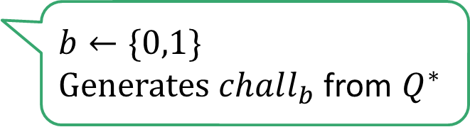
Decisional Security Model with Oracle
$$pub$$
Init: Generates $\left(pub,sec\right)$
Oracle Query
$q$ times
Answer using $sec$
$$Q_{i}$$
$$ans_{i}$$
$b←\{0,1\}$
Generates $chall_{b}$ from $Q^{∗}$
Adversary $𝒜$
$$Q^{∗}$$
Challenger $C$
Challenge Query
$${chall}_{b}$$
4
Notes:
Then, the challenger chooses a random bit b and generates challenge from b and Q* and returns it.

Slide 11


Decisional Security Model with Oracle
$$pub$$
Init: Generates $\left(pub,sec\right)$
Oracle Query
$q$ times
Answer using $sec$
$$Q_{i}$$
$$ans_{i}$$
$b←\{0,1\}$
Generates $chall_{b}$ from $Q^{∗}$
Adversary $𝒜$
$$Q^{∗}$$
Challenger $C$
Challenge Query
$${chall}_{b}$$
$$b′$$
$𝒜$ wins if $b=b′$
4
Notes:
Eventually, an adversary outputs a bit b’. If b’ is equal to b, then it can win the game.

Slide 12
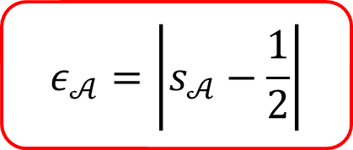
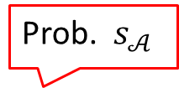
Decisional Security Model with Oracle
$$pub$$
Init: Generates $\left(pub,sec\right)$
Oracle Query
$q$ times
Answer using $sec$
$$Q_{i}$$
$$ans_{i}$$
$b←\{0,1\}$
Generates $chall_{b}$ from $Q^{∗}$
Adversary $𝒜$
$$Q^{∗}$$
Challenger $C$
Challenge Query
$${chall}_{b}$$
Prob. $s_{𝒜}$
$$ε_{𝒜}=\left|s_{𝒜}−\frac{1}{2}\right|$$
$$b′$$
$𝒜$ wins if $b=b′$
4
Notes:
For this security game, the advantage of an adversary is defined by this where s_A is the winning probability of A.

Slide 13

Partitioning Technique
Space of $Q$ is divided into two sets $S_{0}$ and $S_{1}$ by using a function $F:𝒬→\{0,1\}$
Query Space $𝒬$
5
Notes:
When we prove such security, we sometimes use partitioning techniques.
Typically, to show the security, we construct the reduction reduction solving some computational problem which runs an adversary internally.
The partitioning technique divides a space of queries into two sets by using a partitioning function.

Slide 14


Partitioning Technique
Space of $Q$ is divided into two sets $S_{0}$ and $S_{1}$ by using a function $F:𝒬→\{0,1\}$
Query Space $𝒬$
$$S_{0}=\left\{Q | F\left(Q\right)=0\right\}$$
$$S_{1}=\{Q|F\left(Q\right)=1\}$$
5
Notes:
Specifically, if F of Q is 0, such Q belongs to S_0, Otherwise, it belongs to S_1.

Slide 15

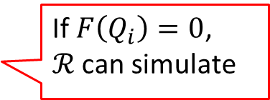


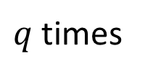

Partitioning Technique
Space of $Q$ is divided into two sets $S_{0}$ and $S_{1}$ by using a function $F:𝒬→\{0,1\}$
Query Space $𝒬$
$q$ times
$$Q_{i}$$
If $F\left(Q_{i}\right)=0$,
$ℛ$ can simulate
$$S_{0}=\left\{Q | F\left(Q\right)=0\right\}$$
$$ans_{i}$$
$$Q^{∗}$$
$${chall}_{b}$$
$$S_{1}=\{Q|F\left(Q\right)=1\}$$
5
Notes:
In the security reduction, the reduction can succeed in the simulation only when F of queried Q is 0.

Slide 16
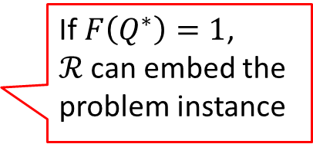
Partitioning Technique
Space of $Q$ is divided into two sets $S_{0}$ and $S_{1}$ by using a function $F:𝒬→\{0,1\}$
Query Space $𝒬$
$q$ times
$$Q_{i}$$
If $F\left(Q_{i}\right)=0$,
$ℛ$ can simulate
$$S_{0}=\left\{Q | F\left(Q\right)=0\right\}$$
$$ans_{i}$$
$$Q^{∗}$$
If $F\left(Q^{∗}\right)=1$,
$ℛ$ can embed the problem instance
$${chall}_{b}$$
$$S_{1}=\{Q|F\left(Q\right)=1\}$$
5
Notes:
Also, it can embed the problem instance into challenge only when F of Q* is 1.

Slide 17
Partitioning Technique
Space of $Q$ is divided into two sets $S_{0}$ and $S_{1}$ by using a function $F:𝒬→\{0,1\}$
Query Space $𝒬$
$q$ times
$$Q_{i}$$
If $F\left(Q_{i}\right)=0$,
$ℛ$ can simulate
$$S_{0}=\left\{Q | F\left(Q\right)=0\right\}$$
$$ans_{i}$$
$$Q^{∗}$$
If $F\left(Q^{∗}\right)=1$,
$ℛ$ can embed the problem instance
$${chall}_{b}$$
$$S_{1}=\{Q|F\left(Q\right)=1\}$$
If abort, outputs a random bit
5
Notes:
Otherwise, the reduction aborts the game and outputs a random bit.

Slide 18
Partitioning Technique
Space of $Q$ is divided into two sets $S_{0}$ and $S_{1}$ by using a function $F:𝒬→\{0,1\}$
Query Space $𝒬$
$q$ times
$$Q_{i}$$
If $F\left(Q_{i}\right)=0$,
$ℛ$ can simulate
$$S_{0}=\left\{Q | F\left(Q\right)=0\right\}$$
$$ans_{i}$$
$$Q^{∗}$$
If $F\left(Q^{∗}\right)=1$,
$ℛ$ can embed the problem instance
$${chall}_{b}$$
$$S_{1}=\{Q|F\left(Q\right)=1\}$$
Now can we complete the proof? ⇒ No
5
Notes:
Now we want to complete the security proof, but this reduction does not work well in some cases.

Slide 19

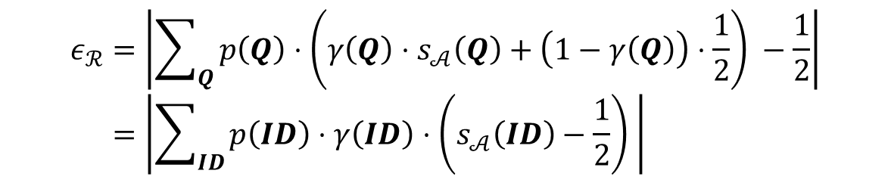




Advantage of Reduction $ℛ$
※$Q=(Q_{1},…,Q_{q},Q^{∗})$
$$ε_{ℛ}=\left|\sum_{Q}{p\left(Q\right)⋅\left(γ\left(Q\right)⋅s_{𝒜}\left(Q\right)+\left(1−γ\left(Q\right)\right)⋅\frac{1}{2}\right) }−\frac{1}{2}\right| \\ =\left|\sum_{ID}{p\left(ID\right)⋅γ\left(ID\right)⋅\left(s_{𝒜}\left(ID\right)−\frac{1}{2}\right) }\right|$$
$𝒜$ masks queries $Q$
$𝒜$ wins
Not Abort
※Conditioned on $Q$
6
Notes:
Let’s consider a case where we show the security under the decisional problem.
Then, the advantage of the reduction is given by this equation.
More concretely, p is a probability that A masks query sequence Q.
S_A is a winning probability of A, and gamma is probability of not aborting.

Slide 20



Advantage of Reduction $ℛ$
※$Q=(Q_{1},…,Q_{q},Q^{∗})$
$$ε_{ℛ}=\left|\sum_{Q}{p\left(Q\right)⋅\left(γ\left(Q\right)⋅s_{𝒜}\left(Q\right)+\left(1−γ\left(Q\right)\right)⋅\frac{1}{2}\right) }−\frac{1}{2}\right| \\ =\left|\sum_{ID}{p\left(ID\right)⋅γ\left(ID\right)⋅\left(s_{𝒜}\left(ID\right)−\frac{1}{2}\right) }\right|$$
Winning prob. of $ℛ$ in no-abort case
Winning prob. of $ℛ$ in abort case
※Conditioned on $Q$
7
Notes:
So this first terms means a winning probability of R in no-abort case, and the second terms means a winning that in abort case conditioned on Q.

Slide 21
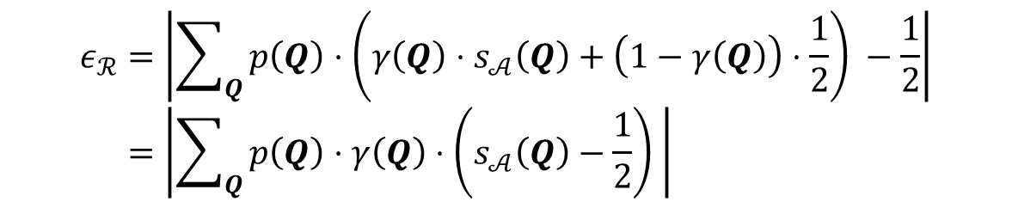
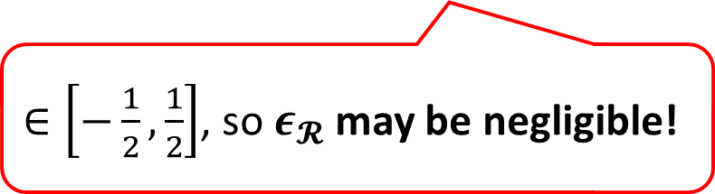
Advantage of Reduction $ℛ$
※$Q=(Q_{1},…,Q_{q},Q^{∗})$
No abort
Abort
$$ε_{ℛ}=\left|\sum_{Q}{p\left(Q\right)⋅\left(γ\left(Q\right)⋅s_{𝒜}\left(Q\right)+\left(1−γ\left(Q\right)\right)⋅\frac{1}{2}\right) }−\frac{1}{2}\right| \\ =\left|\sum_{Q}{p\left(Q\right)⋅γ\left(Q\right)⋅\left(s_{𝒜}\left(Q\right)−\frac{1}{2}\right) }\right|$$
$∈\left[−\frac{1}{2},\frac{1}{2}\right]$, so $ε_{𝓡}$ may be negligible!
※Conditioned on $Q$
7
Notes:
Then, we can rewrite this equation like this.
Notice that, because s_A is a winning probability of A, so this term belongs between this interval.
So the advantage of R may be negligible.

Slide 22



Artificial Abort
[Wat05] introduced the artificial abort technique
$$b′$$
Outputs $b′$
Adversary $𝒜$
8
Notes:
To solve this problem, Waters introduced artificial abort technique.

Slide 23

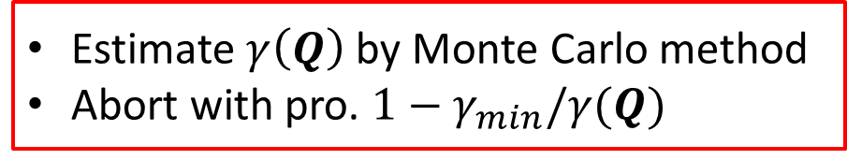

Artificial Abort
[Wat05] introduced the artificial abort technique
Sampling $F$ many times
Estimate $γ\left(Q\right)$ by Monte Carlo method
Abort with pro. $1−γ_{min}/γ(Q)$
$$b′$$
Outputs $b′$
Lower bound of $γ(Q)$
Adversary $𝒜$
8
Notes:
Which adds abort step after A outputs b’ even if the game does not abort .
Specifically, it first estimate the non-aborting probability by monte carlo method by sampling F many times for queried Q.
After that, it aborts with this probability. This is a lower bound of gamma.

Slide 24
Artificial Abort
[Wat05] introduced the artificial abort technique
Sampling $F$ many times
Estimate $γ\left(Q\right)$ by Monte Carlo method
Abort with pro. $1−γ_{min}/γ(Q)$
$$b′$$
Outputs $b′$
Lower bound of $γ(Q)$
Adversary $𝒜$
No abort
Artificial Abort
Abort
$$ε_{ℛ}=\left|\sum_{Q}{p\left(Q\right)⋅\left(γ\left(Q\right)⋅\frac{γ_{min}}{γ\left(Q\right)}⋅s_{𝒜}\left(Q\right)+γ\left(Q\right)⋅\left(1−\frac{γ_{min}}{γ\left(Q\right)}\right)⋅\frac{1}{2}+\left(1−γ\left(Q\right)\right)⋅\frac{1}{2}\right) }−\frac{1}{2}\right|$$
8
Notes:
Then, for the advantage of reduction, the term corresponding to non-aborting case is divided into these two terms.

Slide 25
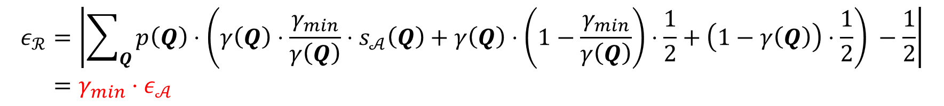
Artificial Abort
[Wat05] introduced the artificial abort technique
Sampling $F$ many times
Estimate $γ\left(Q\right)$ by Monte Carlo method
Abort with pro. $1−γ_{min}/γ(Q)$
$$b′$$
Outputs $b′$
Lower bound of $γ(Q)$
Adversary $𝒜$
No abort
Artificial Abort
Abort
$$ε_{ℛ}=\left|\sum_{Q}{p\left(Q\right)⋅\left(γ\left(Q\right)⋅\frac{γ_{min}}{γ\left(Q\right)}⋅s_{𝒜}\left(Q\right)+γ\left(Q\right)⋅\left(1−\frac{γ_{min}}{γ\left(Q\right)}\right)⋅\frac{1}{2}+\left(1−γ\left(Q\right)\right)⋅\frac{1}{2}\right) }−\frac{1}{2}\right| \\ =γ_{min}⋅ε_{𝒜}$$
Non-negligible
8
Notes:
And then we can rewrite like this.
If advantage of A is not negligible, then advantage of R is also negligible. So we can overcome problematic cases.

Slide 26
Artificial Abort
[Wat05] introduced the artificial abort technique
Expensive Computation😢
Estimate $γ\left(Q\right)$ by Monte Carlo method
Abort with pro. $1−γ_{min}/γ(Q)$
$$b′$$
Outputs $b′$
Lower bound of $γ(Q)$
Adversary $𝒜$
No abort
Artificial Abort
Abort
$$ε_{ℛ}=\left|\sum_{Q}{p\left(Q\right)⋅\left(γ\left(Q\right)⋅\frac{γ_{min}}{γ\left(Q\right)}⋅s_{𝒜}\left(Q\right)+γ\left(Q\right)⋅\left(1−\frac{γ_{min}}{γ\left(Q\right)}\right)⋅\frac{1}{2}+\left(1−γ\left(Q\right)\right)⋅\frac{1}{2}\right) }−\frac{1}{2}\right| \\ =γ_{min}⋅ε_{𝒜}$$
Non-negligible
8
Notes:
On the other hands, the estimation using monte Carlo method is expensive computation.
This increases the running time of the reduction and eventually increases the reduction loss.
Actually, the running time of the reduction in Waters analysis quadratically depends on number of queries and inverse of advantage of A.

Slide 27
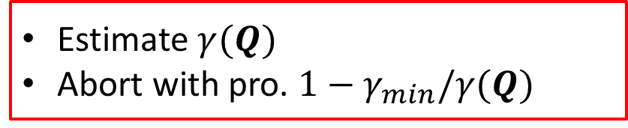
Artificial Abort
[Wat05] introduced the artificial abort technique
Estimate $γ(Q)$
Abort with pro. $1−γ_{min}/γ(Q)$
$$b′$$
Is there another analysis which can achieve smaller reduction loss?
Outputs $b′$
Lower bound of $γ(Q)$
Adversary $𝒜$
Not abort
Artificial Abort
Sim fail
$$ε_{ℛ}=\left|\sum_{Q}{p\left(Q\right)⋅\left(γ\left(Q\right)⋅\frac{γ_{min}}{γ\left(Q\right)}⋅s_{𝒜}\left(Q\right)+γ\left(Q\right)⋅\left(1−\frac{γ_{min}}{γ\left(Q\right)}\right)⋅\frac{1}{2}+\left(1−γ\left(Q\right)\right)⋅\frac{1}{2}\right) }−\frac{1}{2}\right| \\ =γ_{min}⋅ε_{𝒜}$$
Non-negligible
9
Notes:
So, we have a naïve question whether there is another analysis which can achieve smaller reduction loss.

Slide 28
Our New Analysis
10
Notes:
Now I move to our new analysis.

Slide 29


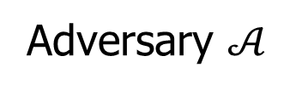
Finer Grained Analysis
$$b′$$
Outputs $b′$
Adversary $𝒜$
11
Notes:
In our analysis, we modified the artificial abort step a bit.

Slide 30
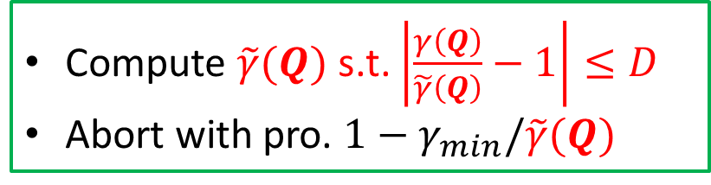
Finer Grained Analysis
Compute $\tilde{γ}(Q)$ s.t. $\left|\frac{γ\left(Q\right)}{\tilde{γ}\left(Q\right)}−1\right|≤D$
Abort with pro. $1−γ_{min}/\tilde{γ}(Q)$
$$b′$$
Outputs $b′$
Adversary $𝒜$
11
Notes:
Specifically, instead of using monte carlo method, it compute an approximation value of non-aborting probability from Q such that this condition holds where D is a certain value.
After that, it aborts with this probability.

Slide 31
Finer Grained Analysis
Compute $\tilde{γ}(Q)$ s.t. $\left|\frac{γ\left(Q\right)}{\tilde{γ}\left(Q\right)}−1\right|≤D$
Abort with pro. $1−γ_{min}/\tilde{γ}(Q)$
$$b′$$
Outputs $b′$
Adversary $𝒜$
Artificial Abort
Abort
No abort
$$ε_{ℛ}=\left|\sum_{Q}{p\left(Q\right)⋅\left(γ\left(Q\right)⋅\frac{γ_{min}}{\tilde{γ}\left(Q\right)}⋅s_{𝒜}\left(Q\right)+γ\left(Q\right)⋅\left(1−\frac{γ_{min}}{\tilde{γ}\left(Q\right)}\right)⋅\frac{1}{2}+\left(1−γ\left(Q\right)\right)⋅\frac{1}{2}\right) }−\frac{1}{2}\right|$$
11
Notes:
Then, we can write the advantage of R like this. So, this terms are no longer canceled out as same as Waters analysis.

Slide 32
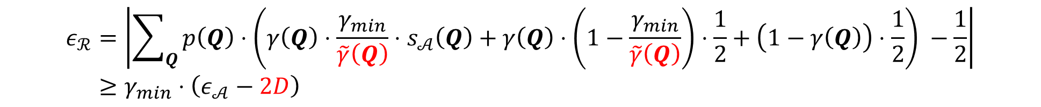
Finer Grained Analysis
Compute $\tilde{γ}(Q)$ s.t. $\left|\frac{γ\left(Q\right)}{\tilde{γ}\left(Q\right)}−1\right|≤D$
Abort with pro. $1−γ_{min}/\tilde{γ}(Q)$
$$b′$$
Outputs $b′$
Adversary $𝒜$
Artificial Abort
Abort
No abort
$$ε_{ℛ}=\left|\sum_{Q}{p\left(Q\right)⋅\left(γ\left(Q\right)⋅\frac{γ_{min}}{\tilde{γ}\left(Q\right)}⋅s_{𝒜}\left(Q\right)+γ\left(Q\right)⋅\left(1−\frac{γ_{min}}{\tilde{γ}\left(Q\right)}\right)⋅\frac{1}{2}+\left(1−γ\left(Q\right)\right)⋅\frac{1}{2}\right) }−\frac{1}{2}\right| \\ ≥γ_{min}⋅\left(ε_{𝒜}−2D\right)$$
11
Notes:
However, by using this condition, we can obtain this lower bound.

Slide 33
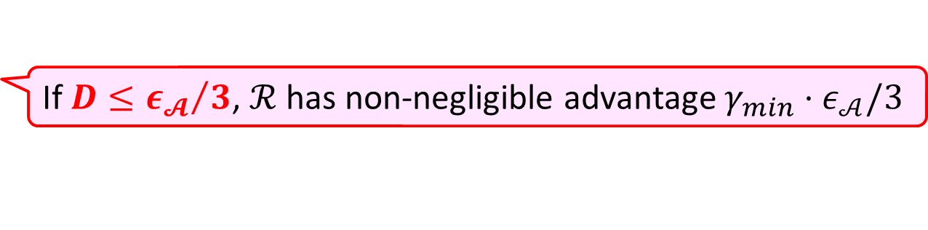
Finer Grained Analysis
Compute $\tilde{γ}(Q)$ s.t. $\left|\frac{γ\left(Q\right)}{\tilde{γ}\left(Q\right)}−1\right|≤D$
Abort with pro. $1−γ_{min}/\tilde{γ}(Q)$
$$b′$$
Outputs $b′$
Adversary $𝒜$
Artificial Abort
Abort
No abort
$$ε_{ℛ}=\left|\sum_{Q}{p\left(Q\right)⋅\left(γ\left(Q\right)⋅\frac{γ_{min}}{\tilde{γ}\left(Q\right)}⋅s_{𝒜}\left(Q\right)+γ\left(Q\right)⋅\left(1−\frac{γ_{min}}{\tilde{γ}\left(Q\right)}\right)⋅\frac{1}{2}+\left(1−γ\left(Q\right)\right)⋅\frac{1}{2}\right) }−\frac{1}{2}\right| \\ ≥γ_{min}⋅\left(ε_{𝒜}−2D\right)$$
If $D≤{ε_{𝓐}}/3$, $ℛ$ has non-negligible advantage $γ_{min}⋅ε_{𝒜}/3$
11
Notes:
Notice that, if D is less than ep/3, then the reduction has non-negligible advantage.
So now we aim to get this condition.

Slide 34

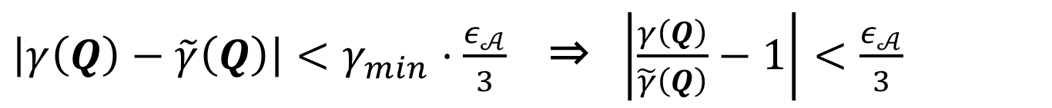
How to Get $D≤\frac{ε_{𝒜}}{3}$
$\left|γ\left(Q\right)−\tilde{γ}\left(Q\right)\right|<γ_{min}⋅\frac{ε_{𝒜}}{3}$ ⇒ $\left|\frac{γ\left(Q\right)}{\tilde{γ}\left(Q\right)}−1\right|<\frac{ε_{𝒜}}{3}$
12
Notes:
The first important observation to get this bound is that, it this condition holds, then this also holds.

Slide 35
How to Get $D≤\frac{ε_{𝒜}}{3}$
$\left|γ\left(Q\right)−\tilde{γ}\left(Q\right)\right|<γ_{min}⋅\frac{ε_{𝒜}}{3}$ ⇒ $\left|\frac{γ\left(Q\right)}{\tilde{γ}\left(Q\right)}−1\right|<\frac{ε_{𝒜}}{3}$
Approximation Error
12
Notes:
Specifically, this term is the gap between actual non-aborting probability and approximated probability.
Thus this can be regarded as approximation error.
So to get this bound, we need a good approximation achieving this accuracy.

Slide 36
How to Get $D≤\frac{ε_{𝒜}}{3}$
$\left|γ\left(Q\right)−\tilde{γ}\left(Q\right)\right|<γ_{min}⋅\frac{ε_{𝒜}}{3}$ ⇒ $\left|\frac{γ\left(Q\right)}{\tilde{γ}\left(Q\right)}−1\right|<\frac{ε_{𝒜}}{3}$
Approximation Error
Let $E^{∗}$: $F\left(Q^{∗}\right)=0$ and $E^{(i)}$: $F\left(Q_{i}\right)=0$
12
Notes:
Now let me define these events.

Slide 37
How to Get $D≤\frac{ε_{𝒜}}{3}$
$\left|γ\left(Q\right)−\tilde{γ}\left(Q\right)\right|<γ_{min}⋅\frac{ε_{𝒜}}{3}$ ⇒ $\left|\frac{γ\left(Q\right)}{\tilde{γ}\left(Q\right)}−1\right|<\frac{ε_{𝒜}}{3}$
Approximation Error
Let $E^{∗}$: $F\left(Q^{∗}\right)=0$ and $E^{(i)}$: $F\left(Q_{i}\right)=0$
From union bound
Previous Improvement [BR09]:
$$Pr\left[E^{∗}\right]−\sum_{i}{\operatorname{Pr}\left[E^{∗}∧E^{\left(i\right)}\right]}≤γ\left(Q\right)≤Pr\left[E^{∗}\right]$$
12
Notes:
In the previous improvement by Bellare-Ristenpart, they use the union bound to get lower and upper bounds.

Slide 38
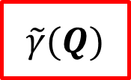
How to Get $D≤\frac{ε_{𝒜}}{3}$
$\left|γ\left(Q\right)−\tilde{γ}\left(Q\right)\right|<γ_{min}⋅\frac{ε_{𝒜}}{3}$ ⇒ $\left|\frac{γ\left(Q\right)}{\tilde{γ}\left(Q\right)}−1\right|<\frac{ε_{𝒜}}{3}$
Approximation Error
Let $E^{∗}$: $F\left(Q^{∗}\right)=0$ and $E^{(i)}$: $F\left(Q_{i}\right)=0$
From union bound
Previous Improvement [BR09]:
$$Pr\left[E^{∗}\right]−\sum_{i}{\operatorname{Pr}\left[E^{∗}∧E^{\left(i\right)}\right]}≤γ\left(Q\right)≤Pr\left[E^{∗}\right]$$
$$\tilde{γ}(Q)$$
12
Notes:
By setting this probability as tilde gamma,

Slide 39
How to Get $D≤\frac{ε_{𝒜}}{3}$
$\left|γ\left(Q\right)−\tilde{γ}\left(Q\right)\right|<γ_{min}⋅\frac{ε_{𝒜}}{3}$ ⇒ $\left|\frac{γ\left(Q\right)}{\tilde{γ}\left(Q\right)}−1\right|<\frac{ε_{𝒜}}{3}$
Approximation Error
Let $E^{∗}$: $F\left(Q^{∗}\right)=0$ and $E^{(i)}$: $F\left(Q_{i}\right)=0$
From union bound
Previous Improvement [BR09]:
$$\tilde{γ}(Q)−\sum_{i}{\operatorname{Pr}\left[E^{∗}∧E^{\left(i\right)}\right]}≤γ\left(Q\right)≤\tilde{γ}(Q)$$
Approximation Error!!
13
Notes:
This term means approximation error.

Slide 40
How to Get $D≤\frac{ε_{𝒜}}{3}$
$\left|γ\left(Q\right)−\tilde{γ}\left(Q\right)\right|<γ_{min}⋅\frac{ε_{𝒜}}{3}$ ⇒ $\left|\frac{γ\left(Q\right)}{\tilde{γ}\left(Q\right)}−1\right|<\frac{ε_{𝒜}}{3}$
Approximation Error
Let $E^{∗}$: $F\left(Q^{∗}\right)=0$ and $E^{(i)}$: $F\left(Q_{i}\right)=0$
From Bonferroni’s Inequality
This work:
$$Pr\left[E^{∗}\right]−\sum_{i}{\operatorname{Pr}\left[E^{∗}∧E^{\left(i\right)}\right]}≤γ\left(Q\right)≤Pr\left[E^{∗}\right]−\sum_{i}{\operatorname{Pr}\left[E^{∗}∧E^{\left(i\right)}\right]}+\sum_{i≠j}{Pr[E^{∗}∧E^{\left(i\right)}∧E^{(j)}]}$$
14
Notes:
In this work, we use Bonferroni’s inequality to get better approximation.
From Bonferroni’s inequality, we can obtain these lower and upper bounds of non-aborting probability.

Slide 41
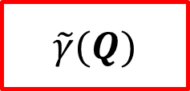
How to Get $D≤\frac{ε_{𝒜}}{3}$
$\left|γ\left(Q\right)−\tilde{γ}\left(Q\right)\right|<γ_{min}⋅\frac{ε_{𝒜}}{3}$ ⇒ $\left|\frac{γ\left(Q\right)}{\tilde{γ}\left(Q\right)}−1\right|<\frac{ε_{𝒜}}{3}$
Approximation Error
Let $E^{∗}$: $F\left(Q^{∗}\right)=0$ and $E^{(i)}$: $F\left(Q_{i}\right)=0$
From Bonferroni’s Inequality
This work:
$$Pr\left[E^{∗}\right]−\sum_{i}{\operatorname{Pr}\left[E^{∗}∧E^{\left(i\right)}\right]}≤γ\left(Q\right)≤Pr\left[E^{∗}\right]−\sum_{i}{\operatorname{Pr}\left[E^{∗}∧E^{\left(i\right)}\right]}+\sum_{i≠j}{Pr[E^{∗}∧E^{\left(i\right)}∧E^{(j)}]}$$
$$\tilde{γ}(Q)$$
14
Notes:
By setting these terms as tilde gamma,

Slide 42
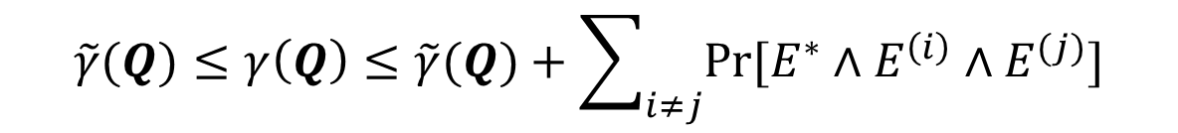
How to Get $D≤\frac{ε_{𝒜}}{3}$
$\left|γ\left(Q\right)−\tilde{γ}\left(Q\right)\right|<γ_{min}⋅\frac{ε_{𝒜}}{3}$ ⇒ $\left|\frac{γ\left(Q\right)}{\tilde{γ}\left(Q\right)}−1\right|<\frac{ε_{𝒜}}{3}$
Approximation Error
Let $E^{∗}$: $F\left(Q^{∗}\right)=0$ and $E^{(i)}$: $F\left(Q_{i}\right)=0$
This work:
$$\tilde{γ}(Q)≤γ\left(Q\right)≤\tilde{γ}(Q)+\sum_{i≠j}{Pr[E^{∗}∧E^{\left(i\right)}∧E^{(j)}]}$$
Approximation Error!!
15
Notes:
this term become approximation error.

Slide 43
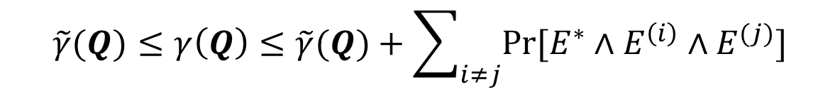
How to Get $D≤\frac{ε_{𝒜}}{3}$
Approximation Error
$$\tilde{γ}(Q)≤γ\left(Q\right)≤\tilde{γ}(Q)+\sum_{i≠j}{Pr[E^{∗}∧E^{\left(i\right)}∧E^{(j)}]}$$
16
Notes:
Then,

Slide 44
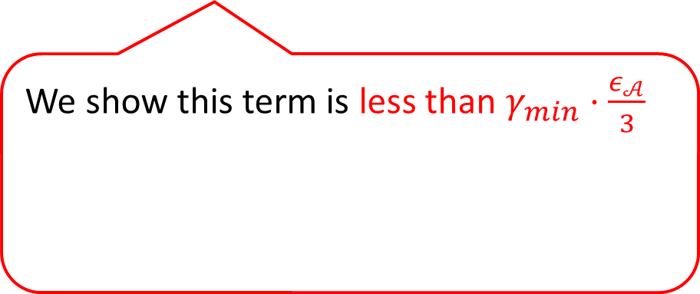
How to Get $D≤\frac{ε_{𝒜}}{3}$
Approximation Error
$$\tilde{γ}(Q)≤γ\left(Q\right)≤\tilde{γ}(Q)+\sum_{i≠j}{Pr[E^{∗}∧E^{\left(i\right)}∧E^{(j)}]}$$
We show this term is less than $γ_{min}⋅\frac{ε_{𝒜}}{3}$
16
Notes:
We show that this term is less than this value for partitioning functions.

Slide 45
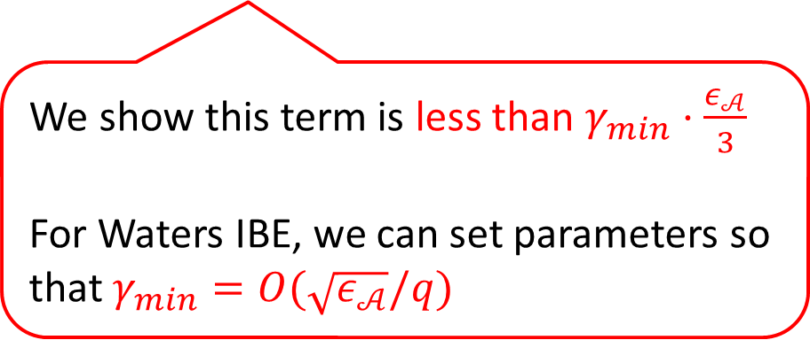
How to Get $D≤\frac{ε_{𝒜}}{3}$
Approximation Error
$$\tilde{γ}(Q)≤γ\left(Q\right)≤\tilde{γ}(Q)+\sum_{i≠j}{Pr[E^{∗}∧E^{\left(i\right)}∧E^{(j)}]}$$
We show this term is less than $γ_{min}⋅\frac{ε_{𝒜}}{3}$
For Waters IBE, we can set parameters so that $γ_{min}=O(\sqrt{ε_{𝒜}}/q)$
16
Notes:
For example, in the context of Waters IBE, we can set parameters so that this holds.

Slide 46

How to Get $D≤\frac{ε_{𝒜}}{3}$
Approximation Error
$$\tilde{γ}(Q)≤γ\left(Q\right)≤\tilde{γ}(Q)+\sum_{i≠j}{Pr[E^{∗}∧E^{\left(i\right)}∧E^{(j)}]}$$
We show this term is less than $γ_{min}⋅\frac{ε_{𝒜}}{3}$
For Waters IBE, we can set parameters so that $γ_{min}=O(\sqrt{ε_{𝒜}}/q)$
[BR09] sets $γ_{min}=O(ε_{𝒜}/q)$
16
Notes:
Compared with Bellare-Ristenpart analysis, since it needs to set this, our analysis improve the reduction loss for advantage.

Slide 47
How to Get $D≤\frac{ε_{𝒜}}{3}$
Approximation Error
$$\tilde{γ}(Q)≤γ\left(Q\right)≤\tilde{γ}(Q)+\sum_{i≠j}{Pr[E^{∗}∧E^{\left(i\right)}∧E^{(j)}]}$$
Can we compute efficiently?
We show this term is less than $γ_{min}⋅\frac{ε_{𝒜}}{3}$
For Waters IBE, we can set parameters so that $γ_{min}=O(\sqrt{ε_{𝒜}}/q)$
[BR09] sets $γ_{min}=O(ε_{𝒜}/q)$
16
Notes:
Also, our reduction has to compute this approximated probability efficiently.
Although the naïve way of computing this value takes inefficient time,

Slide 48
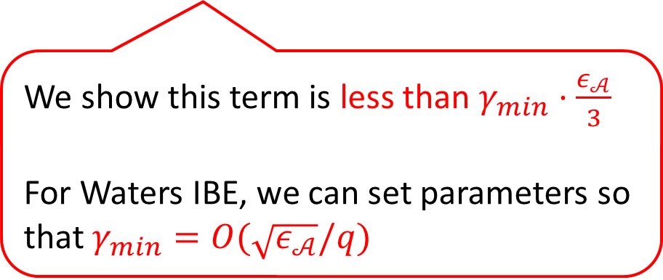
How to Get $D≤\frac{ε_{𝒜}}{3}$
Approximation Error
$$\tilde{γ}(Q)≤γ\left(Q\right)≤\tilde{γ}(Q)+\sum_{i≠j}{Pr[E^{∗}∧E^{\left(i\right)}∧E^{(j)}]}$$
Can we compute efficiently?
Yes!!
Waters IBE: Generating functions
ABB IBE, VRF: d-wise independent hash
We show this term is less than $γ_{min}⋅\frac{ε_{𝒜}}{3}$
For Waters IBE, we can set parameters so that $γ_{min}=O(\sqrt{ε_{𝒜}}/q)$
[BR09] sets $γ_{min}=O(ε_{𝒜}/q)$
16
Notes:
For Waters IBE, we exploit generating functions, and for ABB IBE and VRF, we use d-wise independent hash.
As a result, we can achieves efficient computation time which linearly depends on number of queries as well as or less than previous improvement results.

Slide 49
How to Get $D≤\frac{ε_{𝒜}}{3}$
Approximation Error
$$\tilde{γ}(Q)≤γ\left(Q\right)≤\tilde{γ}(Q)+\sum_{i≠j}{Pr[E^{∗}∧E^{\left(i\right)}∧E^{(j)}]}$$
Can we compute efficiently?
Yes!!
Waters IBE: Generating functions
ABB IBE, VRF: d-wise independent hash
We show this term is less than $γ_{min}⋅\frac{ε_{𝒜}}{3}$
For Waters IBE, we can set parameters so that $γ_{min}=O(\sqrt{ε_{𝒜}}/q)$
[BR09] sets $γ_{min}=O(ε_{𝒜}/q)$
We can improve reduction loss!!
16
Notes:
Eventually, we can improve the reduction loss.
By basing on this new analysis, we achieve some result for IBE and VRF as I explained in the first slide

Slide 50
Thank you for your attention!
https://eprint.iacr.org/2024/1481
Notes:
For more details of our contribution and our analysis, please see our full-version paper on eprint.
Thank you for your attention!

Slide 51
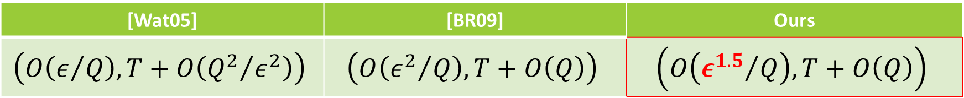
Our Contributions
New Analysis for Partitioning based proof ⇒ Tighter Proof
Waters IBE[Wat05]
[Wat05] | [BR09] | Ours
$$\left(O\left(ε/Q\right), T+O\left({Q^{2}}/{ε^{2}}\right)\right)$$ | $$\left(O\left({ε^{2}}/Q\right), T+O\left(Q\right)\right)$$ | $$\left(O\left({ε^{1.5}}/Q\right), T+O\left(Q\right)\right)$$
$(ε,T)$: Advantage and running time of adversary, $Q$: Number of queries

Slide 52
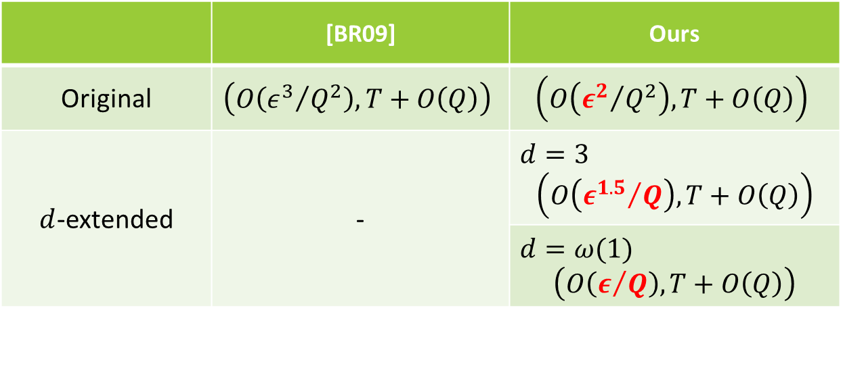
Our Contributions
New Analysis for Partitioning based proof ⇒ Tighter Proof
ABB IBE[ABB10]
 | [BR09] | Ours
Original | $$\left(O\left({ε^{3}}/{Q^{2}}\right), T+O\left(Q\right)\right)$$ | $$\left(O\left({ε^{2}}/{Q^{2}}\right), T+O\left(Q\right)\right)$$
$d$-extended | - | $$d=3$$ $$\left(O\left({ε^{1.5}}/Q\right), T+O\left(Q\right)\right)$$
 |  | $$d=ω(1)$$ $$\left(O\left(ε/Q\right), T+O\left(Q\right)\right)$$
Original ABB IBE
Increasing mpk size
Tweaked ABB IBE
(Analysis with new partitioning function)

Slide 53

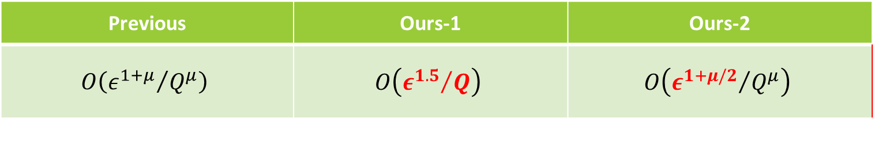
Our Contributions
New Analysis for Partitioning based proof ⇒ Tighter Proof
New VRF
First VRF achieving sublinear vk and proof sizes under the standard d-LIN assumption
Construction is based on [Koh19].
Previous | Ours-1 | Ours-2
$$O\left({ε^{1+μ}}/{Q^{μ}}\right)$$ | $$O\left({ε^{1.5}}/Q\right)$$ | $$O\left({ε^{1+μ/2}}/{Q^{μ}}\right)$$
Arbitrary constant $μ>1$

