Slide 1

Limits on Adaptive Security for Attribute-Based Encryption
Zvika Brakerski, Stav Medina
Weizmann Institute of Science
TCC 2024
Notes:
Good morning. My name is Stav, and I’ll be presenting our work on “Limits on Adaptive Security for Attribute-Based Encryption” , which is a joint work with my supervisor Prof. Zvika Brakerski.
[0:12]

Slide 2
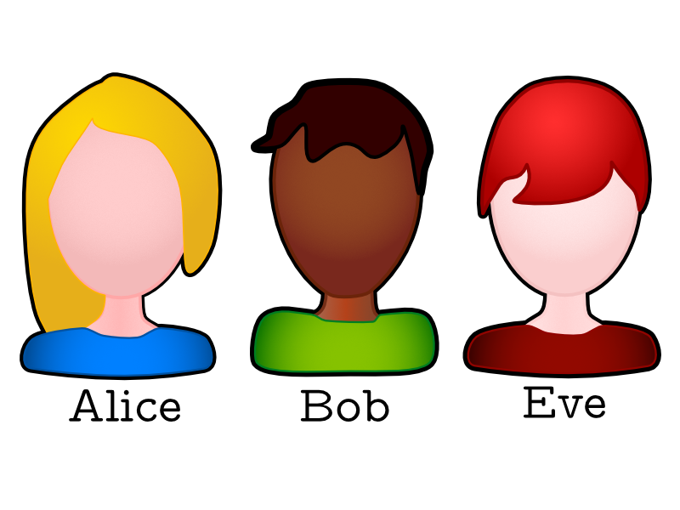





Motivation
Public Key Encryption
$${ PK}_{ Bob}$$
$$M=\text{Decrypt}\text{(}CT\text{,}{ SK}_{ Bob}\text{)}$$
$$CT=\text{Encrypt}\text{(}M\text{,}{ PK}_{ Bob}\text{)}$$
Alice
Bob
$$M$$
$${ PK}_{ Bob}, {SK}_{Bob}$$
Notes:
I’ll start with a quick overview and motivation.
In Public Key Encryption, we have Alice and Bob, and Bob has a pair of public and secret keys.
Bob publishes his public key to Alice, which uses it to encrypt a message M and send the ciphertext to Bob, and Bob can later decrypt it using the secret key.
[0:20]

Slide 3
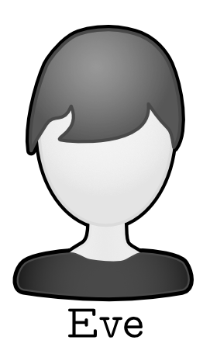

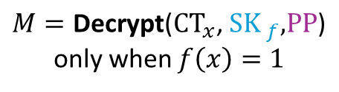

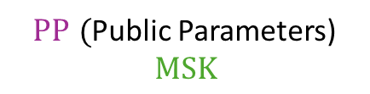
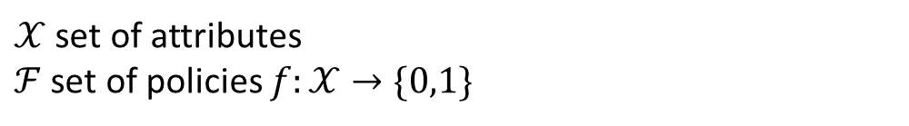

Motivation
${PP}_{ } ($Public Parameters)
$$MSK$$
Attribute-Based Encryption
$𝒳$ set of attributes
$ℱ$ set of policies $f:𝒳→\{0,1\}$
Master
$${ SK}_{f}=\text{KeyGen}\text{(}MSK\text{, }f\text{, }PP\text{)}$$
$${CT}_{x}=\text{Encrypt}\text{(}x, M\text{, }\text{PP}\text{)}$$
$M=\text{Decrypt}\text{(}{CT}_{x}\text{,}{ SK}_{ f}\text{,}\text{PP}\text{)}$ only when $f\left(x\right)=1$
Alice
Bob
$$M$$
Notes:
So Attribute Based Encryption is a generalization of public-key encryption that allows a fine-grained to access encrypted data.
More specifically,
We have a set X of attributes to describe the data, and a set F of access policies which take in an attribute from X and outputs 0 or 1.
A master entity publishes public parameters which are essentially the master public key, and it also has a master secret key.
Alice can encrypt a message using the public parameters ,with respect to an attribute x.
The master entity issues secret keys using the master secret key and with respect to predicate functions f.
And Bob can decrypt the ciphertext if and only if the policy function of the secret key accepts the ciphertext attribute x.
<It’s worth mentioning that throughout the talk I will focus on the key-policy ABE variant which I presented here, where the data is encrypted with a set of attributes, and secret keys are associated with access policies. The distinction between the key-policy variant and the ciphertext-policy one is unimportant for our results.>
[0:42]

Slide 4

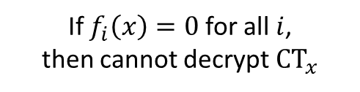


Motivation
Security of Attribute-Based Encryption
Security requirement – Collusion Resilience
Master
$${ SK}_{f_{1}},{ SK}_{f_{2}},{ SK}_{f_{3}}…$$
$${CT}_{x}=\text{Encrypt}\text{(}x, M\text{, }\text{PP}\text{)}$$
If $f_{i}\left(x\right)=0$ for all $i$,
then cannot decrypt ${CT}_{x}$
Alice
Adversary
Notes:
The security requirement of an ABE is collusion resilience.
Namely, even if the adversary has as many secret keys as they want for whichever policies they choose, if none of those policies accept the attribute x, then the adversary cannot decrypt ciphertexts with attribute x.
Let me dive into the formal security definition.
[0:18]

Slide 5











Adaptive Security of ABE
$$PP$$
Challenger
Adversary
Setup Phase
Query Phase I
Challenge Phase
  Encrypts $M_{0}\backslash M_{1}$
Query Phase II
Guess
$$f$$
$${ SK}_{f}$$
$$⋮$$
$$x^{∗}$$
$${ CT}_{x^{∗}}$$
$$f$$
$${ SK}_{f}$$
$$⋮$$
$$M_{0}/M_{1}$$
  If the guess is correct and all policies satisfy $f\left(x^{∗}\right)=0 →\text{Adversary} \text{wins}$
Notes:
Adaptive security, or “full security”, of an ABE scheme is defined using the following “game” between a challenger and an adversary that attempts to break the collusion resilience:
The game begins with a Setup phase, where the challenger sends the public parameters;
Query phase, where the adversary can query secret keys for their choice of policies, and the challenger generates them using the Master Secret Key;
Challenge phase, where the adversary declares a challenge attribute x* and the challenger responds with a ciphertext encrypted w.r.t. x*.
The ciphertext encrypts one of two known messages.
Another query phase, same as the first one;
Finally, the adversary guesses which message was encrypted in the challenge ciphertext. If the guess is correct and none of the queried policies accept x*, then the adversary wins the game.
If the adversary wins with non-negligible probability, we say that it breaks adaptive security.
[0:49]

Slide 6


Adaptive Security of ABE
Proving security = efficiently reducing hardness assumption to an adversary.
Hardness Assumption
Reduction
Adversary
$$⋮$$
$$⋮$$
Notes:
Following the security definition, in order to ensure the scheme is secure, we want to prove that breaking the scheme security is at least as hard as solving another problem which is assumed to be sufficiently hard to solve.
In other words, we wish to construct an efficient reduction algorithm that reduces some hardness assumption to breaking the ABE security.
Although ABE was found to be useful for many purposes, it turns out that proving security for ABE is quite a challenging task.
Let me provide intuition to this difficulty using the following use case:
[0:32]

Slide 7








Adaptive Security of ABE
$$⋮$$
Hardness Assumption
Reduction
Adversary
The reduction “should” be able to decrypt any ciphertext by itself…
$⟹$Full security costs in terms of functionality and simplicity [Wat09, Tsa19]
Is this necessary?
$$f$$
$${ SK}_{f}$$
$$⋮$$
$$\overline{f}$$
$${ SK}_{\overline{f} }$$
$$⋮$$
Notes:
Suppose the adversary makes a key query for policy F, receives a corresponding key SK_f, then makes a query to F’s complement policy and receive a corresponding key.
The reduction should be able to send secret keys for both policies, which essentially means that the reduction should be able to decrypt any ciphertext by itself <Click>- and that is a very strong requirement.
Indeed, although adaptively secure ABE schemes exist, they implement quite complex methods to achieve adaptive security, which appear to take a toll in means of functionality and simplicity.
This leaves us with the intriguing question – is the additional complexity really necessary? because although it is hard to prove adaptive security, actual adaptive attacks are relatively rare.
<ABE schemes that support sufficiently rich function classes to be of interest are currently known to exist only under two types of cryptographic assumptions: assumptions on groups with bilinear maps and lattice assumptions.
Until a few years ago, fully secure ABE schemes were only known to exist under assumptions on bilinear maps, mostly using variants of Waters’ dual-system technique.
In 2019, Tsabary constructed the first fully-secure lattice-based ABE scheme, but only for the very restricted class of policies.
Both Waters and Tsabary implemented quite complex methods to achieve adaptive security, which appear to take a toll in means of functionality and simplicity.
This observed cost is quite intriguing, because although it is hard to prove adaptive security, actual adaptive attacks are relatively rare.>
[0:37]

Slide 8
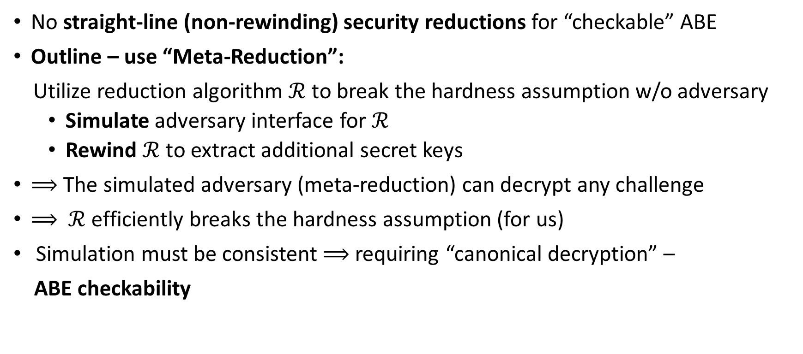
Why Proving Adaptive Security is Difficult
Allison Lewko & Brent Waters, 2014
No straight-line (non-rewinding) security reductions for “checkable” ABE
Outline – use “Meta-Reduction”:
Utilize reduction algorithm $ℛ$to break the hardness assumption w/o adversary
  Simulate adversary interface for $ℛ$
  Rewind $ℛ$ to extract additional secret keys
$⟹$The simulated adversary (meta-reduction) can decrypt any challenge
$⟹$ $ℛ$ efficiently breaks the hardness assumption (for us)
Simulation must be consistent $⟹$ requiring “canonical decryption” –
ABE checkability
Notes:
In 2014, Lewko and Waters attempted to formalize the intuition and showed that it was impossible to produce straight-line security proofs for some schemes that satisfy a “checkability criteria” that I will explain shortly.
The general idea was using a “meta reduction” as following:
Consider some ABE scheme and assume towards contradiction that it has a security proof, that is, a reduction algorithm R such that given access to an adversary, it breaks some hardness assumption.
The idea is to utilize the reduction itself in order to break the hardness assumption, without using an actual adversary algorithm.
How do we do that?
Think of the reduction as our “enemy”, we trick it into thinking it has access to an adversary algorithm by simulating one.
This simulated adversary doesn’t really know how to break adaptive security, so it rewinds R to extract many secret keys without the reduction noticing.
This way, if the reduction challenges the simulated adversary to decrypt a challenge ciphertext, it can do so by using the additional keys.
Finally, since the reduction “thinks” it has access to a real adversary, it should break the hardness assumption.
Essentially we “force” the reduction to break the hardness assumption in polynomial time – which is a contradiction
Now, for this argument to work, we must guarantee that the simulation of the adversary is consistent although it uses secret keys from rewound queries:
Otherwise, the reduction could try to test our simulated adversary and generate the secret keys in a way that would disclose which key the adversary used for the decryption of the challenge ciphertext.
In other words, if the simulation is not consistent, the reduction could essentially “notice” that it is being rewound.
Therefore, secret keys should decrypt the challenge ciphertext in a “canonical” way that does not reveal any information on which key was used.
Lewko and Waters formalized this condition and defined a criterion of an ABE scheme called “checkability”.
[1:14]

Slide 9
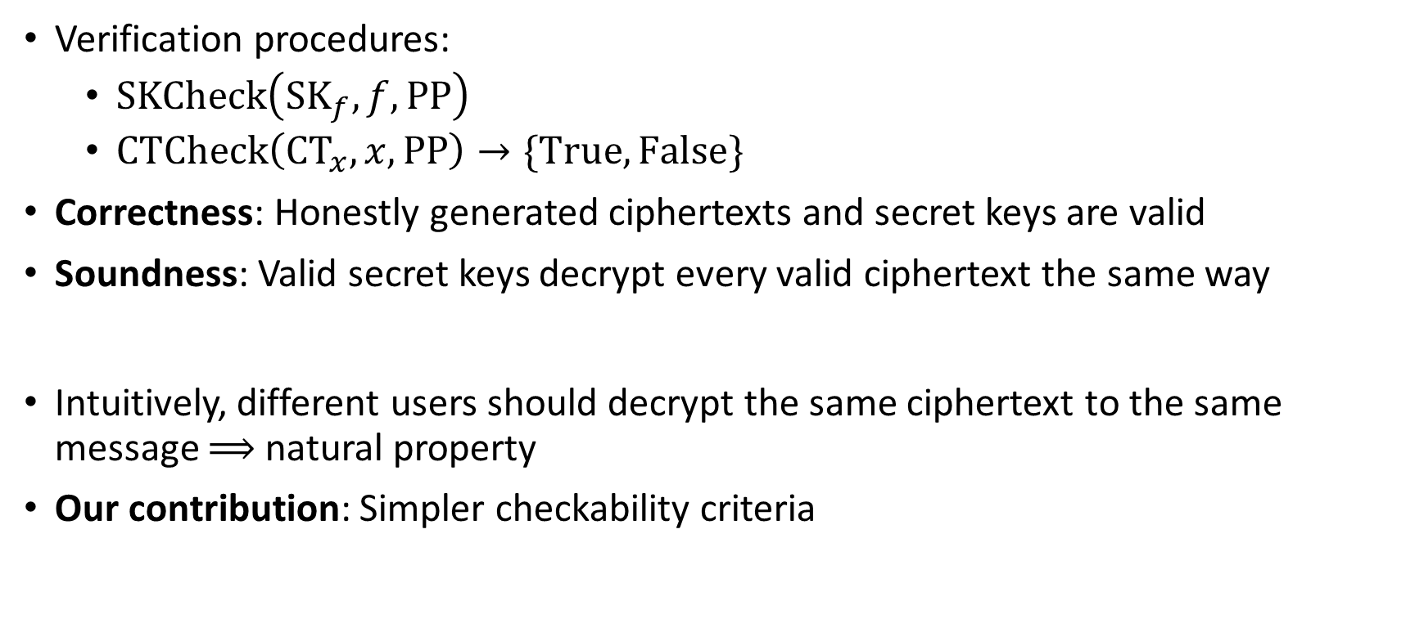
ABE Checkability
Allison Lewko & Brent Waters, 2014
Verification procedures:
  $SKCheck\left({SK}_{f_{ }},f,PP\right)$
  $CTCheck\left({CT}_{x}, x,PP\right)→\{True,False\}$
Correctness: Honestly generated ciphertexts and secret keys are valid
Soundness: Valid secret keys decrypt every valid ciphertext the same way
Intuitively, different users should decrypt the same ciphertext to the same message $⟹$ natural property
Our contribution: Simpler checkability criteria
Notes:
More formally, a checkable ABE scheme is equipped with verification procedures for ciphertexts and secret keys <Click>, SKCheck and CTCheck.
The correctness requirement is that all honestly generated ciphertexts and secret keys are valid according to the verification procedures,
And the soundness requirement is that that any valid secret key decrypts a given valid ciphertext the same way.
This is a very natural property for an ABE scheme, because we intuitively expect different users with different secret keys to have access to the same data if they are allowed to.
During our work, we observed that the security of an ABE scheme does not depend on the decryption procedure, as it does not play any role in the security game since the adversary is not obliged to use it.
As a result, we introduced a simpler notion of the checkability property that does not require ciphertext validation and essentially “embeds” it in the decryption procedure.
[1:15]

Slide 10
Our Results
Informally: No black-box adaptive-security reduction for checkable ABE
Even if the reduction is rewinding
Application to [BGG+14]
Notes:
In our research, we proved that it is impossible to construct a black-box reduction that proves adaptive security for any checkable ABE scheme,
That is - Even if the reduction is rewinding
Therefore, in order to prove adaptive security, we must ensure that the ABE scheme is not checkable, meaning it must be impossible to come up with verification procedures.
Our result sheds light on existing ABE constructions:
We observe that the known methods for constructing fully secure schemes achieve this by forcing the schemes to avoid checkability, for example, by using tools such as semi-functional keys which differ in functionality from “regular” keys, thus inherently violating the checkability property.
As a final step, we applied our result to the prominent lattice-based ABE scheme by Boneh et al. from 2014 (BGG).
More specifically, we proved that the delegatable variant of BGG, which uses lattice trapdoors for policy keys instead of short vectors, is checkable and therefore cannot be proven adaptively secure.
<At a very high level, we achieved this result by applying a delicate rewinding mechanism to how the meta-reduction rewinds the security reduction, such that the meta reduction remains efficient even if the security reduction is rewinding. Moreover, we crafted the key queries during the query phase using a special set of policies so we guarantee successful simulation of the adversary even if the reduction sometimes “misbehaves” and aborts.>
In the next few slides I’ll present an overview of our proof:
[0:50]

Slide 11




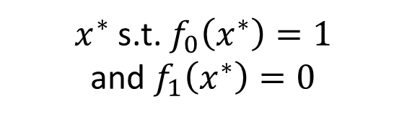

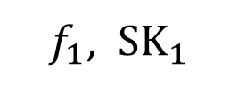
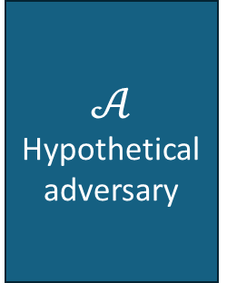
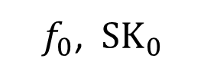
Proof Overview
$𝒞\text{ – }\text{(}\text{possibly} \text{interactive}\text{) }\text{hardness} \text{assumption}$
$𝒜$ – hypothetical inefficient adversary
$ℬ$ (left) forwards the communication of $𝒞$ and $ℛ$
$ℬ$ (right) simulates the hypothetical adversary $𝒜$
If $ℛ^{𝒜}$ breaks $𝒞$, then $ℬ^{ℛ}$ can break $𝒞$ as well, in polynomial time.
$$𝒞$$
Hardness Assumption
$$ℬ$$
“Meta-Reduction”
$$ℛ$$
Reduction
$$ℬ$$
Simulated Adversary
$f_{0}$, ${ SK}_{0}$
$$𝒜$$
Hypothetical adversary
Rewind
$f_{1}$, ${ SK}_{1}$
$x^{∗}$ s.t. $f_{0}\left(x^{∗}\right)=1$
and $f_{1}\left(x^{∗}\right)=0$
Notes:
We start with a layout similar to Lewko and Waters:
Assume there exists a security reduction R from a possibly interactive hardness assumption C to an adversary.
We begin by designing a hypothetical inefficient adversary A that wins the security game using brute-force search.
Next, we construct an efficient algorithm B, which is our “meta reduction”, that runs the reduction R, simulates the adversary A, and forwards all communication between R and C.
At a high level, the idea behind the adversary simulation is similar:
B queries a secret key to some policy f0 and receives a corresponding key SK0 <click>,
then rewinds the reduction to the point before the query was made, <click>
and queries another key for a different policy f1 <click>.
The challenge attribute x* is sampled such that with high enough probability f0(x*)=1 and f1(x*)=0.
On the right side, the reduction “thinks” that the adversary queried a key only for f1, and B uses SK0 to decrypt the challenge ciphertext successfully.
On the left side, B forwards all communication between R and C, which should lead to B breaking the assumption C without ever using an actual adversary A.
So again, B is an efficient algorithm that breaks C in polynomial time, in contradiction to R being a security proof.
But, for this argument to work in general, we must consider what happens if the reduction uses more sophisticated technique to “test” our simulated adversary:
[1:25]

Slide 12
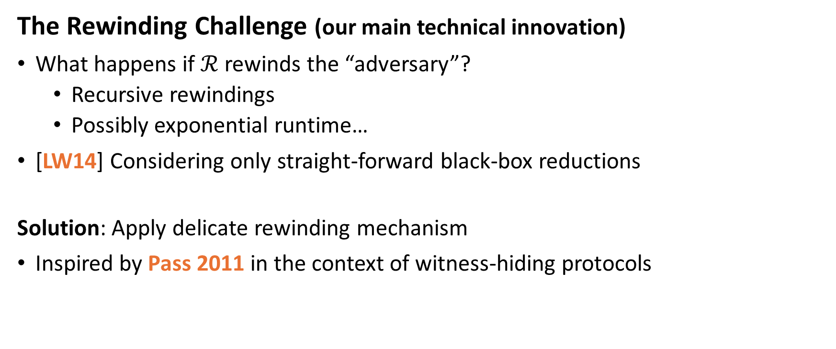
Proof Overview
The Rewinding Challenge (our main technical innovation)
What happens if $ℛ$ rewinds the “adversary”?
  Recursive rewindings
  Possibly exponential runtime…
[LW14] Considering only straight-forward black-box reductions
Solution: Apply delicate rewinding mechanism
Inspired by Pass 2011 in the context of witness-hiding protocols
Notes:
So, what happens if the reduction tries to “test” our simulated adversary and rewind it as well?
This could lead to “recursive” rewindings – our algorithm B would rewind the reduction to get another secret key, but then the reduction would try to rewind the simulated adversary B, which again would rewind the reduction, and so on.
We could end up with an exponential blow-up in running time.
<Click> Lewko and Waters avoided this issue by applying their argument only to straightforward black-box reductions.
In our work, we generalize the result to rewinding reductions by adopting a more delicate rewinding approach introduced by Pass in 2011 in the context of witness-hiding protocols.
[0:37]

Slide 13


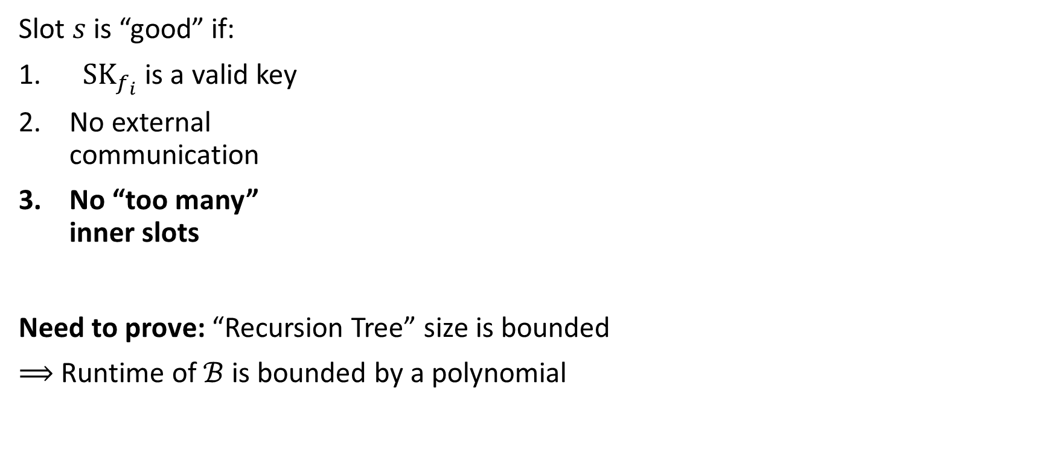

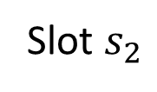

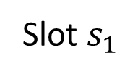




“The Slot Technique”
PP
$$ℛ$$
Reduction
$$ℬ$$
Slot $s$ is “good” if:
${ SK}_{f_{i}}$is a valid key
No external
communication
No “too many”
inner slots
Need to prove: “Recursion Tree” size is bounded
$⟹$ Runtime of $ℬ$ is bounded by a polynomial
$$f_{1}$$
Slot $s_{1}$
$${ SK}_{f_{1}}$$
$$f_{2}$$
Slot $s_{2}$
$${ SK}_{f_{2}}$$
$$⋮$$
$$⋮$$
Notes:
We define a slot S as the shortest “time window” which is a candidate for us to rewind in order to extract an additional secret key. In other words, this is the time frame that contains a single key query and response.
We say a slot is “good” for rewinding if: <Click>
The secret key received is a valid one, of course.
During the slot, there is no communication between R and C (since we don’t want to disturb the interaction of R and C).
There aren’t “too many” inner slots within the slot, so we do not blow up the running time “too much”.
Whenever B encounters a good slot, it rewinds several times it in order to obtain additional secret keys.
I will not go into the technical details, but generally speaking, by using this technique we exploit the fact that the reduction cannot rewind the simulated adversary “too much” because it has to be efficient as well, so there must be enough “good slots” for us to rewind.
As a result, we successfully bound the size of the “recursion tree” that describes the nested rewindings, and this way prove that the runtime of our algorithm B is polynomially bounded.
[1:08]

Slide 14
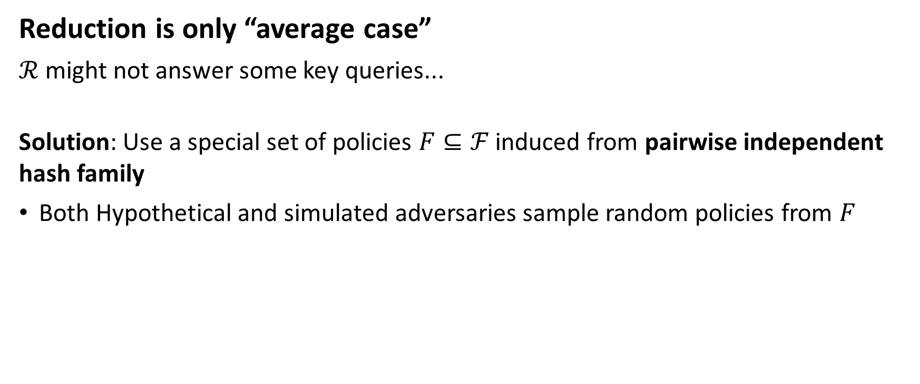
Proof Overview
Reduction is only “average case”
$ℛ$ might not answer some key queries...
Solution: Use a special set of policies $F⊆ℱ$ induced from pairwise independent hash family
Both Hypothetical and simulated adversaries sample random policies from $F$
Notes:
Moving on, there is one more issue that we must resolve:
Recall that our simulated adversary has to “trick” every black box reduction, not only an “average case”. Therefore, it cannot presume that the reduction would always “play nicely”.
That is, in some scenarios the reduction could provide “bad keys” or simply abort the interaction.
So we need a way to guarantee that B can always decrypt challenge ciphertexts same as the hypothetical adversary, even if the reduction sometimes misbehaves.
For that purpose we use a special set of policies, F, that is derived from a pairwise independent hash family.
Both the hypothetical adversary and the simulated one sample random policies from F during the query phases to guarantee indistinguishability
[0:46]

Slide 15
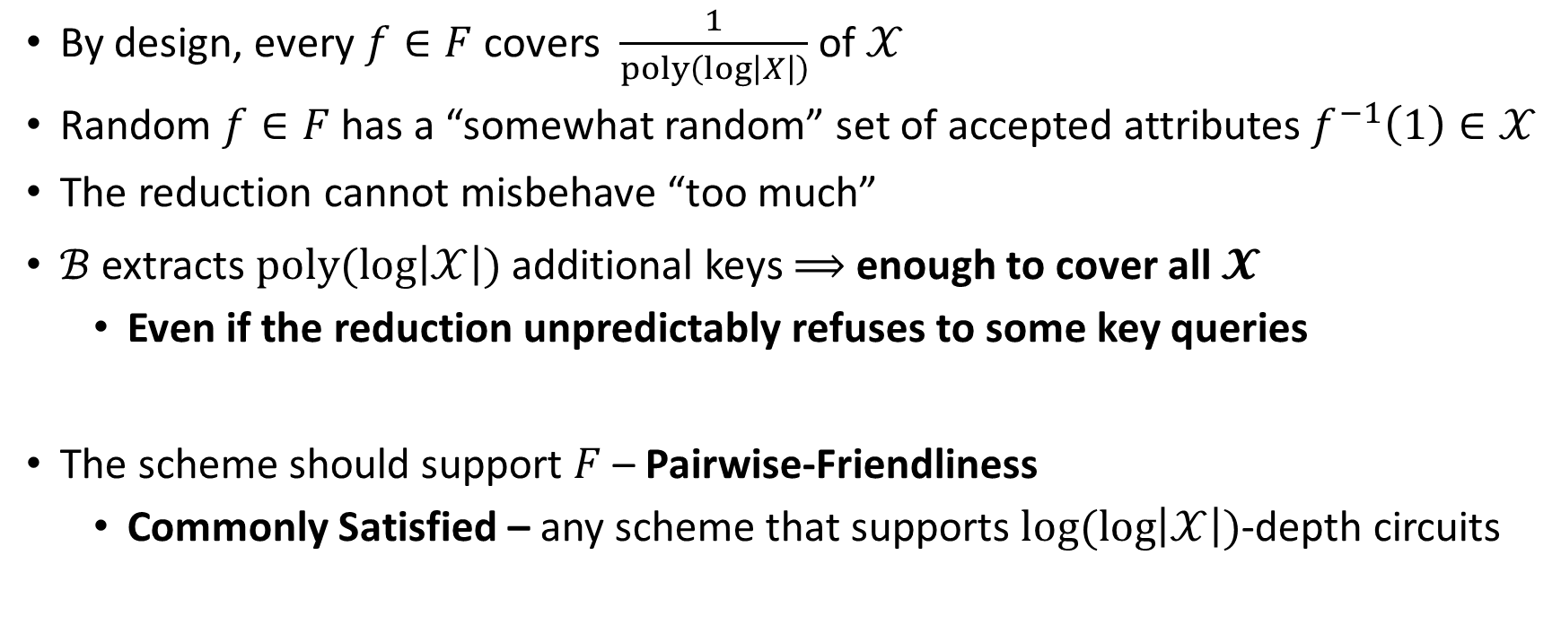
Pairwise-Friendliness
By design, every $f∈F$ covers $\frac{1}{poly\left(log\left|X\right|\right)}$ of $𝒳$
Random $f∈F$ has a “somewhat random” set of accepted attributes $f^{−1}\left(1\right)∈𝒳$
The reduction cannot misbehave “too much”
$ℬ$ extracts $poly(log\left|𝒳\right|)$additional keys $⟹$ enough to cover all $𝓧$
  Even if the reduction unpredictably refuses to some key queries
The scheme should support $F$ – Pairwise-Friendliness
  Commonly Satisfied – any scheme that supports $log(log\left|𝒳\right|)$-depth circuits
Notes:
By design of this special set F, every policy in F covers a fraction of the attribute set X.
Intuitively, the pairwise independence ensures that a uniformly random policy has a “somewhat random” set of accepted attributes, which is again a poly fraction of X.
We combine these properties with the fact that the reduction cannot misbehave “too much”, because it needs the cooperation of the adversary as well, in order to break the hardness assumption.
Without getting into the probabilistic analysis, we use these to prove that no matter what’s the security reduction strategy, B always extracts a polynomial-size set of keys that covers every attribute in X.
An important note here is that the ABE scheme must support our special set of policies – a property which we call Pairwise Friendliness.
Fortunately, this is commonly satisfied, for example by any scheme that supports NC1 circuits.
[0:43]

Slide 16
Wrapping Things Up
To prove adaptive security, one must eliminate the possibility of checkability
Requires more complex and “unnatural” methods [Wat09, Tsa19]
Application to [BGG+14]
Notes:
So, to wrap things up, we proved that any checkable ABE scheme cannot be proven adaptively secure by a black box reduction, even a rewinding one.
An important conclusion is that in order to prove adaptive security for an ABE scheme, one must eliminate the possibility of checkability.
This requires more complex and “unnatural” methods, as observed in existing adaptively secure constructions.
In addition, we applied our result to the delegatable version of the prominent lattice-based ABE scheme introduced by Boneh et al. from 2014, using our simpler checkability notion the application is very natural and elegant.
<The general idea behind the application, without getting into too much details, is using the secret key trapdoor and translating it generically into a trapdoor for the ciphertext attribute, and then “decode” the (unique) noise vector of the ciphertext and validate that it is indeed a short vector.
We formally proved that this “decoding” yields the same result for any valid lattice trapdoor, thus the decryption is canonical, as desired.>
[0:26]

Slide 17
Thank You!

