Slide 1
Unclonable Commitments and Proofs
Vipul Goyal, Giulio Malavolta, and Justin Raizes

Slide 2
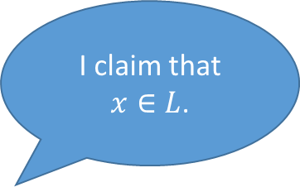
Zero Knowledge Proofs
I claim that $x∈L$.
Prover
Adversarial Verifier
Witness: w
???

Slide 3
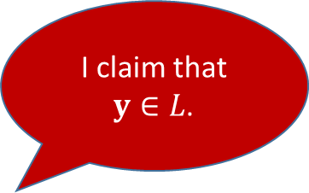
Non-Malleable Proofs [DDN98]
I claim that $y∈L$.
I claim that $x∈L$.
Prover
Prover
Adversarial Verifier
Man-in-the-Middle
(MiM)
Adversarial Verifier
Man-in-the-Middle
(MiM)
Verifier
Witness: w
???

Slide 4
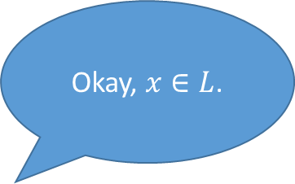

Forwarding in Non-malleable Proofs
I claim that $x∈L$.
Okay, $x∈L$.
I claim that $x∈L$.
Prover
Man-in-the-Middle
(MiM)
Verifier
Witnesses are for losers.

Slide 5
Quantum No-Cloning

Slide 6
Can we construct proofs that cannot be cloned?
More basic question: What about commitments?

Slide 7
Our Results
  Definitions for unclonable commitments and proofs
  Same-Protocol: Right sessions use the same protocol as the left session.
    Commitments from various assumptions, with tradeoffs.
    Proofs are equivalent to public-key quantum money.
Verifier/Receiver
Prover/Sender
Man-in-the-Middle
(MiM)
Verifier/Receiver

Slide 8
Our Results
  Definitions for unclonable commitments and proofs
  Same-Protocol: Right sessions use the same protocol as the left session.
    Commitments from various assumptions, with tradeoffs.
    Proofs are equivalent to public-key quantum money.
  Strong Unclonability: Right sessions may use arbitrary verification
  procedures.
    Commitments in the QROM.
    Proofs are impossible.
Verifier/Receiver
Prover/Sender
Man-in-the-Middle
(MiM)
Verifier/Receiver

Slide 9
Our Results
  Definitions for unclonable commitments and proofs
  Same-Protocol: Right sessions use the same protocol as the left session.
    Commitments from various assumptions, with tradeoffs.
    Proofs are equivalent to public-key quantum money.
  Strong Unclonability: Right sessions may use arbitrary verification
  procedures.
    Commitments in the QROM.
    Proofs are impossible.
This talk
Verifier/Receiver
Prover/Sender
Man-in-the-Middle
(MiM)
Verifier/Receiver

Slide 10
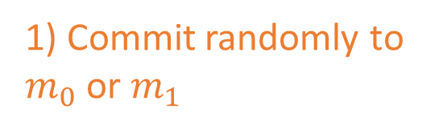

Definition: Commitments
1) Commit randomly to $m_{0}$ or $m_{1}$
$$Com(m_{b})$$
Challenger
Man-in-the-Middle
(MiM)

Slide 11


Definition: Commitments
1) Commit randomly to $m_{0}$ or $m_{1}$
$${\tilde{Com}}_{0}$$
$$Com(m_{b})$$
Challenger
Man-in-the-Middle
(MiM)
$${\tilde{Com}}_{1}$$
2) Adversary splits the commitment

Slide 12


Definition: Commitments
3) Oracle reveals committed message
1) Commit randomly to $m_{0}$ or $m_{1}$
$$\tilde{m_{0}}$$
$${\tilde{Com}}_{0}$$
$$Com(m_{b})$$
Oracle
Challenger
Man-in-the-Middle
(MiM)
$${\tilde{Com}}_{1}$$
$$\tilde{m_{1}}$$
2) Adversary splits the commitment
Oracle

Slide 13
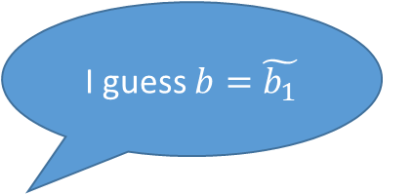
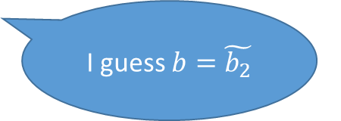
Definition: Commitments
3) Oracle reveals committed message
I guess $b=\tilde{b_{1}}$
1) Commit randomly to $m_{0}$ or $m_{1}$
$$\tilde{m_{0}}$$
$${\tilde{Com}}_{0}$$
$$Com(m_{b})$$
Oracle
Distinguisher 1
4) Distinguishers guess b without communicating
Challenger
Man-in-the-Middle
(MiM)
$$\tilde{m_{1}}$$
I guess $b=\tilde{b_{2}}$
$${\tilde{Com}}_{1}$$
2) Adversary splits the commitment
Oracle
Distinguisher 2

Slide 14
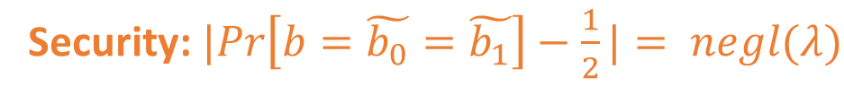
Definition: Commitments
3) Oracle reveals committed message
I guess $b=\tilde{b_{1}}$
1) Commit randomly to $m_{0}$ or $m_{1}$
$$\tilde{m_{0}}$$
$${\tilde{Com}}_{0}$$
$$Com(m_{b})$$
Oracle
Distinguisher 1
4) Distinguishers guess b without communicating
Challenger
Man-in-the-Middle
(MiM)
$$\tilde{m_{1}}$$
I guess $b=\tilde{b_{2}}$
$${\tilde{Com}}_{1}$$
2) Adversary splits the commitment
Oracle
Distinguisher 2
Security: $|Pr\left[b=\tilde{b_{0}}=\tilde{b_{1}}\right]−\frac{1}{2}|= negl(λ)$

Slide 15
Definition: Commitments
I guess $b=\tilde{b_{1}}$
$$\tilde{m_{0}}$$
$${\tilde{Com}}_{0}$$
$$Com(m_{b})$$
Oracle
Distinguisher 1
Challenger
Man-in-the-Middle
(MiM)
$$\tilde{m_{1}}$$
I guess $b=\tilde{b_{2}}$
$${\tilde{Com}}_{1}$$
Oracle
Distinguisher 2
Intuitively, if session 1 is correlated to the left session, then session 2 should be independent.

Slide 16
Unclonable Commitments vs Unclonable Encryption
Unclonable Encryption:
  Adversary tries to split the ciphertext into two parts which it can independently decrypt when it steals the key later.
  Philosophically: adversary wants to collect information for later use.

Slide 17
Unclonable Commitments vs Unclonable Encryption
Unclonable Encryption:
  Adversary tries to split the ciphertext into two parts which it can independently decrypt when it steals the key later.
  Philosophically: adversary wants to collect information for later use.
Unclonable Commitments:
  Philosophically: adversary wants to use the information before it breaks hiding.

Slide 18
Definition: Extraction-Unclonability for Proofs
Real World
Ideal World
Prove(s1, ?)
Prove(s, w)
Prove(s2, ?)
Verifier
Prover
MiM
Verifier

Slide 19

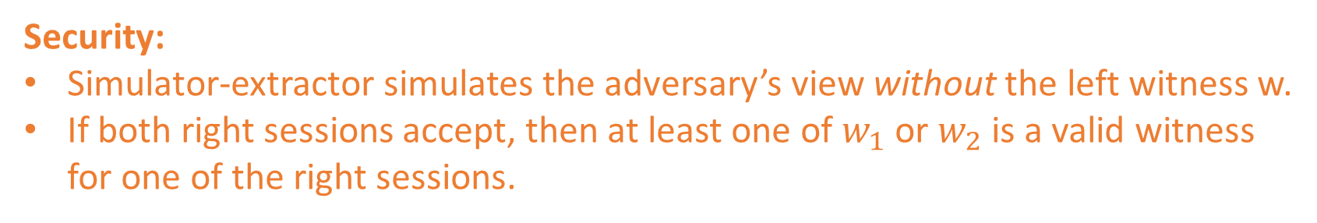

Definition: Extraction-Unclonability for Proofs
Real World
Ideal World
Prove(s1, ?)
Prove(s, w)
$$w_{1}, w_{2}$$
Prove(s2, ?)
Verifier
Prover
MiM
MiM
Simulator
Verifier
Security:
Simulator-extractor simulates the adversary’s view without the left witness w.
If both right sessions accept, then at least one of $w_{1}$ or $w_{2}$ is a valid witness for one of the right sessions.

Slide 20



Construction Key Idea
Non-malleability is very similar:
If $tag≠\tilde{tag}$, then the right session is independent of the left.
Idea: unclonable tags!
$$tag_{}$$
$$\tilde{tag}$$
Prover
MiM
Verifier

Slide 21


Unclonable Tag Generation
At the end of the protocol, Alice and Bob output the same tag.
Alice
Bob
$$tag$$
$$tag$$

Slide 22



Unclonable Tag Generation: Security
$$\tilde{tag_{2}}$$
Honest 2
Honest 1
Man-in-the-Middle
(MiM)
$$\tilde{tag_{3}}$$
$$tag_{L}$$
Honest 3

Slide 23
Unclonable Tag Generation: Security
$$\tilde{tag_{2}}$$
Honest 2
Honest 1
Man-in-the-Middle
(MiM)
$$\tilde{tag_{3}}$$
$$tag_{L}$$
Honest 3
Security: At least one of the three tags output by honest parties is different.

Slide 24
Proof Application: Unclonable Credentials

Slide 25

Non-Interactive Unclonable Tag Generation from Public-Key Quantum Money
Offline phase
Alice
Bob

Slide 26
Non-Interactive Unclonable Tag Generation from Public-Key Quantum Money
Offline phase
Alice
Bob

Slide 27
Non-Interactive Unclonable Tag Generation from Public-Key Quantum Money
Offline phase
Serial number: s
Alice
Bob

Slide 28
Non-Interactive Unclonable Tag Generation from Public-Key Quantum Money
Offline phase
Alice
Bob
Does it match the serial number Alice claimed?
Output: s

Slide 29
Non-Interactive Unclonable Tag Generation from Public-Key Quantum Money
Offline phase
Alice
Bob
Does it match the serial number Alice claimed?
Output: s
Output: s

Slide 30
Non-Interactive Unclonable Tag Generation from Public-Key Quantum Money
Offline phase
Serial number: s
Alice
Bob
Hey, this doesn’t match!
Serial number: s
Charlie

Slide 31
Non-Interactive Unclonable Commitments
Commitment Phase
Sender
Receiver
Opening Phase
Sender
Receiver

Slide 32
Non-Interactive Unclonable Commitments
Tag is generated and used, but not checked.
Commitment Phase
Sender
Receiver
Don’t need public verifiability!
Reveal secret information allowing the tag to be checked.
Opening Phase
Sender
Receiver

Slide 33
Thanks for listening!

