Slide 1
Monotone-Policy BARGs from BARGs and additively homomorphic encryption
Shafik Nassar Brent Waters David Wu

Slide 2
Non-interactive Batch Arguments (BARGs)
Common random string
$$x_{1},…, x_{k}$$
$$π$$
$$x_{1},…, x_{k}$$
$$w_{1},…, w_{k}$$
Completeness: If $∀i :\left(x_{i},w_{i}\right)∈ℛ_{ℒ}$ then verifier accepts
Non-adaptive Soundness: If $∃i :x_{i}∉ℒ$ then verifier rejects
Adversary chooses $x_{1},…, x_{k}$, then $crs$ is sampled
Succinctness: $\left|π\right|=poly\left(λ,n,\log{k}\right)$

Slide 3
Somewhere Extractable BARGs
Common random string
$$x_{1},…, x_{k}$$
$$π$$
$$x_{1},…, x_{k}$$
$$w_{1},…, w_{k}$$
CRS generation: $crs←Gen$ or $\left(crs,td\right)←TrapGen\left(i∈\left[k\right]\right)$
Index hiding: $\left\{crs←Gen\right\}≈_{c}\left\{crs :\left(crs,td\right)←TrapGen\left(i∈\left[k\right]\right)\right\}$
Somewhere Extraction: If verifier accepts $π$ then ${{\tilde{w}}_{i}←Extract}_{td}\left(π\right)$ such that $\left(x_{i},{\tilde{w}}_{i}\right)∈ℛ_{ℒ}$

Slide 4
Importance of BARGs
Applications of BARGs
Proving many statements “at the price of 1”
SNARGs for $P$ [KVZ21, CJJ21]
NIZKs [CW23, BKPRV23, BWW24]
Aggregate signatures [WW22,DGKV22]
Sufficient assumptions for BARGs
Based on LWE [CJJ21]
k-Lin in pairing groups [WW22]
Sub-exponential DDH [CGJJZ23]
Notes:
Let’s talk about a specific application

Slide 5
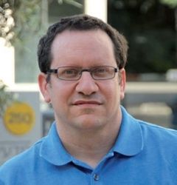
Multi-Signatures
Given $k$ parties, prove that all of them signed a message $m$
$${vk}_{1},…, {vk}_{k}$$
$${vk}_{1},…, {vk}_{k}$$
$$σ_{1},m$$
$${sk}_{1},{vk}_{1}$$
$$\tilde{σ},m$$
$$σ_{2},m$$
$$σ_{k},m$$
$${sk}_{2},{vk}_{2}$$
$${sk}_{k},{vk}_{k}$$
Succinctness: $\left|\tilde{σ}\right|=poly\left(λ,\log{k}\right)$
Notes:
Here, I look at the specific case of multi-signature, i.e., all parties sign the same message

Slide 6
Threshold Multi-Signatures
(Monotone-Policy)
Given $k$ parties, prove that most of them signed a message $m$
$${vk}_{1},…, {vk}_{k}$$
$${vk}_{1},…, {vk}_{k}$$
$$σ_{1},m$$
$${sk}_{1},{vk}_{1}$$
$$\tilde{σ},m$$
$$σ_{2},m$$
$$σ_{k},m$$
$${sk}_{2},{vk}_{2}$$
$${sk}_{k},{vk}_{k}$$
Succinctness: $\left|\tilde{σ}\right|=poly\left(λ,\log{k}\right)$
Notes:
We can generalize this to threshold signatures, where my goal is to convince the verifier that maybe a majority of the parties have signed the message.
Even more generally, I might want to prove that the signing parties satisfy a certain monotone policy. Let us quickly recall what that is...

Slide 7
Monotone Boolean Circuits
A monotone Boolean circuit $P :{\left\{0,1\right\}}^{k}→\left\{0,1\right\}$ has only $∧$ and $∨$ gates
Computes a monotone policy
Captures conjunction, disjunction, majority, weighted thresholds, monotone CNF...
Notes:
A monotone circuit is a circuit without negations, so if I flip any input from 0 to 1, the output may only be flipped from 0 to 1 (and not the opposite).
So such a circuit computes a monotone policy, and those policies capture everything we might want from an aggregate signature scheme...
Now, if aggregate signatures can be constructed using BARGs, then maybe MP aggregate signatures can be constructed using MP BARGs?

Slide 8
Monotone-Policy BARGs [BBKLP23]
Common random string
$$x_{1},…, x_{k}$$
$$π$$
$$x_{1},…, x_{k}$$
$$w_{1},…, w_{k}$$
$$P$$
$$P$$
Additional input: monotone policy $P :{\left\{0,1\right\}}^{k}→\left\{0,1\right\}$
Define bits $b_{i}≔\left(x_{i}∈ℒ\right)$
Completeness: If $P\left(b_{1},…,b_{k}\right)=1$ then verifier accepts
Soundness: If $P\left(b_{1},…,b_{k}\right)=0$ then verifier rejects
Succinctness: $\left|π\right|=poly\left(λ,n,\log{k}\right)$

Slide 9
Known Constructions
SNARGs trivially imply (monotone-policy) BARGs
So we interested in assumptions that do not imply SNARGs
Monotone-policy BARGs are a generalization of BARGs
Natural to start from a BARG as a baseline assumption
Previous work:
Regular BARG and FHE give a monotone-policy BARG for all poly-size monotone circuits [BBKLP23]
Regular BARG and only CRH give a constrained monotone-policy BARG [BBKLP23] and concurrent to our work [BCJP24]
... and that’s it
log-depth or read-once bounded-space
From what assumptions can we compile BARGs into general monotone-policy BARGs?
Notes:
Actually, the bounded space might need more than CRHF? Check BCJP24.
It doesn’t. Need a vPIR, but that can be constructed from BARGs + CRHF.

Slide 10
Our Results
TL;DR: Compile a regular BARG into a general monotone-policy BARG using additively homomorphic encryption
Theorem: Assuming additively homomorphic encryption and a somewhere-extractable BARG, there exists a monotone-policy BARG for all poly-size monotone circuits with:
Proof size $poly\left(λ,n,\log{k}\right)$
Non-adaptive soundness
Corollary: can instantiate monotone-policy BARGs from more assumptions like bilinear maps or sub-exp DDH
Notes:
As you can see, we don’t get extraction, but rather only soundness. Is that enough to get any useful applications? Absolutely! And we prove it in the following result...

Slide 11
Back to signatures...

Slide 12
Batch Arguments
$$m,{vk}_{1},…, {vk}_{k}$$
$$π$$
$$m,{vk}_{1},…, {vk}_{k}$$
$$σ_{1},…, σ_{k}$$
Constructions crucially relied on somewhere extractability
Multi Signatures
$${vk}_{1},…, {vk}_{k}$$
$${vk}_{1},…, {vk}_{k}$$
$$σ_{1},m$$
$${sk}_{1},{vk}_{1}$$
$$\tilde{σ},m$$
$$σ_{2},m$$
$$σ_{k},m$$
$${sk}_{2},{vk}_{2}$$
$${sk}_{k},{vk}_{k}$$
Notes:
But to prove security, we need to use an adversary that breaks the aggregate signature to an adversary that breaks the original signature scheme using the BARG, therefore we need to “extract” a forgery from the BARG proof for the original signature scheme!
Enter Extraction...

Slide 13
We didn’t define somewhere extractability for monotone policy BARGs
It is not even clear what the natural definition would be
Can we get any applications without somewhere extractability?
YES

Slide 14
Our Additional Results
TL;DR: a monotone-policy BARG can be used for constructing monotone-policy multi-signatures
Theorem: Assuming non-extractable (monotone-policy) BARGs and puncturable signature schemes, there exist (monotone-policy) multi-signature schemes
Notes:
It is not even clear how to define a natural and useful extraction property for monotone BARGs. We do indeed get some notion of extraction, but it’s not clear that it is more useful than non-extractable BARGs.
For example, in the latest Eurocrypt, a paper on aggregate signatures posed “defining the right notion of extractability for monotone BARGs” as an open question

Slide 15
Today: monotone-policy BARGs from (BARGs and) additively homomorphic encryption

Slide 16
Soundness: Previous Work [BBKLP23]
Define “predicate-extractable hash”
The hash key is programmed to “bind” on certain indices e.g. $hk$ binds $y_{1}=0,y_{17}=0$
There is a secret extraction trapdoor
$${Hash}_{hk}$$
$${Extr}_{td}$$
$$Matching$$
$$y^{∗}$$
$$17$$
$$y=$$
0
0
$$dig$$
1
$$y_{1}$$
$$y_{17}$$
If hashed string does not satisfy binding, then we can extract a violating index using the trapdoor
Can be constructed using FHE
FHE seems inherent because of the extraction property!
Notes:
PEH is a generalization of SSB.

Slide 17
Soundness: Our Work
relaxed extraction: only outputs a flag Matching/NotMatching
Define zero-fixing hash
The hash key is programmed to “bind” on certain indices e.g. $hk$ binds $y_{1}=0,y_{17}=0$
There is a secret extraction trapdoor
$${Hash}_{hk}$$
$${Extr}_{td}$$
$$17$$
$$y^{∗}$$
$$NotMatching$$
$$y=$$
0
0
$$dig$$
1
$$y_{1}$$
$$y_{17}$$
Because of the relaxed extraction, we can implement zero-fixing hash from a wide variety of assumptions:
Generic construction using additively homomorphic encryption and BARGs
Direct construction from pairings
Notes:
Of course, there is still the challenge of actually constructing the MP BARG from this weaker extraction property. We don’t have time to go over it here, but I’d love to talk about it offline.

Slide 18
Conclusions
Additively homomorphic encryption suffices to compile BARGs to monotone-policy BARGs
This work actually requires additively homomorphic encryption over large groups
In a follow up work, we show that any AHE (e.g., Goldwasser-Micali) suffices
Notes:
Require things weaker than additively HE, ideally just collision resistant hash? In particular, maybe the original blueprint can be proved secure?
Has to be a “deep” circuit
Beyond aggregate signatures and the natural theoretical appeal.

Slide 19
Open questions
What are the minimal assumptions needed to compile BARGs to monotone-policy BARGs?
In the log-depth case, CRHF suffices
Do monotone-policy BARGs have additional applications?
Other than monotone-policy multi signatures
Can we get a monotone-policy BARG with a short CRS (independent of the policy size)?
Did not mention it here, but the CRS grows linearly with the policy size
Notes:
Require things weaker than additively HE, ideally just collision resistant hash? In particular, maybe the original blueprint can be proved secure?
Has to be a “deep” circuit
Beyond aggregate signatures and the natural theoretical appeal.

Slide 20
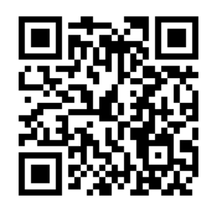
https://ia.cr/2023/1967

Slide 21
Generic Construction for Monotone-Policy BARGs

Slide 22
Hash & BARG: Soundness
1
$$b_{out}$$
0
Idea:
Fix a NO instance $P,x_{1},…,x_{k}$
$P\left(b_{1},…,b_{k}\right)=0$
Circuit is monotone $⇒$ Can only make output 1 by flipping $0$ to $1$
Not vice versa
Series of hybrids
$$∨$$
0
1
0
$$b_{5}$$
$$b_{6}$$
$$∧$$
$$∨$$
$$b_{1}$$
$$b_{2}$$
$$b_{3}$$
$$b_{4}$$
0
Extract $w_{1}$ s.t. $b_{1}=ℛ_{ℒ}\left(x_{1},w_{1}\right)$
1
1
0
0
Contradiction to $x_{1}∉ℒ$
Notes:
If adversary wins the non-adaptive soundness game, then it can flip the output from 0 to 1.
Using the BARG and the commitment scheme, if you can flip the output of some game to 1, then you must also be able to flip one of its inputs! We do this inductively until we get to the base case; a leaf!

Slide 23
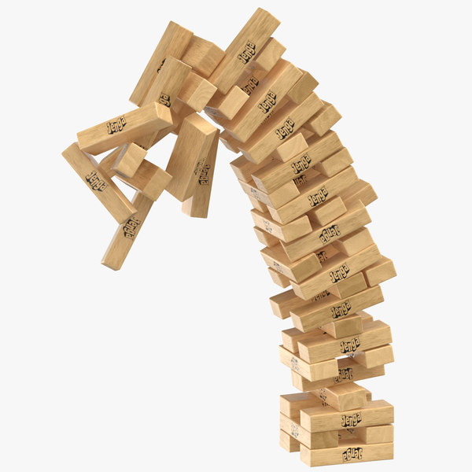
Hash & BARG: Soundness
$$b_{out}$$
0
Problem:
To flip $b_{6}$, enough to flip either $b_{3}$ or $b_{4}$:
$${err}_{6}≥{err}_{3}+{err}_{4}=2⋅negl$$
Error doubles with each layer
With OR gates
Total error is exponential in depth
Can only afford logarithmic depth
$$∨$$
0
1
0
$$b_{5}$$
$$b_{6}$$
$$∧$$
$$∨$$
$$b_{1}$$
$$b_{2}$$
$$b_{3}$$
$$b_{4}$$
0
1
1
0
0
1
Notes:
Because relation requires

Slide 24
How we use Zero-Fixing Hash

Slide 25
Soundness: Our Work
$$b_{7}$$
0
How to prove soundness using the relaxed extraction?
Propagating Zeroes via ZFH
Process layer by layer bottom up
If we can’t flip any wire in layer $i$
Then we can’t flip any wire in layer $i+1$
Use 2 hashes to propagate constraints, without pinpointing the exact wire
$$∨$$
0
0
$$∧$$
$$b_{5}$$
$$b_{6}$$
$$∨$$
$$b_{1}$$
$$b_{2}$$
$$b_{3}$$
$$b_{4}$$
0
1
0
0
$$x_{1}$$
$$x_{2}$$
$$x_{3}$$
$$x_{4}$$

Slide 26
Constructing Zero-Fixing Hash

Slide 27
ZFH Construction: Overview
The digest is a ciphertext
$Dec_{sk}\left({ct}_{out}\right)=0⇔Matching$
The trapdoor is the decryption key
Each index is associated with a ciphertext
Use homomorphic operation to combine
When hashing $y=y_{1}y_{2}y_{3}y_{4}$, if $y_{1}=0$ then ${ct}_{1}$ should not “count”!
Provide a special ciphertext ${ct}_{zero}$
For each bit $i$, use ${ct}_{i}$ if $y_{i}=1$ or ${ct}_{z}$ if $y_{i}=0$
$${ct}_{out}$$
Homomorphic Evaluation
$${ct}_{z}$$
$${ct}_{1}$$
$${ct}_{2}$$
$${ct}_{3}$$
$${ct}_{4}$$

Slide 28
ZFH Construction: Overview
The digest contains a ciphertext
$Dec_{sk}\left({ct}_{out}\right)=0⇔Matching$
The trapdoor is the decryption key
Each index is associated with a ciphertext
$${ct}_{i}←\left\{\begin{aligned}{Enc}_{pk}\left(1\right) if i∈S \\ {Enc}_{pk}\left(0\right) if i∉S\end{aligned}\right.$$
A special ciphertext ${ct}_{zero}←$ ${Enc}_{pk}\left(0\right)$
Combine in a way that ensures invariant
$${ct}_{out}$$
Homomorphic Computation
$${ct}_{z}$$
$${ct}_{1}$$
$${ct}_{2}$$
$${ct}_{3}$$
$${ct}_{4}$$

