Slide 1
Secure Computation with Parallel Calls to 2-ary Functions
Varun Narayanan, UCLA
Shubham Vivek Pawar, Royal Holloway
Akshayaram Srinivasan, University of Toronto

Slide 2





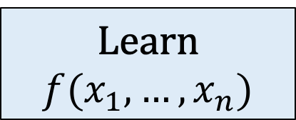


Secure Computation
[Yao 86, GMW 87]
$$x_{1}$$
$$f:𝕏^{n}→𝕐$$
Correctness
$$x_{n}$$
$$x_{2}$$
.
.
.
Learn
$$f(x_{1},…,x_{n})$$
$$x_{5}$$
$$x_{3}$$
$$x_{4}$$
Notes:
Let me recall secure computation.
We have n parties and each party has its own private input denoted by x_i. The parties have a description of a function f and the parties want to learn the output of the function applied on their private inputs.
For this purpose, the parties exchange messages with each other and this message exchange could happen over multiple rounds.
We require that at the end of the message exchange, all the parties to be able to learn the output of f on their private inputs. This is the correctness requirement.

Slide 3
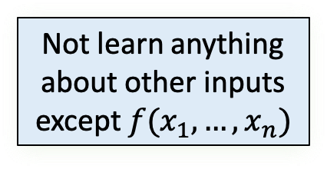
Secure Computation
[Yao 86, GMW 87]
$$x_{1}$$
$$f:𝕏^{n}→𝕐$$
Correctness
Security
$$x_{n}$$
$$x_{2}$$
.
.
.
Not learn anything about other inputs except $f(x_{1},…,x_{n})$
$$x_{5}$$
$$x_{3}$$
$$x_{4}$$
Notes:
The second property is the security which requires that even if an arbitrary subset of the parties get corrupted by an adversary, the corrupted parties should not be able to anything else about the private inputs of the uncorrupted parties except the output of the function.

Slide 4





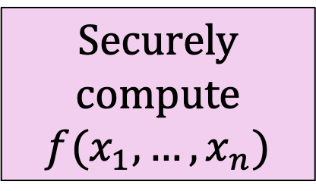


Randomized Encodings
[Yao 86, Ishai-Kushilevitz 00, Applebaum-Ishai-Kushilevitz 04]
$$x_{1}$$
$$f:𝕏^{n}→𝕐$$
$$x_{n}$$
$$x_{2}$$
Securely compute
$$f(x_{1},…,x_{n})$$
.
.
.
$$x_{5}$$
$$x_{3}$$
$$x_{4}$$
Notes:
Randomized encodings is a key tool used in the construction of secure computation protocols. At a high-level, it allows us to reduce the task of securely computing an arbitrary function f to

Slide 5


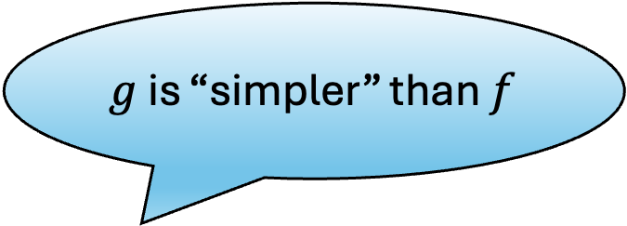



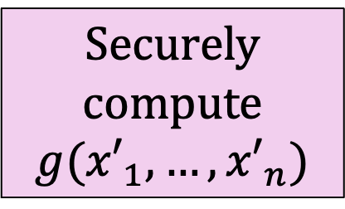


Randomized Encodings
[Yao 86, Ishai-Kushilevitz 00, Applebaum-Ishai-Kushilevitz 04]
$${x′}_{1}$$
$g$ is “simpler” than $f$
$$g:{𝕏′}^{n}→𝕐′$$
$${x′}_{n}$$
$${x′}_{2}$$
Securely compute
$$g({x′}_{1},…,{x′}_{n})$$
.
.
.
$${x′}_{5}$$
$${x′}_{3}$$
$${x′}_{4}$$
Notes:
Securely computing a related function g. Here, we want g to be simpler than f.

Slide 6
What is the measure of simplicity?
$${x′}_{1}$$
Previous works equated simplicity with constant degree
$$g:{𝕏′}^{n}→𝕐′$$
$${x′}_{n}$$
$${x′}_{2}$$
Securely compute
$$g({x′}_{1},…,{x′}_{n})$$
.
.
.
$${x′}_{5}$$
$${x′}_{3}$$
$${x′}_{4}$$
Notes:
Previous works equated simplicity with functions with constant degree. This has been instrumental in constructing constant round protocols for securely computing arbitrary functions.

Slide 7
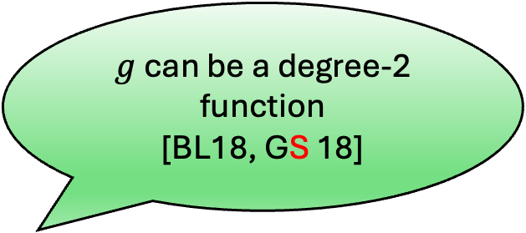
What is the measure of simplicity?
$g$ can be a degree-2 function
[BL18, GS 18]
$${x′}_{1}$$
$$g:{𝕏′}^{n}→𝕐′$$
$${x′}_{n}$$
$${x′}_{2}$$
Securely compute
$$g({x′}_{1},…,{x′}_{n})$$
Abstracted as MPRE
[ABT 18]
.
.
.
$${x′}_{5}$$
$${x′}_{3}$$
$${x′}_{4}$$
Notes:
A long sequence of works have reduced the degree of g to be 2.
This reduction has been abstracted as multiparty randomized encoding in a work of Applebaum et al.

Slide 8
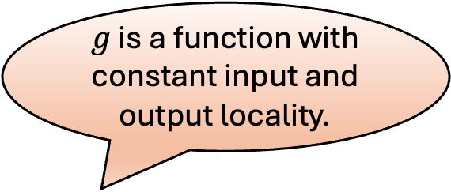
Our Notion of Simplicity
$g$ is a function with constant input and output locality.
$${x′}_{1}$$
$$g:{𝕏′}^{n}→𝕐′$$
$${x′}_{n}$$
$${x′}_{2}$$
Securely compute
$$g({x′}_{1},…,{x′}_{n})$$
.
.
.
$${x′}_{5}$$
$${x′}_{3}$$
$${x′}_{4}$$
Notes:
In this work, we consider a different notion of simplicity. We require g to be a function with constant input and output locality. This is nearly the best that one could hope for and the key question we want to answer here is that is it possible to reduce securely computing any function to securely computing functions with constant input and output locality.

Slide 9
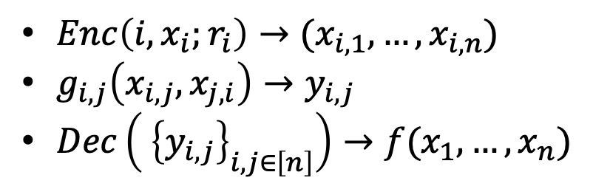
Our Model : Parallel Calls to 2-ary Functions
We can convert any protocol in this model to one making calls to a function with constant input and output locality.
[BL18,GS18]
In the semi-honest setting, we can compute any degree-2 function with parallel calls to 2-ary functions.
$Enc\left({i,x}_{i};r_{i}\right)→(x_{i,1},…,x_{i,n})$
$g_{i,j}\left(x_{i,j},x_{j,i}\right)→y_{i,j}$
$Dec\left( {\left\{y_{i,j}\right\}}_{i,j∈\left[n\right]}\right)→f(x_{1},…,x_{n})$
Is it complete against malicious adversaries?
Notes:
Towards resolving this question, we consider an extremely simple model of secure computation. We call this model as parallel calls to 2-ary functions.
Specifically, there is an encode algorithm that maps the parties private inputs to a sequence of n shares.
The 2-ary function between I,j takes in the j-th share of party I and the i-th share of party j and outputs y_{I,j}.
The decode function takes in all y_{I,j} between every pair (I,j) and computes the output of the function f.
This model is interesting because any protocol in this model can be converted into one where we make calls to a function with constant input and output locality.
Furthermore, It is not too hard to see that in the semi-honest setting constant arity is equivalent to constant degree. Specifically, we can compute each monomial and combine them to get the output.
The key question we want to answer in this work is constant arity equivalent to constant degree in the malicious setting.

Slide 10
Our Main Results
Theorem: There exists a degree-2 function that cannot be securely computed against malicious adversaries with parallel calls to 2-ary functions.
Theorem: Every degree-2 function can be securely computed against malicious adversaries with PwKO by making parallel calls to 2-ary functions.
Theorem: Assume oblivious transfer. Then, every function can be securely computed against malicious adversaries by making parallel calls to 2-ary functions.
Notes:
We show that it is not the case.
We show that there exists a degree-2 function that cannot be securely computed with parallel calls to 2-ary functions against malicious adversaries.
We show that this negative result can be overcome if we relax the security requirement to privacy with knowledge of output. PwKO guarantees that the adversarial party can force the honest parties to output an arbitrary value after learning the output from the ideal functionality.

Slide 11
Negative Result
Notes:
Let me give the main idea behind the negative result.

Slide 12
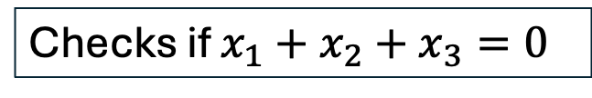
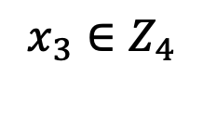
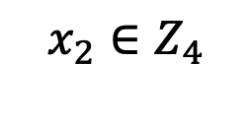
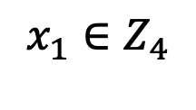
Functionality
$$x_{1}∈Z_{4}$$
This can be expressed as a degree-2 polynomial over binary
Checks if $x_{1}+x_{2}+x_{3}=0$
$$x_{2}∈Z_{4}$$
$$x_{3}∈Z_{4}$$
Notes:
Let me first describe the functionality which we show cannot be computed with parallel calls to 2-ary function.
It is a three-party functionality. The private inputs are elements from Z_3 and the function checks if x_1+x_2+x_3 = 0 over Z_3. In the paper, we show how to modify the function to computing a degree-2 function.

Slide 13



Impossibility Result
$$x_{1}∈Z_{4}$$
$$g_{1,2}$$
$$g_{1,3}$$
$$g_{2,3}$$
$$x_{2}∈Z_{4}$$
$$x_{3}∈Z_{4}$$
Notes:
Assume for the sake of contradiction that there exists a protocol for computing the given function f with parallel calls to 2-ary functions. Let us denote the 2-ary functions by g_1,2, g_2,3, and g_1,3.

Slide 14
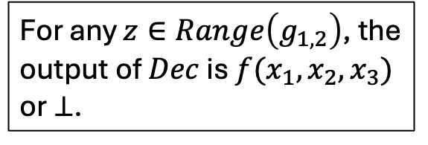
Impossibility Result
$$x_{1}∈Z_{4}$$
For any $z∈Range\left(g_{1,2}\right)$, the output of $Dec$ is $f(x_{1},x_{2},x_{3})$ or $⊥$.
$$g_{1,2}$$
$$g_{1,3}$$
$$g_{2,3}$$
$$x_{2}∈Z_{4}$$
$$x_{3}∈Z_{4}$$
Notes:
Consider an adversary that is corrupting parties 1 and 2. This adversary behaves honestly when interacting with the oracles g_2,3 and g_{1,3}. The first key observation is that for any z in the range of g_{1,2}, the output of Dec is f(x_1,x_2,x_3) or \bot. If not, this adversary can be used to distinguish between the real and ideal worlds.

Slide 15
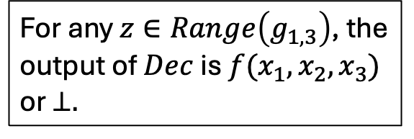
Impossibility Result
$$x_{1}∈Z_{4}$$
For any $z∈Range\left(g_{1,3}\right)$, the output of $Dec$ is $f(x_{1},x_{2},x_{3})$ or $⊥.$
$$g_{1,2}$$
$$g_{1,3}$$
$$g_{2,3}$$
$$x_{2}∈Z_{4}$$
$$x_{3}∈Z_{4}$$
Notes:
Similarly, consider another adversary that is corrupting P_1 and P_3. This adversary behaves honestly when interacting with oracles g_1,2 and g_2,3. Via a symmetric argument, for any z in the range of g_{1,3}, it follows that the output of Dec is f(x_1,x_2,x_3) or \bot.

Slide 16
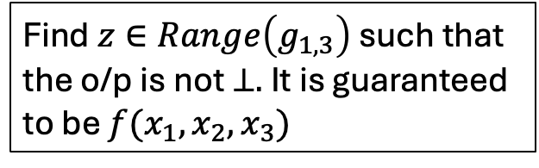
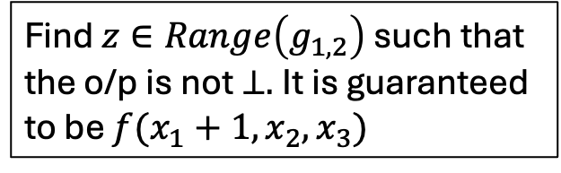
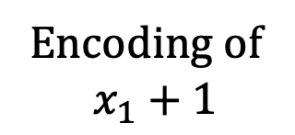
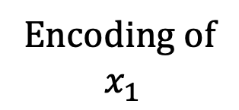
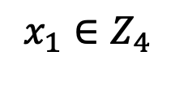
Impossibility Result
$$x_{1}∈Z_{4}$$
Encoding of
$$x_{1}$$
Encoding of
$$x_{1}+1$$
Find $z∈Range\left(g_{1,3}\right)$ such that the o/p is not $⊥.$ It is guaranteed to be $f(x_{1},x_{2},x_{3})$
$$g_{1,3}$$
Find $z∈Range\left(g_{1,2}\right)$ such that the o/p is not $⊥.$ It is guaranteed to be $f(x_{1}+1,x_{2},x_{3})$
$$g_{1,2}$$
$$g_{2,3}$$
$$x_{2}∈Z_{4}$$
$$x_{3}∈Z_{4}$$
Notes:
Now, consider an adversary that is corrupting just P_1. This adversary behaves honestly using input x_1 when interacting with g_{1,2} but uses x_1+1 as its input when interacting with g_{1,3}. We now claim that this adversary can break the security of this protocol. This adversary finds a z in the range of g_{1,2} such that the o/p of the decoder is not \bot. By the previous claims, it follows that this output is f(x_1+1,x_2,x_3). Similarly, it finds a z in the range of g_{1,3} such that the output of the decoder is not \bot. By previous claims, it follows that this output is f(x_1,x_2,x_3). Thus, this adversary breaks the security of the protocol.

Slide 17
Positive Result
How to ensure that a corrupt party does not send inconsistent inputs?
Notes:
Let’s now look at our positive result.
At a high-level, the impossibility result crucially relied on the adversary submitting inconsistent inputs to two different oracles. To overcome this, we need to somehow ensure that the corrupt party does not send inconsistent inputs.

Slide 18
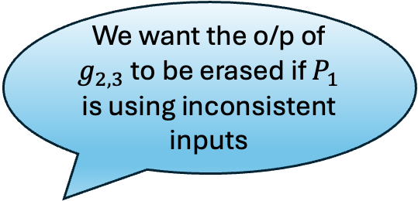




A special CDS protocol
See the paper for the details!
$$x_{1}∈Z_{4}$$
$$g_{1,3}$$
We want the o/p of $g_{2,3}$ to be erased if $P_{1}$ is using inconsistent inputs
$$g_{1,2}$$
$$g_{2,3}$$
Notes:
For this purpose, we design a special purpose CDS protocol. If P_1 uses inconsistent inputs, we want the output of g_{2,3} to be erased from adversary’s view.

Slide 19






A special CDS protocol
$$x_{1}∈Z_{4}$$
$$q_{1}\left(x\right)=ax^{2}+bx+x_{1}$$
$$q_{2}\left(x\right)=ax^{2}+bx+x_{1}$$
$$q_{1}(α_{1})$$
$$q_{2}(α_{2})$$
$$α_{2}$$
$$g_{1,2}$$
$$g_{1,3}$$
$$α_{1}$$
$$g_{2,3}$$
If $q_{1}≠q_{2},$ there exists at least one non-zero $α$ such that $q_{1}\left(α\right)≠q_{2}(α)$.
Notes:
To do this, we augment g_{1,2} and g_{1,3} as follows. P_1 now sends a random degree-2 polynomial p_1 with constant term being x_1 to g_{1,2}. It is supposed to send the same polynomial to g_1,3. P_2 sends a random non-zero field element \alpha_1 to g_1,2 and similarly, P_3 sends a random field element \alpha_2 to g_1,3. g_{1,2} outputs p_1(\alpha_1) and g_{1,3} outputs p_2(\alpha_2). Note that since a and b are randomly chosen p_1(\alpha_1) and p_2(\alpha_2) give no information about x_1.
Additionally, if p_1 \neq p_2, there exists a non-zero \alpha such that p_1(\alpha) \neq p_2(\alpha)

Slide 20
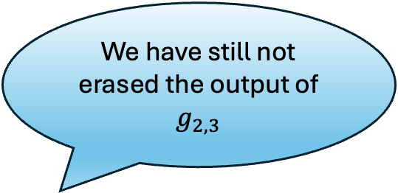

A special CDS protocol
$$x_{1}∈Z_{3}$$
$$q_{1}\left(x\right)=ax^{2}+bx+x_{1}$$
$$q_{2}\left(x\right)=ax^{2}+bx+x_{1}$$
$$q_{1}(α_{1})$$
$$q_{2}(α_{2})$$
$$α_{2}$$
$$g_{1,2}$$
$$g_{1,3}$$
$$α_{1}$$
We have still not erased the output of $g_{2,3}$
$$g_{2,3}$$
With probability 1/9, we have $α_{1}=α_{2}=α$.
Notes:
Since \alpha_1,\alpha_2 were uniformly chosen, we have with probability 1/9 that \alpha_1=\alpha_2=\alpha.
This allows us to detect with constant probability that if P_1 is cheating when sending inputs to g_1,2 and g_1,3.
However, we are not quite done as we have still not erased the output of g_2,3 from adversary’s view. We have only detected if the adversary has cheated.

Slide 21
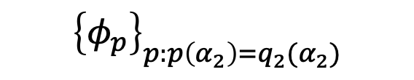
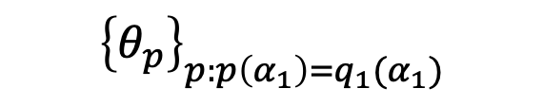


A special CDS protocol
$$x_{1}∈Z_{3}$$
$$q_{1}\left(x\right)=ax^{2}+bx+x_{1}$$
$$q_{2}\left(x\right)=ax^{2}+bx+x_{1}$$
$${\left\{θ_{p}\right\}}_{p:p\left(α_{1}\right)=q_{1}(α_{1})}$$
$${\left\{φ_{p}\right\}}_{p:p\left(α_{2}\right)=q_{2}(α_{2})}$$
$$α_{2},\{φ_{p}\}$$
$$g_{1,2}$$
$$g_{1,3}$$
$$α_{1},{\{θ}_{p}\}$$
$$g_{2,3}$$
Notes:
To additionally erase the output of g_2,3 from adversary’s view, we ask P_2 to send a bunch of random masks \theta_p for every possible degree-2 polynomial over Z_4. Simiarly, P_3 sends a bunch of random pads \phi_p for every possible degree-2 polynomial over Z_4. g_{1,2} outputs \theta_p for every p such that p(\alpha_1)= p_1(\alpha_1). Similarly, g_1,3 outputs \phi_p for every p such that p(\alpha_2) = p_2(\alpha_2)

Slide 22

A special CDS protocol
$$x_{1}∈Z_{3}$$
$$q_{1}\left(x\right)=ax^{2}+bx+x_{1}$$
$$q_{2}\left(x\right)=ax^{2}+bx+x_{1}$$
$${\left\{θ_{p}\right\}}_{p:p\left(α_{1}\right)=q_{1}(α_{1})}$$
$${\left\{φ_{p}\right\}}_{p:p\left(α_{2}\right)=q_{2}(α_{2})}$$
$$α_{2},\{φ_{p}\}$$
$$g_{1,2}$$
$$g_{1,3}$$
$$α_{1},{\{θ}_{p}\}$$
$${\{g}_{2,3}+θ_{p}+φ_{p}\}$$
With probability 1/9, o/p of $g_{2,3}$ is erased
Notes:
We additionally modify the output of g_{2,3} to be masked with \theta_p and \phi_p for every p. Note that if P_1 is not cheating, there is at least one p such that \theta_p and \phi_p are revealed. Further, this does not reveal any information about x_1 because only p_1(\alpha_1) and p_2(\alpha_2) are leaked.
If p_1 \neq p_2, then with probability 1/9, \alpha_1 = \alpha_2 = differing \alpha and in that case, there is no polynomial p such that both \theta_p and \phi_p are leaked and hence, g_2,3 is erased.

Slide 23
Other Results
Assuming one-way functions, we can compute any function with standard security against malicious adversaries with parallel calls to 3-ary functions.
Assuming one-way functions, in the honest majority setting, we can compute any function with standard security against malicious adversaries with parallel calls to 2-ary functions.

Slide 24
Thank you! https://eprint.iacr.org/2024/1701

