Slide 1
On One-way Functions, Worst-case Hardness of Time-bounded Kolmogorov complexity, and Computational Depth
Yanyi Liu
Cornell Tech
Rafael Pass
Cornell Tech
Technion
Tel Aviv U.

Slide 2
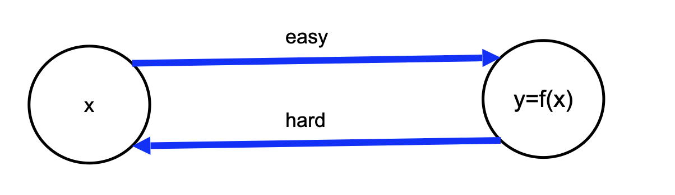
One-way Functions (OWF) [Diffie-Hellman’76]
A function f that is
Easy to compute: can be computed in poly time
Hard to invert: no PPT can invert it
OWF both necessary [IL’89] and sufficient for:
Private-key encryption [GM84,HILL99]
Pseudorandom generators [Shamir’83,BM’82,Yao’82,GL89,HILL99]
Digital signatures [Rompel90]
Authentication schemes [FS90]
Pseudorandom functions [GGM84]
Commitment schemes [Naor90]
Coin-tossing [Blum’84]
…
Not included:
public-key encryption [RSA83],
OT [Rabin81],
obfuscation [BGI+01]

Slide 3
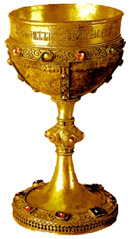
“Holy grail” [DH’76]
Can we base OWF on the worst-case hardness of NP?
(Observation: OWF => NP ⊈ BPP)

Slide 4
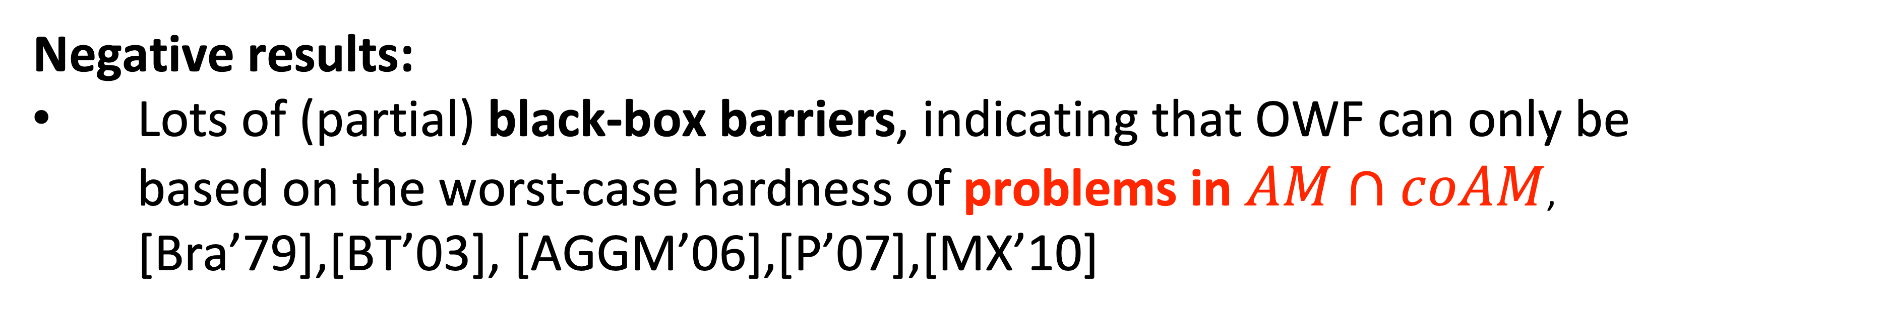
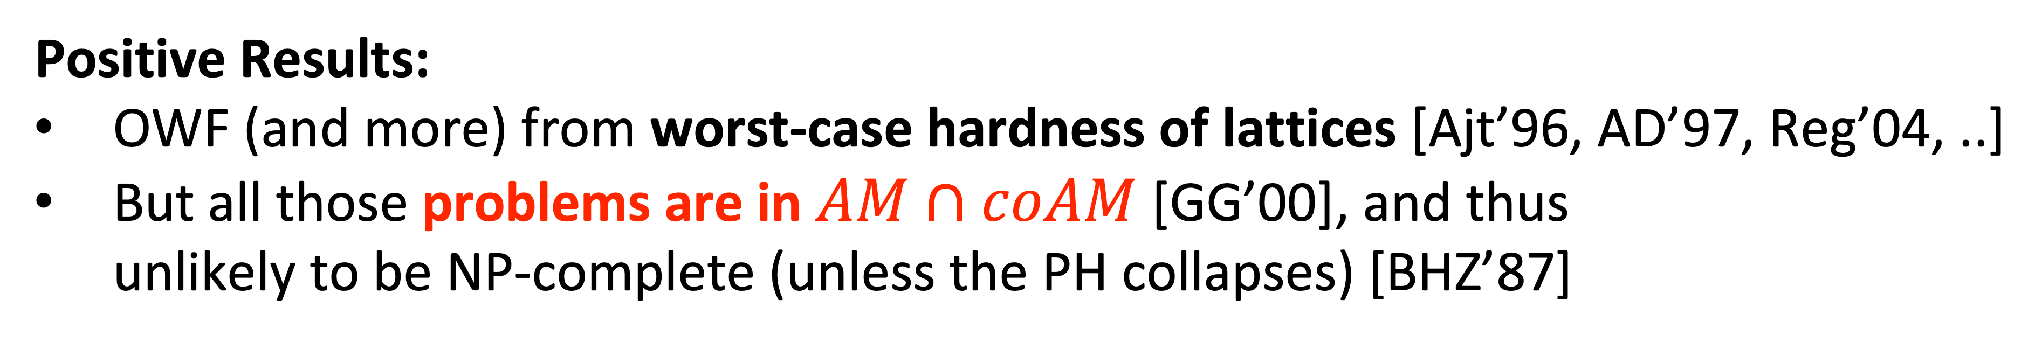
  Towards OWF from Worst-case Hardness of NP
Positive Results:
OWF (and more) from worst-case hardness of lattices [Ajt’96, AD’97, Reg’04, ..]
But all those problems are in $AM∩coAM$ [GG’00], and thus
unlikely to be NP-complete (unless the PH collapses) [BHZ’87]
Negative results:
Lots of (partial) black-box barriers, indicating that OWF can only be
based on the worst-case hardness of problems in $AM∩coAM$,
[Bra’79],[BT’03], [AGGM’06],[P’07],[MX’10]
OWF from the worst-case hardness of $Π∉AM∩coAM$?

Slide 5
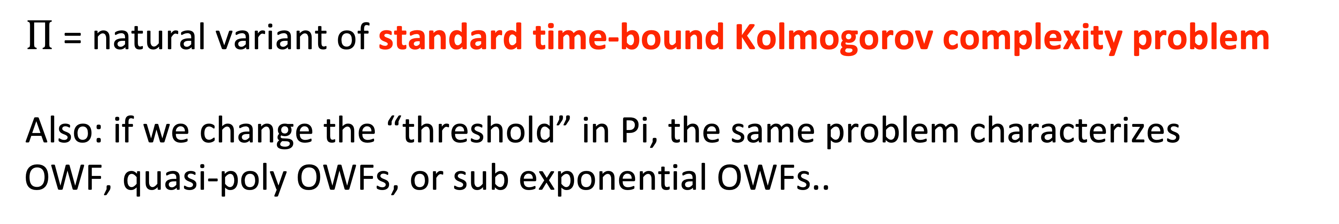
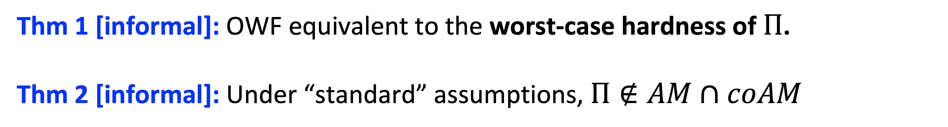
Today
Thm 1 [informal]: OWF equivalent to the worst-case hardness of $Π$.
Thm 2 [informal]: Under “standard” assumptions, $Π∉AM∩coAM$
$Π$ = natural variant of standard time-bound Kolmogorov complexity problem
Also: if we change the “threshold” in Pi, the same problem characterizes
OWF, quasi-poly OWFs, or sub exponential OWFs..

Slide 6
Theorem [LP’20]
For every polynomial t(n)>1.1n:
OWFs exist iff t-bounded Kolmogorov-complexity is mildly hard-on-average
w.r.t the uniform distribution.
Today: OWFs from worst-case hardness of Kolmogorov Complexity

Slide 7
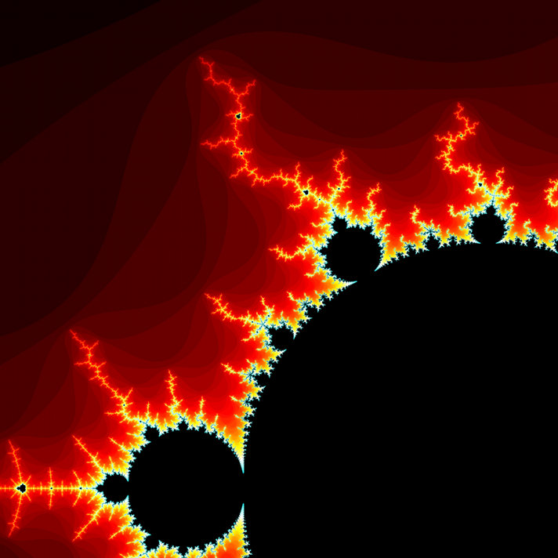
Kolmogorov Complexity [Sol’64,Kol’65,Cha’69]
Which of the following strings is more “random”:
1231231231231231231
1730544459347394037
K(x) = length of the shortest program that outputs x
K^{t}(x) = length of the shortest program that outputs x within time t(|x|)
Can K^{t} be efficiently computed when t is a polynomial?
Studied in the Soviet Union since 60s [Kol’65,T’84]
Independently by Hartmanis [83], Sipser [83], Ko [86]
Closely related to MCSP (Minimum Circuit Size Problem) [T’84,KC’00]
Perebor conjecture: No better algorithm than brute-force!

Slide 8
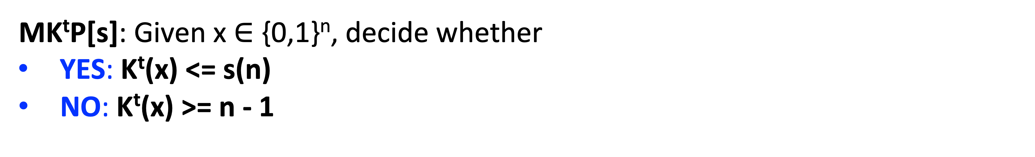
The Minimum K^{t} Problem (MK^{t}P)
MK^{t}P[s]: Given x $∈$ {0,1}^{n}, decide whether
                YES: K^{t}(x) <= s(n)
NO: K^{t}(x) >= n - 1
Long standing open problem whether NP-complete:
Lots of recent progress [Ila’20, ILO’20, Ila’21, LP’22, Hir’22, Ila’23]
Also some barriers…[MP’24] (w.r.t Levin-NP completeness, assuming iO)

Slide 9
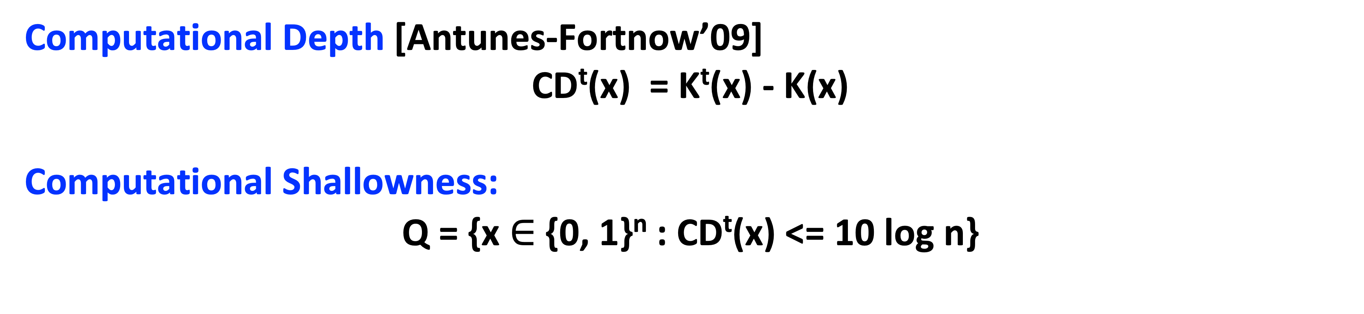
Small Computational Depth
Computational Depth [Antunes-Fortnow’09]
      CD^{t}(x) = K^{t}(x) - K(x)
Computational Shallowness:
      Q = {x $∈$ {0, 1}^{n} : CD^{t}(x) <= 10 log n}
Computational depth is a measure of “unnaturally”.
Random strings are computationally shallow
Computationally hard to find non-shallow instances [Hir’23,Ben’88]
(assuming derandomization assumptions)
[AF’09]: worst-case to errorless average-case reduction when restricting to Q!
(Already known without Q for MK^{t}P [Hir’18])

Slide 10
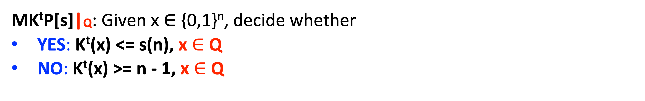
Comp Shallow MK^{t}P:
MK^{t}P[s]|Q: Given x $∈$ {0,1}^{n}, decide whether
                YES: K^{t}(x) <= s(n), x $∈$ Q
NO: K^{t}(x) >= n - 1, x $∈$ Q
The problem that we will consider:
In essence, MK^{t}P[s] “conditioned on natural instances”
Hardness of MK^{t}P[s]|Q means that any decider must fail to decide MK^{t}P[s] on a computationally shallow (i.e., natural) instance.

Slide 11
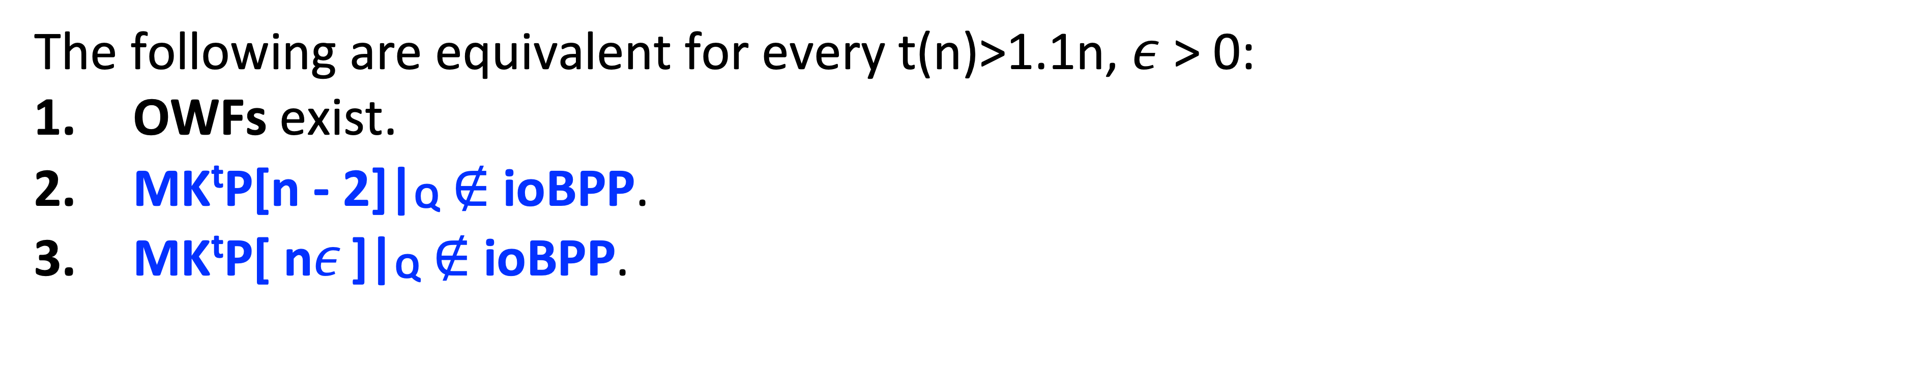
Main Theorem: A OWF-Complete Problem
The following are equivalent for every t(n)>1.1n, $ε$ > 0:
OWFs exist.
MK^{t}P[n - 2]|Q $∉$ ioBPP.
MK^{t}P[ n$ε$ ]|Q $∉$ ioBPP.
Remarks:
Uses non-black box techniques: we also prove a fully BB separation!
But still extends to the non-uniform setting.
Also characterizes quasi/subexp OWFs: by switching to a smaller “threshold”
(and considering “local compression” of K^{t}) (a la [LP’22])

Slide 12
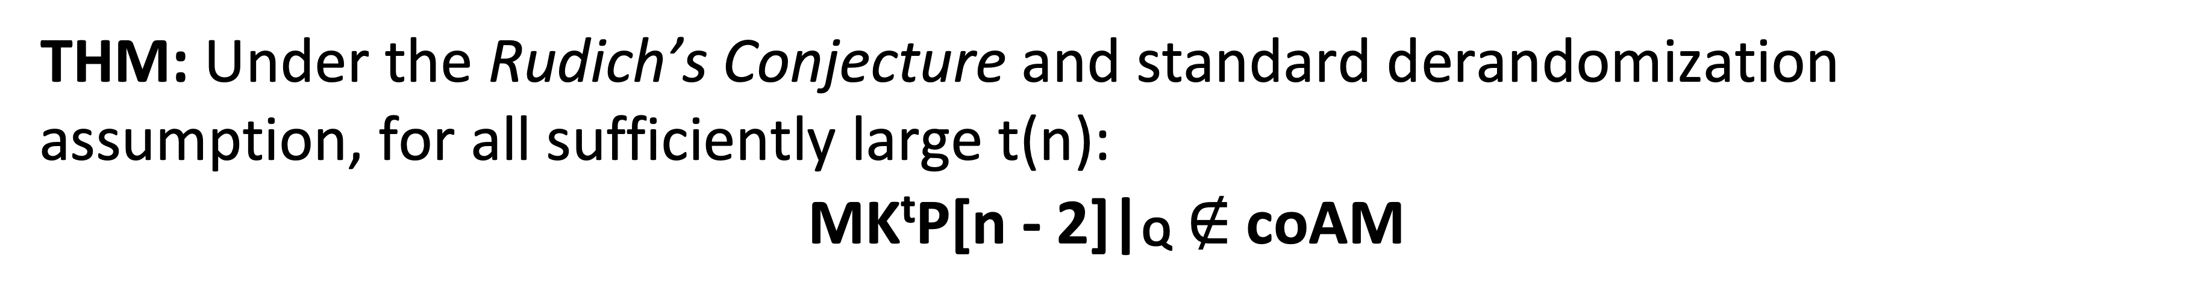
Main Theorem: A OWF-Complete Problem
The following are equivalent for every t(n)>1.1n, $ε$ > 0:
OWFs exist.
MK^{t}P[n - 2]|Q $∉$ ioBPP.
MK^{t}P[ n$ε$ ]|Q $∉$ ioBPP.
THM: Under the Rudich’s Conjecture and standard derandomization assumption, for all sufficiently large t(n):
  MK^{t}P[n - 2]|Q $∉$ coAM

Slide 13
Main Theorem: A OWF-Complete Problem
The following are equivalent for every t(n)>1.1n, $ε$ > 0:
OWFs exist.
MK^{t}P[n - 2]|Q $∉$ ioBPP.
MK^{t}P[ n$ε$ ]|Q $∉$ ioBPP.
Concurrent and independent work [HN’23]:
Also presents a worst-case characterization of OWF:
Different problem, but using a related notion of computational depth
Other differences: only characterizes ioOWF (as opposed to OWFs), not proven in the non-uniform setting.

Slide 14
The Key-idea in a Nut-Shell
Thm: MK^{t}P[n - 2]|Q $∉$ ioBPP => OWFs.
By [LP’20], average-case hardness of MKtP[n - 2] over uniform implies OWFs.
In other words, any OWF inverter can be used to solve MKtP[n - 2]
while failing only on 2^{n}/n⁴ instances
Argue: All those instance must have “small” Kolmogorov complexity < n- log n,
once we consider a particular A (which later can be used to show large CD)
- Fix some A, randomness of R such that R succeeds with the best probability
    - Since there at most there are at most 2^{n}/n⁴ instances, they can be encoded
    using log (2^{n}/n⁴) bits = n - 4 log n
    - Need log n extra bits to encode n, and O(1) to write the program that decodes.

Slide 15

today
[LP’20]
？
NP
MK^{t}P|Q
MK^{t}P
OWF
Hard for BPP
Hard for BPP
mild-HoA
      First OWF-complete problem;
      same problem but different thresholds <=> subexp OWF
      Believed to be outside of coAM, so could plausibly be NP-complete too!
      (indeed, a closely related problem McK^{t}P is NP-complete [LP’22])
      Inherently using non-black-box techniques
Basing OWF on NP $⊈$ BPP is equivalent to proving a
MK^{t}P|Q is NP-complete
Thank you!

