Slide 1
From One-Time to Two-Round Reusable Multi-Signatures without Nested Forking
Eylon Yogev
Bar-Ilan University
Joint work with:
Lior Rotem (Stanford University)
Gil Segev (Hebrew University)

Slide 2
Multi Signatures
Set $S$
$$σ^{∗}$$
Message $m$
Verify
KeyAgg($pp,\vec{vk})→vk^{∗}$

Slide 3
Multi Signatures
$${\left\{m_{i},S_{i}\right\}}_{i}$$
Adversary
Set $S$
$$σ^{∗}$$
Message $m$
Verify
KeyAgg($pp,\vec{vk})→vk^{∗}$

Slide 4
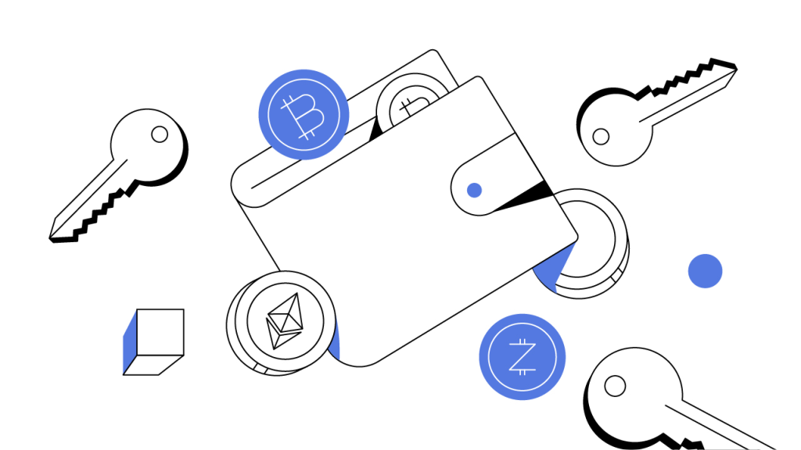
Multi Signatures [ItakuraNakamura83, BonehNeven06]
Multi Signatures allow a set of users to jointly sign a message
Permissionless system
Renewed interest due to many blockchain applications [BDN18, MPS+19, DEF+19, NRS+20, AB21, BD21, NRS21, BTT22, DOT+22, FSZ22, LK23, PW23, TZ23,…]
Non-interactive aggregation of verification keys
Drop-in replacement
Smart contracts with multi-owner validation
Notes:
Itakura and Nakamura
Boneh, Neven

Slide 5
Security of Multi-Signatures
How to get good security bounds for multi-signatures?
Focus for this talk:
Schemes based on DLOG in prime order groups (e.g., Curve25519)
Plain public-key model: malicious keys may depend on honest keys
Security loss: nested application of the forking lemma
insufficient security for 256-bit groups
Alternative solutions:
New and strong assumptions (e.g., interactive XIDL)
Restricted classes of attackers (e.g., algebraic attackers)

Slide 6
Forking Lemma
Used for re-running the adversary to extract more information
DLOG success probability: $t^{2}/p$ ($t$-runtime, $p$-group size)
Applying forking lemma leads to a security loss
e.g., Schnorr: ${\left(t^{2}/p\right)}^{1/2}$
Existing two-round schemes:
Two applications of the forking lemma
Intuitively: one malicious keys, one for signature
Success probability attackers ${\left(t^{2}/p\right)}^{1/4}$
Not good for 256-bit groups

Slide 7
Back to the foundations

Slide 8
A step back
Study the basic security notions for multi signatures
Propose: two weaker notions of security
Allow to prove better security bounds in the plain model
Suffices for several applications
Hopefully: a steppingstone to full-fledge security

Slide 9
One-Time Signatures
One-Time security
Allows the adversary to obtain a single signature
A success story for post-quantum signatures (SPHINCS+)
From one-time to full-fledged post-quantum signatures
Two notions for multi-signatures:
One signature
Many signatures – one signing group

Slide 10
One-Time Security
Only once!
$$m,S$$
Adversary
Set $S$
$$σ^{∗}$$
Message $m$
Verify
KeyAgg($pp,\vec{vk})→vk^{∗}$

Slide 11
Single-Set Security
Same set!
Many messages!
$${\{m_{i}\}}_{i},S$$
Adversary
Set $S$
$$σ^{∗}$$
Message $m$
Verify
KeyAgg($pp,\vec{vk})→vk^{∗}$

Slide 12
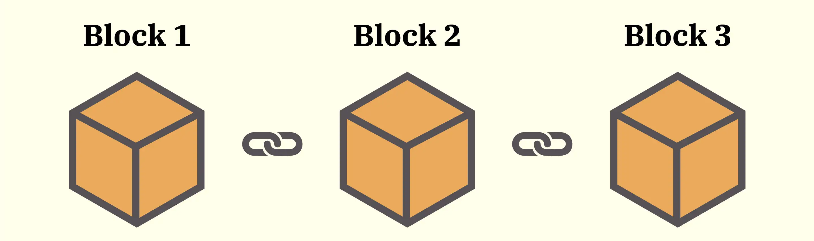
Applications
Validating one-time transactions (e.g., Bitcoin UTXOs)
UTXO is spent after validating one or more signatures
Validating standard transactions via account abstraction
Leverage the blockchain structure to get reusability
Sign transaction + newly-generated one-time verification key
n-out-of-n signing (with not setup)

Slide 13
Our Results

Slide 14
Our Results #1
Theorem:
We construct a one-time multi-signature in the ROM based on any ring-homomorphic one-way function (e.g,. DDH, RSA)
Advantages:
Non-interactive signing
Verification key: 2 group elements
Signature: 1 group element
Single application of the forking lemma $⇒$ security bound ${\left(t^{2}/p\right)}^{1/2}$
Can be extended to t-times signature:
Verification key: t+1 group elements
Signature: 1 group element

Slide 15
Our Results #2
Theorem:
One-time multi-signature scheme (with non-interactive signing) $⇒$ Single-set multi-signature scheme (assuming NIZK).
Key properties:
Two-round signing
Verification and signature size: independent of number of signers
No extra forking lemma $⇒$ similar security bound
Not concretely efficient (tree based)
Point: no inherent security loss for single-set multi-signature schemes

Slide 16
Structure vs. Hardness

Slide 17
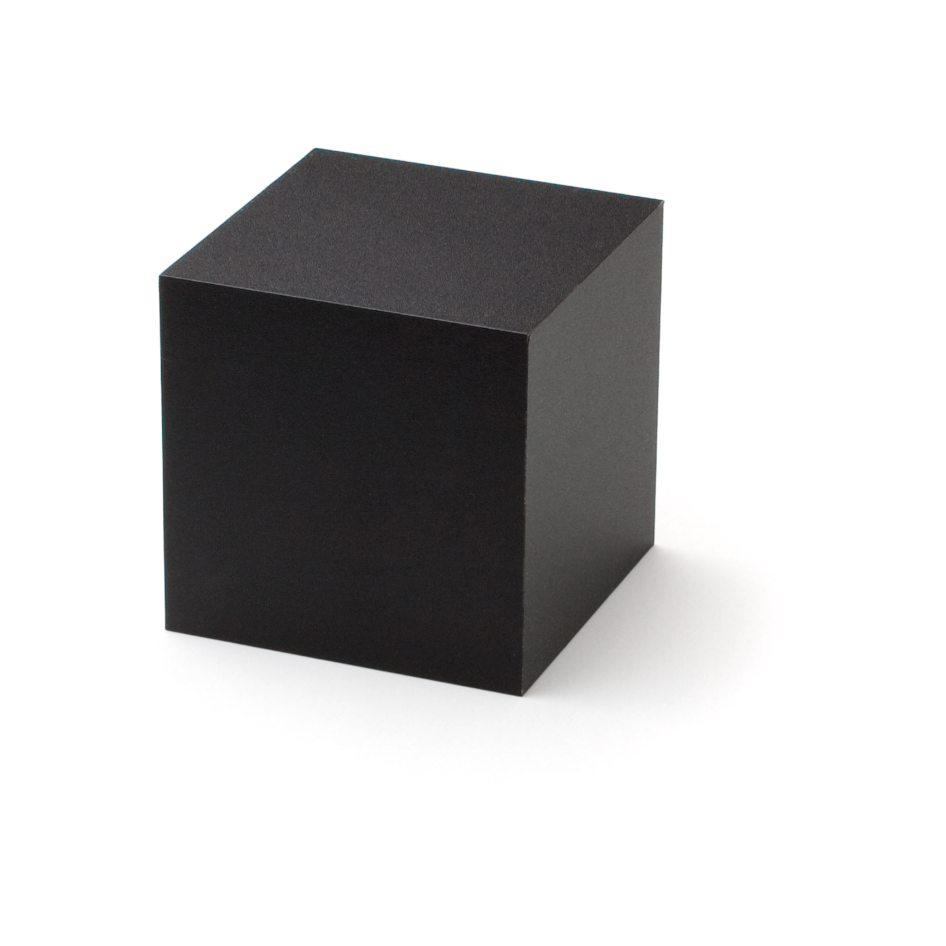
Our Results #3
Theorem:
No fully black-box construction of non-trivial one-time multi-signatures* from one-way functions
Key points:
Not true for standard signatures
Explains our need for stronger one-way functions
* satisfying a natural property:
Key generation algorithm defines an injective mapping of its randomness to its verification keys

Slide 18
Construction One-Time Signature

Slide 19
Our One-Time Scheme
ring-homomorphic one-way function: $f:A→B$
KeyGen: Sample $x_{i}, r_{i}←A$
$sk_{i}=(x_{i},r_{i})$,
$vk_{i}=\left(X_{i},R_{i}\right)=f\left(x_{i}\right), f(r_{i})$
KeyAgg:
$$vk^{∗}=\left(X^{∗},R^{∗}\right)={(Π}_{i}X_{i}^{a_{i}}, Π_{i}R_{i}^{a_{i}})$$
$a=H_{1}(\vec{vk})$
SignAgg:
$$σ^{∗}=\sum_{i}{a_{i}⋅σ_{i}}$$
$$a=H_{1}(\vec{vk})$$
Sign:
$$m′=H_{0}\left(m,vk^{∗}\right)$$
$$σ_{i}=m^{′}⋅x_{i}+r_{i}$$
Verify:
$m′=H_{0}\left(m,vk^{∗}\right)$
$$f\left(σ^{∗}\right)={X^{∗}}^{m^{′}}⋅R^{∗}$$

