Slide 1

Distributing Keys and Random Secrets with Constant Complexity
Benny Applebaum
Tel Aviv University
Benny Pinkas
Aptos Labs and Bar Ilan University
Available postdoc positions
Notes:
Add disclaimer

Slide 2







Motivating Example:
Threshold Signatures in the Blockchain Era
Public Bulletin Board (Ledger)
Public-key
$$g^{s}$$
+ Commitments to shares
Distributed Key Generation
Commitments to shares
Signature
request
$S_{1}$, $S_{2}$ … $S_{n}$
Message $M$
$H{\left(M\right)}^{S}$
Linear Decoding
…
$H{\left(M\right)}^{S_{1}}$, $H{\left(M\right)}^{S_{2}}$ … $H{\left(M\right)}^{S_{n}}$

Slide 3
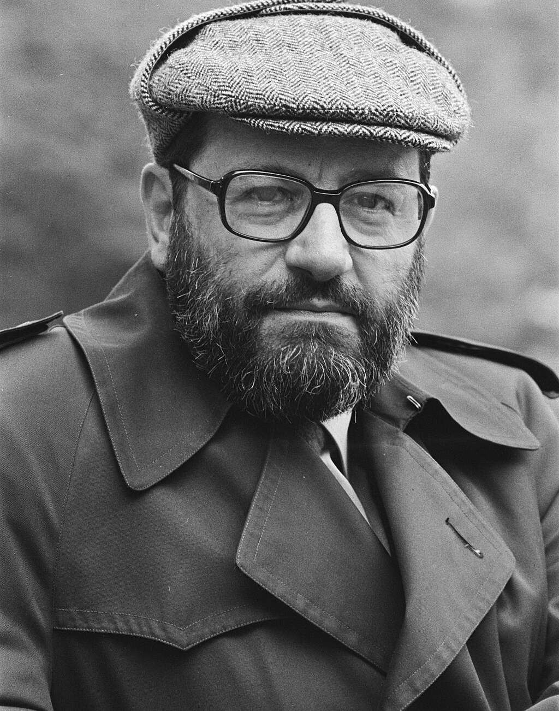


Motivating Example:
Threshold Signatures in the Blockchain Era
Public Bulletin Board (Ledger)
Public-key
$$g^{s}$$
+ Commitments to shares
Distributed Key Generation
$$g^{s}$$
Signature
verification
accept/reject
$S_{1}$, $S_{2}$ … $S_{n}$
Message $M$
$H{\left(M\right)}^{S}$
Linear Decoding
…
$H{\left(M\right)}^{S_{1}}$, $H{\left(M\right)}^{S_{2}}$ … $H{\left(M\right)}^{S_{n}}$

Slide 4


Motivating Example:
Threshold Signatures in the Blockchain Era
Public Bulletin Board (Ledger)
Public-key
$$g^{s}$$
+ Commitments to shares
Distributed Key Generation
Commitments to shares
Signature verification
Signature
request
$S_{1}$, $S_{2}$ … $S_{n}$
Message $M$
$H{\left(M\right)}^{S}$
Linear Decoding
…
$H{\left(M\right)}^{S_{1}}$, $H{\left(M\right)}^{S_{2}}$ … $H{\left(M\right)}^{S_{n}}$

Slide 5

Motivating Example:
Threshold Signatures in the Blockchain Era
Public Bulletin Board (Ledger)
Public-key
$$g^{s}$$
+ Commitments to shares
$$g^{s}$$
Distributed Key Generation
Commitments to shares
Signature verification
Signature
request
accept/reject
$S_{1}$, $S_{2}$ … $S_{n}$
Message $M$
$H{\left(M\right)}^{S}$
Linear Decoding
…
$H{\left(M\right)}^{S_{1}}$, $H{\left(M\right)}^{S_{2}}$ … $H{\left(M\right)}^{S_{n}}$

Slide 6


Motivating Example:
Threshold BLS signatures in the Blockchain Era
Public Bulletin Board (Ledger)
Public-key
$$g^{s}$$
+ Commitments to the shares
Signature verification
Distributed Key Generation
Commitments to the shares
Message M
$S_{1}$, $S_{2}$ … $S_{n}$
Signature request
$H{\left(M\right)}^{S}$
Message M
…
$H{\left(M\right)}^{S_{1}}$, $H{\left(M\right)}^{S_{2}}$ … $H{\left(M\right)}^{S_{n}}$
Decoding

Slide 7

Motivating Example:
Threshold BLS signatures in the Blockchain Era
Public Bulletin Board (Ledger)
Public-key
$$g^{s}$$
+ Commitments to the shares
Signature verification
$$g^{s}$$
Distributed Key Generation
Commitments to the shares
Message M
$S_{1}$, $S_{2}$ … $S_{n}$
Signature request
$H{\left(M\right)}^{S}$
Message M
…
$H{\left(M\right)}^{S_{1}}$, $H{\left(M\right)}^{S_{2}}$ … $H{\left(M\right)}^{S_{n}}$
Decoding

Slide 8
Distributed Key Generation in the DLOG setting
Public Bulletin Board (Ledger)
Public-key
$$g^{s}$$
+ Commitments to the shares
DKG: Typically most expensive part
Recent applications n~10K
Requires coordination
Need actively-secure protocol
Invoked for key-refreshing
Large communication (quadratic in n) and large computation
Distributed Key Generation
$S_{1}$, $S_{2}$ … $S_{n}$
…

Slide 9
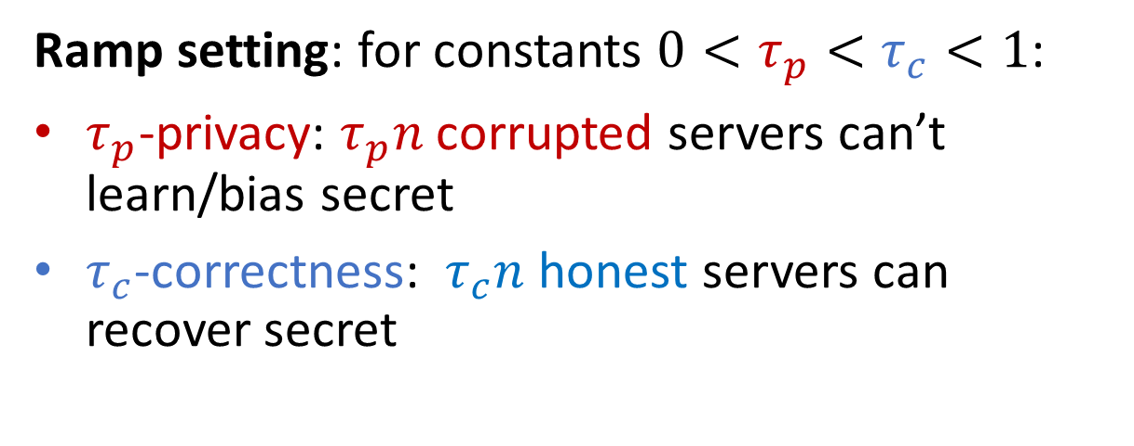
Distributed Secret Generation
Public Bulletin Board (Ledger)
Ramp setting: for constants $0<τ_{p}<τ_{c}<1$:
$τ_{p}$-privacy: $τ_{p}n$ corrupted servers can’t learn/bias secret
$τ_{c}$-correctness: $τ_{c}n$ honest servers can recover secret
Distributed Secret Generation
Linear Secret Sharing
$S_{1}$, $S_{2}$ … $S_{n}$
…

Slide 10
Distributed Secret Generation
Public Bulletin Board (Ledger)
Useful primitive in MPC
Distributed committed coin-tossing
Information-theoretic core of threshold crypto (lattice/DLOG )
Can be easily upgraded to DKG
Closely related to VSS (but no dealer)
Distributed Secret Generation
Linear Secret Sharing
$S_{1}$, $S_{2}$ … $S_{n}$
…

Slide 11
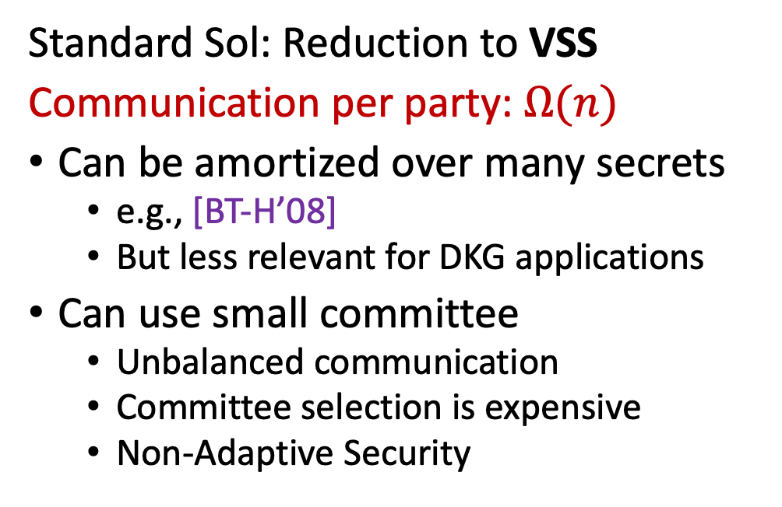
Distributed Secret Generation with O(1) Communication?
Public Bulletin Board (Ledger)
Standard Sol: Reduction to VSS
Communication per party: $Ω(n)$
Can be amortized over many secrets
  e.g., [BT-H’08]
  But less relevant for DKG applications
Can use small committee
  Unbalanced communication
  Committee selection is expensive
  Non-Adaptive Security
VSS
…
VSS
…

Slide 12
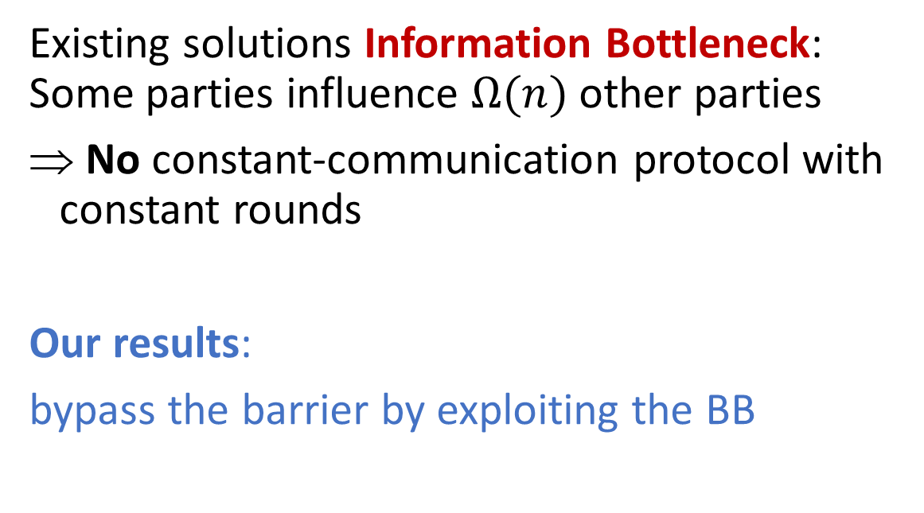
Distributed Secret Generation with O(1) Communication?
Public Bulletin Board (Ledger)
Existing solutions Information Bottleneck: Some parties influence $Ω(n)$ other parties
No constant-communication protocol with constant rounds
Our results:
bypass the barrier by exploiting the BB
…

Slide 13
Distributed Secret Generation with public BB
The model:
Each party has write access to her sector
…

Slide 14
Distributed Secret Generation with public BB
The model:
Each party has write access to her sector
Everyone can read everything
Protocol specifies which addresses to read/write
But adversary can read everything
Can be abstracted by Broadcast
Refined communication measures upstream/downstream complexity
…
Notes:
Direct access, non-anonymous

Slide 15
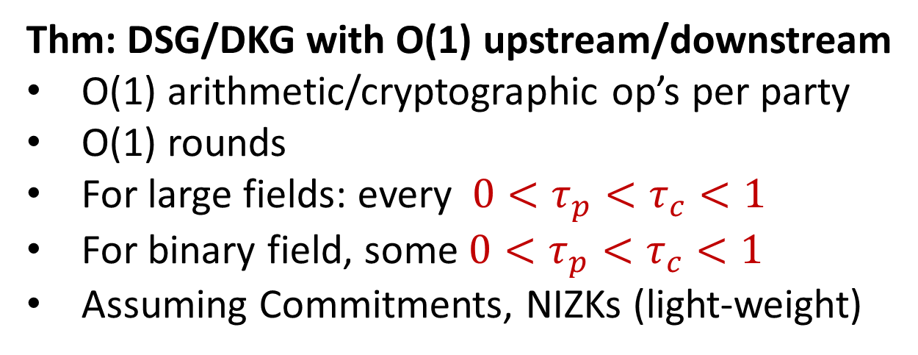
Distributed Secret Generation with Public BB
Thm: DSG/DKG with O(1) upstream/downstream
O(1) arithmetic/cryptographic op’s per party
O(1) rounds
For large fields: every $0<τ_{p}<τ_{c}<1$
For binary field, some $0<τ_{p}<τ_{c}<1$
Assuming Commitments, NIZKs (light-weight)
Distributed Secret Generation
…
Notes:
Large: super-polynomial

Slide 16
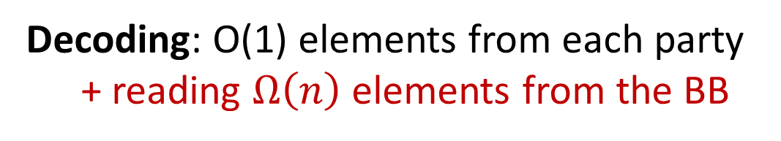
Distributed Secret Generation with Public BB
Decoding: O(1) elements from each party
+ reading $Ω\left(n\right)$ elements from the BB
Provably necessary to bypass the information barrier
Compatible with DKG application
Amortized over many signatures
Decoding
…
Notes:
Large: super-polynomial

Slide 17
Technical Overview
Design special-purpose secret-sharing scheme
Supports distributed sampling
New special “robustness” property to get constant-round protocol

Slide 18

Locally-Samplable Secret-Sharing
Want: random sharing can be sampled locally
But correctness requires correlation (e.g., shares lie on low-degree polynomial)
Sol: Sample independent shares & publish some public header (syndrome)
Move to Affine Secret Sharing
Bypasses the information bottleneck
Public BB
Public header
Securely computing
header
$S_{1}$, $S_{2}$ … $S_{n}$
…
Notes:
Shares must lie on low-degree polynomial or more generally over low-dimensional linear subspace

Slide 19
Secure Computation of Header with Low Communication
Need constant locality
Public BB
Public header
Securely computing
header
$S_{1}$, $S_{2}$ … $S_{n}$
…

Slide 20
Secure Computation of Header with low communication
Need constant locality
LDPC-based secret sharing [ANP’23]
Great param’s over large fields
  New results for LDPC over large fields
Easy: Active protocol with abort
Based on commitments + ZK
Handling aborts
Recomputing=> large round complexity
Header-robust AFS=> constant-round
Rely on expansion
More complicated protocol
Public BB
Public header
$S_{1}$, $S_{2}$ … $S_{n}$
…

Slide 21

Secure Computation of Header with Low Communication
Need constant locality
LDPC-based secret sharing [ANP’23]
Great param’s over large fields
  New results for LDPC over large fields
Easy: Active protocol with abort
Based on commitments + ZK
Public BB
Public header
$S_{1}$, $S_{2}$ … $S_{n}$
Linear
$$S$$
…

Slide 22

How to Handle Aborts?
Recomputing=> large round complexity
Public BB
Public header
$S_{1}$, $S_{2}$ … $S_{n}$
Linear
$$S$$
…

Slide 23

How to Handle Aborts?
Recomputing=> large round complexity
Public BB
Public header
$0$ $S_{2}$ … $S_{n}$
Linear
$$S$$
…

Slide 24

How to Handle Aborts?
Recomputing=> large round complexity
Header-robust AFS=> constant-round
  Effectively give up on some honest parties
  Poor threshold
1+2=>Near-threshold & const. round
Recompute + Limited robustness
O(1) com’s requires careful implementation
Public BB
Public header
$S_{1}$, $S_{2}$ … $S_{n}$
Linear
$$S$$
…

Slide 25
Secure Computation of Header with low communication
Need constant locality
LDPC-based secret sharing [ANP’23]
Great param’s over large fields
  New results for LDPC over large fields
Easy: Active protocol with abort
Based on commitments + ZK
Handling aborts
Recomputing=> large round complexity
Header-robust AFS=> constant-round
Rely on expansion
More complicated protocol
Public BB
Public header
Securely computing
header
$S_{1}$, $S_{2}$ … $S_{n}$
…

Slide 26
Conclusion
DKG/DSG with constant communication and computation
New secret sharing schemes
  Affine Secret Sharing may be better than Linear SS
More general MPC-based formalization of DKG/DSG
  Subtle: Security holds even if the adversary aborts after knowing the header
Future: Practical efficiency?
  Identifiable abort may be good enough

