Slide 1


A Pure Indistinguishability Obfuscation Approach to Adaptively Sound SNARGs
Brent Waters David Wu

Slide 2



Succinct Arguments (SNARGs) for NP
CRS
CRS
Sound: Only accepts if exists w where R(x,w) =1
Succinct: Proof size polynomial in only the security parameter; independent of |x|,|w|

Slide 3
How do we get SNARGs for NP?
Path 1: Random oracle or knowledge assumption [Kilian92, Micali94,…]
Standard assumptions?
(Including subexponential hardness)
Path 2: Non-adaptive SNARGs from indist. obfuscation [Sahai-W14]
Obfuscation: sub exponentially hard LPN, PRG constant locality, bilinear maps [Jain-Lin-Sahai21]
Non-adaptive: Statement x independent of CRS

Slide 4

Getting Adaptive Security
(1) W-Wu24 iO + Perfectly Rerandomizable OWFs (DL, Factoring)
(2) W-Zhandry24 iO + Very Lossy Functions (LWE)
Requires additional number theory
This Result: Pure iO! (iO + OWF)

Slide 5
Let’s take a closer look at SW14

Slide 6




Indistinguishability Obfuscation
Cannot distinguish between obfuscations of two functionally equivalent programs
int f(int a,b,c)
{
return (a+b) * c;
}
L ,o ,P ,_=dt,T,Z,D=
s[999],E,h= 8,I,
J,K,w[999],M,m,O
,n[999],j=33e-3,i=1E3,r,t, u,v ,W
int g(int a,b,c)
{
return a*c+ b*c;
}

Slide 7
Puncturable PRFs
[Boneh-W13, Kiayias-Papadopoulos-Triandopoulos-Zacharias13, Boyle-Goldwasser-Ivan14]
Idea: Punctured PRF key K{x*} evaluate PRF on all points, but x*
7

Slide 8




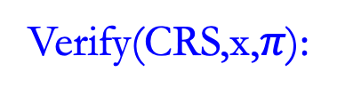
SW14 SNARG
Setup:
Prove(CRS,x,w):
Verify(CRS,x,$π$):
8

Slide 9
Does sub-exponential hardness give adaptive security via guessing?

Slide 10

Sub-exponential Hardness and Guessing
Poly hardness: All polytime attackers advantage at most
Sub-exp hardness: All polytime attackers advantage at most
Inflating Step:
Post-inflation hardness: All polytime attackers advantage at most
Allows exponential (in n) hybrids or guessing!
Verifiable random functions [Micali-Rabin-Vadhan99]
Identity-Based Encryption [Boneh-Boyen04]

Slide 11
Blowup in SNARGs
CRS
Proof size grows with n!

Slide 12
Getting Adaptive Security

Slide 13

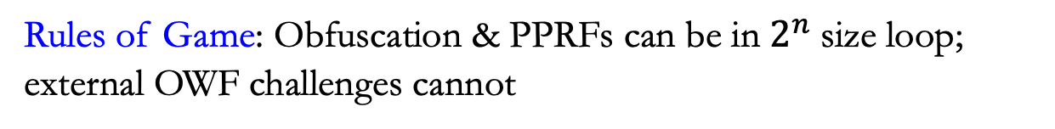
Parameter Setting
Sub-exp hardness: All polytime attackers advantage at most
CRS grows with n
Proof size independent of n
Rules of Game: Obfuscation & PPRFs can be in $2^{n}$size loop; external OWF challenges cannot

Slide 14


Construction
Setup:
14

Slide 15
Part 1
Attacker wins off path (if at all)

Slide 16
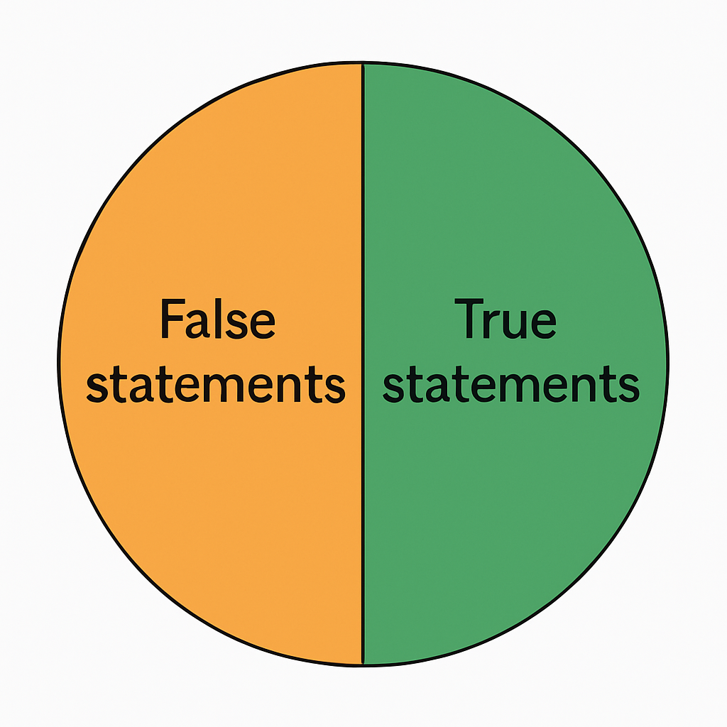
(1) All Attacker Advantage
(2) Selector PRF bit hidden
Intuition: Difficult to always match proof selector bit for false statements
16

Slide 17
Part 2
Embedding Challenges
Everything, Everywhere, All at Once

Slide 18





Embedding Injective OWF
Challenge:
GenProof unchanged; does not know r!
18

Slide 19

Moving a Single Statement
Hyb 0:
19

Slide 20

Moving a Single Statement
Hyb 0:
iO, PPRF
Hyb 1:
20

Slide 21

Moving a Single Statement
Hyb 0:
iO, PPRF
Hyb 1:
iO , distribution
Hyb 2:
21

Slide 22

Moving a Single Statement
Hyb 0:
iO, PPRF
Hyb 1:
iO , distribution
Hyb 2:
iO, injectiveness
Hyb 3:
22

Slide 23
Moving a Single Statement
Hyb 0:
iO, PPRF
Hyb 1:
iO , distribution
Hyb 2:
iO, injectiveness
Hyb 3:
iO, PPRF
Hyb 4:
23

Slide 24
Finishing the Proof
Challenge:
Finish: Any off path solution immediately gives OWF solution!
24

Slide 25
Injective OWFs?
Prior Work: iO + OWFs gives injective OWFs Bitansky, Paneth, Wichs 2015
Our Method: Injective OWF with inefficient sampling from OWFs
How? Injective OWF only needed in proof
Future? Fully Homomorphic Encryption, Garbled Circuits

Slide 26
Some Other Recent Works
SNARGs from LWE if propositional proofs [Jin, Kalai, Lombardi,Vaikuntanathan24]
SW14 is Designatured Verifier Adaptively Sound [Mathialagan, Peters,Vaikuntanathan24]
Adaptive Batching of SNARGs[Devadas, W, Wu 25]
Universal SNARGs [Jin,Kalai,Lombardi,Mathialagan 25]

Slide 27


