Slide 1


How to Make Any Computational Secret Sharing Scheme Adaptively Secure
George Lu Brent Waters

Slide 2
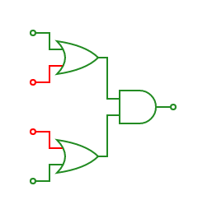
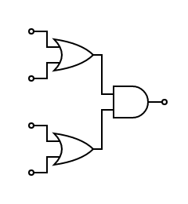
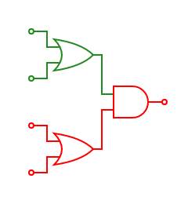










Secret Sharing
✔
x

Slide 3

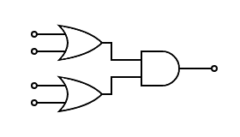
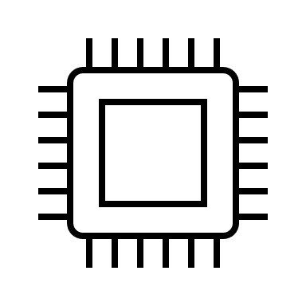
Secret Sharing
Threshold [Sha79, Bla79]
Montone Span Programs [Bei96]
Monotone Boolean Formulas
Monotone Circuits [Yao89, VNS⁺03]
Information-Theoretic SS
Computational SS

Slide 4












Secret Sharing Security - Static
Notes:
Bolden red users, horns bigger?

Slide 5

Secret Sharing Security - Adaptive

Slide 6




Why Adaptive?
Stronger
More Realistic
$$adaptive ⇒static$$
Statically Secure ☹
Secret Sharing for Monotone Circuits
[Yao89, VNS⁺03]
Secret Sharing for NP
[KNY14]
Notes:
While we often think of adversaries as a group of bad users …, oftentimes it’s the case hacker bla bla

Slide 7
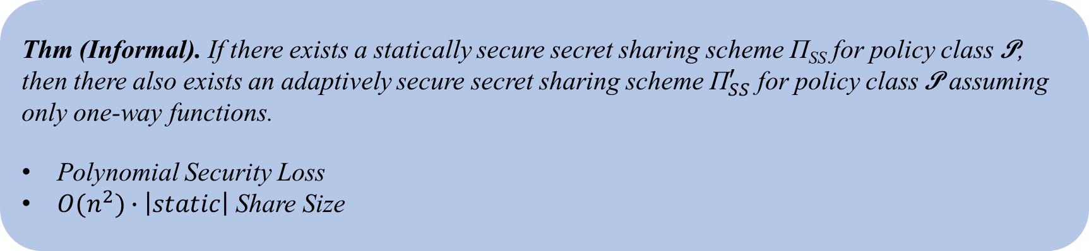
Our Result
Thm (Informal). If there exists a statically secure secret sharing scheme Π_{SS} for policy class P, then there also exists an adaptively secure secret sharing scheme ${\text{Π}}_{SS}^{′}$ for policy class P assuming only one-way functions.
Polynomial Security Loss
$O(n^{2})∙\left|static\right|$ Share Size

Slide 8
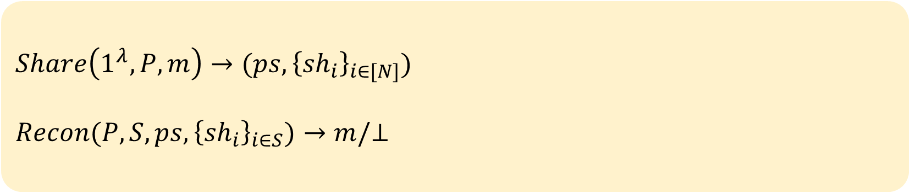


Secret Sharing Syntax
$$Public Share$$
$$Number Users$$
$$Share\left(1^{λ},P, m\right)→(ps,{\left\{{sh}_{i}\right\}}_{i∈[N]})$$
$$Recon(P, S,ps,{\left\{{sh}_{i}\right\}}_{i∈S})→m/⊥$$
Notes:
N number of shares
Label public share

Slide 9






Transformation Roadmap
Symmetric Key Encryption
Static Secret Sharing
“Semi-Adaptive” Secret Sharing
Adaptive Secret Sharing
Notes:
Roadmap

Slide 10











Semi-Adaptive Security
Static Security
Adaptive Security
$$1^{N}, P, m_{0},m_{1}$$
$$1^{N}, P, m_{0},m_{1}$$
$$S⊆[N]$$
$$ps$$
$$ps$$
$$i∈[N]$$
$${sh}_{i}$$
$${\left\{{sh}_{i}\right\}}_{i∈S}$$
Guess $b$
Guess $b$
Notes:
Might be wasting time/energy on semi-adaptive, maybe don’t go through reduction?

Slide 11

















Semi-Adaptive Security
Static Security
Semi-Adaptive Security
Adaptive Security
$$1^{N}, P, m_{0},m_{1}$$
$$1^{N}$$
$$1^{N}, P, m_{0},m_{1}$$
$$S⊆[N]$$
$$ps$$
$$i∈[N]$$
$${sh}_{i}$$
$$ps$$
$$i∈[N]$$
$${P, m}_{0},m_{1}$$
$${sh}_{i}$$
$${\left\{{sh}_{i}\right\}}_{i∈S}$$
$$ps$$
Guess $b$
Guess $b$
Guess $b$
*$m independent of {sh}_{i}$
Notes:
Add in sh_0 oracle
Sh_i independent of m

Slide 12

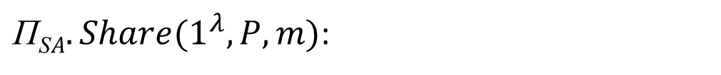

Decomposability
${\text{Π}\text{S}A.Share(1}^{λ}, P,m)$:
$$ShareKey\left(1^{λ},N\right) →{\{sh}_{1},…,{sh}_{N}\}$$
$$ShareMsg\left({\{sh}_{1},…,{sh}_{N}\},P,m\right)→ps$$
Notes:
Introduce sharekey/sharemsg

Slide 13




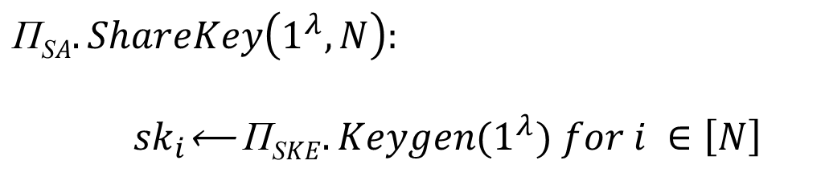
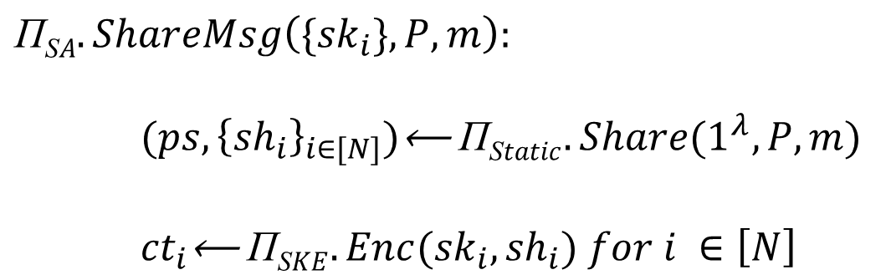
Static to Semi-Adaptive
$$\text{Π}\text{S}A.ShareKey\left(1^{λ},N\right):$$
${sk}_{i}\text{⟵ }\text{Π}\text{S}KE.Keygen{(1}^{λ}) for i ∈\left[N\right]$
$${\text{Π}\text{S}A.sh}_{i}={sk}_{i}$$
$$\text{Π}\text{S}A.ShareMsg\left(\{{sk}_{i}\},P,m\right):$$
${(ps,{\left\{{sh}_{i}\right\}}_{i∈[N]})\text{⟵ }\text{Π}\text{S}tatic.Share(1}^{λ}, P, m)$
${ct}_{i}\text{⟵ }\text{Π}\text{S}KE.Enc{(sk}_{i},{sh}_{i}) for i ∈\left[N\right]$
$\text{Π}\text{S}A.ps=$ $(ps,{\left\{{ct}_{i}\right\}}_{i∈\left[N\right]})$
Notes:
Static to semiadaptive def
Maybe consider removing ct encap illustration?
Try editing line on top of the cube
Spacing
-matter later on – reuse individual shares with new public shares
Share size independent of
Banner at bottom – can reuse shares for secret keys,
Maybe introduce these in line? As sharekey/sharemsg
Verbally say one share to multiple messages

Slide 14

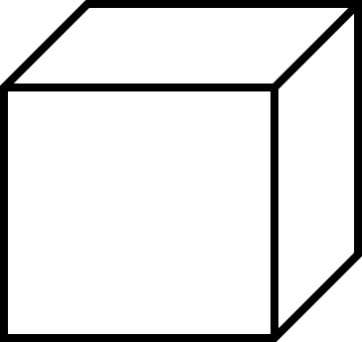





Semi-Adaptive to Adaptive Secret Sharing
$$Level 0$$
$$Level 1$$
$$…$$
$$Level n$$
$$Level n−1$$
Notes:
One way to view this is adaptive until public info revealed

Slide 15






Our Scheme
$$Level 5$$
$$Level 4$$
$$Level 3$$
$$Level 2$$
$$Level 1$$
$$Level 0$$
Notes:
Maybe do this with last slide, emphasize single user pov

Slide 16

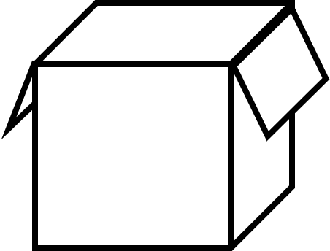


Our Scheme
$$Level 5$$
$$Level 4$$
$$Level 3$$
$$Level 2$$
$$Level 1$$
$$Level 0$$
$$\text{✓}$$
Notes:
Show final construction
Level n key, level n box w/ level n box w/ level n-1 key
Users vertically
Give textual description

Slide 17
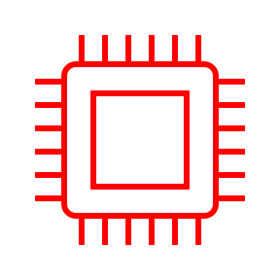






Arguing Adaptive Security
$$Level 5$$
$$×$$
Notes:
Describing security argument/hybrid i
-erase key material for last (emph) i corrupted users
Give 2 bullet description
Try ~5 users?
N users, q corruptions – guess number of corruptions, separate this distinction

Slide 18


Arguing Adaptive Security
$$Level 5$$
$$×$$
$$0$$
Semi-Adaptive Security
Notes:
Describing security argument/hybrid i
-erase key material for last (emph) i corrupted users
Give 2 bullet description
Try ~5 users?
N users, q corruptions – guess number of corruptions, separate this distinction

Slide 19







Arguing Adaptive Security
$$Level 5$$
$$Level 4$$
$$Level 0$$
$$×$$
$$0$$
$$0$$
$$0$$
$$0$$
$$0$$
Notes:
Describing security argument/hybrid i
-erase key material for last (emph) i corrupted users
Give 2 bullet description
Try ~5 users?
N users, q corruptions – guess number of corruptions, separate this distinction

Slide 20


Arguing Adaptive Security
$$Level 4$$
$$Level 0$$
$$×$$
Notes:
Because we *never* give out

Slide 21












Arguing Adaptive Security
$$0$$
$$Level 5$$
$$Level 0$$
$$×$$
$$0$$
$$0$$
$$0$$
$$0$$
$$0$$
$$0$$
$$0$$
$$0$$
$$0$$
$$0$$
$$0$$
$$0$$
Notes:
Td: fix morph

Slide 22
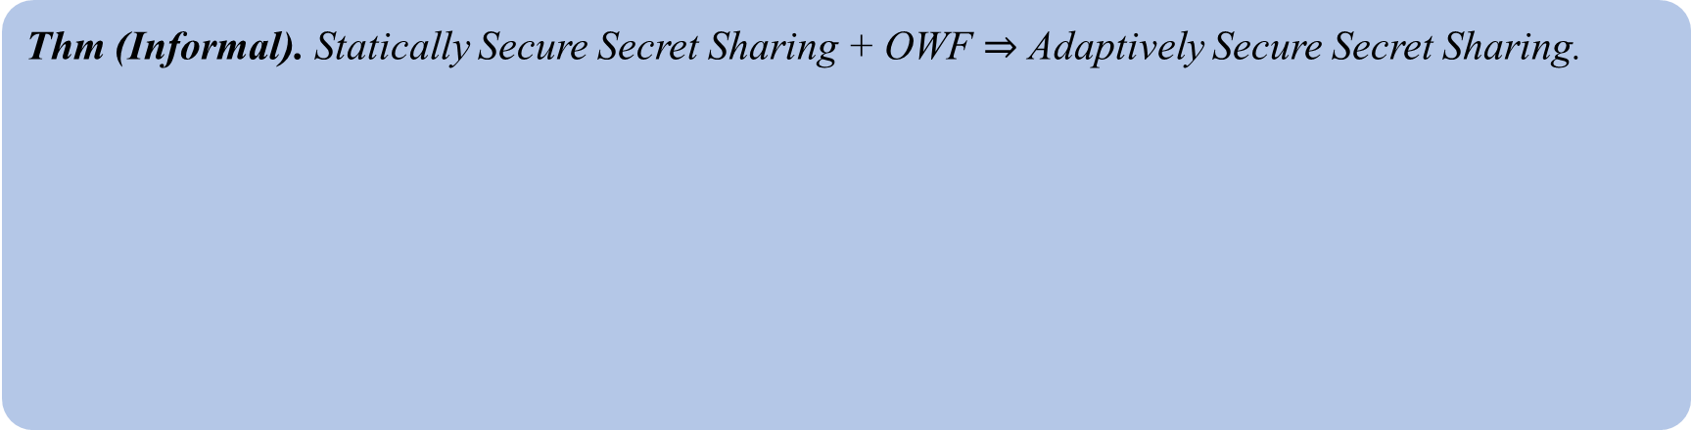
Summarizing Results
Thm (Informal). Statically Secure Secret Sharing + OWF $⇒$ Adaptively Secure Secret Sharing.
Corollary (via [Yao89, VNS⁺03]). There exists adaptively secure secret sharing for monotone boolean circuits assuming polynomially secure one-way functions.
Corollary (via [KNY14]). There exists adaptively secure secret sharing for monotone NP assuming polynomially secure witness encryption and one-way functions.
Extension – Adaptively Secure Secret Sharing for specific policy classes with lower overhead (threshold, graph, etc.)
Open Questions – General lower overhead transformation? Lower bounds?
Read our paper 2025/1014
Notes:
Rethink title

