Slide 1




Verifiable Decapsulation:
Recognizing Faulty Implementations of Post-Quantum KEMs eprint.iacr.org/2025/450
Lewis Glabush, Felix Günther, Kathrin Hövelmanns, Douglas Stebila
Notes:
Paint Story:
Imp-Exp eq establishes trust, even when using FO in bigger protocols.
Salted for new designs, Frodo, HQC.
Verif to avoid footguns. (Standards done, but could still be deployed in bigger protocols)

Slide 2
Motivation
Cryptographic protocols often include verification steps which are essential for security, but which may not impact basic functionality.
One such verification step is re-encryption in the Fujisaki-Okamoto transform.
A bug in the re-encryption step in the implementation of HQC took 19 months to surface.
“Fragility under human error should be a cryptographic design consideration.”
– Heninger 2019

Slide 3
This Work
We propose a new KEM security property called verifiable decapsulation. Intuitively a KEM with verifiable decapsulation will surface implementation bugs with basic correctness tests.
We construct a modified Fujisaki-Okamoto transform, which constructs a KEM with verifiable decapsulation.
We apply our construction to ML-KEM and HQC, with small overhead increase (0.25% for HQC, and 3.4% for ML-KEM).

Slide 4






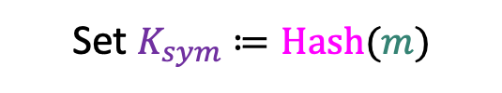



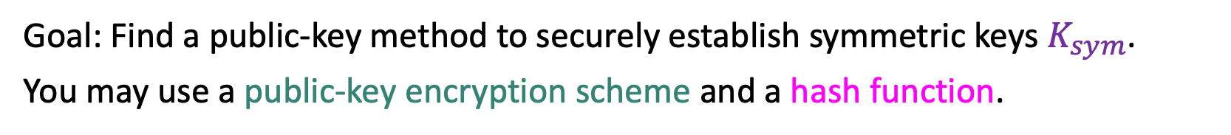

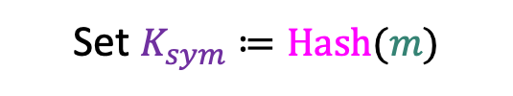
Fujisaki-Okamoto KEMs: initial idea
Goal: Find a public-key method to securely establish symmetric keys $K_{sym}$.
You may use a public-key encryption scheme and a hash function.
Pick random $m$
Decrypt
Encrypt $m:$
$$m$$
$$m$$
Set $K_{sym}≔Hash(m)$
Set $K_{sym}≔Hash(m)$
$$m$$
pk
sk
Notes:
key = message’s hash digest value. assuming that hash behaves unpredictably, result should look be unpredictable (unless you can break the ciphertext)

Slide 5




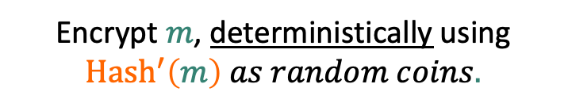



Fujisaki-Okamoto KEMs: Derandomization
Decrypt
$$m$$
$$m$$
Pick random $m$
Only if $m$ encrypts to
$$m$$
Encrypt $m$, deterministically using ${Hash}^{′}\left(m\right) as random coins.$
Set $K_{sym}≔Hash(m)$
Set $K_{sym}≔Hash(m)$
$$m$$
pk
sk
Notes:
Let’s additionally alter how Bob reacts to the ciphertext: Because encryption is now deterministic, Bob can make a sanity check on the ciphertext by re-encrypting the decryption result and checking whether this results in the ciphertext he received.

Slide 6




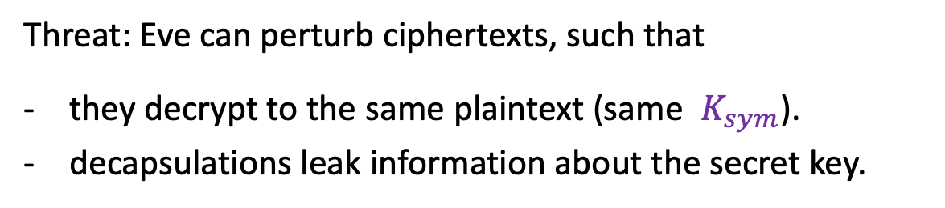

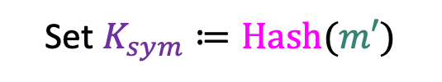
Fujisaki-Okamoto KEMs: Re-encryption
Threat: Eve can perturb ciphertexts, such that
they decrypt to the same plaintext (same $K_{sym}$).
decapsulations leak information about the secret key.
Decrypt
$$m′$$
Only if $m′$ encrypts to :
Set $K_{sym}≔Hash(m′)$
Otherwise, reject!
pk
sk
Eve

Slide 7
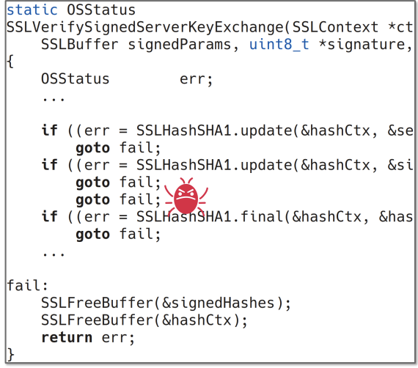
Cryptography is Brittle
Functionality
Security
Many cryptographic protocols have “verification steps” which are necessary for security, but not necessarily for basic functionality.
Bugs in these steps are not captured by basic correctness tests.
Notes:
key = message’s hash digest value. assuming that hash behaves unpredictably, result should look be unpredictable (unless you can break the ciphertext)

Slide 8
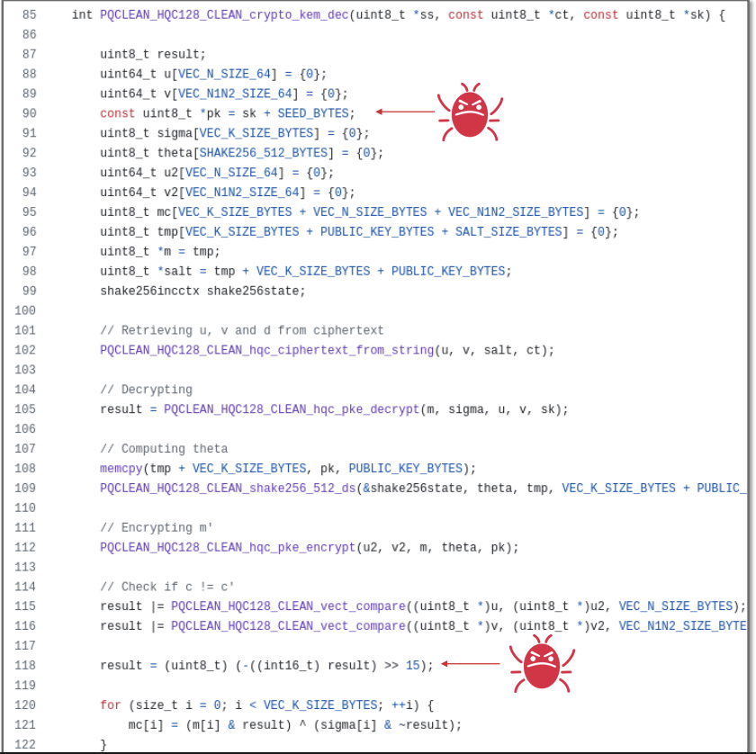
HQC Example
Encryption uses the correct public key.
During re-encryption public key is incorrectly parsed.
Equality check contains a second bug.
Went unnoticed for 19 months.
Notes:
key = message’s hash digest value. assuming that hash behaves unpredictably, result should look be unpredictable (unless you can break the ciphertext)

Slide 9
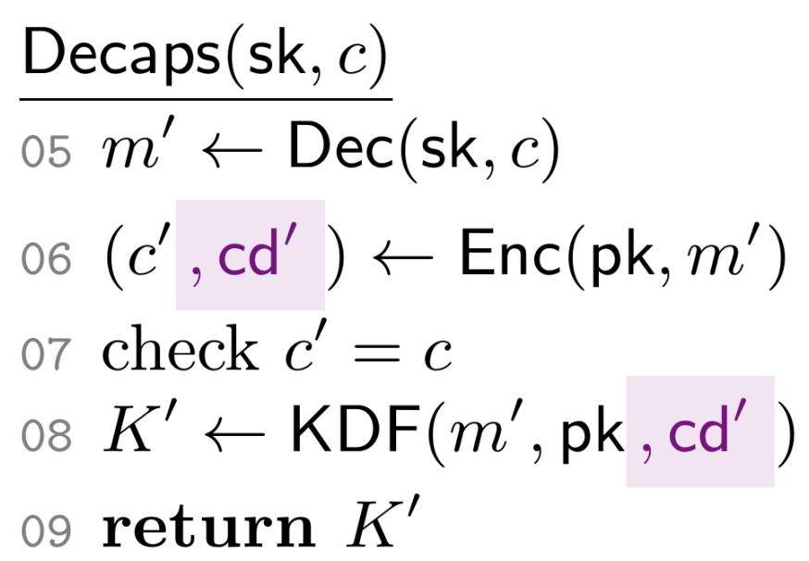
Enter Confirmation Codes
Confirmation codes were introduced in by Günther and Fischlin in [CCS:GünFis23].
Intuition: augment verification steps to output a pseudorandom “code.”
Use this code in your protocol to make the verification step critical for functionality.
Notes:
key = message’s hash digest value. assuming that hash behaves unpredictably, result should look be unpredictable (unless you can break the ciphertext)

Slide 10

Criteria For Confirmation Codes
Confirmation codes should be short (low overhead cost).
Confirmation codes should be deterministic (correctness).
Confirmation codes should be unpredictable (security).
Idea: look for information computed during encryption, which cannot be derived from the ciphertext.
Notes:
key = message’s hash digest value. assuming that hash behaves unpredictably, result should look be unpredictable (unless you can break the ciphertext)

Slide 11


Confirmation Code Unpredictability
Intuition: it should be hard to compute confirmation code without performing encryption.
Challenge: introducing the right formalism is tricky.
Goal: predict confirmation code.
Input:
- If we give both sk and c, they can
easily compute the correct cd.
-If we do not give both sk and c,
certain “bad” codes, will be considered unpredictable.
Notes:
key = message’s hash digest value. assuming that hash behaves unpredictably, result should look be unpredictable (unless you can break the ciphertext)

Slide 12
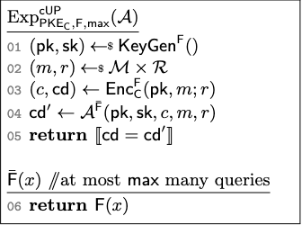

Confirmation Code Unpredictability
Intuition: it should be hard to compute confirmation code without performing encryption.
Challenge: introducing the right formalism is tricky.
Goal: predict confirmation code.
Input:
$$pk, sk, c, \overline{F}$$
- If we give both sk and c, they can
easily compute the correct cd.
-If we do not give both sk and c,
certain “bad” codes, will be considered unpredictable.
Note: we do not require cryptographically small advantage in the above experiment.
Notes:
key = message’s hash digest value. assuming that hash behaves unpredictably, result should look be unpredictable (unless you can break the ciphertext)

Slide 13
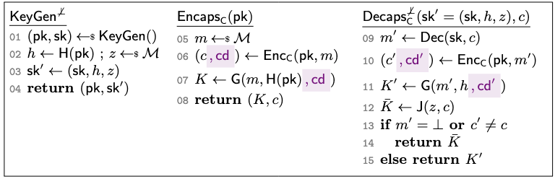
Confirmation Augmented FO
Cannot derive the correct code without performing re-encryption.
Notes:
key = message’s hash digest value. assuming that hash behaves unpredictably, result should look be unpredictable (unless you can break the ciphertext)

Slide 14

Faulty Implementation (In)correctness
Intuition: faulty implementations should fail basic correctness tests.
Probability that a code guessing adversary guesses cd without encrypting.
Probability that a faulty implementation produces the correct output.
Correctness errors are a “trivial” win.
Notes:
key = message’s hash digest value. assuming that hash behaves unpredictably, result should look be unpredictable (unless you can break the ciphertext)

Slide 15
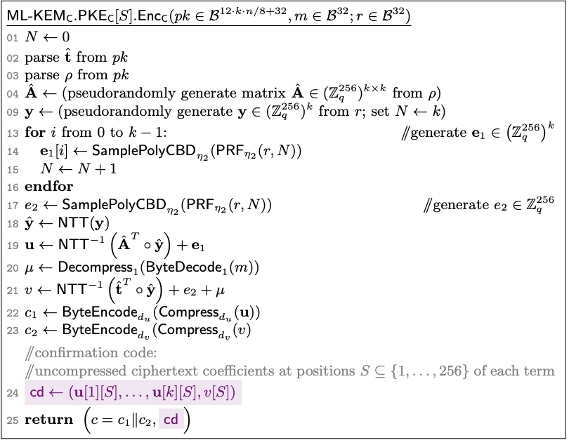
ML-KEM
A PRF is used to sample error terms.
ML-KEM utilizes ciphertext compression. Saving some bits lost to compression yields a viable confirmation code.
Incurs an overhead increase of at most 3.4% in experimental testing.
Notes:
key = message’s hash digest value. assuming that hash behaves unpredictably, result should look be unpredictable (unless you can break the ciphertext)

Slide 16
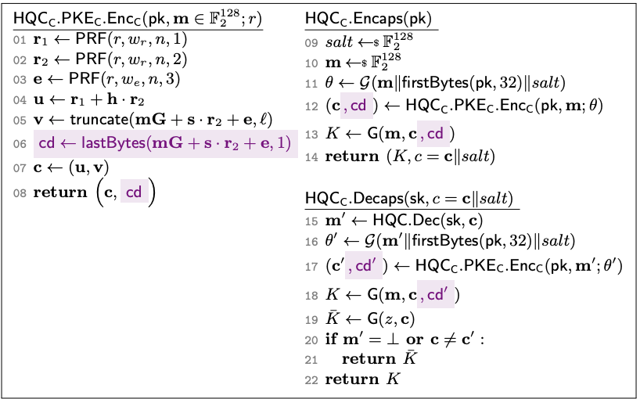
HQC
A PRF is used to derive random values.
HQC utilizes ciphertext truncation. Saving some bits lost to truncation yields a viable confirmation code.
Incurs an overhead increase of at most 0.25% in experimental testing.
We confirmed that this code surfaces bug in HQC reference implementation.
Notes:
key = message’s hash digest value. assuming that hash behaves unpredictably, result should look be unpredictable (unless you can break the ciphertext)

Slide 17
Conclusion
Confirmation can be used to surface bugs in security critical verification steps.
This can be applied to FO based KEMs to ensure that the decapsulation algorithm correctly performs re-encryption.
Lewis Glabush, Felix Günther, Kathrin Hövelmanns, Douglas Stebila
eprint.iacr.org/2025/450
Notes:
key = message’s hash digest value. assuming that hash behaves unpredictably, result should look be unpredictable (unless you can break the ciphertext)

