Slide 1
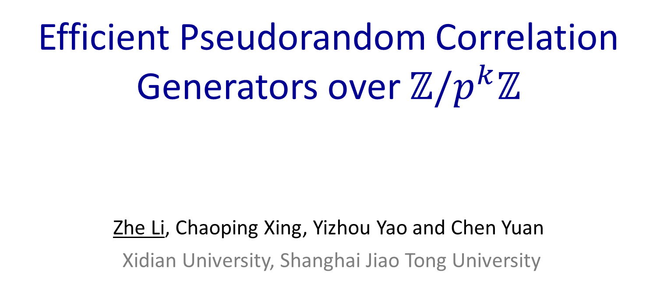
Efficient Pseudorandom Correlation Generators over $ℤ/p^{k}ℤ$
Zhe Li, Chaoping Xing, Yizhou Yao and Chen Yuan
Xidian University, Shanghai Jiao Tong University
Crypto 2025
https://eprint.iacr.org/2025/1223
Code is available at:
https://github.com/zhli271828/Trace-F2-OLE-PCG
Aug 20, 2025

Slide 2
Outline
Motivations
Results
Techniques

Slide 3

Secure Multiparty Computation
$n=5$ and $t=2$

Slide 4
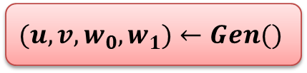



The Preprocessing Model [Bea92]
$$(u,v,w_{0},w_{1})←Gen()$$
Preprocessing
$$(u,w_{0})$$
OLE/OT Correlations
$$u⋅v=w_{0}+w_{1}$$
$$(v,w_{1})$$
Fast online protocol consuming one triple per multiplication.
How to efficiently produce many OLEs?
Notes:
Modern MPC considers a preprocessing model.

Slide 5

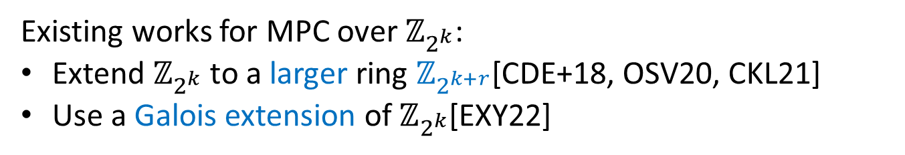
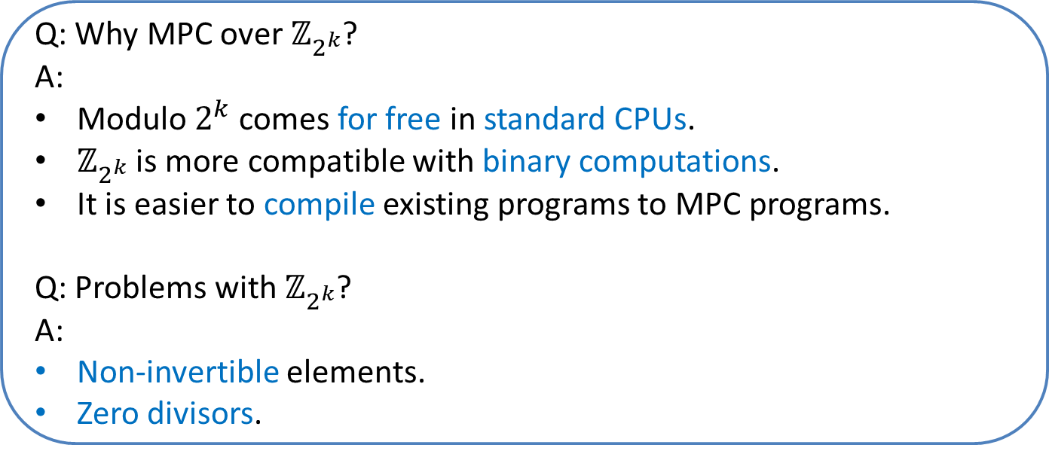
MPC over $ℤ_{2^{k}}$
Q: Why MPC over $ℤ_{2^{k}}$?
A:
Modulo $2^{k}$ comes for free in standard CPUs.
$ℤ_{2^{k}}$ is more compatible with binary computations.
It is easier to compile existing programs to MPC programs.
Q: Problems with $ℤ_{2^{k}}$?
A:
Non-invertible elements.
Zero divisors.
Existing works for MPC over $ℤ_{2^{k}}$:
Extend $ℤ_{2^{k}}$ to a larger ring $ℤ_{2^{k+r}}$[CDE+18, OSV20, CKL21]
Use a Galois extension of $ℤ_{2^{k}}$[EXY22]

Slide 6
How to Produce OT/OLE Correlations?
 | Field | Ring
OT(OLE) | [KOS16] | [CDE+18, EXY22]
HE | [BDOZ11,DPSZ12,BEP+22] | [OSV20, CKL21]
PCGs | [BCG+20,BCCD23,BBC+24,LXYY25] | ?
The OT based approach has a quadratic blow-up in the ring size.
The HE approach has high computational overhead and at least linear communication cost.
Notes:
For ring cases, only the first two methods have been explored.

Slide 7






Pseudorandom Correlation Generator(PCG)[BCGI18, BCGIKS19]
Target correlation: $(R_{0},R_{1})$
$$\left(k_{0},k_{1}\right)←Gen(1^{λ})$$
$$k_{0}$$
$$k_{1}$$
$$\tilde{R_{0}}←Expand(k_{0})$$
$$\tilde{R_{1}}←Expand(k_{1})$$
Correctness: $\left(\tilde{R_{0}}, \tilde{R_{1}}\right)≈_{c}(R_{0},R_{1})$.
Security: $\left(k_{0},\tilde{R_{1}}\right)≈_{c}(k_{0},R_{1}|\tilde{R_{0}})$.

Slide 8
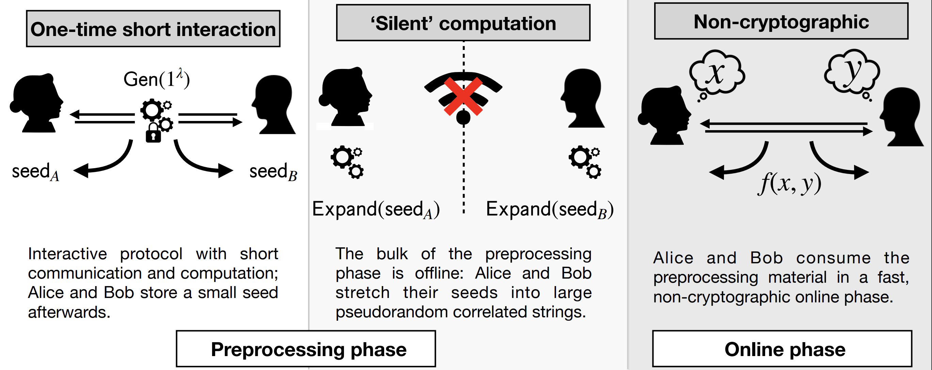
MPC with Silent Preprocessing

Slide 9
Outline
Motivations
Results
Techniques

Slide 10
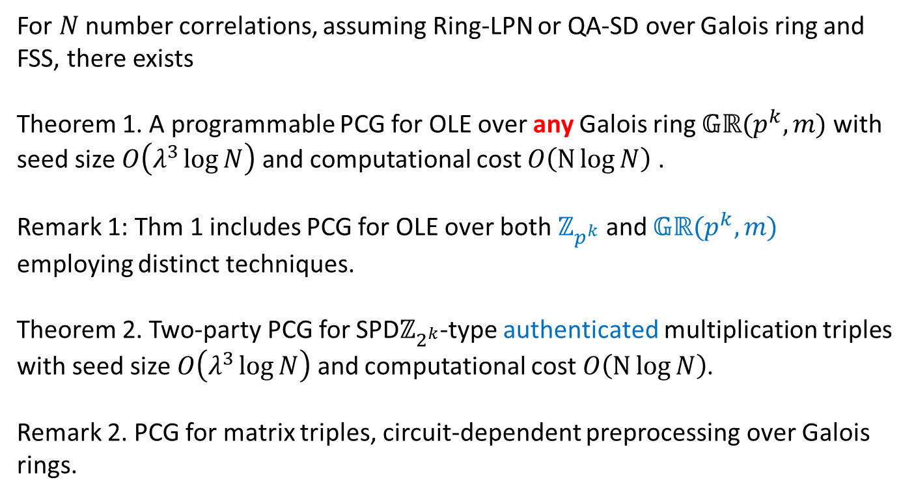
Main Results
For $N$ number correlations, assuming Ring-LPN or QA-SD over Galois ring and FSS, there exists
Theorem 1. A programmable PCG for OLE over any Galois ring $𝔾ℝ(p^{k},m)$ with seed size $O\left(λ^{3}\log{N}\right)$ and computational cost $O\left(N\log{N}\right)$ .
Remark 1: Thm 1 includes PCG for OLE over both $ℤ_{p^{k}}$ and $𝔾ℝ(p^{k},m)$ employing distinct techniques.
Theorem 2. Two-party PCG for SPD$ℤ_{2^{k}}$-type authenticated multiplication triples with seed size $O\left(λ^{3}\log{N}\right)$ and computational cost $O\left(N\log{N}\right)$.
Remark 2. PCG for matrix triples, circuit-dependent preprocessing over Galois rings.

Slide 11
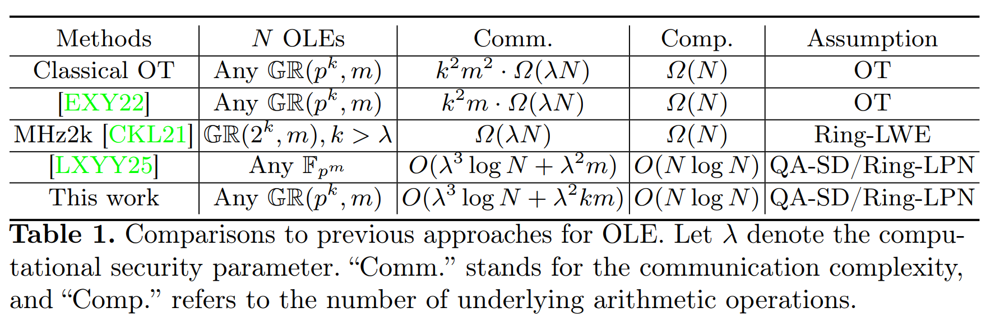
Theoretical Efficiency Comparisons

Slide 12
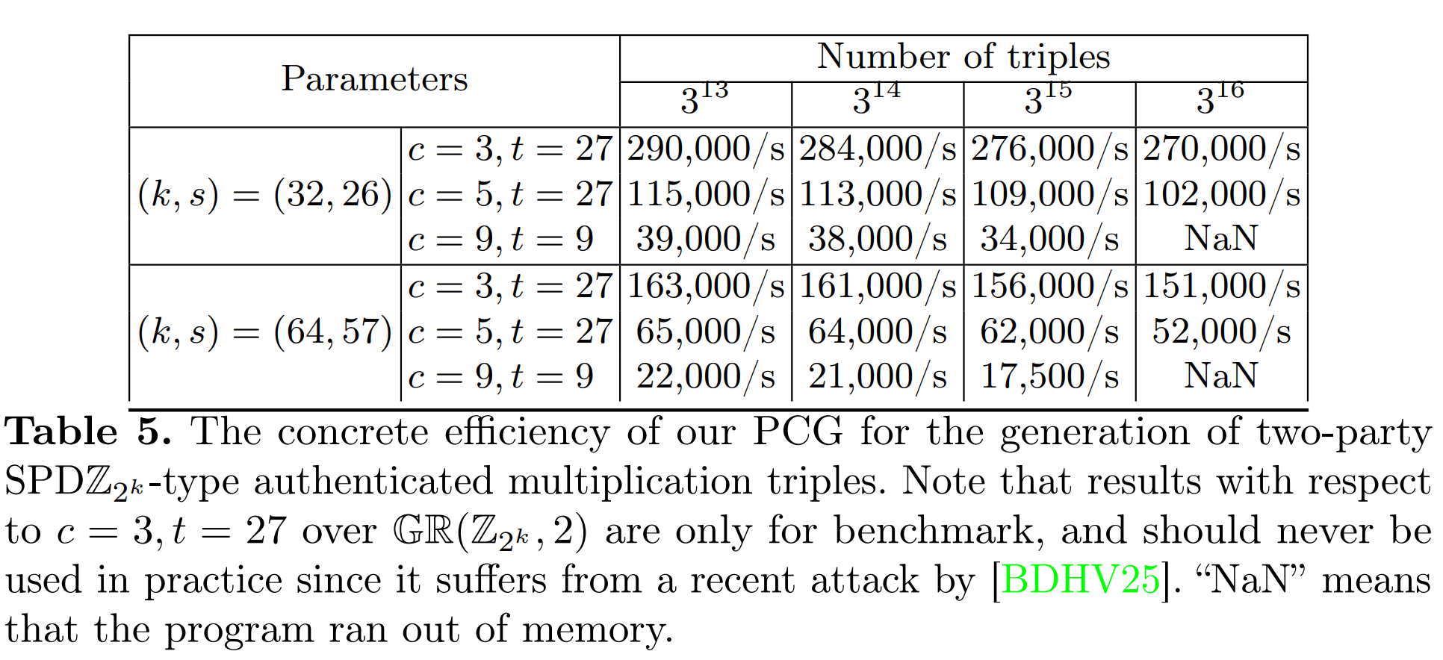
Concrete Efficiency
Code is available at: https://github.com/zhli271828/Trace-F2-OLE-PCG

Slide 13
Outline
Motivations
Results
Techniques

Slide 14
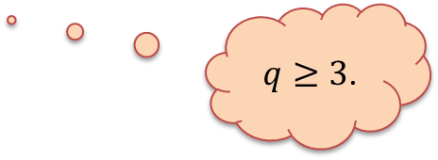

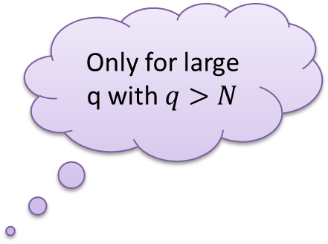
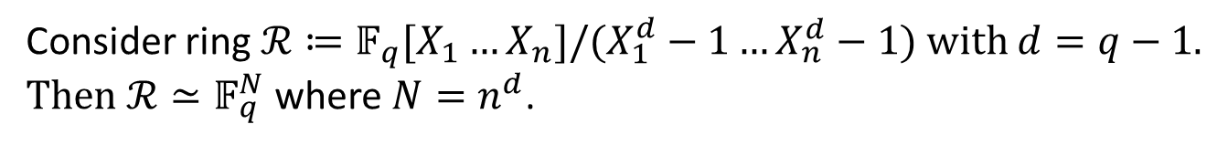
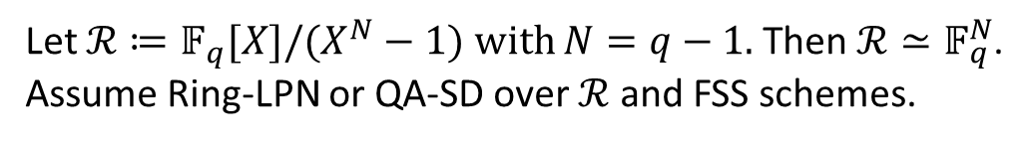
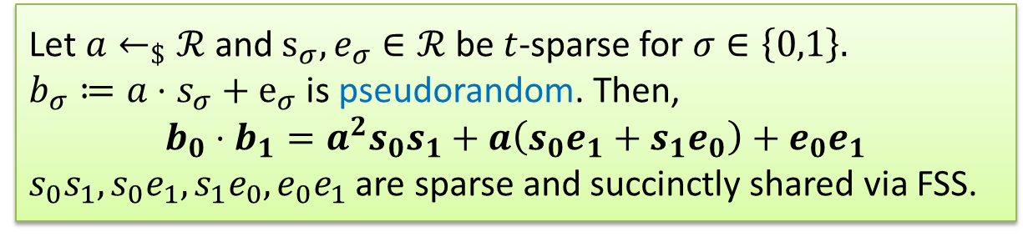
Recall PCG for $𝔽_{q}$-OLEs [BCGIKS20,BCCD23]
Only for large q with $q>N$
Method: Reduce multiple OLEs over $𝔽_{q}$ to one OLE over $ℛ$
Let $ℛ≔𝔽_{q}[X]/(X^{N}−1)$ with $N=q−1$. Then $ℛ≃𝔽_{q}^{N}$.
Assume Ring-LPN or QA-SD over $ℛ$ and FSS schemes.
Let $a←_{\$}ℛ$ and $s_{σ},e_{σ}∈ℛ$ be $t$-sparse for $σ∈\left\{0,1\right\}.$
$b_{σ}≔a⋅s_{σ}+e_{σ}$ is pseudorandom. Then,
$$b_{0}⋅b_{1}=a^{2}s_{0}s_{1}+a\left(s_{0}e_{1}+s_{1}e_{0}\right)+e_{0}e_{1}$$
$s_{0}s_{1},s_{0}e_{1},s_{1}e_{0},e_{0}e_{1}$ are sparse and succinctly shared via FSS.
For point function of domain size $N$, FSS has key size $O(log{N)}.$
Consider ring $ℛ≔𝔽_{q}[X_{1}…X_{n}]/(X_{1}^{d}−1…X_{n}^{d}−1)$ with $d=q−1$.
Then $ℛ≃𝔽_{q}^{N}$ where $N=n^{d}$.
$q≥3$.

Slide 15








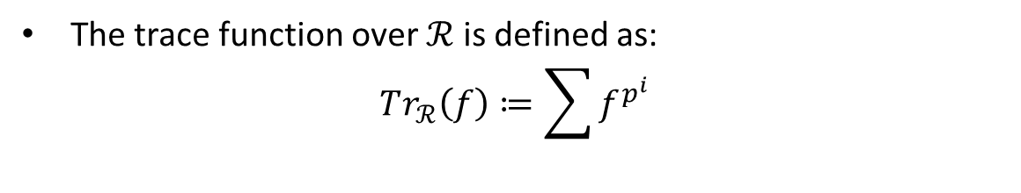

Polynomial Ring Trace [LXYY25]
Isomorphism $ℛ≃𝔽_{q}^{N}$ with $q=p^{k}$.
The trace function over $ℛ$ is defined as:
$$Tr_{ℛ}\left(f\right)≔\sum{f^{p^{i}}}$$
$$Tr_{ℛ}\left(⋅\right)$$
$$ℛ$$
$$Tr_{ℛ}(ℛ)$$
$$φ(⋅)$$
$$φ(⋅)$$
$$Tr_{𝔽_{q}^{N}}(⋅)$$
$$𝔽_{q}^{N}$$
$$𝔽_{p}^{N}$$
Then $φ\left(Tr_{ℛ}\left(f\right)\right)∈𝔽_{p}^{N}$.
Notes:
LXYY25 overcomes the barrier via a well-defined trace function over the polynomial ring

Slide 16
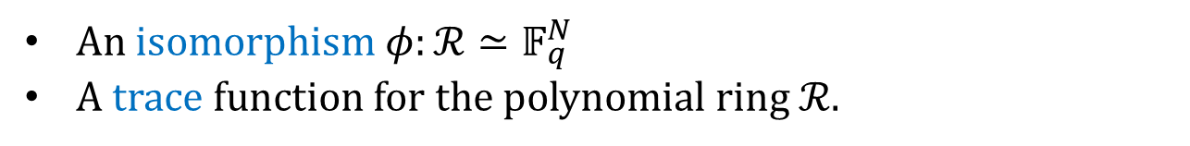
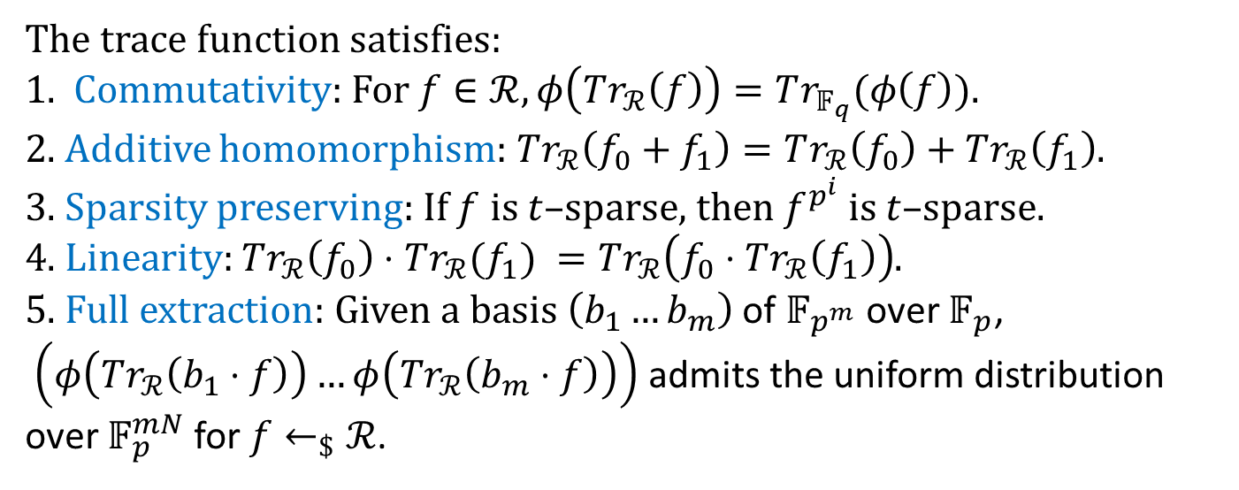
Ingredients of Previous PCG Constructions
An isomorphism $φ:ℛ≃𝔽_{q}^{N}$
A trace function for the polynomial ring $ℛ$.
The trace function satisfies:
1. Commutativity: For $f∈ℛ, φ\left(Tr_{ℛ}\left(f\right)\right)=Tr_{𝔽_{q}}(φ\left(f\right))$.
2. Additive homomorphism: $Tr_{ℛ}\left(f_{0}+f_{1}\right)=Tr_{ℛ}\left(f_{0}\right)+Tr_{ℛ}\left(f_{1}\right)$.
3. Sparsity preserving: If $f$ is $t$–sparse, then $f^{p^{i}}$ is $t$–sparse.
4. Linearity: $Tr_{ℛ}\left(f_{0}\right)⋅Tr_{ℛ}(f_{1}) =Tr_{ℛ}\left(f_{0}⋅Tr_{ℛ}\left(f_{1}\right)\right)$.
5. Full extraction: Given a basis $\left(b_{1}…b_{m}\right)$ of $𝔽_{p^{m}}$ over $𝔽_{p}$,
$\left(φ\left(Tr_{ℛ}\left(b_{1}⋅f\right)\right)…φ\left(Tr_{ℛ}\left(b_{m}⋅f\right)\right)\right)$ admits the uniform distribution over $𝔽_{p}^{mN}$ for $f←_{\$}ℛ$.
Notes:
We briefly summary the requirements of previous PCG constructions.

Slide 17
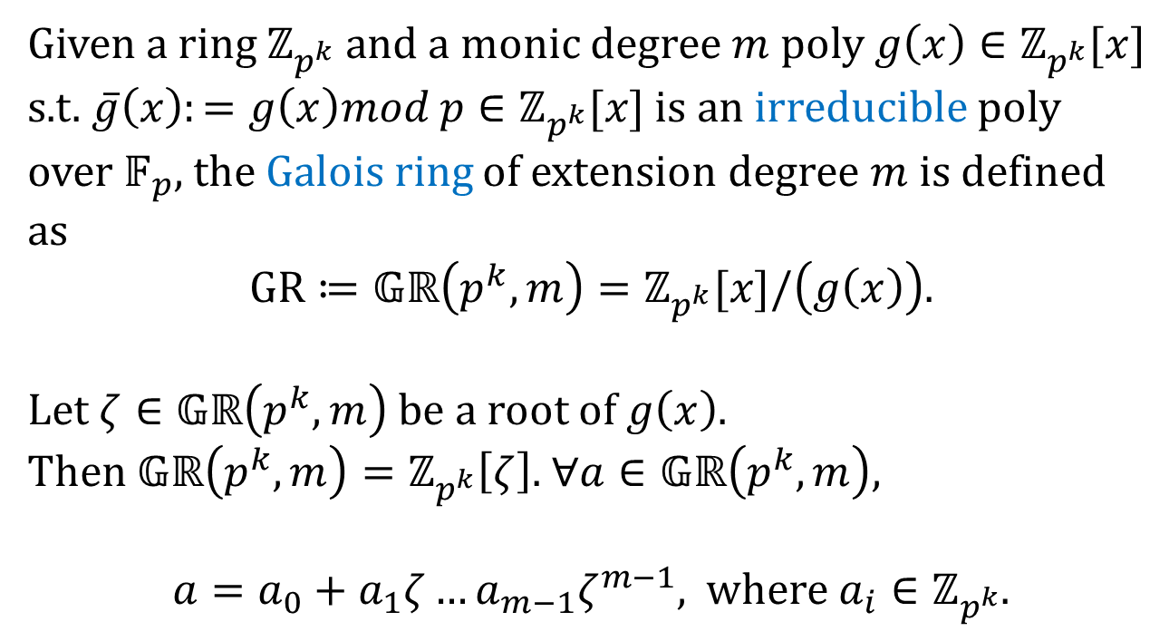
Galois Ring Preliminaries
Given a ring $ℤ_{p^{k}}$ and a monic degree $m$ poly $g\left(x\right)∈ℤ_{p^{k}}[x]$ s.t. $\overline{g}\left(x\right):=g\left(x\right)mod p∈ℤ_{p^{k}}[x]$ is an irreducible poly over $𝔽_{p}$, the Galois ring of extension degree $m$ is defined as
$GR≔𝔾ℝ\left(p^{k},m\right)=ℤ_{p^{k}}[x]/\left(g\left(x\right)\right)$.
Let $ζ∈𝔾ℝ\left(p^{k},m\right)$ be a root of $g\left(x\right)$.
Then $𝔾ℝ\left(p^{k},m\right)=ℤ_{p^{k}}\left[ζ\right]$. $∀a∈𝔾ℝ\left(p^{k},m\right),$
$a=a_{0}+a_{1}ζ…a_{m−1}ζ^{m−1},$ where $a_{i}∈ℤ_{p^{k}}$.
Notes:
Given a degree m poly g(x) satisfying g bar(x) is irreducible, the Galois ring of degree m is defined as
Let zeta be a root of g(x).
a can be uniquely represented in this form w.r.t zeta

Slide 18
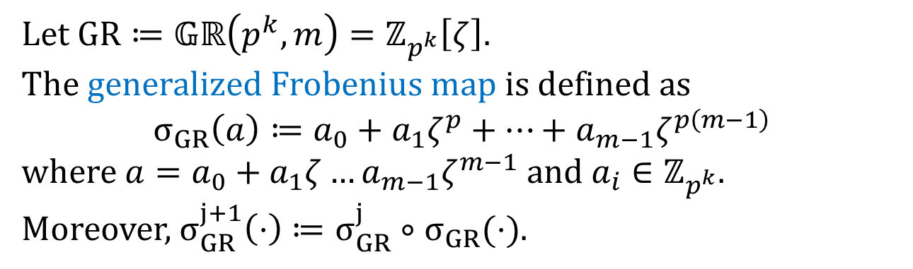
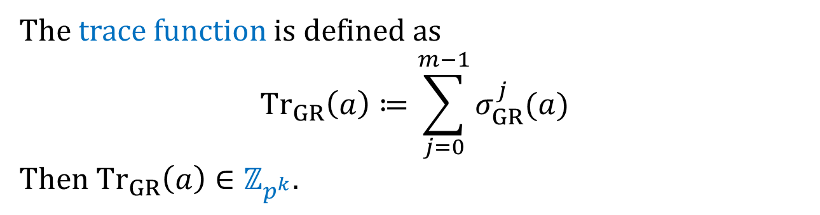
Galois Ring Preliminaries
Let $GR≔𝔾ℝ\left(p^{k},m\right)=ℤ_{p^{k}}\left[ζ\right].$
The generalized Frobenius map is defined as
$$σ_{GR}\left(a\right)≔a_{0}+a_{1}ζ^{p}+…+a_{m−1}ζ^{p\left(m−1\right)}$$
where $a=a_{0}+a_{1}ζ…a_{m−1}ζ^{m−1}$ a$nd a_{i}∈ℤ_{p^{k}}$.
Moreover, $σ_{GR}^{j+1}\left(⋅\right)≔σ_{GR}^{j}∘σ_{GR}(⋅)$.
The trace function is defined as
$${Tr}_{GR}\left(a\right)≔\sum_{j=0}^{m−1}{σ_{GR}^{j}(a)}$$
Then ${Tr}_{GR}\left(a\right)∈ℤ_{p^{k}}$.
Notes:
Next, we recall the Frobenius map and trace function definitions.

Slide 19
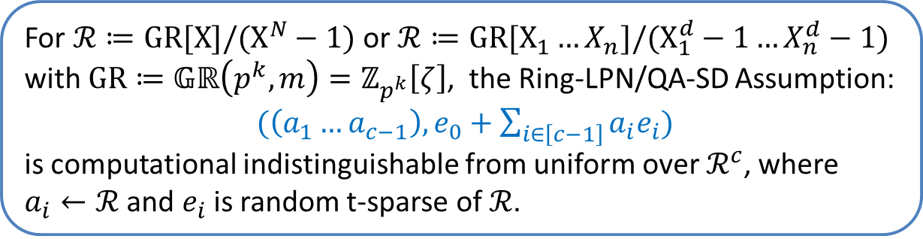
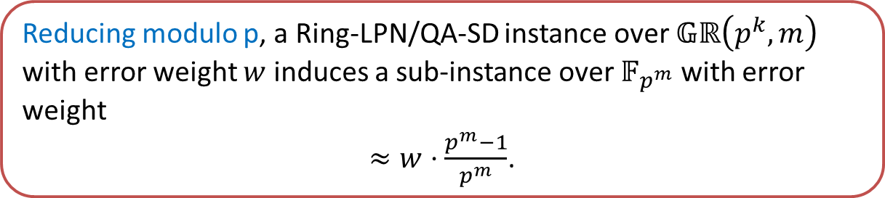
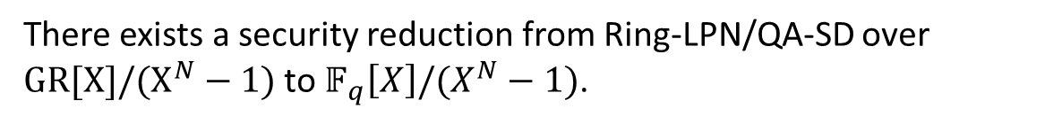
Ring-LPN and QA-SD over Galois Rings
For $ℛ≔GR[X]/(X^{N}−1)$ or $ℛ≔GR[X_{1}…X_{n}]/(X_{1}^{d}−1…X_{n}^{d}−1)$ with $GR≔𝔾ℝ\left(p^{k},m\right)=ℤ_{p^{k}}\left[ζ\right]$, the Ring-LPN/QA-SD Assumption:
$(\left(a_{1}…a_{c−1}\right),e_{0}+\sum_{i∈\left[c−1\right]}{a_{i}e_{i})}$
is computational indistinguishable from uniform over $ℛ^{c}$, where $a_{i}←ℛ$ and $e_{i}$ is random t-sparse of $ℛ$.
There exists a security reduction from Ring-LPN/QA-SD over $GR[X]/(X^{N}−1)$ to $𝔽_{q}\left[X\right]/(X^{N}−1)$.
Reducing modulo p, a Ring-LPN/QA-SD instance over $𝔾ℝ\left(p^{k},m\right)$ with error weight $w$ induces a sub-instance over $𝔽_{p^{m}}$ with error weight
$≈w⋅\frac{p^{m}−1}{p^{m}}$.
Notes:
We first show the Ring-LPN and QA-SD assumptions over Galois rings are secure.

Slide 20
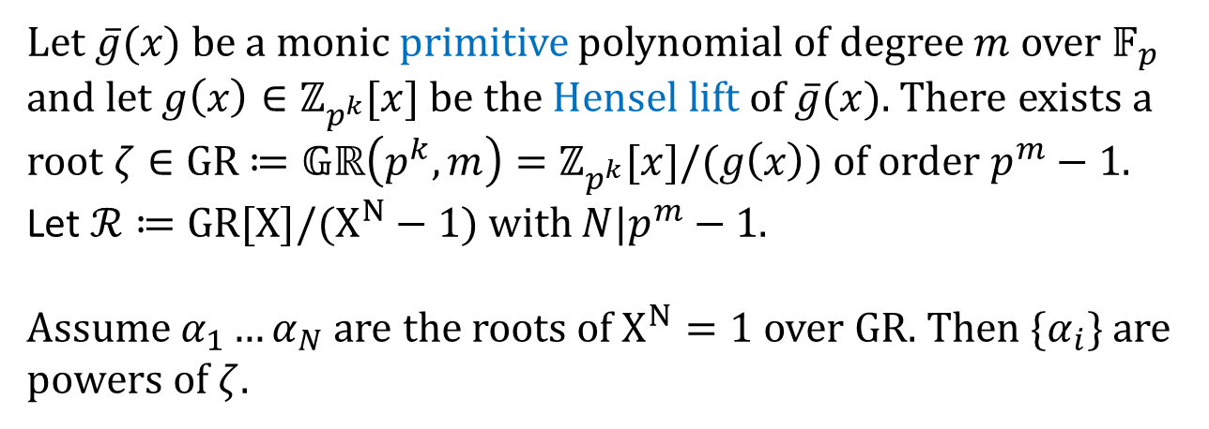
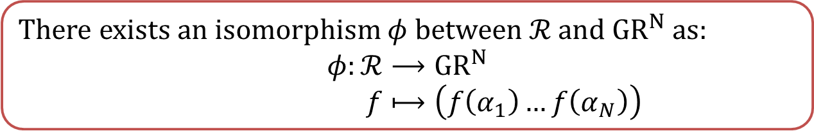
Isomorphism for Polynomial Ring
In Galois ring definition, it is irreducible.
Let $\overline{g}(x)$ be a monic primitive polynomial of degree $m$ over $𝔽_{p}$ and let $g\left(x\right)∈ℤ_{p^{k}}[x]$ be the Hensel lift of $\overline{g}(x)$. There exists a root $ζ∈GR$ $≔𝔾ℝ\left(p^{k},m\right)=ℤ_{p^{k}}[x]/(g\left(x\right))$ of order $p^{m}−1$.
Let $ℛ≔GR[X]/(X^{N}−1)$ with $N|p^{m}−1$.
Assume $α_{1}…α_{N}$ are the roots of $X^{N}=1$ over $GR$. Then ${\{α}_{i}\}$ are powers of $ζ$.
There exists an isomorphism $φ$ between $ℛ$ and $GR^{N}$ as:
$$φ:ℛ⟶GR^{N}$$
$f⟼\left(f\left(α_{1}\right)…f\left(α_{N}\right)\right)$
Notes:
Next, we establish an isomorphism between the polynomial ring and the vector over Galois ring.

Slide 21





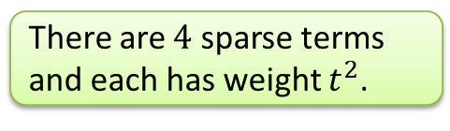
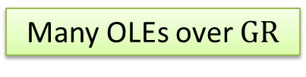
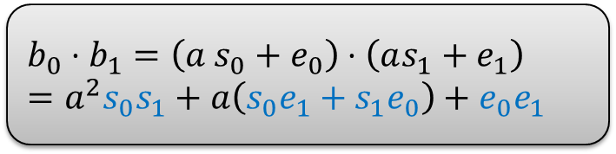

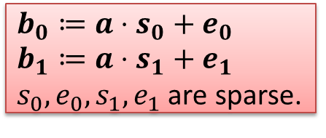
PCG for OLEs over Galois Rings
Given $φ:ℛ⟶GR^{N}$,
$$b_{0}≔a⋅s_{0}+e_{0}$$
$$b_{1}≔a⋅s_{1}+e_{1}$$
$s_{0},e_{0},s_{1},e_{1}$ are sparse.
Goal: Generate many OLEs over $GR$.
$ℛ≔GR[X]/(X^{N}−1)$ with $N=p^{m}−1$.
ONE OLE over $ℛ$
$b_{0}⋅b_{1}=w_{0}+w_{1}$.
Local Comp.
$$b_{0}⋅b_{1}=\left(a s_{0}+e_{0}\right)⋅\left(as_{1}+e_{1}\right)=a^{2}s_{0}s_{1}+a\left(s_{0}e_{1}+s_{1}e_{0}\right)+e_{0}e_{1}$$
Many OLEs over $GR$
$${φ{\left(b_{0}\right)}_{i}⋅φ{\left(b_{1}\right)}_{i}=φ{\left(w_{0}\right)}_{i}+φ(w_{1})}_{i}$$
There are $4$ sparse terms and each has weight $t^{2}$.
Notes:
With the isomorphism phi and the RingLPN assumption, we obtain the first PCG for Galois rings.

Slide 22
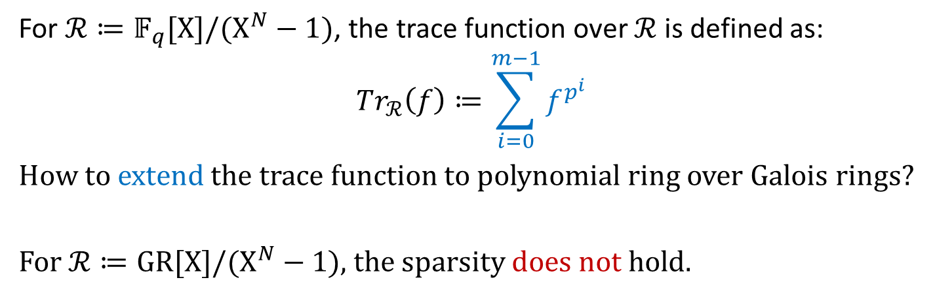
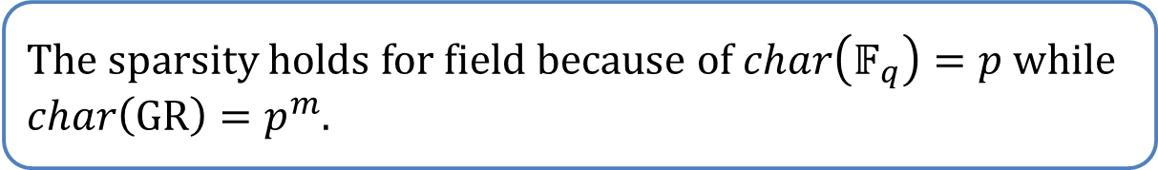
Recall Trace for Polynomial Ring over Fields
For $ℛ≔𝔽_{q}[X]/(X^{N}−1)$, the trace function over $ℛ$ is defined as:
$$Tr_{ℛ}\left(f\right)≔\sum_{i=0}^{m−1}{f^{p^{i}}}$$
How to extend the trace function to polynomial ring over Galois rings?
For $ℛ≔GR[X]/(X^{N}−1)$, the sparsity does not hold.
The sparsity holds for field because of $char\left(𝔽_{q}\right)=p$ while $char\left(GR\right)=p^{m}$.
Notes:
To construction PCG for Z_{p^k}, we recall the trace function polynomial ring over Galois field

Slide 23
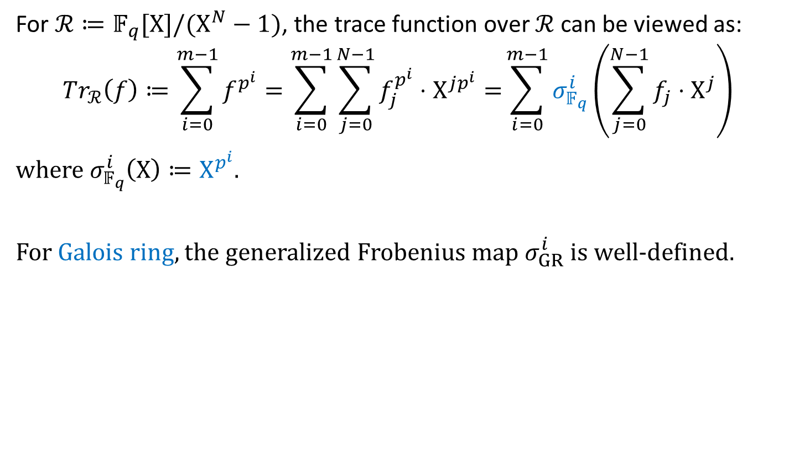
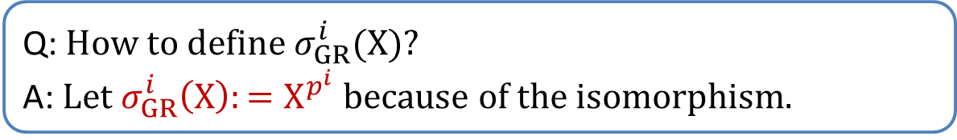
Trace for Polynomial Ring
For $ℛ≔𝔽_{q}[X]/(X^{N}−1)$, the trace function over $ℛ$ can be viewed as:
$$Tr_{ℛ}\left(f\right)≔\sum_{i=0}^{m−1}{f^{p^{i}}=\sum_{i=0}^{m−1}{\sum_{j=0}^{N−1}{f_{j}^{p^{i}}⋅X^{jp^{i}}}}=}\sum_{i=0}^{m−1}{σ_{𝔽_{q}}^{i}\left(\sum_{j=0}^{N−1}{f_{j}{⋅X}^{j}}\right)}$$
where $σ_{𝔽_{q}}^{i}\left(X\right)≔X^{p^{i}}$.
For Galois ring, the generalized Frobenius map $σ_{GR}^{i}$ is well-defined.
Q: How to define $σ_{GR}^{i}(X)$?
A: Let $σ_{GR}^{i}\left(X\right):=X^{p^{i}}$ because of the isomorphism.
Notes:
The trace function can also be viewed with respect to the Frobenius map
For indeterminate X, the Frobenius map is defined as Xpi

Slide 24
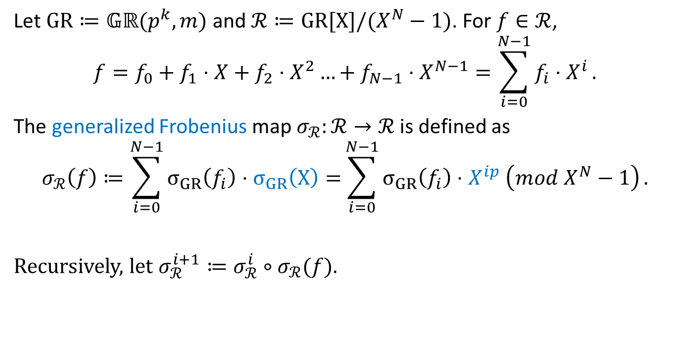
Generalized Frobenius Map for Polynomial Ring over Galois Ring
Let $GR≔𝔾ℝ(p^{k},m)$ and $ℛ≔GR[X]/(X^{N}−1)$. For $f∈ℛ$,
$$f=f_{0}+f_{1}⋅X+f_{2}⋅X^{2}…+f_{N−1}⋅X^{N−1}=\sum_{i=0}^{N−1}{f_{i}⋅X^{i}}.$$
The generalized Frobenius map $σ_{ℛ}:ℛ→ℛ$ is defined as
$$σ_{ℛ}\left(f\right)≔\sum_{i=0}^{N−1}{σ_{GR}\left(f_{i}\right)⋅σ_{GR}\left(X\right)=}\sum_{i=0}^{N−1}{σ_{GR}\left(f_{i}\right)⋅X^{ip} \left(mod X^{N}−1\right)}.$$
Recursively, let $σ_{ℛ}^{i+1}≔σ_{ℛ}^{i}∘σ_{ℛ}(f)$.
Notes:
The Frobenius map over the polynomial ring can be defined as

Slide 25

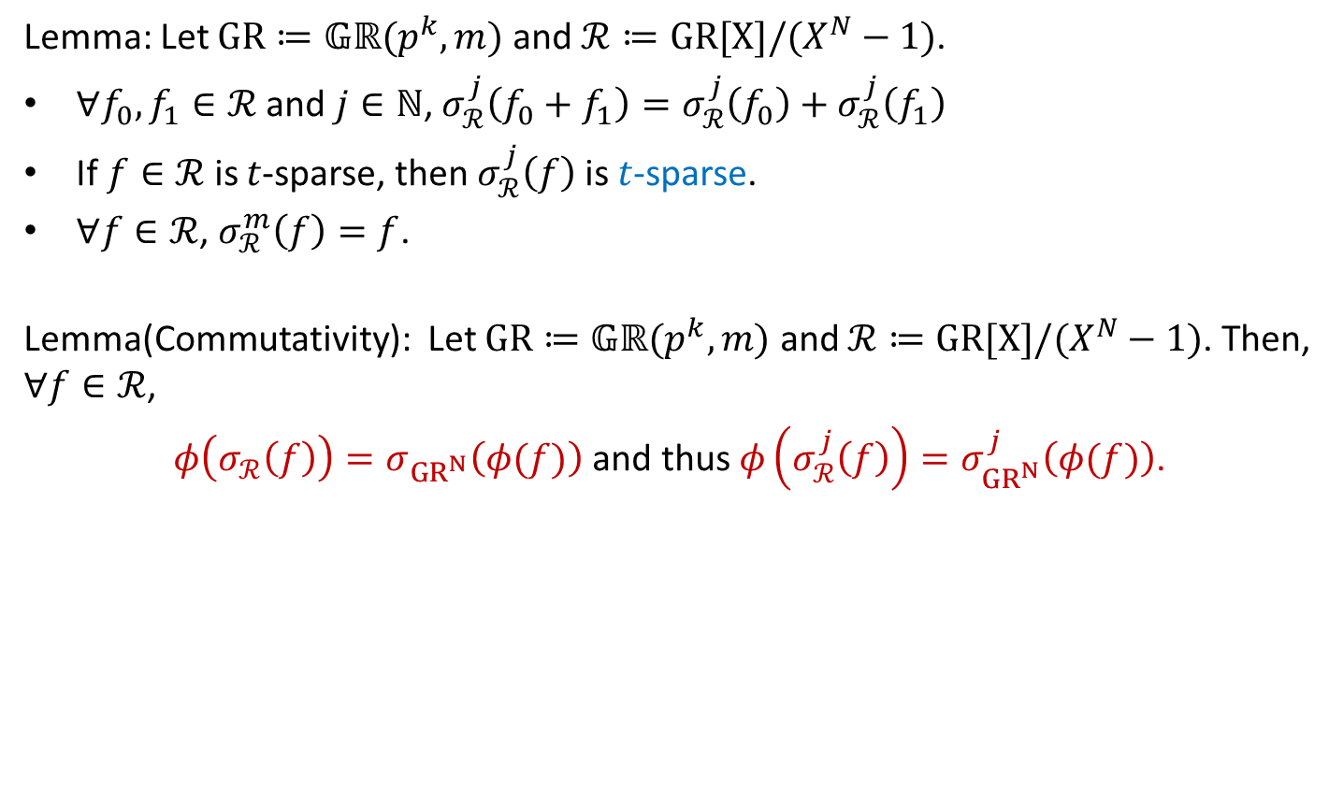







Properties of Generalized Frobenius Map
Lemma: Let $GR≔𝔾ℝ(p^{k},m)$ and $ℛ≔GR[X]/(X^{N}−1)$.
$∀f_{0},f_{1}∈ℛ$ and $j∈ℕ$, $σ_{ℛ}^{j}\left(f_{0}+f_{1}\right)=σ_{ℛ}^{j}\left(f_{0}\right)+σ_{ℛ}^{j}\left(f_{1}\right)$
If $f∈ℛ$ is $t$-sparse, then $σ_{ℛ}^{j}\left(f\right)$ is $t$-sparse.
$∀f∈ℛ$, $σ_{ℛ}^{m}\left(f\right)=f$.
Lemma(Commutativity): Let $GR≔𝔾ℝ(p^{k},m)$ and $ℛ≔GR[X]/(X^{N}−1)$. Then, $∀f∈ℛ$,
$φ\left(σ_{ℛ}\left(f\right)\right)=σ_{GR^{N}}\left(φ(f)\right)$ and thus $φ\left(σ_{ℛ}^{j}\left(f\right)\right)=σ_{GR^{N}}^{j}\left(φ(f)\right)$.
$$φ(⋅)$$
$$ℛ$$
$$GR^{N}$$
$$σ_{ℛ}^{j}(⋅)$$
$$σ_{GR}^{j}(⋅)$$
$$φ(⋅)$$
$$ℛ$$
$$GR^{N}$$

Slide 26

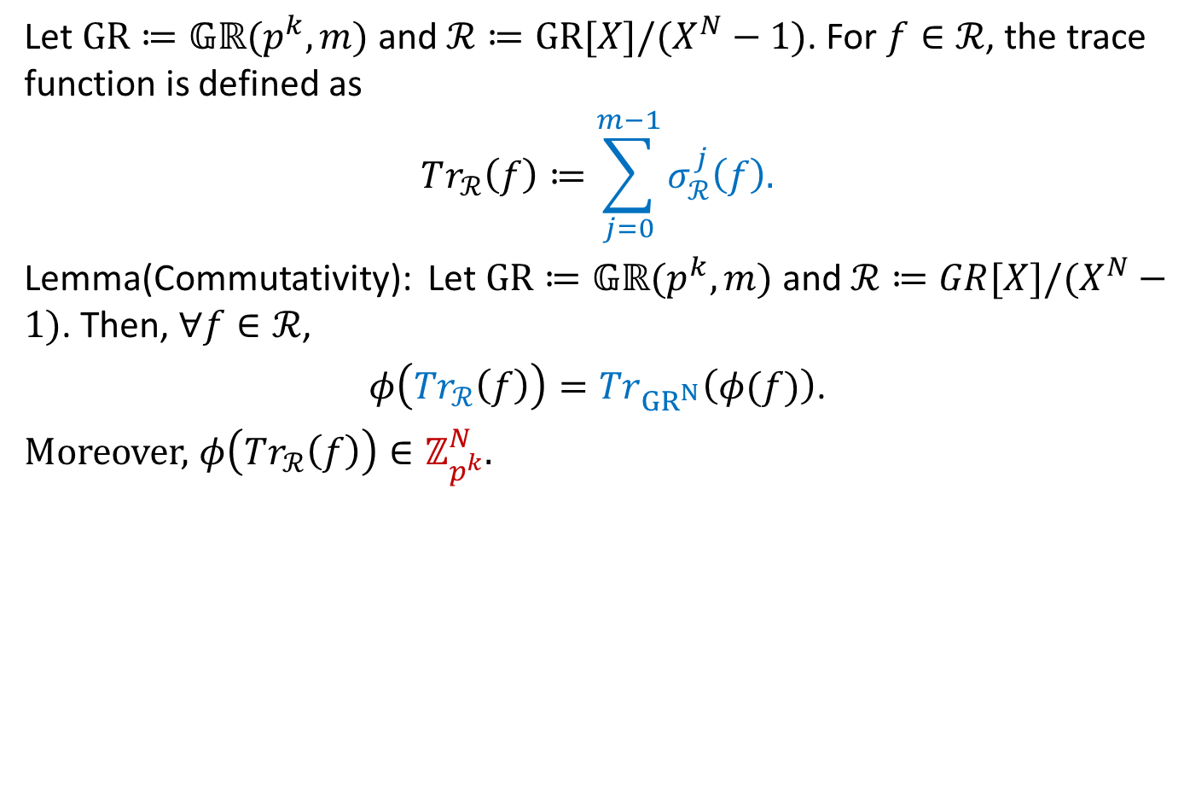







Trace Function
Let $GR≔𝔾ℝ(p^{k},m)$ and $ℛ≔GR[X]/(X^{N}−1)$. For $f∈ℛ$, the trace function is defined as
$$Tr_{ℛ}\left(f\right)≔\sum_{j=0}^{m−1}{σ_{ℛ}^{j}\left(f\right).}$$
Lemma(Commutativity): Let $GR≔𝔾ℝ(p^{k},m)$ and $ℛ≔GR[X]/(X^{N}−1)$. Then, $∀f∈ℛ$,
$φ\left({Tr}_{ℛ}\left(f\right)\right)={Tr}_{GR^{N}}\left(φ(f)\right)$.
Moreover, $φ\left(Tr_{ℛ}\left(f\right)\right)∈ℤ_{p^{k}}^{N}$.
$$φ(⋅)$$
$$ℛ$$
$$GR^{N}$$
$$Tr_{ℛ}(⋅)$$
$$Tr_{ℛ}(⋅)$$
$$φ(⋅)$$
$$Im(Tr_{ℛ})$$
$$ℤ_{p^{k}}$$
Notes:
With the Frobenius map, the trace function is defined as

Slide 27
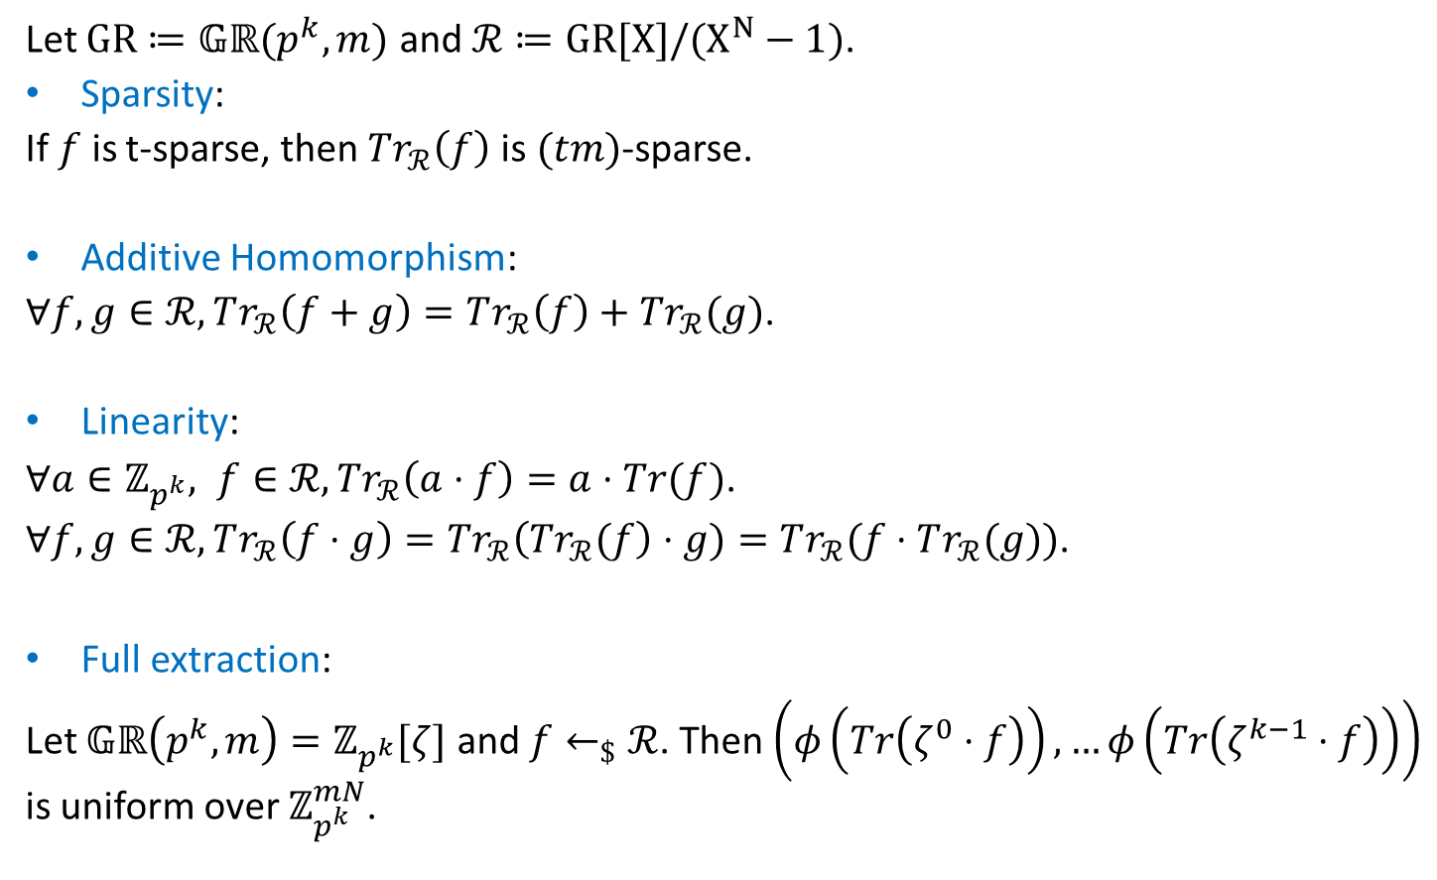
Properties of the Trace Function
Let $GR≔𝔾ℝ(p^{k},m)$ and $ℛ≔GR[X]/(X^{N}−1)$.
Sparsity:
If $f$ is t-sparse, then $Tr_{ℛ}\left(f\right)$is $(tm)$-sparse.
Additive Homomorphism:
$∀f,g∈ℛ,Tr_{ℛ}\left(f+g\right)=Tr_{ℛ}\left(f\right)+Tr_{ℛ}(g)$.
Linearity:
$∀a∈ℤ_{p^{k}}, f∈ℛ,Tr_{ℛ}\left(a⋅f\right)=a⋅Tr(f)$.
$∀f,g∈ℛ, Tr_{ℛ}\left(f⋅g\right)=Tr_{ℛ}\left(Tr_{ℛ}(f\right)⋅g)=Tr_{ℛ}(f⋅Tr_{ℛ}(g))$.
Full extraction:
Let $𝔾ℝ\left(p^{k},m\right)=ℤ_{p^{k}}[ζ]$ and $f←_{\$}ℛ$. Then $\left(φ\left(Tr\left(ζ^{0}⋅f\right)\right),…φ\left(Tr\left(ζ^{k−1}⋅f\right)\right)\right)$ is uniform over $ℤ_{p^{k}}^{mN}$.

Slide 28
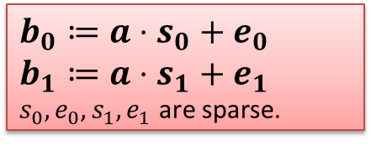


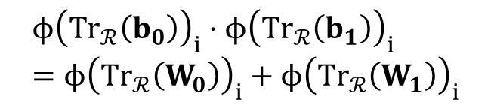
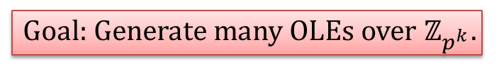


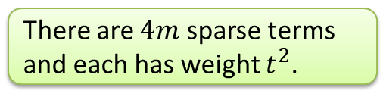
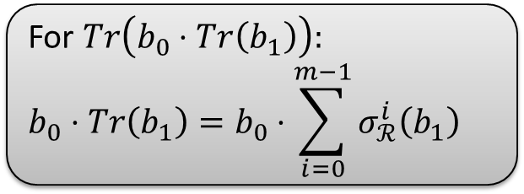
PCG for $ℤ_{p^{k}}$-OLEs
$$b_{0}≔a⋅s_{0}+e_{0}$$
$$b_{1}≔a⋅s_{1}+e_{1}$$
$s_{0},e_{0},s_{1},e_{1}$ are sparse.
Goal: Generate many OLEs over $ℤ_{p^{k}}$.
$ℛ≔GR[X]/(X^{N}−1)$ with $N=p^{m}−1$.
ONE OLE over $ℛ$
$Tr_{ℛ}\left(b_{0}\right)⋅Tr_{ℛ}\left(b_{1}\right)={Tr}_{ℛ}(W_{0})+{Tr}_{ℛ}(W_{1})$.
Local Comp.
For $Tr\left(b_{0}⋅Tr\left(b_{1}\right)\right):$
$$b_{0}⋅Tr\left(b_{1}\right)=b_{0}⋅\sum_{i=0}^{m−1}{σ_{ℛ}^{i}\left(b_{1}\right)}$$
Many OLEs over $ℤ_{p^{k}}$
$$ϕ{\left(Tr_{ℛ}\left(b_{0}\right)\right)}_{i}⋅ϕ{\left(Tr_{ℛ}\left(b_{1}\right)\right)}_{i}=ϕ{\left(Tr_{ℛ}\left(W_{0}\right)\right)}_{i}+ϕ{\left(Tr_{ℛ}\left(W_{1}\right)\right)}_{i}$$
There are $4m$ sparse terms and each has weight $t^{2}$.
Notes:
With the Trace function, the PCG can be constructed as

Slide 29
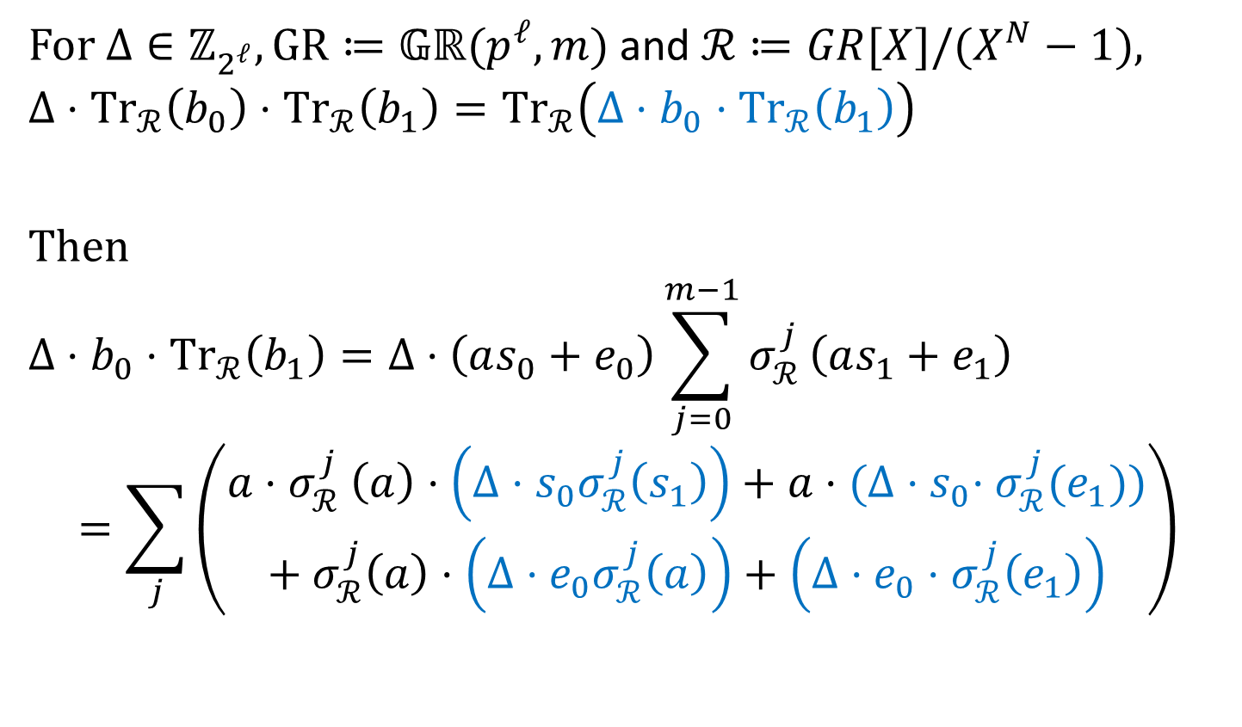

SPD$ℤ_{2^{k}}$-Type Multiplication Triples
For $Δ∈ℤ_{2^{ℓ}}, GR≔𝔾ℝ(p^{ℓ},m)$ and $ℛ≔GR[X]/(X^{N}−1)$,
$$Δ⋅{Tr}_{ℛ}\left(b_{0}\right)⋅{Tr}_{ℛ}\left(b_{1}\right)={Tr}_{ℛ}\left(Δ⋅b_{0}⋅{Tr}_{ℛ}\left(b_{1}\right)\right)$$
Then
$$Δ⋅b_{0}⋅{Tr}_{ℛ}\left(b_{1}\right)=Δ⋅\left(as_{0}+e_{0}\right)\sum_{j=0}^{m−1}{σ_{ℛ}^{j}}\left(as_{1}+e_{1}\right)$$
$$=\sum_{j}{\left(\begin{aligned}a{⋅σ}_{ℛ}^{j}\left(a\right)⋅\left(Δ⋅s_{0}σ_{ℛ}^{j}\left(s_{1}\right)\right)+a⋅{(Δ⋅s}_{0}⋅σ_{ℛ}^{j}(e_{1})) \\ + σ_{ℛ}^{j}\left(a\right)⋅\left({Δ⋅e}_{0}σ_{ℛ}^{j}\left(a\right)\right)+\left(Δ⋅e_{0}⋅σ_{ℛ}^{j}\left(e_{1}\right)\right)\end{aligned}\right)}$$
Notes:
For SPDZ2k type triples, the target correlation is

Slide 30

Summary
Programmble PCGs for multiplication triples over any Galois ring.
Two-party PCG for SPD$ℤ_{2^{k}}$-Type authenticated multiplication triples.
Problems:
PCG for Multi-party authenticated Beaver triples?
Thank you!

