Slide 1


Quantum Cryptography and Meta-Complexity
Taiga Hiroka^{1,2}
Tomoyuki Morimae^{2,1}
¹ Foxconn
² Yukawa Institute for Theoretical Physics, Kyoto University
2025 Hon Hai Precision Industry Co, Ltd All rights reserved.

Slide 2


Background (OWF = Necessary for Classical Crypto)
One-Way Function (OWF) f:
Easy for PPT
Pseudo-Random Generator
$$x$$
$$f(x)$$
Secret-Key Encryption
Hard for PPT
Digital Signature…
Is OWF necessary for quantum cryptography?
2025 Hon Hai Precision Industry Co, Ltd All rights reserved.

Slide 3
Background (Necessary assumption for QCrypto)
One-Way Function
Known Implication:
Open Question:
[Kre21]
[KQT25]
[JLS18]
Quantum-SKE
with Classical Communications…
Pseudo-Random State Generator…
Necessary for almost all quantum cryptographic primitives
with pure state outputs
Necessary for almost all quantum cryptographic primitives
with classical communications
[KT24]
One-Way Puzzle (OWPuzz)
[JLS18] Z. Ji, Y. Liu, F.Song, CRYPTO21
[Kre21] W. Kretchmer, TQC21
[KQT25] W. Kretchmer, L. Qian, A. Tal, STOC25
2025 Hon Hai Precision Industry Co, Ltd All rights reserved.
[KT24] D.Khurana, K. Tomer, STOC24

Slide 4



Background (OWPuzz = Quantum Analog of OWF)
Definition of One-Way Puzzle [KT24]:
puzz
QPT Algorithm
QPT adversary
(puzz, ans)
Samp
$$ans^{∗}$$
Inefficient Algorithm
1 or 0
Vrfy
(puzz, ans)
Correctness:
1$←$Vrfy(puzz, ans) with high probability if (puzz,ans) ←Samp
Security:
No QPT adversary can output ans such that 1$←$Vrfy(puzz, ans) with high probability
2025 Hon Hai Precision Industry Co, Ltd All rights reserved.

Slide 5

Background (OWPuzz from BQP$≠$PP ?)
It seems difficult to construct OWPuzz unconditionally
Known Implication:
[CGGHLP25]
Open Question:
One-Way Puzzle
BQP$≠$PP
Open Question in Quantum Cryptography:
Can we construct OWPuzz from BQP$≠$PP ?
This is a quantum analog of OWF from P$≠$NP.
Meta-Complexity is an emerging approach for the open problem
[CGGHLP25] B.Cavalar, E.Goldin, M.Gray, P.Hall, Y.Liu, A.Pelecanos, Quantum25
2025 Hon Hai Precision Industry Co, Ltd All rights reserved.

Slide 6
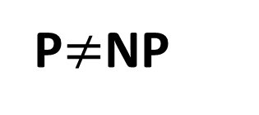
Motivation (Meta-Complexity)
The complexity of problems to ask for complexity
One-Way Function
Several Average-Case Hardness
of Meta-Complexity Problems
[LP20],[IRS22]…
Natural Open Question:
Can we obtain quantum analog of these results?
Worst-case to average-case reduction
within Meta Complexity
Our Result:
Several Worst-Case Hardness
of Meta-Complexity Problems
First characterization of quantum cryptographic primitive
P$≠$NP
[CGGH25] concurrently obtains a similar result
[ILO20],[LP22]…
[LP20] Y.Liu, R.Pass, FOCS20
[IRS22] R.Ilango, H.Len, R,Santhnam, STOC22
[CGGH25] B.Cavalar, E.Goldin, M.Gray, P.Hall, Eurocrypt25
[ILO20] R.Ilango, B. Loff, I.Oliveira, CCC20
[LP22] Y.Liu, R.Pass, CCC22
2025 Hon Hai Precision Industry Co, Ltd All rights reserved.

Slide 7
Our Results (Meta-Characterization of OWPuzz)
Quantum Avg Hardness of GapK:
One-Way Puzzle
Informally, hardness of estimating
Kolmogorov Complexity
First characterization of quantum cryptographic primitive by Meta-Complexity.
2025 Hon Hai Precision Industry Co, Ltd All rights reserved.

Slide 8
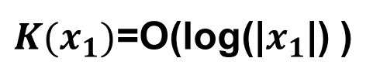
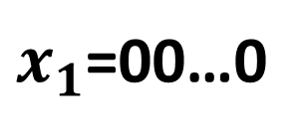

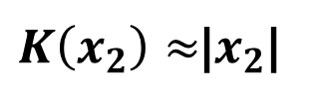
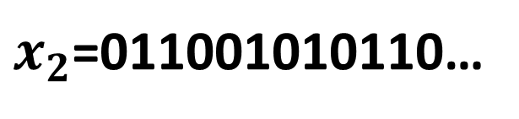
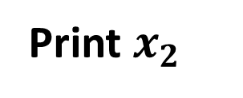
Our Results (Kolmogorov Complexity)
Kolmogorov Complexity:
K(x) =
Minimum Length of Program that prints x
Examples:
Program
$x_{1}$=00…0
Repeat 0 for |$x_{1}$| times
$K(x_{1})$=O(log(|$x_{1}$|) )
Program
$x_{2}$=011001010110…
Print $x_{2}$
$K\left(x_{2}\right)≈$|$x_{2}$|
2025 Hon Hai Precision Industry Co, Ltd All rights reserved.

Slide 9

Our Results (OWPuzz and Meta-Complexity)
One-Way Puzzle
Quantum Average-Case Hardness of GapK:
$$x$$
QPT algorithm
No QPT algorithms can decide if K(x) small or large?
QPT algorithm
Q
2025 Hon Hai Precision Industry Co, Ltd All rights reserved.

Slide 10
Previous Results (OWF and Meta-Complexity)
OWF
Our Results can be seen as a quantum analog of [IRS22]
[IRS22]
Classical Average-Case Hardness of GapK:
$$x$$
PPT algorithm
No PPT algorithms
can decide if K(x) small or large?
PPT algorithm
C
[IRS22] R.Ilango, H.Len, R,Santhnam, STOC22
2025 Hon Hai Precision Industry Co, Ltd All rights reserved.

Slide 11
Techniques (Recall [IRS22] Approach)
Does [IRS22] approach trivially works in the quantum setting?
NO!
Estimating Classical Probability:
Given a PPT algorithm C, on average, estimate Pr[x←C] within multiplicative error
[IRS22]
[IL90]
Classical Avg-Hardness of GapK
OWF
PRG
[IRS22]
[HILL99]
2025 Hon Hai Precision Industry Co, Ltd All rights reserved.

Slide 12
Techniques (Our Approach)
Does [IRS22] approach trivially works in the quantum setting?
Heavily depends on classical algorithms having a random seed.
NO!
Estimating Classical Probability:
Estimating Quantum Probability:
Given a PPT algorithm C, on average, estimate Pr[x←C] within multiplicative error
Given a QPT algorithm Q, on average, estimate Pr[x←Q] within multiplicative error
✓
[IRS22]
[IL90]
[IRS22] depends on PRGs having a random seed.
Classical Avg-Hardness of GapK
OWPuzz
Quantum Avg-Hardness of GapK
OWF
(Non-Uniform) QPRG
PRG
✓
(1). Statistically far from Uniform
(2). Computationally Indistinguishable
from Uniform
[KT24]
[HILL99]
✓
[CGG24]
2025 Hon Hai Precision Industry Co, Ltd All rights reserved.

Slide 13
Techniques (Estimating Quantum Probability)
Distributional OWPuzz:
[CGG24]
Estimating Quantum Probability:
QPT algorithm Samp⇒(k,s).
Given s, no QPT adversary A can simulate conditional distribution.
OWPuzz
Given a QPT algorithm Q, on average, estimate Pr[x←Q] within multiplicative.
Our contribution
Outlook of our approach:
We show the contraposition!
On average, additive error estimation is sufficient for multiplicative error estimation
Pr[${x_{1}x_{2}x}_{3}$←Q]=Pr[$x_{1}$]・ Pr[$x_{2}$|$x_{1}$]・ Pr[$x_{3}$|$x_{1}x_{2}$]
Assuming non-existence of Distributional OWPuzz,
we can estimate each term within additive error.
Concurrent work:
[KT25] Similar technique
[CGGH25] Different technique
[CGG24] K.Chung, E.Goldin, M.Gray, Crypto24
[KT25] D.Khurana, K.Tomer, STOC25
[CGGH25] B.Cavalar, E.Goldin, M.Gray, P.Hall, Eurocrypt25
2025 Hon Hai Precision Industry Co, Ltd All rights reserved.

Slide 14

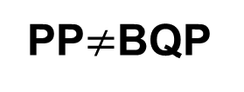
Summary & Future Directions
Our Result
OWPuzz
QAvg-Hardness of GapK
Folklore
Open
DistPP HeurBQP
?????
[CGGHLP24]
Classical techniques heavily depends on that NP is efficiently verifiable given witness.
Open
PP$≠$BQP
?????
2025 Hon Hai Precision Industry Co, Ltd All rights reserved.

Slide 15
Appendix (Reminder of [IL90])
Stockmeyer
The number of witnesses for NP statement can be approximated by NP oracle
Goal:
Estimate Pr[x←C] on average
The non-existence of OWF
*C is a PPT algorithm
Observation
Pr[x←C] can be estimated by counting
the number of r s.t. x←C(r)
2025 Hon Hai Precision Industry Co, Ltd All rights reserved.

Slide 16
Appendix (Sampling Advantage from OWPuzz)
Informally,
if we can instantiate OWPuzz from mild assumption, which does not imply OWF, then we have sampling quantum advantage.
OWPuzz
[MSY25]
Sampling
Quantum Advantage
OWF
OR
2025 Hon Hai Precision Industry Co, Ltd All rights reserved.
[MSY25] T. Morimae, Y.Shirakawa, T.Yamakawa, STOC25

