Slide 1




The Round Complexity of Black-Box Post-Quantum Secure Computation
Slides prepared by this guy, whose U.S. visa got rejected (again).
Rohit Chatterjee
National University of Singapore
Xiao Liang
The Chinese University of Hong Kong
Omkant Pandey
Stony Brook University
Takashi Yamakawa
NTT Social Informatic Laboratories
Notes:
Hello everyone, I’m Takashi from NTT.
The title of my talk is The Round Complexity of Black-Box Post-Quantum Secure Computation.
This is joint work with Rohit Chatterjee, Xiao Liang, and Omkant Pandey.
As you can see, the slides were prepared by Xiao, but unfortunately, he could not attend the conference because of a visa issue. So, I will be giving the talk instead.

Slide 2
Secure (Quantum) Multi-Party Computation
MPC is important and ubiquitous:
A formal definition is redundant for Crypto audience
Only need to emphasize:
  MPC security is simulation-based; security proofs typically involve rewinding.
Quantum computing puts new threats:
Rewinding-based techniques requires re-investigation due to the no-cloning theorem
Post-quantum (PQ) model (our main focus):
Honest parties (and their communication) are entirely classical
Adversaries can be quantum locally (i.e., still classical communication)
Challenging due to the asymmetric power favoring stronger (quantum) adversaries
PQ feasibilities typically extend to “fully-quantum” setting (e.g., [BCKM21])
Notes:
Let me start with some background on secure multi-party computation, or MPC.
MPC is a fundamental and widely used concept in cryptography. I don’t think I need to give the formal definition for this audience, but I want to emphasize that MPC security is simulation-based, and that security proofs often rely on rewinding.
Now, when we consider quantum computing, things get tricky. Rewinding techniques need to be re-examined because of the no-cloning theorem. Since an adversary’s internal state cannot be cloned, rewinding a quantum adversary is often difficult.
In this talk, we focus on the post-quantum setting — where honest parties and their communication are entirely classical, but the adversary can perform quantum computations locally.
Typically, results in the post-quantum setting can be extended to the fully quantum setting, as shown in [BCKM21].

Slide 3
Post-Quantum MPC: Desirable Features
Fundamental Aspects of MPC Constructions:
Round complexity
Minimal assumptions (semi-honest OT)
Black-box constructions
Communication complexity
Parties’ computational cost
…
Our focus
What are black-box Constructions?
Making I/O access to building blocks (e.g., OT, PRG, …)
Similar to the concept of API (application programming interface)
Why black-box Constructions?
Modular design
Often lead to better efficiency
Valid even if building blocks are physical objects (e.g., temper-proof hardware)
Traditionally, an important research theme: [IKLP06, IKOS07, Hai08, IPS08, PW09, CDMW09, Wee10, Goy11, … ]
Notes:
Now, let’s talk about black-box secure computation.
Here, the term “black-box” means that we treat the underlying primitives — such as one-way functions, oblivious transfer, or public-key encryption — as black boxes. We only use their input-output behavior, without looking at their code.
There are several reasons why we study black-box constructions.
First, they enable modular designs.
Second, they often lead to better concrete efficiency.
Third, the construction still works even if the building blocks are physical objects, like tamper-proof hardware.
And finally, black-box constructions have traditionally been an important research theme in cryptography.

Slide 4
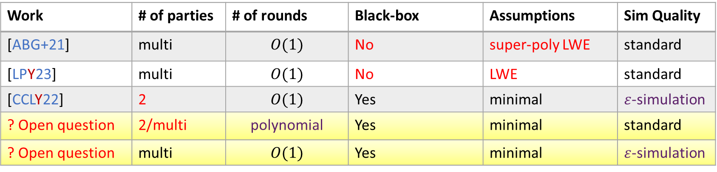
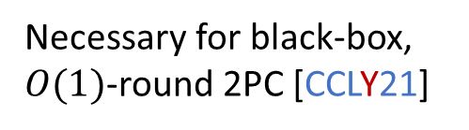
Post-Quantum MPC: State of the Art
Work | # of parties | # of rounds | Black-box | Assumptions | Sim Quality
[ABG+21] | multi | $$O(1)$$ | No | super-poly LWE | standard
[LPY23] | multi | $$O(1)$$ | No | LWE | standard
[CCLY22] | 2 | $$O(1)$$ | Yes | minimal | $ε$-simulation
? Open question | 2/multi | polynomial | Yes | minimal | standard
? Open question | multi | $$O(1)$$ | Yes | minimal | $ε$-simulation
Necessary for black-box, $O(1)$-round 2PC [CCLY21]
Notes:
This slide shows the state of the art in post-quantum MPC.
The two works at the top give post-quantum MPC in constant rounds. However, they are non–black-box and rely on stronger assumptions than the minimal assumption.
The work of CCLY22 constructs post-quantum two-party computation in constant rounds by black-box constructions from the minimal assumption. But there is a subtlety: it only achieves a security notion called epsilon-simulation security, which is slightly weaker than the standard simulation-based security.
In fact, it is shown that this weakening is necessary for obtaining black-box constructions in constant rounds.
Given these results, we can now ask the following two questions.
First, can we construct post-quantum MPC in a black-box manner from the minimal assumption and achieve standard simulation-based security, if we are allowed to use a super-constant number of rounds?
Second, can we generalize the result of CCLY22 to the multi-party setting — that is, can we construct post-quantum MPC in constant rounds, in a black-box manner from the minimal assumption, with epsilon-simulation security?

Slide 5
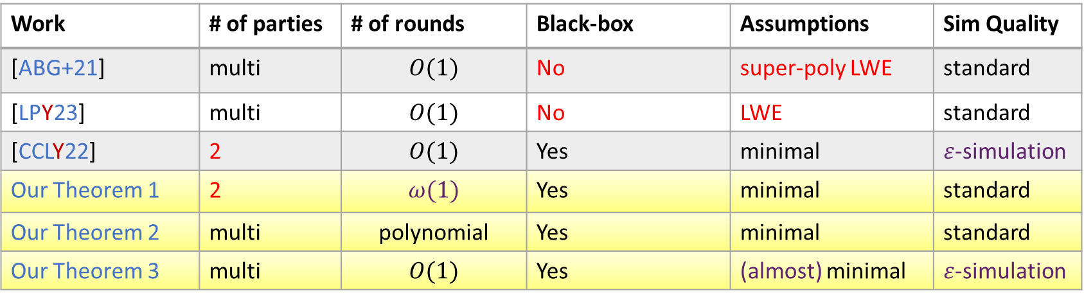
Our Results
Work | # of parties | # of rounds | Black-box | Assumptions | Sim Quality
[ABG+21] | multi | $$O(1)$$ | No | super-poly LWE | standard
[LPY23] | multi | $$O(1)$$ | No | LWE | standard
[CCLY22] | 2 | $$O(1)$$ | Yes | minimal | $ε$-simulation
Our Theorem 1 | 2 | $$ω(1)$$ | Yes | minimal | standard
Our Theorem 2 | multi | polynomial | Yes | minimal | standard
Our Theorem 3 | multi | $$O(1)$$ | Yes | (almost) minimal | $ε$-simulation
Necessary for black-box, $O(1)$-round 2PC [CCLY21]
(Post-quantum) lossy PKE, linearly homomorphic PKE, or dense cryptosystem
Matches the best in the classical setting
Full picture for the round complexity of black-box PQ-MPC!
Notes:
We answer both of those questions affirmatively.
Theorem 1 and Theorem 2 address the first question, and Theorem 3 answers the second question.
Theorem 1 gives post-quantum two-party computation in slightly super-constant rounds, in a black-box manner, from the minimal assumption, and achieving standard simulation-based security.
Theorem 2 generalizes this to the multi-party setting, at the cost of increasing the round complexity to polynomial.
Theorem 3 gives post-quantum MPC in constant rounds, in a black-box manner, from almost minimal assumptions, achieving epsilon-simulation security. Here, “almost minimal” refers to post-quantum lossy PKE, linear homomorphic PKE, or dense cryptosystems. While these are not the minimal assumptions for MPC, they match the assumptions used in the state of the art for classical constant-round black-box MPC — so we consider this essentially optimal.
With these results, we now have a complete picture of the round complexity of black-box post-quantum MPC.

Slide 6
Black-Box PQ-2PC from Minimal Assumptions
Classical
Post-Quantum
Semi-honest OT
Semi-honest PQ-OT
Option 1 (non-black-box):
ZKAoK (e.g., [GMW86])
Can we “quantize” it?
Option 2 (black-box):
Cut-and-choose based techniques (e.g., [HIK+11, CDMW09])
Malicious OT
Malicious PQ-OT
Black-box,
information-theoretic
(e.g., [Kilian88])
straightforward
MPC
PQ-MPC
Notes:
Now, let me talk about how we get our first result — black-box post-quantum two-party computation from minimal assumptions, achieving standard simulation-based security, using a super-constant number of rounds.
The diagram on the left shows the classical setting. We start from semi-honest OT, upgrade it to maliciously secure OT, and then compile it into MPC.
For the first step, upgrading semi-honest OT to malicious OT, there are two approaches. One is based on zero-knowledge proofs using the GMW-style approach, but this relies on non–black-box constructions. The other is the so-called cut-and-choose–based approach — and this is the one we use for black-box constructions.
For the second step, converting malicious OT to MPC, there is an information-theoretic black-box technique.
Moving to the post-quantum setting, the idea is that if we can “quantize” both steps, we’re done. In fact, the second step is relatively straightforward to extend to the post-quantum setting.
So the main challenge is how to “quantize” the first step — the cut-and-choose–based approach for upgrading semi-honest OT to malicious OT.

Slide 7

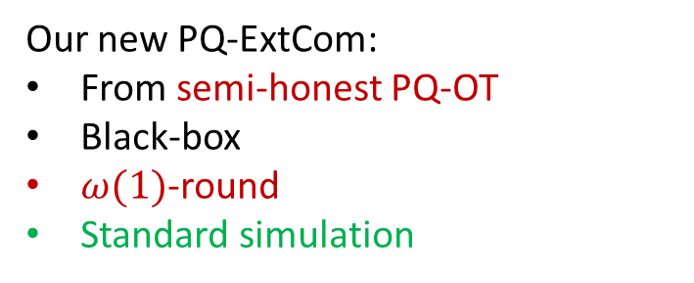
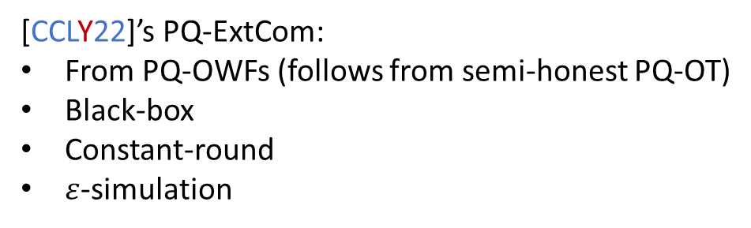
Final Step: Quantizing Black-Box OT Compiler
Semi-honest OT
Key component:
Post-quantum extractable commitment (PQ-ExtCom) in black-box
Option 2 (black-box):
Cut-and-choose based techniques (e.g., [HIK+11, CDMW09])
PQ-ExtCom: there exists a QPT Simulation-Extractor that can extract the committed message from a malicious committer, while simultaneously simulating the post-extraction state
Malicious OT
[CCLY22]’s PQ-ExtCom:
From PQ-OWFs (follows from semi-honest PQ-OT)
Black-box
Constant-round
$ε$-simulation
Our new PQ-ExtCom:
From semi-honest PQ-OT
Black-box
$ω(1)$-round
Standard simulation
Malicious PQ-OT with $ε$-simulation
Standard malicious PQ-OT
Notes:
Let me now focus on the first step — upgrading semi-honest OT to malicious OT in the post-quantum setting.
As I already mentioned, we choose Option 2, the cut-and-choose–based approach, and we try to “quantize” it.
The key component in this approach is a post-quantum extractable commitment. Intuitively, post-quantum extractability means that there exists a quantum polynomial-time simulation–extractor that can both extract the committed message from a malicious committer, and at the same time simulate the post-extraction state.
Let’s review what is known about black-box post-quantum extractable commitments. CCLY22 gives a PQ-ExtCom from PQ-OWFs, in a black-box way and in constant rounds — but it only achieves epsilon-simulation security.
In contrast, we aim for standard simulation security, while allowing a super-constant number of rounds. What we did is exactly to construct such a version of post-quantum extractable commitments.
Our PQ-ExtCom relies on semi-honest PQ-OT, remains black-box, uses slightly super-constant rounds, and most importantly achieves standard simulation security. Plugging this new PQ-ExtCom into the existing template, we get a post-quantum black-box compiler from semi-honest OT to malicious OT — preserving standard simulation security rather than epsilon-simulation security. I don’t have time to explain how we constructed such post-quantum extractable commitments in this talk, so please refer to our paper if you’re interested.

Slide 8
Further Application of Our Black-Box MPC
Recently active research topic “MicroCrypt”:
Roughly, cryptography when P=NP (i.e., even without OWFs)
Made possible by quantum computing
[KQT25]:
Relative to a classical oracle, it holds that P = NP, yet LOCC semi-honest OT exist!
Parties can perform local quantum operations,
but communicate via classical channels only.
Our fully-black-box MPC from semi-honest OT
Corollary 1:
Relative to a classical oracle, it holds that P = NP, yet LOCC MPC exists!
Notes:
Let me now talk about a further application of our black-box post-quantum MPC.
Recently, there has been an active research area called Microcrypt. Roughly speaking, this refers to cryptography in a world where P = NP and thus no one-way functions exist. Still, some sort of cryptography is possible if honest parties are allowed to use quantum computations.
In a recent work by Kretschmer, Qian, and Tal, they showed that, relative to a classical oracle, P = NP, yet LOCC semi-honest OT still exists. Here, LOCC stands for “local operations and classical communication,” meaning that parties can perform local quantum operations, but all communication happens over classical channels.
Since our construction is black-box, it works equally well in the LOCC setting. As a result, by simply plugging their result into ours, we obtain the corollary that, relative to a classical oracle, P = NP yet LOCC MPC exists.
This application is particularly interesting because it shows the usefulness of black-box constructions in the context of LOCC cryptography — which goes beyond our original motivation.

Slide 9
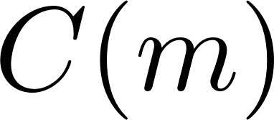


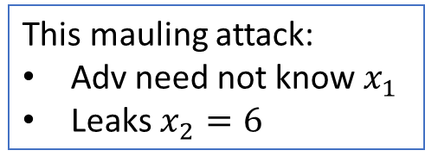

Black-Box PQ-MPC in Constant Rounds
Recall [CCLY22]:
Const.-round
Black-box
PQ-2PC
What we want:
Const.-round
Black-box
PQ-MPC
Shouldn’t this be easy?
NO!
Missing tool:
1-many non-malleable commitment in const.-round
(Informal) Def. of Non-Malleable Com
Why necessary for MPC?
This mauling attack:
Adv need not know $x_{1}$
Leaks $x_{2}=6$
Session 0
Session 1
Adv
…
…
3PC for Sum
(effectively)
Learns:
Requirement: $m$ and $\tilde{m}$ are “independent”
Notes:
Next, let me move to the second question — black-box post-quantum MPC in constant rounds, with epsilon-simulation security.
Let’s first review the existing work of CCLY22. They constructed constant-round black-box post-quantum two-party computation. At first glance, you might think it would be straightforward to generalize this to the multi-party setting.
But in fact, that’s not the case. There’s a missing tool: 1-many non-malleable commitments in constant rounds.
Informally, non-malleable commitment requires the following security: suppose a man-in-the-middle adversary interacts with an honest committer in a left session, and also interacts with an honest receiver in a right session. Non-malleability says that the committed value mtilde in the right session should be independent of the honest committer’s message m in the left session.
Why is non-malleability important for MPC? Here’s a simple example: imagine a three-party computation protocol that computes the sum of each party’s input. If the third party, P3, is malicious, it might try to set its input, x3, to be effectively the negation of P1’s input, –x1. If it can do that, x1 + x3 cancels out, and the malicious P3 learns x2 — the other honest party’s input — breaking MPC security.
To prevent such an attack, we need to ensure that a malicious party’s input cannot depend on the other parties’ inputs — which is essentially a form of non-malleability.
This is the intuition for why non-malleability is crucial in MPC.

Slide 10
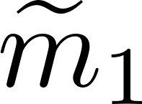
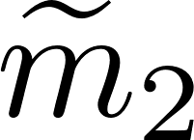
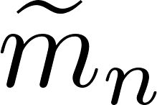
What We Really Need
1-Many Parallel Non-Malleable Com
Session 0
Session 1
Session 2
…
Session poly(n)
Adv
…
…
…
…
…
Requirement: $m$ and $({\tilde{m}}_{1},{\tilde{m}}_{2}, …,{\tilde{m}}_{n})$ are “independent”
(i.e., none of the right session can depend on the left session)
Why 1-Many Parallel NMCom for MPC?
There are multiple parties (and thus multiple sessions)
“1-many” implies “many-many”
No need for fully concurrency: channels are synchronous in typical MPC setting
Notes:
Let me go into a bit more detail about what we actually need.
Specifically, we need what’s called 1-many parallel non-malleable commitment.
In this setting, we consider a man-in-the-middle attacker who interacts with a single honest committer in the left session, and with polynomially many honest receivers in the right sessions. The requirement is that none of the committed values in the right sessions can depend on the committed value in the left session.
Why is 1-many parallel non-malleable commitment crucial for MPC?
In MPC, there are multiple parties and multiple sessions, and many parties commit to their inputs simultaneously. This makes the parallel setting a very natural one to consider.
You might wonder why we only consider one committer in the left. The reason is that 1-many non-malleability actually implies many-many non-malleability — where there are polynomially many committers in the left as well.
I should also note that in the context of MPC, we don’t need full concurrency. MPC protocols are typically synchronous, so we only need non-malleability in the synchronous setting.

Slide 11
Our Contribution
Main technical lemma:
Post-quantum 1-Many (weak) Parallel NMCom can be constructed in constant rounds, making black-box use of post-quantum OWFs.
Recall [CCLY22]:
Const.-round
Black-box
PQ-2PC
The first
Const.-round
Black-box
PQ-MPC
Our new PQ 1-many (weak) parallel NMCom
Notes:
This brings us to our main technical lemma.
We construct post-quantum 1-many parallel non-malleable commitments in constant rounds, making black-box use of post-quantum one-way functions.
In fact, what we achieve is a slightly weaker variant of parallel non-malleability — but it is still sufficient for our application to MPC. For the exact definition and proof details, please refer to the paper.
With this new post-quantum 1-many parallel non-malleable commitment, we can generalize the result of CCLY22 from the two-party setting to the multi-party setting.

Slide 12
Further Application of Our 1-Many NMCom
[BQSY24]:
Assuming const.-round many-many (weak) parallel PQ-NMCom, parallel repetition does not always reduce the soundness error of PQ interactive arguments.
Our construction from PQ-OWFs
Corollary 2:
Assuming PQ-OWFs, parallel repetition does not always reduce the soundness error of const. round PQ interactive arguments.
Matches the classical analog from [BIN97]
Assuming OWFs, parallel repetition does not always reduce the soundness error of (classical) const.-round interactive arguments.
Notes:
Finally, let me mention a further application of our 1-many non-malleable commitment beyond MPC.
In a recent work by Bostanci, Qian, Spooner, and Yuen, they assumed constant-round many-many parallel post-quantum non-malleable commitment, and used it to construct a constant-round interactive argument protocol whose soundness error does not decrease under parallel repetition.
Since we construct the required non-malleable commitment from post-quantum one-way functions, as a corollary, we can obtain the same conclusion while assuming only post-quantum one-way functions.
This matches an analogous result known in the classical setting.
That concludes my talk. Thank you for your attention.

Slide 13
Summary
Work | # of parties | # of rounds | Black-box | Assumptions | Sim Quality
[ABG+21] | multi | $$O(1)$$ | No | super-poly LWE | standard
[LPY23] | multi | $$O(1)$$ | No | LWE | standard
[CCLY22] | 2 | $$O(1)$$ | Yes | minimal | $ε$-simulation
Our Theorem 1 | 2 | $$ω(1)$$ | Yes | minimal | standard
Our Theorem 2 | multi | polynomial | Yes | minimal | standard
Our Theorem 3 | multi | $$O(1)$$ | Yes | (almost) minimal | $ε$-simulation
By-products:
LOCC MPC in Microcrypt
Counterexample to soundness amplification for const. round PQ arguments

Slide 14
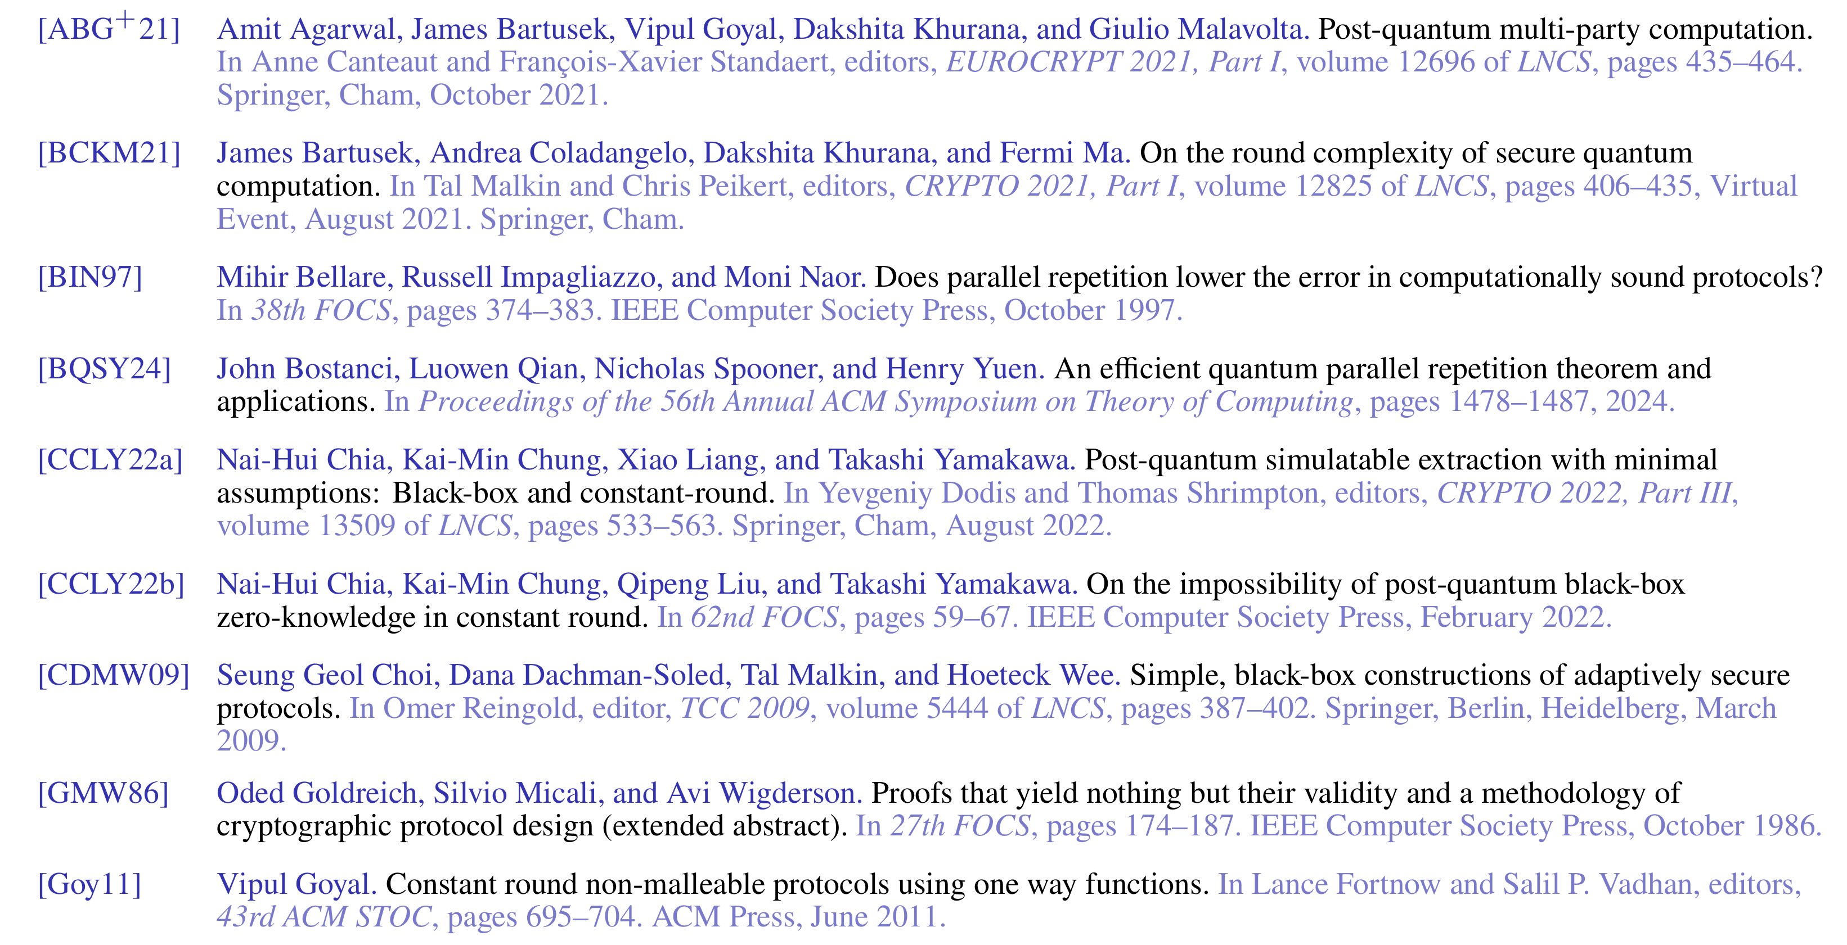
Reference (1/2)

Slide 15
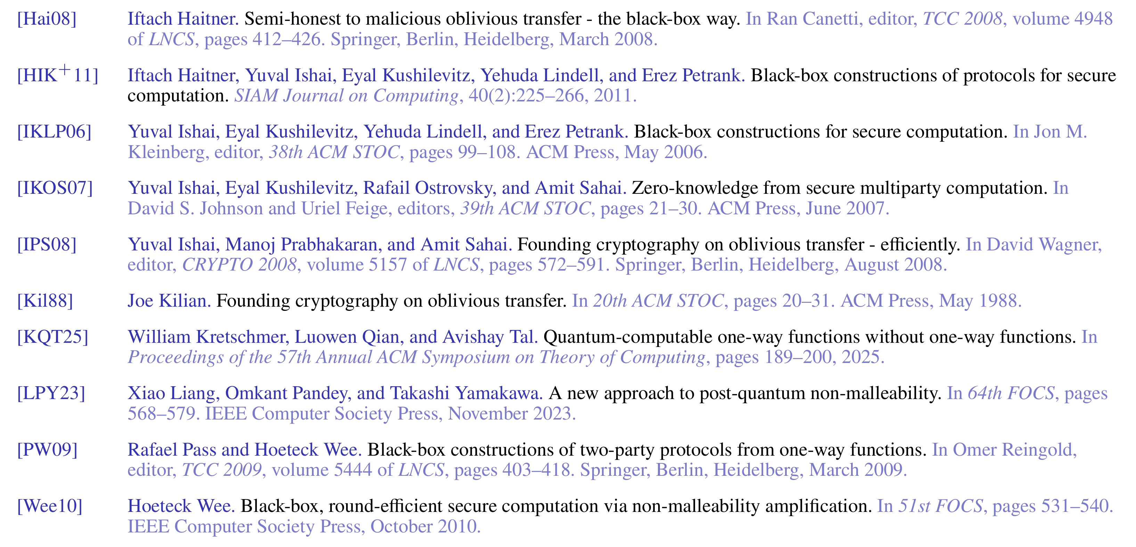
Reference (2/2)

