Slide 1
Towards Building Scalable Constant-Round MPC from Minimal Assumptions via Round Collapsing
Vipul Goyal
NTT Research
Carnegie Mellon University
Junru Li
Tsinghua University
Rafail Ostrovsky
University of California, Los Angeles
Yifan Song
Tsinghua University
Shanghai Qi Zhi Institute
Notes:
Hello everyone, I am very happy to share our recent progress in constant-round MPC with you. This is a joint work with Vipul Goyal, Junru Li, and Rafail Ostrovsky.

Slide 2





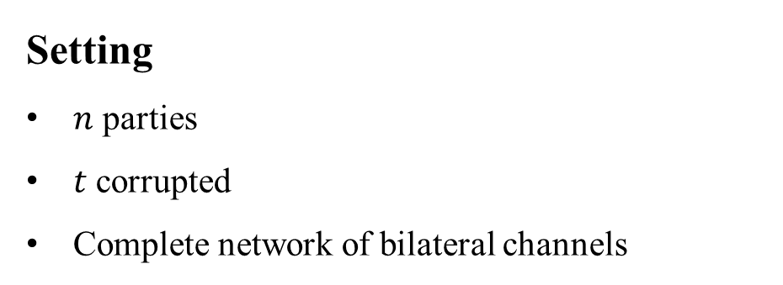
Multiparty Computation
Setting
$n$ parties
$t$ corrupted
Complete network of bilateral channels
Notes:
The main object we study is the notion of secure multiparty computation. In this talk, I am going to use n for the number of parties and t for the number of corrupted parties. We assume a P2P communication channel between every pair of parties.

Slide 3
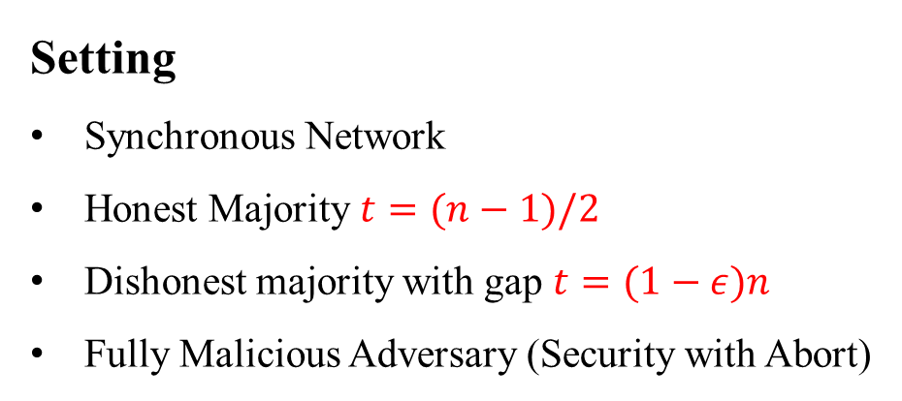
Multiparty Computation
Setting
Synchronous Network
Honest Majority $t=(n−1)/2$
Dishonest majority with gap $t=(1−ε)n$
Fully Malicious Adversary (Security with Abort)
Notes:
We focus on the synchronous network and consider both honest majority, and dishonest majority with gap where the number of corrupted parties is bounded by (1-\eps)*n for any constant epsilon between 0 and 1. We aim to achieve malicious security with abort.

Slide 4
Multiparty Computation
Setting
Synchronous Network
Honest Majority $t=(n−1)/2$
Dishonest majority with gap $t=(1−ε)n$
Fully Malicious Adversary (Security with Abort)
Target
Lightweight Cryptographic Primitives (no FHE)
Constant Round Complexity
Improving Communication Complexity
Notes:
Our goal is to build a constant-round multiparty computation protocol from lightweight cryptographic primitives that do not imply fully homomorphic encryption schemes. And we aim to improve the communication complexity.

Slide 5
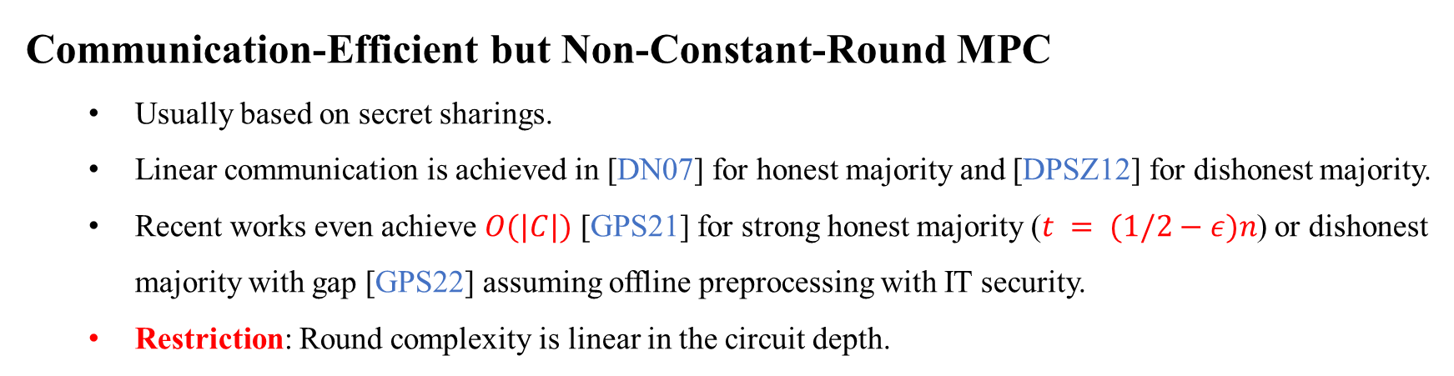
Known Results from Literatures
Communication-Efficient but Non-Constant-Round MPC
  Usually based on secret sharings.
  Linear communication is achieved in [DN07] for honest majority and [DPSZ12] for dishonest majority.
  Recent works even achieve $O(|C|)$ [GPS21] for strong honest majority ($t = (1/2−ε)n$) or dishonest majority with gap [GPS22] assuming offline preprocessing with IT security.
  Restriction: Round complexity is linear in the circuit depth.
Notes:
In the literatures of secure multiparty computation, there are two main categories. The first category is usually based on secret sharings and this kind of protocols can achieve high communication-efficiency but the number of rounds depend on the circuit structure.
With more details, linear communication has been achieved since DN07 for honest majority, and SPDZ for dishonest majority. When considering the strong honest majority or dishonest majority with gap, my previous works showed that it is even possible to achieve O(|C|) communication, which is independent of the number of parties.
However, usually this kind of protocols require to interact in each layer of the circuit. The round complexity is linear in the circuit depth.

Slide 6
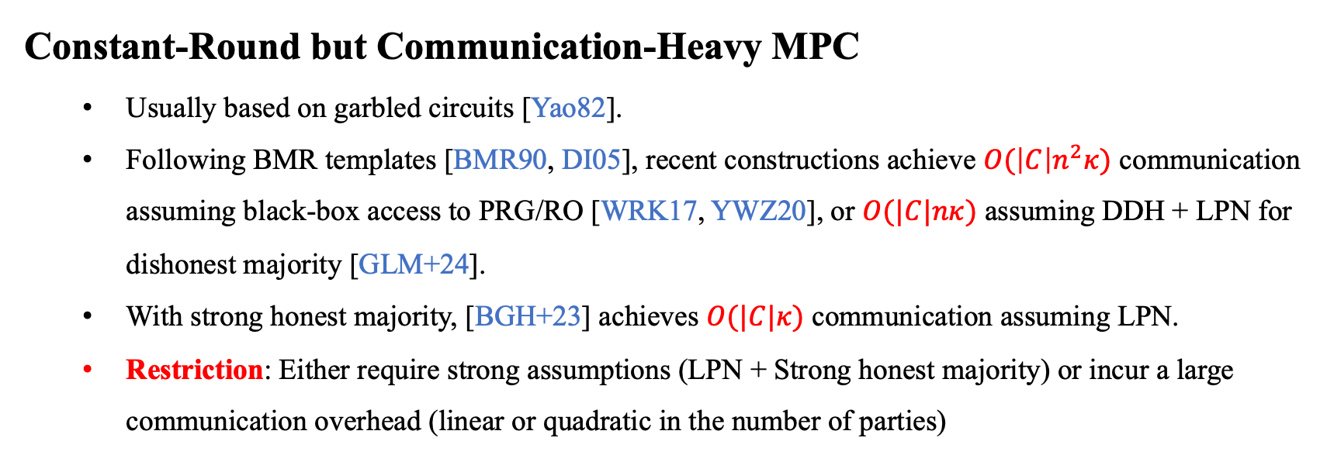
Known Results from Literatures
Constant-Round but Communication-Heavy MPC
  Usually based on garbled circuits [Yao82].
  Following BMR templates [BMR90, DI05], recent constructions achieve $O(\left|C\right|n^{2}κ)$ communication assuming black-box access to PRG/RO [WRK17, YWZ20], or $O(|C|nκ)$ assuming DDH + LPN for dishonest majority [GLM+24].
  With strong honest majority, [BGH+23] achieves $O(|C|κ)$ communication assuming LPN.
  Restriction: Either require strong assumptions (LPN + Strong honest majority) or incur a large communication overhead (linear or quadratic in the number of parties)
Notes:
The other category focuses on achieving constant round, and is usually based on the Yao’s garbled circuits. Following the BMR templates, recent constructions can achieve O(|C|n^2\kappa) communication assuming black-box access to PRG/RO, or linear communication assuming DDH + LPN. With strong honest majority, the recent work [BGH+23] manages to achieve O(|C|\kappa) communication assuming LPN.
Compared with the first category, these protocols either need strong assumptions such as LPN + strong honest majority or require a large communication overhead.

Slide 7
Our Question
Can we construct an MPC protocol that achieves
constant round complexity + constant communication complexity
from lightweight cryptographic primitives?
Notes:
This leads to our following question, can we construct an MPC protocol which achieves both constant number of rounds and constant communication overhead only from lightweight cryptographic primitives? Here by constant communication, I mean the communication does not grow with the number of parties.

Slide 8
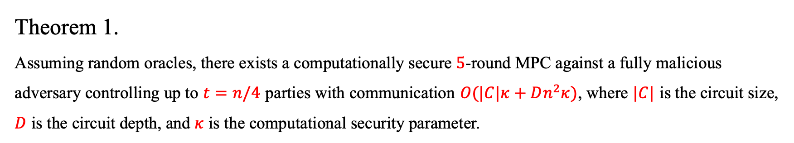
Our Result
Theorem 1.
Assuming random oracles, there exists a computationally secure $5$-round MPC against a fully malicious adversary controlling up to $t=n/4$ parties with communication $O(|C|κ+Dn^{2}κ)$, where $|C|$ is the circuit size, $D$ is the circuit depth, and $κ$ is the computational security parameter.
Notes:
Our work achieves the following result. Our first result considers ¼ corruption. We show that by only assuming random oracles, we can construct a 5-round MPC whose communication complexity is O(|C|\kappa + Dn^2\kappa). Here |C| is the circuit size, D is the circuit depth, and \kappa is the security parameter.

Slide 9
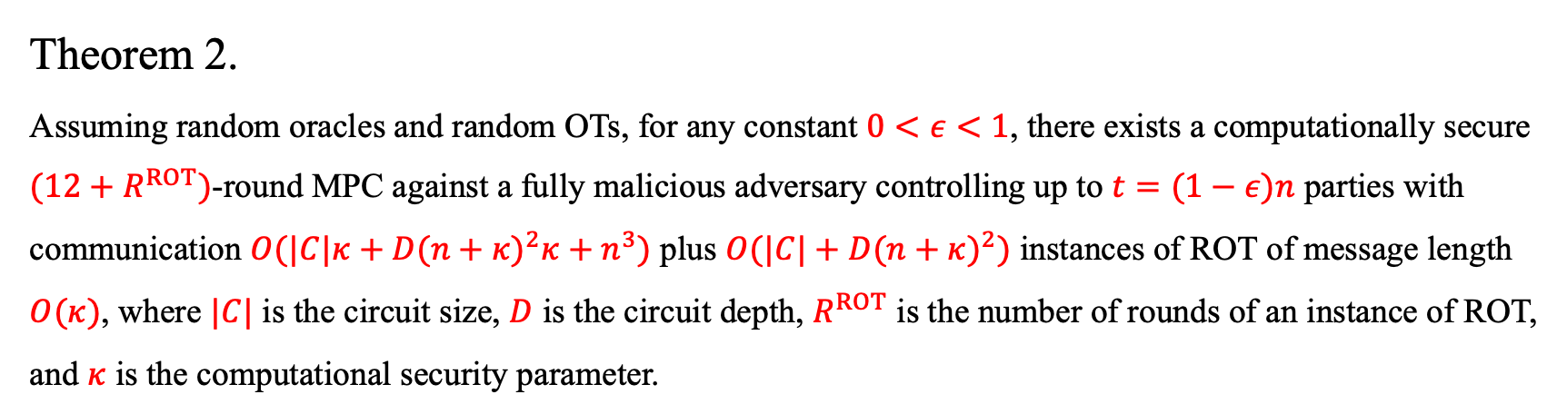
Our Result
Theorem 2.
Assuming random oracles and random OTs, for any constant $0<ε<1$, there exists a computationally secure $(12+R^{ROT})$-round MPC against a fully malicious adversary controlling up to $t=(1−ε)n$ parties with communication $O(|C|κ+D{(n+κ)}^{2}κ+n^{3})$ plus $O(|C|+D{(n+κ)}^{2})$ instances of ROT of message length $O(κ)$, where $|C|$ is the circuit size, $D$ is the circuit depth, $R^{ROT}$ is the number of rounds of an instance of ROT, and $κ$ is the computational security parameter.
Remarks.
Theorem 1 + Party Virtualization
Notes:
Then, by using random OTs and party virtualization techniques, we manage to handle the dishonest majority with any constant gap. To be more concrete, assuming random oracles and random OTs, for any constant 0<\eps<1, there is an MPC against (1-\epsilon)n corrupted parties with communication complexity O(|C|\kappa + D(n+\kappa)^2\kappa + n^3). Note that OT is necessary without honest majority.

Slide 10
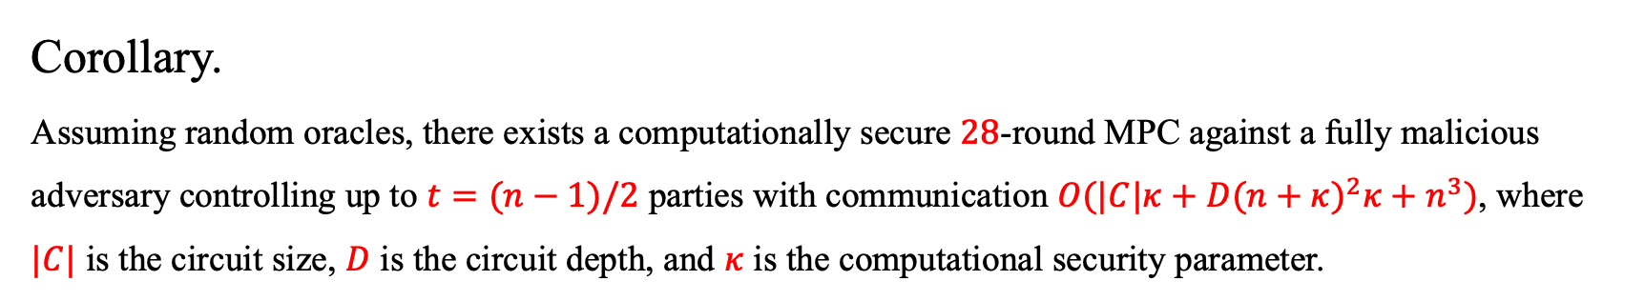
Our Result
Corollary.
Assuming random oracles, there exists a computationally secure $28$-round MPC against a fully malicious adversary controlling up to $t=(n−1)/2$ parties with communication $O(|C|κ+D{(n+κ)}^{2}κ+n^{3})$, where $|C|$ is the circuit size, $D$ is the circuit depth, and $κ$ is the computational security parameter.
Remarks.
Theorem 2 + OT Extension
Notes:
From our second result, we also obtain an interesting corollary in the standard honest majority setting. Basically, we achieve the same amount of communication but remove the assumption of random OTs. This is realized by taking \epsilon to be ½ in our second theorem, and using OT extension to prepare random OTs.

Slide 11
Our Techniques
Our Ideas
Round-Compression Compiler for Certain Class of Non-Constant-Round MPC Protocols
  Let each party garble his own next-message functions
Instantiation of Non-Constant-Round MPC Protocols via Packed Sharings
  Use AG codes for constant-rate packed sharings over the binary domain
Party Virtualization + MPC-in-the-Head for Malicious Security
  Different from committee-based approach, can potentially achieve adaptive security
Notes:
To achieve our result, we first construct a round-compression compiler for certain class of non-constant-round MPC protocols. As we will see soon, our core idea is to let each party garble his own next-message functions. Then with all garbled circuits, the evaluator can emulate the whole execution of the underlying MPC protocol.
To obtain O(|C|) communication, we instantiate the underlying non-constant-round MPC protocols by using packed secret sharings, following the line of my previous works with Vipul and Antigoni. Here we use AG codes for packed sharings over the binary domain.
The above allows us to obtain the first result that is secure against ¼ corruption. To boost the corruption threshold, we use the technique of party virtualization, and combines the idea of MPC-in-the-head to achieve malicious security.

Slide 12
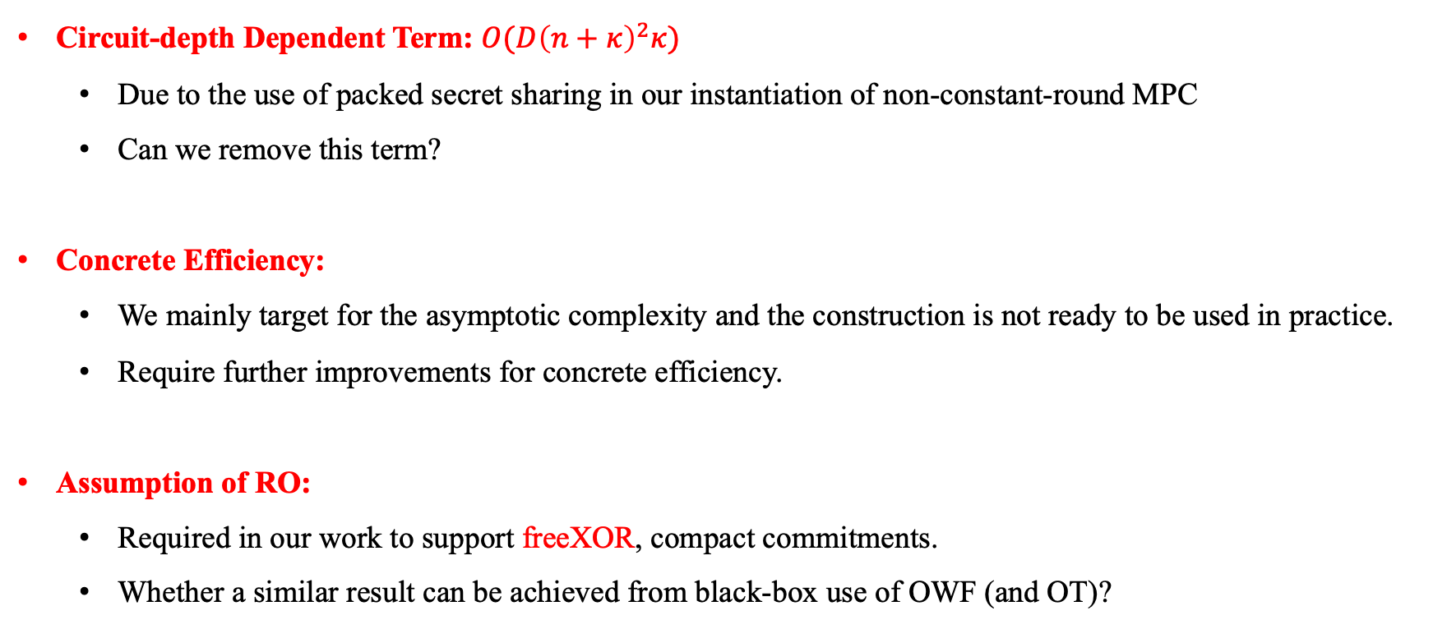
Limitations and Future Directions
Circuit-depth Dependent Term: $O(D{\left(n+κ\right)}^{2}κ)$
  Due to the use of packed secret sharing in our instantiation of non-constant-round MPC
  Can we remove this term?
Concrete Efficiency:
  We mainly target for the asymptotic complexity and the construction is not ready to be used in practice.
  Require further improvements for concrete efficiency.
Assumption of RO:
  Required in our work to support freeXOR, compact commitments.
  Whether a similar result can be achieved from black-box use of OWF (and OT)?
Notes:
Before moving to the technical section, I want to briefly discuss the limitations of our results and potential future directions.
Our result contains a circuit-depth dependent communication overhead, this is mainly due to the use of packed secret sharing for the non-constant-round MPC. An interesting question is whether we can remove this term or at least reduce it to linear in n.
Our current result mainly focuses on the asymptotic complexity. Further improvements are needed for concrete efficiency.
Our result assumes a random oracle, which is due to the need of supporting free XOR and compact commitments. An interesting question is whether a similar result can be achieved based on black-box use of OWF.

Slide 13
Outline
Review of Yao’s Garbled Circuits, BMR Template, and Our Starting Idea
Compiling Reconstruction Only Message (ROM) Protocol
Instantiation of ROM Protocol
Towards Dishonest Majority via Party Virtualization
Notes:
Here is an outline of my talk. We will start from reviewing the Yao’s garbled circuit and introducing our starting idea.

Slide 14






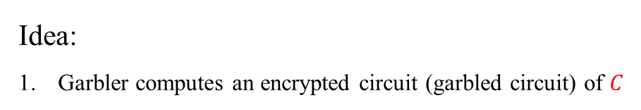
Yao’s Garbled Circuit
Goal: Compute $C(x_{1},x_{2})$
Garbler
Evaluator
$$GC(C)$$
$$x_{1}$$
$$x_{2}$$
Idea:
Garbler computes an encrypted circuit (garbled circuit) of $C$
Notes:
It is known that Yao’s garbled circuit can be used to compute a constant-round 2PC. At a high level, one party acts as the garbler and computes an encrypted circuit or a garbled circuit of the target function.

Slide 15
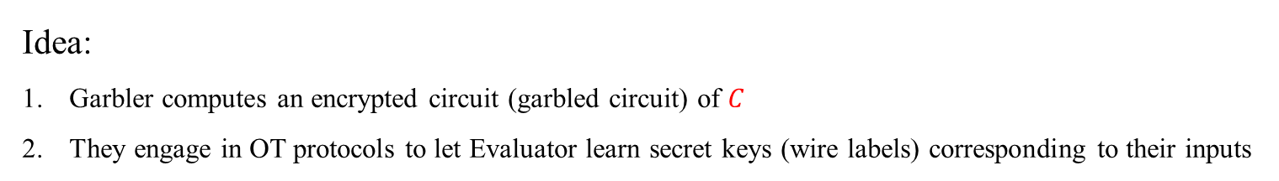
Yao’s Garbled Circuit
Goal: Compute $C(x_{1},x_{2})$
Garbler
Evaluator
$$GC(C)$$
OT for Input Wire Labels
$$x_{1}$$
$$x_{2}$$
Idea:
Garbler computes an encrypted circuit (garbled circuit) of $C$
They engage in OT protocols to let Evaluator learn secret keys (wire labels) corresponding to their inputs
Notes:
Then the two parties use OT to let the evaluator learns the secret keys corresponding to their inputs. Here secret keys are also referred to as wire labels.

Slide 16
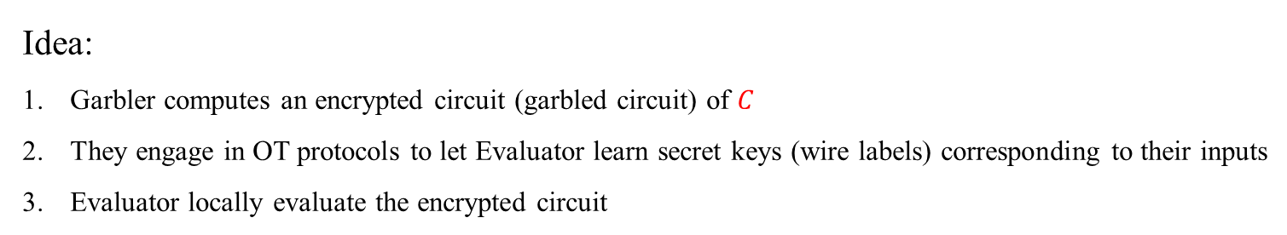

Yao’s Garbled Circuit
Goal: Compute $C(x_{1},x_{2})$
Garbler
Evaluator
$$GC(C)$$
OT for Input Wire Labels
$$x_{1}$$
$$C(x_{1},x_{2})$$
$$x_{2}$$
Idea:
Garbler computes an encrypted circuit (garbled circuit) of $C$
They engage in OT protocols to let Evaluator learn secret keys (wire labels) corresponding to their inputs
Evaluator locally evaluate the encrypted circuit
Notes:
With the secret keys associated with both parties’ inputs, the evaluator can locally evaluate the encrypted circuit and learn the function output.

Slide 17
BMR Template
Idea:
All parties jointly emulate the garbler and compute a garbled circuit.
Compute a secret sharing for each value.
Notes:
To build a multiparty protocol, we cannot let a single party act as the garbler due to the potential collusion between the garbler and the evaluator. Instead, we ask all parties to jointly emulate the garbler and compute a garbled circuit using a generic multiparty computation protocol. The main observation here is that the computation carried by the garbler has constant depth. Thus, we can use for example the SPDZ protocol to emulate the garbler.

Slide 18
BMR Template
Idea:
All parties jointly emulate the garbler and compute a garbled circuit.
Compute a secret sharing for each value.
Main Difficulty
Need to use the underlying cryptographic primitive in a non-black-box way.
Notes:
However the main difficulty of this approach is that all parties need to run an MPC protocol to compute the cryptographic primitives involved in the garbler’s computation, which may incur a large computation and communication overhead.

Slide 19
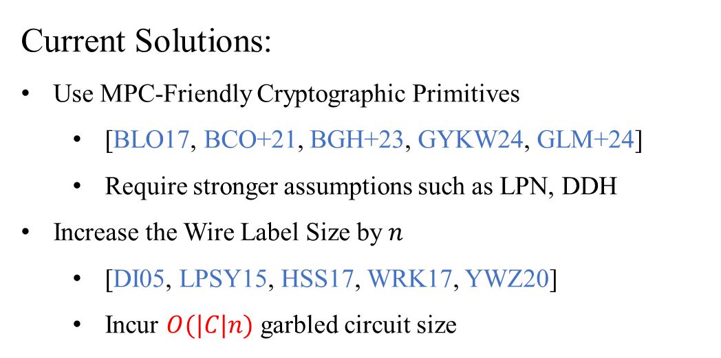
BMR Template
Current Solutions:
Use MPC-Friendly Cryptographic Primitives
  [BLO17, BCO+21, BGH+23, GYKW24, GLM+24]
  Require stronger assumptions such as LPN, DDH
Increase the Wire Label Size by $n$
  [DI05, LPSY15, HSS17, WRK17, YWZ20]
  Incur $O(|C|n)$ garbled circuit size
Main Difficulty
Need to use the underlying cryptographic primitive in a non-black-box way.
Notes:
One way to address this difficulty is to use an MPC-friendly cryptographic primitives. But usually this kind of constructions require stronger assumptions such as LPN, DDH.
Another way, proposed by DI05, is to let each party generate his own wire labels. This allows us to use the underlying cryptographic primitives in a black-box way. But it would increase the wire label size, and thus the garbled circuit size by a factor of n.

Slide 20













Our Idea – Compiling Non-Constant-Round MPC
$$f_{1}^{(1)}$$
$$f_{2}^{(1)}$$
$$f_{k}^{(1)}$$
$$f_{1}^{(2)}$$
$$f_{2}^{(2)}$$
$$f_{k}^{(2)}$$
$$…$$
Output
$$f_{1}^{(3)}$$
$$f_{2}^{(3)}$$
$$f_{k}^{(3)}$$
$$f_{1}^{(4)}$$
$$f_{2}^{(4)}$$
$$f_{k}^{(4)}$$
Round 1
Round 2
Round k
Notes:
Our idea deviates from the BMR template. We start from considering the execution of a non-constant-round MPC.

Slide 21

















Our Idea – Compiling Non-Constant-Round MPC
$${\left\{GC\left(f_{i}^{\left(1\right)}\right)\right\}}_{i=1}^{k}$$
$$GC\left(f_{1}^{\left(1\right)}\right)$$
$$GC\left(f_{1}^{\left(2\right)}\right)$$
$$GC\left(f_{1}^{\left(k\right)}\right)$$
$${\left\{GC\left(f_{i}^{\left(2\right)}\right)\right\}}_{i=1}^{k}$$
$$GC\left(f_{2}^{\left(1\right)}\right)$$
$$GC\left(f_{2}^{\left(2\right)}\right)$$
$$GC\left(f_{2}^{\left(k\right)}\right)$$
$$…$$
Output
$${\left\{GC\left(f_{i}^{\left(3\right)}\right)\right\}}_{i=1}^{k}$$
$$GC\left(f_{3}^{\left(1\right)}\right)$$
$$GC\left(f_{3}^{\left(2\right)}\right)$$
$$GC\left(f_{3}^{\left(k\right)}\right)$$
$${\left\{GC\left(f_{i}^{\left(4\right)}\right)\right\}}_{i=1}^{k}$$
$$GC\left(f_{4}^{\left(1\right)}\right)$$
$$GC\left(f_{4}^{\left(2\right)}\right)$$
$$GC\left(f_{4}^{\left(k\right)}\right)$$
Garblers
Evaluator
Round 1
Round 2
Round k
Notes:
Then we want to compile it to be a constant-round protocol. The high-level picture is that each party locally garbles his own next-message functions and send them to the evaluator. Then the evaluator locally emulate the whole execution.

Slide 22
Our Idea – Problem
$${\left\{GC\left(f_{i}^{\left(1\right)}\right)\right\}}_{i=1}^{k}$$
$$GC\left(f_{1}^{\left(1\right)}\right)$$
$$GC\left(f_{1}^{\left(2\right)}\right)$$
$${\left\{GC\left(f_{i}^{\left(2\right)}\right)\right\}}_{i=1}^{k}$$
$$GC\left(f_{2}^{\left(1\right)}\right)$$
$$GC\left(f_{2}^{\left(2\right)}\right)$$
How can the evaluator obtain wire labels for Round 2?
$${\left\{GC\left(f_{i}^{\left(3\right)}\right)\right\}}_{i=1}^{k}$$
$$GC\left(f_{3}^{\left(1\right)}\right)$$
$$GC\left(f_{3}^{\left(2\right)}\right)$$
$${\left\{GC\left(f_{i}^{\left(4\right)}\right)\right\}}_{i=1}^{k}$$
$$GC\left(f_{4}^{\left(1\right)}\right)$$
$$GC\left(f_{4}^{\left(2\right)}\right)$$
Garblers
Evaluator
Round 1
Round 2
Notes:
But unfortunately, this idea does not work directly. The issue is that it is not clear how the evaluator can obtain wire labels for the next round.

Slide 23
Outline
Review of Yao’s Garbled Circuits, BMR Template, and Our Starting Idea
Compiling Reconstruction Only Message (ROM) Protocol
Instantiation of ROM Protocol
Towards Dishonest Majority via Party Virtualization
Notes:
To address this issue,

Slide 24
Observation
For most of secret-sharing-based MPC protocols,
Can be separated into the offline phase and online phase
  Offline phase has constant rounds.
Online phase only involves public reconstruction
  Can potentially be run over the broadcast channel
  No private message
Each party only uses the reconstruction results as inputs in the next round
  Individual shares are not important
Notes:
We first observe that for most of secret-sharing-based MPC protocols, we may divide the protocol into an offline phase and an online phase where the offline phase has constant rounds. In the online phase, parties only need to do public reconstruction of some secret sharing scheme. In particular, this process can be potentially done over the broadcast channel, and there is no private message in the online phase. Furthermore, each party only uses the reconstruction results as inputs in the next round, and individual shares are not important.

Slide 25











Observation
Can be public
$$f_{1}^{(1)}$$
$$z$$
$$f_{2}^{(1)}$$
$$f_{k}^{(1)}$$
$$[z]$$
$$f_{1}^{(2)}$$
$$f_{2}^{(2)}$$
$$f_{k}^{(2)}$$
$$…$$
Output
$$f_{1}^{(3)}$$
$$f_{2}^{(3)}$$
$$f_{k}^{(3)}$$
$$f_{1}^{(4)}$$
$$f_{2}^{(4)}$$
$$f_{k}^{(4)}$$
Round 1
Round 2
Round k
Notes:
Here is an illustration of such a scheme. In the first round, all parties will compute a secret sharing of the value z, which is reconstructed to the first party. This step is done by just sending their shares to the first party. Then the first party reconstructs the secret z, and only uses z as input in his second-round next-message function.

Slide 26
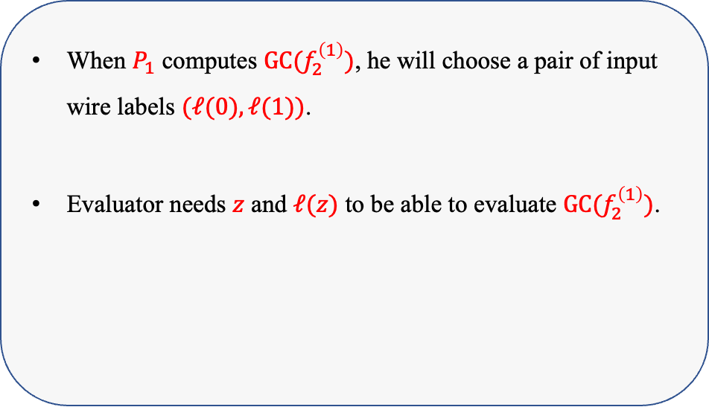

Focusing on First Reconstruction
When $P_{1}$ computes $GC(f_{2}^{\left(1\right)})$, he will choose a pair of input wire labels $(ℓ(0),ℓ(1))$.
Evaluator needs $z$ and $ℓ(z)$ to be able to evaluate $GC(f_{2}^{\left(1\right)})$.
$$f_{1}^{(1)}$$
$$z$$
$$f_{2}^{(1)}$$
$$[z]$$
$$f_{1}^{(2)}$$
$$f_{1}^{(3)}$$
$$f_{1}^{(4)}$$
Round 1
Round 2
Notes:
Now recall that our idea is to let each party garble his own next-message functions. In particular, P_1 will choose a pair of input wire labels for the value z when he garbles the second-round next-message function. Note that at this moment, he does not know the value z.
On the other hand, the evaluator has to learn z and the wire label \ell_w(z) to be able to evaluate P_1’s garbled circuit for the second round.

Slide 27
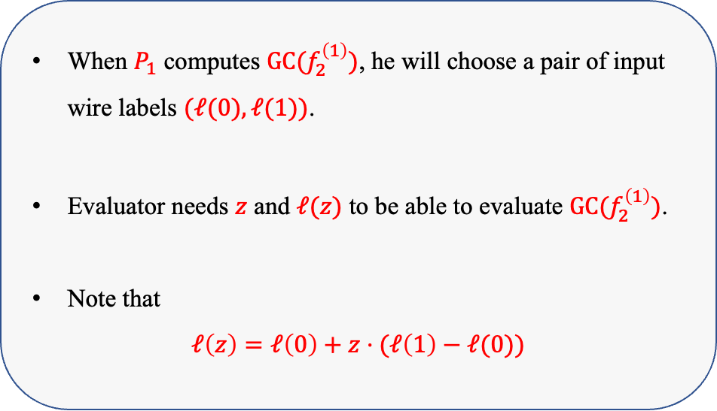
Focusing on First Reconstruction
When $P_{1}$ computes $GC(f_{2}^{\left(1\right)})$, he will choose a pair of input wire labels $(ℓ(0),ℓ(1))$.
Evaluator needs $z$ and $ℓ(z)$ to be able to evaluate $GC(f_{2}^{\left(1\right)})$.
Note that
$$ℓ\left(z\right)=ℓ\left(0\right)+z⋅(ℓ\left(1\right)−ℓ(0))$$
$$f_{1}^{(1)}$$
$$z$$
$$f_{2}^{(1)}$$
$$[z]$$
$$f_{1}^{(2)}$$
$$f_{1}^{(3)}$$
$$f_{1}^{(4)}$$
Round 1
Round 2
Notes:
We note that the label for z, \ell_w(z) can be computed as follows. It is equal to \ell_w(0) + z * (\ell_w(1)-\ell_w(0)). You can check this equation by plugging in both z is 0 and z is 1.

Slide 28
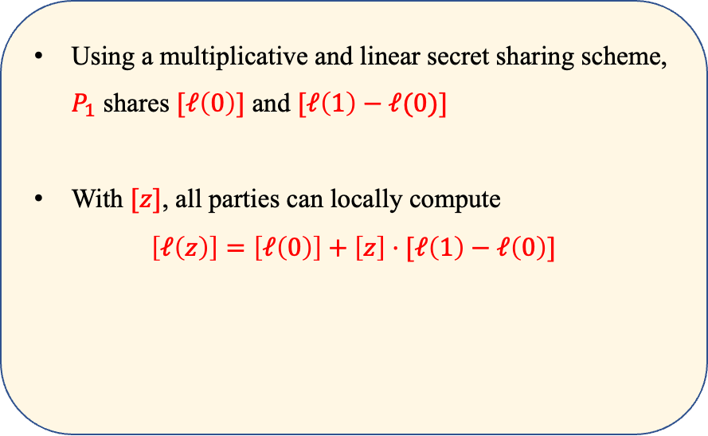
Focusing on First Reconstruction
Using a multiplicative and linear secret sharing scheme, $P_{1}$ shares $[ℓ\left(0\right)]$ and $[ℓ\left(1\right)−ℓ(0)]$
With $[z]$, all parties can locally compute
$$\left[ℓ\left(z\right)\right]=\left[ℓ\left(0\right)\right]+\left[z\right]⋅[ℓ\left(1\right)−ℓ\left(0\right)]$$
$$f_{1}^{(1)}$$
$$z$$
$$f_{2}^{(1)}$$
$$[z]$$
$$f_{1}^{(2)}$$
$$f_{1}^{(3)}$$
$$f_{1}^{(4)}$$
Round 1
Round 2
Notes:
Then if we use a multiplicative and linear secret sharing scheme, we can ask P1 to share \ell_w(0) and \ell_1(1)-\ell_w(0). Now with secret sharing [z], all parties can locally compute a secret sharing of \ell_w(z) following this equation.

Slide 29
Focusing on First Reconstruction
Using a multiplicative and linear secret sharing scheme, $P_{1}$ shares $[ℓ\left(0\right)]$ and $[ℓ\left(1\right)−ℓ(0)]$
With $[z]$, all parties can locally compute
$$\left[ℓ\left(z\right)\right]=\left[ℓ\left(0\right)\right]+\left[z\right]⋅[ℓ\left(1\right)−ℓ\left(0\right)]$$
$$f_{1}^{(1)}$$
$$z$$
$$f_{2}^{(1)}$$
$$[z]$$
$$f_{1}^{(2)}$$
$$f_{1}^{(3)}$$
$$f_{1}^{(4)}$$
Round 1
Round 2
Each party’s garbled circuit outputs his shares of both $[z]$ and $[ℓ\left(z\right)]$
Notes:
Then it is sufficient to ask each party’s garbled circuit in the first round to output both his shares of [z] and [\ell_w(z)]. In this way, the evaluator can learn both z and \ell_w(z) and then evaluate P_1’s second-round garbled circuit.

Slide 30
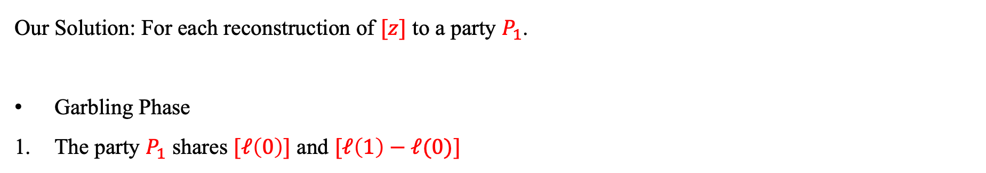
Summary
Our Solution: For each reconstruction of $[z]$ to a party $P_{1}$.
Garbling Phase
The party $P_{1}$ shares $[ℓ\left(0\right)]$ and $[ℓ\left(1\right)−ℓ(0)]$
Notes:
In summary, for each reconstruction of [z] to a party P_1 in the underlying non-constant round MPC, P_1 first shares his chosen labels to other parties.

Slide 31
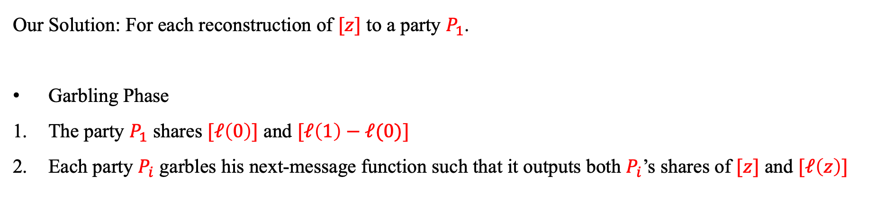
Summary
Our Solution: For each reconstruction of $[z]$ to a party $P_{1}$.
Garbling Phase
The party $P_{1}$ shares $[ℓ\left(0\right)]$ and $[ℓ\left(1\right)−ℓ(0)]$
Each party $P_{i}$ garbles his next-message function such that it outputs both $P_{i}$’s shares of $[z]$ and $[ℓ\left(z\right)]$
Notes:
Then each party P_i garbles his next-message function such that it outputs both P_i’s shares of [z] and [\ell_w(z)]

Slide 32
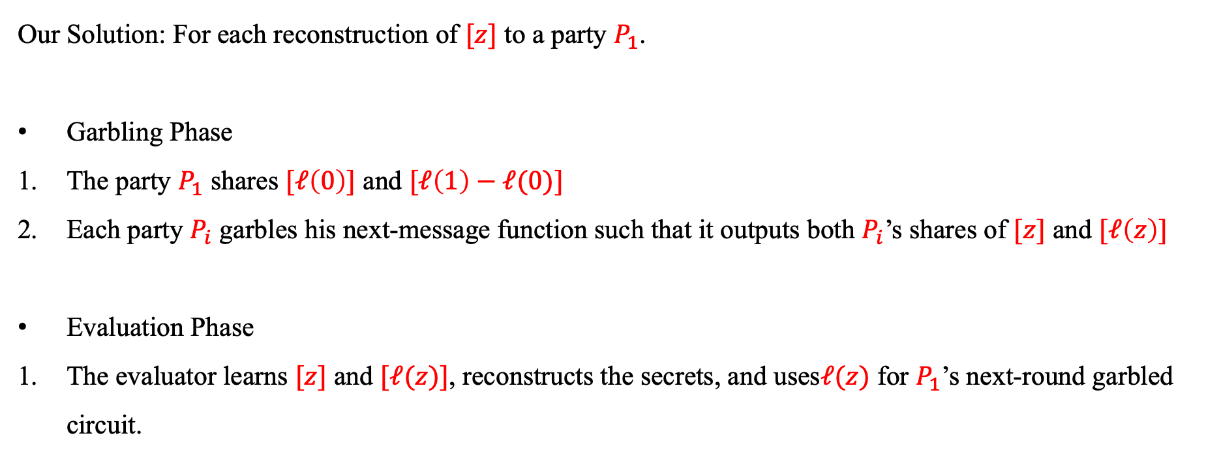
Summary
Our Solution: For each reconstruction of $[z]$ to a party $P_{1}$.
Garbling Phase
The party $P_{1}$ shares $[ℓ\left(0\right)]$ and $[ℓ\left(1\right)−ℓ(0)]$
Each party $P_{i}$ garbles his next-message function such that it outputs both $P_{i}$’s shares of $[z]$ and $[ℓ\left(z\right)]$
Evaluation Phase
The evaluator learns $[z]$ and $[ℓ(z)]$, reconstructs the secrets, and uses$ℓ(z)$ for $P_{1}$’s next-round garbled circuit.
Notes:
During the evaluation phase, the evaluator can learn both the secret sharing of [z] and [\ell_w(z)]. Therefore, he can reconstruct the secrets and uses \ell_w(z) for P_1’s next-round garbled circuit.

Slide 33
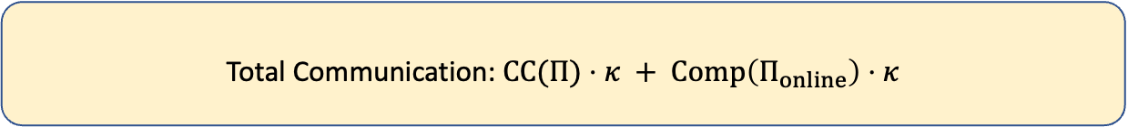
Cost
Total Communication: $CC(Π)⋅κ + Comp\left(Π_{online}\right)⋅κ$
Notes:
The total communication of our compiler is the total communication complexity of the underlying protocol times kappa plus the computation complexity of the online phase times kappa.

Slide 34
Outline
Review of Yao’s Garbled Circuits, BMR Template, and Our Starting Idea
Compiling Reconstruction Only Message (ROM) Protocol
Instantiation of ROM Protocol
Towards Dishonest Majority via Party Virtualization
Notes:
To achieve the desired efficiency, we need to instantiate the underlying reconstruction only message protocol

Slide 35
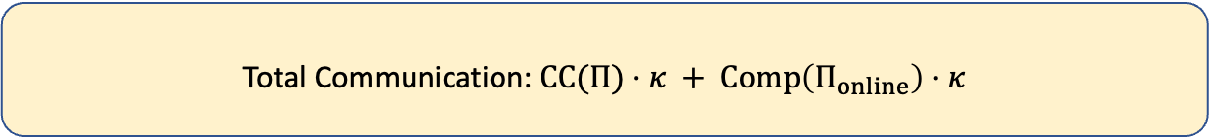
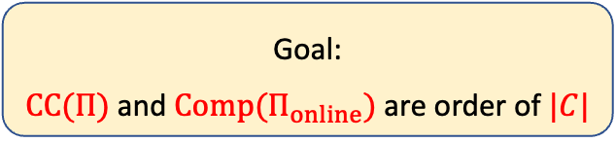
Instantiation of ROM Protocol
Total Communication: $CC(Π)⋅κ + Comp\left(Π_{online}\right)⋅κ$
Goal:
$CC(Π)$ and $Comp(Π_{online})$ are order of $|C|$
Notes:
Such that the communication and the online computation are order of |C|.

Slide 36
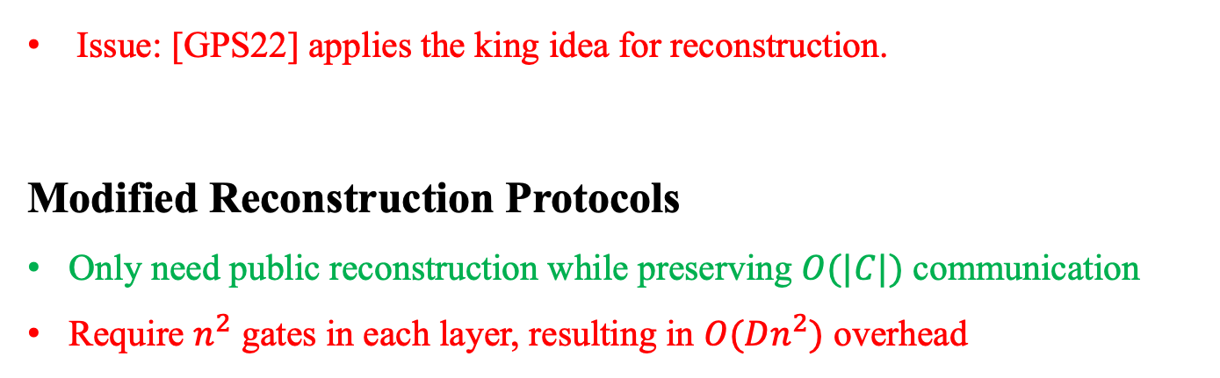
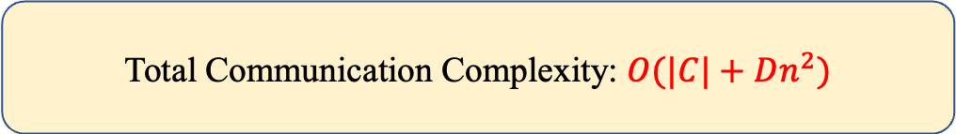
Instantiation from [GPS22] + AG Code
Issue: [GPS22] applies the king idea for reconstruction.
Modified Reconstruction Protocols
Only need public reconstruction while preserving $O(|C|)$ communication
Require $n^{2}$ gates in each layer, resulting in $O(Dn^{2})$ overhead
Total Communication Complexity: $O(|C|+Dn^{2})$
Notes:
We instantiate the underlying protocol by using a modified version of [GPS22] plus AG code for packed secret sharing. Here we use AG code because the secrets are over binary field and we use AG code to avoid the logn factor in the Shamir secret sharing scheme. One issue we need to address is that the original [GPS22] applies the king idea for reconstruction, where parties first reconstruct the secrets to the king, and then the king reshares the result back. Our compiler however, only supports reconstruction to each party directly. So we modify the reconstruction protocol to make it compatible with our compiler. The communication remains to be O(|C|) but now it requires at least n^2 gates per layer, resulting in O(Dn^2) overhead.

Slide 37
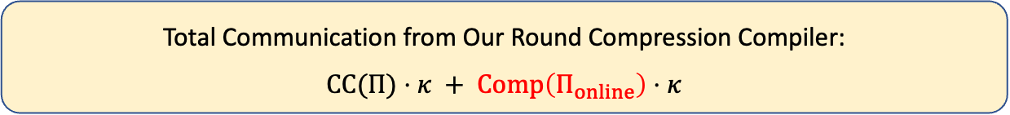
Issue with Computation Complexity
But wait…
What is the computation complexity of our instantiation?
Total Communication from Our Round Compression Compiler:
$$CC(Π)⋅κ + Comp\left(Π_{online}\right)⋅κ$$
$O(n)$ per multiplication!
Even true for a SIMD circuit, due to the modified reconstruction protocol!
Notes:
But how about the computation complexity in the online phase?
Unfortunately, the online computation is still O(n) per multiplication. This is even true for a SIMD circuit due to the modified reconstruction protocol.

Slide 38
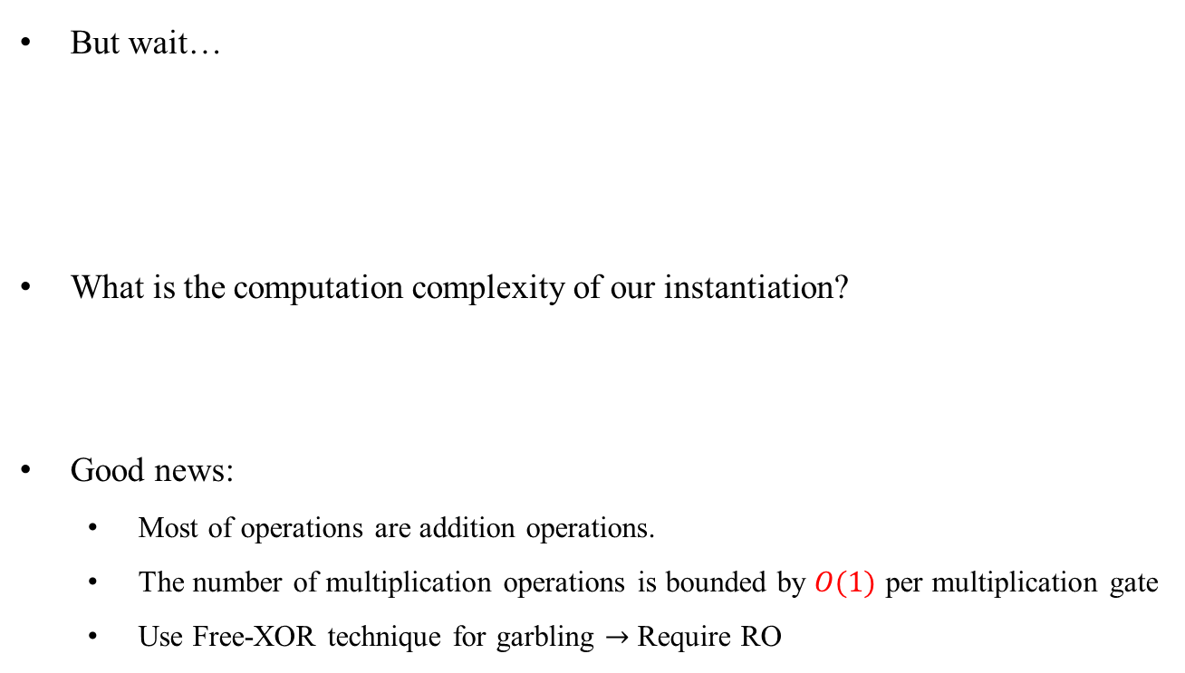
Issue with Computation Complexity
But wait…
What is the computation complexity of our instantiation?
Good news:
  Most of operations are addition operations.
  The number of multiplication operations is bounded by $O(1)$ per multiplication gate
  Use Free-XOR technique for garbling $→$ Require RO
Total Communication from Our Round Compression Compiler:
$$CC(Π)⋅κ + Comp\left(Π_{online}\right)⋅κ$$
$O(n)$ per multiplication!
Notes:
The good news is that most of operations are addition operations, whereas the number of multiplication operations among all parties is bounded by O(1) per multiplication gate. Thus, we will use the free-xor technique for the garbling circuits, which does not need to pay for xor gate. And this is the place we need random oracle.

Slide 39
Summary of Our Result
Theorem 1.
Assuming random oracles, there exists a computationally secure $5$-round MPC against a fully malicious adversary controlling up to $t=n/4$ parties with communication $O(|C|κ+Dn^{2}κ)$, where $|C|$ is the circuit size, $D$ is the circuit depth, and $κ$ is the computational security parameter.
Notes:
In summary, assuming random oracles, we obtain a constant-round MPC against ¼ corruption with communication complexity O(|C|\kappa +Dn^2\kappa).

Slide 40
Outline
Review of Yao’s Garbled Circuits, BMR Template, and Our Starting Idea
Compiling Reconstruction Only Message (ROM) Protocol
Instantiation of ROM Protocol
Towards Dishonest Majority via Party Virtualization
Notes:
To boost the corruption threshold, we use the party virtualization technique.

Slide 41




Basic Idea
Actual Parties
$$P_{1}$$
$$P_{2}$$
$$P_{3}$$
$$P_{4}$$
Notes:
Let’s say we have 4 parties.

Slide 42





Basic Idea
Actual Parties
$$P_{1}$$
$$P_{2}$$
$$P_{3}$$
$$P_{4}$$
Committees
$$V_{1}$$
$$V_{2}$$
$$V_{3}$$
$$V_{4}$$
$$V_{5}$$
Notes:
These parties will form several committees, where in this example, each committee contains two party.

Slide 43






Basic Idea
Actual Parties
$$P_{1}$$
$$P_{2}$$
$$P_{3}$$
$$P_{4}$$
Committees
$$V_{1}$$
$$V_{2}$$
$$V_{3}$$
$$V_{4}$$
$$V_{5}$$
Via dishonest
majority MPC
Via dishonest
majority MPC
Virtual Parties
$$V_{1}$$
$$V_{2}$$
$$V_{3}$$
$$V_{4}$$
$$V_{5}$$
Outer Protocol $Π$
Notes:
Then we use each committee to simulate a virtual party by using a generic dishonest majority MPC. And run some protocol \Pi over all virtual parties.
So the virtual party V_1 is simulated by P_1 and P_2, and they will use a generic dishonest majority MPC to emulate the computation of V_1 in the protocol Pi.

Slide 44

Basic Idea
A virtual party is honest as long as one party in the committee is honest
Actual Parties
$$P_{1}$$
$$P_{2}$$
$$P_{3}$$
$$P_{4}$$
Committees
$$V_{1}$$
$$V_{2}$$
$$V_{3}$$
$$V_{4}$$
$$V_{5}$$
Via dishonest
majority MPC
Via dishonest
majority MPC
Virtual Parties
$$V_{1}$$
$$V_{2}$$
$$V_{3}$$
$$V_{4}$$
$$V_{5}$$
Outer Protocol $Π$
Notes:
The benefit is that, as long as a committee contains an honest party, then the corrupted party does not have any information about this virtual party’s view. This allows us to have a better corruption threshold for the virtual parties.

Slide 45
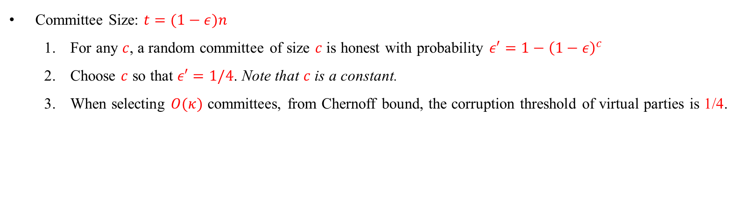
Basic Idea
Committee Size: $t=(1−ε)n$
  For any $c$, a random committee of size $c$ is honest with probability $ε′=1−{\left(1−ε\right)}^{c}$
  Choose $c$ so that $ε′=1/4$. Note that $c$ is a constant.
  When selecting $O(κ)$ committees, from Chernoff bound, the corruption threshold of virtual parties is 1/4.
Notes:
In general, say the corruption threshold is 1-\epsilon. For any parameter c, if we choose a random committee of size c, then this committee contains at least one honest party with probability 1- (1-\epsilon)^c. We will choose c so that this probability is ¼. Note that when \epsilon is a constant, the parameter c is also a constant.
Now when we randomly choose O(\kappa) committees, by the Chernoff bound, the corruption threshold of virtual parties is close to ¼.

Slide 46
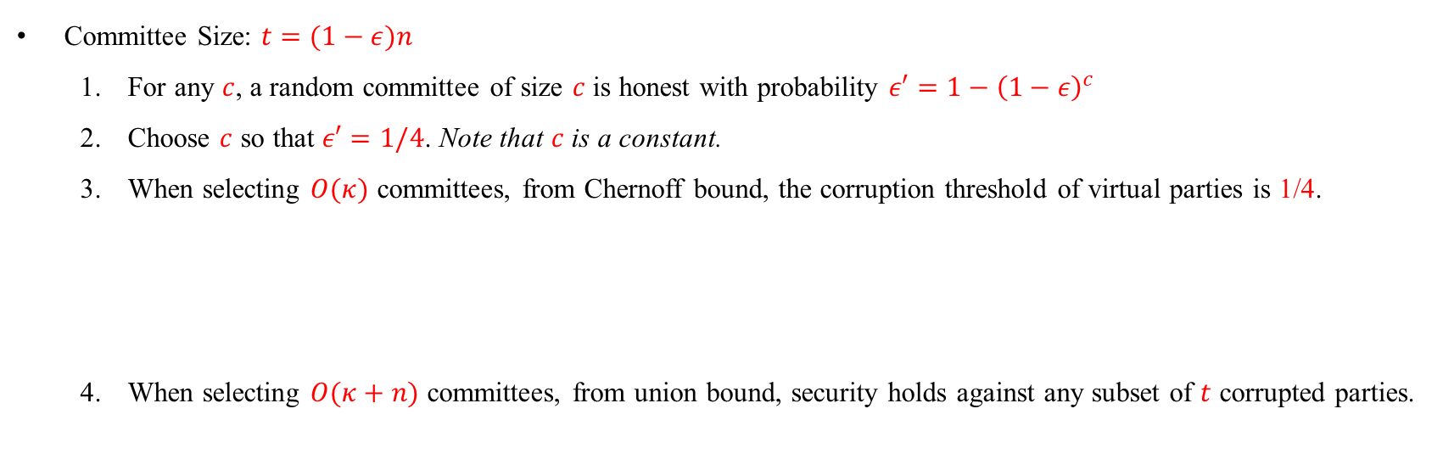
Basic Idea
Committee Size: $t=(1−ε)n$
  For any $c$, a random committee of size $c$ is honest with probability $ε′=1−{\left(1−ε\right)}^{c}$
  Choose $c$ so that $ε′=1/4$. Note that $c$ is a constant.
  When selecting $O(κ)$ committees, from Chernoff bound, the corruption threshold of virtual parties is 1/4.
  When selecting $O(κ+n)$ committees, from union bound, security holds against any subset of $t$ corrupted parties.
Only hold for static adversaries!
Notes:
However, this only holds if the adversary is static. Indeed, if the adversary is adaptive, he may only corrupt parties that are in the committee.
But, we can improve this by choosing O(\kappa+n) committees, from union bound, the security would hold for any subset of t corrupted parties, and thus is secure even if the adversary can choose parties to corrupt after learning the choices of the committees.

Slide 47

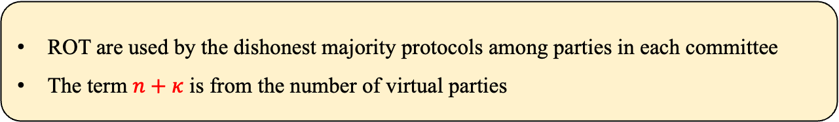
Summary of Our Result
Theorem 2.
Assuming random oracles and random OTs, for any constant $0<ε<1$, there exists a computationally secure $(12+R^{ROT})$-round MPC against a fully malicious adversary controlling up to $t=(1−ε)n$ parties with communication $O(|C|κ+D{(n+κ)}^{2}κ+n^{3})$ plus $O(|C|+D{(n+κ)}^{2})$ instances of ROT of messages length $O(κ)$, where $|C|$ is the circuit size, $D$ is the circuit depth, $R^{ROT}$ is the number of rounds of an instance of ROT, and $κ$ is the computational security parameter.
ROT are used by the dishonest majority protocols among parties in each committee
The term $n+κ$ is from the number of virtual parties
Notes:
In summary, we obtain our second main result. For any constant \epsilon between 0 and 1, there is a constant-round MPC with communication O(|C|\kappa+D(n+\kappa)^2\kappa + n^3), together with O(|C|+D(n+\kappa)^2) instances of ROT of message length O(\kappa). Here random OTs are used by the multiparty garbling protocols in each committee, and the term n+\kappa is from the number of virtual parties.

Slide 48
Summary of Our Result
Corollary.
Assuming random oracles, there exists a computationally secure $28$-round MPC against a fully malicious adversary controlling up to $t=(n−1)/2$ parties with communication $O(|C|κ+D{(n+κ)}^{2}κ+n^{3})$, where $|C|$ is the circuit size, $D$ is the circuit depth, and $κ$ is the computational security parameter.
Use an honest majority MPC to prepare base OTs
Apply OT extension to remove the assumption of ROT
Notes:
An interesting corollary of our result is that, with honest majority, we can instantiate random OT by preparing base OTs plus OT extension. Base OT can be prepared by an honest majority MPC, and the OT extension only assumes RO.
Thus, in the honest majority setting, only assuming random oracles, we obtain a constant-round MPC with communication O(|C|\kappa + D(n+\kappa)^2\kappa + n^3).

Slide 49
Thanks!
Notes:
Thanks, I am happy to take any question.

