Slide 1





Pseudorandomness Properties of Random Reversible Circuits
William He
(CMU)
Based on joint works with:
William Gay
(CMU $→$ UIUC)
Nicholas Kocurek
(CMU $→$ UW)
Ryan O’Donnell
(CMU)

Slide 2

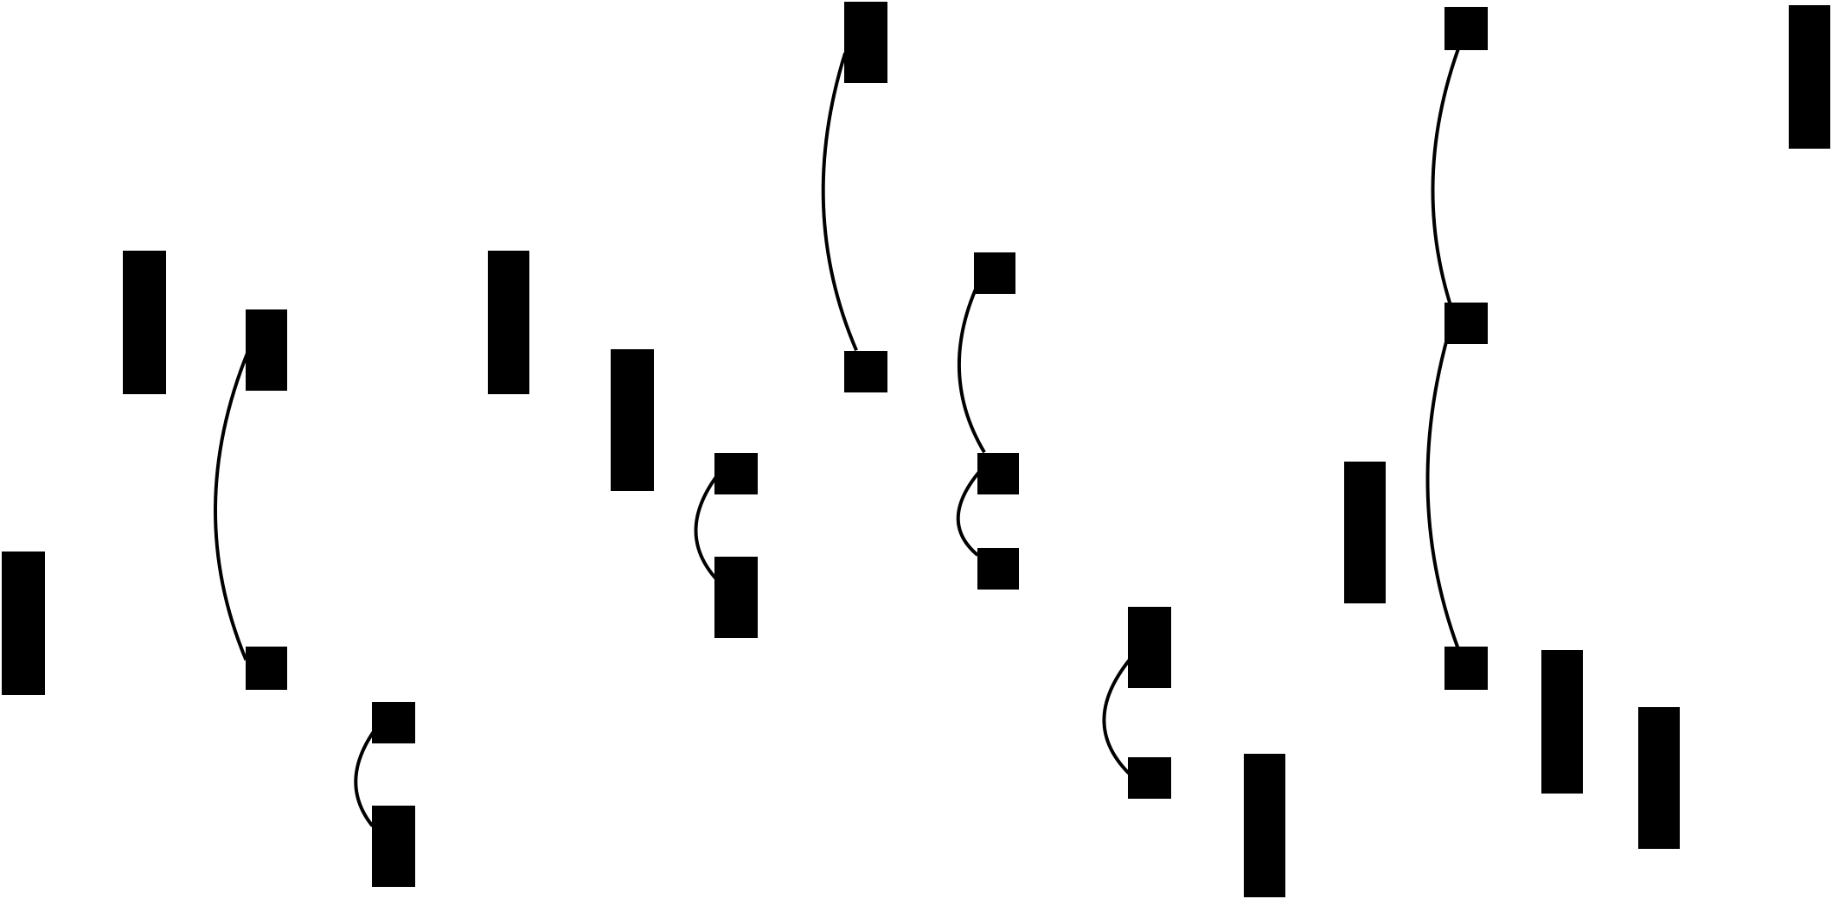

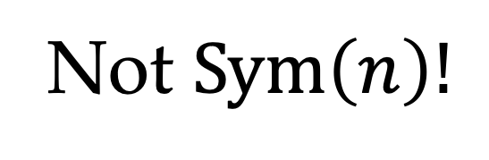

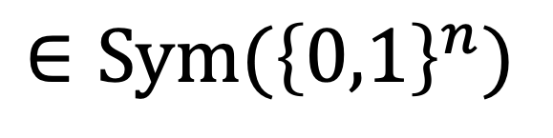
Reversible Circuit
1
0
1
1
0
0
1
1
1
0
0
0
0
0
01
1
1
0
0
0
0
0
0
$n$wires
0
0
0
1
1
1
0
0
0
0
0
1
1
1
1
0
0
0
0
0
0
1
1
1
1
1
1
0
0
1
000
001
010
011
100
101
110
111
110
111
010
011
000
101
100
001
$$∈\text{Sym}({\left\{0,1\right\}}^{n})$$
Not $\text{Sym}\left(n\right)!$

Slide 3
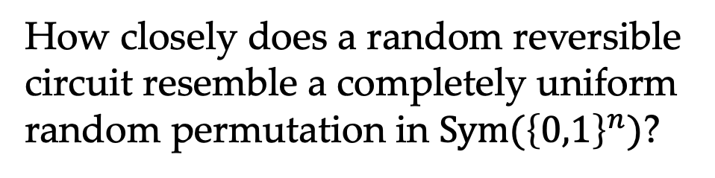
Random Reversible Circuit
Reversible circuit where each gate is randomly chosen i.i.d.
Induces a distribution on $\text{Sym}({\left\{0,1\right\}}^{n})$.
How closely does a random reversible circuit resemble a completely uniform random permutation in $\text{Sym}({\left\{0,1\right\}}^{n})$?

Slide 4
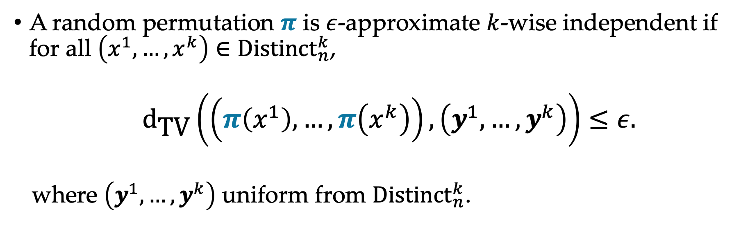

Approximate $k$-wise Independence
A random permutation $π$ is $ε$-approximate $k$-wise independent if for all $\left(x^{1},…,x^{k}\right)∈{\text{Distinct}}_{n}^{k}$,
  ${\text{d}}_{\text{TV}}\left(\left(π\left(x^{1}\right),…, π\left(x^{k}\right)\right),\left(y^{1},…,y^{k}\right)\right)≤ε.$
where $\left(y^{1},…, y^{k}\right)$ uniform from ${\text{Distinct}}_{n}^{k}$.

Slide 5
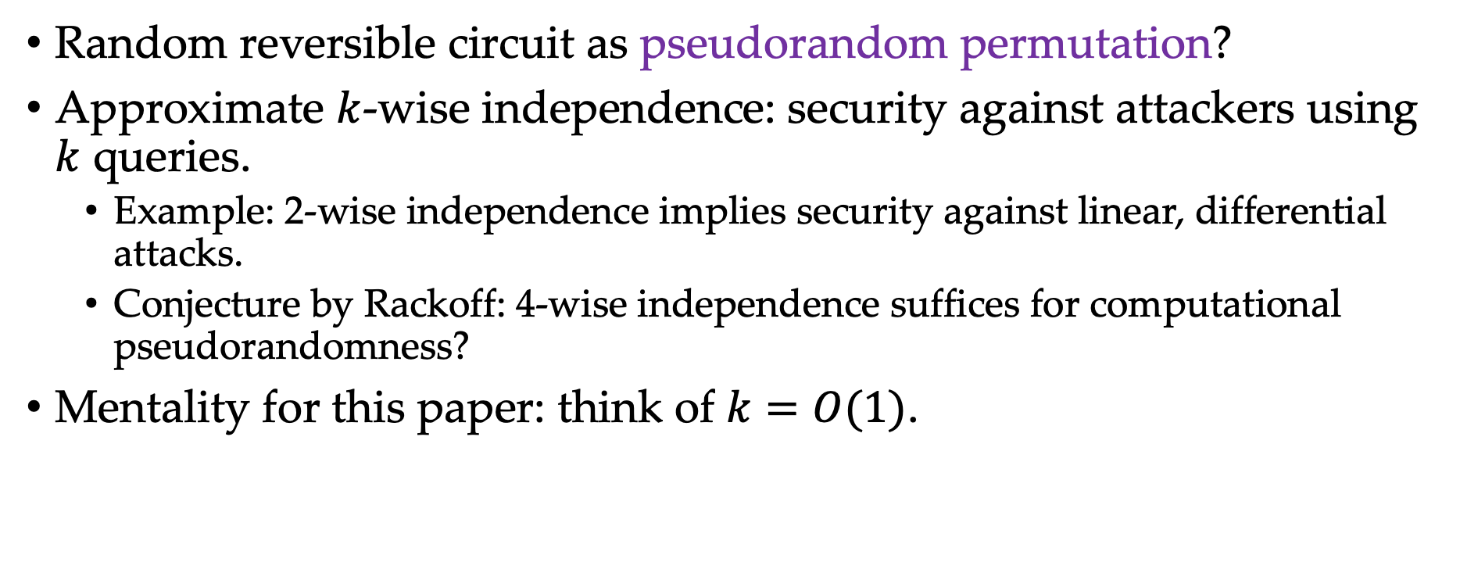
Cryptographic Motivation
Random reversible circuit as pseudorandom permutation?
Approximate $k$-wise independence: security against attackers using $k$ queries.
  Example: 2-wise independence implies security against linear, differential attacks.
  Conjecture by Rackoff: 4-wise independence suffices for computational pseudorandomness?
Mentality for this paper: think of $k=O(1)$.

Slide 6

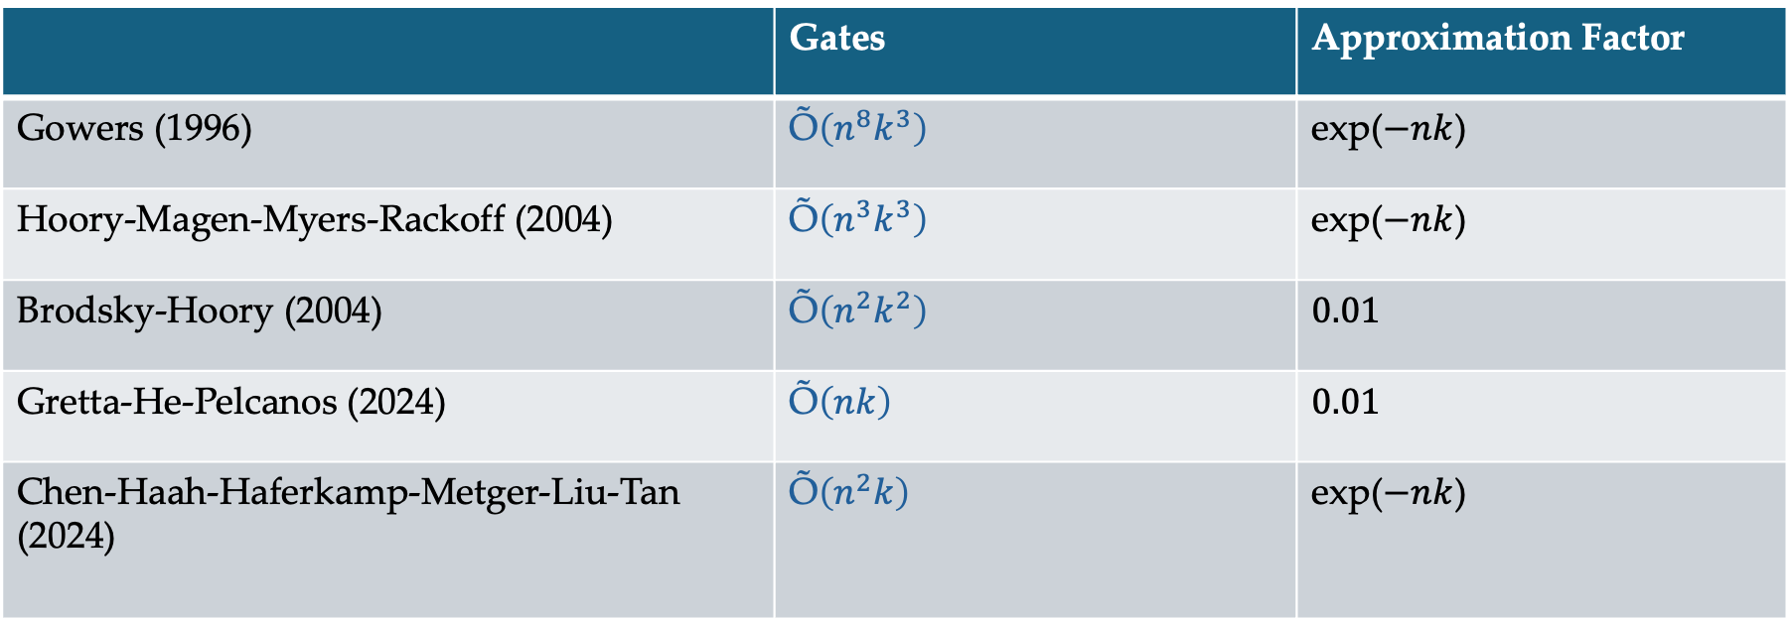
Previous and Related Results
If you want closeness to $k$-wise independent, then you need:
 | Gates | Approximation Factor
Gowers (1996) | Õ$\left(n^{8}k^{3}\right)$ | exp($−nk$)
Hoory-Magen-Myers-Rackoff (2004) | Õ$\left(n^{3}k^{3}\right)$ | exp($−nk$)
Brodsky-Hoory (2004) | Õ$\left(n^{2}k^{2}\right)$ | $$0.01$$
Gretta-He-Pelcanos (2024) | Õ$\left(nk\right)$ | $$0.01$$
Chen-Haah-Haferkamp-Metger-Liu-Tan (2024) | Õ$\left(n^{2}k\right)$ | exp($−nk$)

Slide 7
Cryptographic Motivation
Want our reversible circuits to be practical:
  Fixed architecture
  Nearest-neighbor gates in some geometric lattice
  Low depth

Slide 8

Our Intermediate Result
A random reversible circuit with Õ$\left(nk^{2}\right)$ layers of 1D-geometrically local gates is exp($−nk$)-approximate $k$-wise independent.

Slide 9



Our Main Result
Linear dependence on $n$ is tight from previous result is tight because of 1D architecture.
Main Result: A random reversible circuit with Õ$\left(\sqrt{n}k^{3}\right)$ layers of 2D-geometrically local gates is exp($−\sqrt{n}k$)-approximate $k$-wise independent.
$\sqrt{n}$wires
Random 1D brickwork circuit on $\sqrt{n}$wires.
Notes:
3D circuits

Slide 10
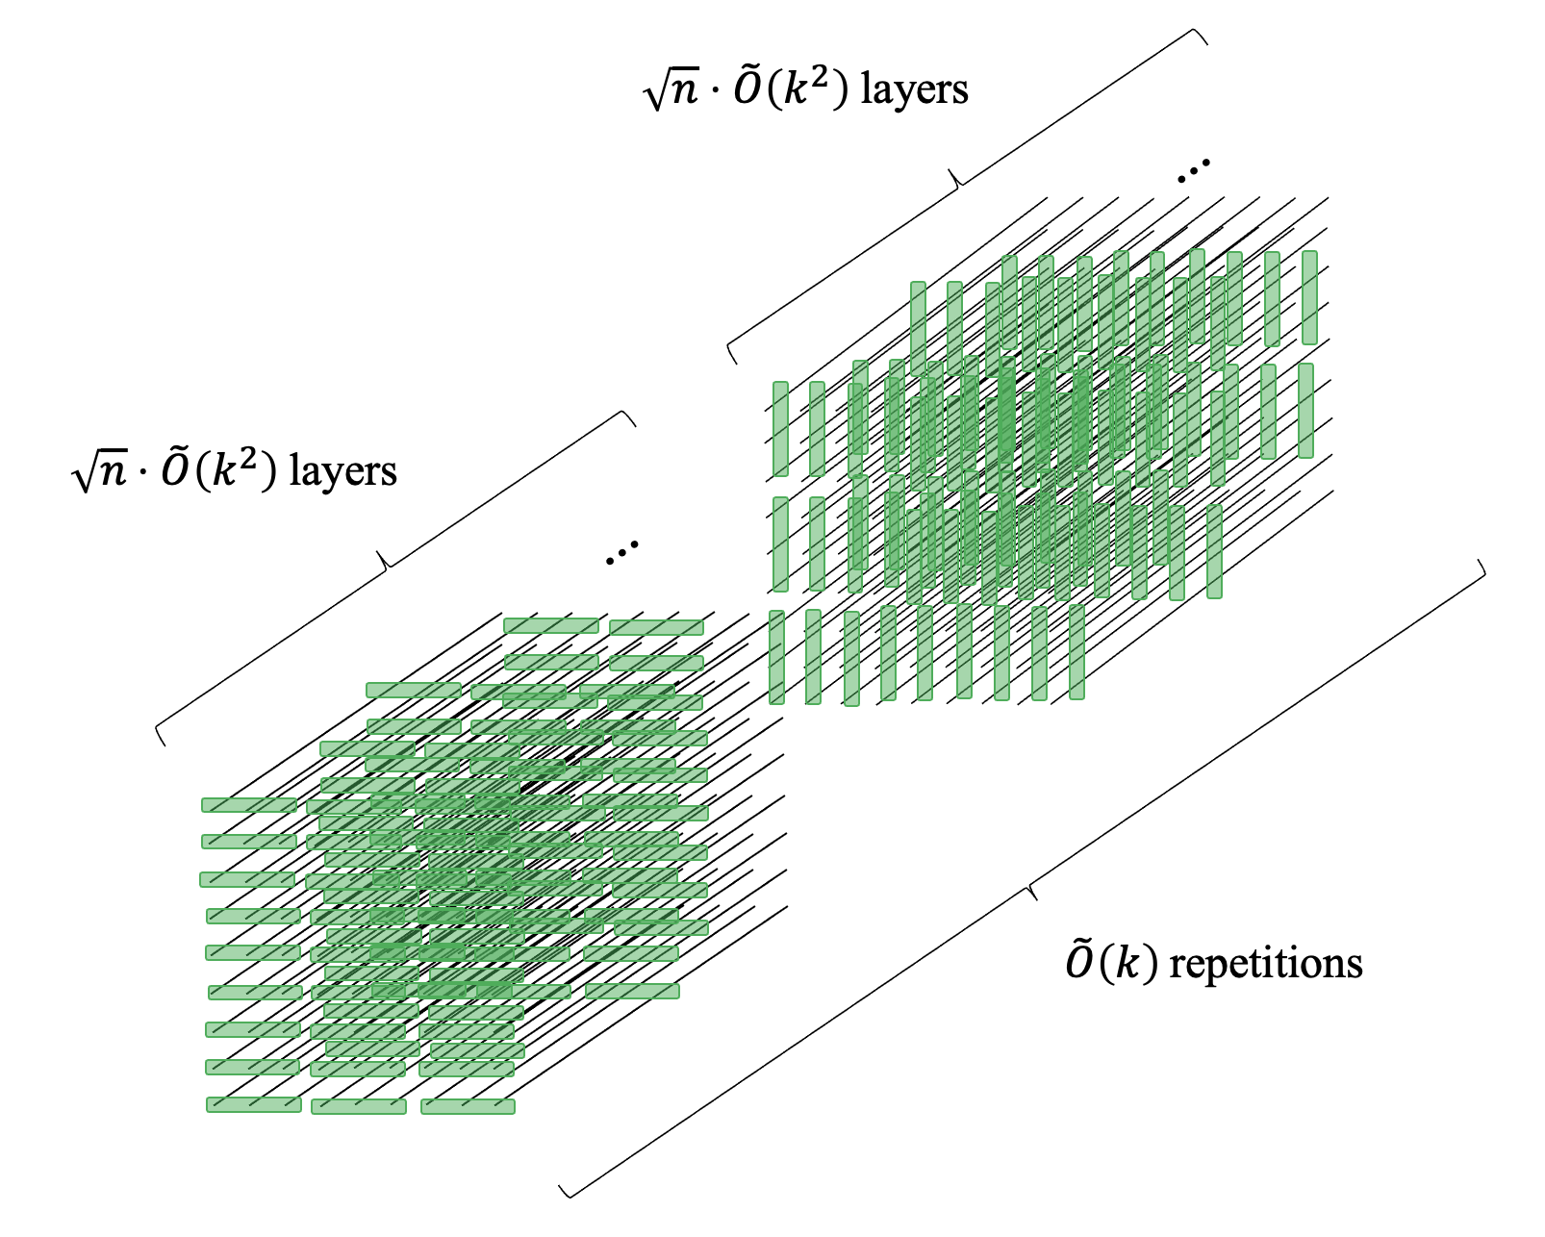

Slide 11
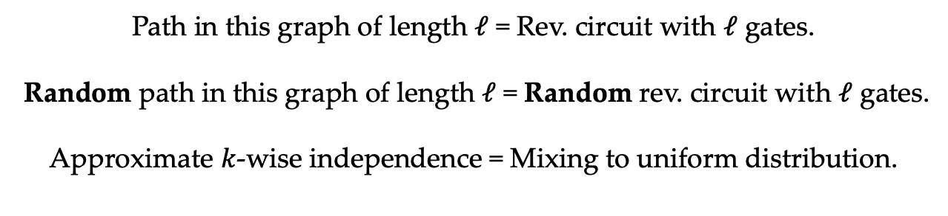





Techniques: random walk perspective
$${\text{Distinct}}_{n}^{k}$$
$$\left(x^{1},…, x^{k}\right)$$
$$\left(g(x^{1}),…,g(x^{k})\right)$$
$$\left(g′(x^{1}),…,g′(x^{k})\right)$$
$$\left(gg′(x^{1}),…,gg′(x^{k})\right)$$
Path in this graph of length $ℓ$ = Rev. circuit with $ℓ$ gates.
Random path in this graph of length $ℓ$ = Random rev. circuit with $ℓ$ gates.
Approximate $k$-wise independence = Mixing to uniform distribution.
Notes:
Degree: (n choose 3)8!

Slide 12
Techniques
Markov chain mixing is implied by spectral gap of transition matrix.
Previous results
  [Gow96]: canonical paths
  [HMMR04]: canonical paths
  [BH04]: comparison method
  [GHP24]: comparison method, log-Sobolev inequalities
  [CHHLMT24]: comparison method, algebraic expanders
1D theorem: spectral gaps from quantum physics tools.
  Tools adapted from study of unitary designs [BHH12,HM18].
2D theorem: upgraded spectral analysis with state space decomposition.

Slide 13
Thanks!

Slide 14

Future Directions
Computational security: Is a random reversible circuit with $n^{3}$ gates a computationally pseudorandom permutation? (Gowers’ conjecture)
NP-hardness: Minimum reversible circuit size problem (compute smallest circuit from truth table) has search-to-decision reductions.

Slide 15

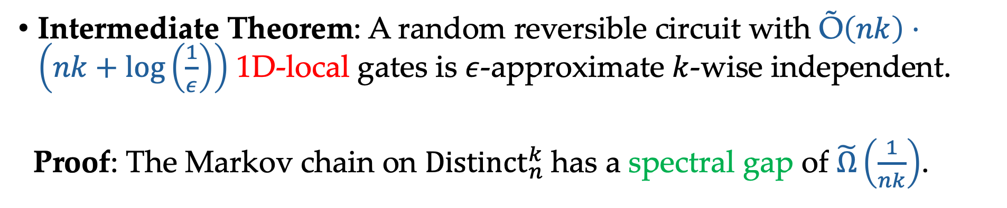

Proof of 1D Theorem
Intermediate Theorem: A random reversible circuit with Õ$\left(nk\right)⋅\left(nk+\log\left(\frac{1}{ε}\right)\right)$ 1D-local gates is $ε$-approximate $k$-wise independent.
Proof: The Markov chain on ${\text{Distinct}}_{n}^{k}$has a spectral gap of $\tilde{Ω}\left(\frac{1}{nk}\right)$.
The Laplacian for the 1D-local gates walk is different. In the baby theorem, we had a Laplacian of the form
$$L_{baby}={\text{avg}}_{i,j,k}\left[L_{\left\{i,j,k\right\}}\right].$$
Now the Laplacian is different.
$$L_{1D}={\text{avg}}_{i}\left[L_{\left\{i,i+1,i+2\right\}}\right].$$

Slide 16

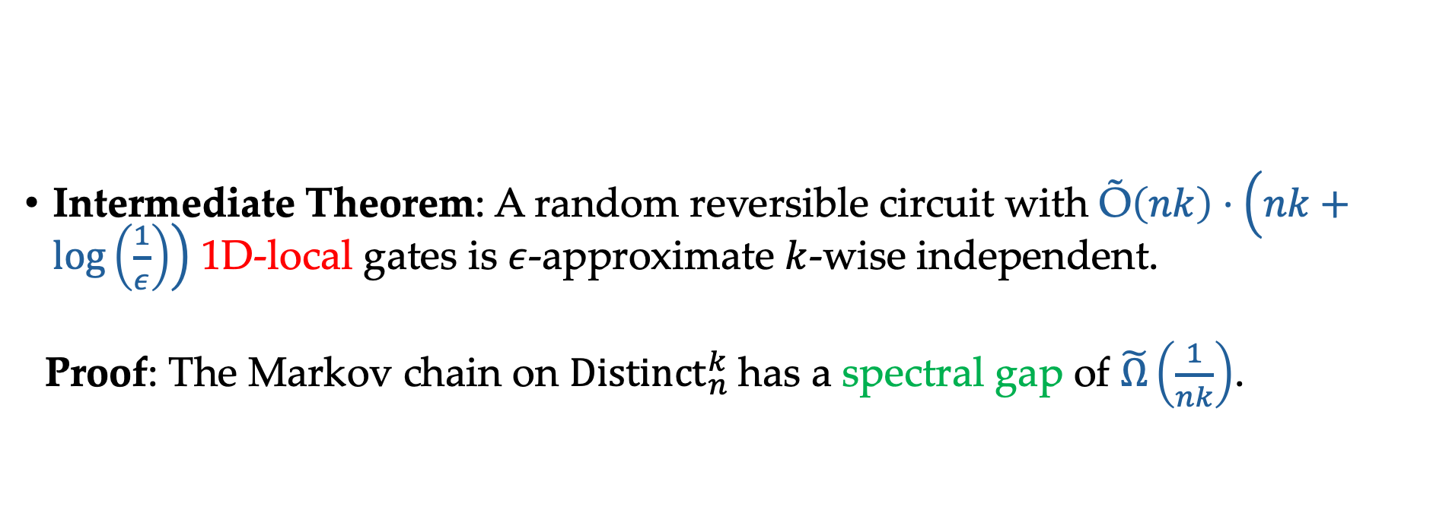
Proof of 1D Theorem
Intermediate Theorem: A random reversible circuit with Õ$\left(nk\right)⋅\left(nk+\log\left(\frac{1}{ε}\right)\right)$ 1D-local gates is $ε$-approximate $k$-wise independent.
Proof: The Markov chain on ${\text{Distinct}}_{n}^{k}$has a spectral gap of $\tilde{Ω}\left(\frac{1}{nk}\right)$.
$$L_{1D}={\text{avg}}_{i}\left[L_{\left\{i,i+1,i+2\right\}}\right].$$
Lemma of Nachtergaele from quantum many-body physics shows how to prove spectral gaps for Hamiltonians of this form.
Main Theorem follows from Intermediate Theorem by detectability lemma of Ahanorov et al.

Slide 17
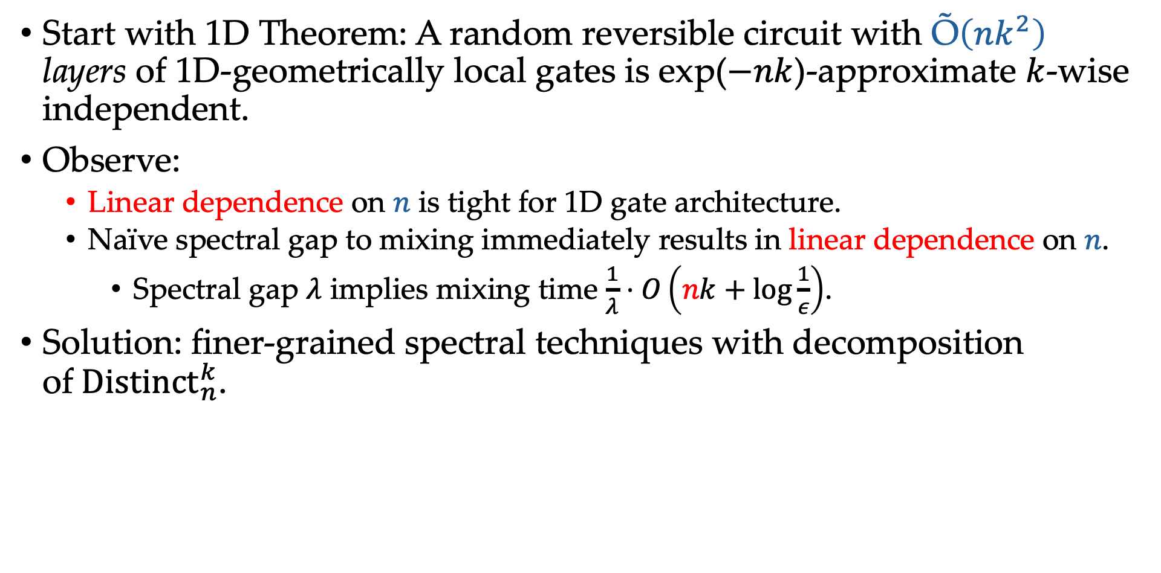
Proof of 2D Theorem
Start with 1D Theorem: A random reversible circuit with Õ$\left(nk^{2}\right)$ layers of 1D-geometrically local gates is exp($−nk$)-approximate $k$-wise independent.
Observe:
  Linear dependence on $n$ is tight for 1D gate architecture.
  Naïve spectral gap to mixing immediately results in linear dependence on $n$.
    Spectral gap $λ$ implies mixing time $\frac{1}{λ}⋅O\left(nk+\log{\frac{1}{ε}}\right)$.
Solution: finer-grained spectral techniques with decomposition of${ \text{Distinct}}_{n}^{k}$.

Slide 18







$k\log{k}$ repetitions
Analyze random walk given by $P_{R}P_{C}P_{R}P_{C}…P_{R}P_{C}$.
$\sqrt{n}$wires
$\sqrt{n}$wires
$$≈$$
Random 1D brickwork circuit on $\sqrt{n}$wires.
Random permutation of ${\left\{0,1\right\}}^{\sqrt{n}}.$

