Slide 1


General Functional Bootstrapping using CKKS
eprint.iacr.org/2024/1623
Andreea Alexandru
Duality Technologies
aalexandru@dualitytech.com
Andrey Kim
Altbridge AI
kimandr@altbridge.ai
Yuriy Polyakov
Duality Technologies
ypolyakov@dualitytech.com
CRYPTO 2025 August 20

Slide 2
1. Background on FHE schemes & research question

Slide 3





“Generations” of FHE schemes
First gen:
Unicellular life
Gentry’s PhD thesis proposed the first FHE scheme [Gen09]
  Ideal lattices, SwHE, bootstrapping, and squashing were key ingredients
[DGHV10]: based on approximate integer GCD and Gentry’s blueprint
Not considered practical, and other schemes are now used in practice
Second gen:
Fungi kingdom
Third gen:
Animalia kingdom
Fourth gen:
Plantae kingdom
Pixabay Free Images
Foundational works of Brakerski and Vaikuntanathan formulating leveled (R)LWE schemes for integers
[BGV14]: first leveled FHE scheme; introduced relinearization, modulus switching instead of squashing, SIMD packing by [SV14]
[Bra12], [FV12]: Scale-invariant leveled FHE scheme
Gentry, Sahai, and Waters’ scheme with asymmetric noise grown for multiplication [GSW13]
[DM15]: hybrid cryptosystem LWE—GSW, fast functional bootstrapping for small plaintexts
[CGGI17]: new blind rotation scheme over DM blueprint, bootstrap runtime reduced to 0.1s
Cheon, Kim, Kim, and Song proposed an approximate homomorphic encryption scheme
[CKKS17]: rescaling operation enables the efficient scaling down of encrypted numbers, supports efficient implementation of polynomial interpolations over real/complex numbers
Bootstrapping for BGV and BFV has been slow so far (hope from [KSS24], [GV25])
Main efficiency limitation: Bootstrapping can be done only for one number at a time
CKKS provides best bootstrapping throughput, but does not support functional bootstrapping
3

Slide 4

Research Question
DM/CGGI approach supports general functional bootstrapping and low-latency bootstrapping, but its throughput is 2-3 orders of magnitude lower than for CKKS bootstrapping
CKKS achieves the best throughput among all schemes, but does not support general functional bootstrapping
Can a vectorized (SIMD) cryptosystem be developed that supports the same general functionality as DM/CGGI and achieves the same SIMD efficiency as CKKS?

Slide 5

New Vectorized Hybrid Cryptosystem
Our answer is positive!
We propose a vectorized hybrid cryptosystem with functional bootstrapping capability
The vectorized hybrid cryptosystem is based on the DM blueprint
  LWE -> BFV in coefficient encoding (BFV can be interpreted as an additive input RLWE scheme)
  RGSW -> CKKS
CKKS is used for evaluating LUTs via a functional bootstrapping capability, which also reduces the noise at the same time.
  The main tool is trigonometric Hermite interpolation.
The result is switched back to BFV
  Advantage: no noise flooding is needed if the decrypted result is shared (if correctness is maintained)
Fifth gen:
Technota Kingdom?
Image generated with ChatGPT 5
[LW23], [BCKS24], [AKP24], [BKSS24]
Inspired by [BGG+20], [DMPS24], [CKKL24]

Slide 6
2. Trigonometric Hermite interpolation & noise reduction

Slide 7
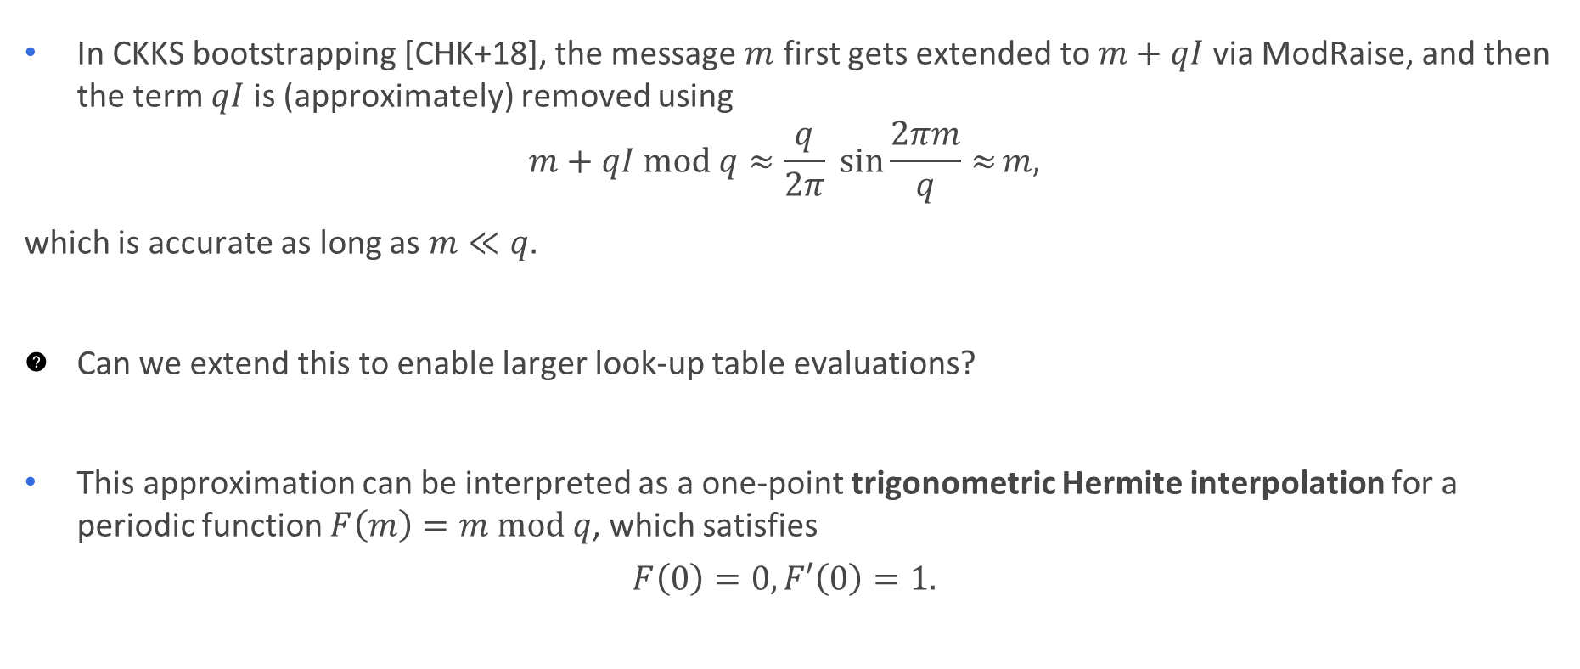
Sine wave in CKKS Bootstrapping
In CKKS bootstrapping [CHK+18], the message $m$ first gets extended to $m+qI$ via ModRaise, and then the term $qI$ is (approximately) removed using
$$m+qI mod q≈\frac{q}{2π} \sin{\frac{2πm}{q}≈}m,$$
which is accurate as long as $m≪q.$
Can we extend this to enable larger look-up table evaluations?
This approximation can be interpreted as a one-point trigonometric Hermite interpolation for a periodic function $F\left(m\right)=m mod q$, which satisfies
$$F\left(0\right)=0,F′\left(0\right)=1.$$

Slide 8
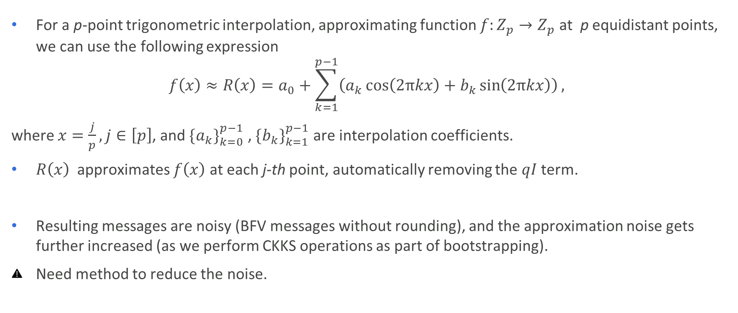
Trigonometric Interpolation
For a p-point trigonometric interpolation, approximating function ${f:Z}_{p}{→Z}_{p}$ at p equidistant points, we can use the following expression
$$f\left(x\right)≈R\left(x\right)=a_{0}+\sum_{k=1}^{p−1}{\left(a_{k}\cos\left(2πkx\right)+b_{k}\sin\left(2πkx\right)\right)},$$
where $x=\frac{j}{p}, j∈\left[p\right]$, and $\{a_{k}\}_{k=0}^{p−1}$ , $\{b_{k}\}_{k=1}^{p−1}$ are interpolation coefficients.
$R\left(x\right)$ approximates $f\left(x\right)$ at each j-th point, automatically removing the $qI$ term.
Resulting messages are noisy (BFV messages without rounding), and the approximation noise gets further increased (as we perform CKKS operations as part of bootstrapping).
Need method to reduce the noise.

Slide 9
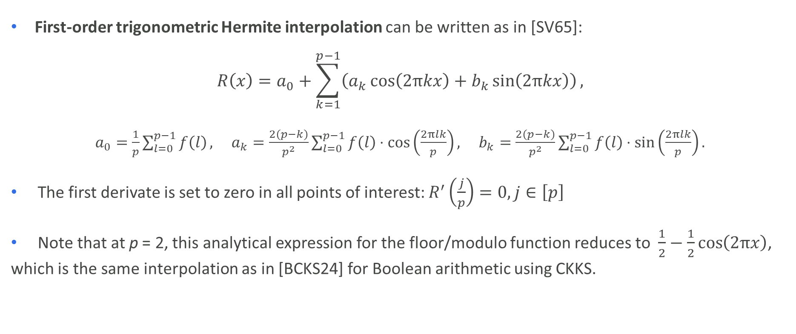
General Analytical Expression
First-order trigonometric Hermite interpolation can be written as in [SV65]:
$$R\left(x\right)=a_{0}+\sum_{k=1}^{p−1}{\left(a_{k}\cos\left(2πkx\right)+b_{k}\sin\left(2πkx\right)\right)},$$
$a_{0}=\frac{1}{p}\sum_{l=0}^{p−1}{f\left(l\right)},$ $a_{k}=\frac{2\left(p−k\right)}{p^{2}}\sum_{l=0}^{p−1}{f\left(l\right)}⋅\cos\left(\frac{2πlk}{p}\right),$ $b_{k}=\frac{2\left(p−k\right)}{p^{2}}\sum_{l=0}^{p−1}{f\left(l\right)}⋅\sin\left(\frac{2πlk}{p}\right).$
The first derivate is set to zero in all points of interest: $R^{′}\left(\frac{j}{p}\right)=0,j∈\left[p\right]$
Note that at p = 2, this analytical expression for the floor/modulo function reduces to $\frac{1}{2}−\frac{1}{2}\cos\left(2πx\right)$, which is the same interpolation as in [BCKS24] for Boolean arithmetic using CKKS.

Slide 10
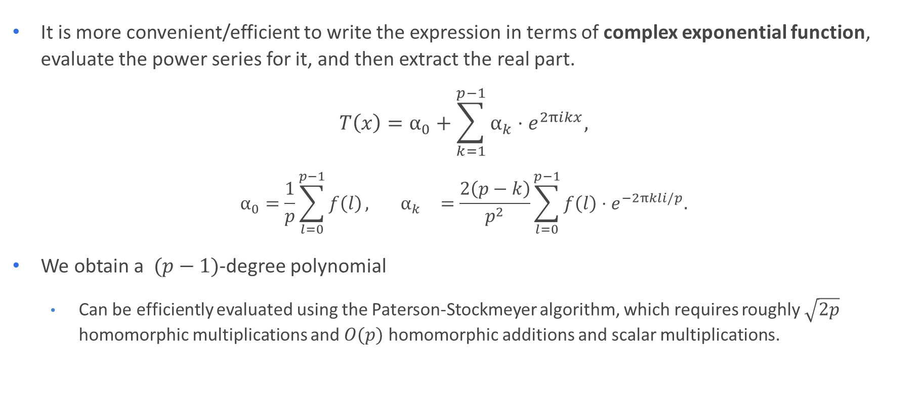
FHE-friendly Analytical Expression
It is more convenient/efficient to write the expression in terms of complex exponential function, evaluate the power series for it, and then extract the real part.
$$T\left(x\right)=α_{0}+\sum_{k=1}^{p−1}{α_{k}}⋅e^{2πikx},$$
$$α_{0}=\frac{1}{p}\sum_{l=0}^{p−1}{f\left(l\right)}, { α}_{k}=\frac{2\left(p−k\right)}{p^{2}}\sum_{l=0}^{p−1}{f\left(l\right)}⋅e^{−2πkli/p}.$$
We obtain a $(p−1)$-degree polynomial
  Can be efficiently evaluated using the Paterson-Stockmeyer algorithm, which requires roughly $\sqrt{2p}$ homomorphic multiplications and $O(p)$ homomorphic additions and scalar multiplications.

Slide 11
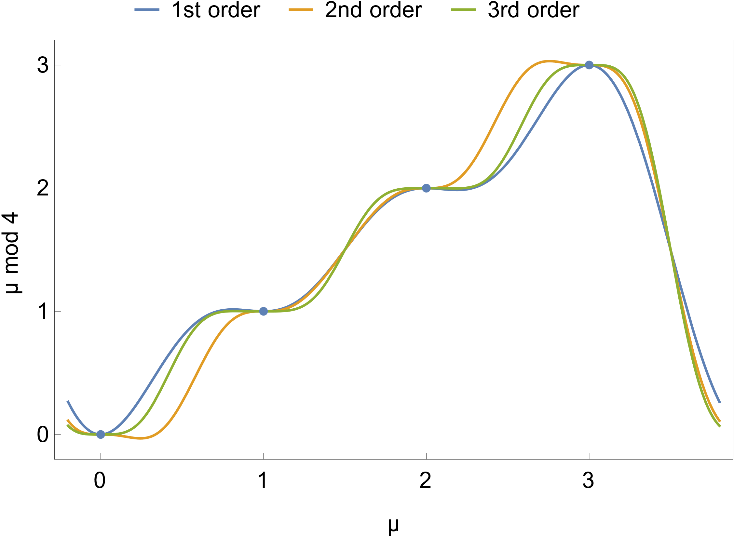
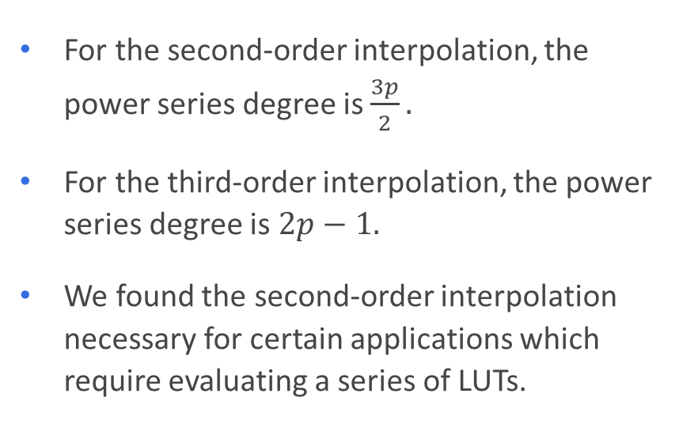
Analytical Expressions for Higher Orders
We also derived analytical expressions for second-order and third-order trigonometric Hermite interpolations, where the first two and three derivatives, respectively, are set to zero at the p points.
These interpolations provide extra noise reduction
For the second-order interpolation, the power series degree is $\frac{3p}{2}.$
For the third-order interpolation, the power series degree is $2p−1.$
We found the second-order interpolation necessary for certain applications which require evaluating a series of LUTs.

Slide 12
3. Hybrid RLWE-CKKS cryptosystem & CKKS Functional Bootstrapping

Slide 13
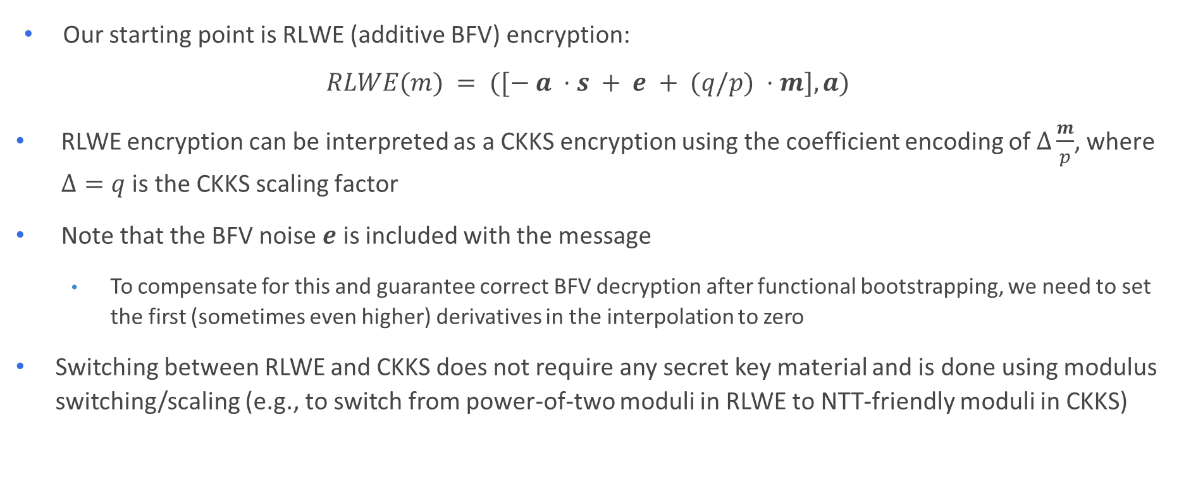
Switching between RLWE and CKKS
Our starting point is RLWE (additive BFV) encryption:
$$RLWE(m) = ([− a ⋅s + e + (q/p) ⋅m], a)$$
RLWE encryption can be interpreted as a CKKS encryption using the coefficient encoding of$Δ\frac{m}{p}$, where $Δ=q$ is the CKKS scaling factor
Note that the BFV noise $e$ is included with the message
    To compensate for this and guarantee correct BFV decryption after functional bootstrapping, we need to set the first (sometimes even higher) derivatives in the interpolation to zero
Switching between RLWE and CKKS does not require any secret key material and is done using modulus switching/scaling (e.g., to switch from power-of-two moduli in RLWE to NTT-friendly moduli in CKKS)

Slide 14
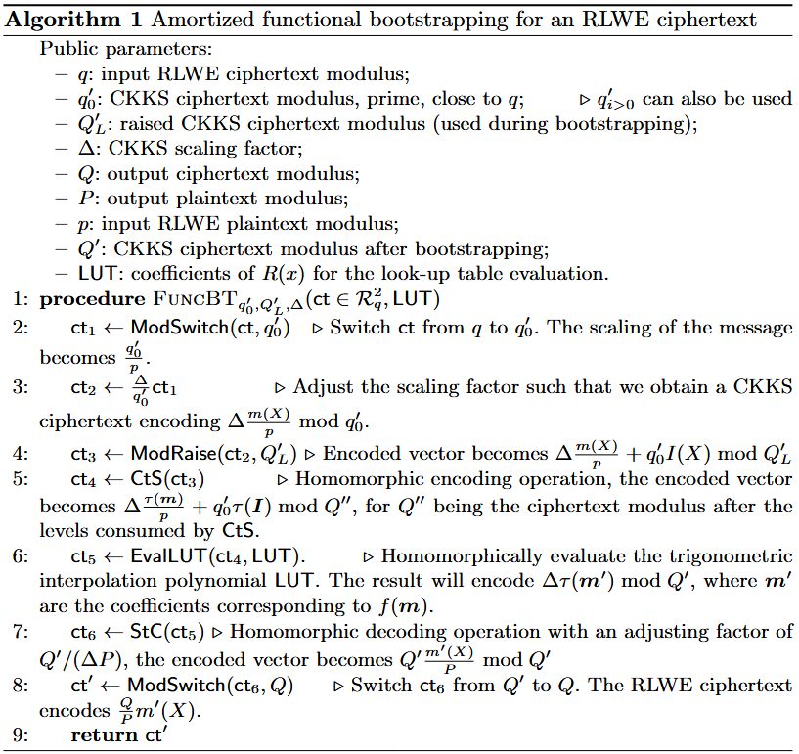
CKKS Functional Bootstrapping
Supports different, arbitrary input and output plaintext moduli, just like DM/CGGI
CKKS “bootstrapping” with EvalLUT instead of EvalMod
If more (slot) homomorphic computations need to be performed after functional bootstrapping, they can be performed in CKKS before calling StC.
Pure CKKS functional bootstrapping is also possible.

Slide 15
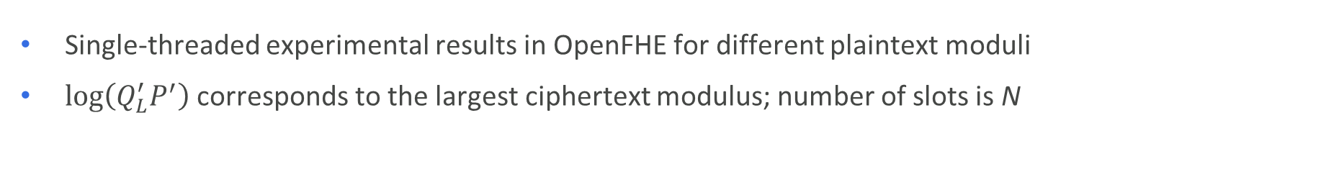
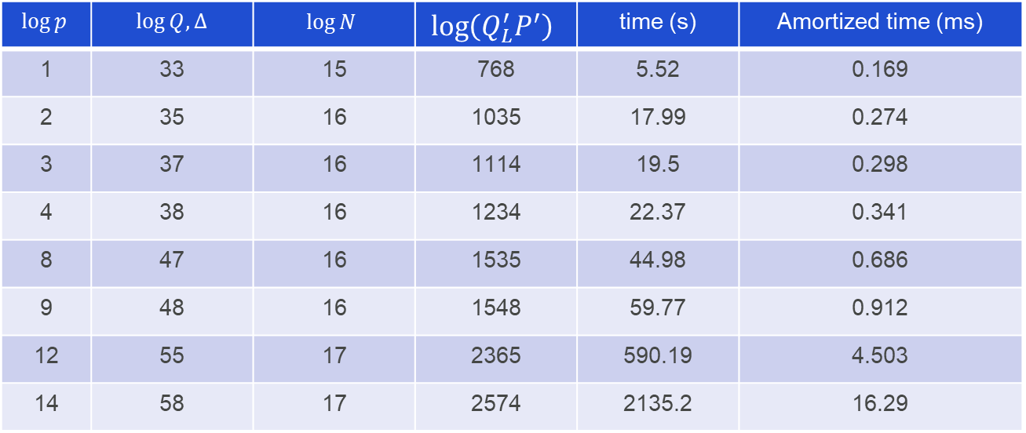
Experimental Results for LUT Evaluation
$$\log{p}$$ | $\log{Q,∆}$ | $$\log{N}$$ | $$\log\left(Q_{L}^{′}P^{′}\right)$$ | time (s) | Amortized time (ms)
1 | 33 | 15 | 768 | 5.52 | 0.169
2 | 35 | 16 | 1035 | 17.99 | 0.274
3 | 37 | 16 | 1114 | 19.5 | 0.298
4 | 38 | 16 | 1234 | 22.37 | 0.341
8 | 47 | 16 | 1535 | 44.98 | 0.686
9 | 48 | 16 | 1548 | 59.77 | 0.912
12 | 55 | 17 | 2365 | 590.19 | 4.503
14 | 58 | 17 | 2574 | 2135.2 | 16.29
Single-threaded experimental results in OpenFHE for different plaintext moduli
$\log\left(Q_{L}^{′}P^{′}\right)$ corresponds to the largest ciphertext modulus; number of slots is N

Slide 16
4. Extending to higher precision

Slide 17
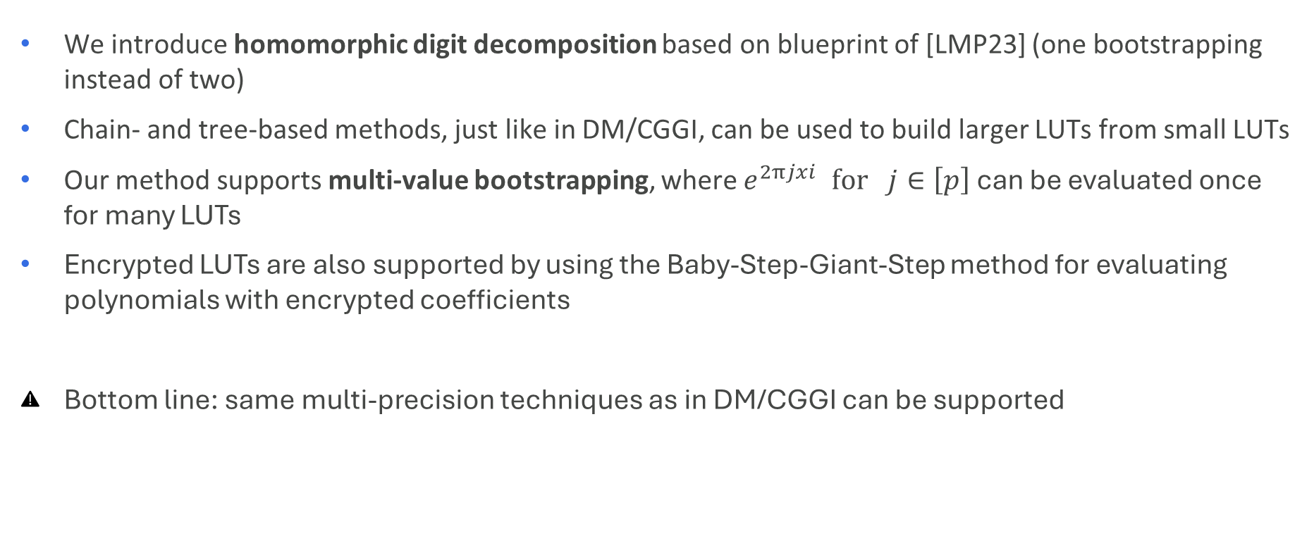
Multi-precision LUT Evaluation
We introduce homomorphic digit decomposition based on blueprint of [LMP23] (one bootstrapping instead of two)
Chain- and tree-based methods, just like in DM/CGGI, can be used to build larger LUTs from small LUTs
Our method supports multi-value bootstrapping, where $e^{2πjxi} for j∈\left[p\right]$ can be evaluated once for many LUTs
Encrypted LUTs are also supported by using the Baby-Step-Giant-Step method for evaluating polynomials with encrypted coefficients
Bottom line: same multi-precision techniques as in DM/CGGI can be supported

Slide 18
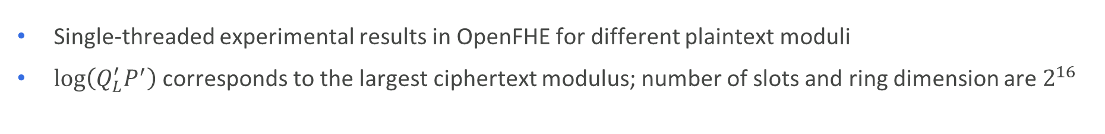
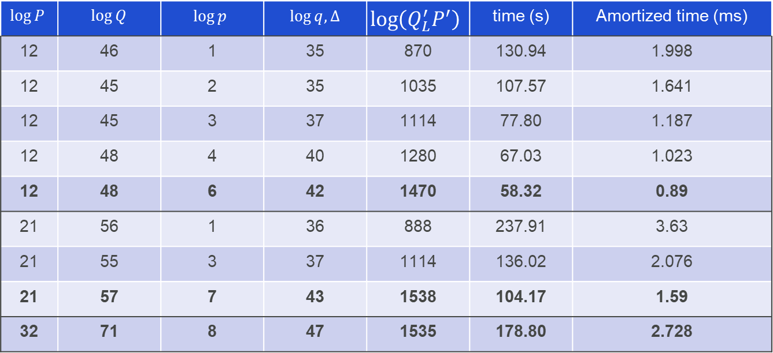
Experimental Results for Sign Evaluation
$$\log{P}$$ | $\log{Q}$ | $$\log{p}$$ | $\log{q,∆}$ | $$\log\left(Q_{L}^{′}P^{′}\right)$$ | time (s) | Amortized time (ms)
12 | 46 | 1 | 35 | 870 | 130.94 | 1.998
12 | 45 | 2 | 35 | 1035 | 107.57 | 1.641
12 | 45 | 3 | 37 | 1114 | 77.80 | 1.187
12 | 48 | 4 | 40 | 1280 | 67.03 | 1.023
12 | 48 | 6 | 42 | 1470 | 58.32 | 0.89
21 | 56 | 1 | 36 | 888 | 237.91 | 3.63
21 | 55 | 3 | 37 | 1114 | 136.02 | 2.076
21 | 57 | 7 | 43 | 1538 | 104.17 | 1.59
32 | 71 | 8 | 47 | 1535 | 178.80 | 2.728
Single-threaded experimental results in OpenFHE for different plaintext moduli
$\log\left(Q_{L}^{′}P^{′}\right)$ corresponds to the largest ciphertext modulus; number of slots and ring dimension are $2^{16}$

Slide 19
5. Comparison with other methods & concluding remarks

Slide 20
Comparison with other Functional Bootstrapping Methods
For 8-bit LUT evaluation, our method has a throughput that is
  9x higher than the BFV method in [LW23,LW24].
  3 orders of magnitude higher than the CGGI functional bootstrapping method [LMP22, TCBS23].
  2 orders of magnitude higher than using CGGI circuit bootstrapping [WHS+24].
  5x higher than concurrent work [BKSS24].
For multi-precision sign evaluation, our method’s throughput is
  3 orders of magnitude higher than the CGGI-based implementation in OpenFHE [LMP22] for 8—21 bit LUTs.
  19x—49x higher than the (multi-precision) PBS implementation in TFHE-rs for 8—32 bit LUTs.
More efficient when #slots reaches the order of 1000s (or even 100s for larger LUTs)

Slide 21

Concluding remarks
CKKS-based solution for homomorphic vectorized evaluation of arbitrary LUTs
Functional bootstrapping offers error reduction
Efficient extension to “chainable”-LUTs, more extensions possible
Extension to larger arbitrary LUTs (see eprint.iacr.org/2025/1301)
Extension to “difficult” large-precision functions, piece-wise function evaluation
Seamless integration with fixed-point CKKS computations
Theoretical error estimation
Reduce depth (and ring dimension)
Many other questions
Image generated with ChatGPT 4o
Exciting new era for FHE!
21

Slide 22
References
[BCKS24] Youngjin Bae, Jung Hee Cheon, Jaehyung Kim, and Damien Stehlé. Bootstrapping bits with CKKS. In Marc Joye and Gregor Leander, editors,Advances in Cryptology – EUROCRYPT 2024, pages 94–123, Cham, 2024. Springer Nature Switzerland.
[BKSS24] Youngjin Bae, Jaehyung Kim, Damien Stehlé, and Elias Suvanto. Bootstrapping small integers with CKKS. In ASIACRYPT 2024. Springer-Verlag, 2024.
[BGG+20] Boura, C., Gama, N., Georgieva, M. and Jetchev, D., 2020. Chimera: Combining ring-lwe-based fully homomorphic encryption schemes. Journal of Mathematical Cryptology, 14(1), pp.316-338.
[BGV14] Zvika Brakerski, Craig Gentry, and Vinod Vaikuntanathan. (leveled) fully homomorphic encryption without bootstrapping. ACM Transactions on Computation Theory (TOCT), 6(3):1–36, 2014.
[Bra12] Zvika Brakerski. Fully homomorphic encryption without modulus switching from classical GapSVP. In Advances in Cryptology–CRYPTO 2012:32nd Annual Cryptology Conference, Santa Barbara, CA, USA, August19-23, 2012. Proceedings, pages 868–886. Springer, 2012.
[CGGI16] Ilaria Chillotti, Nicolas Gama, Mariya Georgieva, and Malika Izabachéne. Faster fully homomorphic encryption: Bootstrapping in less than 0.1 seconds. In Advances in Cryptology–ASIACRYPT 2016: 22nd International Conference on the Theory and Application of Cryptology and Information Security, Hanoi, Vietnam, December 4-8, 2016, Proceedings, Part I 22,pages 3–33. Springer, 2016.
[CHK+18] Jung Hee Cheon, Kyoohyung Han, Andrey Kim, Miran Kim, and Yongsoo Song. Bootstrapping for approximate homomorphic encryption. In Jesper Buus Nielsen and Vincent Rijmen, editors, Advances in Cryptology –EUROCRYPT 2018, pages 360–384, Cham, 2018. Springer International Publishing.
[CKK20] Jung Hee Cheon, Dongwoo Kim, and Duhyeong Kim. Efficient homomorphic comparison methods with optimal complexity. In Shiho Moriai andHuaxiong Wang, editors, Advances in Cryptology – ASIACRYPT 2020, pages 221–256, Cham, 2020. Springer International Publishing.
[CKKL24] Heewon Chung, Hyojun Kim, Young-Sik Kim, and Yongwoo Lee. Amortized large look-up table evaluation with multivariate polynomials for homomorphic encryption. Cryptology ePrint Archive, Paper 2024/274, 2024.

Slide 23
References [cont’d]
[CKKS17] Jung Hee Cheon, Andrey Kim, Miran Kim, and Yongsoo Song. Homo-morphic encryption for arithmetic of approximate numbers. In Advance sin Cryptology–ASIACRYPT 2017: 23rd International Conference on the Theory and Applications of Cryptology and Information Security, Hong Kong, China, December 3-7, 2017, Proceedings, Part I 23, pages 409–437.Springer, 2017.
[DAP+25] Dumezy, J., Alexandru, A., Polyakov, Y., Clet, P.E., Chakraborty, O. and Boudguiga, A., 2025. Evaluating Larger Lookup Tables using CKKS. Cryptology ePrint Archive, Paper 2025/1301, 2025.
[DGHV10] van Dijk, M., Gentry, C., Halevi, S., Vaikuntanathan, V.: Fully homomorphic encryption over the integers. In: Gilbert, H. (ed.) EUROCRYPT 2010. LNCS, vol. 6110, pp. 24–43. Springer, Heidelberg (2010)
[DM15] Léo Ducas and Daniele Micciancio. FHEW: bootstrapping homomorphicencryption in less than a second. In Elisabeth Oswald and Marc Fischlin, editors, Advances in Cryptology - EUROCRYPT 2015 - 34th Annual International Conference on the Theory and Applications of Cryptographic Techniques, Sofia, Bulgaria, April 26-30, 2015, Proceedings, Part I, vol-ume 9056 of Lecture Notes in Computer Science, pages 617–640. Springer,2015.
[DMPS24] Nir Drucker, Guy Moshkowich, Tomer Pelleg, and Hayim Shaul.BLEACH: cleaning errors in discrete computations over CKKS. J. Cryptol., 37(1):3, 2024.
[FV12] Junfeng Fan and Frederik Vercauteren. Somewhat practical fully homomorphic encryption. Cryptology ePrint Archive, Paper 2012/144, 2012. [Gen09a] Craig Gentry. A fully homomorphic encryption scheme. PhD thesis, Stan-ford University, 2009. crypto.stanford.edu/craig.
[GSW13] Gentry, C., Sahai, A., & Waters, B. (2013, August). Homomorphic encryption from learning with errors: Conceptually-simpler, asymptotically-faster, attribute-based. In Annual cryptology conference (pp. 75-92). Berlin, Heidelberg: Springer Berlin Heidelberg.
[GV25] Geelen, R. and Vercauteren, F., 2025, April. Fully homomorphic encryption for cyclotomic prime moduli. In Annual International Conference on the Theory and Applications of Cryptographic Techniques (pp. 366-397). Cham: Springer Nature Switzerland.
[KSS24] Kim, Jaehyung, Jinyeong Seo, and Yongsoo Song. Simpler and faster BFV bootstrapping for arbitrary plaintext modulus from CKKS. In Proceedings of the 2024 on ACM SIGSAC Conference on Computer and Communications Security, pp. 2535-2546. 2024.

Slide 24
References [cont’d]
[LMP23] Zeyu Liu, Daniele Micciancio, and Yuriy Polyakov. Large-precision homo-morphic sign evaluation using FHEW/TFHE bootstrapping. In Advancesin Cryptology – ASIACRYPT 2022: 28th International Conference on the Theory and Application of Cryptology and Information Security, Taipei, Taiwan, December 5–9, 2022, Proceedings, Part II, page 130–160, Berlin, Heidelberg, 2023. Springer-Verlag.
[LW23] Zeyu Liu and Yunhao Wang. Amortized functional bootstrapping in less than 7 ms, with Õ(1) polynomial multiplications. In Jian Guo and Ron Steinfeld, editors, Advances in Cryptology - ASIACRYPT 2023 - 29th International Conference on the Theory and Application of Cryptology and Information Security, Guangzhou, China, December 4-8, 2023, Proceedings, Part VI, volume 14443 of Lecture Notes in Computer Science, pages 101–132. Springer, 2023.
[LW24] Zeyu Liu and Yunhao Wang. Relaxed functional bootstrapping: A new perspective on BGV/BFV bootstrapping. Cryptology ePrint Archive, Pa-per 2024/172, 2024.
[KN24] Jaehyung Kim and Taeyeong Noh. Modular Reduction in CKKS. Cryptology ePrint Archive, Paper 2024/1638, 2024.
[SV65] A. Sharma and A. K. Varma. Trigonometric interpolation. Duke Mathematical Journal, 32(2):341 – 357, 1965.
[SV14] NP. Smart and F Vercauteren. Fully Homomorphic SIMD Operations. Designs, codes and cryptography, 71(1), 57-81.

Slide 25
Thank you!
Andreea Alexandru
aalexandru@dualitytech.com

Slide 26
Backup slides

Slide 27

“Generations” of FHE schemes
First gen:
Unicellular life
Gentry’s PhD thesis proposed the first FHE scheme [Gen09]
  Ideal lattices, SwHE, bootstrapping, and squashing were key ingredients
[DGHV10]: based on approximate integer GCD and Gentry’s blueprint
Second gen:
Fungi kingdom
Third gen:
Animalia kingdom
Fourth gen:
Plantae kingdom
Pixabay Free Images
Foundational works of Brakerski and Vaikuntanathan formulating leveled (R)LWE schemes
[BGV14]: first leveled FHE scheme; introduced relinearization, modulus switching instead of squashing, SIMD packing by [SV14]
[Bra12], [FV12]: Scale-invariant leveled FHE scheme
Gentry, Sahai, and Waters’ scheme with asymmetric noise grown for multiplication [GSW13]
[DM15]: hybrid cryptosystem LWE—GSW, fast functional bootstrapping for small plaintexts
[CGGI17]: new blind rotation scheme over DM blueprint, bootstrap runtime reduced to 0.1s
Cheon, Kim, Kim, and Song proposed an approximate homomorphic encryption scheme
[CKKS17]: rescaling operation enables the efficient scaling down of encrypted numbers, supports efficient implementation of polynomial interpolations over real/complex numbers
*Protista Kingdom available for the rest of schemes not captured here
27

Slide 28
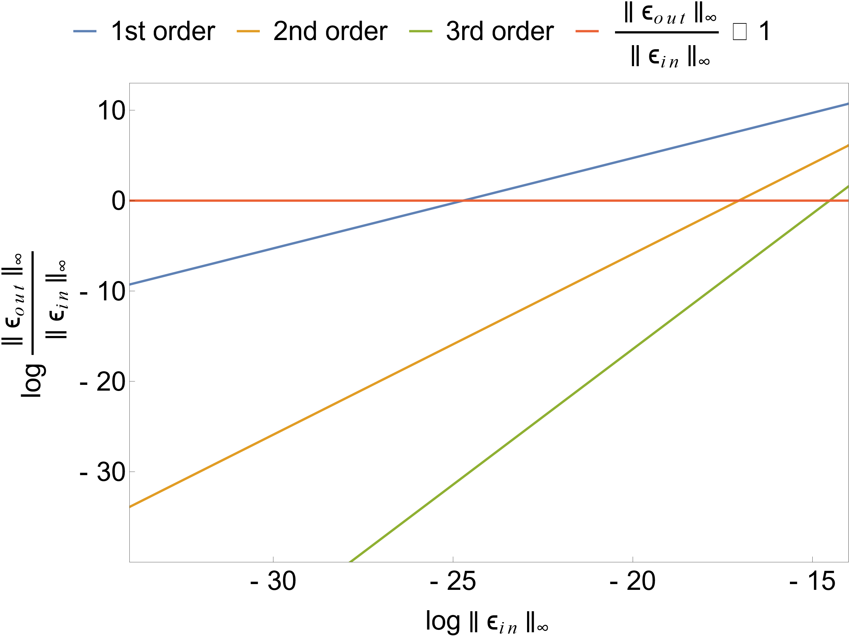
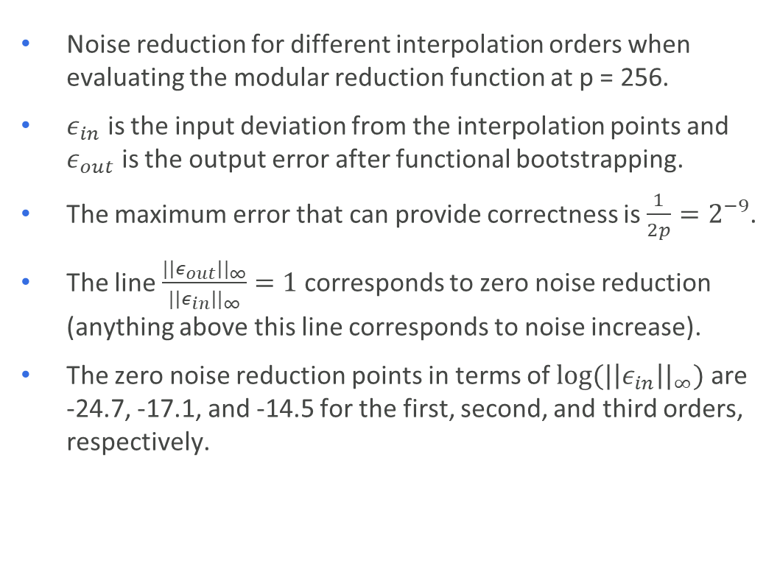
Empirical noise reduction for Trigonometric Hermite Interpolation
Noise reduction for different interpolation orders when evaluating the modular reduction function at p = 256.
$ε_{in}$ is the input deviation from the interpolation points and $ε_{out}$ is the output error after functional bootstrapping.
The maximum error that can provide correctness is $\frac{1}{2p}=2^{−9}$.
The line $\frac{{|\left|ε_{out}\right||}_{∞}}{{|\left|ε_{in}\right||}_{∞}}=1$ corresponds to zero noise reduction (anything above this line corresponds to noise increase).
The zero noise reduction points in terms of ${log⁡(|\left|ε_{in}\right||}_{∞})$ are -24.7, -17.1, and -14.5 for the first, second, and third orders, respectively.
=

Slide 29
Polynomial vs Trigonometric Hermite Interpolation
Combination with polynomial Hermite interpolations for further cleaning is possible.
What if we evaluate bootstrapping and polynomial Hermite interpolation sequentially instead of trigonometric Hermite interpolation at once?
Our analysis shows that the degree of the first approach is doubled.
Moreover, higher values of the CKKS scaling factor are needed for conventional CKKS bootstrapping.
However, polynomial Hermite interpolation are more convenient for shallower computations, which do not require bootstrapping.
  E.g., to clean Boolean outputs.
Note that special cases of polynomial Hermite interpolation were implicitly used in [CKK20, DMPS24].

Slide 30
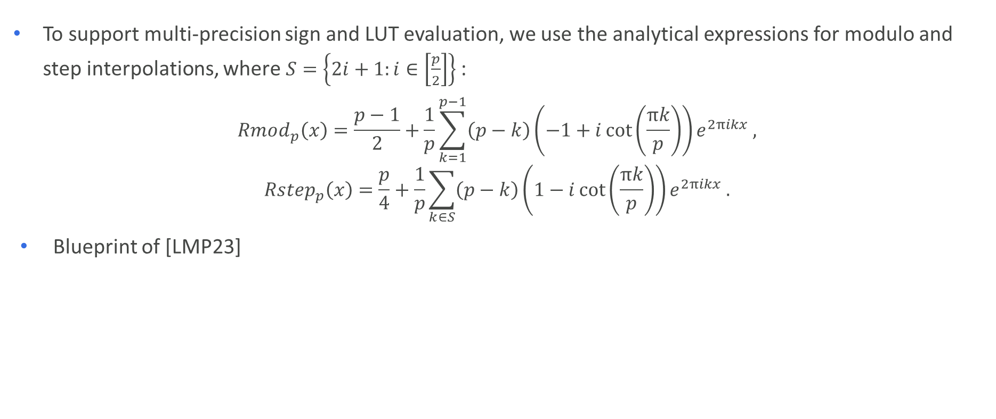
Multi-precision Sign Evaluation
To support multi-precision sign and LUT evaluation, we use the analytical expressions for modulo and step interpolations, where $S=\left\{2i+1:i∈\left[\frac{p}{2}\right]\right\}$:
$$Rmod_{p}\left(x\right)=\frac{p−1}{2}+\frac{1}{p}\sum_{k=1}^{p−1}{\left(p−k\right)\left(−1+i\cot\left(\frac{πk}{p}\right)\right)e^{2πikx}},$$
$$Rstep_{p}\left(x\right)=\frac{p}{4}+\frac{1}{p}\sum_{k∈S}{\left(p−k\right)\left(1−i\cot\left(\frac{πk}{p}\right)\right)e^{2πikx}}.$$
Blueprint of [LMP23]

