Slide 1
Additive Randomized Encodings from Public Key Encryption
Nir Bitansky, Saroja Erabelli, Rachit Garg
NYU
Notes:
Hi, I’m Saroja, and today I’m going to talk to you about Additive Randomized Encodings. This is joint work with Nir Bitansky and Rachit Garg.

Slide 2



Decoding
$$f(x_{1}, x_{2},…, x_{n})$$
I should not learn anything other than the outcome
We want to take a vote on whether the audience likes my talk
We don’t like rounds
MPC: Multiple rounds
of interaction
Audience
😞
😞
😞
🙂
🙂
🙂
Notes:
We start with the simple question where I’m giving a talk, you are the audience, and I want to know whether or not you like my talk. We would rather not do this with a public show of hands, because I’m really petty, and I’m gonna be really mad if you say you don’t like my talk. So we have an MPC scenario where I’m going to tally all the votes, and you don’t want me to learn anything other than the outcome of the vote. There are MPC protocols to do this that require multiple rounds of interaction. But I don’t like that, you don’t like that, we don’t want to sit here all day coordinating multiple rounds. And if you have ever been to any other MPC talk, you know we don’t like rounds.

Slide 3

One-Round MPC?
Decoding
$$f(x_{1}, x_{2},…, x_{n})$$
I should not learn anything other than the outcome
IMPOSSIBLE without correlated randomness
Possible with [FKN94]
🙂
🙂
🙂
I learn Charlie’s vote
YES
NO
Notes:
So the obvious question to ask is can we do this in one round? So I’m going to try to learn Charlie’s vote here. So evil me is going to choose the encodings for Alice and Bob, and then I learn Charlie’s vote. So it turns out this is impossible without correlated randomness. But I really want to find a way to do this in one round without setup, so I’m going to add a box at the front of the room. In this box, you can anonymously drop in your votes.

Slide 4
One-Round MPC with Anonymity?
Decoding
$$f(x_{1}, x_{2},…, x_{n})$$
I should not learn anything other than the outcome
NO
Change a vote
I learn that the vote was close
STILL IMPOSSIBLE
YES
YES
NO
Shuffle
🙂
🙂
🙂
Notes:
Here, we have this box as a random shuffle, and let’s say the votes are YES, YES, and NO. Evil me is going to change one of the votes to be no, and if the outcome of the vote changes, then I learn that the vote was close, so it’s still impossible in this scenario.
I’m going to make one final addition, where I allow Alice, Bob, and Charlie to input multiple slips of paper into the box.

Slide 5



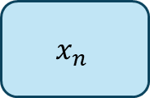


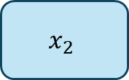

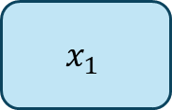





One-Round MPC with Anonymity in Multi-Message Shuffle Model?
Huh??? Which encodings do I change?
Evaluator – learns nothing beyond output
$$x_{1}^{(1)}$$
🙂
$$x_{1}$$
Shuffle
$$x_{1}^{(2)}$$
$$x_{1}^{(3)}$$
$$x_{2}^{(1)}$$
🙂
$$x_{2}$$
$$x_{2}^{(2)}$$
Decoding
$$x_{2}^{(3)}$$
.
.
.
$$f(x_{1}, x_{2},…, x_{n})$$
.
.
.
$$x_{n}^{(1)}$$
🙂
$$x_{n}$$
$$x_{n}^{(2)}$$
$$x_{n}^{(3)}$$
Shuffle Model is a popular model in differential privacy
Attack no longer applies!
Notes:
We call this setting the multi-message shuffle model. The shuffle model has become quite popular, especially in the context of differential privacy as a relaxation for the central model. In this scenario, the previous attack no longer applies because I have no idea which encodings to change anymore that correspond to a single vote.
Reference for shuffle model

Slide 6
Q: Under what assumptions does shuffle MPC exist?
Yes, unconditionally
From OWF
From PKE
From OT
From Pairings
From LWE
From iO + OWF
No, it’s impossible
Notes:
So the main question we explore in our work, is under what assumptions does shuffle MPC exist? You can take a second to think about what your guess would be. iO seems like a reasonable guess, since most things can be built from iO. LWE would be nice, since it’s post-quantum. You would think we would at least need OT, because most MPC protocols requires at least OT. But surprisingly, we show how to build this from PKE.

Slide 7
Q: Under what assumptions does shuffle MPC exist?
Yes, unconditionally
From OWF
From PKE (This work)
From OT
From Pairings
From LWE
From iO + OWF
No, it’s impossible

Slide 8
Additive Randomized Encodings (ARE)
[Halevi-Ishai-Kushilevitz-Rabin23]

Slide 9








Additive Randomized Encoding (ARE)
[Halevi-Ishai-Kushilevitz-Rabin23]
Evaluator (should only learn function output)
Trusted Addition
$$x_{1}$$
$${\hat{x}}_{1}$$
$$x_{2}$$
$${\hat{x}}_{2}$$
$${\hat{x}}_{1}+{\hat{x}}_{2}+…+{\hat{x}}_{n}$$
Decoding
.
.
.
$$f(x_{1}, x_{2},…, x_{n})$$
ARE (local encoding)
.
.
.
$$x_{n}$$
$${\hat{x}}_{n}$$
falls under the general paradigm of randomized encodings (RE) [IK00, AIK06] and multi-party RE [ABT21]

Slide 10
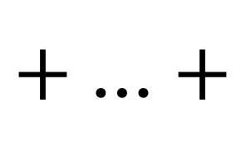
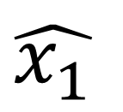

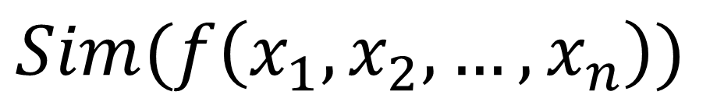

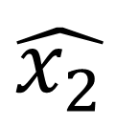
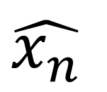
ARE Security
[Halevi-Ishai-Kushilevitz-Rabin23]
There is a PPT Sim s.t.
$$\hat{x_{1}}$$
$$+$$
$$\hat{x_{2}}$$
$+$ …$+$
$$\hat{x_{n}}$$
$$≈_{c}$$
$$Sim(f\left(x_{1},x_{2}, …, x_{n}\right))$$
Note: we assume the evaluator does not collude with the parties
Note: There also exists a stronger notion of robust ARE which requires security against insiders, but for general functions is equivalent to obfuscation
Notes:
To more formally define security, this means that there is a PPT simulator that can simulate the sum of the encodings given only the function output. One thing I want to point out here is that we assume that the evaluator does not collude with the parties. You can also define a stronger notion of ARE, known as robust ARE, which requires security against insiders, but we do not look at this setting in this work.

Slide 11

From ARE to Shuffle MPC
Addition can be realized in shuffle model [IKOS06]
Corollary: ARE for $f$ → shuffle MPC for $f$ [HIKR23]
Notes:
How does ARE relate to MPC in the shuffle model? It turns out from a result by Ishai, Kushilevitz, Ostrovsky, and Sahai, that addition can be implemented in the shuffle model. So this implies that if we can build ARE for a function f, then we can get non-interactive MPC in the shuffle model with no setup.

Slide 12

Q: Under what assumptions does ARE exist?
Previous work
ARE for all $f$
  under the Decision Squaring XDH assumption based on pairings [HIKR23]
Notes:
The question we asked before of under what conditions does shuffle MPC exist reduces to the question of under what assumptions do additive randomized encodings exist? Previously in HIKR, they showed that ARE exists under the Decision Squaring XDH based on pairings.

Slide 13

Our Main Result
ARE for all $f$
  assuming Public Key Encryption.
  A more efficient construction under the Computational Diffie Hellman (CDH) Assumption.
Notes:
Our main result is a construction generically from Public Key Encryption, and we also have a more efficient construction under CDH.

Slide 14
Construction of ARE from Public Key Encryption

Slide 15
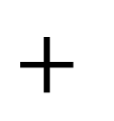
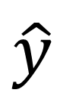
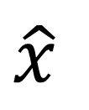
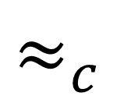
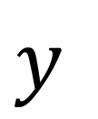
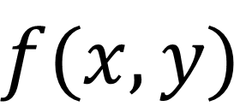
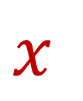
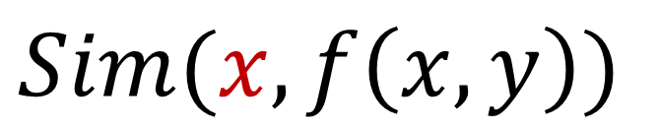
Main Enabler: One-Sided 2-Party ARE (OSARE)
$$x$$
leaks
$$y$$
$$\hat{x}$$
$$+$$
$$\hat{y}$$
$$≈_{c}$$
$$Sim(x,f\left(x,y\right))$$
$$f(x,y)$$
Notes:
The main insight of our construction is defining the notion of one-sided ARE. Where we relax the security definition to allow the sum of the encodings to leak party 1’s input.

Slide 16

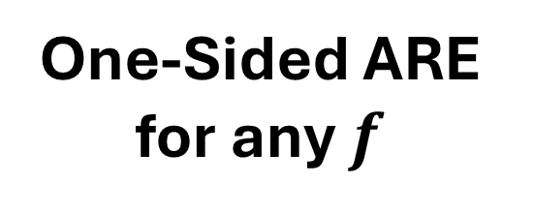
ARE from OSARE?
Techniques from HIKR23
One-Sided ARE
for any $f$
ARE
for any $f$
?
Notes:
So it turns out to be straightforward to construct one-sided ARE for any function using techniques from HIKR. So the main question of our work is can we lift one-sided ARE to full-fledged two-sided ARE?

Slide 17
ARE from OSARE?
Techniques from HIKR23
One-Sided ARE
for any $f$
ARE
for any $f$
PKE
Notes:
And it turns out we can do this with public key encryption.

Slide 18

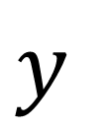
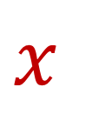
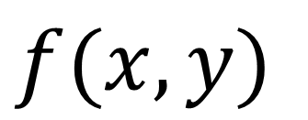
STARE at
OSARE
$$x$$
leaks
$$y$$
$$+$$
$$f(x,y)$$
Notes:
How do we do this? We start with a one-sided ARE. And then the most crucial step is that we st-ARE at it. OK you maybe argue that this is not the most crucial step, but in any case, what we get from staring at it is. The most obvious way to stop something from leaking is to encrypt it!

Slide 19
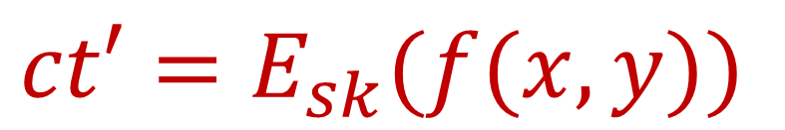
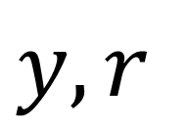
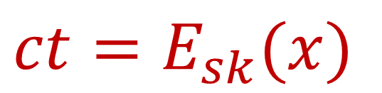
Encrypt $x$, Compute Homomorphically…
$$ct=E_{sk}(x)$$
$$y,r$$
leaks
$$ct′=E_{sk}(f(x,y))$$
Problem: can’t decrypt…
Notes:
And to compute a function output on an encrypted input, we try using FHE to compute f homomorphically

Slide 20
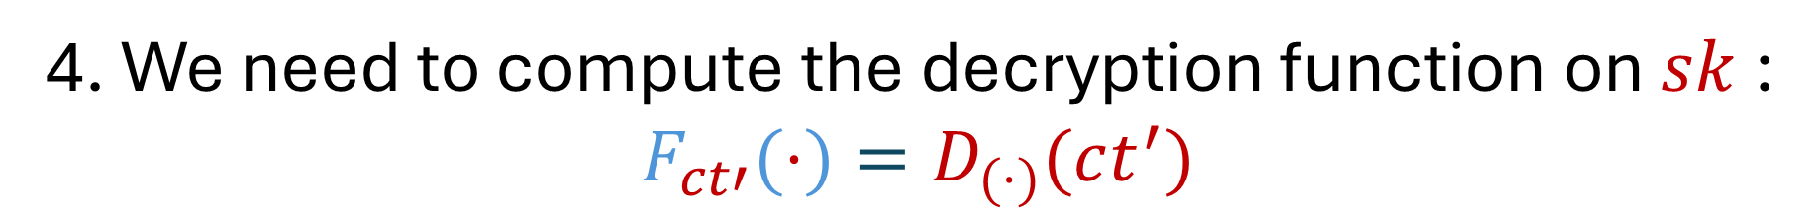
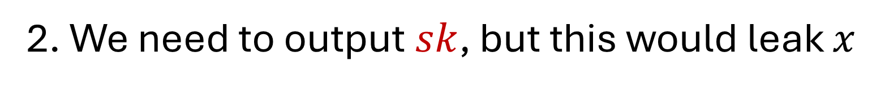
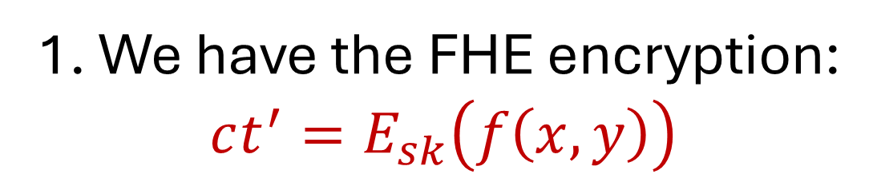
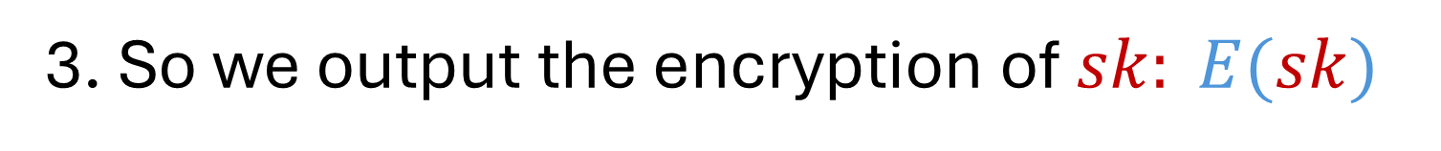
homomorphic encryption
1. We have the FHE encryption:
$$ct^{′}=E_{sk}\left(f\left(x,y\right)\right)$$
2. We need to output $sk$, but this would leak $x$
3. So we output the encryption of $sk: E(sk)$
4. We need to compute the decryption function on $sk$:
$$F_{ct′}(⋅)=D_{(⋅)}(ct^{′})$$

Slide 21
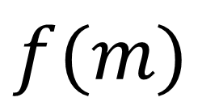
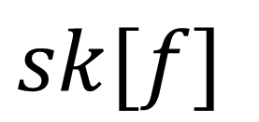
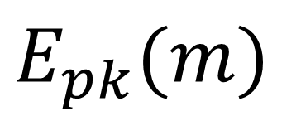
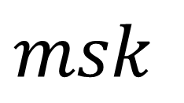
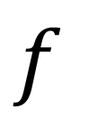
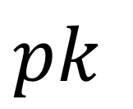
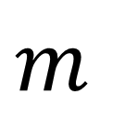
Public-Key Functional Encryption (weakest version)
Boneh-Sahai-Waters, O’Neill
$$pk$$
$$msk$$
$$m$$
$$f$$
$$E_{pk}(m)$$
$$sk[f]$$
$$f(m)$$

Slide 22
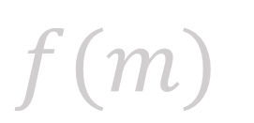


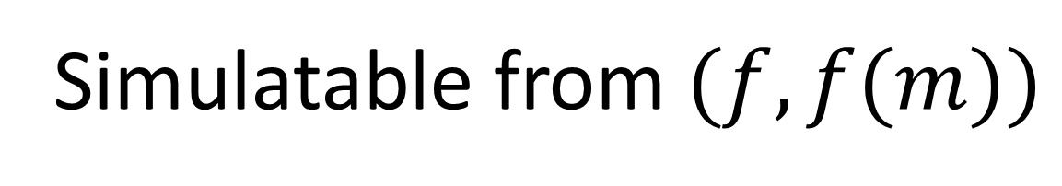

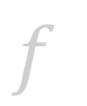

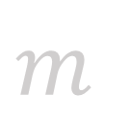
Public-Key Functional Encryption (weakest version)
$$pk$$
$$msk$$
$$m$$
$$f$$
$$E_{pk}(m)$$
$$sk[f]$$
Simulatable from $(f,f(m))$
$$f(m)$$
Follows from public-key encryption
Sahai-Seyalioglu10

Slide 23
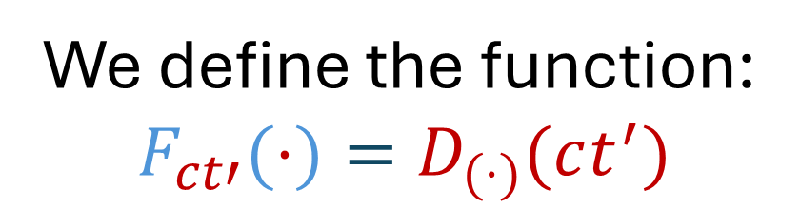
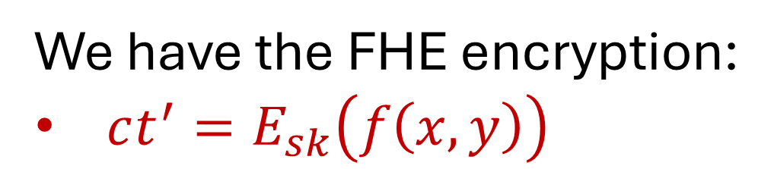
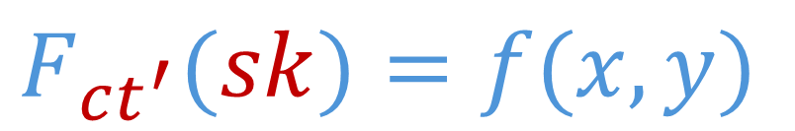
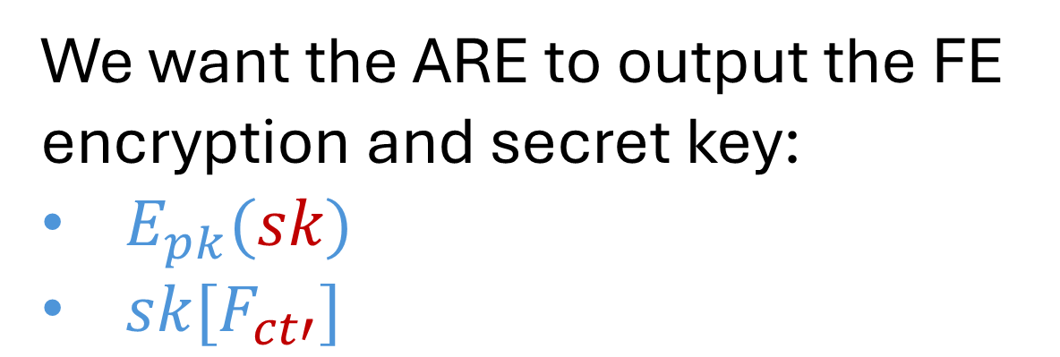
Combine FHE and FE
homomorphic encryption
functional encryption
We have the FHE encryption:
$ct^{′}=E_{sk}\left(f\left(x,y\right)\right)$
We define the function:
$$F_{ct′}(⋅)=D_{(⋅)}(ct^{′})$$
$$F_{ct^{′}}(sk)=f(x,y)$$
We want the ARE to output the FE encryption and secret key:
$E_{pk}(sk)$
$sk[F_{ct′}]$

Slide 24
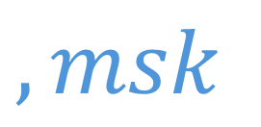
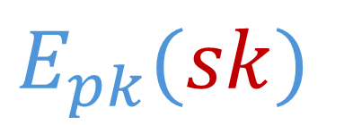
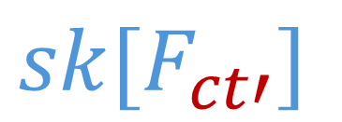




Derive Function Key
homomorphic encryption
functional encryption
$$ct=E_{sk}(x)$$
$$y,r$$
$$, msk$$
1. Compute the FHE encryption:
$$ct^{′}=E_{sk}\left(f\left(x,y\right)\right)$$
2. Compute function secret key for $F_{ct′}$
$$sk[F_{ct′}]$$
Missing:
$$E_{pk}(sk)$$

Slide 25






Attempt 1
homomorphic encryption
functional encryption
$$ct=E_{sk}\left(x\right)$$
$$, sk$$
$$y,r$$
$$, msk, pk$$
$$Problem:sk leaks$$
$$sk[F_{ct^{′}}],$$
$$E_{pk}(sk)$$

Slide 26








Solution: Reverse OSARE
homomorphic encryption
functional encryption
Alice
Bob
Alice
Bob
$${ct=E}_{sk}(x)$$
leaks
$$y,r$$
$$, msk$$
$$sk,r′$$
$$pk$$
leaks
Observe: In the first OSARE, only $ct$ and $ct′$ are leaked
$$sk[F_{ct′}]$$
$$E_{pk}(sk)$$

Slide 27








Do we need FHE?
Only $ct$ and $ct′$ are leaked
$$x$$
$$y$$
$$ct$$
$$Alice$$
$$Bob$$
$$ct′$$
$$f(x,y)$$
Only need security against external observer
Don’t need compactness…

Slide 28


Actually Just PKE…
$$x$$
$$y$$
$$pk$$
$$Alice$$
$$Bob$$
$$E_{pk}(y)$$
$$f(x,y)$$
Only need security against external observer
Don’t need compactness…

Slide 29








Final ARE
public-key encryption
functional encryption
Alice
Bob
Alice
Bob
$pk$ leaks
$$y,r$$
$$, msk$$
$$x ,sk,r^{′}$$
$pk$ leaks
$$ct=E_{pk}\left(y\right)$$
$F_{ct}(⋅,⋅)=f(⋅,D_{(⋅)}(ct)$ $)$
$$sk[F_{ct}]$$
$$E_{pk}(x,sk)$$

Slide 30
End of Construction

Slide 31

Subsequent Work
[Bitansky-Erabelli-Garg-Ishai25]
ARE for all $f$
  information theoretically with negligible correctness and security errors
  Follows similar “leaky ARE” paradigm
  PKE construction still has one advantage – perfect correctness
Notes:
I would also like to highlight a recent result constructing statistically secure ARE for all functions. Initially, we set out to construct ARE from some post-quantum assumption, and we were very surprised to get a construction generically from PKE. And even more surprising, is our recent result that you can do this information theoretically. Especially since in HIKR23, they strongly conjecture that statistically secure ARE for all functions does not exist.

Slide 32
Open Questions
  Does every function have a perfectly correct, statistically secure ARE?
    [BEGI25] does not have perfect correctness.
  Do finite domain functions have robust ARE from assumptions << iO?
    Robust ARE requires security against insiders.
    [HIKR23] Efficient robust ARE for all functions implies obfuscation.
    [Bitansky-Freizeit24] constructs robust ARE from iO + LWE/DDH.

Slide 33
Thank you!

Slide 34
Appendix

Slide 35


ARE from PKE
OSARE
for Equality
free
Garbling [HIKR23]
ARE
for any $f$
OSARE
for any $f$
PKE

Slide 36








One-Sided ARE for Equality
Domain: $\{1, 2, 3\}$
Alice: $i=2$
leaks
$$\hat{i}=(u_{1}, 0, u_{3})$$
$u_{1},u_{3}$ randomly sampled from nonzero values of $G$
$$+$$
Bob: $j=2$
$$\hat{j}=(0, v, 0)$$
$v$randomly sampled from nonzero values of $G$
$$(u_{1}, {v, u}_{3})$$
eq $=\left\{\begin{aligned}equal if all entries are nonzero \\ notequal otherwise\end{aligned}\right.$

Slide 37



One-Sided ARE for Equality
Domain: $\{1, 2, 3\}$
Alice: $i=1$
leaks
$$\hat{i}=(0, u_{2}, u_{3})$$
$u_{2},u_{3}$ randomly sampled from nonzero values of $G$
$$+$$
Bob: $j=2$
$$\hat{j}=(0, v, 0)$$
$v$randomly sampled from nonzero values of $G$
$$(0, {u_{2}+v, u}_{3})$$
eq $=\left\{\begin{aligned}equal if all entries are nonzero \\ notequal otherwise\end{aligned}\right.$

Slide 38


ARE from PKE
OSARE
for Equality
free
Garbling [HIKR23]
ARE
for any $f$
OSARE
for any $f$
PKE

Slide 39






From Equality to Small Functions $f$
[Halevi, Ishai, Kushilevitz, Rabin 2023]
All $y_{i}$ such that $f\left(x, y_{i}\right)=1$
$$x$$
$$\hat{x}=(y_{1}, y_{2},…, y_{k})$$
EQ
$$y$$
$$\hat{y}=(y, y,…, …,y)$$
$f(x, y)$ $=\left\{\begin{aligned}1 if some entry is equal \\ 0 otherwise\end{aligned}\right.$

Slide 40






From Equality to Small Functions $f$
[Halevi, Ishai, Kushilevitz, Rabin 2023]
Padded with $a$ and randomly rotated
All $y_{i}$ such that $f\left(x, y_{i}\right)=1$
$$x$$
$$\hat{x}=({a, …, a, y}_{1}, y_{2},…, y_{k},a, …, a)$$
EQ
$$y$$
$$\hat{y}=(y, …,y,y,y, …,y, y…,y)$$
$f(x, y)$ $=\left\{\begin{aligned}1 if some entry is equal \\ 0 otherwise\end{aligned}\right.$

Slide 41






From Small Functions to Any Efficient Function
[Halevi, Ishai, Kushilevitz, Rabin 2023]
Alice
Bob
$$x$$
OT wires $w_{i, b}$
Garbled circuit $C_{y}$
OT
OT wires $w_{i, x_{i}}$
Garbled circuit $C_{y}$
$$f(x, y)$$

