Slide 1


Succinct PPRFs via
Memory-Tight Reductions
Joël Alwen, AWS Wickr
Chris Brzuska, Aalto University
Jérôme Govinden, TU Darmstadt
Patrick Harasser, TU Darmstadt
Stefano Tessaro, University of Washington

Slide 2
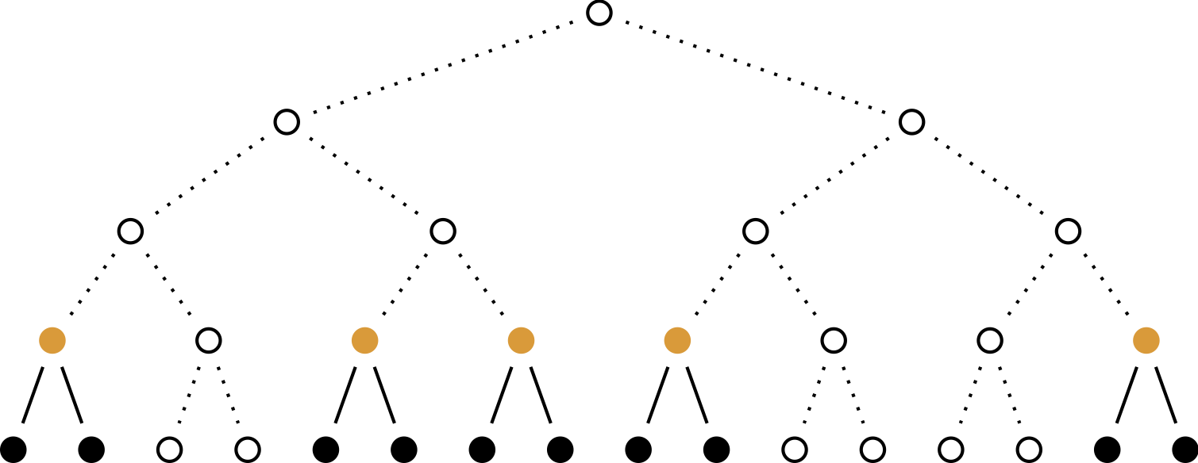
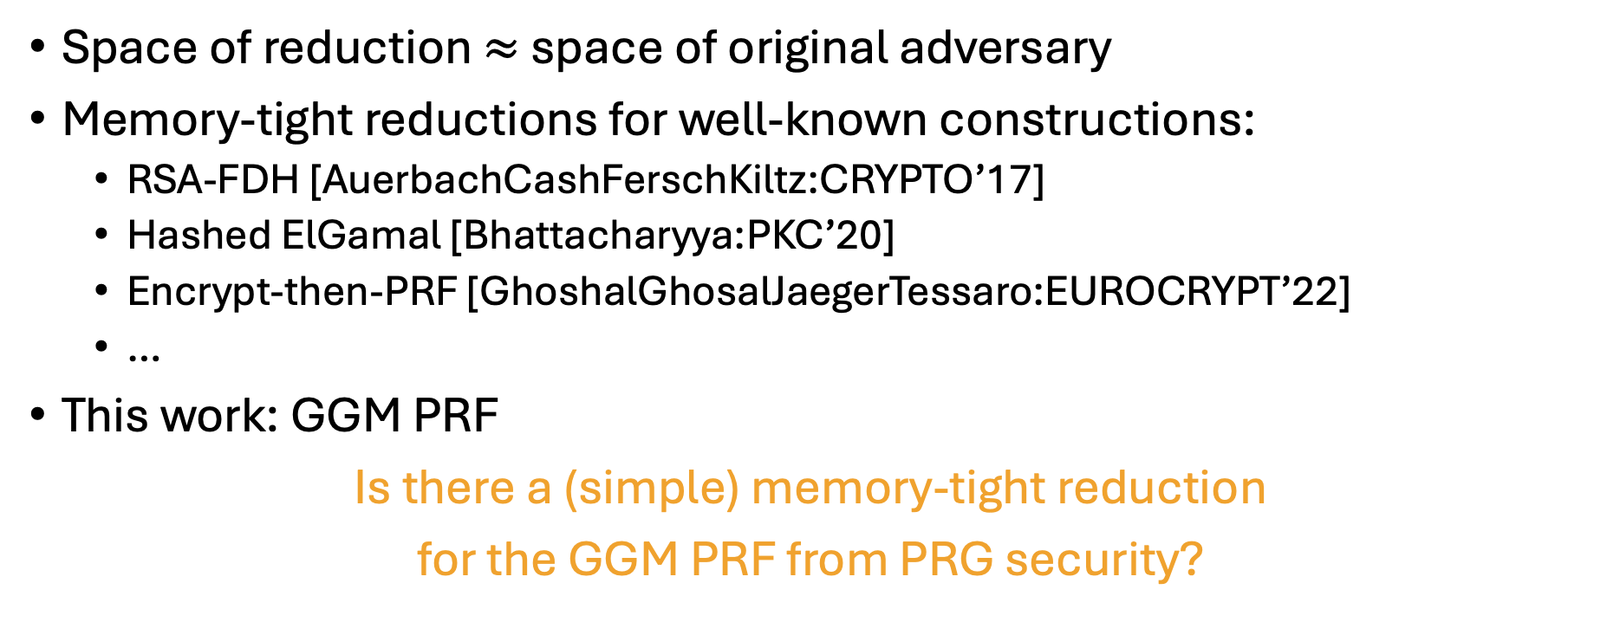
Memory-Tight Reductions
[AuerbachCashFerschKiltz:CRYPTO’17]
Space of reduction $≈$ space of original adversary
Memory-tight reductions for well-known constructions:
  RSA-FDH [AuerbachCashFerschKiltz:CRYPTO’17]
  Hashed ElGamal [Bhattacharyya:PKC’20]
  Encrypt-then-PRF [GhoshalGhosalJaegerTessaro:EUROCRYPT’22]
  …
This work: GGM PRF
Is there a (simple) memory-tight reduction
for the GGM PRF from PRG security?

Slide 3


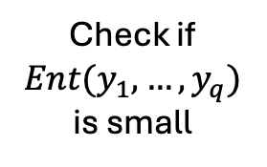


No Memory-Tight Reduction for the GGM PRF
A
PRF
R
PRG
Is there a (simple) memory-tight reduction
for the GGM PRF from PRG security
for adversaries that do not repeat queries?
$$1, …, q$$
$$y_{1}, …, y_{q}$$
Check =
$$1, …, q$$
$${\overline{y}}_{1}, …, {\overline{y}}_{q}$$
Check if
$$Ent(y_{1},…,y_{q})$$
is small
Small!

Slide 4















For Non-Repeating Adversaries: Yes!
random
$$i+1$$
$$i+2$$
$$q$$
$$H_{i}:$$
queries
$$1$$
$$2$$
$$3$$
$$i$$
real
random
$$i+2$$
$$q$$
$$H_{i+1}:$$
queries
$$1$$
$$2$$
$$3$$
$$i$$
$$i+1$$
real

Slide 5
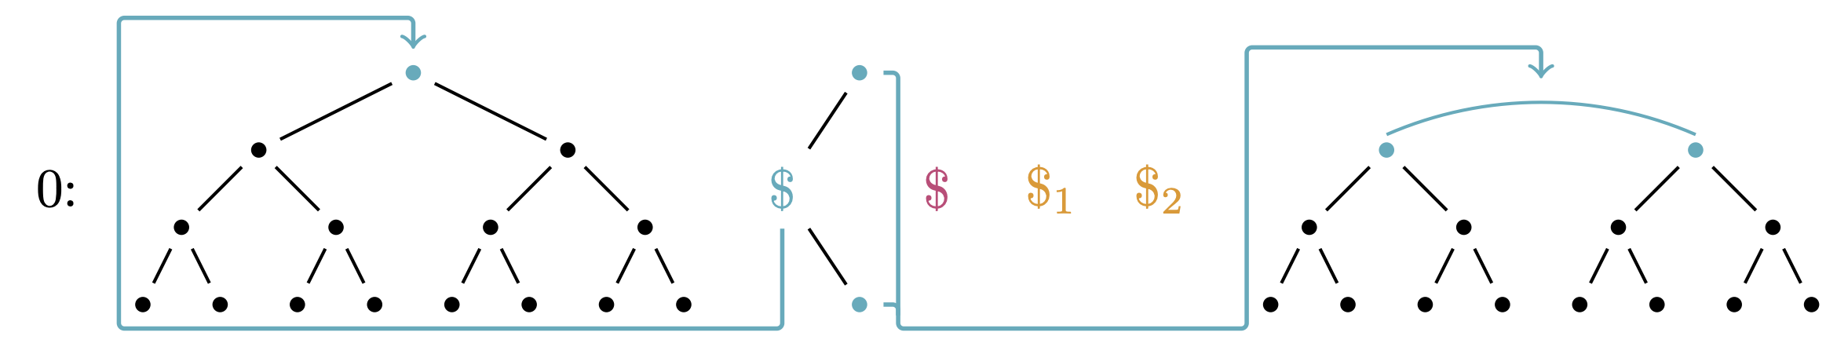
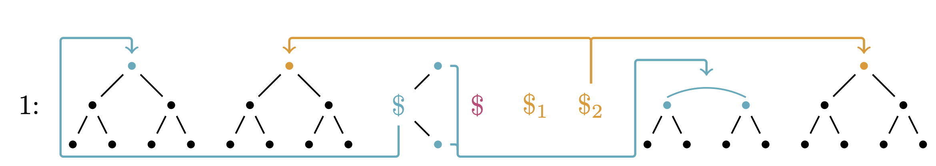
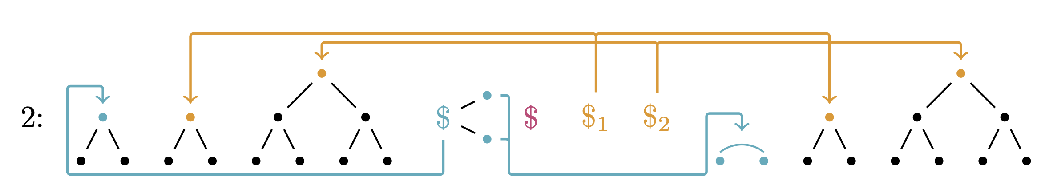
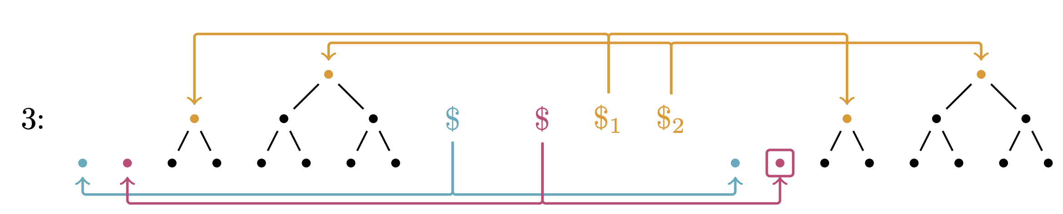

From $H_{i}$ to $H_{i+1}$
(Example GGM tree of depth 3, query $x^{∗}=001$)
(+ reverse)

Slide 6
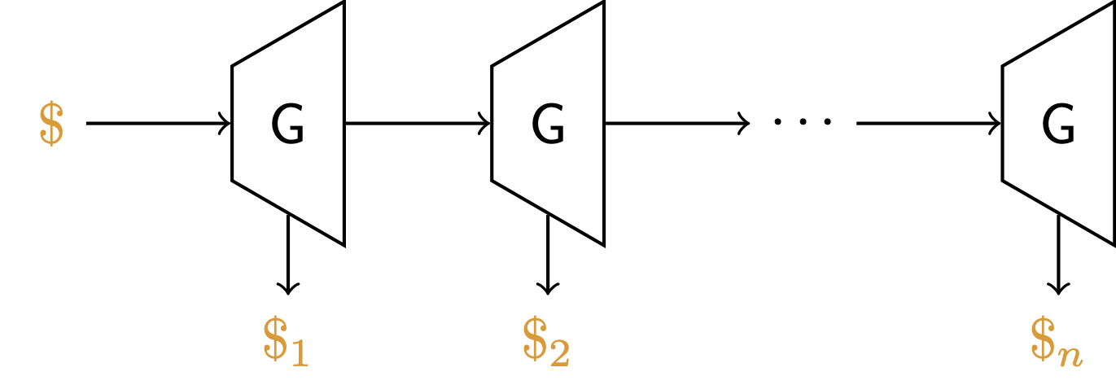
Storage Gadget
𝐺 is length-doubling PRG
Half of the output gives a value on the copath,
the other half seeds the next round

Slide 7
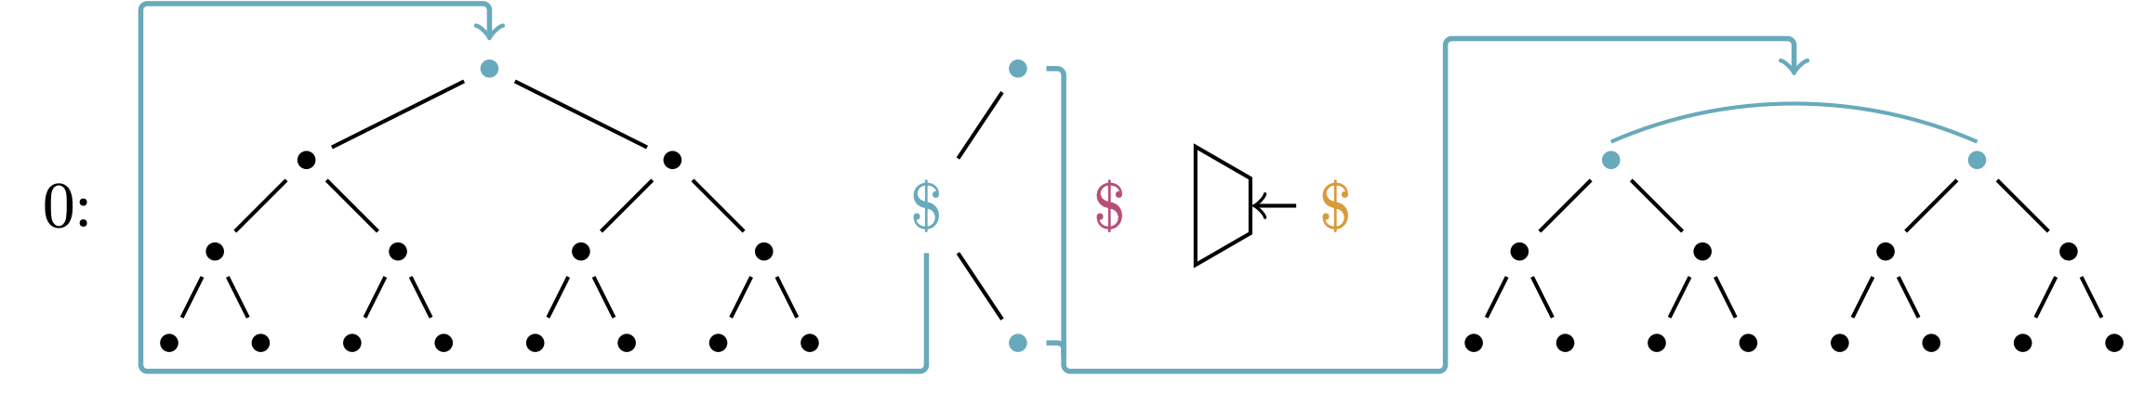
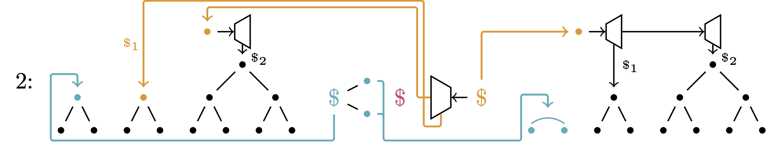
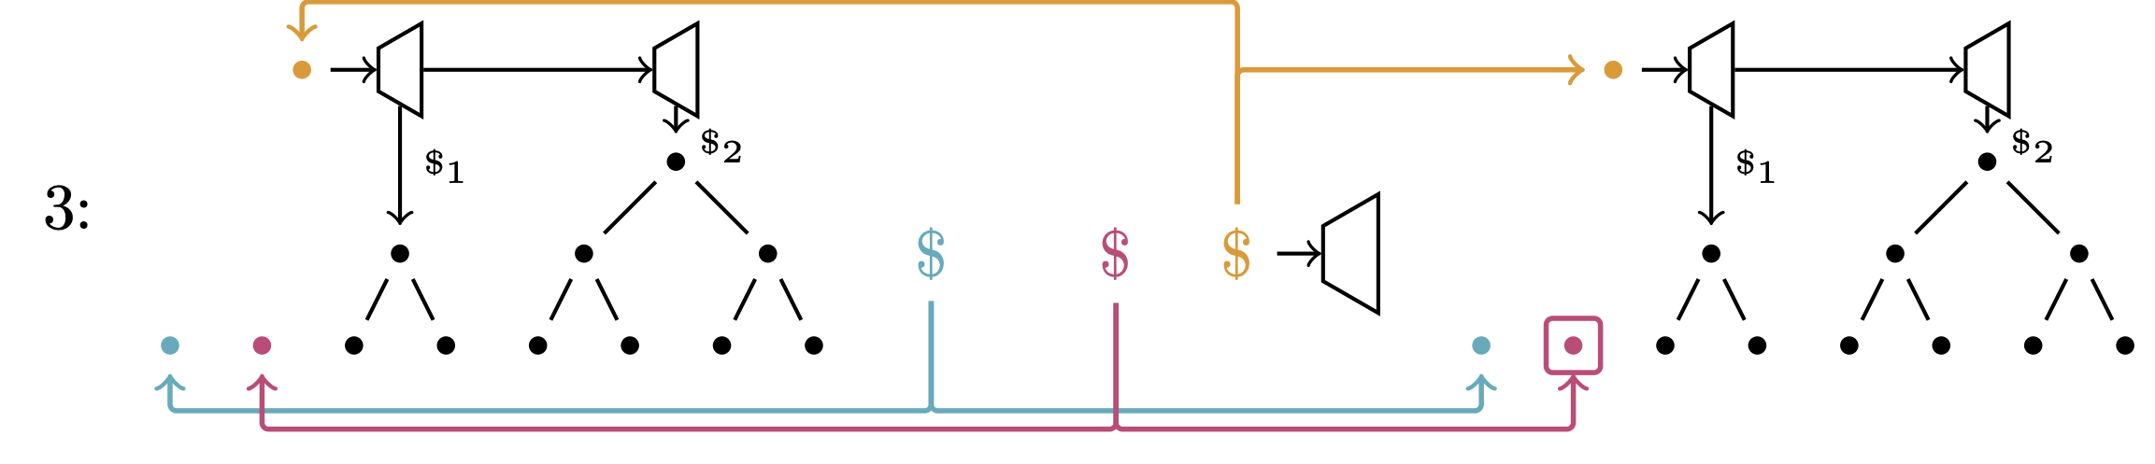
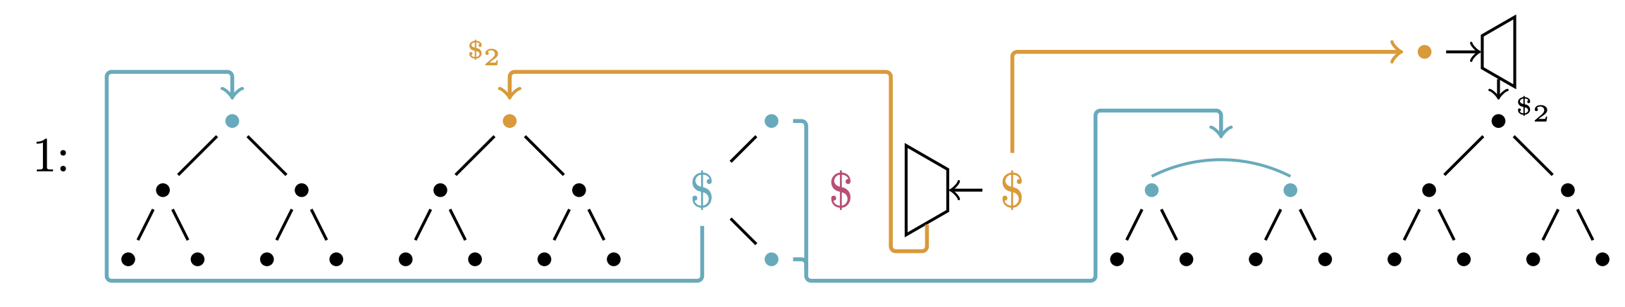

From $H_{i}$ to $H_{i+1}$ – With Storage Gadget
(+ reverse)

Slide 8
PPRFs with Relaxed Correctness (rcPPRFs)
FE
FE
Ind
Ind
Ind
FE
FE
(+ reverse)
PRF with transition from the real to punctured construction via
sequence of functional equivalence and indistinguishability steps

Slide 9
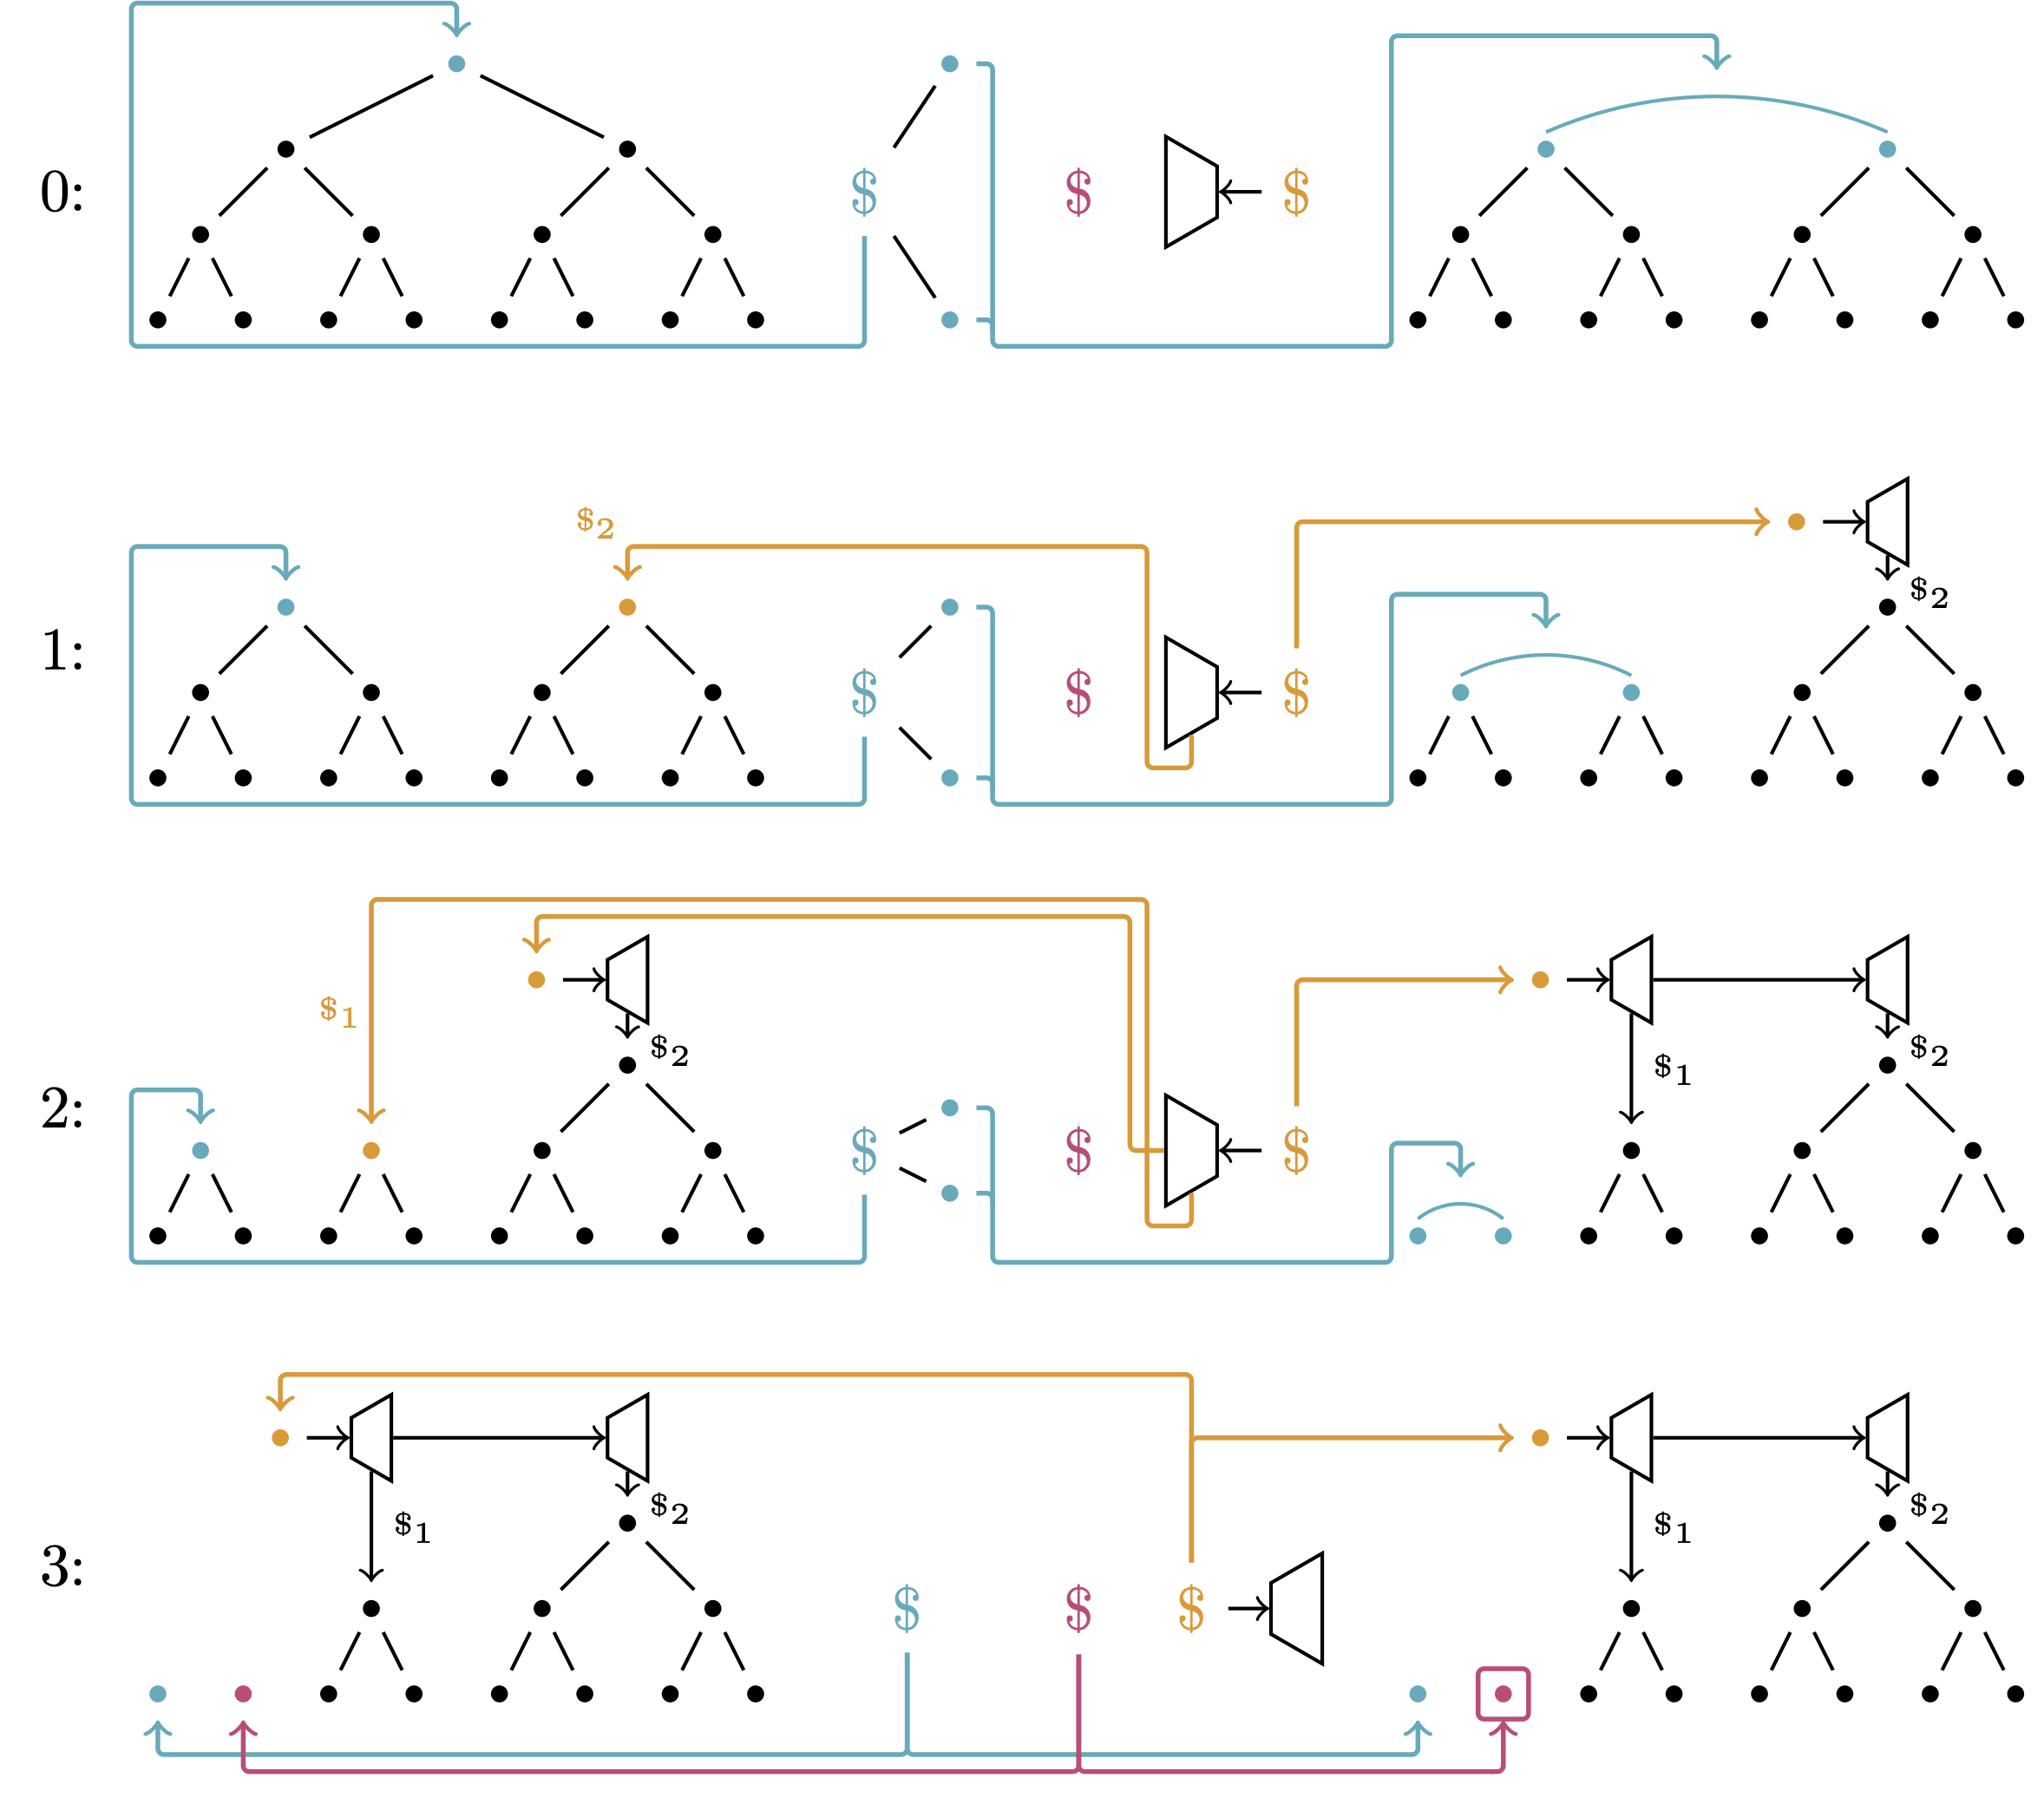
PPRFs vs. rcPPRFs
 | PPRFs | rcPPRFs
Punctured key | Yes | No
# of FE and Ind steps | One each | Many
FE | Yes | No
FE and pseudorandomness | Defined separately | Defined jointly
(+ reverse)

Slide 10
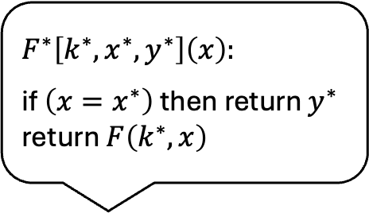
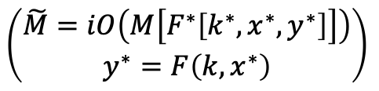
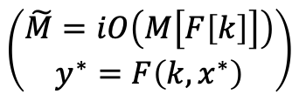
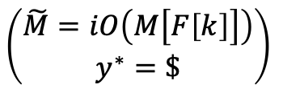
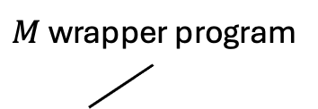
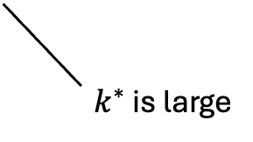
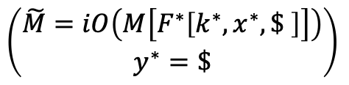

(rc)PPRFs and iO
The Punctured Program Technique [SahaiWaters: STOC’14]
Programs
are small
(for SPPRFs)
$$F^{∗}\left[k^{∗},x^{∗},y^{∗}\right]\left(x\right):$$
if $\left(x=x^{∗}\right)$ then return $y^{∗}$
return $F\left(k^{∗},x\right)$
$M$ wrapper program
(+ reverse)
iO
$$k$$
PPRF
$$k$$
M
$$\left(\begin{aligned}\tilde{M}=iO\left(M\left[F\left[k\right]\right]\right) \\ y^{∗}=F\left(k, x^{∗}\right)\end{aligned}\right)$$
$$\left(\begin{aligned}\tilde{M}=iO\left(M\left[F^{∗}\left[k^{∗},x^{∗},y^{∗}\right]\right]\right) \\ y^{∗}=F\left(k, x^{∗}\right)\end{aligned}\right)$$
$$\left(\begin{aligned}\tilde{M}=iO\left(M\left[F^{∗}\left[k^{∗},x^{∗},\$ \right]\right]\right) \\ y^{∗}=\$\end{aligned}\right)$$
$$\left(\begin{aligned}\tilde{M}=iO\left(M\left[F\left[k\right]\right]\right) \\ y^{∗}=\$\end{aligned}\right)$$
$k^{∗}$ is large
Takeaway, for SPPRFs: - Punctured program technique still works
Takeaway, for SPPRFs: - No large punctured keys → Less padding

Slide 11











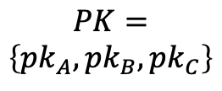






Succinct Multi-Party NIKE
Functionality | Correctness | Security
Functionality
| Correctness
| Security
$$Der\left({sk}_{A},PK\right)→K_{A}$$
$$\left({sk}_{A}, {pk}_{A}\right)$$
$${∀i ∀j : K}_{i}=K_{j}$$
$$K≈\$$$
$${pk}_{A}, {pk}_{B}$$
$${pk}_{A}, {pk}_{C}$$
$$PK=$$
$$\left\{{pk}_{A},{pk}_{B},{pk}_{C}\right\}$$
$${pk}_{B}, {pk}_{C}$$
$$PK$$
$$PK$$
$$\left({sk}_{B}, {pk}_{B}\right)$$
$$\left({sk}_{C}, {pk}_{C}\right)$$
$$Der\left({sk}_{B},PK\right)→K_{B}$$
$$Der\left({sk}_{C},PK\right)→K_{C}$$

Slide 12










Construction
Inspired by [BonehZhandry:CRYPTO’14]
$$KGen():$$
$$Der\left(sk,PK\right):$$
$$k,sk↞\$$$
return $iO\left(M\left[F\left[k\right]\right]\right)\left(sk,PK\right)$
$$pk←\left(G\left(sk\right),iO\left(M\left[F\left[k\right]\right]\right)\right)$$
(The one with
the smallest first coordinate)
$$M\left[F\left[k\right]\right]\left(sk,PK\right):$$
$$Der\left({sk}_{A},PK\right)→K_{A}$$
$$\left({sk}_{A}, {pk}_{A}\right)$$
if $\left(G\left(sk\right),∙\right)∈PK$ then $return F\left[k\right]\left(PK\right)$
return $⊥$

Slide 13
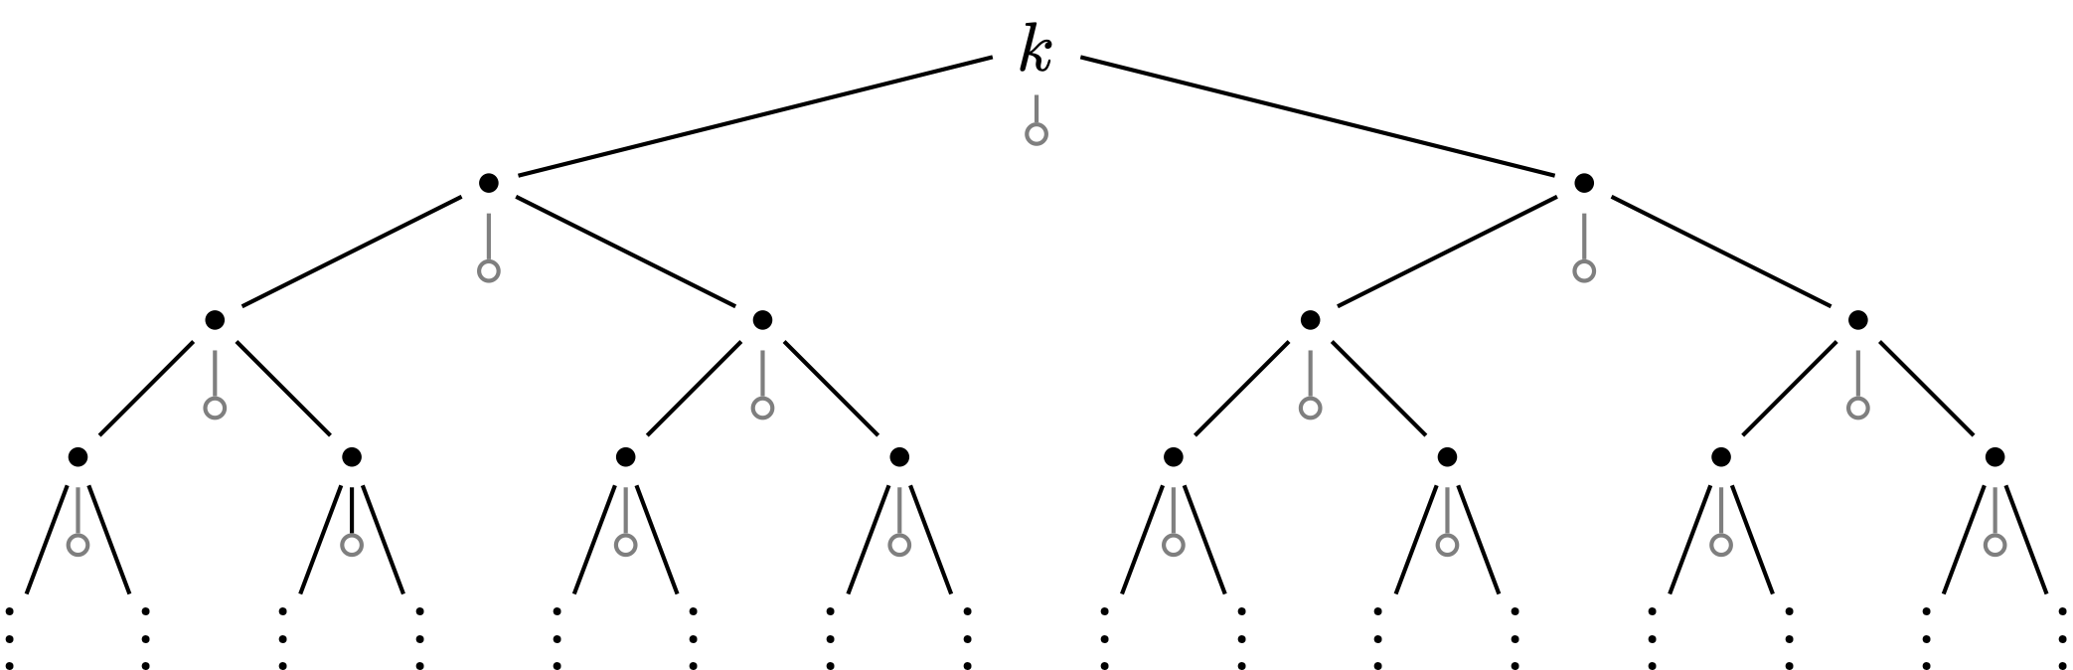
Challenges in the Proof
Need SPPRF with arbitrary input length
  Use ternary GGM, based on length-tripling PRG
  Ternary GGM is an SPPRF, using more complex storage gadget
Use input-succinct iO for Turing machines [JainJin:FOCS’22],
which requires special functional equivalence proofs
  Patch punctured programs technique with range-disjoint PRGs

Slide 14

Summary
A
R
PRG
Explore memory-tight reductions
for the GGM PRF
Introduce rcPPRFs and SPPRFs
Use SPPRFs + iO to obtain
succinct MNIKE
Thank you!
$$PK$$
(+ reverse)

