Slide 1
Quantum One-Time Protection of any Randomized Algorithm
Sam Gunn*† and Ramis Movassagh*
*Google Quantum
†UC Berkeley

Slide 2






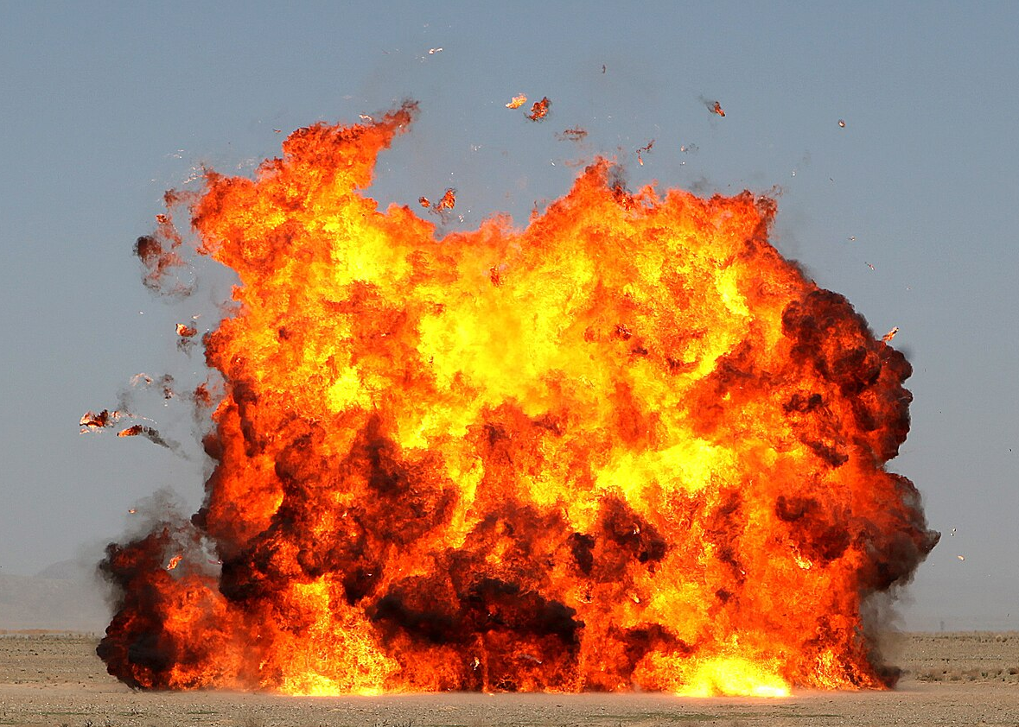
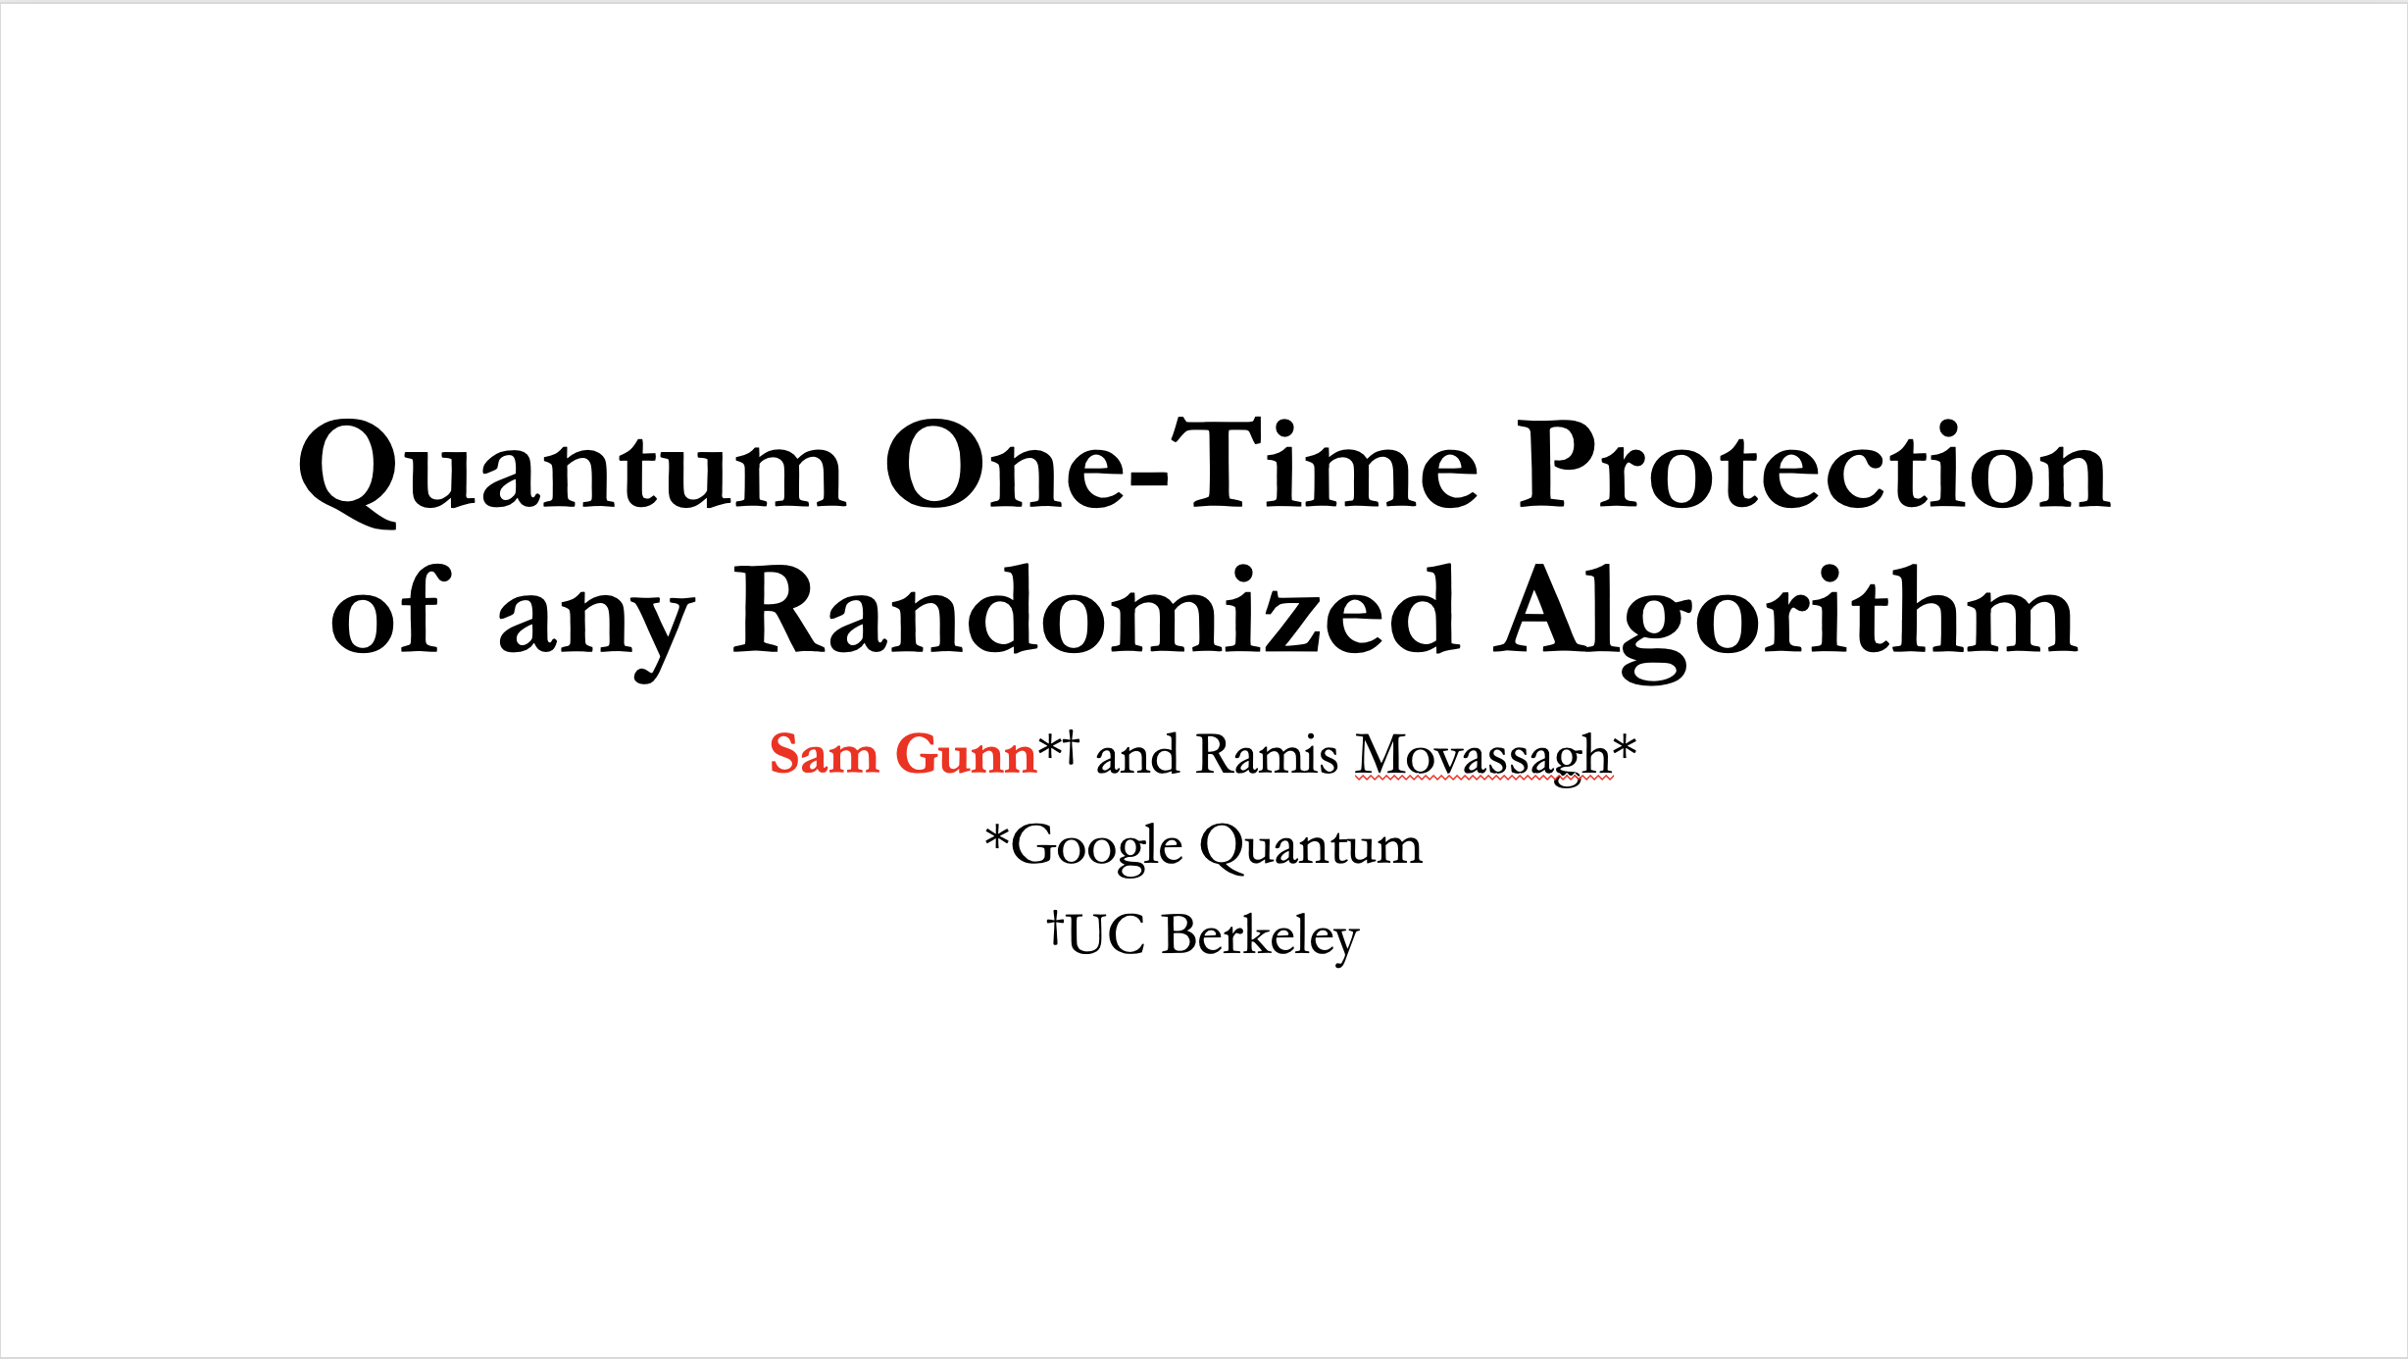
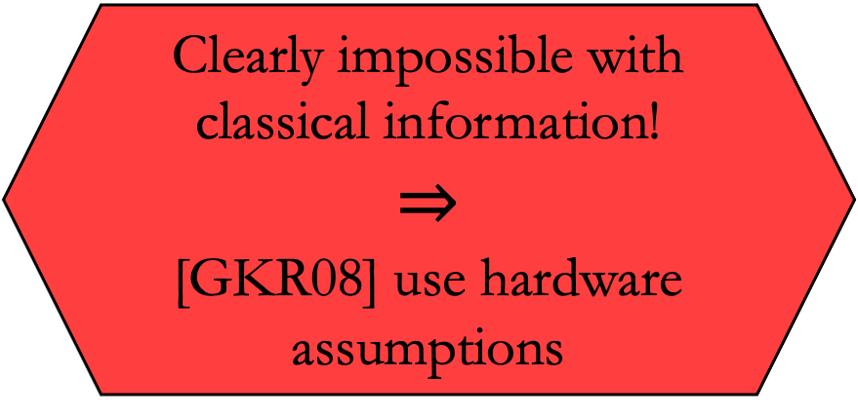
One-time programs [GKR08]
“Give me slides for my talk at Crypto”
Clearly impossible with classical information!
$$⇒$$
[GKR08] use hardware assumptions

Slide 3
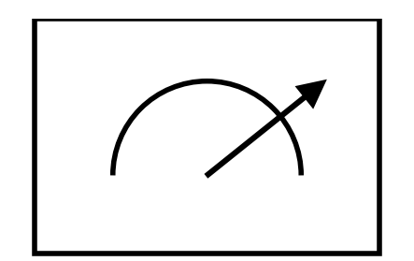








Quantum one-time programs [BGS13]
General one-time protection (even of classical functions) is still impossible in a quantum world!
$$f(x)$$
$$U$$
$$U^{†}$$
$$x$$
$$x$$
$$|ψ⟩$$
$$|ψ⟩$$
But what if $f$ is randomized?

Slide 4
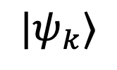
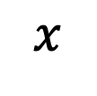



One-time authentication [BS23]
$$|ψ_{k}⟩$$
$$|ψ_{k}⟩$$
$$x$$
$${ver}_{k}(x,sign_{k}(x))$$
$$sign_{k}(x)$$
Alice can only sign as many messages as she has tokens.
Verification may require a secret key.

Slide 5
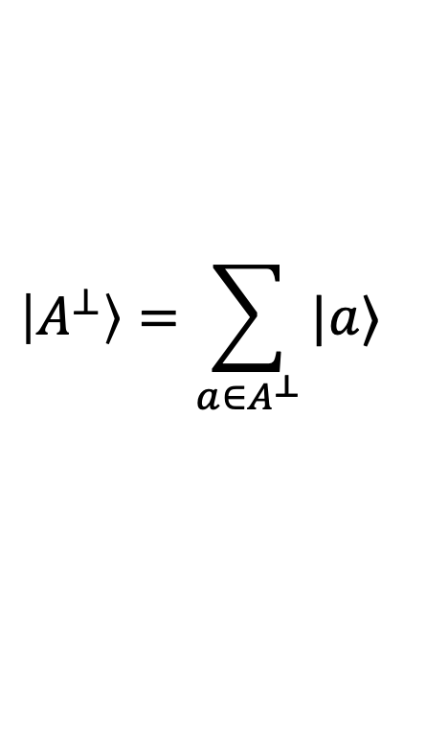
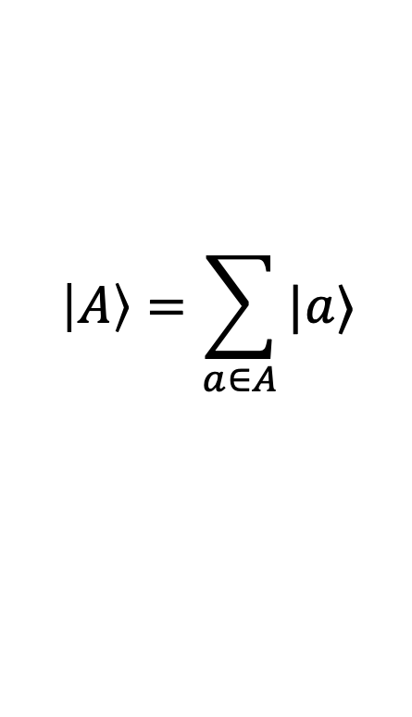
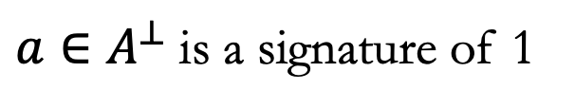
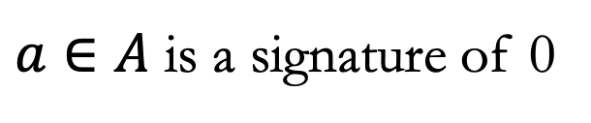
One-time authentication example [BS23]
$$\left|A\right\rangle =\sum_{a∈A}{|a⟩}$$
Hadamard
$$\left|A^{⊥}\right\rangle =\sum_{a∈A^{⊥}}{|a⟩}$$
The token:
$a∈A$ is a signature of 0
$a∈A^{⊥}$ is a signature of 1

Slide 6
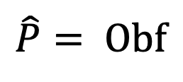
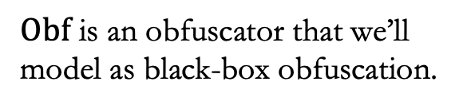
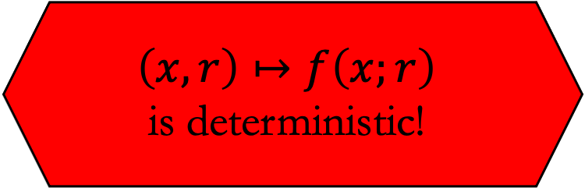
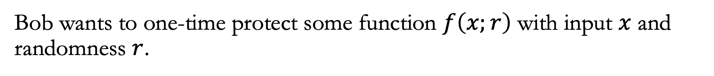
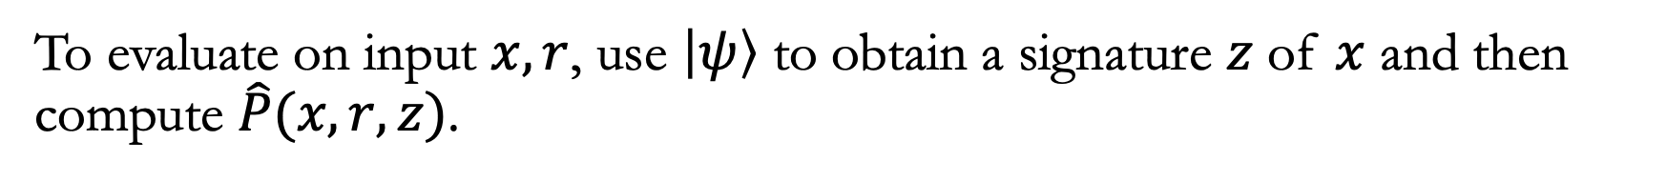
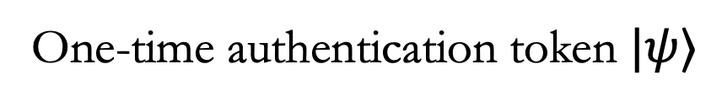
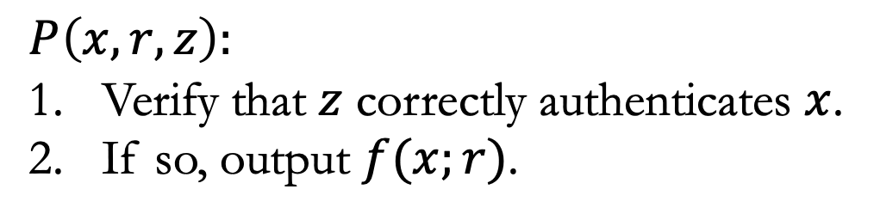
Attempted construction?
Bob wants to one-time protect some function $f\left(x;r\right)$ with input $x$ and randomness $r$.
$Obf$ is an obfuscator that we’ll model as black-box obfuscation.
One-time authentication token $|ψ⟩$
$$P\left(x,r, z\right):$$
Verify that $z$ correctly authenticates $x$.
If so, output $f(x;r)$.
$$\hat{P}= Obf$$
$$\left(x,r\right)↦f\left(x;r\right)$$
is deterministic!
To evaluate on input $x,r$, use $\left|ψ\right\rangle$ to obtain a signature $z$ of $x$ and then compute $\hat{P}(x, r,z)$.

Slide 7
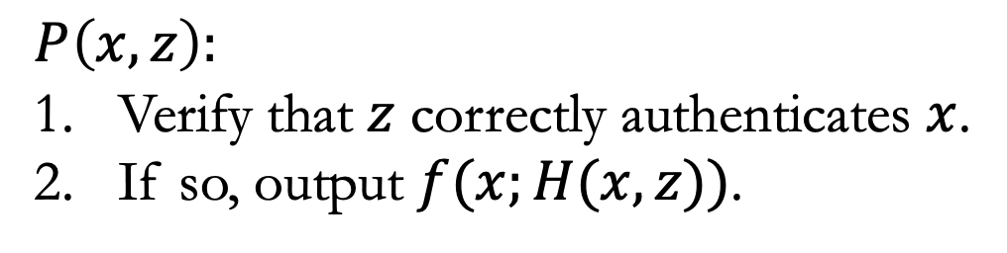
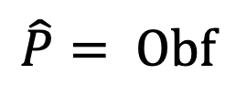
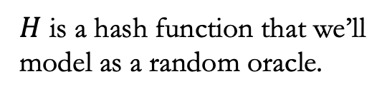
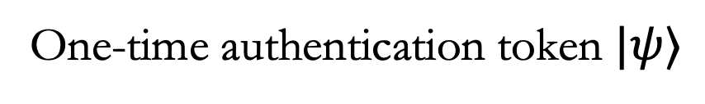
Our construction
One-time authentication token $|ψ⟩$
$$P\left(x, z\right):$$
Verify that $z$ correctly authenticates $x$.
If so, output $f(x;H(x,z))$.
$$\hat{P}= Obf$$
$H$ is a hash function that we’ll model as a random oracle.

Slide 8
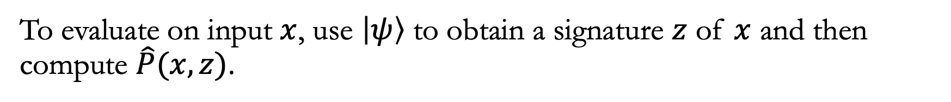
Our construction
One-time authentication token $|ψ⟩$
$$P\left(x, z\right):$$
Verify that $z$ correctly authenticates $x$.
If so, output $f(x;H(x,z))$.
$$\hat{P}= Obf$$
To evaluate on input $x$, use $\left|ψ\right\rangle$ to obtain a signature $z$ of $x$ and then compute $\hat{P}(x, z)$.

Slide 9
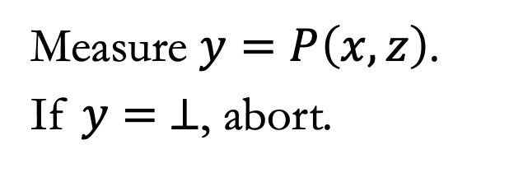
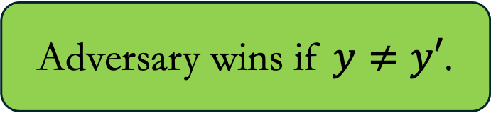




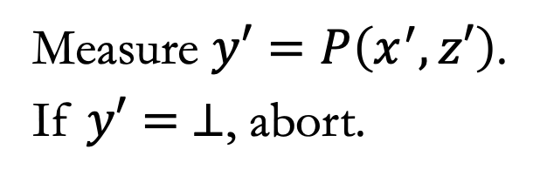
“Security” of the construction
Adversary
$$P$$
$$|ψ⟩$$
Challenger
$$x,z$$
Measure $y=P\left(x,z\right)$.
If $y= ⊥$, abort.
$$y$$
$$x^{′},z′$$
Measure $y′=P\left(x^{′},z′\right)$.
If $y′= ⊥$, abort.
Adversary wins if $y≠y′$.

Slide 10
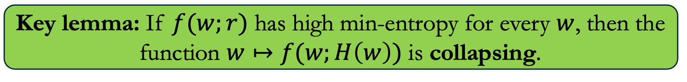
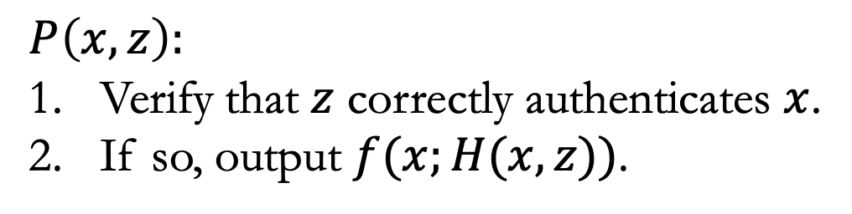
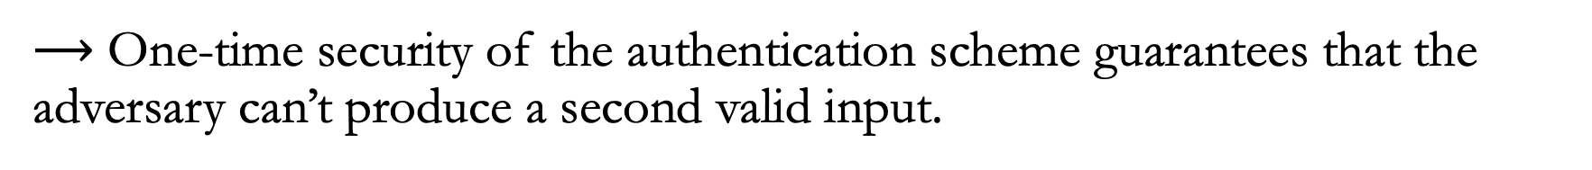
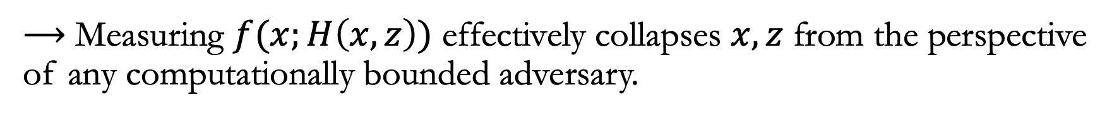
Technical result
$$P\left(x, z\right):$$
Verify that $z$ correctly authenticates $x$.
If so, output $f(x;H(x,z))$.
Key lemma: If $f(w;r)$ has high min-entropy for every $w$, then the function $w↦f(w;H\left(w\right))$ is collapsing.
$⟶$ Measuring $f(x;H\left(x,z\right))$ effectively collapses $x,z$ from the perspective of any computationally bounded adversary.
$⟶$ One-time security of the authentication scheme guarantees that the adversary can’t produce a second valid input.

Slide 11
Features of the construction
Quantum requirements are independent of the program being protected!
  In fact, all that is needed is preparation and measurement of subspace states.
Quantum communication can be removed using remote state preparation for coset states [Shm22, CHV23]!
  Unfortunately, with existing schemes this would dramatically increase the amount of quantum computation required.

Slide 12
Thanks!
[GKR08] Shafi Goldwasser, Yael Kalai, and Guy Rothblum. One-time programs. CRYPTO 2008.
[BGS13] Anne Broadbent, Gus Gutoski, and Douglas Stebila. Quantum one-time programs. CRYPTO 2013.
[Shm22] Omri Shmueli. Semi-quantum tokenized signatures. CRYPTO 2022.
[CHV23] Céline Chevalier, Paul Hermouet, and Quoc-Huy Vu. Semi-quantum copy-protection and more. TCC 2023.
[BS23] Shalev Ben-David and Or Sattath. Quantum tokens for digital signatures. Quantum 2023.
[Zha19] Mark Zhandry. How to record quantum queries, and applications to quantum indifferentiability. CRYPTO 2019.
[GLRRV25] Aparna Gupte, Jiahui Liu, Justin Raizes, Bhaskar Roberts, and Vinod Vaikuntanathan. Quantum one-time programs, revisited. STOC 2025.

