Slide 1


PicoGRAM
Practical Garbled RAM from DDH
Tianyao Gu
Joint work with Afonso Tinoco, Sri Rajan, Elaine Shi

Slide 2



Garbled Circuit (GC)
f(x, y):
z = x + y + 1
output x * z
100010101010000100110101010110…
Output is 8
Garbler
Evaluator
Circuit
Garbled Circuit
Encoded
input
Encoder
Input
x = 10111…
y = 10010…
x = 2
y = 1

Slide 3


Yao’s Garbled Circuit [Yao86]
0
1
0
1
…
X
Z
…
0
1
Y
…
Garbled AND
0
0
0
1
0 0
0 1
1 0
1 1

Slide 4


From Circuit to Random-Access Machine (RAM)
Read / Write

Slide 5



Garbled RAM (GRAM)
f(x, y):
for t = 1…100
x = y[x]
output x
100010110001110110101010100111…
Output is 4
Garbler
Evaluator
Garbled program
RAM program
Encoded
input
Encoder
Input
x = 11000…
y = 10100…
x = 2
y = [5,3,1,6,4,2,...]

Slide 6
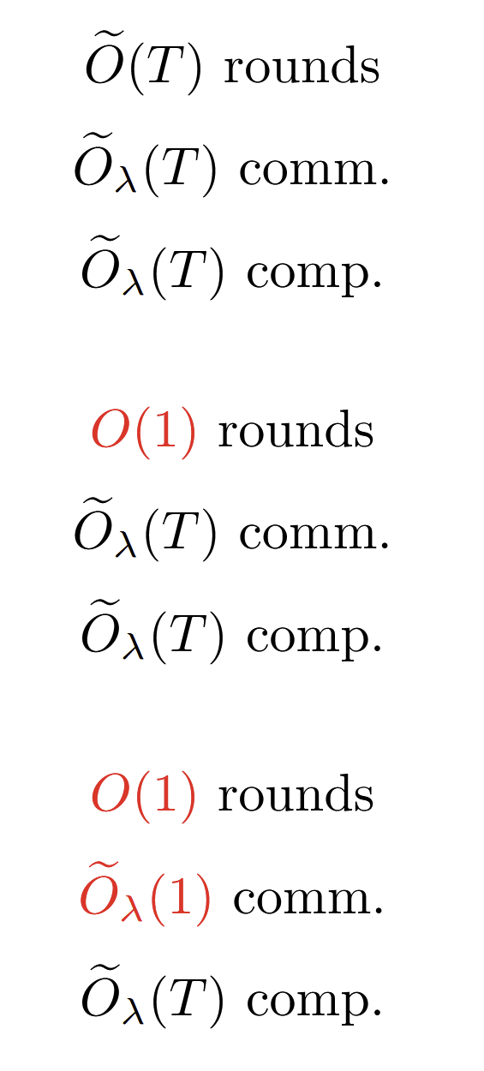
A Bit of History
Not practical
RAM Model 2PC
[GKKKMRV12]
Garbled RAM
[LO13]
Succinct GRAM
[BGLPT+15, CHJV15, KLW15]

Slide 7
A Bit of History
RAM Model 2PC
[GKKKMRV12]
Garbled RAM
[LO13]
Practical GRAM
[HKO22, PLS23, HKO23]

Slide 8


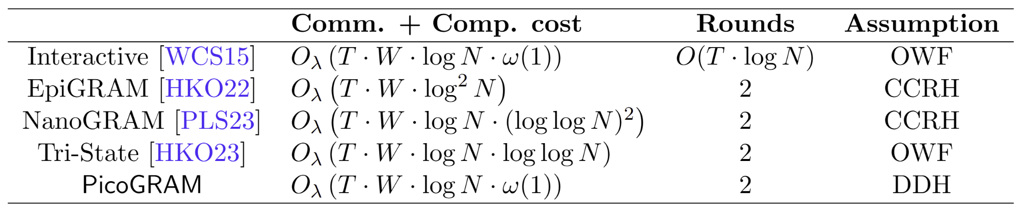
Our Result
For word width , where denotes the RAM space
First to match the SOTA Interactive RAM model 2PC

Slide 9
RAM = CPU Circuit + Memory
Computational Model
Reg
Reg
Reg
Reg
Reg
CPU
T=1
CPU
T=2
CPU
T=3
CPU
T=4
CPU
T=5
addr₁
data₁
Memory

Slide 10
RAM = CPU Circuit + Memory
Computational Model
Reg
Reg
Reg
Reg
Reg
CPU
T=1
CPU
T=2
CPU
T=3
CPU
T=4
CPU
T=5
addr₂
data₂
Memory

Slide 11
RAM = CPU Circuit + Memory
Computational Model
Reg
Reg
Reg
Reg
Reg
CPU
T=1
CPU
T=2
CPU
T=3
CPU
T=4
CPU
T=5
addr₃
data₃
Memory

Slide 12
Memory
CPU timesteps
T=1
T=2
T=3
Cannot be efficiently expressed as a Boolean circuit 🥺
Memory locations

Slide 13
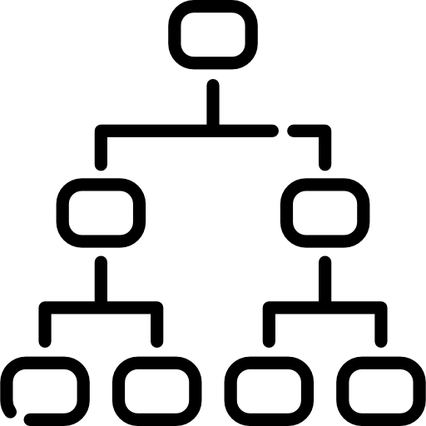

Memory
=
+
[HKO22, ...]
Memory
ORAM
Stacks

Slide 14
Memory
=
+
[HKO22, ...]
Memory
ORAM
Stacks
Captures the unpredictability

Slide 15
Stack
t=1
t=2
t=3
t=4
t=5
t=6
Only two instructions:
Pop next
No-op

Slide 16
Selector (minimal stack)
Case One
Case Two
x
y
x
y
c = 0
c = 1
z = x
z = y

Slide 17
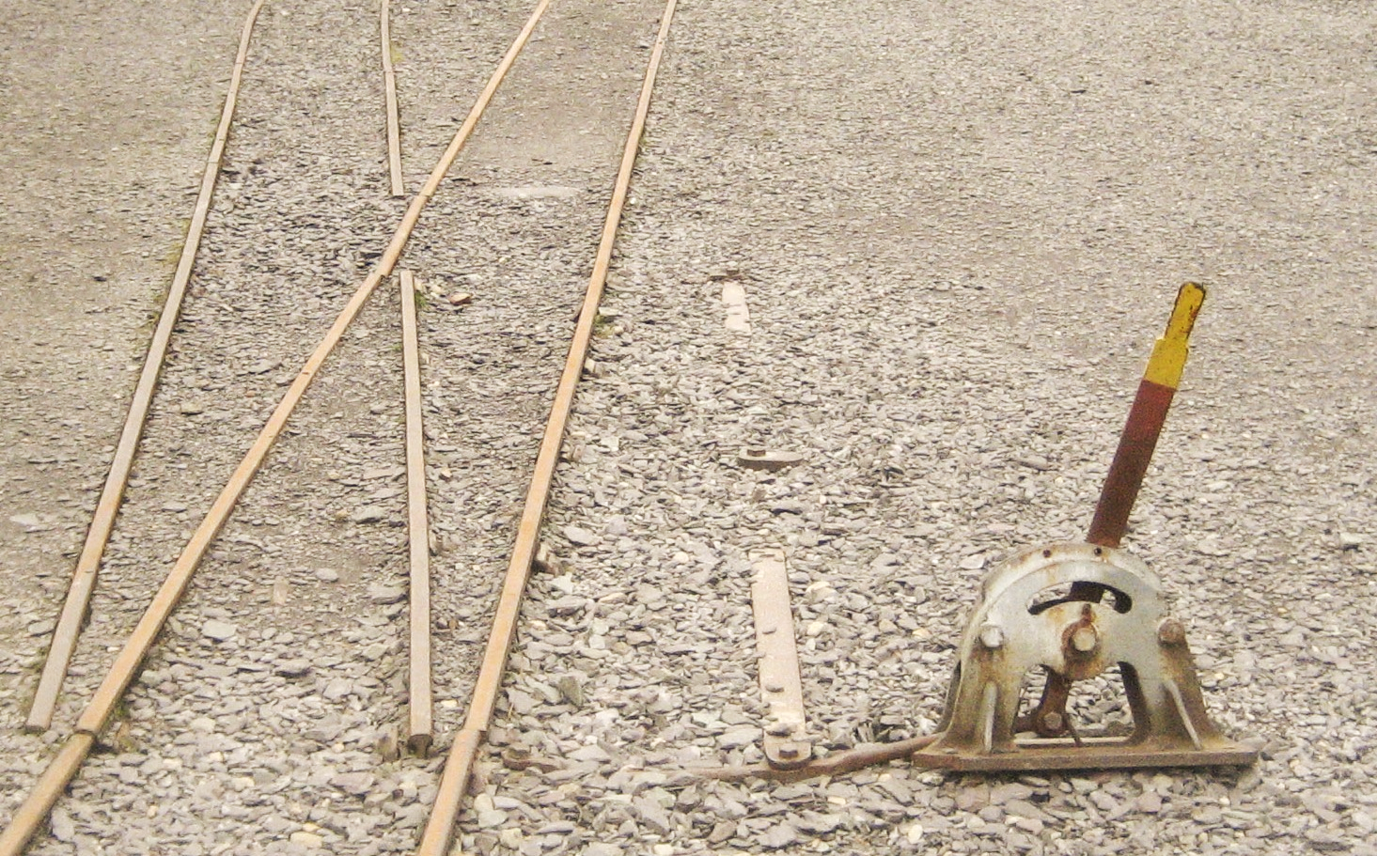
Selector (minimal stack)

Slide 18
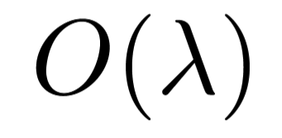
Garbling a Selector [HKO23]
L_{x=0} L_{x=1}
L_{y=0} L_{y=1}
Enc L_{c=0} ( L_{x=b} ⊕ L_{z=b} )
Enc L_{c=1} ( L_{y=b} ⊕ L_{z=b} )
L_{c=0} L_{c=1}
for b = 0, 1
bits of comm.
L_{z=0} L_{z=1}

Slide 19
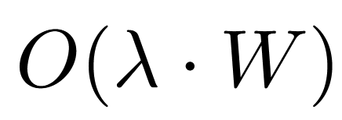
Garbling SIMD Selectors - Naive Approach
L_{x_i = b}
L_{y_i = b}
…
…
…
…
Enc L_{c=0} ( L_{x_i=b} ⊕ L_{z_i=b} )
Enc L_{c=1} ( L_{y_i=b} ⊕ L_{z_i=b} )
L_{c=0} L_{c=1}
for b = 0, 1 and
i = 1, 2, …, W
…
bits of comm.
…
L_{z_i = b}

Slide 20
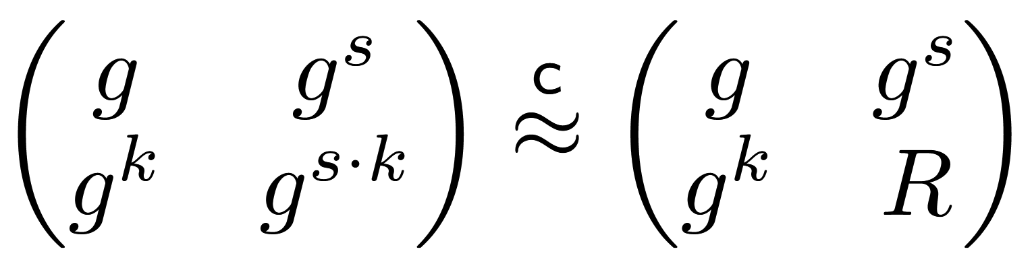
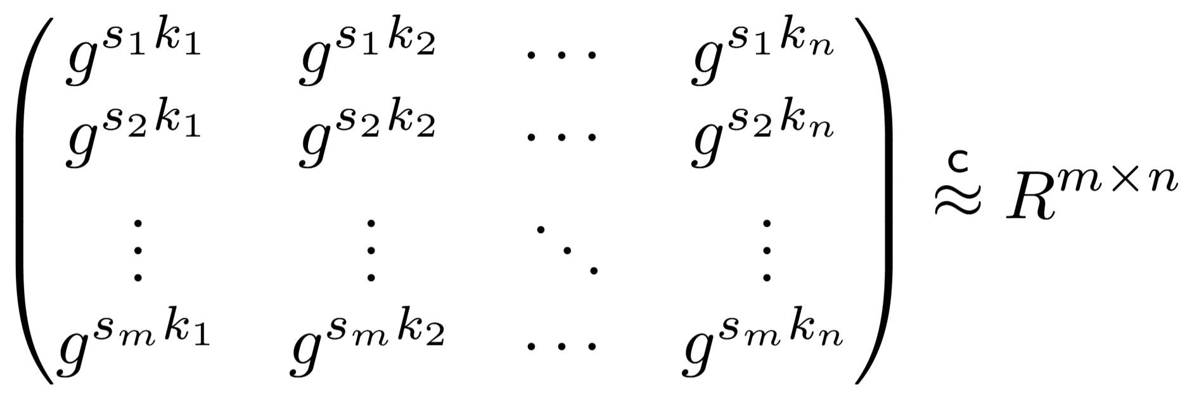
Matrix DDH Lemma
DDH:
implies

Slide 21
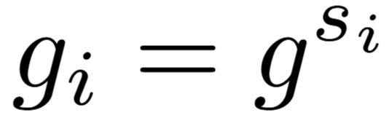
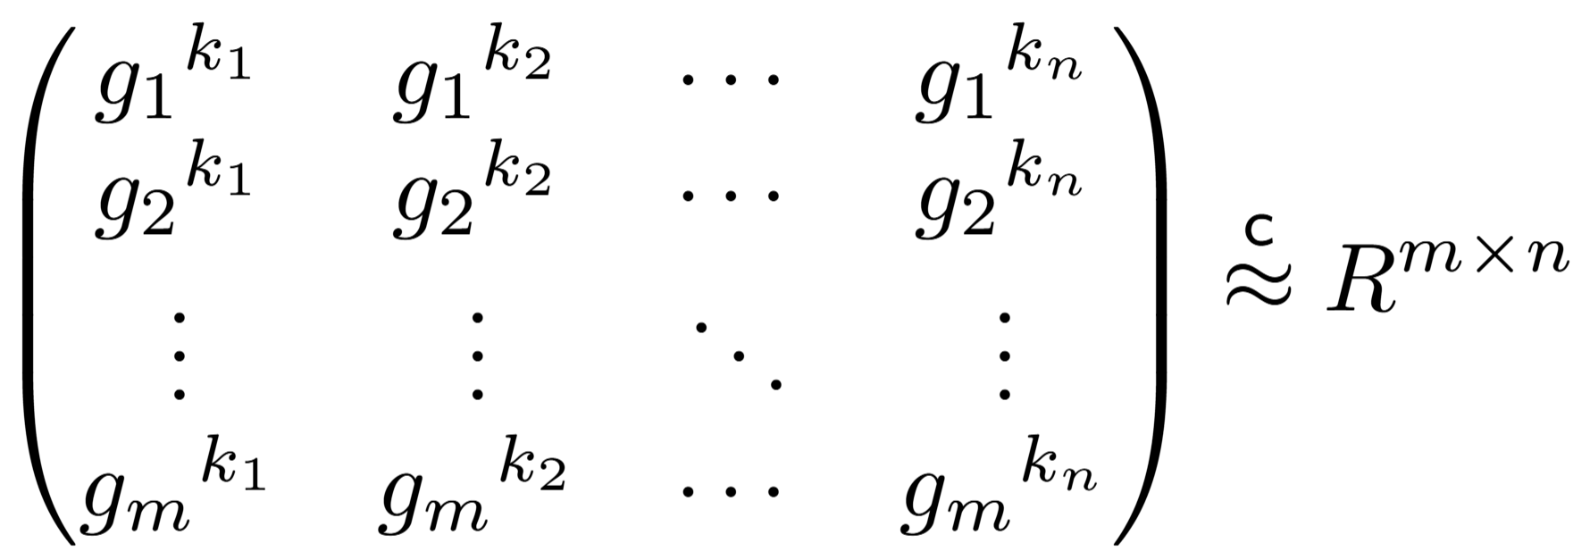
Matrix DDH Lemma
Let
Then, DDH ⇒
Wire labels

Slide 22
Garbling a Selector with DDH
L_{x=b} = g_{b}^{kx}
L_{y=b} = g_{b}^{ky}
L_{c=0} L_{c=1}
Enc L_{c=0} ( k_{z} / k_{x} )
Enc L_{c=1} ( k_{z} / k_{y} )
for b = 0, 1
L_{z=b} = g_{b}^{kz}

Slide 23
Garbling SIMD Selectors with DDH
L_{x_i = b} = g_{2i+b}^{kx}
L_{y_i = b} = g_{2i+b}^{ky}
…
…
…
…
L_{c=0} L_{c=1}
Enc L_{c=0} ( k_{z} / k_{x} )
Enc L_{c=1} ( k_{z} / k_{y} )
for b = 0, 1
and i = 1, 2, …, W
…
…
L_{z_i=b} = g_{2i+b}^{kz}

Slide 24
Garbling SIMD Selectors with DDH
L_{x_i = b} = g_{2i+b}^{kx}
L_{y_i = b} = g_{2i+b}^{ky}
…
…
…
…
L_{c=0} L_{c=1}
Comm. cost does not depend on W
for b = 0, 1
and i = 1, 2, …, W
…
…
L_{z_i=b} = g_{2i+b}^{kz}

Slide 25
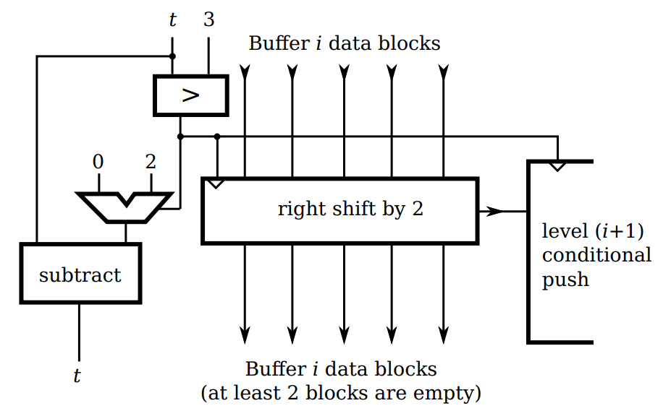
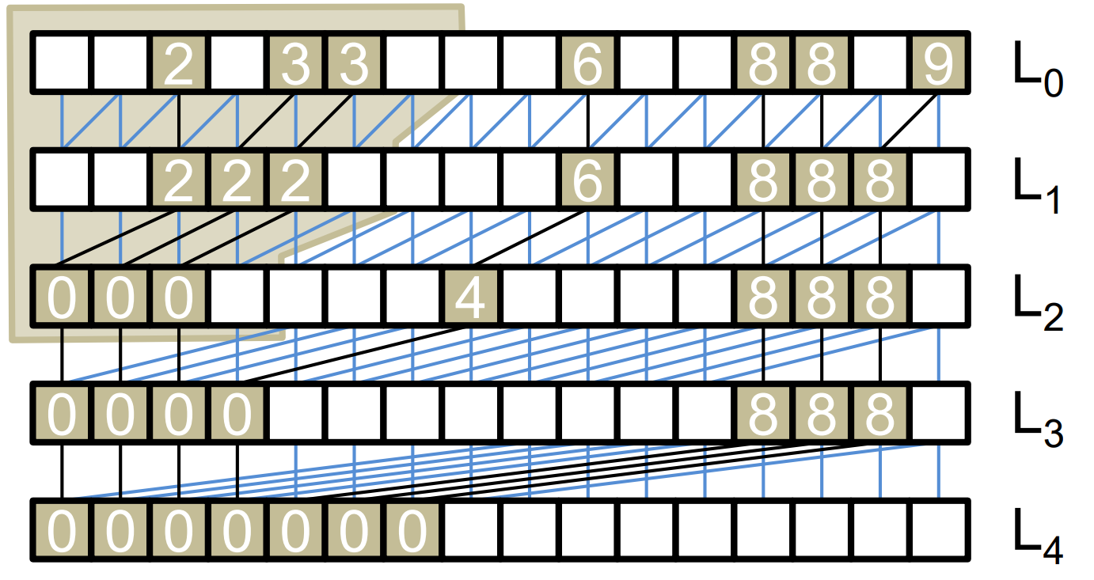
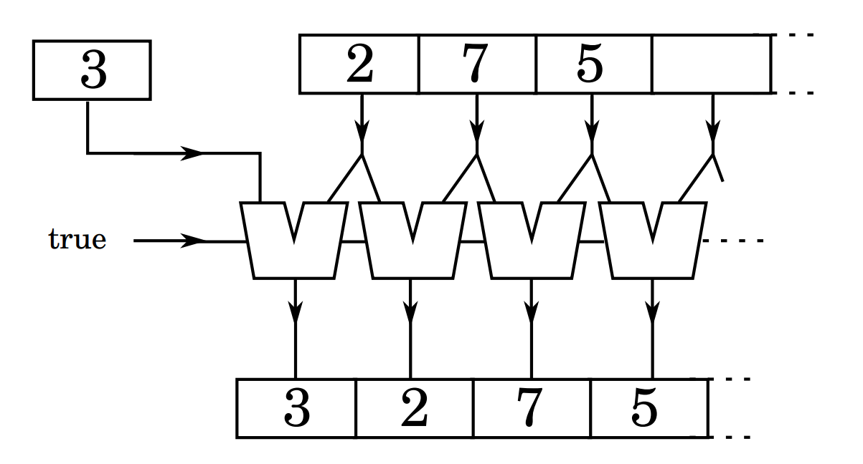
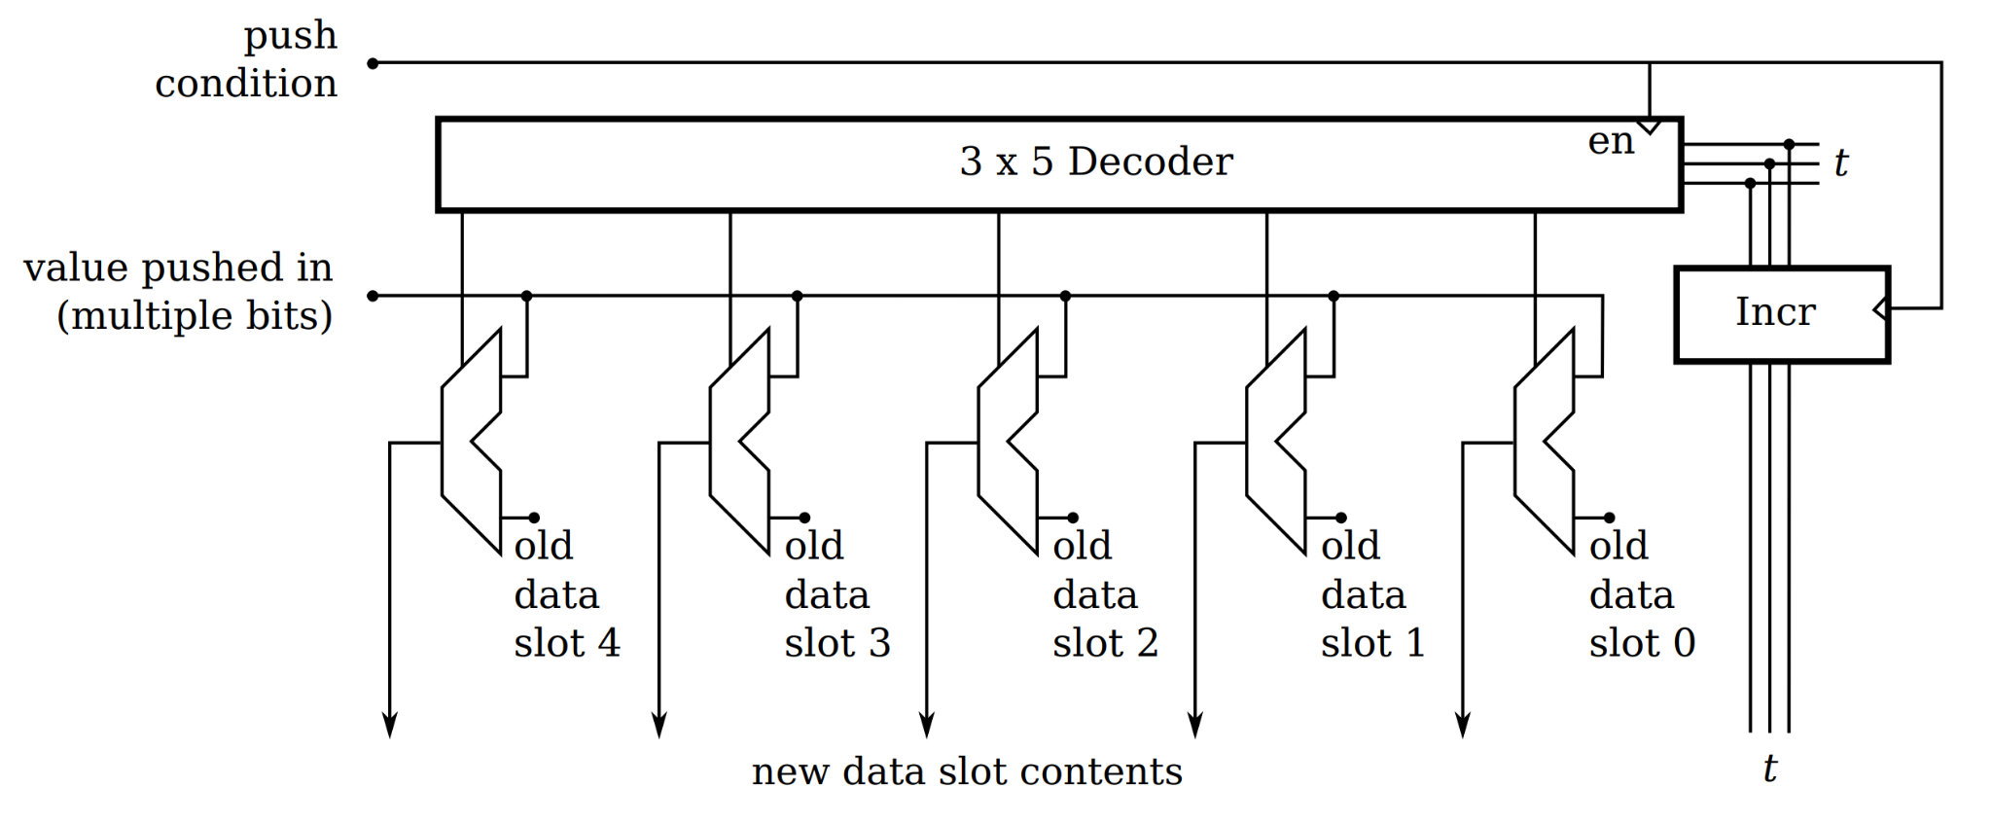
From Selectors to Stack
Prior works [HKO22, PLS23, HKO23]
Oblivious Stack [ZE13]
Our Approach
Oblivious Compaction [Goo11]
Circuit size: ~4× reduction
Pseudocode: 30+ lines ⇒ 8 lines

Slide 26
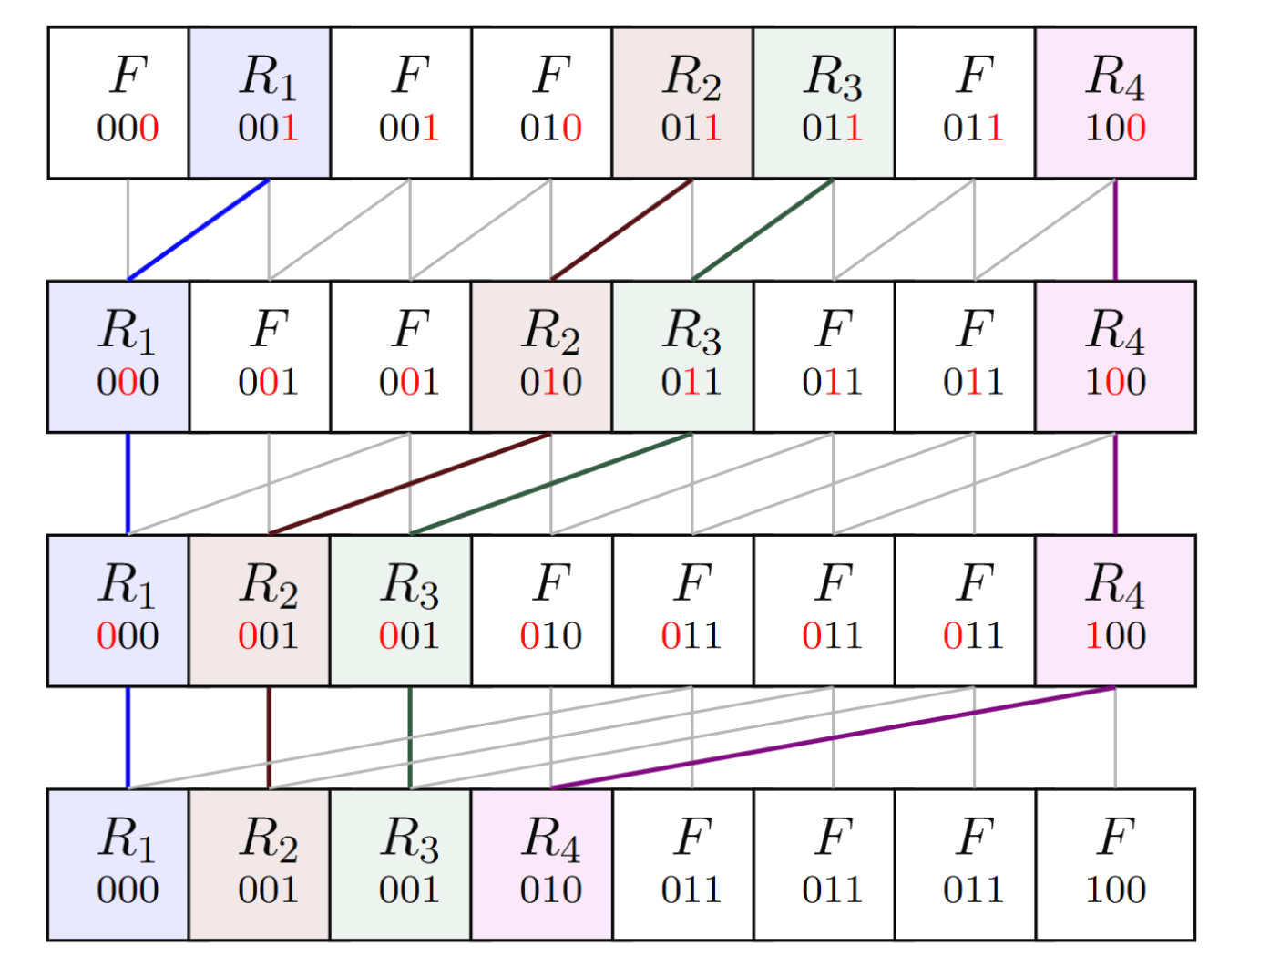
From Selectors to Stack
Max shift = 1
Consists of
n log n selectors
Max shift = 2
Max shift = 4
Goodrich’s Compaction Network [Goo11]

Slide 27
How About Computation?
L_{x}
k_{y} / k_{x}
Neither garbler nor evaluator needs to compute L_{y}
L_{y}
k_{z} / k_{y}
# of exponentiation does not depend on the network depth!
L_{z}

Slide 28
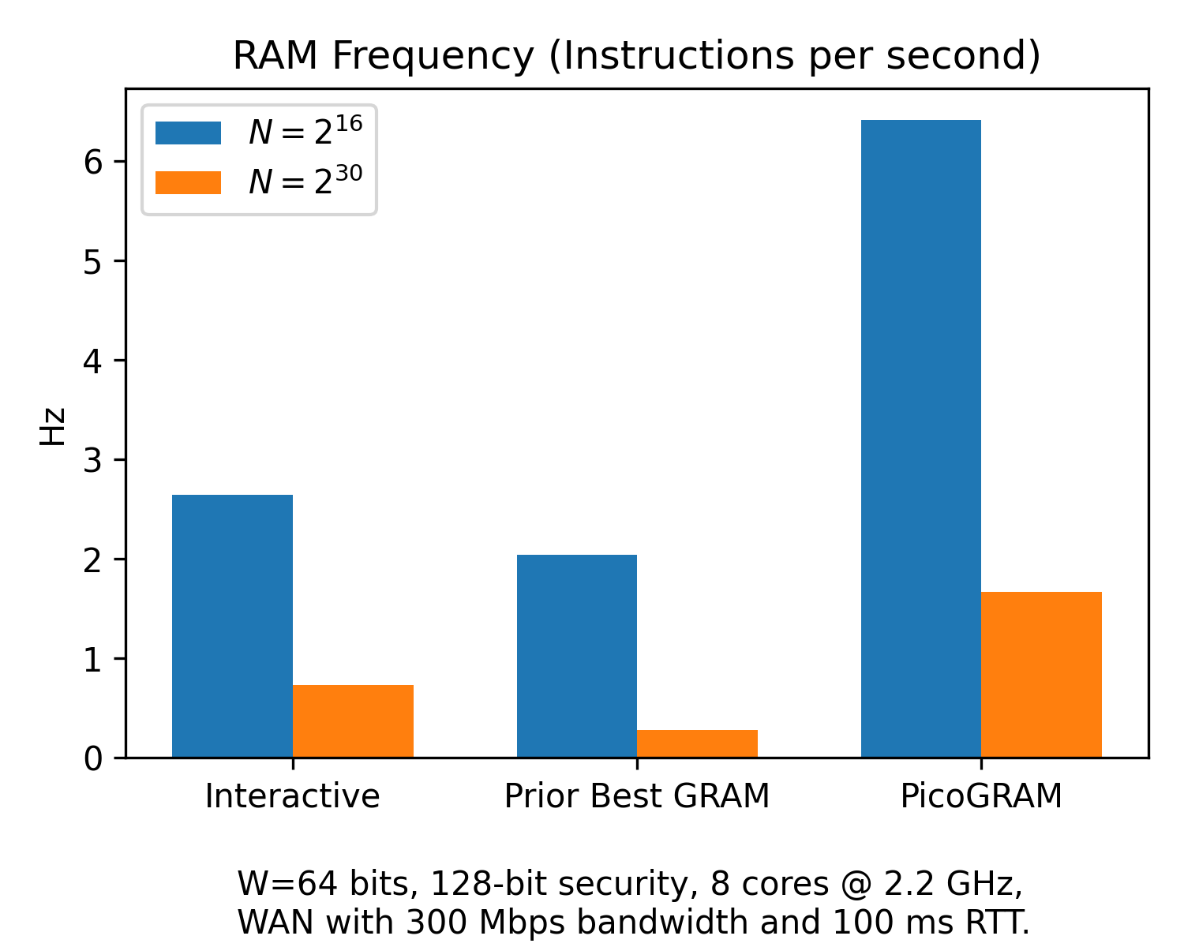
Concrete Performance (end-to-end time)
Costs for N = 2^30 are extrapolated to match large-scale real world use cases such as Signal private contact discovery and Ethereum balance checker.
2.5 ×

Slide 29
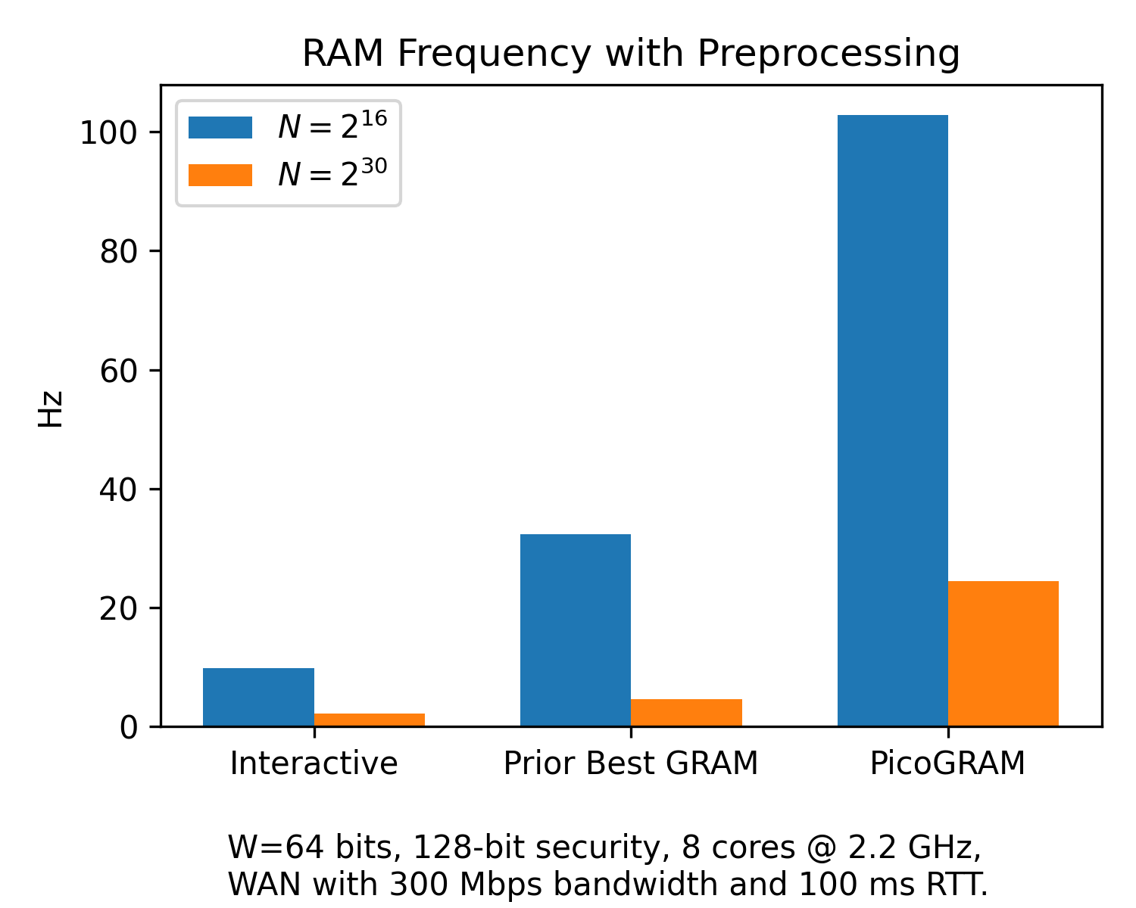
Concrete Performance (online time)
Costs for N = 2^30 are extrapolated to match large-scale real world use cases such as Signal private contact discovery and Ethereum balance checker.
3.2 ×

Slide 30
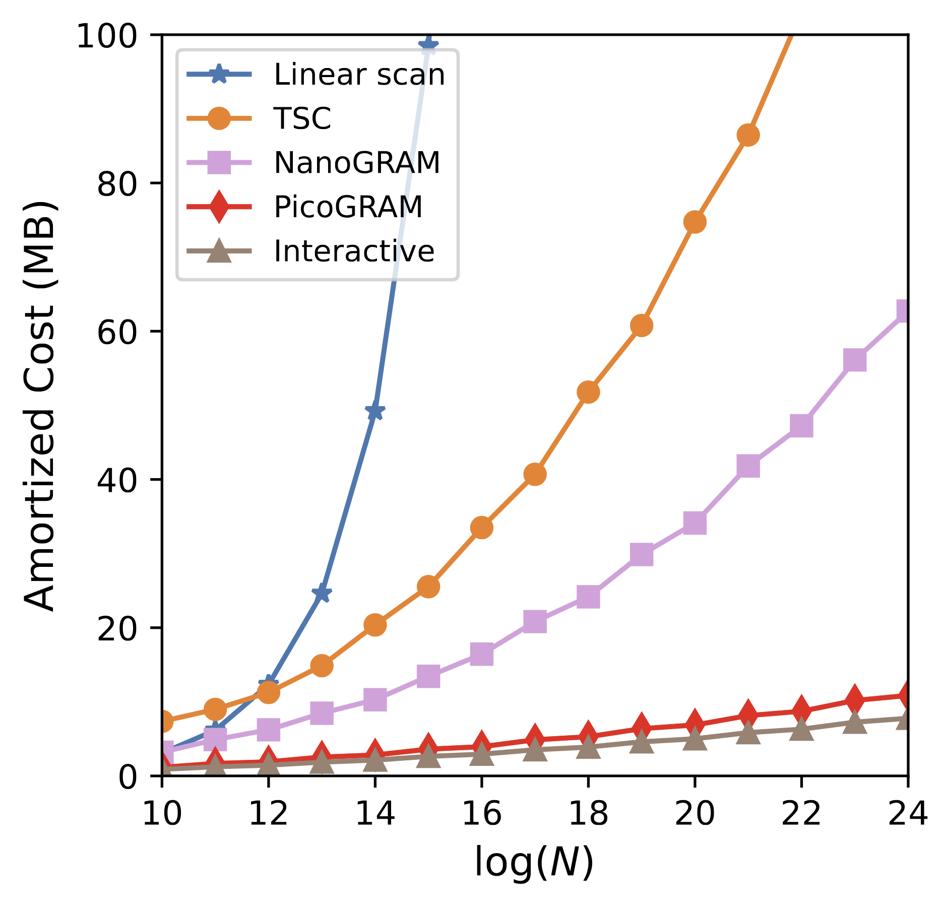
Concrete Performance (communication)
Only 34% higher than Interactive baseline

Slide 31





Future Works
Further
Speedup
Malicious / Adaptive Security
Multi-Party
Setting
Weaker
Assumptions

Slide 32


Thank you
Github Code
Icons from Flaticon.com
tianyaog@cmu.edu

Slide 33
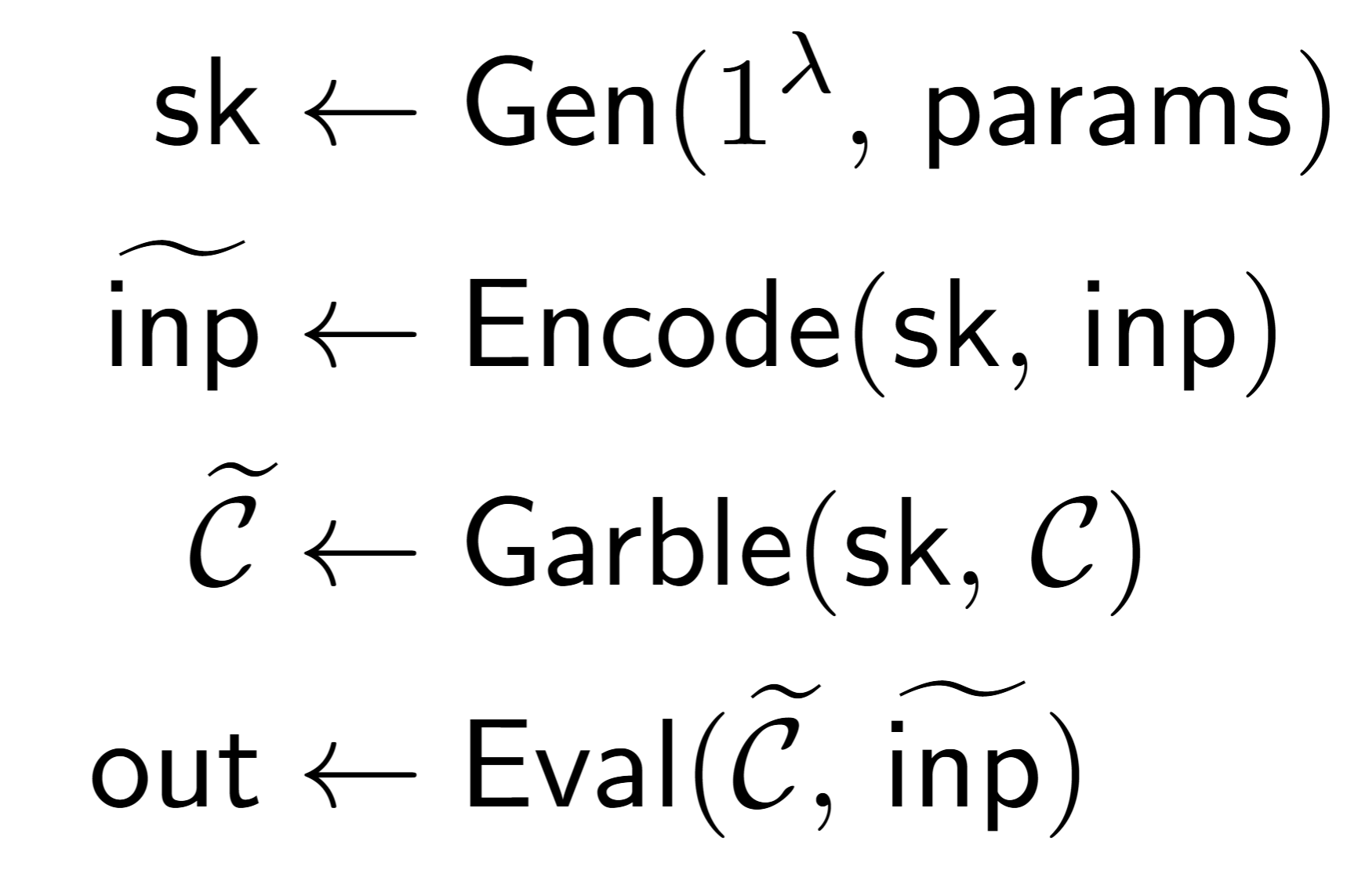
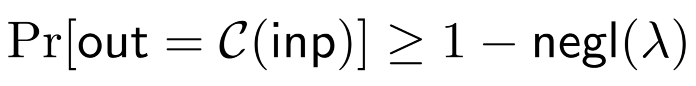
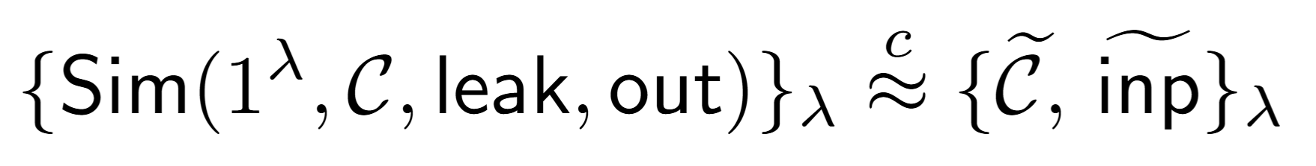
Garbled Circuit (GC)
More formally
Correctness
Experiment
Security

Slide 34
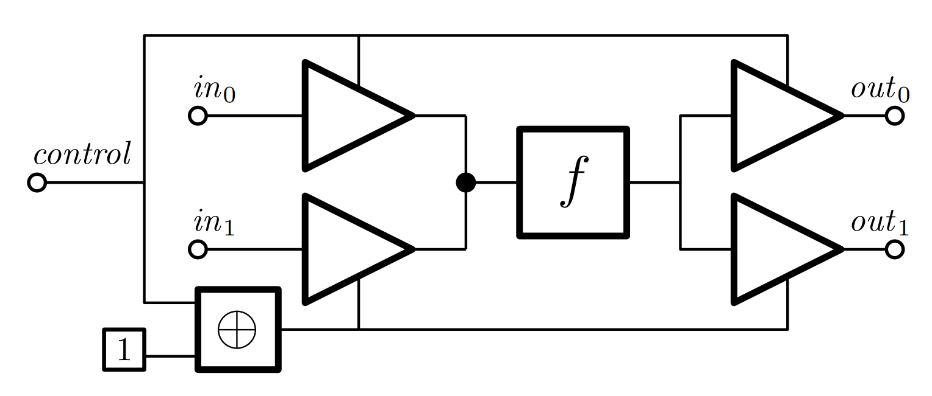
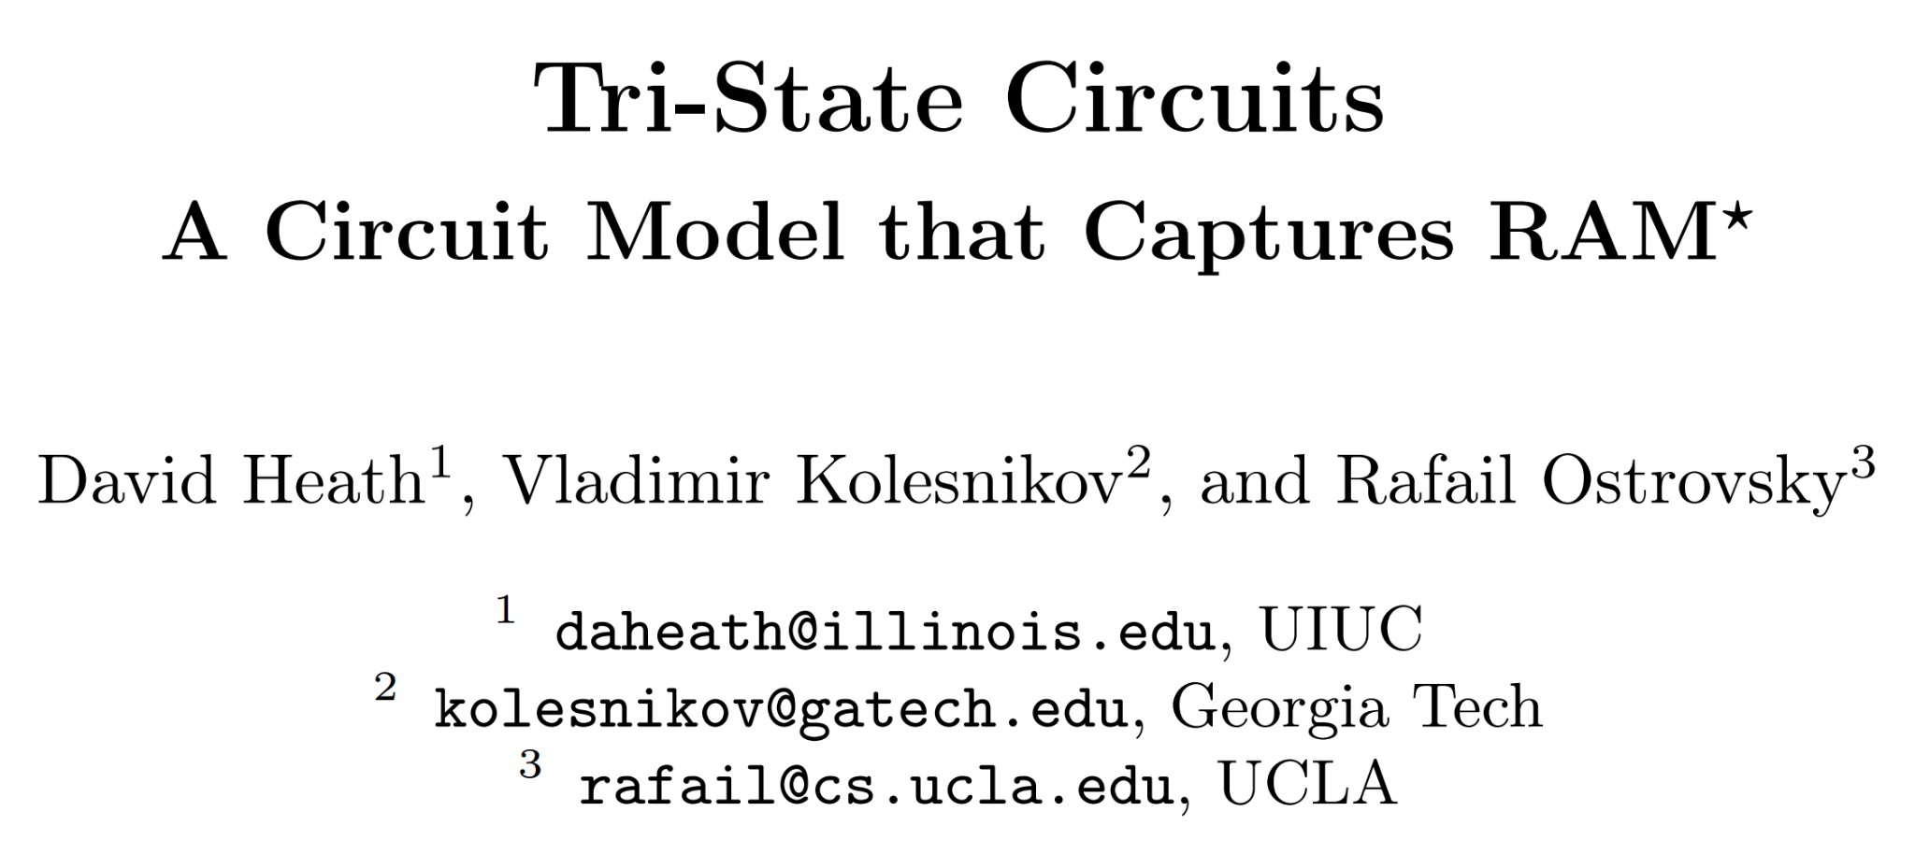
Our Starting Point
[HKO23]

Slide 35

Memory == Position Map + Data Store
Computational Model
Reg
Reg
Reg
Reg
Reg
CPU
T=1
CPU
T=2
CPU
T=3
CPU
T=4
CPU
T=5
addr₃
data₃
pos₃
Position Map
Data Store

Slide 36

Data Store
addr₃
data₃
Circuit ORAM [WCS15] circuitry
pos₃
t=1
t=2
t=3
t=4
addr₂ | pos₂ | data₂
N/A | N/A | N/A
Local store
data₃
Left sub-tree
Right sub-tree

Slide 37

Cost Sum-up (per instruction)
CPU ⋅⋅⋅⋅⋅⋅⋅⋅⋅⋅⋅⋅⋅⋅⋅⋅⋅⋅⋅⋅⋅⋅⋅⋅⋅⋅⋅⋅⋅⋅⋅⋅⋅⋅⋅⋅⋅⋅⋅⋅⋅⋅⋅⋅⋅⋅ |  |  |  | O(λ ⋅ W)
Mem | Data Store | Root | Store ⋅⋅⋅⋅⋅⋅⋅⋅ | O(λ ⋅ W ⋅ log^{1+ε} N)
 |  |  | Stack ⋅⋅⋅⋅⋅⋅⋅ | O(λ ⋅ log N)
 |  | Sub- trees | Store ⋅⋅⋅⋅⋅⋅⋅⋅ | O(λ ⋅ W ⋅ log N)
 |  |  | Stack ⋅⋅⋅⋅⋅⋅⋅ | O(λ ⋅ log² N)
 | Position Map ⋅⋅⋅⋅⋅⋅⋅⋅⋅⋅⋅⋅⋅⋅⋅⋅⋅⋅⋅⋅⋅ |  |  | O(λ ⋅ log³ N)
Sum ⋅⋅⋅⋅⋅⋅⋅⋅⋅⋅⋅⋅⋅⋅⋅⋅⋅⋅⋅⋅⋅⋅⋅⋅⋅⋅⋅⋅⋅⋅⋅⋅⋅⋅⋅⋅⋅⋅⋅⋅⋅⋅⋅ |  |  |  | O(λ ⋅ (W ⋅ log^{1+ε} N + log³ N))

Slide 38
Garbling Selector from DDH
For the evaluator, if c = 0
Decrypts k_{z} / k_{x}
L_{z=b} = (g_{b}^{kx} )^{kz / kx} = (L_{x=b} )^{kz / kx}

Slide 39
Garbling Selector from DDH
For the evaluator, if c = 1
Decrypts k_{z} / k_{y}
L_{z=b} = (g_{b}^{ky} )^{kz / ky} = (L_{y=b} )^{kz / ky}

Slide 40
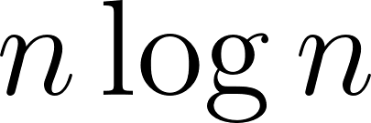
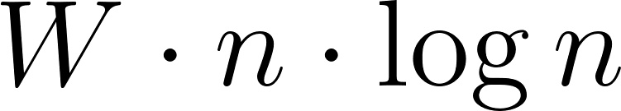
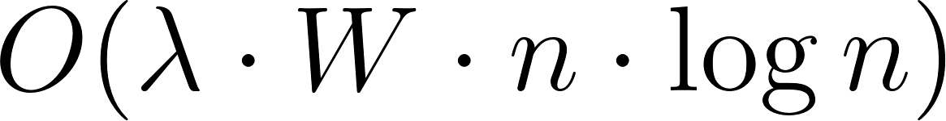
Garbling a Stack
input cells
selectors
Straightforward Garbling [HKO23]
depth
bits
parallel bits per cell

Slide 41
Garbling a Stack
input cells
selectors
SIMD Garbling!
depth
bits
parallel bits per cell

Slide 42

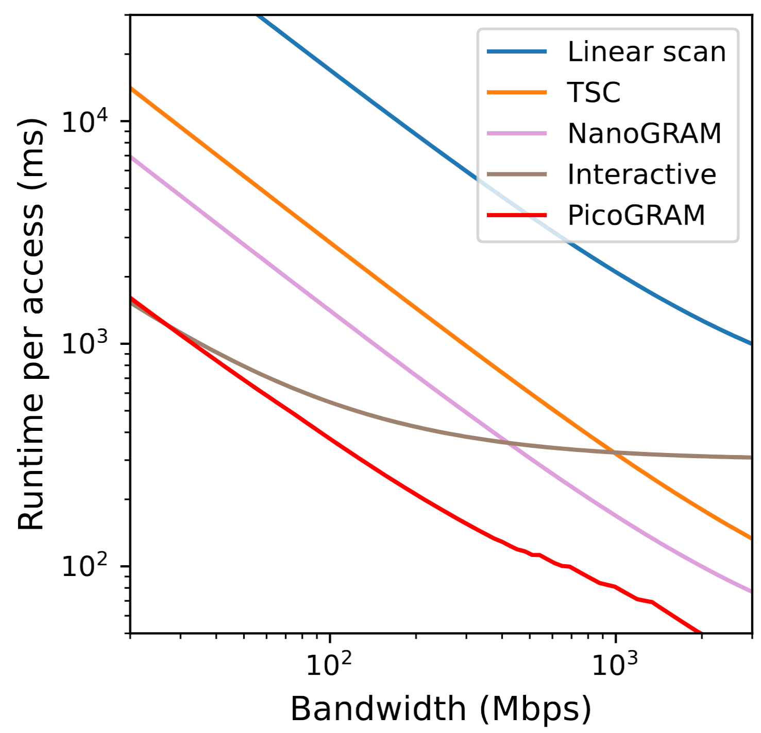
Concrete Performance
End-to-end time vs. BW
for N = 2¹⁶
Each query fetches a 64-bit word
Amortized across T >= N instructions
300 Mbps bandwidth, 100 ms RTT
8 CPU cores @ 2.2 GHz

