Slide 1
On the Power of Oblivious State Preparation
James Bartusek Dakshita Khurana
Columbia University UIUC and NTT Research

Slide 2
Oblivious State Preparation (OSP)

Slide 3

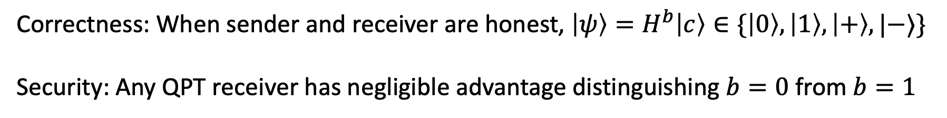

Oblivious State Preparation (OSP)
[CCKW19]: Malicious 4-states QFactory with basis-blindness
Classical Sender
Quantum Receiver
$$b,c∈\{0,1\}$$
$$|ψ⟩$$
Correctness: When sender and receiver are honest, $\left|ψ\right\rangle =H^{b}\left|c\right\rangle ∈\{\left|0\right\rangle ,\left|1\right\rangle ,\left|+\right\rangle ,|−⟩\}$
Security: Any QPT receiver has negligible advantage distinguishing $b=0$ from $b=1$
Note: We don’t require any verifiability property [GV19, GMP22, …]

Slide 4
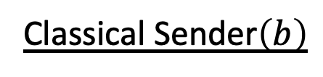
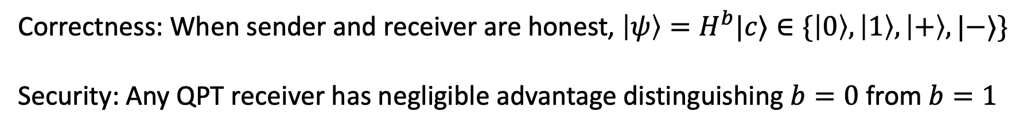

Two-Round OSP
Classical Sender$\left(b\right)$
Quantum Receiver
$$c∈\{0,1\}$$
$$|ψ⟩$$
Correctness: When sender and receiver are honest, $\left|ψ\right\rangle =H^{b}|c⟩∈\{\left|0\right\rangle ,\left|1\right\rangle ,\left|+\right\rangle ,|−⟩\}$
Security: Any QPT receiver has negligible advantage distinguishing $b=0$ from $b=1$

Slide 5
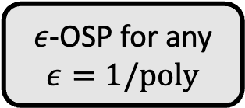
Results
Lattice isomorphism problem
Proof of quantumness (and anti-commutation test)
$ε$-OSP for any $ε=1/poly$
[BMR25]
Classical verification of quantum computation
Blind classical delegation of quantum computation
Plain TCFs
OSP
Quantum money with classical communication
Two-round
Two-round
[RS19]
Dual-mode TCFs
1-of-2 puzzles
Two-round
(+ classical FHE)
[AMR22, GV24]
QFHE
[LLQ22]
Classically-verifiable position verification
[BCMVV18]
Extended LHS on group actions
Two-round
LWE
Oblivious transfer between one classical and one quantum party
PKE with classical keys and ciphertexts

Slide 6
Takeaways
OSP a simple primitive that unifies several constructions in the classical-client quantum-server setting
In some cases, going through OSP gives new implications
  Dual-mode TCFs -> quantum money with classical communication
  Plain TCFs -> blind classical delegation of quantum computation
  Plain TCFs -> classical verification of quantum computation
  (concurrent with [BKMSW25, Zha25])

Slide 7
Takeaways
OSP a simple primitive that unifies several constructions in the classical-client quantum-server setting
In some cases, going through OSP gives new implications
  Group actions -> quantum money with classical communication
  Group actions -> blind classical delegation of quantum computation
  Group actions -> classical verification of quantum computation
  (concurrent with [BKMSW25, Zha25])

Slide 8
Remainder of this talk
“Computational Bell test” from OSP and applications
Two-round OSP implies PKE
Open directions
See next talk and/or our paper for applications to blind and verifiable quantum computation

Slide 9





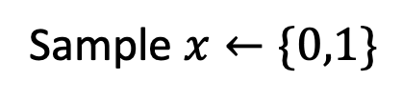






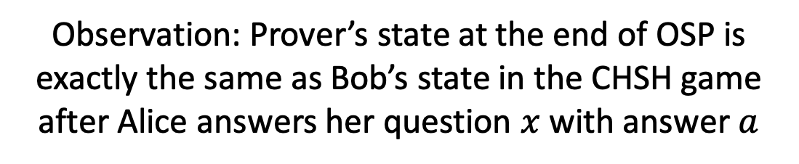
Proof of quantumness from OSP
Prover
Verifier
$$x$$
OSP
Sample $x←\{0,1\}$
$$H^{x}|a⟩$$
$$a$$
$$|0⟩$$
$$x=0,a=0$$
Observation: Prover’s state at the end of OSP is exactly the same as Bob’s state in the CHSH game after Alice answers her question $x$ with answer $a$
$$|+⟩$$
$$|−⟩$$
$$x=1,a=0$$
$$x=1,a=1$$
[KCVY21, BGKPV23, ABCC24]
$$|1⟩$$
$$x=0,a=1$$

Slide 10





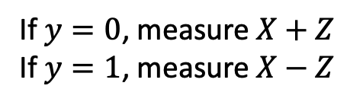

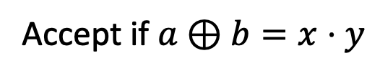



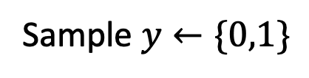

Proof of quantumness from OSP
Quantum completeness: $\cos^{2}\left(\frac{π}{8}\right)>0.85$
Classical soundness: 0.75 + $negl(λ)$
Prover
Verifier
$$x$$
OSP
Sample $x←\{0,1\}$
$$H^{x}|a⟩$$
$$a$$
$$|0⟩$$
$$y$$
$$b=0$$
$$x=0,a=0$$
$$b=0$$
Sample $y←\{0,1\}$
$$X+Z$$
$$X−Z$$
$$b$$
Accept if $a⊕b=x⋅y$
$$|+⟩$$
$$|−⟩$$
$$x=1,a=0$$
$$x=1,a=1$$
Soundness argument:
$$b=1$$
$$b=1$$
$$|1⟩$$
$$x=0,a=1$$
If $y=0$, measure $X+Z$
If $y=1$, measure $X−Z$

Slide 11
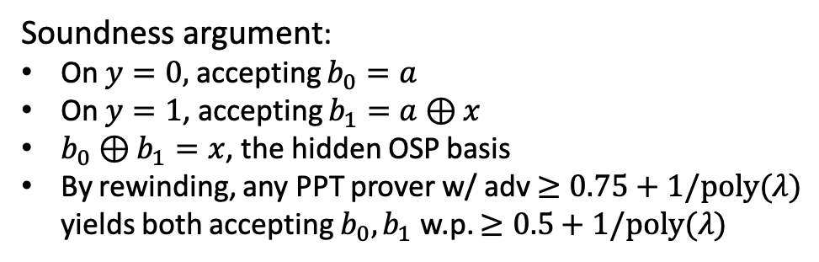
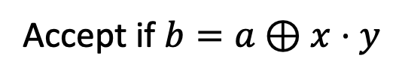
Proof of quantumness from OSP
Quantum completeness: $\cos^{2}\left(\frac{π}{8}\right)>0.85$
Classical soundness: 0.75 + $negl(λ)$
Prover
Verifier
$$x$$
OSP
Sample $x←\{0,1\}$
$$H^{x}|a⟩$$
$$a$$
$$|0⟩$$
$$y$$
$$b=0$$
$$x=0,a=0$$
$$b=0$$
Sample $y←\{0,1\}$
$$X+Z$$
$$X−Z$$
$$b$$
Accept if $b=a⊕x⋅y$
$$|+⟩$$
$$|−⟩$$
$$x=1,a=0$$
$$x=1,a=1$$
Soundness argument:
On $y=0,$ accepting $b_{0}=a$
On $y=1$, accepting $b_{1}=a⊕x$
$b_{0}⊕b_{1}=x$, the hidden OSP basis
By rewinding, any PPT prover w/ adv $≥0.75+1/poly(λ)$ yields both accepting $b_{0},b_{1}$ w.p. $≥0.5+1/poly(λ)$
$$b=1$$
$$b=1$$
$$|1⟩$$
$$x=0,a=1$$
If $y=0$, measure $X+Z$
If $y=1$, measure $X−Z$

Slide 12
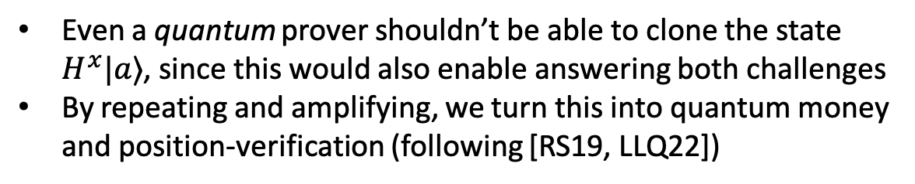
Unclonable states from OSP
Prover
Verifier
$$x$$
OSP
Sample $x←\{0,1\}$
$$H^{x}|a⟩$$
$$a$$
$$|0⟩$$
$$y$$
$$b=0$$
$$x=0,a=0$$
$$b=0$$
Sample $y←\{0,1\}$
$$X+Z$$
$$X−Z$$
$$b$$
Accept if $b=a⊕x⋅y$
$$|+⟩$$
$$|−⟩$$
$$x=1,a=0$$
$$x=1,a=1$$
Observation:
Even a quantum prover shouldn’t be able to clone the state $H^{x}|a⟩$, since this would also enable answering both challenges
By repeating and amplifying, we turn this into quantum money and position-verification (following [RS19, LLQ22])
$$b=1$$
$$b=1$$
$$|1⟩$$
$$x=0,a=1$$
If $y=0$, measure $X+Z$
If $y=1$, measure $X−Z$

Slide 13
Public-key encryption from (two-round) OSP
Two-round OSP
Two-round Encrypted CNOT
PKE

Slide 14
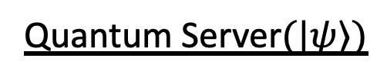
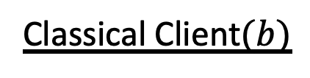



Encrypted CNOT
Classical Client$(b)$
Quantum Server$(|ψ⟩)$
$$x,z$$
$$X^{x}Z^{z}CNOT^{b}|ψ⟩$$
Learns nothing about $b$
Introduced in [Mah18] as a building block for QFHE

Slide 15



Two-round Encrypted CNOT
Classical Client$(b)$
Quantum Server$(|ψ⟩)$
$${EC}_{1}(b)$$
$${EC}_{state}$$
$${EC}_{2}$$
$$x,z$$
$$X^{x}Z^{z}CNOT^{b}|ψ⟩$$
Learns nothing about $b$
Introduced in [Mah18] as a building block for QFHE

Slide 16
(Two-round) Encrypted CNOT from (Two-round) OSP
Two-round OSP

Slide 17
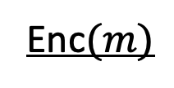



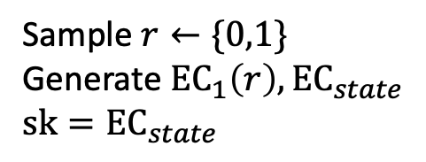
PKE from (Two-round) Encrypted CNOT
KeyGen
Enc$(m)$
$$pk={EC}_{1}\left(r\right)$$
Sample $r←\{0,1\}$
Generate $EC_{1}\left(r\right), EC_{state}$
$$sk={EC}_{state}$$
$$\left|+\right\rangle \left|0\right\rangle$$
$X^{x}Z^{z}(\left|0\right\rangle \left|0\right\rangle +\left|1\right\rangle \left|r\right\rangle ),$ ${EC}_{2}$

Slide 18





PKE from (Two-round) Encrypted CNOT
KeyGen
Enc$(m)$
$$pk={EC}_{1}\left(r\right)$$
Sample $r←\{0,1\}$
Generate $EC_{1}\left(r\right), EC_{state}$
$$sk={EC}_{state}$$
$$\left|+\right\rangle \left|0\right\rangle$$
(where $x_{0}⊕x_{1}=r$)
$\left|0\right\rangle \left|x_{0}\right\rangle +{\left(−1\right)}^{z}\left|1\right\rangle \left|x_{1}\right\rangle ,$ ${EC}_{2}$
Measure $→(b,x_{b})$
Dec
$$ct=\left({EC}_{2},b,m⊕x_{b}\right)$$
Recover $(x_{0},x_{1})$ from ${EC}_{2}$
Recover $m$ from $(b,m⊕x_{b})$

Slide 19
Open directions
  Other applications of OSP
    Certified deletion / revocable crypto with classical communication?
  What else implies OSP
    Coding-based assumptions?
    Anti-commutation tests?
    OT? Or is there a separation?
  Exploring OSP as a basic cryptographic primitive
    OSP extension (see [Zha21])?
    OSP for several binary observables? Or multi-output observables?
    Amplification? Combiners?

