Slide 1
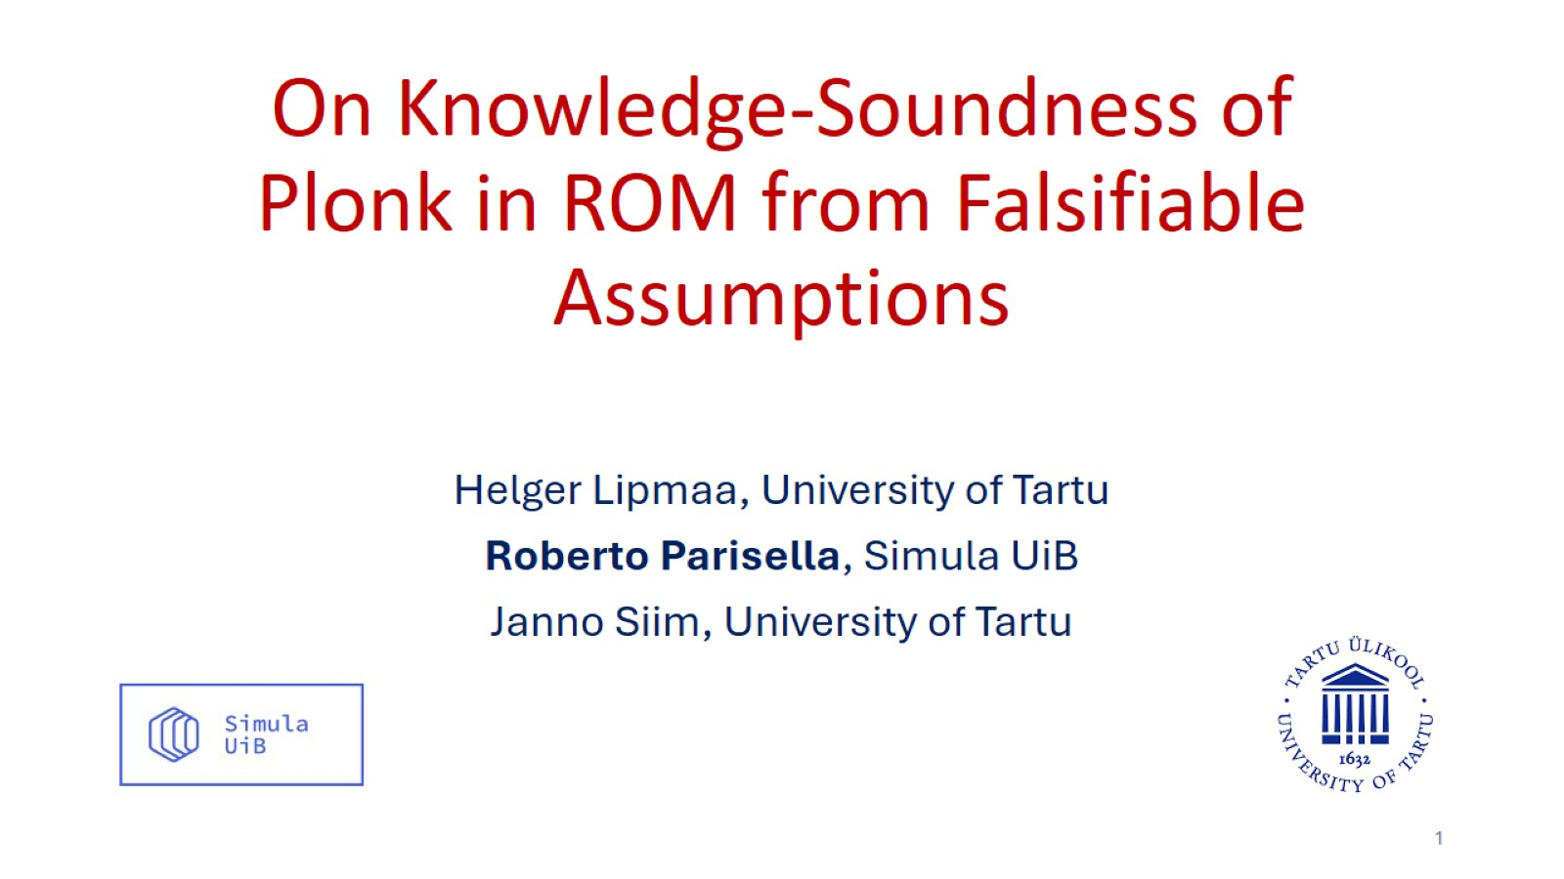
On Knowledge-Soundness of Plonk in ROM from Falsifiable Assumptions

Slide 2
Talk Outlines
Plonk preliminaries and limitations in previous security proofs.
On the knowledge soundness of the linearization trick.
On the knowledge soundness of Plonk.

Slide 3
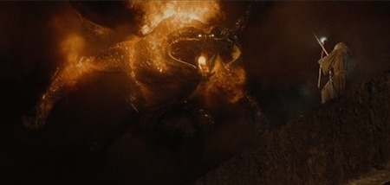

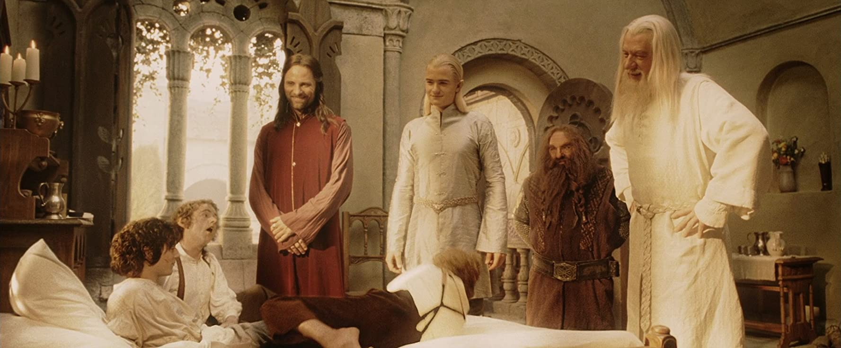
A Research Trilogy
Plonk proof does not
translate into standard model security
Volume I (TCC 2023)
Algebraic Group Model
with Oblivious sampling
Volume II (EC 2024)
Constant-Size zk-SNARKs in ROM
From Falsifiable Assumptions
Non-optimized Plonk is secure
Volume III (C 2025)
On Knowledge-Soundness of Plonk in ROM
From Falsifiable Assumptions

Slide 4





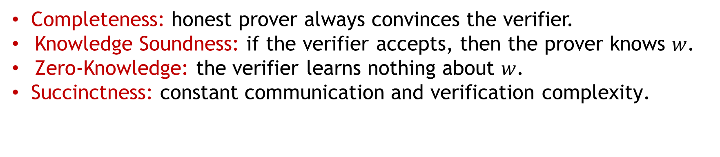

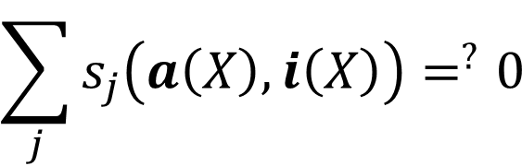
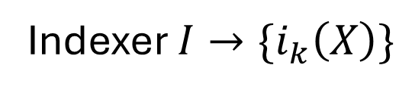


Ideal Plonk
Indexer $I→\{i_{k}\left(X\right)\}$
$$P(I,x,w)$$
$$V(I,x)$$
$$a_{1}\left(X\right),a_{2}(X)$$
$$chall_{1}$$
$$a_{n−1}\left(X\right),a_{n}(X)$$
$$\sum_{j}{s_{j}\left(a\left(X\right),i\left(X\right)\right)=^{?}0}$$
$$ξ←\$ℤ_{p}$$
$$\sum_{j}{s_{j}\left(a\left(ξ\right),i\left(ξ\right)\right)=^{?}0}$$
Completeness: honest prover always convinces the verifier.
Knowledge Soundness: if the verifier accepts, then the prover knows $w$.
Zero-Knowledge: the verifier learns nothing about $w$.
Succinctness: constant communication and verification complexity.

Slide 5
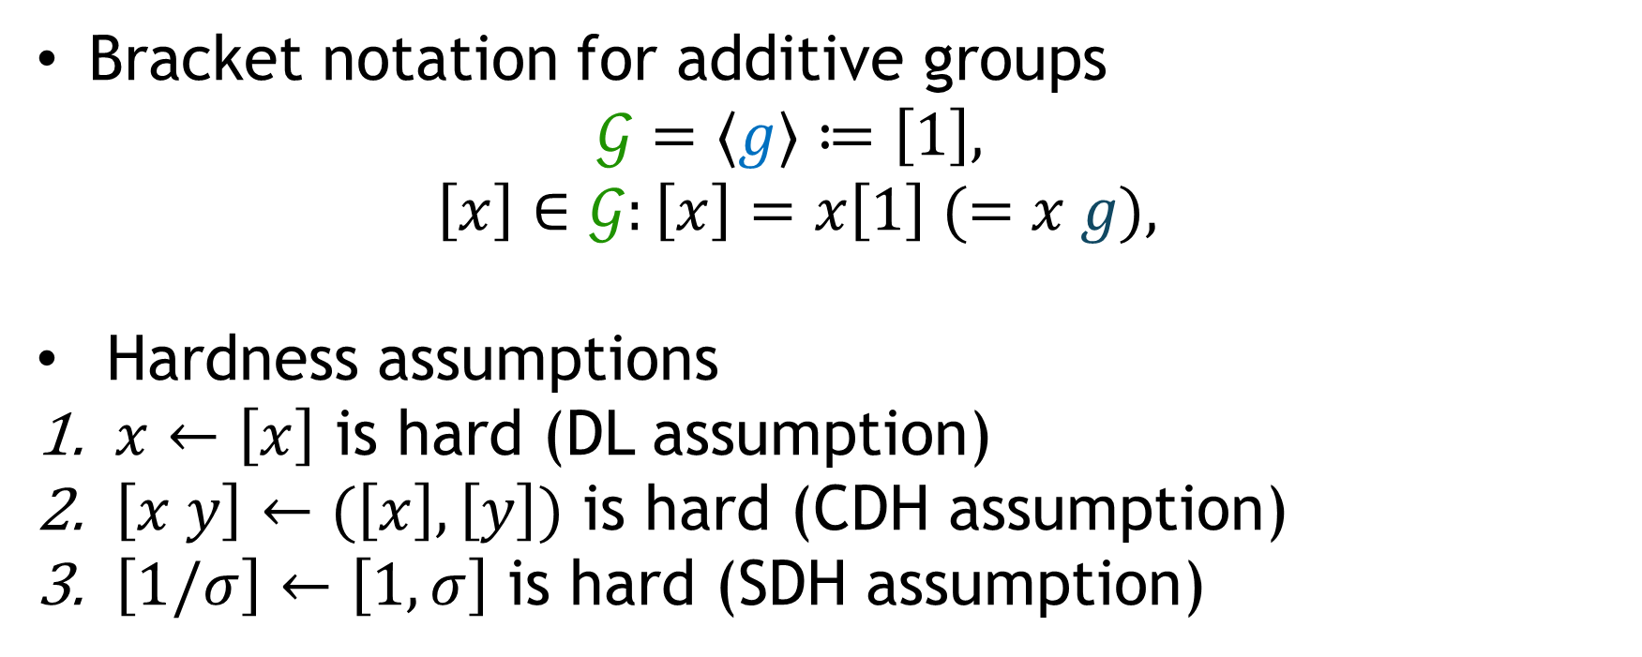
Cryptographic groups
Bracket notation for additive groups
  $$𝒢=⟨g⟩≔\left[1\right],$$
  $$\left[x\right]∈𝒢:\left[x\right]=x\left[1\right] (=x g),$$
Hardness assumptions
$x←\left[x\right]$ is hard (DL assumption)
$\left[x y\right]←(\left[x\right],\left[y\right])$ is hard (CDH assumption)
$\left[1/σ\right]←\left[1,σ\right]$ is hard (SDH assumption)

Slide 6
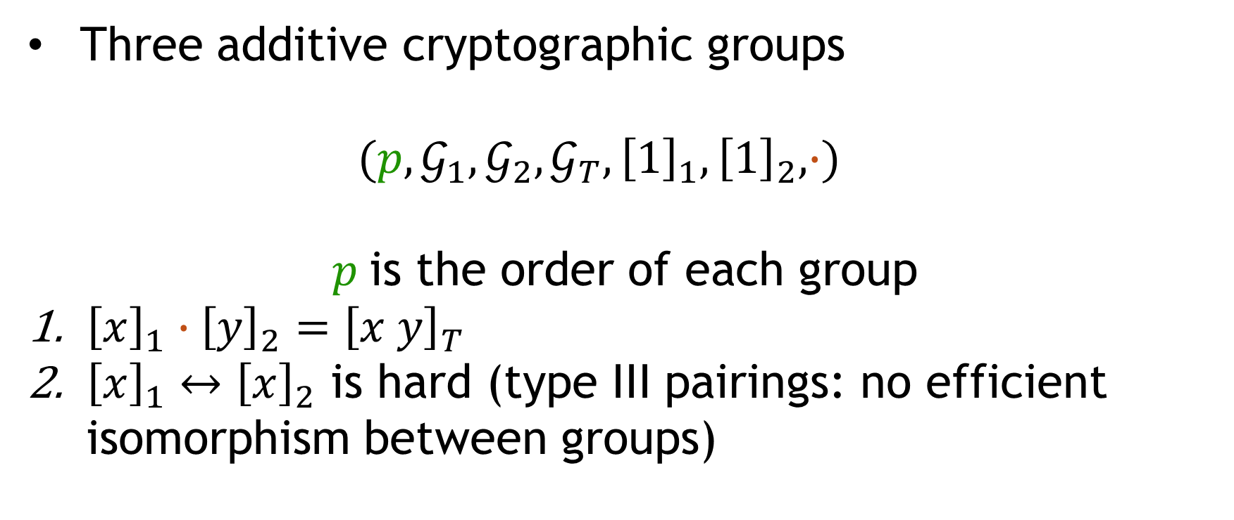
Bilinear Pairing Groups
Three additive cryptographic groups
  $$(p,𝒢_{1},𝒢_{2},𝒢_{T}, {\left[1\right]}_{1},{\left[1\right]}_{2}, ∙)$$
$p$is the order of each group
${\left[x\right]}_{1}∙{\left[y\right]}_{2}={\left[x y\right]}_{T}$
${\left[x\right]}_{1}↔{\left[x\right]}_{2}$ is hard (type III pairings: no efficient isomorphism between groups)

Slide 7
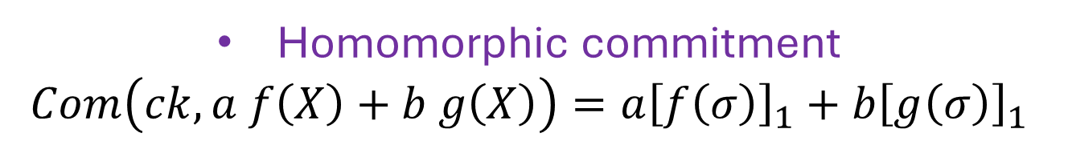
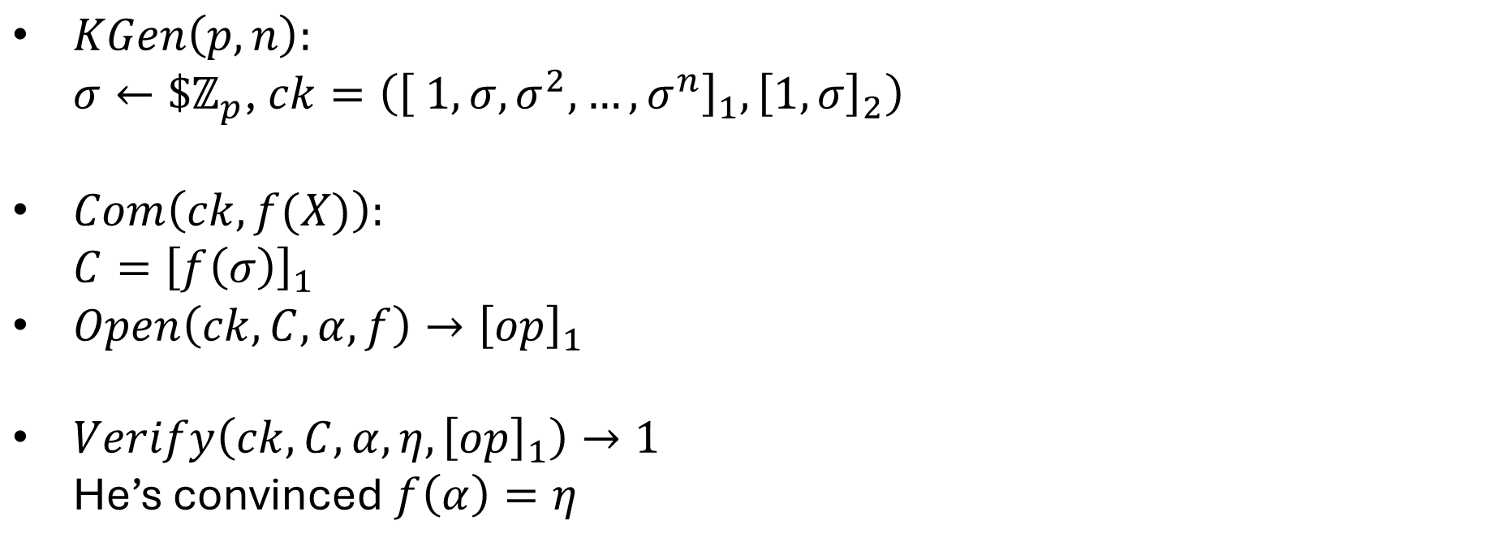
KZG Polynomial Commitment Scheme
$KGen\left(p,n\right):$
  $σ←\$ℤ_{p}$, $ck=\left({\left[ 1, σ,σ^{2},…,σ^{n}\right]}_{1},{\left[1,σ\right]}_{2}\right)$
$Com\left(ck,f(X)\right):$
  $C={\left[f\left(σ\right)\right]}_{1}$
$Open\left(ck,C,α,f\right)→{\left[op\right]}_{1}$
$Verify\left(ck,C,α,η,{\left[op\right]}_{1}\right)→1$
  He’s convinced $f\left(α\right)=η$
Homomorphic commitment
$$Com\left(ck,a f\left(X\right)+b g\left(X\right)\right)=a{\left[f\left(σ\right)\right]}_{1}+b{\left[g\left(σ\right)\right]}_{1}$$

Slide 8





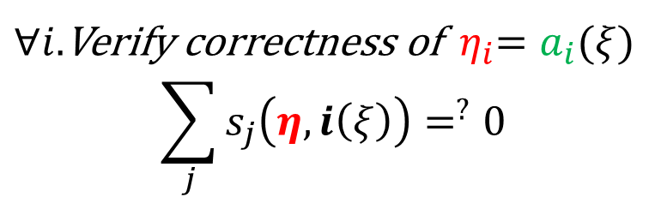
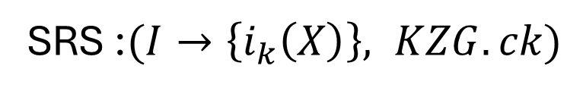
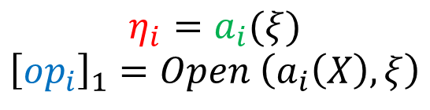



Interactive non-optimized Plonk
SRS :$(I→\left\{i_{k}\left(X\right)\right\}, KZG.ck)$
$$P(SRS,x,w)$$
$$V(SRS,x)$$
$${\left[a_{1},a_{2}\right]}_{1}$$
$${\left[a_{i}\right]}_{1}=Com \left(a_{i}\left(X\right)\right)$$
$$chall_{1}$$
$${\left[a_{m−1},a_{m}\right]}_{1}$$
$$ξ$$
$∀i.$Verify correctness of ${ η}_{i}=a_{i}(ξ)$
$$\sum_{j}{s_{j}\left(η,i\left(ξ\right)\right)=^{?}0}$$
$$η_{i}=a_{i}(ξ)$$
$${\left[{op}_{i}\right]}_{1}=Open \left(a_{i}\left(X\right),ξ\right)$$
$${\left[{op}_{1},…,{op}_{m}\right]}_{1},η_{1},…,η_{m}$$

Slide 9
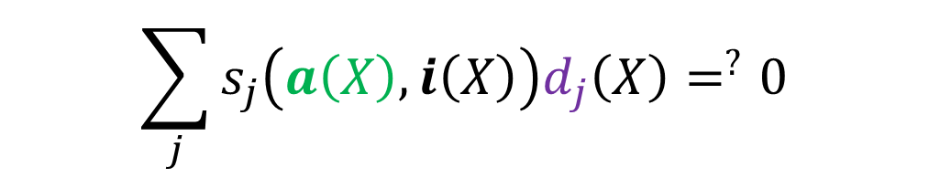
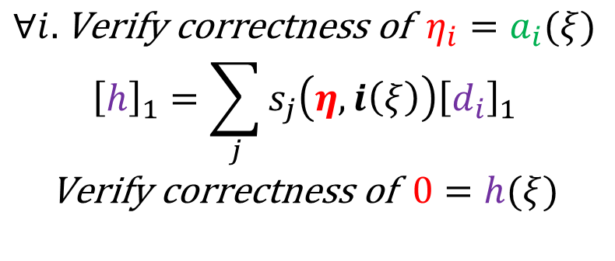


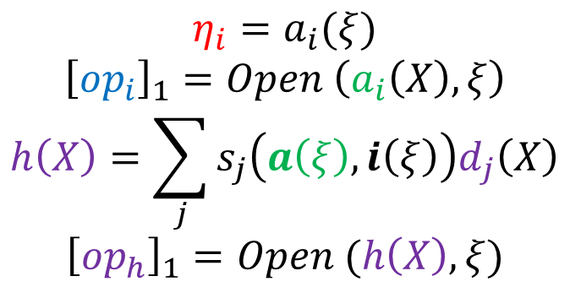


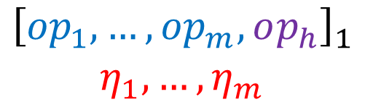


Linearization trick
$$\sum_{j}{s_{j}\left(a\left(X\right),i\left(X\right)\right)d_{j}\left(X\right)=^{?}0}$$
$$P(SRS,x,w)$$
$$V(SRS,x)$$
$${\left[a_{i}\right]}_{1}=Com \left(a_{i}\left(X\right)\right)$$
$${\left[a,d \right]}_{1}$$
$${\left[d_{i}\right]}_{1}=Com \left(d_{i}\left(X\right)\right)$$
$$ξ$$
$$η_{i}=a_{i}(ξ)$$
$${\left[{op}_{i}\right]}_{1}=Open \left(a_{i}\left(X\right),ξ\right)$$
$$h\left(X\right)=\sum_{j}{s_{j}\left(a\left(ξ\right),i\left(ξ\right)\right)d_{j}\left(X\right)}$$
$${\left[op_{h}\right]}_{1}=Open (h\left(X\right),ξ)$$
$${\left[{op}_{1},…,{op}_{m},op_{h}\right]}_{1}$$
$$η_{1},…,η_{m}$$
$$∀i.\text{Verify} \text{correctness} \text{of} { η}_{i}=a_{i}(ξ)$$
$${\left[h\right]}_{1}=\sum_{j}{s_{j}\left(η,i\left(ξ\right)\right){\left[d_{i}\right]}_{1}}$$
$$\text{Verify} \text{correctness} \text{of} 0=h(ξ)$$

Slide 10


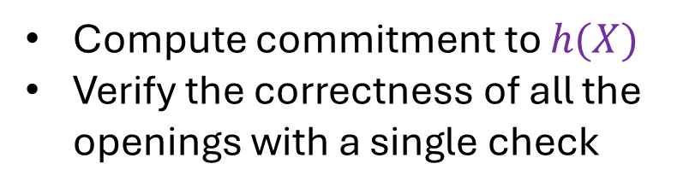


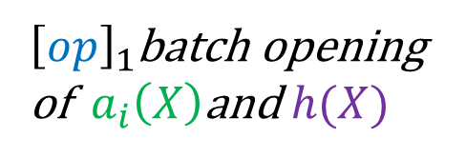
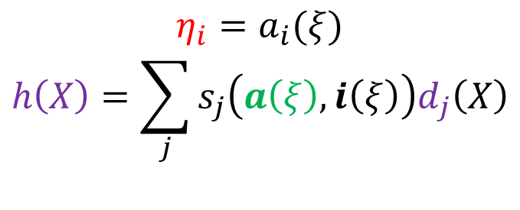


Interactive optimized Plonk
$$\sum_{j}{s_{j}\left(a\left(X\right),i\left(X\right)\right)d_{j}\left(X\right)=^{?}0}$$
$$P(SRS,x,w)$$
$$V(SRS,x)$$
$${\left[a_{i}\right]}_{1}=Com \left(a_{i}\left(X\right)\right)$$
$${\left[d_{i}\right]}_{1}=Com \left(d_{i}\left(X\right)\right)$$
$${\left[a,d \right]}_{1}$$
$$ξ$$
$$η_{i}=a_{i}(ξ)$$
$$h\left(X\right)=\sum_{j}{s_{j}\left(a\left(ξ\right),i\left(ξ\right)\right)d_{j}\left(X\right)}$$
$$η_{1},…,η_{m}$$
$$β$$
Compute commitment to $h(X)$
Verify the correctness of all the openings with a single check
${\left[op\right]}_{1}$batch opening of $a_{i}\left(X\right)$and $h(X)$
$${\left[op\right]}_{1}$$

Slide 11
Popular Framework (Plonk, Lunar, Marlin)
An information-theoretic proof model
  Ideal Plonk
An extractable polynomial commitment scheme
  KZG
Compiler
Succinct interactive ZK argument
Fiat-Shamir transform
Random Oracle
Idealized cryptographic groups (AGM, GGM)
SNARK

Slide 12






KZG Extractability in Plonk Original Proof
$$KGen\left(p,n\right)→ck$$
$$C←A(ck,aux)$$
AGM extractor
$$f\left(X\right) :C=Com\left(ck,f\left(X\right)\right)$$
Extraction only from commitment, without an opening
Extraction from the KZG commitment does not hold in the standard model!!!
[Lipmaa,Parisella,Siim 2023]

Slide 13
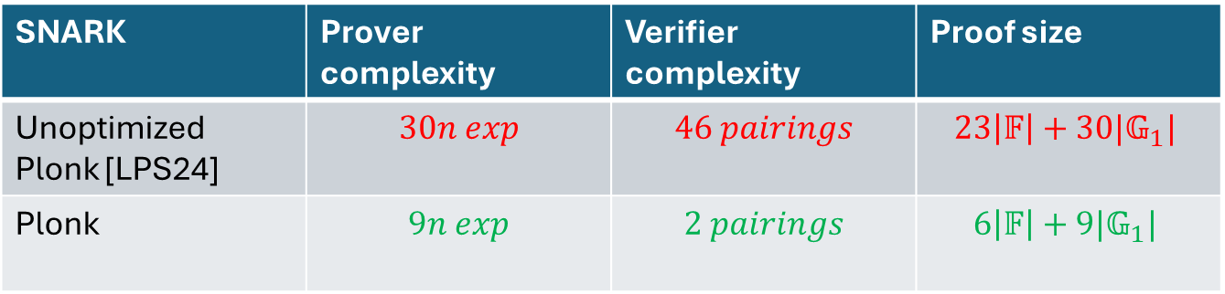
EC 2024 security proof
[Lipmaa,Parisella,Siim 2024]
KZG is extractable under a falsifiable assumption
ARSDH assumption
New succinct knowledge-sound interactive argument
Plonk PIOP (no optimization) in ROM
No batching
No linearization trick
SNARK | Prover complexity | Verifier complexity | Proof size
Unoptimized Plonk [LPS24] | $$30n exp$$ | $$46 pairings$$ | $$23\left|𝔽\right|+30|𝔾_{1}|$$
Plonk | $$9n exp$$ | $$2 pairings$$ | $$6\left|𝔽\right|+9|𝔾_{1}|$$

Slide 14
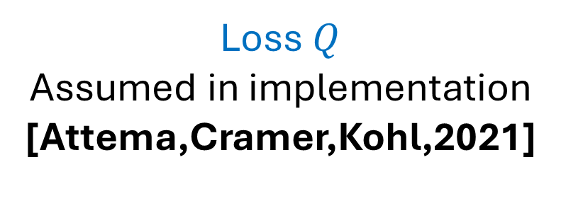
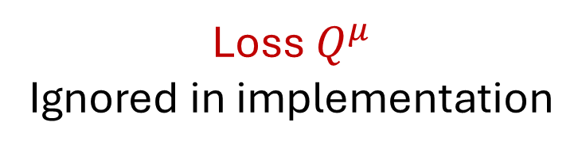
Fiat-Shamir from knowledge-sound arguments
Fiat-Shamir transform
Succinct interactive ZK argument
SNARK
Random Oracle
Knowledge-soundness
[Gabizon,Williamson,Ciobotaru 2019]
[Lipmaa,Parisella,Siim 2024]
Loss $Q^{μ}$
Ignored in implementation
Loss $Q$
Assumed in implementation
[Attema,Cramer,Kohl,2021]
Special-soundness
(stronger soundness notion)
Is Plonk special-sound?

Slide 15
Talk Outlines
Plonk preliminaries and limitations in previous security proofs.
On the knowledge soundness of the linearization trick.
On the knowledge soundness of Plonk.

Slide 16
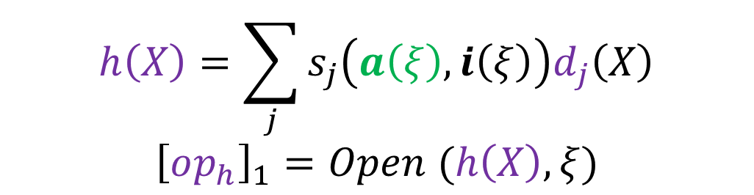
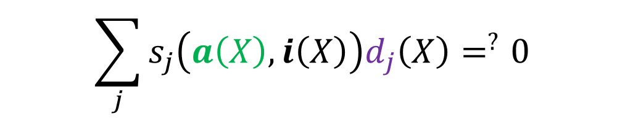
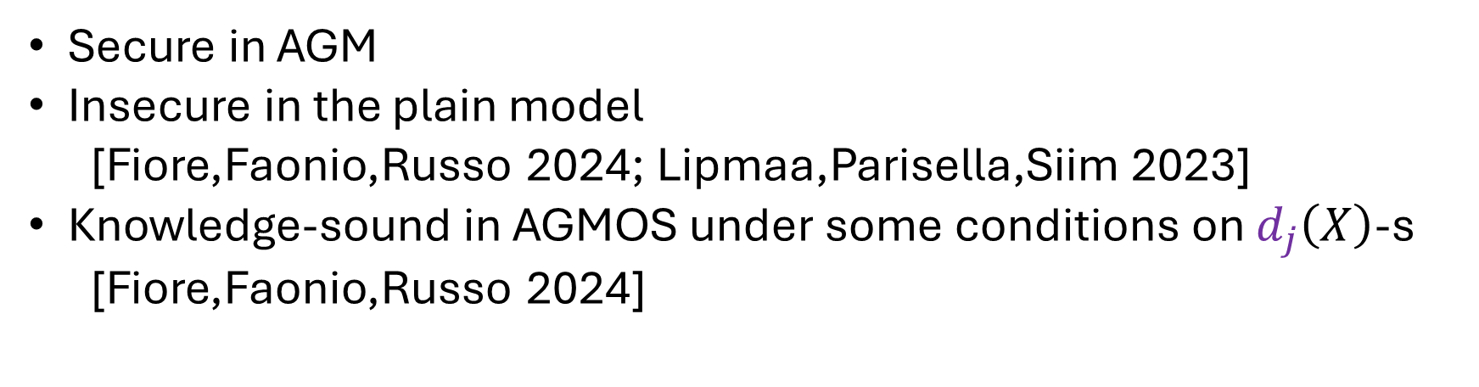
Linearization trick security
$$\sum_{j}{s_{j}\left(a\left(X\right),i\left(X\right)\right)d_{j}\left(X\right)=^{?}0}$$
$$h\left(X\right)=\sum_{j}{s_{j}\left(a\left(ξ\right),i\left(ξ\right)\right)d_{j}\left(X\right)}$$
$${\left[op_{h}\right]}_{1}=Open (h\left(X\right),ξ)$$
Secure in AGM
Insecure in the plain model
  [Fiore,Faonio,Russo 2024; Lipmaa,Parisella,Siim 2023]
Knowledge-sound in AGMOS under some conditions on $d_{j}\left(X\right)$-s
  [Fiore,Faonio,Russo 2024]

Slide 17
Special-soundness of Lin-trick
The linearization trick cannot be special-sound
Even when knowledge-soundness holds in AGMOS
Special-soundness is impossible
DL-assumption
Can be extended to knowledge-soundness is impossible

Slide 18
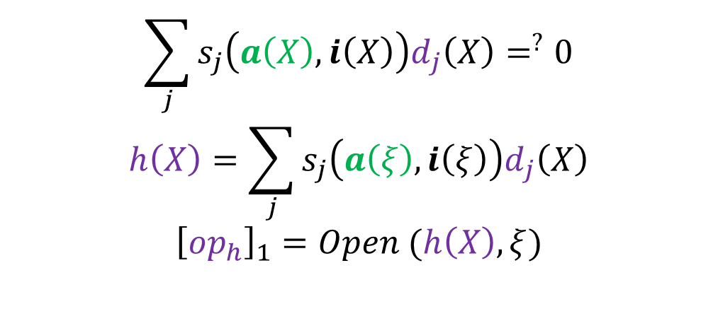
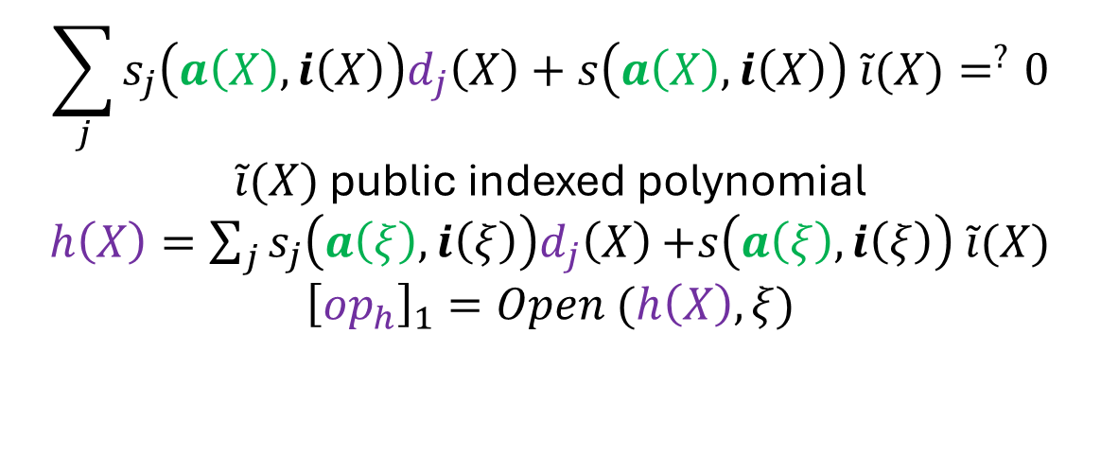
Plonk use linearization trick …
Or does it?
Linearization trick
Plonk
$$\sum_{j}{s_{j}\left(a\left(X\right),i\left(X\right)\right)d_{j}\left(X\right)=^{?}0}$$
$$h\left(X\right)=\sum_{j}{s_{j}\left(a\left(ξ\right),i\left(ξ\right)\right)d_{j}\left(X\right)}$$
$${\left[op_{h}\right]}_{1}=Open (h\left(X\right),ξ)$$
$$\sum_{j}{s_{j}\left(a\left(X\right),i\left(X\right)\right)d_{j}\left(X\right)+s\left(a\left(X\right),i\left(X\right)\right) \tilde{i}(X)=^{?}0}$$
$\tilde{i}(X)$ public indexed polynomial
$h\left(X\right)=\sum_{j}{s_{j}\left(a\left(ξ\right),i\left(ξ\right)\right)d_{j}\left(X\right)}$ $+s\left(a\left(ξ\right),i\left(ξ\right)\right) \tilde{i}(X)$
$${\left[op_{h}\right]}_{1}=Open (h\left(X\right),ξ)$$

Slide 19
Talk Outlines
Plonk preliminaries and limitations in previous security proofs.
On the knowledge soundness on the linearization trick.
On the knowledge soundness of Plonk.

Slide 20


RHINO
Reduction to a hard assumption if not polynomial
The last epic challenge
Ensure extraction of unopened polynomials ${\left[d\right]}_{1}$ for Plonk

Slide 21
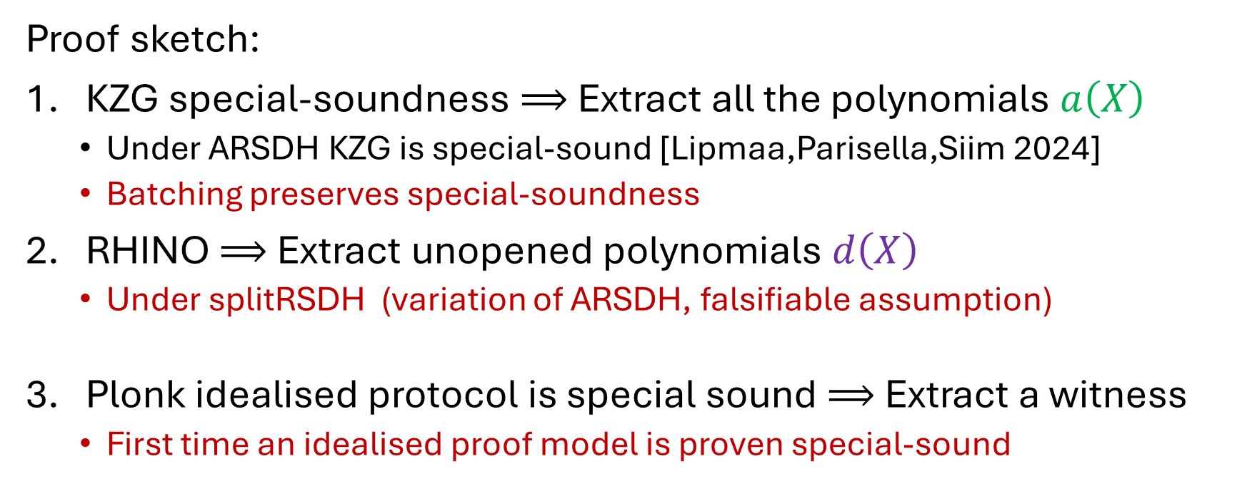
Interactive Plonk is special-sound
Proof sketch:
KZG special-soundness $⟹$ Extract all the polynomials $a\left(X\right)$
  Under ARSDH KZG is special-sound [Lipmaa,Parisella,Siim 2024]
  Batching preserves special-soundness
RHINO $⟹$ Extract unopened polynomials $d\left(X\right)$
  Under splitRSDH (variation of ARSDH, falsifiable assumption)
Plonk idealised protocol is special sound $⟹$ Extract a witness
  First time an idealised proof model is proven special-sound
Plonk is tightly knowledge-sound in the ROM

Slide 22
Thanks for your attention
Questions?
[Gabizon,Williamson,Ciobataru 2019]
  PLONK: Permutations over Lagrange-bases for Oecumenical Noninteractive Arguments of Knowledge
[Attema,Cramer,Kohl,2021]
  A compressed Σ-protocol theory for lattices
[Lipmaa,Parisella,Siim 2023]
  Algebraic Group Model with Oblivious Sampling
[Lipmaa,Parisella,Siim 2024]
  Constant-Size zk-SNARKs in ROM from Falsifiable Assumptions
[Fiore,Faonio,Russo 2024]
  Real-world Universal zkSNARKs are non-malleable

