Slide 1



Straight-Line Knowledge Extraction for Multi-Round Protocols
Lior Rotem
Stanford → Hebrew University
Stefano Tessaro
University of Washington

Slide 2
What this talk is about:
Non-interactive arguments of knowledge in the ROM
Interactive arguments of knowledge

Slide 3






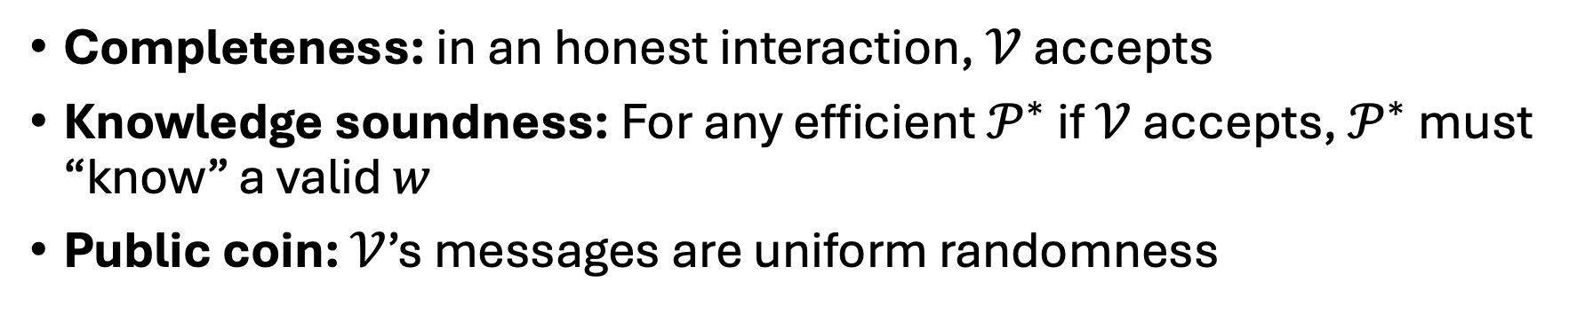
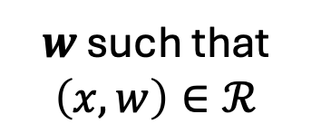
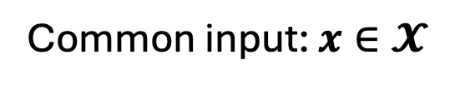

Interactive Arguments of Knowledge
Prover $𝓟$
Common input: $x∈𝓧$
Verifier $𝓥$
$$a_{1}$$
$$c_{1}$$
$w$ such that
$$\left(x,w\right)∈ℛ$$
…
accept/reject
$$a_{r+1}$$
Completeness: in an honest interaction, $𝒱$ accepts
Knowledge soundness: For any efficient $𝒫^{∗}$ if $𝒱$ accepts, $𝒫^{∗}$ must “know” a valid $w$
Public coin: $𝒱$’s messages are uniform randomness

Slide 4
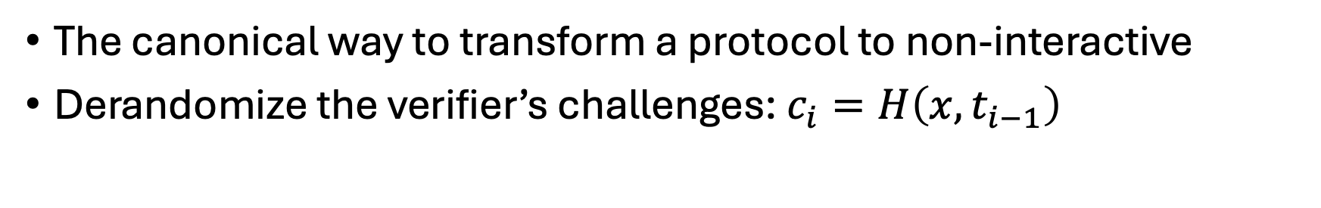
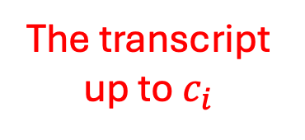
The Fiat-Shamir Transform [FS’86,PS’96,BN’06,…]
Prover $𝓟$
Common input: $x∈𝓧$
Verifier $𝓥$
$$a_{1}$$
$$c_{1}$$
$w$ such that
$$\left(x,w\right)∈ℛ$$
…
…
accept/reject
$$a_{r+1}$$
The canonical way to transform a protocol to non-interactive
Derandomize the verifier’s challenges: $c_{i}=H\left(x,t_{i−1}\right)$
The transcript up to $c_{i}$

Slide 5
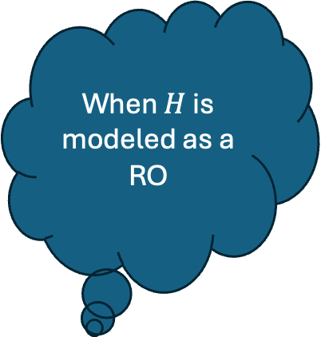

The Fiat-Shamir Transform [FS’86,PS’96,BN’06,…]
Prover $𝓟$
Common input: $x∈𝓧$
Verifier $𝓥$
When $H$ is modeled as a RO
$$π=\left(a_{1},c_{1},…,a_{r},c_{r},a_{r+1}\right)$$
$w$ such that
$$\left(x,w\right)∈ℛ$$
accept/reject
Knowledge soundness proven via rewinding & the Forking Lemma
Rewinding introduces issues:
Non-tight reductions

Slide 6
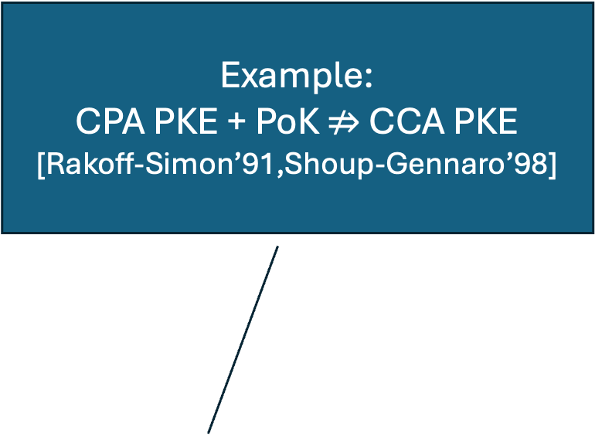
The Fiat-Shamir Transform [FS’86,PS’96,BN’06,…]
Prover $𝓟$
Common input: $x∈𝓧$
Verifier $𝓥$
Example:
CPA PKE + PoK $⇏$ CCA PKE
[Rakoff-Simon’91,Shoup-Gennaro’98]
$$π=\left(a_{1},c_{1},…,a_{r},c_{r},a_{r+1}\right)$$
$w$ such that
$$\left(x,w\right)∈ℛ$$
accept/reject
Knowledge soundness proven via rewinding & the Forking Lemma
Rewinding introduces issues:
Non-tight reductions
May not be secure under composition

Slide 7
The Fiat-Shamir Transform [FS’86,PS’96,BN’06,…]
Prover $𝓟$
Common input: $x∈𝓧$
Verifier $𝓥$
Only recently proven secure
[Attema-Fehr-Klooß’22, Wikstrom21,…]
$$π=\left(a_{1},c_{1},…,a_{r},c_{r},a_{r+1}\right)$$
$w$ such that
$$\left(x,w\right)∈ℛ$$
accept/reject
Knowledge soundness proven via rewinding & the Forking Lemma
Rewinding introduces issues:
Non-tight reductions
May not be secure under composition
Cumbersome for multi-round

Slide 8

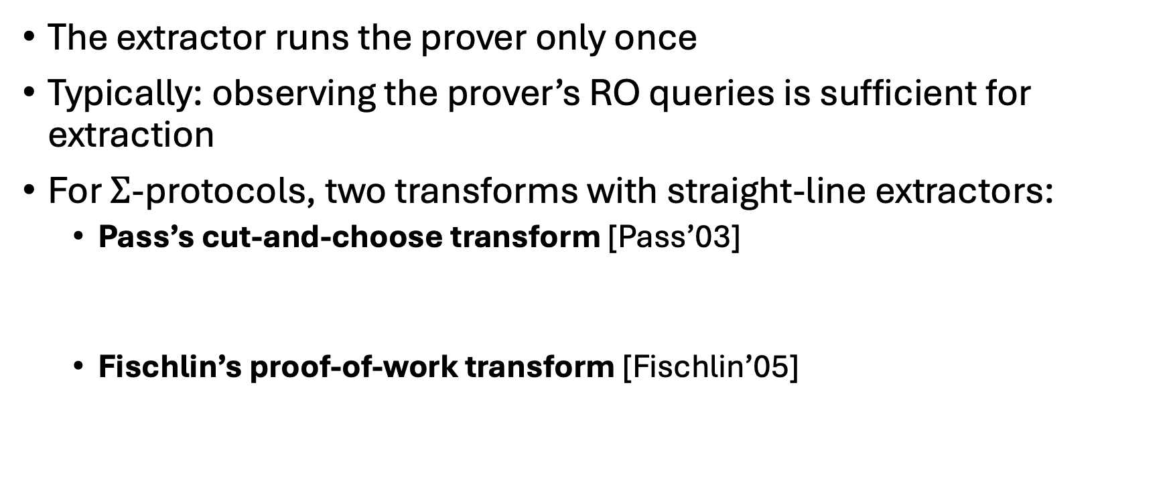
Straight-Line Extraction
The extractor runs the prover only once
Typically: observing the prover’s RO queries is sufficient for extraction
For $Σ$-protocols, two transforms with straight-line extractors:
  Pass’s cut-and-choose transform [Pass’03]
  Fischlin’s proof-of-work transform [Fischlin’05]
Post-quantum secure [Unruh’12…]
Secure under composition*
[Bernhard-Fischlin-Warinschi’15,…]
Tight reductions
Notes:
* At least sometimes

Slide 9
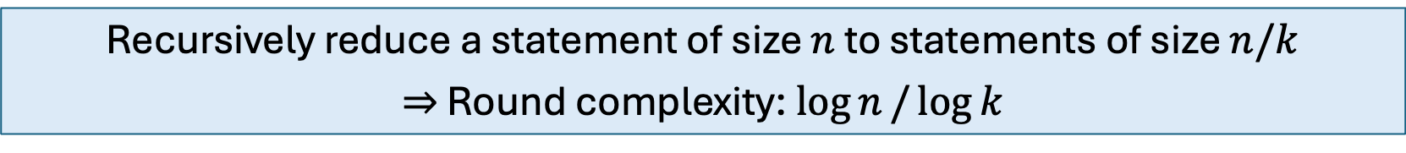
Multi-round protocols?
Pass’s and Fischlin’s transforms are for 3-round protocols
Not all public coin, special-sound protocols are 3-round
  5-round identification schemes
  Recursion-based arguments
  (Bulletproofs-style protocols, sumcheck-based protocls, accumualtion/folding)
Recursively reduce a statement of size $n$ to statements of size $n/k$
$⇒$ Round complexity: $\log{n}/\log{k}$
Can we design general transforms for multi-round protocols that achieve straight-line knowledge extraction in the ROM?

Slide 10
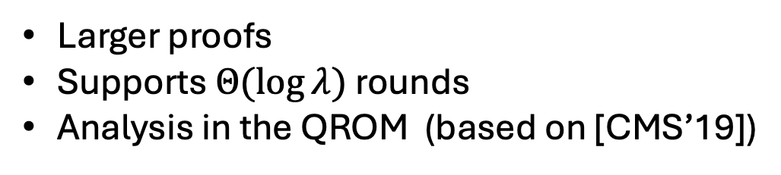
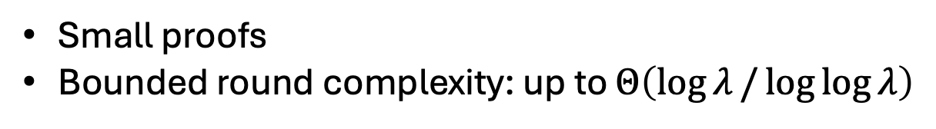
This Work
Two transformations in the ROM for multi-round protocols with straight-line knowledge extraction:
Transformation #1: Multi-round Fischlin
Small proofs
Bounded round complexity: up to $Θ\left(\log{λ}/\log{\log{λ}}\right)$
Today’s focus
Transformation #2: Multi-round cut-and-choose
First restriction-free transformation for
super-constant number of rounds
Larger proofs
Supports $Θ(log{λ})$ rounds
Analysis in the QROM (based on [CMS’19])

Slide 11
This Work
Two transformations in the ROM for multi-round protocols with straight-line knowledge extraction:
Without making further assumptions
Compilers that make additional assumptions exist

Slide 12
Remainder of the talk
Definitions:
  Multi-round special soundness
  Non-interactive RO arguments
Our Fischlin-based transform
Conclusion and open questions

Slide 13









Generalized Special Soundness
An $\left(n_{1},…,n_{r}\right)$-tree of transcripts – a collection of $N=n_{1}⋯n_{r}$ transcripts of a $\left(2r+1\right)$-round public coin argument of the form:
$$a_{1}$$
$$c_{1}^{1}$$
$$c_{1}^{n_{1}}$$
$c_{1}^{i}≠c_{1}^{j}$ for every $i≠j$
$$c_{1}^{2}$$
$$a_{2}^{1}$$
$$a_{2}^{2}$$
…
$$a_{2}^{n_{1}}$$

Slide 14







Generalized Special Soundness
An $\left(n_{1},…,n_{r}\right)$-tree of transcripts – a collection of $N=n_{1}⋯n_{r}$ transcripts of a $\left(2r+1\right)$-round public coin argument of the form:
$$a_{1}$$
$$c_{1}^{1}$$
$$c_{1}^{n_{1}}$$
$$c_{1}^{2}$$
$$a_{2}^{1}$$
$$a_{2}^{2}$$
…
$$a_{2}^{n_{1}}$$
$$c_{2}^{1}$$
$$c_{2}^{2}$$
$$c_{2}^{n_{2}}$$
$c_{2}^{i}≠c_{2}^{j}$ for every $i≠j$
$$a_{3}^{1}$$
$$a_{3}^{2}$$
…
$$a_{3}^{n_{2}}$$

Slide 15
Generalized Special Soundness
An $\left(n_{1},…,n_{r}\right)$-tree of transcripts – a collection of $N=n_{1}⋯n_{r}$ transcripts of a $\left(2r+1\right)$-round public coin argument of the form:
$$a_{1}$$
$$c_{1}^{1}$$
$$c_{1}^{n_{1}}$$
$$c_{1}^{2}$$
$$a_{2}^{1}$$
$$a_{2}^{2}$$
…
$$a_{2}^{n_{1}}$$
$$c_{2}^{1}$$
$$c_{2}^{2}$$
$$c_{2}^{n_{2}}$$
$c_{2}^{i}≠c_{2}^{j}$ for every $i≠j$
$$a_{3}^{1}$$
$$a_{3}^{2}$$
…
$$a_{3}^{n_{2}}$$

Slide 16
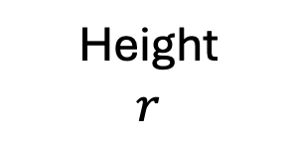
Generalized Special Soundness
An $\left(n_{1},…,n_{r}\right)$-tree of transcripts – a collection of $N=n_{1}⋯n_{r}$ transcripts of a $\left(2r+1\right)$-round public coin argument of the form:
$$a_{1}$$
$$c_{1}^{1}$$
$$c_{1}^{n_{1}}$$
$$c_{1}^{2}$$
$$a_{2}^{1}$$
$$a_{2}^{2}$$
…
$$a_{2}^{n_{1}}$$
Height
$$r$$
$$c_{2}^{1}$$
$$c_{2}^{2}$$
$$c_{2}^{n_{2}}$$
$$a_{3}^{1}$$
$$a_{3}^{2}$$
…
$$a_{3}^{n_{2}}$$

Slide 17
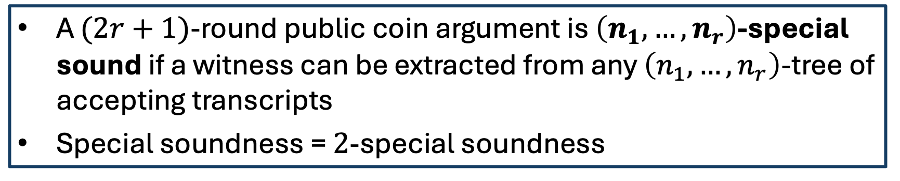
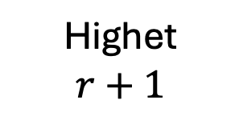
Generalized Special Soundness
An $\left(n_{1},…,n_{r}\right)$-tree of transcripts – a collection of $N=n_{1}⋯n_{r}$ transcripts of a $\left(2r+1\right)$-round public coin argument of the form:
$$a_{1}$$
$$c_{1}^{1}$$
$$c_{1}^{n_{1}}$$
$$c_{1}^{2}$$
$$a_{2}^{1}$$
$$a_{2}^{2}$$
…
$$a_{2}^{n_{1}}$$
Highet
$$r+1$$
A $(2r+1)$-round public coin argument is $\left(n_{1},…,n_{r}\right)$-special sound if a witness can be extracted from any $\left(n_{1},…,n_{r}\right)$-tree of accepting transcripts
Special soundness = $2$-special soundness
$$c_{2}^{1}$$
$$c_{2}^{2}$$
$$c_{2}^{n_{2}}$$
$$a_{3}^{1}$$
$$a_{3}^{2}$$
…
$$a_{3}^{n_{2}}$$

Slide 18


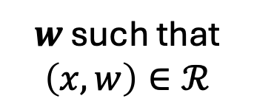
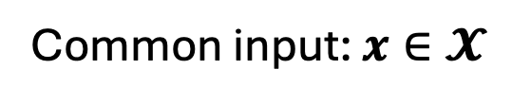
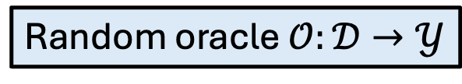



Non-Interactive RO Arguments
Random oracle $𝒪:𝒟→𝒴$
Prover $𝓟$
Verifier $𝓥$
Common input: $x∈𝓧$
$$π$$
$w$ such that
$$\left(x,w\right)∈ℛ$$
accept/reject
Completeness: in an honest interaction, $𝒱$ accepts

Slide 19
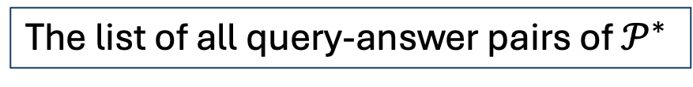

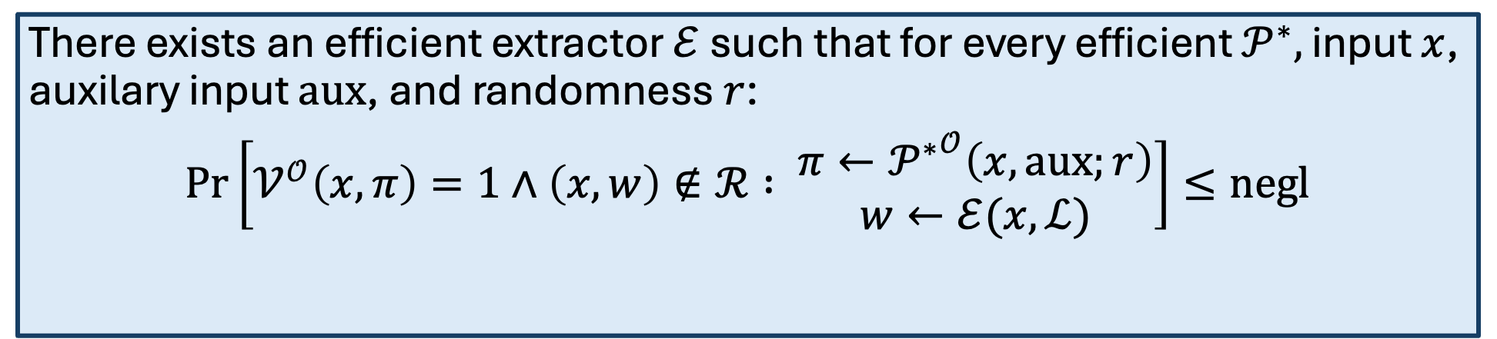
Straight Line Knowledge Soundness
Random oracle $𝒪:𝒟→𝒴$
$$𝓟^{∗}$$
Verifier $𝓥$
Common input: $x∈𝓧$
$$π$$
accept/reject
There exists an efficient extractor $ℰ$ such that for every efficient $𝒫^{∗},$ input $x$, auxilary input $aux$, and randomness $r$:
$\operatorname{Pr}\left[𝒱^{𝒪}\left(x,π\right)=1∧\left(x,w\right)∉ℛ : \begin{matrix}π←{𝒫^{∗}}^{𝒪}\left(x,aux;r\right) \\ w←ℰ(x,ℒ)\end{matrix}\right]≤negl$
The list of all query-answer pairs of $𝒫^{∗}$
Notes:
Extends to the adaptive setting

Slide 20
Remainder of the talk
Definitions:
  Multi-round special soundness
  Non-interactive RO arguments
Our Fischlin-based transform
Security in the QROM?
Conclusion and open questions

Slide 21



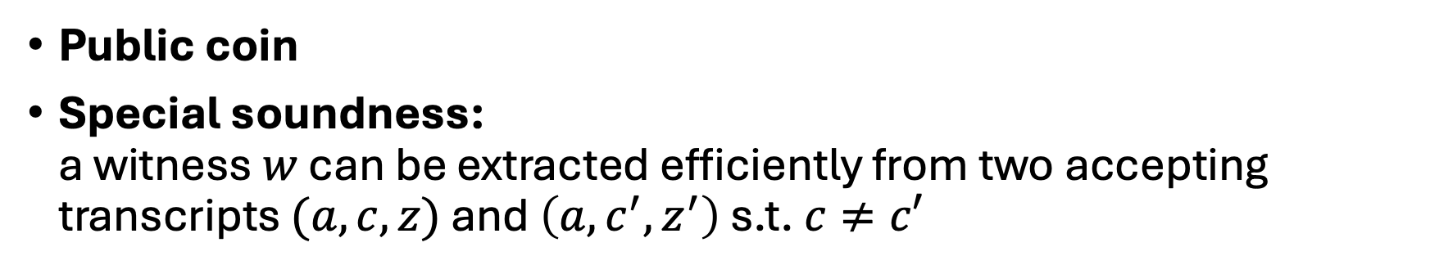

Recall: $Σ$-Protocols
Prover $𝓟$
Common input: $x∈𝓧$
Verifier $𝓥$
$$a$$
$$c$$
$w$ such that
$$\left(x,w\right)∈ℛ$$
$$z$$
accept/reject
Public coin
Special soundness:
a witness $w$ can be extracted efficiently from two accepting transcripts $(a,c,z)$ and $\left(a,c^{′},z^{′}\right)$ s.t. $c≠c′$

Slide 22
Recall: $Σ$-Protocols
Prover $𝓟$
Common input: $x∈𝓧$
Verifier $𝓥$
$$a$$
Fischlin’s idea: use a proof-of-work mechanism to force the prover querying the oracle on two accepting transcripts
$$c$$
$w$ such that
$$\left(x,w\right)∈ℛ$$
$$z$$
accept/reject
Public coin
Special soundness:
a witness $w$ can be extracted efficiently from two accepting transcripts $(a,c,z)$ and $\left(a,c^{′},z^{′}\right)$ s.t. $c≠c′$

Slide 23
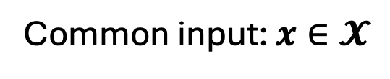
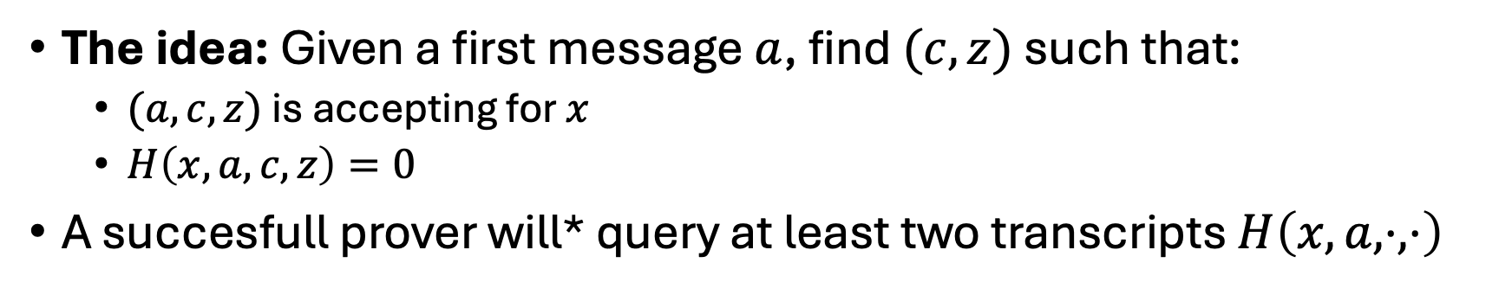



Fischlin’s transform
Prover $𝓟$
Common input: $x∈𝓧$
Verifier $𝓥$
$$π=\left(a,c,z\right)$$
accept/reject
The idea: Given a first message $a$, find $(c,z)$ such that:
  $(a,c,z)$ is accepting for $x$
  $H\left(x,a,c,z\right)=0$
A succesfull prover will* query at least two transcripts $H\left(x,a,⋅,⋅\right)$

Slide 24
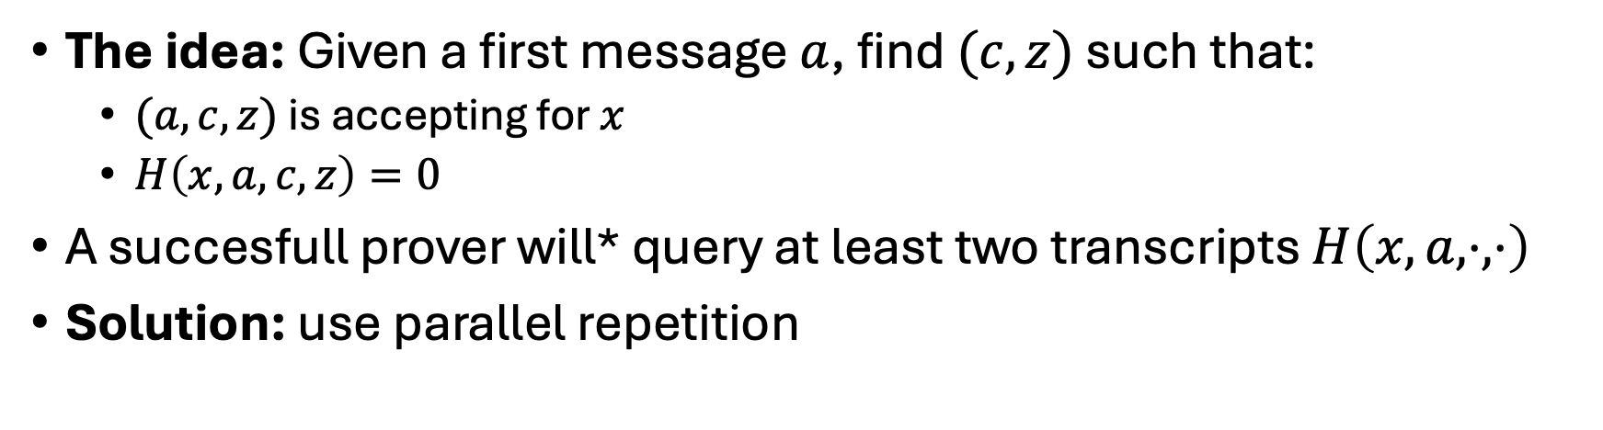
Fischlin’s transform
Prover $𝓟$
Common input: $x∈𝓧$
Verifier $𝓥$
$$π=\left(a,c,z\right)$$
accept/reject
Not quite true
The idea: Given a first message $a$, find $(c,z)$ such that:
  $(a,c,z)$ is accepting for $x$
  $H\left(x,a,c,z\right)=0$
A succesfull prover will* query at least two transcripts $H\left(x,a,⋅,⋅\right)$
Solution: use parallel repetition

Slide 25


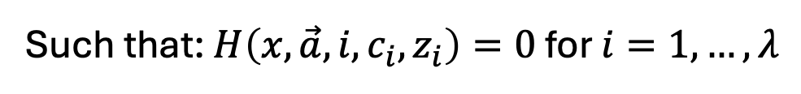


Fischlin’s transform
Prover $𝓟$
Common input: $x∈𝓧$
Verifier $𝓥$
$$a_{1},c_{1},z_{1}$$
…
$$π=$$
accept/reject
$$a_{λ},c_{λ},z_{λ}$$
Such that: $H\left(x,\vec{a},i,c_{i},z_{i}\right)=0$ for $i=1,…,λ$
Knowledge soundness error: ${≈2}^{−λ}$

Slide 26

Extending Fischlin’s transform: a first attempt
Repeat the same trick: Given a first message $a_{1}$, find $\left(c_{1},a_{2},…,a_{r},c_{r},a_{r+1}\right)$ such that:
  $(a_{1},c_{1},a_{2},…,a_{r},c_{r},a_{r+1})$ is accepting for $x$
  $H\left(x,a_{1},c_{1},a_{2},…,a_{r},c_{r},a_{r+1}\right)=0$
Repeat in parallel

Slide 27


Extending Fischlin’s transform: a first attempt
Prover $𝓟$
Common input: $x∈𝓧$
Verifier $𝓥$
$$a_{1}^{1},c_{1}^{1},a_{2}^{1},…,a_{r}^{1},c_{r}^{1},a_{r+1}^{1}$$
…
$$π=$$
accept/reject
$$a_{1}^{λ},c_{1}^{λ},a_{2}^{λ},…,a_{r}^{λ},c_{r}^{λ},a_{r+1}^{λ}$$
Such that: $H\left(x,\vec{a},i,c_{1}^{i},a_{2}^{i},…,a_{r}^{i},c_{r}^{i},a_{r+1}^{i}\right)=0$ for $i=1,…,λ$
NO!
Is this knowledge sound?

Slide 28
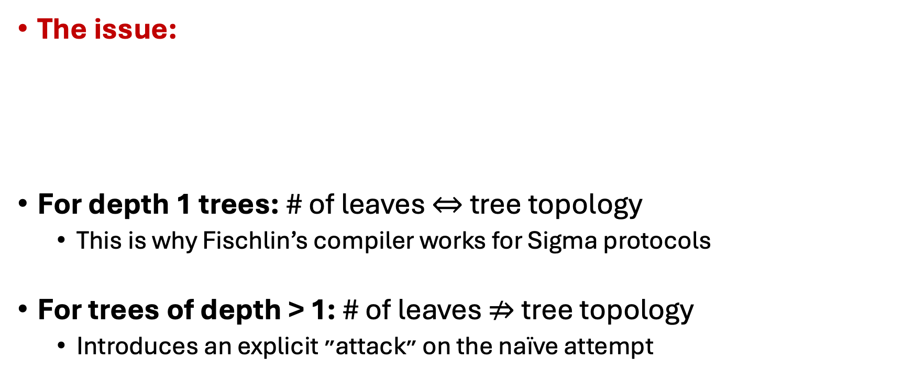
Extending Fischlin’s transform: a first attempt
The issue:
For depth 1 trees: # of leaves $⇔$ tree topology
  This is why Fischlin’s compiler works for Sigma protocols
For trees of depth > 1: # of leaves $⇏$ tree topology
  Introduces an explicit ״attack״ on the naïve attempt
We need:
A transcript tree with a special topology
We only get:
A transcript tree with many leaves

Slide 29















Extending Fischlin’s transform: a first attempt
Consider a (2,2)-special sound protocol
To extract, need a transcript tree of the form:
$$a_{1}$$
$$c_{1}$$
$$c_{1}^{′}$$
$${c_{1}≠c}_{1}^{′}$$
$$a_{2}^{1}$$
$$a_{2}^{2}$$
$$c_{2}$$
$$c_{2}^{′}$$
$$c_{2}^{′′}$$
$$c_{2}^{′′′}$$
$c_{2}≠c_{2}^{′}$ and $c_{2}^{′′}≠c_{2}^{′′′}$
$$a_{3}^{1}$$
$$a_{3}^{2}$$
$$a_{3}^{3}$$
$$a_{3}^{4}$$

Slide 30
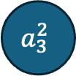










Extending Fischlin’s transform: a first attempt
A prover $𝒫^{∗}$ can:
  Fix $a_{1},c_{1},a_{2}$
  Re-sample $c_{2},a_{3}$ until $H\left(x,a_{1},c_{1},a_{2},c_{2},a_{3}\right)=0$
What we need:
$$a_{1}$$
$$c_{1}$$
$$c_{1}^{′}$$
$$a_{2}^{1}$$
$$a_{2}^{2}$$
$$c_{2}$$
$$c_{2}^{′}$$
$$c_{2}^{′′}$$
$$c_{2}^{′′′}$$
$$a_{3}^{1}$$
$$a_{3}^{2}$$
$$a_{3}^{3}$$
$$a_{3}^{4}$$

Slide 31


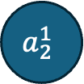





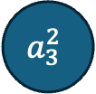

Extending Fischlin’s transform: a first attempt
What we need:
What we might get:
Insufficient for extraction!
$$a_{1}$$
$$a_{1}$$
$$c_{1}$$
$$c_{1}^{′}$$
$$c_{1}$$
$$a_{2}^{1}$$
$$a_{2}^{2}$$
$$a_{2}^{1}$$
$$c_{2}$$
$$c_{2}^{′}$$
$$c_{2}^{′′}$$
$$c_{2}^{′′′}$$
$$c_{2}^{1}$$
$$c_{2}^{m}$$
$m=O\left(1\right)$ whp
$$c_{2}^{2}$$
$$a_{3}^{1}$$
$$a_{3}^{2}$$
$$a_{3}^{3}$$
$$a_{3}^{4}$$
$$a_{3}^{1}$$
$$a_{3}^{2}$$
…
$$a_{3}^{m}$$

Slide 32
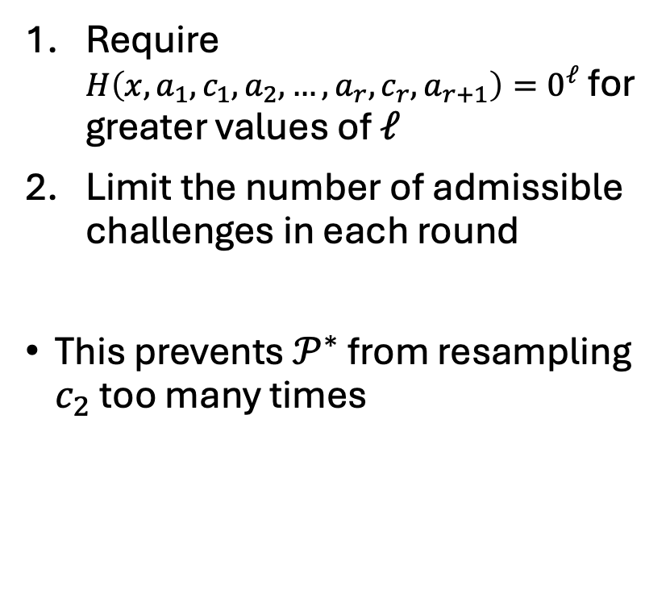
Extending Fischlin’s transform: a first attempt
Fix idea:
What we might get:
Require $H\left(x,a_{1},c_{1},a_{2},…,a_{r},c_{r},a_{r+1}\right)=0^{ℓ}$ for greater values of $ℓ$
Limit the number of admissible challenges in each round
This prevents $𝒫^{∗}$ from resampling $c_{2}$ too many times
Insufficient for extraction!
$$a_{1}$$
$$c_{1}$$
$$a_{2}^{1}$$
$$c_{2}^{1}$$
$$c_{2}^{m}$$
$m=O\left(1\right)$ whp
$$c_{2}^{2}$$
$$a_{3}^{1}$$
$$a_{3}^{2}$$
…
$$a_{3}^{m}$$

Slide 33



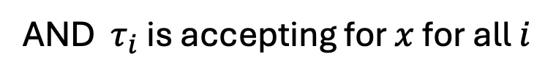
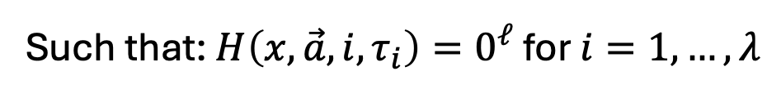
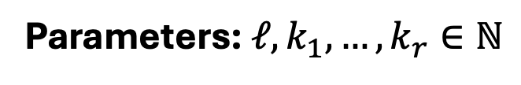


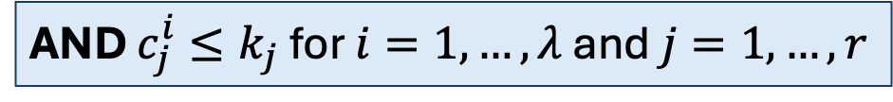
Our Transformation
Parameters: $ℓ,k_{1},…,k_{r}∈ℕ$
Prover $𝓟$
Common input: $x∈𝓧$
Verifier $𝓥$
$$τ_{1}=a_{1}^{1},c_{1}^{1},…,a_{r}^{1},c_{r}^{1},a_{r+1}^{1}$$
Suppose challenges are integers…
…
$$π=$$
$${τ_{λ}=a}_{1}^{λ},c_{1}^{λ},…,a_{r}^{λ},c_{r}^{λ},a_{r+1}^{λ}$$
Such that: $H\left(x,\vec{a},i,τ_{i}\right)=0^{ℓ}$ for $i=1,…,λ$
AND $τ_{i}$ is accepting for $x$ for all $i$
AND $c_{j}^{i}≤k_{j}$ for $i=1,…,λ$ and $j=1,…,r$

Slide 34
Our Transformation
Parameters: $ℓ,k_{1},…,k_{r}∈ℕ$
Prover $𝓟$
Common input: $x∈𝓧$
Verifier $𝓥$
Main insight:
For bounded arity trees: # of leaves $⇝$ topolgy of the tree
$$τ_{1}=a_{1}^{1},c_{1}^{1},…,a_{r}^{1},c_{r}^{1},a_{r+1}^{1}$$
Limiting the challenge space essentially bounds the arity of transcript tree induces by the adversary’s queries
…
$$π=$$
$${τ_{λ}=a}_{1}^{λ},c_{1}^{λ},…,a_{r}^{λ},c_{r}^{λ},a_{r+1}^{λ}$$
Such that: $H\left(x,\vec{a},i,τ_{i}\right)=0^{ℓ}$ for $i=1,…,λ$
AND $τ_{i}$ is accepting for $x$ for all $i$
AND $c_{j}^{i}≤k_{j}$ for $i=1,…,λ$ and $j=1,…,r$

Slide 35

A careful balance act
A “malicious” prover $𝒫^{∗}$ will eventually run out of transcripts…
On the other hand... an honest prover is bounded too
Yes!
(sometimes)
An honest prover has a greater “budget”
Can we set the parameters in such that:
An honest prover succeeds whp
A “malicious” prover does not
?

Slide 36
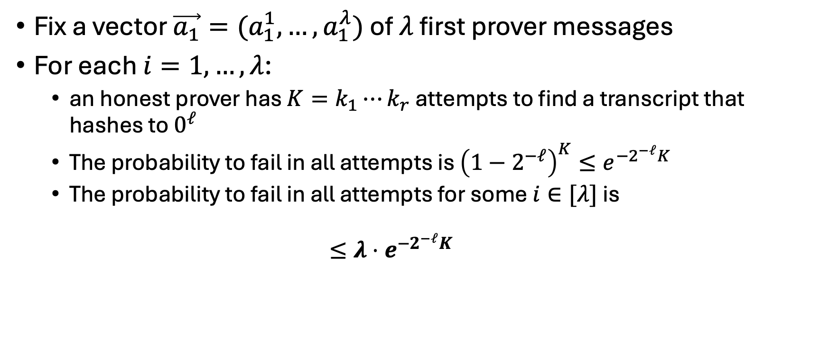
Completeness
Fix a vector $\vec{a_{1}}=(a_{1}^{1},…,a_{1}^{λ})$ of $λ$ first prover messages
For each $i=1,…,λ$:
  an honest prover has $K=k_{1}⋯k_{r}$ attempts to find a transcript that hashes to $0^{ℓ}$
  The probability to fail in all attempts is ${\left(1−2^{−ℓ}\right)}^{K}≤e^{−2^{−ℓ}K}$
  The probability to fail in all attempts for some $i∈[λ]$ is
  ${≤λ⋅e}^{−2^{−ℓ}K}$

Slide 37
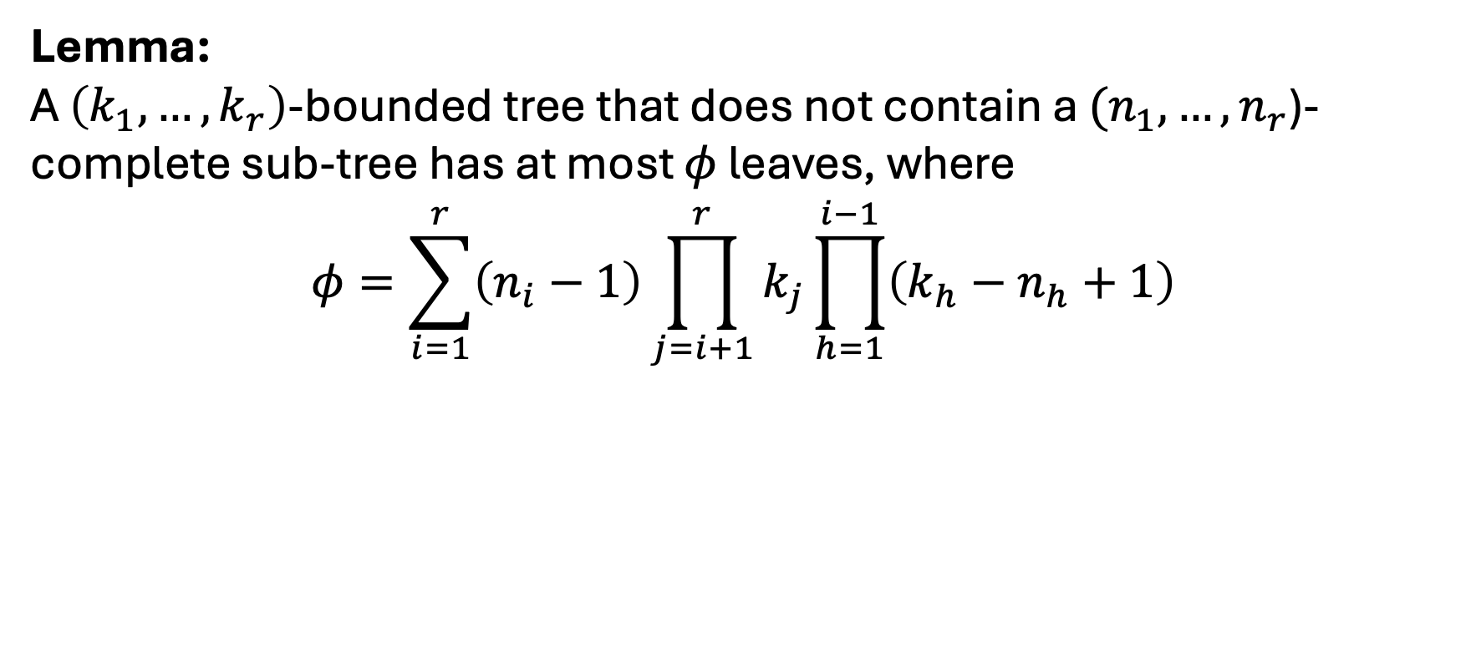
Knowledge Soundness
We want to argue that a prover from which we cannot extract has much fewer attempts to find a “good” transcript
But how many attempts does it have?
Lemma:
A $\left(k_{1},…,k_{r}\right)$-bounded tree that does not contain a $(n_{1},…,n_{r}$)-complete sub-tree has at most $φ$ leaves, where
$$φ=\sum_{i=1}^{r}{\left(n_{i}−1\right)}\prod_{j=i+1}^{r}{k_{j}}\prod_{h=1}^{i−1}{\left(k_{h}−n_{h}+1\right)}$$

Slide 38
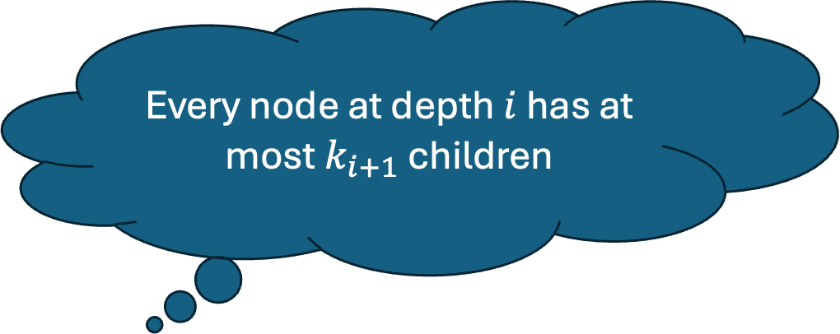
Knowledge Soundness
Every node at depth $i$ has at most $k_{i+1}$ children
We want to argue that a prover from which we cannot extract has much fewer attempts to find a “good” transcript
But how many attempts does it have?
Lemma:
A $\left(k_{1},…,k_{r}\right)$-bounded tree that does not contain a $(n_{1},…,n_{r}$)-complete sub-tree has at most $φ$ leaves, where
$$φ=\sum_{i=1}^{r}{\left(n_{i}−1\right)}\prod_{j=i+1}^{r}{k_{j}}\prod_{h=1}^{i−1}{\left(k_{h}−n_{h}+1\right)}$$

Slide 39
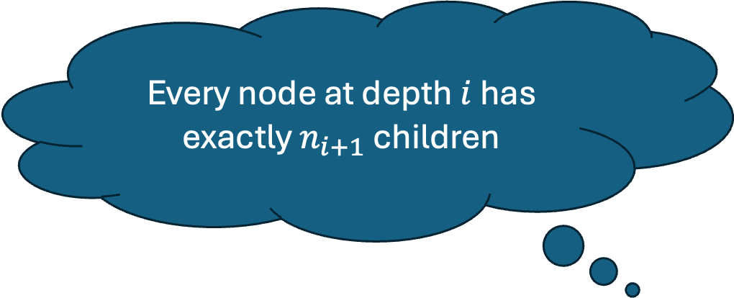
Knowledge Soundness
Every node at depth $i$ has exactly $n_{i+1}$ children
We want to argue that a prover from which we cannot extract has much fewer attempts to find a “good” transcript
But how many attempts does it have?
Lemma:
A $\left(k_{1},…,k_{r}\right)$-bounded tree that does not contain a $(n_{1},…,n_{r}$)-complete sub-tree has at most $φ$ leaves, where
$$φ=\sum_{i=1}^{r}{\left(n_{i}−1\right)}\prod_{j=i+1}^{r}{k_{j}}\prod_{h=1}^{i−1}{\left(k_{h}−n_{h}+1\right)}$$

Slide 40
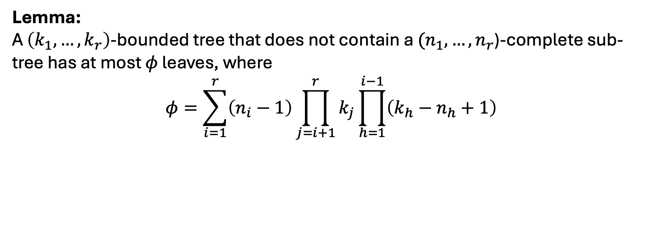
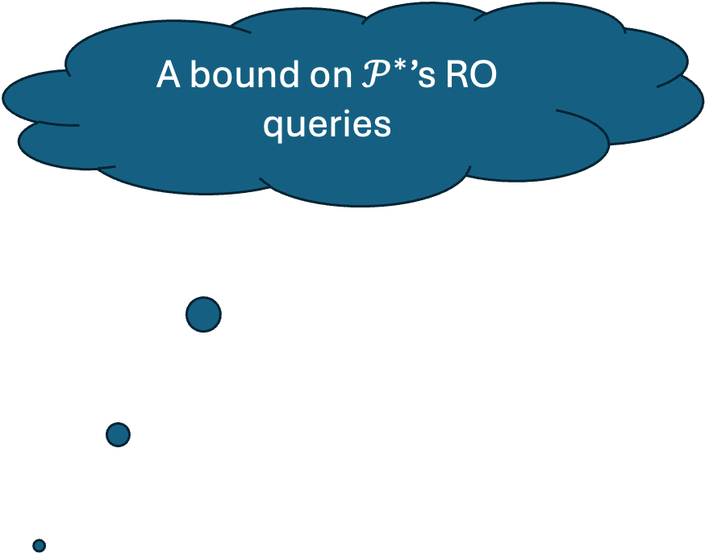
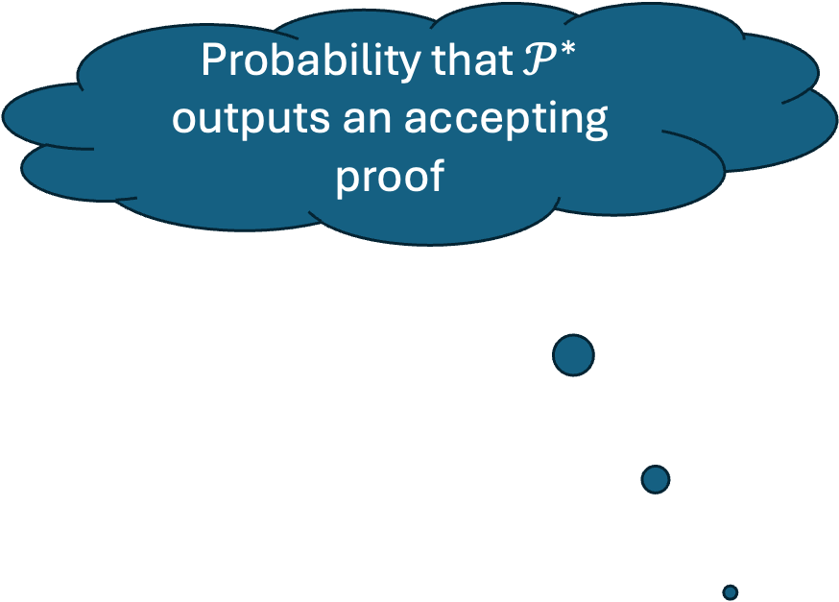

Knowledge Soundness
Lemma:
A $\left(k_{1},…,k_{r}\right)$-bounded tree that does not contain a $(n_{1},…,n_{r}$)-complete sub-tree has at most $φ$ leaves, where
$$φ=\sum_{i=1}^{r}{\left(n_{i}−1\right)}\prod_{j=i+1}^{r}{k_{j}}\prod_{h=1}^{i−1}{\left(k_{h}−n_{h}+1\right)}$$
A bound on $𝒫^{∗}$’s RO queries
Probability that $𝒫^{∗}$ outputs an accepting proof
Theorem (informal):
If the underlying protocol is $\left(n_{1},…,n_{r}\right)$-special sound, then there is an extractor $ℰ$ that for every prover $𝒫^{∗}$ outputs a witness w.p. at least
$$ε_{𝒫^{∗}}−Q_{𝒫^{∗}}⋅{\left(2^{−ℓ}⋅φ\right)}^{λ}$$
Notes:
Explain how the theorem follows

Slide 41











Setting the parameters
$$K=k_{1}⋯k_{r}$$
If $k_{i}=c⋅n_{i}$ for some parameter $c$ then
$\sum_{i=1}^{r}{\left(n_{i}−1\right)}\prod_{j=i+1}^{r}{k_{j}}\prod_{h=1}^{i−1}{\left(k_{h}−n_{h}+1\right)}≤\frac{K⋅r}{c}$
Correctness error: ${λ⋅e}^{−2^{−ℓ}K}$
Knowledge soundness error: ${\left(\frac{2^{−ℓ}Kr}{c}\right)}^{λ}$
$$2^{−ℓ}K≈\log{2λ}$$
$$c=Θ\left(r\log{λ}\right)$$
$⇒$ correctness error $≈1/2$
$⇒$ soundness error $≈2^{−λ}$
$⇒$ $2^{−ℓ}≈\frac{\log{2λ}}{N⋅{\left(\log{λ}\right)}^{r}}$
Works as long as $r=O\left(\frac{\log{λ}}{\log{\log{λ}}}\right)$
$$\left(N=n_{1}⋯n_{r}\right)$$
Notes:
Remark about correctness error

Slide 42
An ignored fact
Our transform (like Fischlin’s) requires some notion of unique responses
Most protocols do not satisfy the standard notion of unique responses!
We define a new weaker notion: “random-challenge unique response” and show that it:
  Suffices for our transformation
  Satisfied by natural protocols (e.g., Bulletproofs)

Slide 43



Recapping
Two transformations for multi-round protocols with straight-line extraction:
Transformation #1:
Multi-round Fischlin
Transformation #2:
Multi-round cut-and-choose
Small proofs
Bounded round complexity: up to $Θ\left(\log{λ}/\log{\log{λ}}\right)$
Larger proofs
Supports $Θ(log{λ})$ rounds
Analysis in the QROM
Open questions:
  $\log{λ}$ rounds without the cut-and-choose overhead (in the ROM)?
  Is parallel repetition necessary in the ROM?
  QROM security of Transformation #1?
  Generally, QROM security of games where “winning” is done bit-by-bit
Thank you!
ia.cr/2024/1724

