Slide 1

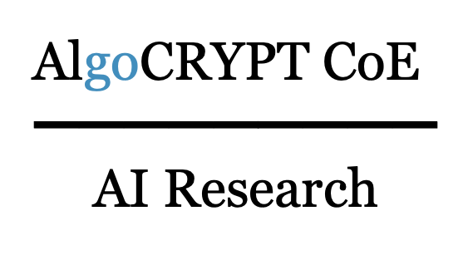

OPA: One-shot Private Aggregation with Single Client Interaction and its Applications to Federated Learning
Willow: Secure Aggregation with One-Shot Clients
Harish Karthikeyan, Antigoni Polychroniadou
James Bell-Clark, Adria Gascon, Baiyu Li, Mariana Raykova,
Phillipp Schoppmann

Slide 2
OPA: One-shot Private Aggregation with Single Client Interaction and its Applications to Federated Learning
Willow: Secure Aggregation with One-Shot Clients
WillOPA
Harish Karthikeyan, Antigoni Polychroniadou
James Bell-Clark, Adria Gascon, Baiyu Li, Mariana Raykova,
Phillipp Schoppmann

Slide 3



PC Chair
Merge!

Slide 4
Outline
Background: secure aggregation protocols
One-shot aggregation with low committee communication
Willow: decryption via threshold homomorphic encryption
OPA: decryption via secret sharing

Slide 5
Background: secure aggregation protocols

Slide 6


Setting
Single-server secure aggregation:
Many weak Clients. Client i∈ [n] owns x_{i} ∈ [t]^{ℓ}
A central Server wants to compute ∑ x_{i}
Typical use cases: federated learning, private statistics
Server trains a model (for example, Gboard suggestions)
Devices submit model updates or statistics (quantized vector with ℓ coordinates)
But inputs can be sensitive (untrusted Server) and Clients can drop offline or act maliciously (untrusted Clients)

Slide 7


Secure aggregation properties
Security: malicious Server, colluding with n-1 malicious Clients, should not be able to learn anything more than the output of the functionality.
Functionality (correctness): Server receives ∑ x_{i} or ⊥ (abort). Malicious Server can additionally drop certain honest clients before receiving the sum.
Attacks that are out of scope in this functionality, but can be fixed:
Spurious inputs: Malicious clients can spoil the aggregate. We can plug a proof of valid input (e.g. Acorn’s range check, Committee-based Armadillo).
Sybil attacks: Server can create fake clients to amplify the contribution of a victim. We can add differential privacy to ensure the aggregate output doesn’t leak any single client’s data.
Bell, James, et al. "ACORN: input validation for secure aggregation." USENIX Security 2023.
Ma, Yiping, et al. “Robust Single-Server Secure Aggregation for Federated Learning with Input Validation.” ACM CCS 2025.

Slide 8
Prior Works: A Quick Survey
Bonawitz et al. (CCS’17):
  Clients share masks with one another. When a client drops, other clients help recover the mask.
  Dropout recovery via other online clients => multiple rounds
Bell et al. (CCS’20): Improved efficiency by limiting sharing to an O(log n) neighborhood.
Private Stream Aggregation (Shi et al. NDSS’11): No dropouts allowed, trusted setup where masks sum up to 0
Ma et al. (S&P 2023):
  Enabled limited reuse of setup across multiple rounds using a committee-based approach before requiring a refresh.
    Simpler dropout resilience: Server doesn’t need to wait for all the neighbors, only waits for t committee members
    Can reuse same committee for multiple rounds
Guo et al. (PETS’24): Allowed setup reuse but still required multiple interactions from clients, with sharing behavior similar to Bonawitz et al. and Bell et al.
Li et al. (ASIACRYPT’23): Used a very large committee where clients perform a one-time setup, and the committee assists in reconstruction.
  One-shot setup, one-shot masking phase
Notes:
Federated Learning:
In the Clear: Clients speak once per iteration—simple but lacks privacy.
Prior works with Privacy: Requires multiple rounds, increasing complexity and overhead.

Slide 9
One-shot aggregation with low committee communication

Slide 10
AHE-only baseline: one-shot but high-communication
Use additive homomorphic encryption (AHE), with inputs encrypted under a Decryptor’s public key. The Decryptor role can be distributed across clients or executed by a non-colluding second server.
Simplified protocol (needs an extra zero-knowledge proof to be secure, see later):
Decryptor generates (pk, sk) ← AHE.Gen() and distributes pk
Client i computes a_{i} ← AHE.Enc(x_{i}, pk) and sends to server
Server computes a ← ∑a_{i}
Decryptor computes s ← AHE.Dec(a, sk) = ∑x_{i}
Problem: Decryptor communication depends on input length. Pretty good for short inputs, but not suitable for long vectors / ML tasks.
a
s
a_{i}

Slide 11
Desiderata
o(L), o(n) each
No synchronization point between clients
Committee member computation and communication sublinear in number of clients and input length
Security against malicious servers

Slide 12
On random oracles
n
k
Informal Thm. Assuming OWF and ∑^{n}_{k=min_n} ( ) > 2^{λ}. If the server’s communication after the last point where it can drop clients, is o(L), then there is no proof for the protocol in the standard model against a malicious server.
Intuition:
Simulated inputs of honest clients
Decide dropouts based on honest clients’ contributions
Sim
dropouts
o(L) communication

Slide 13
On random oracles
n
k
Informal Thm. Assuming OWF and ∑^{n}_{k=min_n} ( ) > 2^{λ}. If the server’s communication after the last point where it can drop clients, is o(L), then there is no proof for the protocol in the standard model against a malicious server.
Intuition:
Simulated inputs of honest clients
Decide dropouts based on honest clients’ contributions
Sim
dropouts
o(L) communication
Not enough entropy to fix the sum of the honest inputs

Slide 14
New primitive: leakage-resilient key-homomorphic additive HE
Idea: encrypt inputs with symmetric key additive HE (KAHE) instead of asymmetric additive HE (AHE). Then use a sub-protocol to aggregate short symmetric keys.
Simplified protocol:
Client: k_{i} ← KAHE.Gen(), a_{i} ←KAHE.Enc(x_{i,} k_{i}), b_{i} ← Enc*(k_{i}, pk)
Server: a ←∑a_{i}
Committee: k ←Dec*(∑b_{i}) = ∑k_{i}
Server: s ← KAHE.Dec(a, k) = ∑x_{i}
Main difference between Willow and OPA:
Instantiation of KAHE
Implementation of Enc*/Dec*:
  Willow uses threshold AHE
  OPA uses linear secret sharing and any PKE
b
k
a_{i} , b_{i}

Slide 15
Willow: decryption via threshold homomorphic encryption

Slide 16
Instantiating Enc* using Additive HE
Recap of simplified protocol:
Client: k_{i} ← KAHE.Gen(), a_{i} ←KAHE.Enc(x_{i,} k_{i}), b_{i} ← Enc*(k_{i}, pk)
Server: a ←∑a_{i}
Committee: k ←Dec*(∑b_{i}) = ∑k_{i}
Server: s ← KAHE.Dec(a, k) = ∑x_{i}
b
k
a_{i} , b_{i}

Slide 17
Instantiating Enc* using Additive HE
Recap of simplified protocol:
Decryptor: (pk, sk) ← AHE.Gen()
Client: k_{i} ← KAHE.Gen(), a_{i} ←KAHE.Enc(x_{i,} k_{i}), b_{i} ← AHE.Enc(k_{i}, pk)
Server: a ←∑a_{i,} b ←∑b_{i}
Decryptor: k ←AHE.Dec(b) = ∑k_{i}
Server: s ← KAHE.Dec(k, a) = ∑x_{i}
b
k
a_{i} , b_{i}

Slide 18

Privacy against malicious clients (and semi-honest server)
Recap of simplified protocol:
Decryptor: (pk, sk) ← AHE.Gen()
Client: k_{i} ← KAHE.Gen(), a_{i} ←KAHE.Enc(x_{i,} k_{i}), b_{i} ← AHE.Enc(k_{i}, pk)
Server: a ←∑a_{i,} b ←∑b_{i}
Decryptor: k ←AHE.Dec(b) = ∑k_{i}
Server: s ← KAHE.Dec(k, a) = ∑x_{i}
Correlated ciphertext attack:
A corrupted Client n-1 can craft b_{n-1} = ∑_{i<n-1} b_{i} to force ∑b_{i} = b_{n}
The server gets AHE.Dec(∑b_{i}) = k_{n} and can decrypt Client n’s input x_{n}
Solution: ask Clients to provide a ZKPoK of k_{i} to the Server.
b
k
a_{i} , b_{i}

Slide 19
Implementing the distributed decryptor
Recap of simplified protocol:
Decryptor: (pk, sk) ← AHE.Gen()
Client: k_{i} ← KAHE.Gen(), a_{i} ←KAHE.Enc(x_{i,} k_{i}), b_{i} ← AHE.Enc(k_{i}, pk)
Server: a ←∑a_{i,} b ←∑b_{i}
Decryptor: k ←AHE.Dec(b) = ∑k_{i}
Server: s ← KAHE.Dec(k, a) = ∑x_{i}
b
k
a_{i} , b_{i}

Slide 20
Implementing the distributed decryptor
Committee of m clients, with coordination by the Server
Implement a Threshold AHE protocol
  Distributed key generation
  Distributed decryption: each committee member produces a partial decryption, final decryption is obtained by adding them up
  Resilience to t dropouts by secret-sharing the key (so the coordinator can replay dropouts).
Proof of key generation: ensure that a malicious decryptor cannot tamper with the distributed key generation to obtain a public key with known private key.
  Server can check the proofs
  If malicious server, other decryptors can check the proofs (and clients can check that there are enough decryptor signatures)

Slide 21
Willow: malicious server

Slide 22
Preventing repeated inclusions
Problem: a malicious server can:
Add a honest Client’s contribution multiple times
Drop a honest Client’s contribution
Create fake malicious Clients (Sybil attack)
We can’t fix (2) and (3) without extra trust assumptions (e.g. PKI for all Clients).
But if we prevent (1) from happening, then we can securely implement a pretty reasonable functionality. We can then use differential privacy to mitigate the impact of (2) and (3).
Solution: ask the server to prove that it summed contributions from n distinct clients. The decryptor only decrypts after that.

Slide 23
The verifier role
Client i embeds their ID i in the proof of knowledge of k_{i}
Server creates additively homomorphic commitments of ciphertexts
  Short commitments → cost independent on ℓ
  Non-interactive: server sends commitments and final sum
Verifier checks that:
  All proofs of k_{i} are valid
  All the IDs from the proofs are distinct
  Commitments add up to a commitment of the sum
Publicly verifiable, no confidential data in the proofs/commitments

Slide 24
Distributed verifier
Server produces an aggregation tree structure for the commitments and proofs
Split leaves into contiguous intervals, sample clients to form one committee per interval
  → w.h.p. each committee has at least t honest clients
Each committee member checks their interval, and the path to the root
  → each committee member does little work
Can support O(√n) committee members with O(√n) work each
c₁ + c₂
c_{n-1} + c_{n}
(c₁, p₁)
…
…
(c_{n}, p_{n})

Slide 25
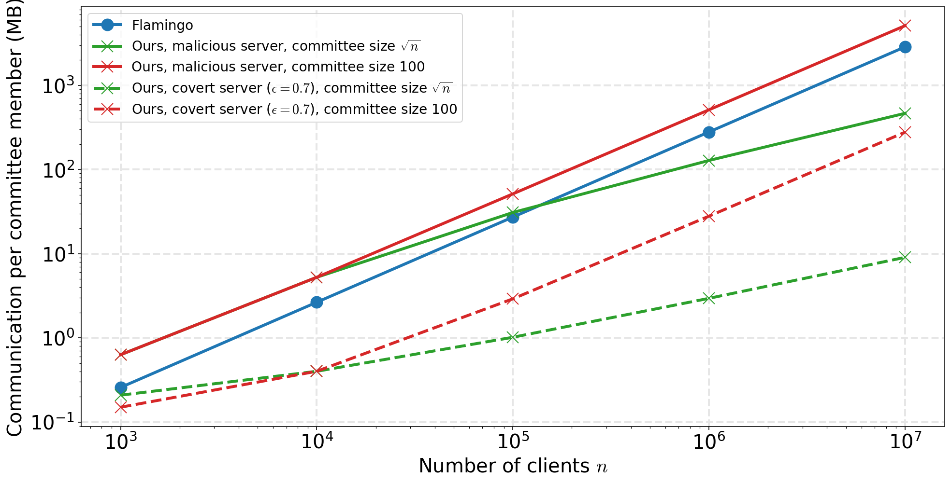

Slide 26
Wait! What about the random oracle?
k_{i} ← KAHE.Gen(), a_{i} ←KAHE.Enc(x_{i} + H(r_{i}), k_{i}), b_{i} ← AHE.Enc(k_{i}, pk), c_{i} = Enc'(r_{i}, pk^{aux})
How to remove ∑H(r_{i}) from the result?
Single aggregation: Decryptors reveal sk^{aux} to the server after set of clients is fixed.
Alternative with re-usable sk^{aux}: Use threshold encryption scheme
  Total decryptor work is O(n),
  but can be split up between decryptors similar to verification

Slide 27
OPA: decryption via secret sharing

Slide 28
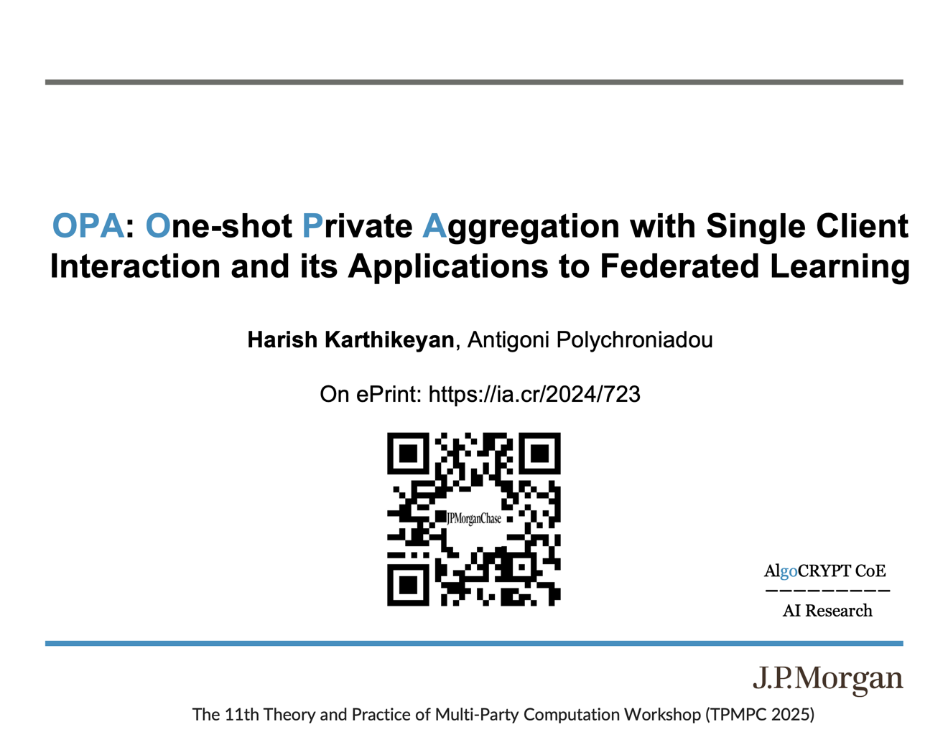

Slide 29
Our Contributions
Federated Learning:
  In the Clear: Clients speak once per iteration—simple but lacks privacy.
  Prior works with Privacy: Requires multiple rounds, increasing complexity and overhead.
OPA:
  First protocol to enable single communication per iteration for all clients (incl. committee) even in malicious security settings
  Clients (incl. Committee) do not need to maintain state across iterations
  No special-purpose PKE/setup needed for the committee
    Generic PKE to encrypt to the Committee
    PKI for Clients to authenticate
OPA
Leakage Resilience
Seed-Homomorphic PRG
(Packed) Secret Sharing
Learning with Rounding
(Ring) Learning with Errors
+
+

Slide 30
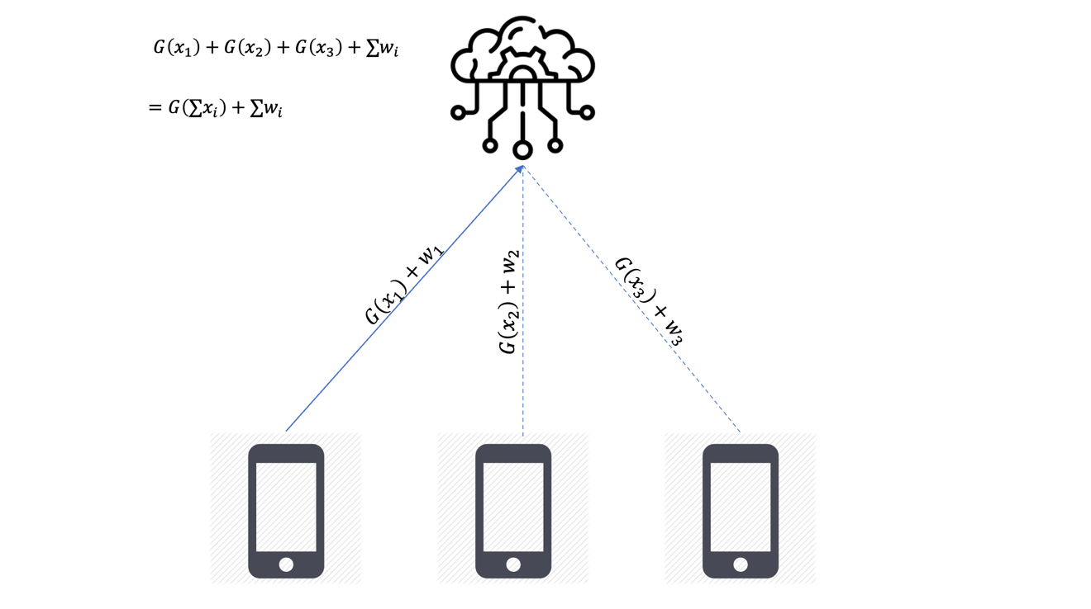
OPA: One-shot Private Aggregation

Slide 31
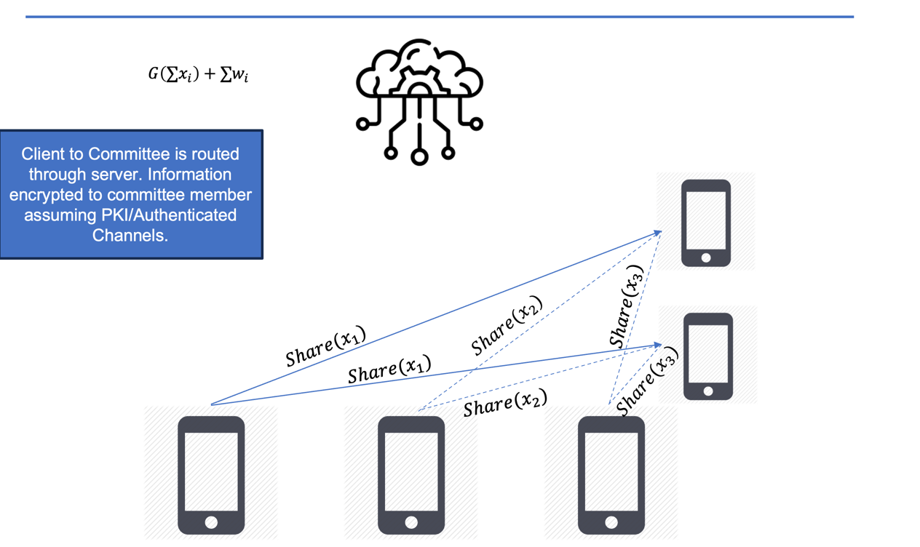
OPA: One-shot Private Aggregation

Slide 32
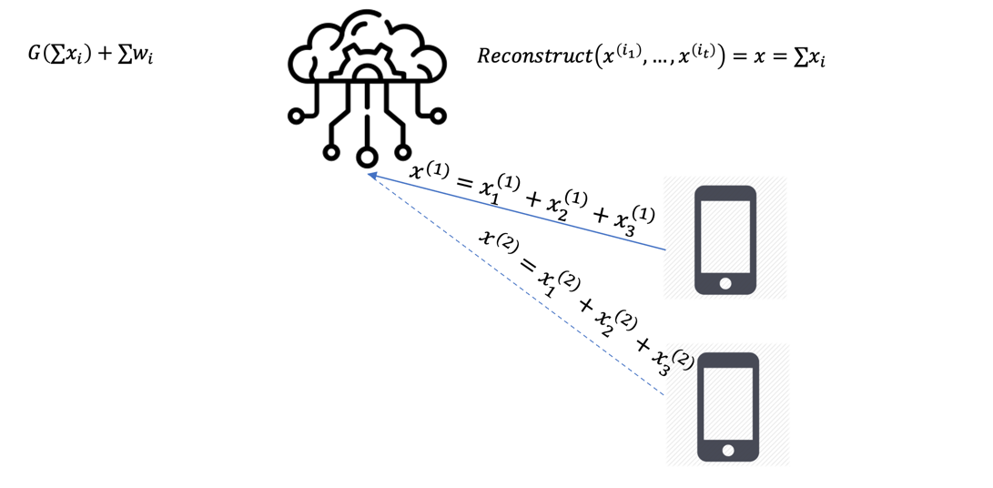
OPA: One-shot Private Aggregation

Slide 33
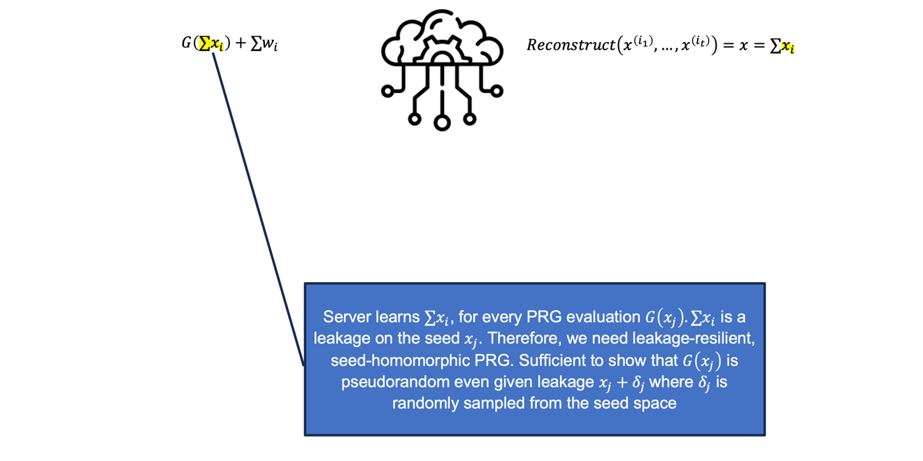
OPA: One-shot Private Aggregation
Notes:
therefore we need leakage-resilient seed-homomorphic PRG, to ensure that output is pseudorandom even conditioned on some leakage.

Slide 34
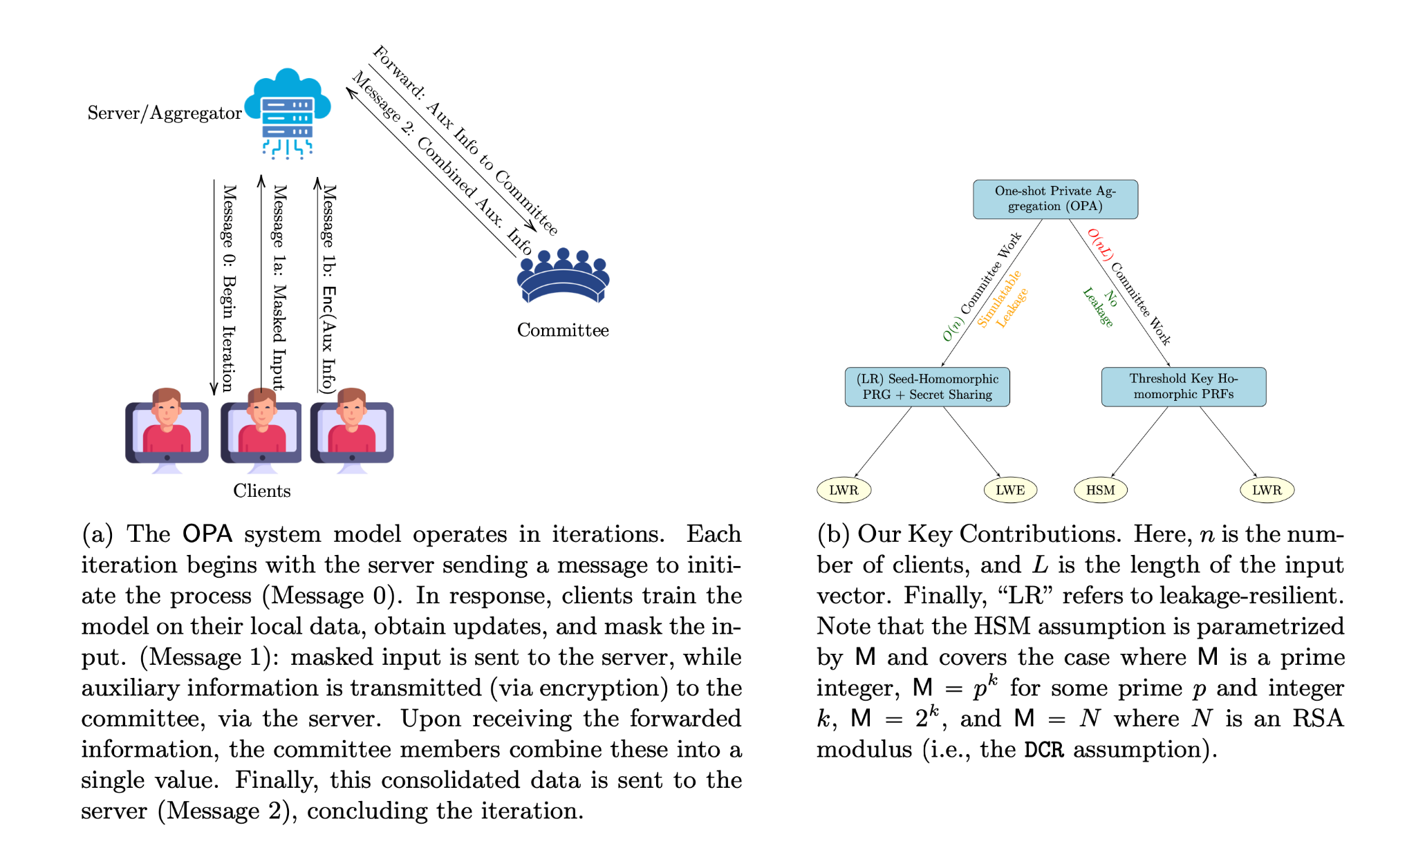
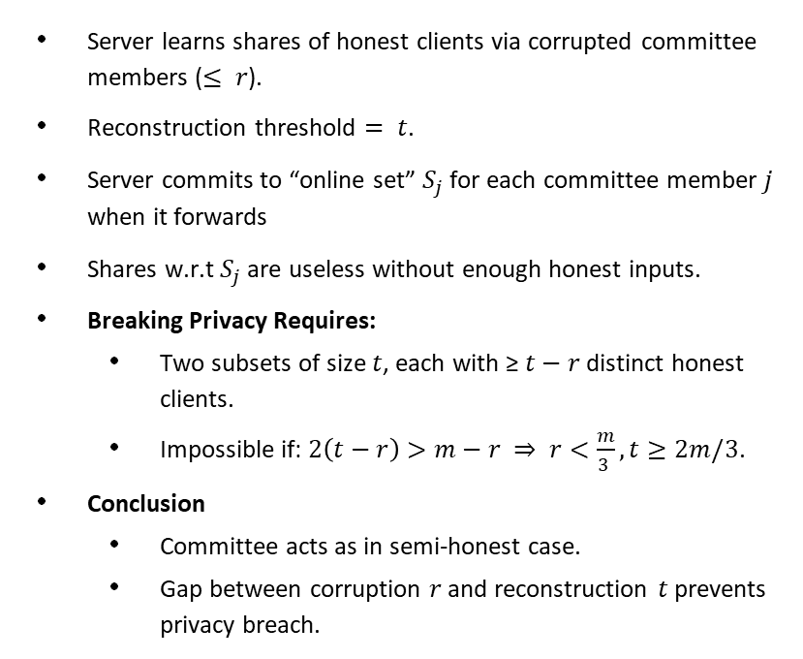
One-shot Committee with Malicious Server
Server learns shares of honest clients via corrupted committee members ($≤ r$).
Reconstruction threshold $= t$.
Server commits to “online set” $S_{j}$ for each committee member $j$ when it forwards
Shares w.r.t $S_{j}$ are useless without enough honest inputs.
Breaking Privacy Requires:
  Two subsets of size $t$, each with ≥ $t−r$ distinct honest clients.
  Impossible if: $2\left(t−r\right)>m−r ⇒ r<\frac{m}{3 }, t≥2m/3$.
Conclusion
  Committee acts as in semi-honest case.
  Gap between corruption $r$ and reconstruction $t$ prevents privacy breach.

Slide 35
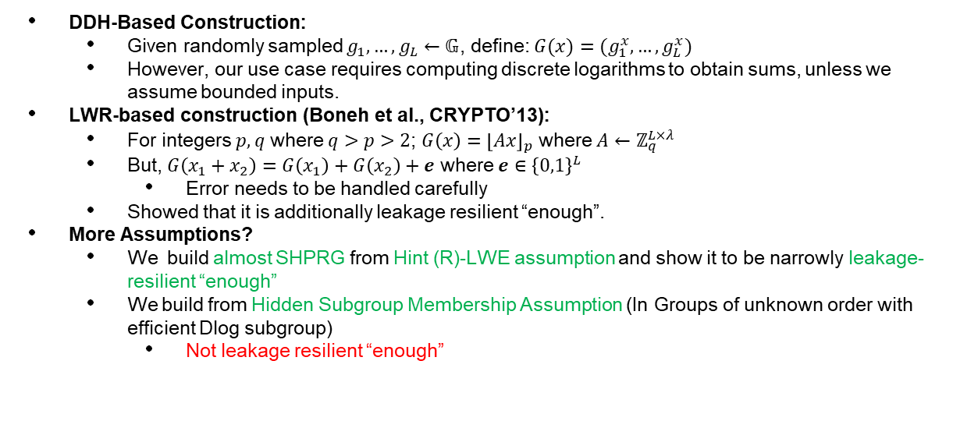
Seed-Homomorphic PRG
DDH-Based Construction:
  Given randomly sampled $g_{1​},…,g_{L​}←𝔾$, define: $G(x)=(g_{1}^{x}​,…,g_{L}^{x}​)$
  However, our use case requires computing discrete logarithms to obtain sums, unless we assume bounded inputs.
LWR-based construction (Boneh et al., CRYPTO’13):
  For integers $p,q$ where $q>p>2$; ${G\left(x\right)=\left\lfloor Ax\right\rfloor }_{p}$ where $A←ℤ_{q}^{L×λ}$
  But, $G\left(x_{1}+x_{2}\right)=G\left(x_{1}\right)+G\left(x_{2}\right)+e$ where $e∈{\left\{0,1\right\}}^{L}$
    Error needs to be handled carefully
  Showed that it is additionally leakage resilient “enough”.
More Assumptions?
  We build almost SHPRG from Hint (R)-LWE assumption and show it to be narrowly leakage-resilient “enough”
  We build from Hidden Subgroup Membership Assumption (In Groups of unknown order with efficient Dlog subgroup)
    Not leakage resilient “enough”

Slide 36
Security with Malicious Actors
Malicious Server: Standard Approach of using a second mask, which is expanded by a hash function H, later programmed in the ROM setting.
Malicious Clients: What if clients send inconsistent information to committee and server?
  Security with Abort
  Inconsistent Secret Sharing:
    Feldman’s VSS: Easy to use, but requires each committee member to verify by doing O(m) work, where m is the size of the committee
    Our Approach: Adapted SCRAPE Test (Cascudo and David 2017)—server handles bulk verification, reducing committee overhead.
      Committee: Checks if commitment to share matches received share; complains if not.
        Server aborts on complaint

Slide 37
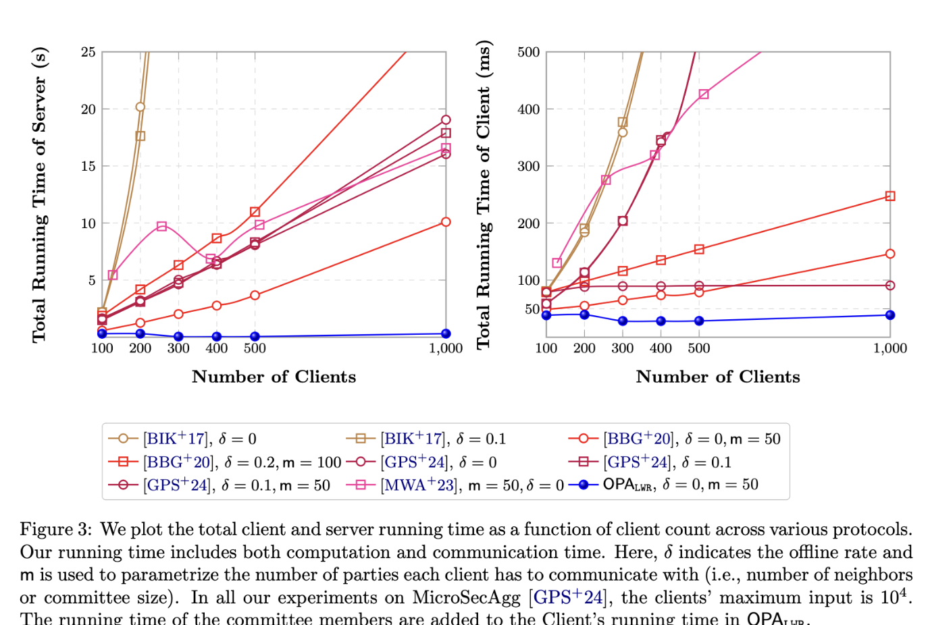
Experiments (more in the paper)

Slide 38
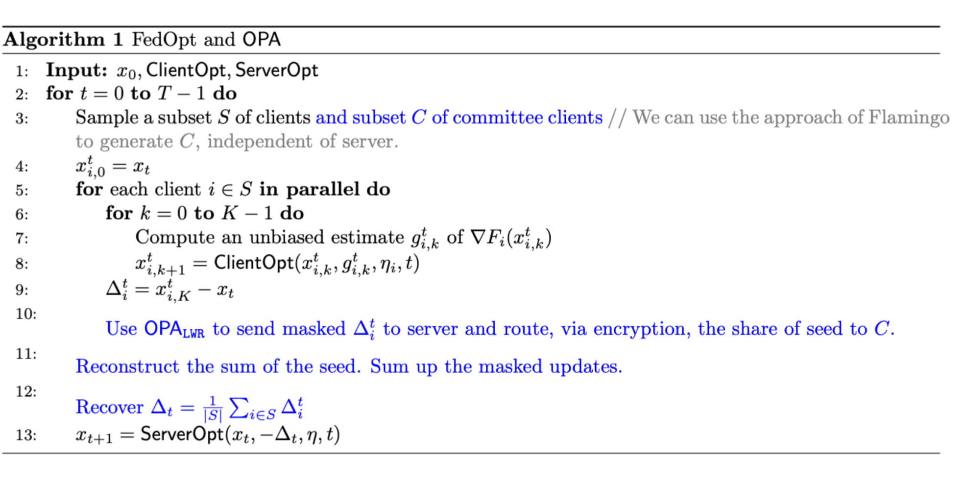
Other Contributions
Extending OPA to support more complex aggregating functionalities for FL applications
  FedAvg is great for IID distribution of client data.
  FedOpt is an algorithm better suited for non-IID.
  We show how to make it privacy-preserving.
  Key Intuition: Server computes the average in FedOpt, before doing optimization with respect to the average before computing new model weights.
  Additional extension to adapt byzantine-robust stochastic aggregation (bRSA) to secure aggregation. bRSA allows for model convergence, even with byzantine client behavior.

Slide 39
Conclusion
We introduce OPA, the first protocol where client interacts once per iteration
  Even committee members speak once
Uses a committee of ephemerally chosen that can change from iteration-to-iteration
  Strictly weaker computation power than a server
  Show extension to be secure even if ALL committee members collude
Our buildings blocks are generic
  Additively Homomorphic Secret Sharing + Seed Homomorphic PRG
    New SHPRG from (R)LWE, Class Groups
  Distributed Key-Homomorphic PRF
Extension of secure aggregation to support more use-cases from federated learning
Malicious Security with Abort: Using Lattice-based ZKPs to identify misbehaving clients

Slide 40
Conclusion (according to an AI that wishes to remain anonymous)
OPA: Single round of participation for stateless decryptors; client upload communication scales with subcommittee size.
Willow: Two rounds of interaction, relies on stateful decryptors; client upload communication independent of committee size.
Suitability: OPA for federated learning (multiple iterations, large client numbers); Willow for single aggregation of histograms over larger client populations (federated analytics).
Caveat: Claims based on asymptotic costs; no concrete communication cost comparison.

Slide 41



Questions

