Slide 1
Server-Aided
Anonymous Credentials
Rutchathon Chairattana-Apirom¹, Franklin Harding²,
Anna Lysyanskaya², and Stefano Tessaro¹
1: University of Washington, Seattle, WA, USA
2: Brown University, Providence, RI, USA

Slide 2




European Digital Identity Wallet (EUDI)
“enable privacy preserving techniques which ensure [unlinkability], where the attestation of attributes does not require the identification of the user”
Age over 21
”Each [EU] member state shall provide at least one EUDI wallet within 24 months of [April 2024]”

Slide 3
European Digital Identity Wallet (EUDI)
Initial proposal from EUDI team: signed vector-commitments
Age over 21
Cryptographers’ feedback [BBCHLLLMMNPsSTTT ’24]: that provides very weak privacy guarantees…
Instead, use anonymous credentials [Chaum ‘82; CL ‘01]

Slide 4
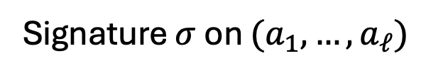


Cryptographers’ feedback [BBCHLLLMMNPsSTTT ’24]
Why BBS?
Small keys and signatures
Very efficient ZKPs [CDL ‘16; TZ ‘23]
Caveat: pairing
$$pk$$
Use Boneh-Boyen-Shacham signatures [BBS ’04]
$$pk$$
Signature $σ$ on $(a_{1},…, a_{ℓ})$
$$a_{1}, π:\text{ZKPoK}\{σ,a_{2},…,a_{ℓ} :\text{Verify}\left(σ,pk,a_{1},a_{2},…,a_{ℓ}\right)=1\}$$
Check $π$ is valid and $a_{1}=1$ (indicating user is $≥$ 21)

Slide 5
Engineers’ (informal) response
BBS requires a pairing-friendly curve
  No standardized pairing-friendly curves
  Limited hardware/software support
This talk: efficient pairing-free anonymous credentials from standard assumptions
Industry (Orange Innovation) EUDI proposal “BBS#”: BBS can be made pairing-free if you can tolerate some additional interaction

Slide 6


BBS# proposal from Orange Innovation
There exists a pairing-free version of BBS anonymous credentials in the “keyed-verification” (issuer=verifier) setting [BBDT ‘16]
Lift [BBDT ‘16] to be publicly verifiable through some extra interaction
Limited formal model and proofs
Uses algebraic group model [FKL’18]
1. Can we formalize this “server-aided” version of anonymous credentials and prove BBS# secure without the AGM?
2. Can we generically lift keyed-verification schemes to be publicly verifiable?

Slide 7
Summary so far
EU needs pairing-free anonymous credentials
BBS is the most promising option, but requires a pairing
BBS#: proposal to make BBS pairing-free through extra interaction
Up next
  Background: BBS signatures and BBS#
  Our results

Slide 8


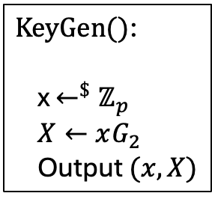
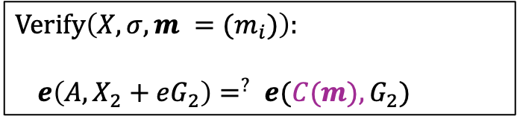
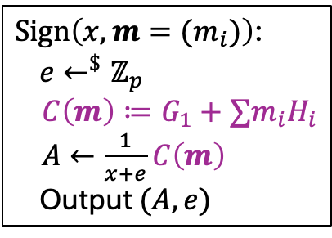

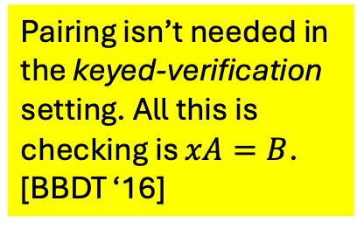
BBS signatures
Pairing: $e\left(aG_{1},bG_{2}\right)=ab e(G_{1},G_{2})$)
Pairing isn’t needed in the keyed-verification setting. All this is checking is $xA=B$. [BBDT ‘16]
$$e:𝔾_{1}×{ 𝔾}_{2} →𝔾_{T},G_{1},G_{2},(H_{i})∈𝔾_{1}$$
$\text{KeyGen}\text{()}$:
x $←^{\$}ℤ_{p}$
$X←xG_{2}$
Output $(x,X)$
$\text{Sign}\left(x, m=(m_{i})\right)$:
$e←^{\$}ℤ_{p}$
$C\left(m\right)≔G_{1}+∑m_{i}H_{i}$
$A←\frac{1}{x+e}C\left(m\right)$
Output $(A,e)$
[TZ ‘23] Zero-Knowledge Proofs
Verification eq. is equivalent to
$e\left(A,X_{2}\right)=^{?} e\left(C\left(m\right)−eA, G_{2}\right)$
For $B ≔C\left(m\right)−eA$ and
$π←$ ZKPoK of $\vec{m},e$ for $A,B,C\left(m\right)$
$\left(A,B,C\left(m\right)\right),π$ attests to a BBS signature
Verify by checking $π$ and using the pairing
Yields a ZKP by blinding $\left(A,B,C\left(m\right)\right),$ into $\left(\tilde{A},\tilde{B},\tilde{C}\right)$ , $π$ additionally proves knowledge of blinding factors
$$\text{Verify}\left(X,σ,m =(m_{i})\right):$$
$e\left(A,X_{2}+eG_{2}\right)=^{?} e(C(m), G_{2})$

Slide 9


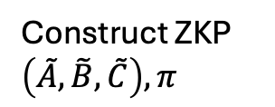
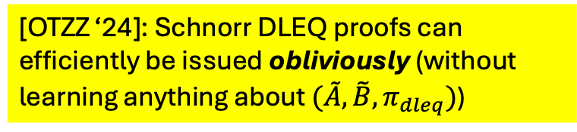




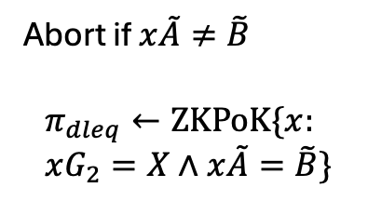

BBS# [Orange Innovation ‘24]
Idea: lift the keyed-verification version of BBS to be publicly verifiable by having the server issue a proof
$$(x,X)$$
$$X$$
$$X$$
BBS signature $(A,e)$ on $m$
Construct ZKP $\left(\tilde{A},\tilde{B},\tilde{C}\right),π$
$$(\tilde{A},\tilde{B})$$
[OTZZ ‘24]: Schnorr DLEQ proofs can efficiently be issued obliviously (without learning anything about $(\tilde{A},\tilde{B},π_{dleq})$)
Abort if $x\tilde{A}≠\tilde{B}$
$$π_{dleq}←\text{ZKPoK}\{x: \\ xG_{2}=X∧x\tilde{A}=\tilde{B}\}$$
$$π_{dleq}$$
$$\tilde{A},\tilde{B},\tilde{C},π,π_{dleq}$$

Slide 10


Our results
Server-Aided Anonymous Credentials (SAAC) formal model, security definitions
Lifting theorem
Two practical constructions
Keyed-Verification Anonymous Credentials (KVAC)* [CMZ ‘14]
BBS-based (gap q-SDH, ROM) SAAC w/
statistical anonymity
$$+$$
DDH-based (ROM) SAAC w/
computational anonymity
Oblivious non-interactive proof issuance (oNIP)** [OTZZ’24]
$$=$$
First practical ACs from standard pairing-free assumptions in the ROM only (no AGM/GGM)! Multi-show!
Server-Aided Anonymous Credentials (SAAC)

Slide 11














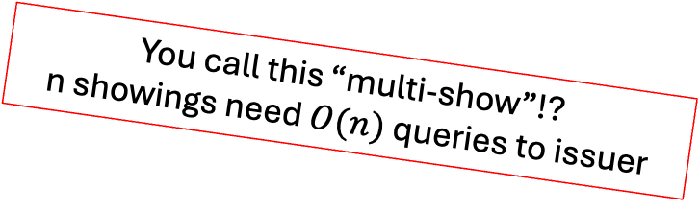


Formal model
Issuer ($sk, φ$)
Holder $(pk, m,φ,ψ)$
Verifier ($pk, ψ$)
$$sk,φ$$
Issuance
$$pk, m, φ$$
Iss
U
You call this “multi-show”!?
n showings need $O(n)$ queries to issuer
Proving $m$ satisfies $φ$ can be expensive!
$$σ/ ⊥$$
No $ψ$!
Help
$$sk$$
$$pk, m,σ$$
Help
ObtHelp
Extremely lightweight
$$aux$$
$$pk,ψ$$
Showing
Show
SVer
Can cache many aux
$$pk, m,σ,aux,ψ$$
$$0/1$$

Slide 12




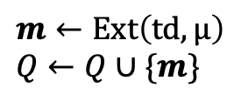
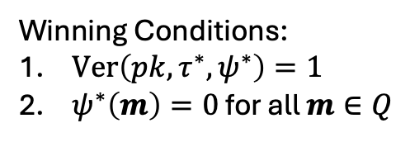


Unforgeability*
Iss
$$m←\text{Ext}\left(\text{td},\text{μ}\right)$$
$$Q←Q∪\{m\}$$
*simplification, see paper
$$μ, φ$$
$$par,pk$$
Help
$$⋮$$
Winning Conditions:
$\text{V}\text{er}\left(pk,τ^{∗},ψ^{∗}\right)=1$
$ψ^{∗}\left(m\right)=0$ for all $m∈Q$
$$ψ^{∗},τ^{∗}$$
Not affected by how adversary queries help.
No “rate-limiting” or one-more unforgeability
$$⋮$$

Slide 13










Anonymity
Simulator $(td,pk, φ)$
Issuer ($sk$)
Holder $(pk, φ)$
Verifier $(pk)$
$$sk,φ$$
Issuance
$$\text{pk}, φ,$$
$$m$$
Iss
U
$$σ/ ⊥$$
Help
$$m,σ$$
$$sk$$
$$pk\text{,}$$
Help
ObtHelp
$$aux$$
$$pk,ψ$$
Showing
Show
SVer
$$pk,ψ,$$
$$m,σ,aux$$
$$0/1$$

Slide 14
Our results
Server-Aided Anonymous Credentials (SAAC) formal model, security definitions
Lifting theorem
Two practical constructions

Slide 15














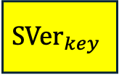
Ingredients for Lifting Theorem: KVAC
$$sk,ψ$$
Showing
Show
SVer
$$pk, m,σ,ψ$$
$$0/1$$
$$pk, m,σ$$
$${\text{Show}}_{key}$$
$$sk,τ_{key}$$
$$pk,ψ,τ_{pub}$$
$$τ_{key},τ_{pub}$$
$$τ_{key}$$
$${\text{SVer}}_{key}$$
$${\text{S}\text{Ver}}_{pub}$$
$\text{pk}\text{, }\text{m}\text{,} \text{σ}$,$ψ$
$${\text{Sho}\text{w}}_{pub}$$
$$0/1$$
$$τ_{pub}$$

Slide 16

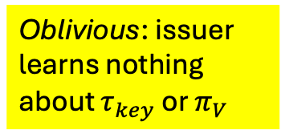

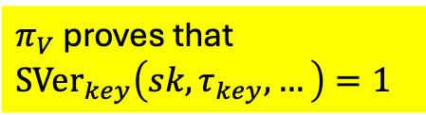





Ingredients for Lifting Theorem: oNIP
Need an oNIP corresponding to the KVAC
Issuer ($sk$)
Holder $(pk, σ, m)$
(Issuance same as in KVAC)
Help
$$pk, σ,m$$
$π_{V}$ proves that ${\text{SVer}}_{key}\left(sk, τ_{key},…\right)=1$
Oblivious: issuer learns nothing about $τ_{key}$ or $π_{V}$
$$KVAC$$
$$.Show_{key}$$
$$sk$$
$$τ_{key}$$
oNIP
Iss
oNIP
U
($τ_{key},π_{V})$

Slide 17












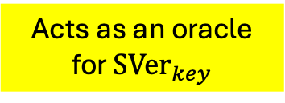


Generic Construction
Issuer ($sk$)
Holder $(pk, σ, m)$
More subtle requirements for the KVAC+oNIP, see paper
Verifier $(pk)$
(Issuance same as in KVAC)
Help
$$pk, σ,m$$
$$KVAC$$
$$.Show_{key}$$
$$sk$$
$$τ_{key}$$
oNIP
Iss
oNIP
U
$$pk,ψ,τ_{pub}$$
($τ_{key},π_{V})$
Showing
$$\text{KVAC}$$
$$\text{S}\text{Ve}{\text{r}}_{pub}$$
Acts as an oracle for ${\text{SVer}}_{key}$
$$(τ_{key},τ_{pub},π_{V})$$
$$\text{pk}, m,σ,(τ_{key},π_{V}),ψ$$
$$\text{KVAC}$$
$$\text{.}\text{Sho}{\text{w}}_{pub}$$
oNIP
Ver
$$pk,τ_{key},π_{V}$$

Slide 18
Our results
Server-Aided Anonymous Credentials (SAAC) formal model, security definitions
Lifting theorem
Two practical constructions

Slide 19
BBS-based construction
KVAC is mostly unchanged from [BBDT ‘16]
  Need to prove security with a restricted DDH oracle due to helper leakage
    Gap q-SDH needed, not just q-SDH

Slide 20

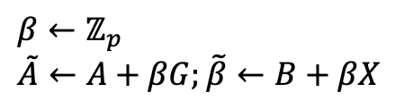

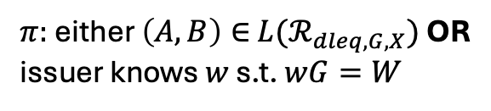

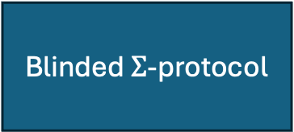

oNIP for BBS-based construction [CATZ ’24, OTZZ ‘24]
Relation: $ℛ_{dleq,G,X}≔\left\{\left(\left(A,B\right),x\right):xG=X∧xA=B\right\}$
Goal: obliviously issue proofs that statements $\left(A,B\right)∈$ ${L(ℛ}_{dleq,G,X})$
AGM typically needed for unforgeability – but we don’t need unforgeability since our SAAC unforgeability game doesn’t do rate-limiting
$$x,G,W$$
$$\left(A,B\right),G,X,W$$
$$β←ℤ_{p}$$
$$\tilde{A}←A+βG;\tilde{β}←B+βX$$
$$(\tilde{A},\tilde{B})$$
Abort if $x\tilde{A}≠\tilde{B}$
Blinded $Σ$-protocol
$π:$either $\left(A,B\right)∈$ ${L(ℛ}_{dleq,G,X})$ OR
issuer knows $w$ s.t. $wG=W$

Slide 21
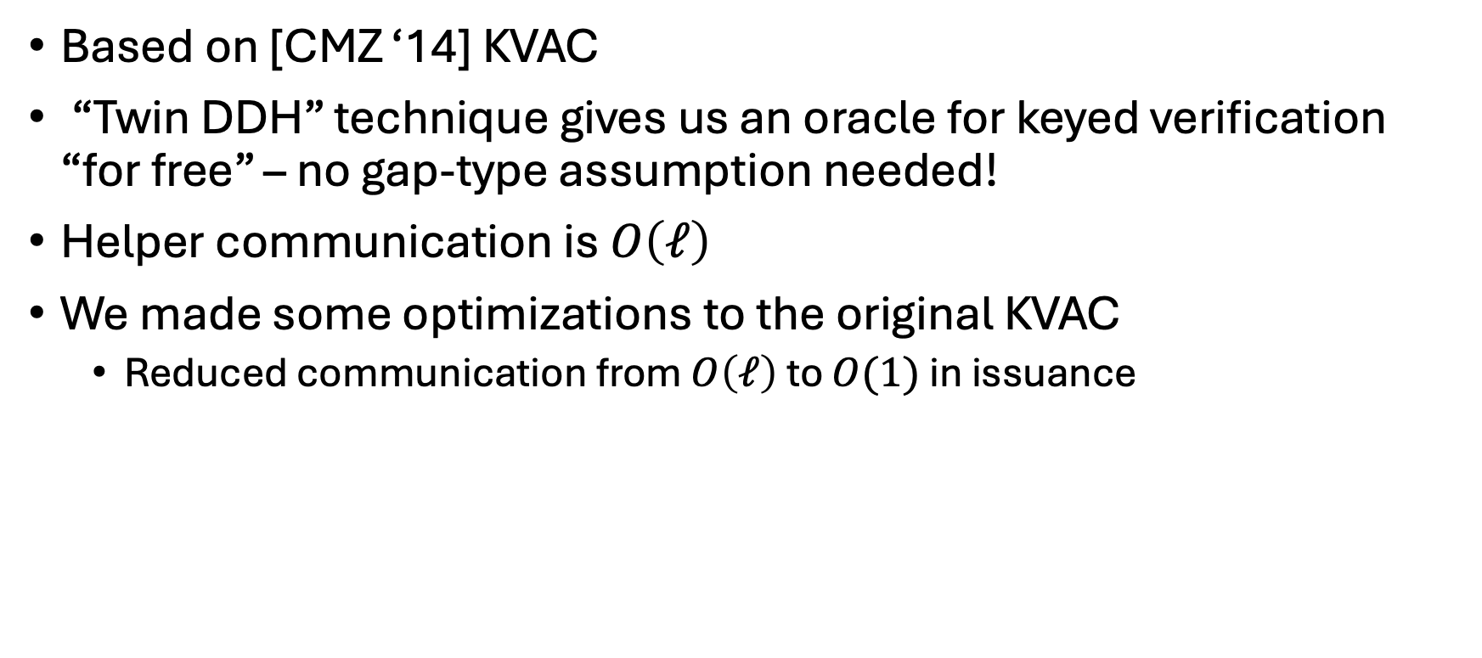
DDH-based construction
Based on [CMZ ‘14] KVAC
“Twin DDH” technique gives us an oracle for keyed verification “for free” – no gap-type assumption needed!
Helper communication is $O\left(ℓ\right)$
We made some optimizations to the original KVAC
  Reduced communication from $O\left(ℓ\right)$ to $O(1)$ in issuance

Slide 22

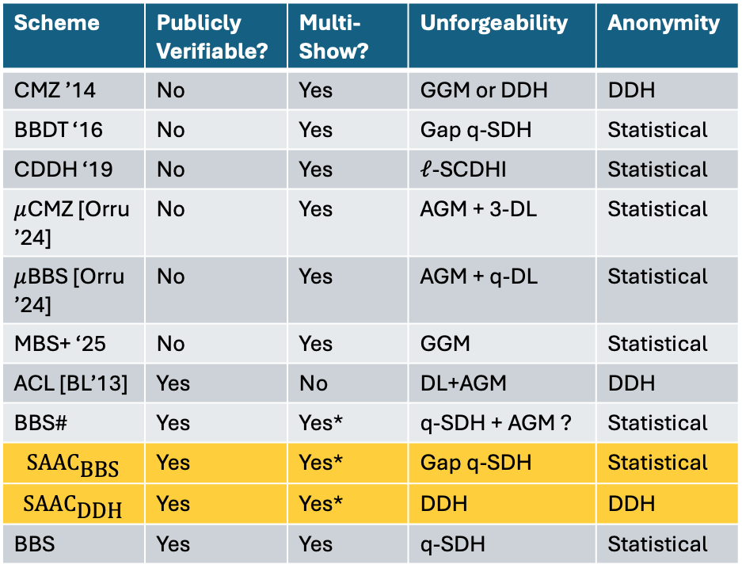
Our results
Server-Aided Anonymous Credentials (SAAC) formal model, security definitions
Lifting theorem
Two practical constructions
Scheme | Publicly Verifiable? | Multi-Show? | Unforgeability | Anonymity
CMZ ’14 | No | Yes | GGM or DDH | DDH
BBDT ‘16 | No | Yes | Gap q-SDH | Statistical
CDDH ‘19 | No | Yes | $ℓ$-SCDHI | Statistical
$μ$CMZ [Orru ’24] | No | Yes | AGM + 3-DL | Statistical
$μ$BBS [Orru ’24] | No | Yes | AGM + q-DL | Statistical
MBS+ ‘25 | No | Yes | GGM | Statistical
ACL [BL’13] | Yes | No | DL+AGM | DDH
BBS# | Yes | Yes* | q-SDH + AGM ? | Statistical
$$\text{SAA}{\text{C}}_{\text{BBS}}$$ | Yes | Yes* | Gap q-SDH | Statistical
$$\text{SAA}{\text{C}}_{\text{DDH}}$$ | Yes | Yes* | DDH | DDH
BBS | Yes | Yes | q-SDH | Statistical
ia.cr/2025/513

