Slide 1
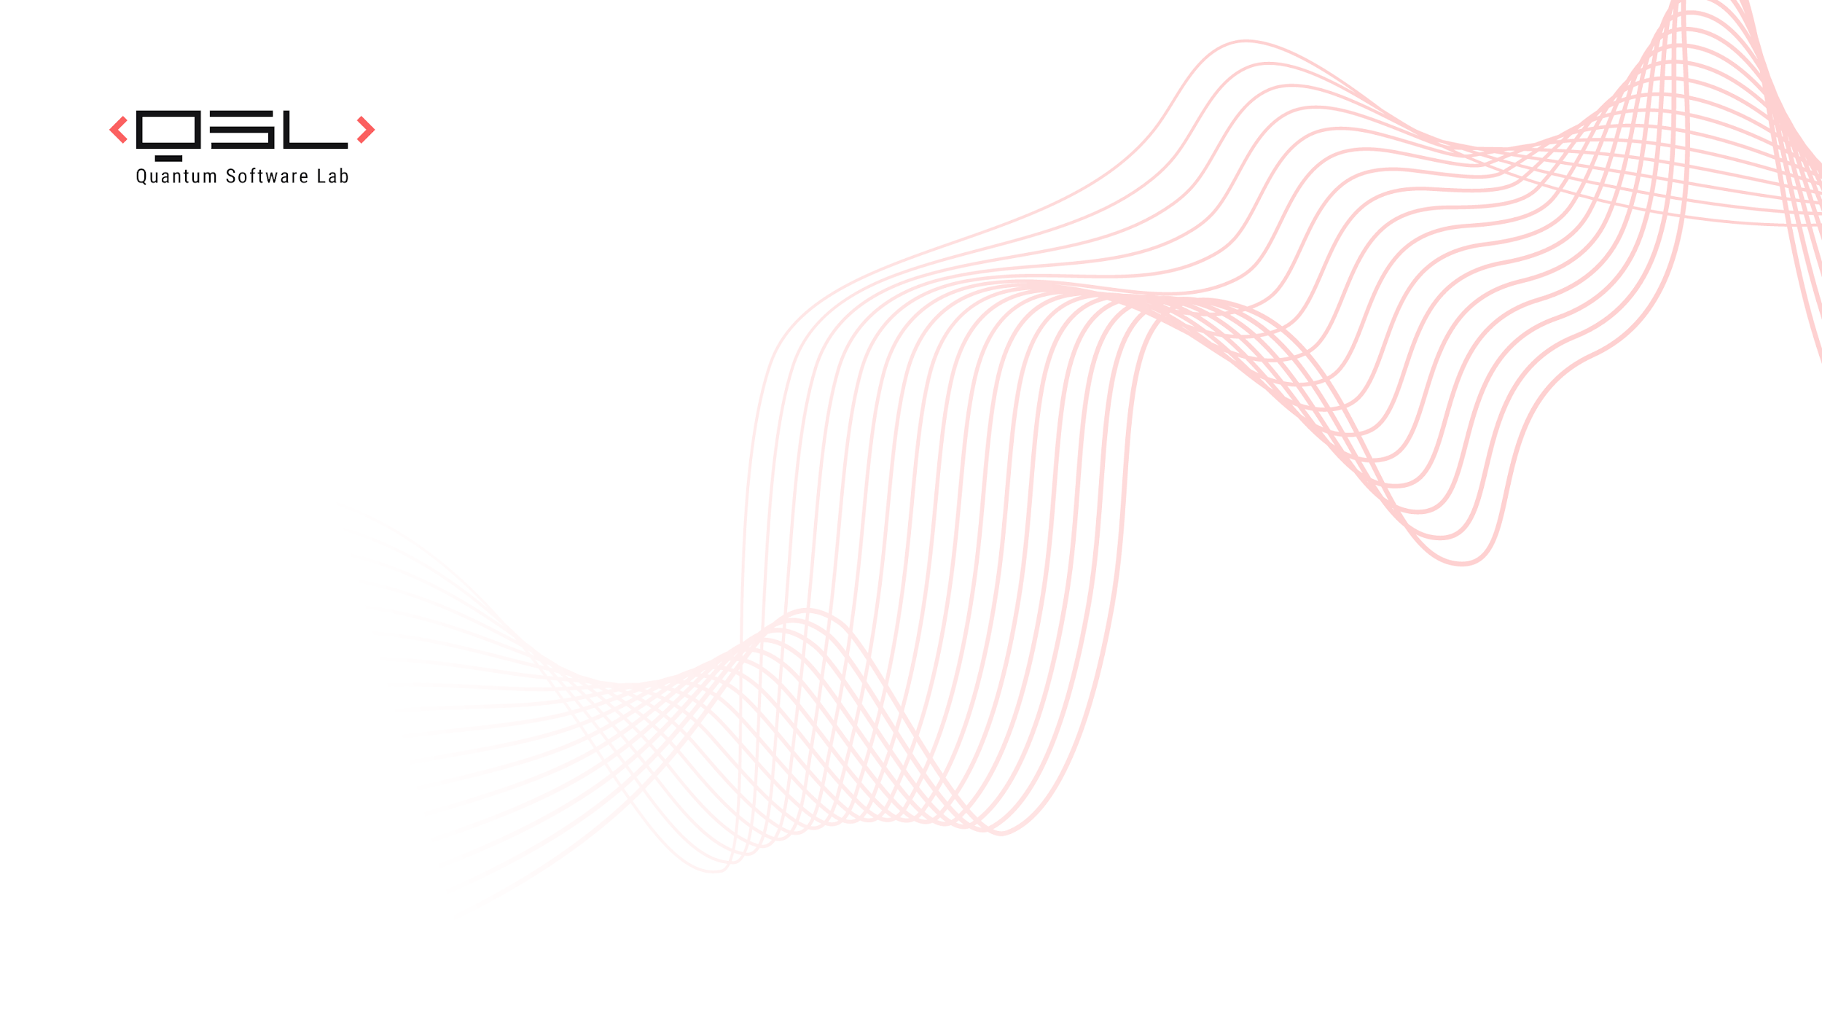







Quantum Lifting for Invertible Permutations and Ideal Ciphers
Alexandru Cojocaru Minki Hhan Qipeng Liu Takashi Yamakawa Aaram Yun
University of Edinburgh
University of Texas at Austin
UC San Diego
NTT Social Informatics Laboratories
Ewha Womans University
CRYPTO 2025

Slide 2

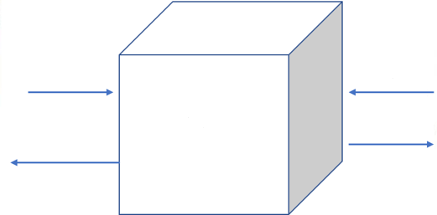
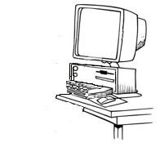

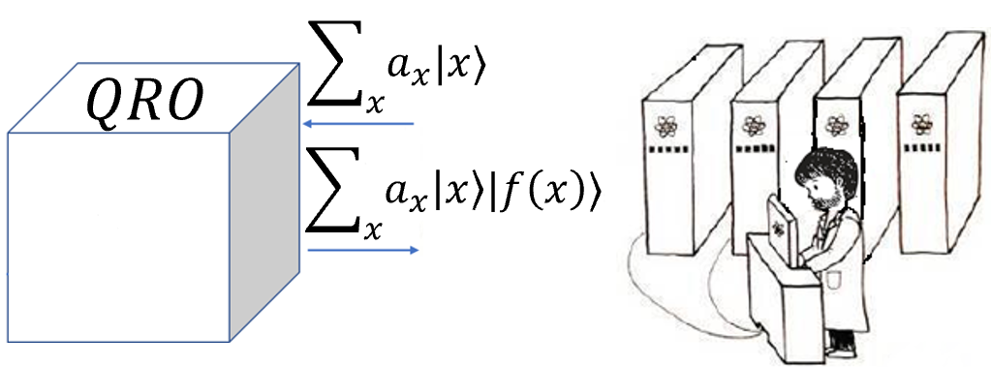
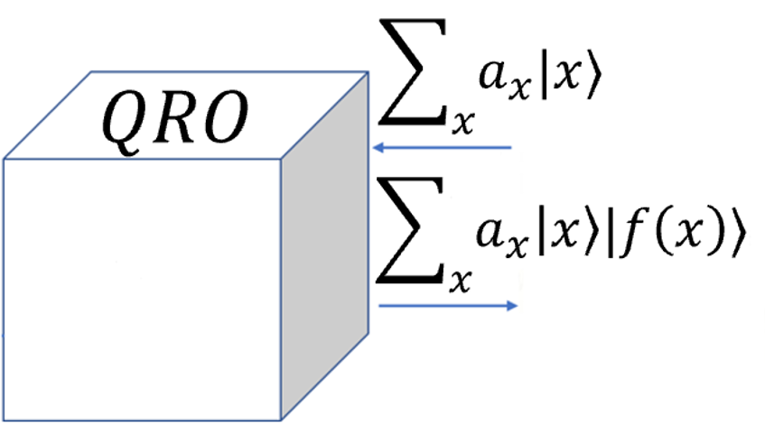
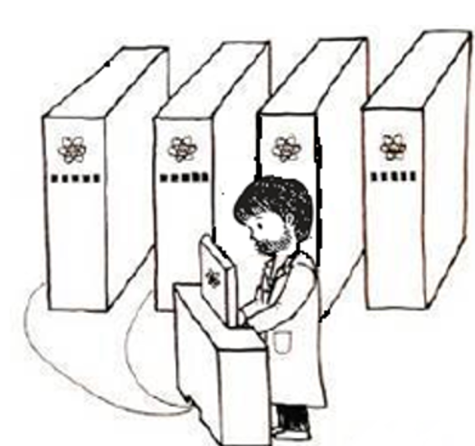



Query Model
Query Model - elegant abstraction adopted Cryptography & Complexity Theory
Random Oracle Model (ROM)
Numerous cryptosystems designed & analyzed in ROM
Query algorithm solves problem querying $f$
  Complexity of Algorithm = # queries to $f$;
$$RO$$
$$x$$
$$y$$
Random
black-box
function $f$
$$f(x)$$
$$f(y)$$
Quantum computing: new query model $→$ Quantum Random Oracle:
  Superposition Queries to $f$ permitted
  Equips quantum parties and quantum algorithms with new capabilities;
Random
black-box
function $f$
When $f$ is a permutation $→$ Quantum Random Permutation Oracle
  Superposition queries to both $f$ and $f^{−1}$ are permitted
$$f$$
$$f^{−1}$$
$$−1$$
Notes:
today we are going to work in this query model, which is

Slide 3
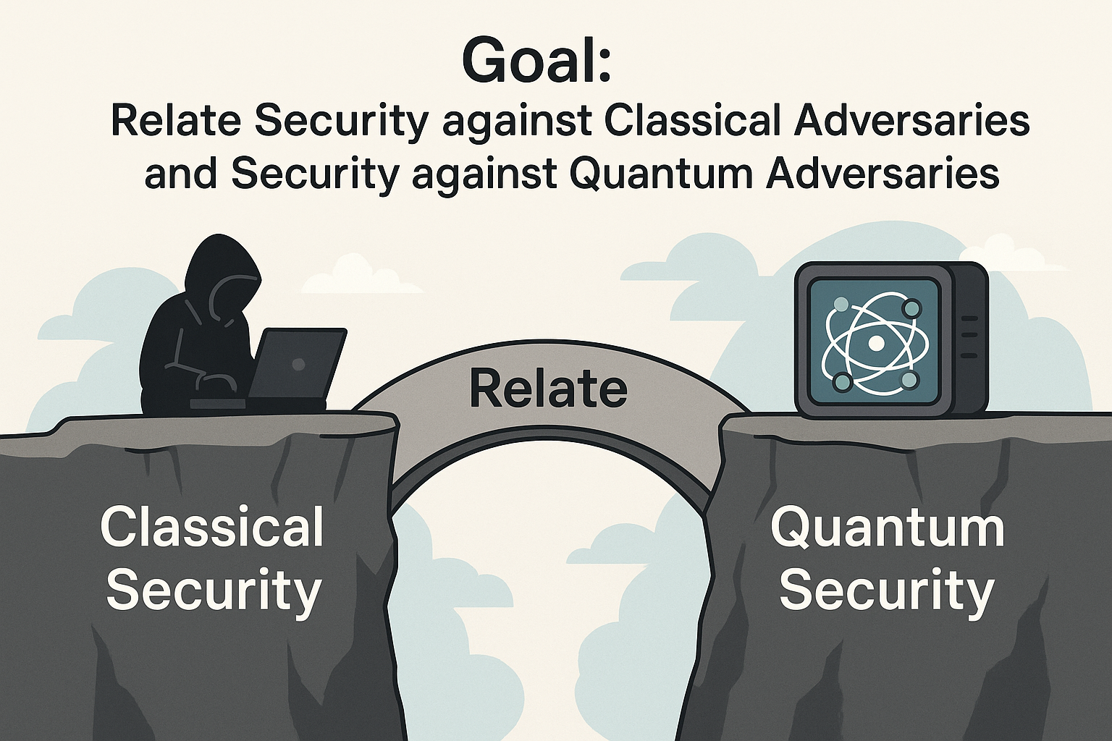
Main Goal
Lifting Theorem:
If we have a scheme/security game that is secure against classical attacks
  Lift to
  Ensure security against quantum adversaries.
Focus on Lifting Theorems for Security (Search) Games in Quantum Random Permutation Oracle Model
Notes:
Our main results focus on Lifting Theorems in QROM that allow us to stufdu the securitry of general search game. More precisely,

Slide 4
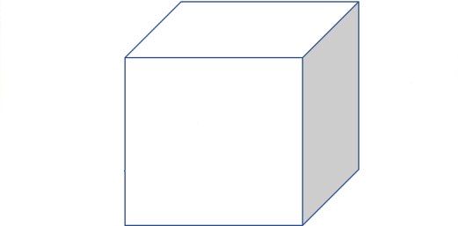


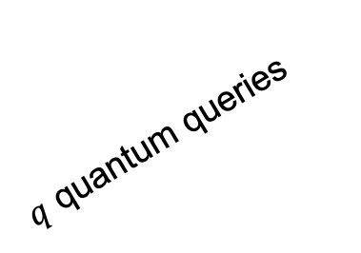

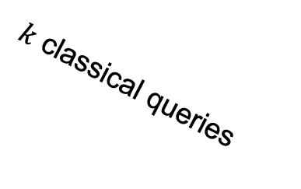



Lifting Theorem in QROM
Focus on Lifting Theorems for Security (Search) Games in Quantum Random Permutation Oracle Model
Search Game
$$π$$
$$π^{−1}$$
$q$ quantum queries
$k$ classical queries
$$Adversary A$$
$Challenger$ $C$
$$Accept or Reject$$
Notes:
Our main results focus on Lifting Theorems in QROM that allow us to study the security of general search game. More precisely,
And finally, at the end of the interaction, the challenger in the security game is going to either accept or reject the adversary

Slide 5


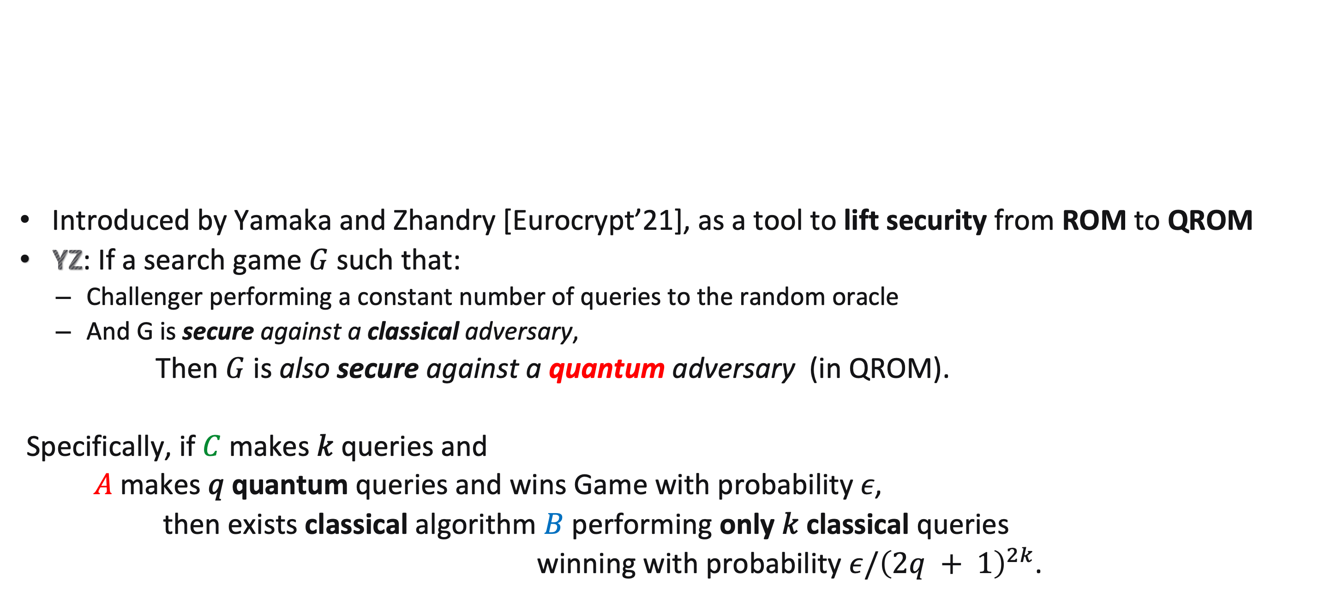




Lifting Theorem in QROM
$$f$$
$q$ quantum queries
$k$ classical queries
Introduced by Yamaka and Zhandry [Eurocrypt’21], as a tool to lift security from ROM to QROM
YZ: If a search game $G$ such that:
  Challenger performing a constant number of queries to the random oracle
  And G is secure against a classical adversary,
Then $G$ is also secure against a quantum adversary (in QROM).
Specifically, if $C$makes 𝑘 queries and
$A$makes 𝑞 quantum queries and wins Game with probability 𝜖,
then exists classical algorithm $B$ performing only 𝑘 classical queries
winning with probability $ε/{\left(2q + 1\right)}^{2k}$.
$$Adversary A$$
$Challenger$ $C$
$$Accept or Reject$$

Slide 6


Main Result: Lifting Theorems in QRPM & QICM
Quantum Lifting
Why are Lifting Theorems useful:
Because it essentially tells us that to study security against arbitrary adversary it suffices
To study security against adversary that performs a small fixed number of classical queries

Slide 7





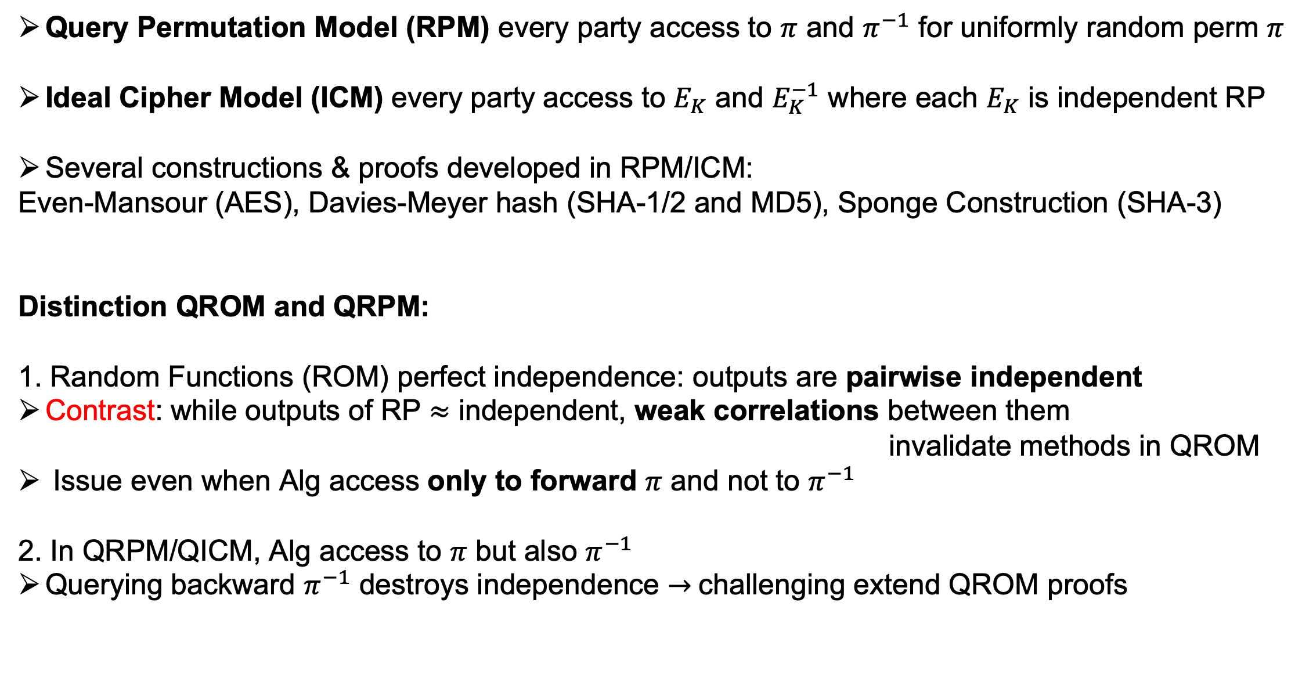

Query Model and Challenges
Query Permutation Model (RPM) every party access to $π$ and $π^{−1}$ for uniformly random perm $π$
Ideal Cipher Model (ICM) every party access to $E_{K}$ and $E_{K}^{−1}$ where each $E_{K}$ is independent RP
Several constructions & proofs developed in RPM/ICM:
Even-Mansour (AES), Davies-Meyer hash (SHA-1/2 and MD5), Sponge Construction (SHA-3)
Distinction QROM and QRPM:
      1. Random Functions (ROM) perfect independence: outputs are pairwise independent
        Contrast: while outputs of RP $≈$ independent, weak correlations between them
        invalidate methods in QROM
        Issue even when Alg access only to forward $π$ and not to $π^{−1}$
      2. In QRPM/QICM, Alg access to $π$ but also $π^{−1}$
      Querying backward $π^{−1}$ destroys independence $→$challenging extend QROM proofs
$$π$$
$$π$$
$$−1$$
$$π^{−1}$$
$$π$$
Notes:
today we are going to work in this query model, which is

Slide 8




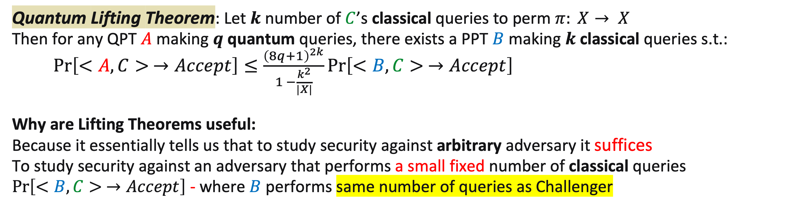



Main Result: Lifting Theorem in QRPM
$$π$$
$q$ classical queries
$π^{−1}$
$k$ classical queries
$Adversary$ $A$
$Challenger$ $C$
$$Accept or Reject$$
Quantum Lifting Theorem: Let $k$number of $C$’s classical queries to perm $π: X→ X$
Then for any QPT $A$making $q$ quantum queries, there exists a PPT $B$ making $k$ classical queries s.t.:
$\operatorname{Pr}\left[<A, C> →Accept\right]≤\frac{{\left(8q+1\right)}^{2k}}{1 −\frac{k^{2}}{|X|}}\operatorname{Pr}\left[<B,C> →Accept\right]$
Why are Lifting Theorems useful:
Because it essentially tells us that to study security against arbitrary adversary it suffices
To study security against an adversary that performs a small fixed number of classical queries
$\operatorname{Pr}\left[<B,C> →Accept\right]$ - where $B$ performs same number of queries as Challenger

Slide 9
Applications
Derive first Lifting Thm for Security in Quantum Random Permutation & Ideal Cipher
Application: New quantum query complexity bounds
& post-quantum security results:
  Derive tight bounds for quantum hardness of Double-sided Zero Search Game
  Post-Quantum Security for:
    Preimage Resistance
    One-Wayness of constant-round Sponge
    Multi-Collision Resistance
    Collision Resistance of Davies-Meyer

Slide 10
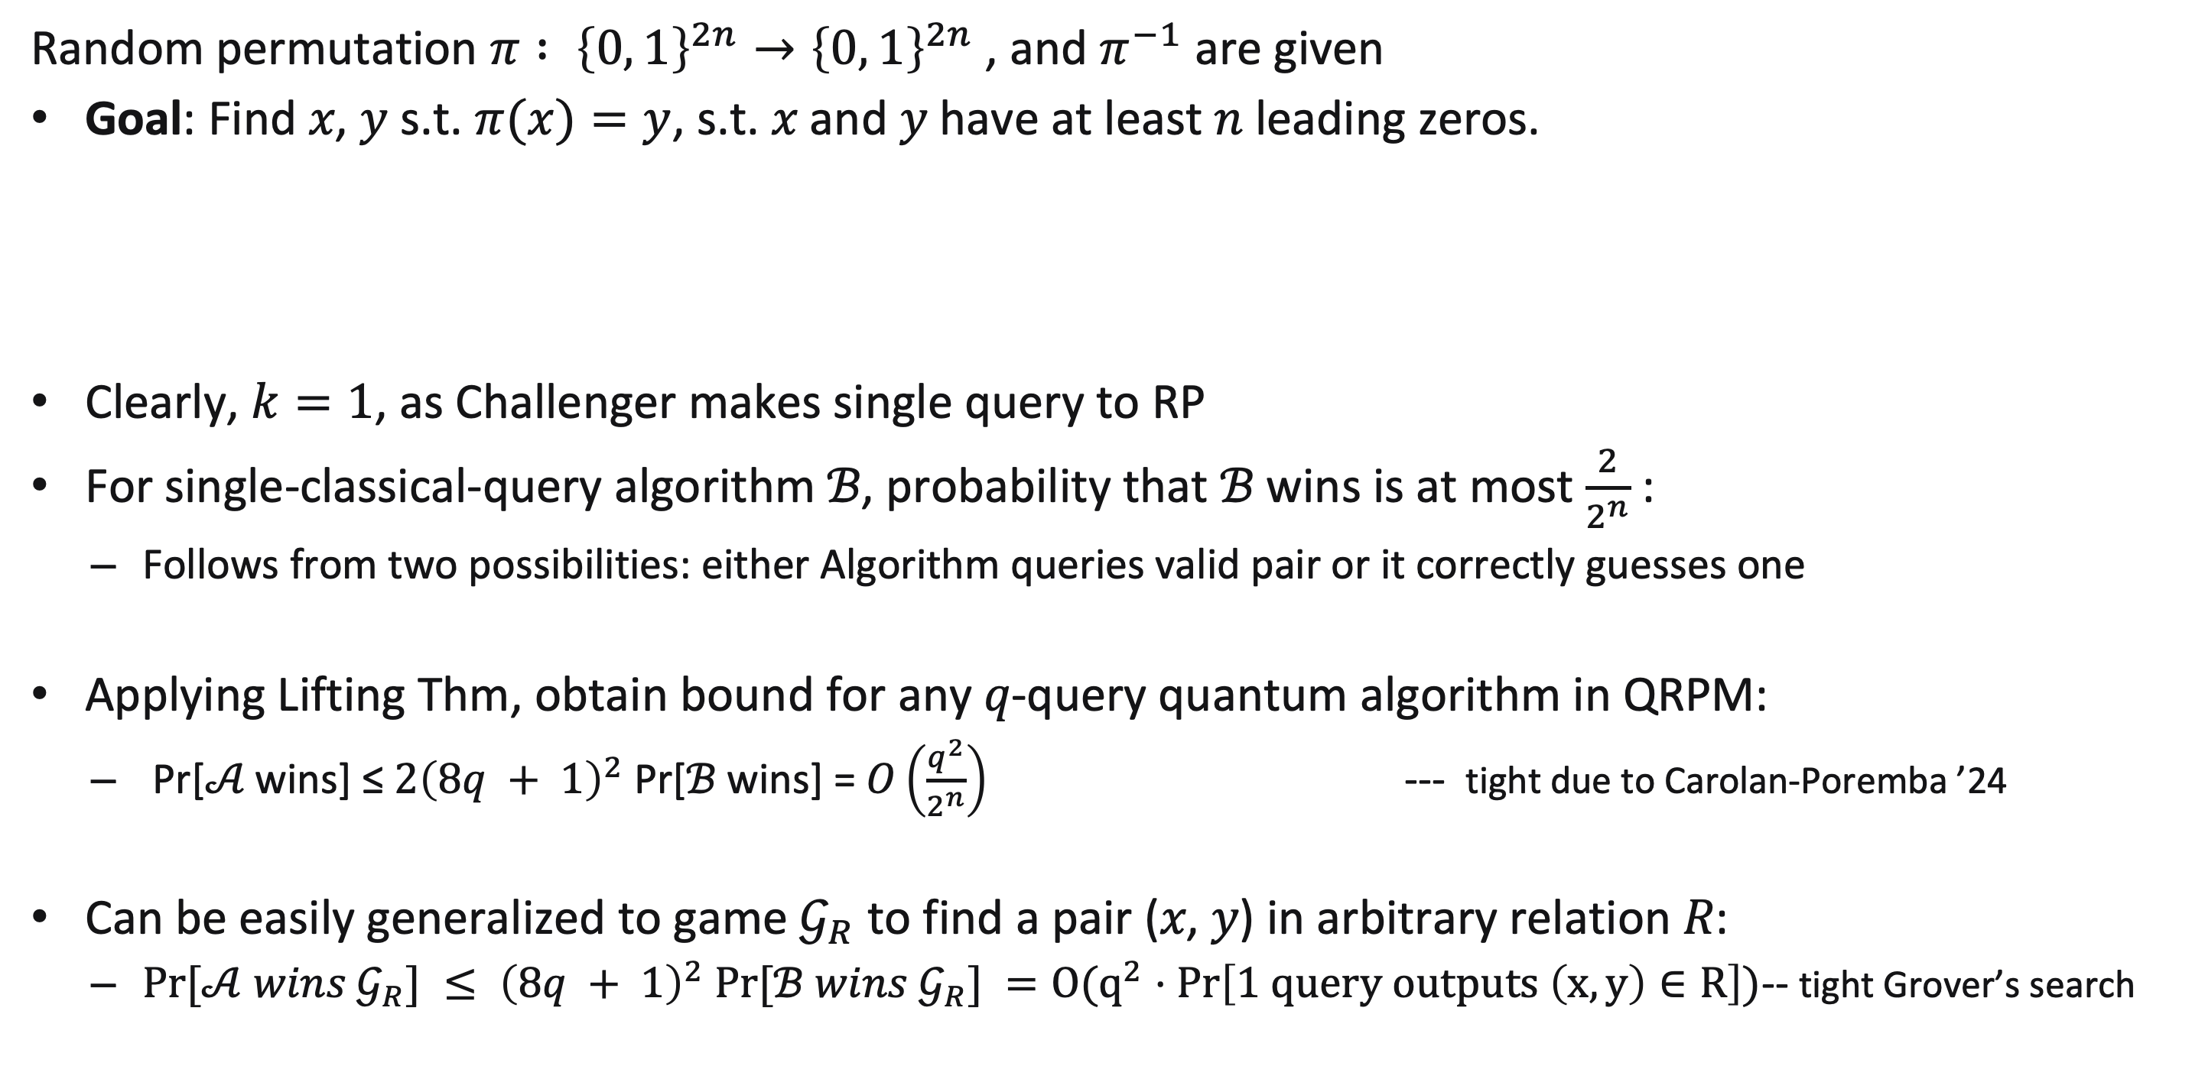
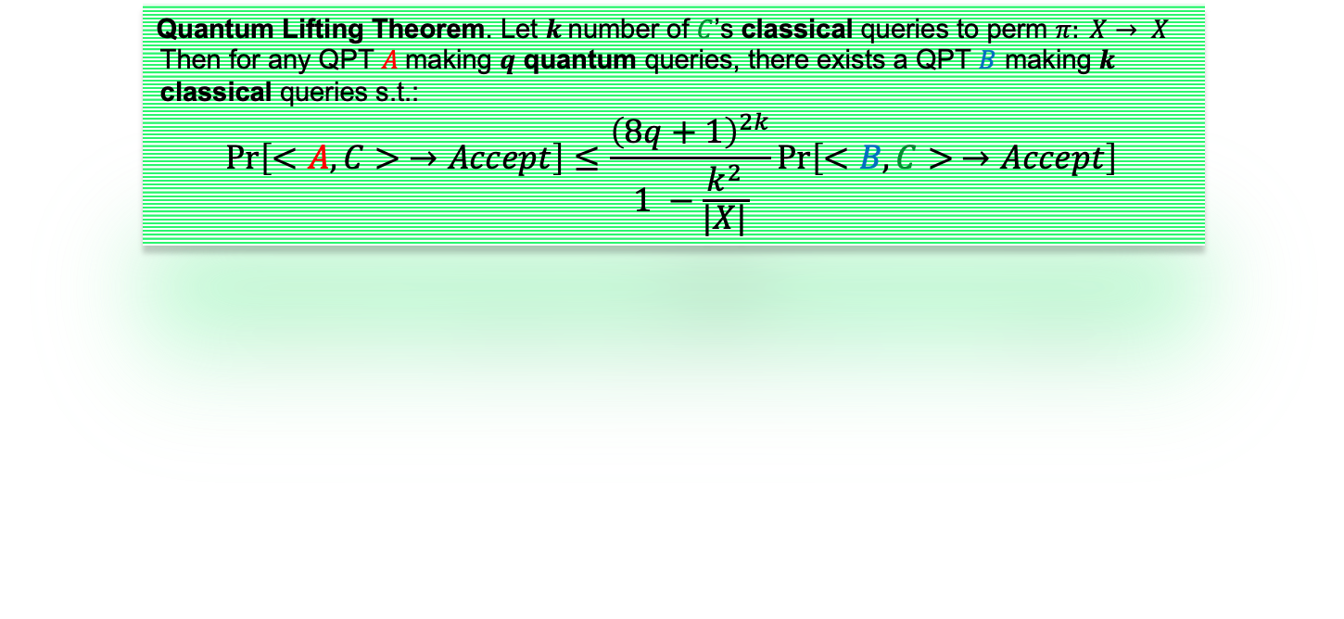
Applications : Double-sided Zero Search Game
Random permutation $π : {\left\{0, 1\right\}}^{2n}→{\left\{0, 1\right\}}^{2n}$, and $π^{−1}$ are given
Goal: Find 𝑥, 𝑦 s.t. $π(x)=y$, s.t. 𝑥 and 𝑦 have at least 𝑛 leading zeros.
Clearly, $k=1$, as Challenger makes single query to RP
For single-classical-query algorithm ℬ, probability that ℬ wins is at most $\frac{2}{2^{n}}$:
  Follows from two possibilities: either Algorithm queries valid pair or it correctly guesses one
Applying Lifting Thm, obtain bound for any 𝑞-query quantum algorithm in QRPM:
  Pr[𝒜 wins] ≤ $2{\left(8q + 1\right)}^{2}$Pr[ℬ wins] = $O\left(\frac{q^{2}}{2^{n}}\right)$ --- tight due to Carolan-Poremba ’24
Can be easily generalized to game $𝒢_{R}$ to find a pair (𝑥, 𝑦) in arbitrary relation 𝑅:
  $Pr⁡[𝒜 wins 𝒢_{R}] ≤ {\left(8q + 1\right)}^{2} Pr⁡[ℬ wins 𝒢_{R}] =O(q^{2}⋅Pr\left[1 query outputs \left(x, y\right)∈R\right])$-- tight Grover’s search
Quantum Lifting Theorem. Let $k$number of $C$’s classical queries to perm $π: X→ X$
Then for any QPT $A$making $q$ quantum queries, there exists a QPT $B$ making $k$ classical queries s.t.:
$$\operatorname{Pr}\left[<A, C> →Accept\right]≤\frac{{\left(8q+1\right)}^{2k}}{1 −\frac{k^{2}}{|X|}}\operatorname{Pr}\left[<B,C> →Accept\right]$$
Notes:
Show power and simplicity of Lifting Thm: double sided zero search
Probabilities of these events sum to $\frac{1}{2^{n}}+\frac{1}{2^{n}}=\frac{2}{2^{n}}$

Slide 11
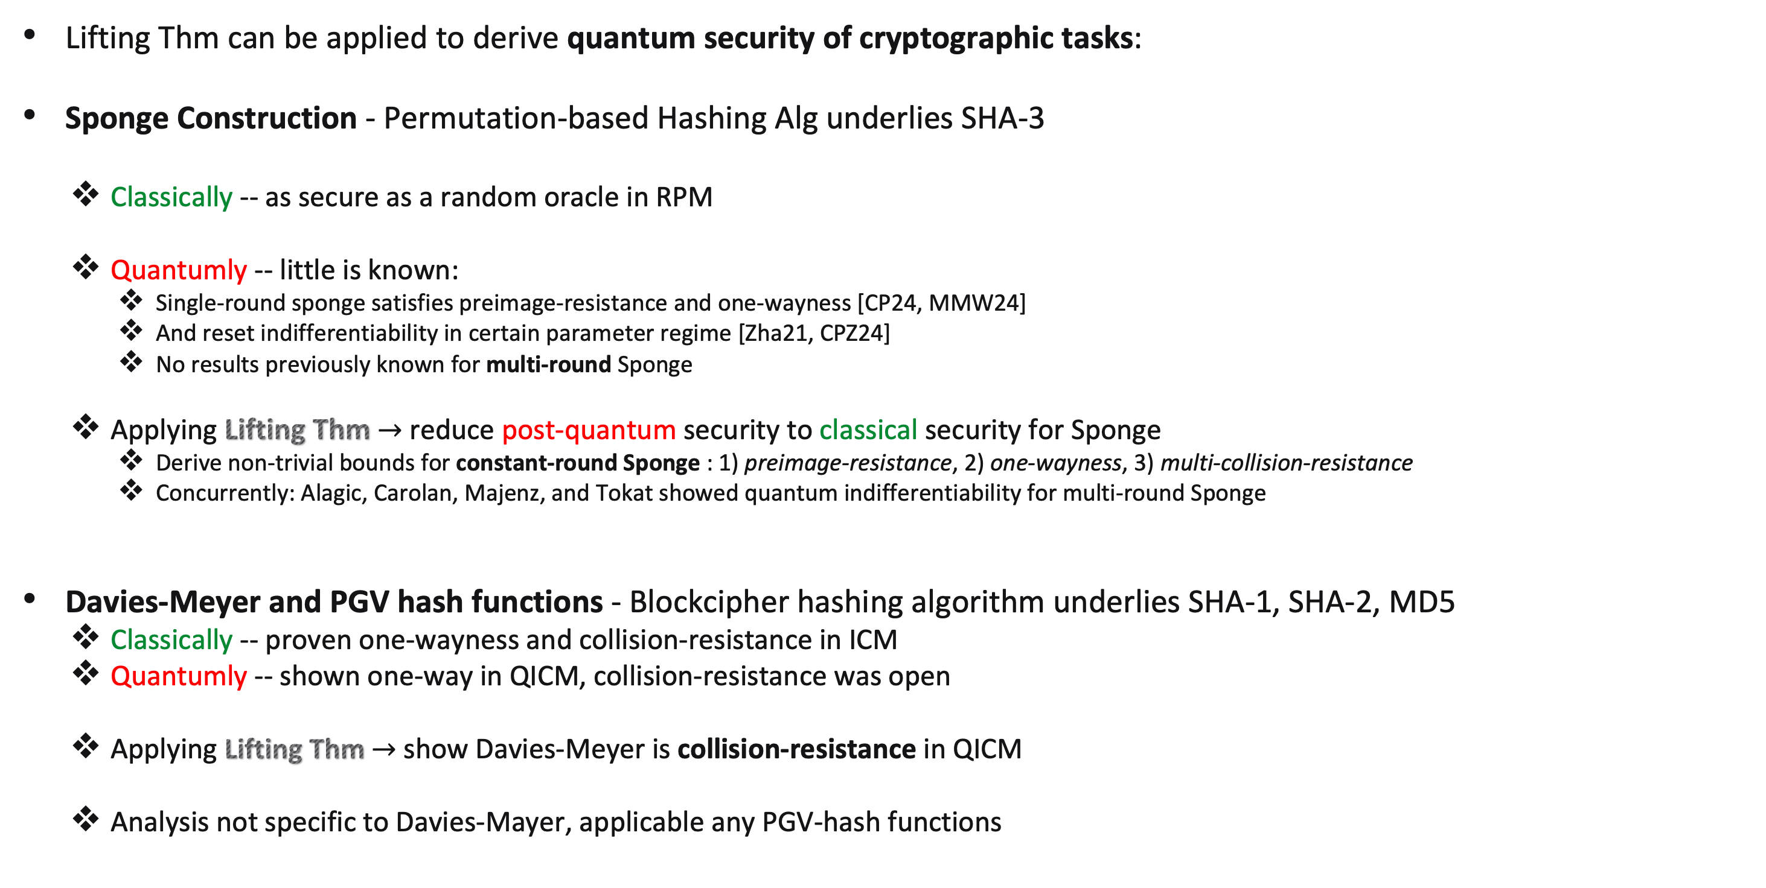
Applications: Sponge, Davies-Meyer, PGV
Lifting Thm can be applied to derive quantum security of cryptographic tasks:
Sponge Construction - Permutation-based Hashing Alg underlies SHA-3
  Classically -- as secure as a random oracle in RPM
  Quantumly -- little is known:
    Single-round sponge satisfies preimage-resistance and one-wayness [CP24, MMW24]
    And reset indifferentiability in certain parameter regime [Zha21, CPZ24]
    No results previously known for multi-round Sponge
  Applying Lifting Thm $→$ reduce post-quantum security to classical security for Sponge
    Derive non-trivial bounds for constant-round Sponge : 1) preimage-resistance, 2) one-wayness, 3) multi-collision-resistance
    Concurrently: Alagic, Carolan, Majenz, and Tokat showed quantum indifferentiability for multi-round Sponge
Davies-Meyer and PGV hash functions - Blockcipher hashing algorithm underlies SHA-1, SHA-2, MD5
  Classically -- proven one-wayness and collision-resistance in ICM
  Quantumly -- shown one-way in QICM, collision-resistance was open
  Applying Lifting Thm $→$ show Davies-Meyer is collision-resistance in QICM
  Analysis not specific to Davies-Mayer, applicable any PGV-hash functions
Notes:
their results encompass ours in most settings, with a few exceptions, such as preimage-resistance in the single- and two-round cases, and collision-resistance in the single-round case.
their approach is tailored specifically to sponge, whereas our lifting theorem applies more broadly to any permutation-based construction.

Slide 12
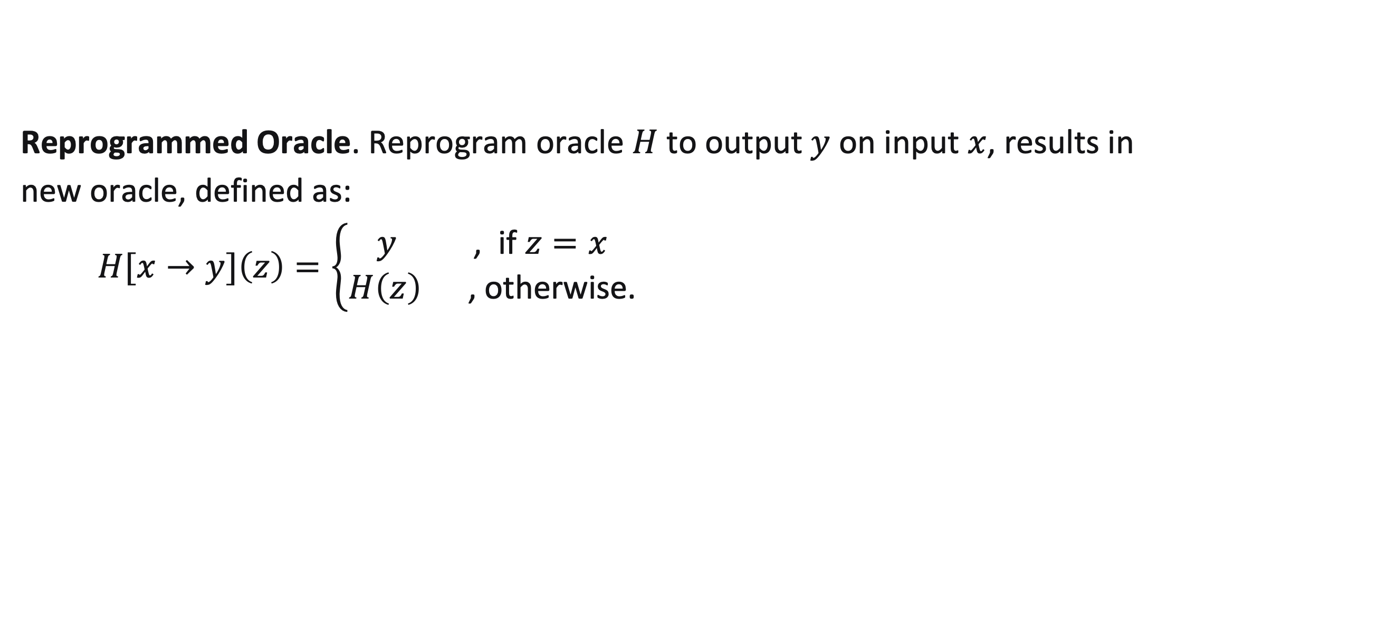
Techniques & Tools
Background: Reprogramming
Reprogrammed Oracle. Reprogram oracle $H$ to output $y$ on input $x$, results in
new oracle, defined as:
$H[x→y]\left(z\right)=\left\{\begin{aligned}y \text{, } \text{if} z=x \\ H\left(z\right) \text{, }\text{otherwise}\text{.}\end{aligned}\right.$

Slide 13
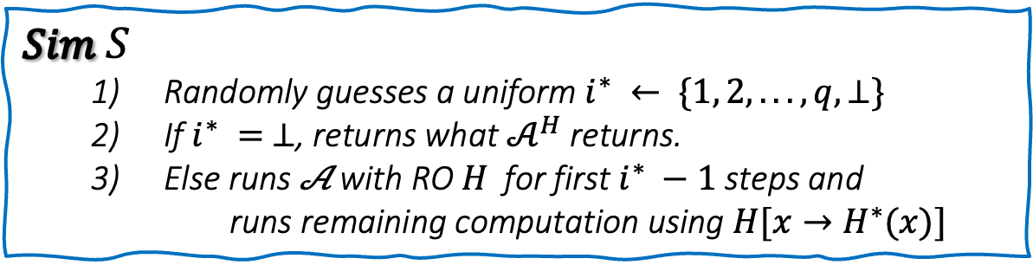
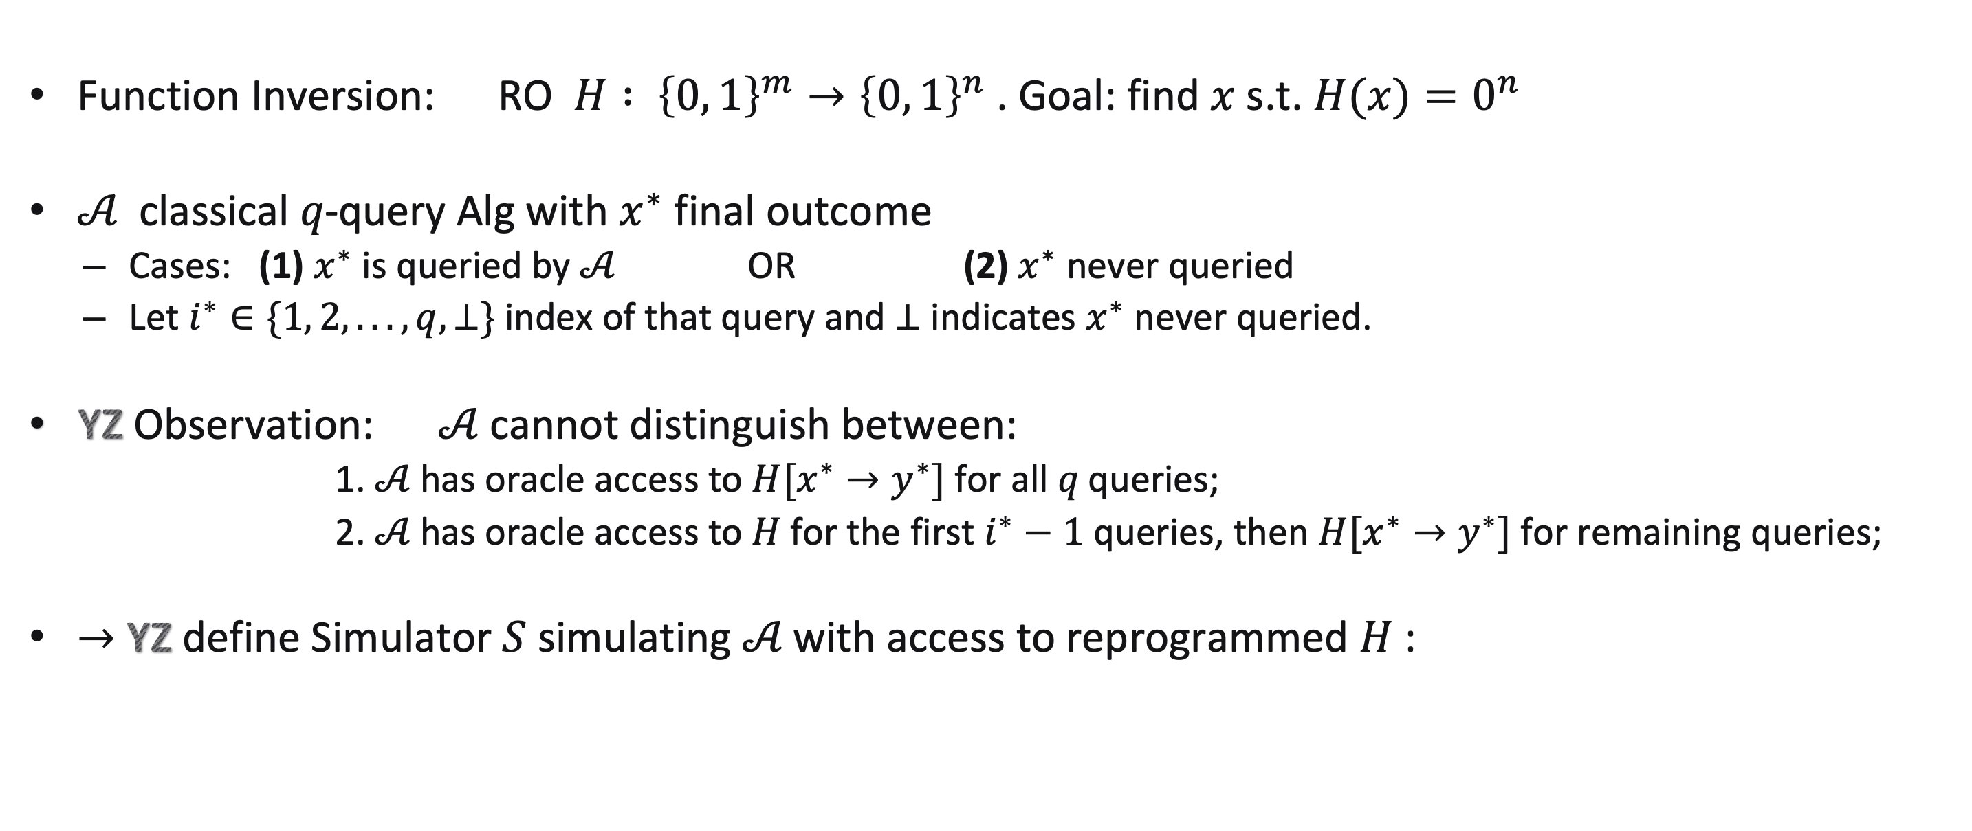

Techniques & Tools:
Classical Lifting in ROM
Revisit YZ Lifting Thm
Function Inversion: RO $H : {\left\{0, 1\right\}}^{m}→{\left\{0, 1\right\}}^{n}$. Goal: find $x$ s.t. $H(x)=0^{n}$
𝒜 classical 𝑞-query Alg with $x^{∗}$ final outcome
  Cases: (1) $x^{∗}$ is queried by 𝒜 OR (2) $x^{∗}$ never queried
  Let $i^{∗}∈\{1, 2, . . . , q, ⊥\}$index of that query and ⊥ indicates $x^{∗}$ never queried.
YZ Observation: 𝒜 cannot distinguish between:
  1. 𝒜 has oracle access to $H[x^{∗}→y^{∗}]$for all 𝑞 queries;
  2. 𝒜 has oracle access to 𝐻 for the first $i^{∗}−1$ queries, then $H[x^{∗}→y^{∗}]$for remaining queries;
$→$ YZ define Simulator $S$ simulating 𝒜 with access to reprogrammed $H$:
$$Sim S$$
  Randomly guesses a uniform $i^{∗} ← \{1, 2, . . . , q, ⊥\}$
  If $i^{∗} = ⊥$, returns what $𝒜^{H}$ returns.
  Else runs 𝒜 with RO 𝐻 for first $i^{∗} −1$ steps and
  runs remaining computation using $H[x→H^{∗}(x)]$
-- 𝑥 is input of $i^{∗}$-th query

Slide 14
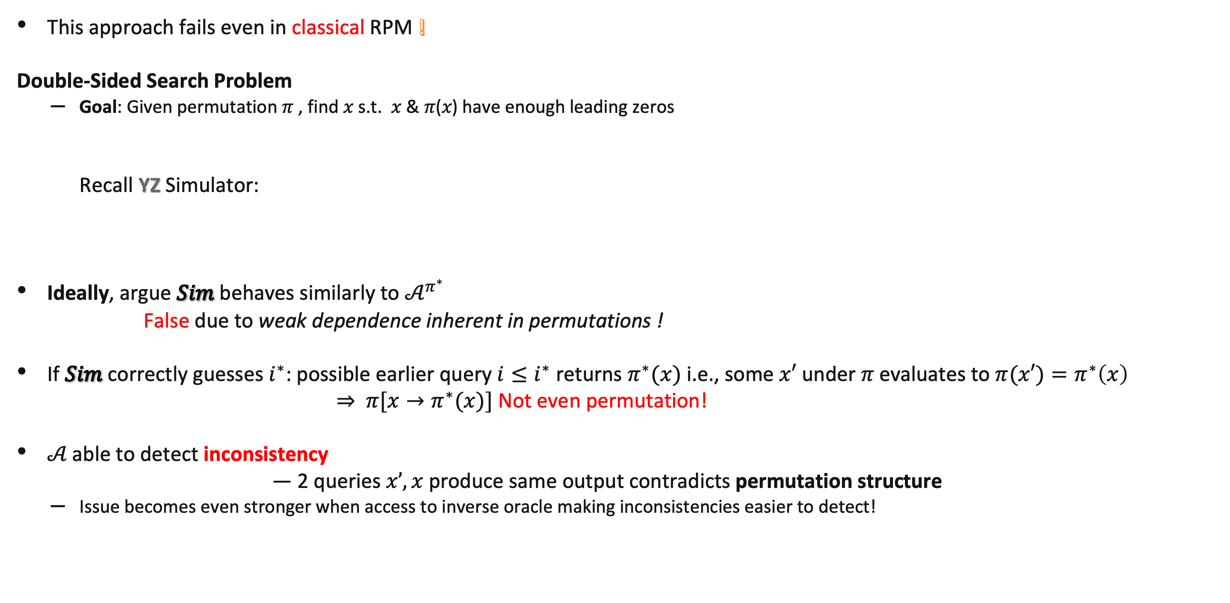
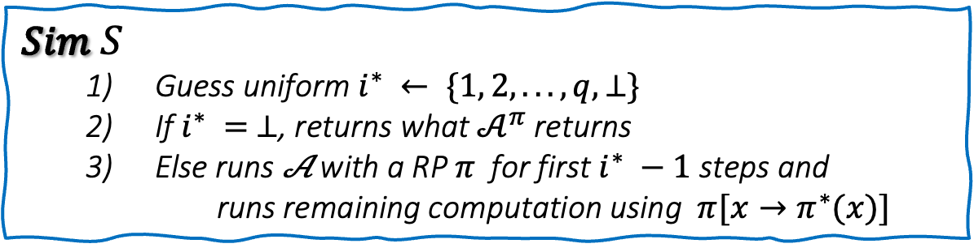
Techniques & Tools:
Classical Lifting in RPM
This approach fails even in classical RPM !
Double-Sided Search Problem
  Goal: Given permutation $π$ , find 𝑥 s.t. 𝑥 & 𝜋(𝑥) have enough leading zeros
Recall YZ Simulator:
Ideally, argue $Sim$ behaves similarly to $𝒜^{π^{∗}}$
False due to weak dependence inherent in permutations !
If $Sim$ correctly guesses $i^{∗}$: possible earlier query $i≤i^{∗}$ returns $π^{∗}(x)$ i.e., some $x′$ under 𝜋 evaluates to $π(x′)=π^{∗}\left(x\right)$
$⇒$ $π[x→π^{∗}(x)]$ Not even permutation!
𝒜 able to detect inconsistency
— 2 queries $x’,x$ produce same output contradicts permutation structure
  Issue becomes even stronger when access to inverse oracle making inconsistencies easier to detect!
$$Sim S$$
  Guess uniform $i^{∗} ← \{1, 2, . . . , q, ⊥\}$
  If $i^{∗} = ⊥$, returns what $𝒜^{π}$ returns
  Else runs 𝒜 with a RP $π$ for first $i^{∗} −1$ steps and
  runs remaining computation using $π[x→π^{∗}(x)]$
Notes:
Ideally, argue $Sim$ behaves similarly to $𝒜^{π^{∗}}$ up to $(q + 1)$ - loss -- from guessing $i^{∗}$

Slide 15
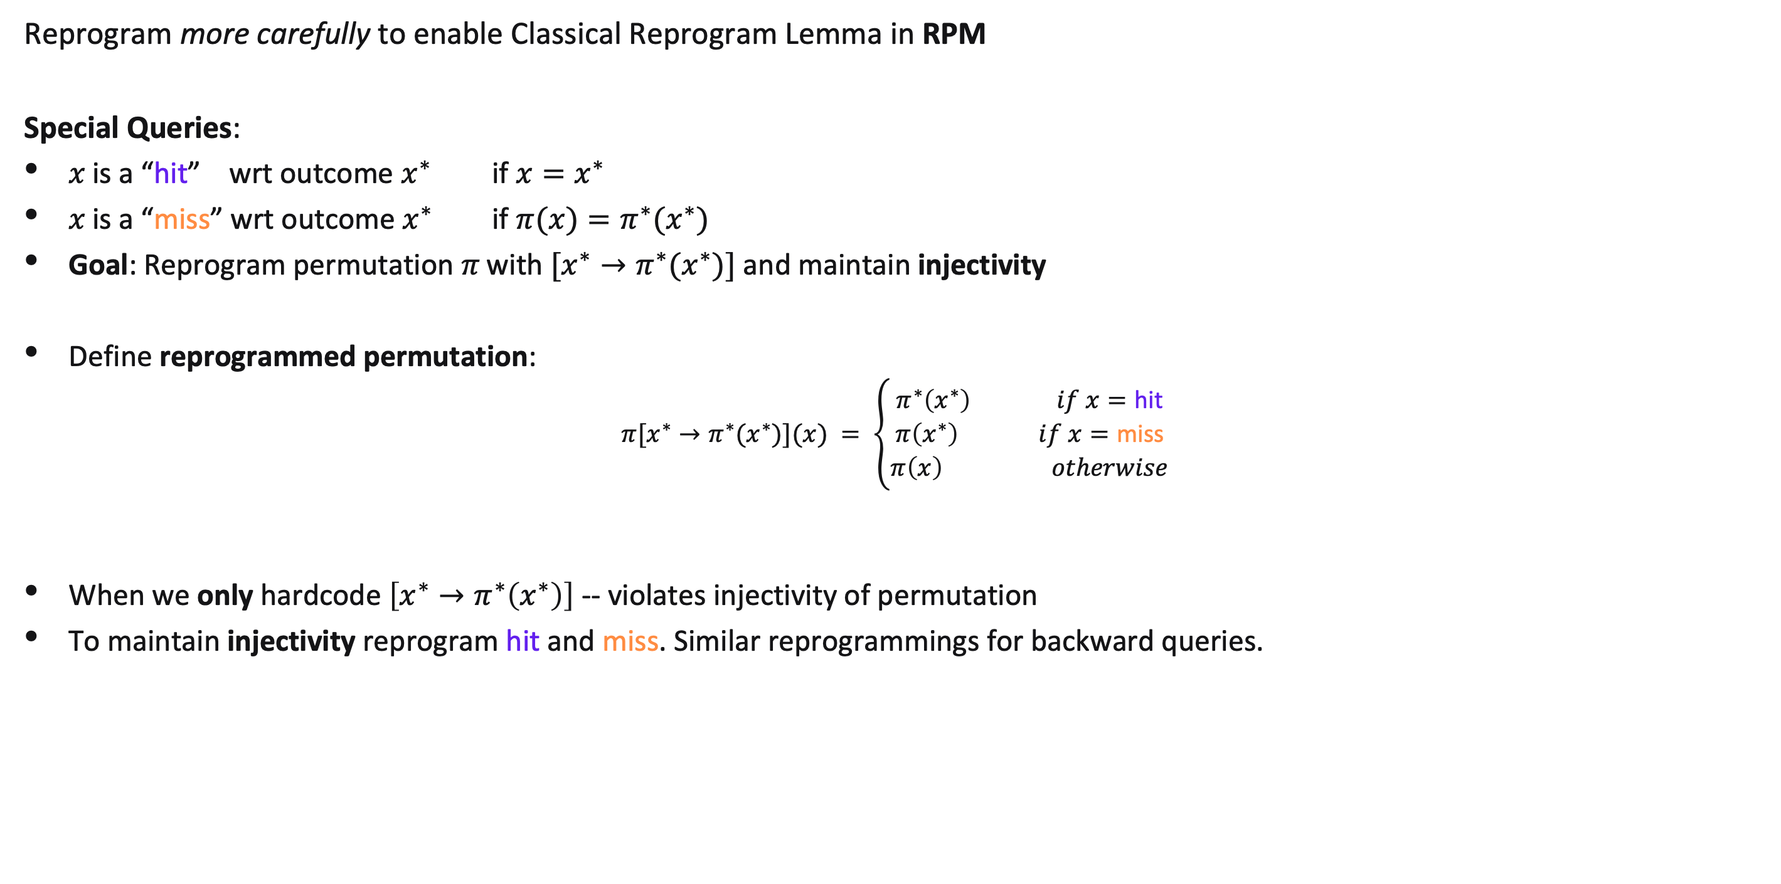
Techniques & Tools:
Classical Lifting in RPM
Reprogram more carefully to enable Classical Reprogram Lemma in RPM
Special Queries:
𝑥 is a “hit” wrt outcome $x^{∗}$ if $x=x^{∗}$
𝑥 is a “miss” wrt outcome $x^{∗}$ if $π(x)=π^{∗}(x^{∗})$
Goal: Reprogram permutation 𝜋 with $[x^{∗}→π^{∗}(x^{∗})]$and maintain injectivity
Define reprogrammed permutation:
$$π[x^{∗}→π^{∗}(x^{∗})](x) = \left\{\begin{aligned}π^{∗}\left(x^{∗}\right) if x=\text{hit} \\ π\left(x^{∗}\right) if x=\text{miss} \\ π\left(x\right) otherwise\end{aligned}\right.$$
When we only hardcode $\left[x^{∗}→π^{∗}\left(x^{∗}\right)\right]$ -- violates injectivity of permutation
To maintain injectivity reprogram hit and miss. Similar reprogrammings for backward queries.
Notes:
Similarly, for backward query to $π^{−1}$ call a query 𝑦 “hit” wrt final outcome $y^{∗}= π^{∗}(x^{∗})$ if $y^{hit}=$ $y^{∗}$
We call a query 𝑦 “miss” (or just 𝑦 𝗆𝗂𝗌𝗌) if $y =π(x^{∗})$as in Figure 1.

Slide 16

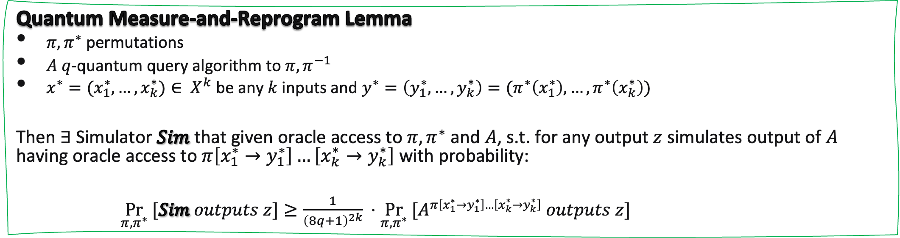
Techniques & Tools:
Quantum Measure and Reprogram in QRPM
Consider $Sim$ not only guesses index $i^{∗}$ but also if $i^{∗}$-th query is hit or miss query
By defining hit and miss queries, capture first query touching outcome $x^{∗}$
  either by querying miss or hit query
With idea in classical setting – generalize to quantum setting $⇒$ Measure-and-Reprogram for QRPM
Quantum Measure-and-Reprogram Lemma
$π, π^{∗}$ permutations
$A$ $q$-quantum query algorithm to $π, π^{−1}$
$x^{∗}=(x_{1}^{∗}, …,x_{k}^{∗})∈ X^{k}$ be any $k$ inputs and $y^{∗}=\left(y_{1}^{∗}, …, y_{k}^{∗}\right)=(π^{∗}\left(x_{1}^{∗}\right),…,π^{∗}\left(x_{k}^{∗}\right))$
Then $∃$ Simulator $Sim$ that given oracle access to $π, π^{∗}$ and $A$, s.t. for any output $z$ simulates output of $A$ having oracle access to $π\left[x_{1}^{∗}→y_{1}^{∗}\right]…\left[x_{k}^{∗}→y_{k}^{∗}\right]$ with probability:
$\underset{π, π^{∗}}{Pr} [Sim outputs z]≥\frac{1}{{\left(8q+1\right)}^{2k}} ⋅\underset{π, π^{∗}}{Pr} [A^{π\left[x_{1}^{∗}→y_{1}^{∗}\right]…\left[x_{k}^{∗}→y_{k}^{∗}\right]} outputs z]$
Notes:
Then it runs the rest of 𝒜’s computation under 𝜋[𝑥 → 𝑦] (and its inverse).

Slide 17
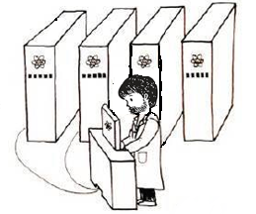
Summary
Main Result: Derive first Lifting Thm for Security in Quantum Random Permutation & Ideal Cipher
Application:
Derive tight bounds for quantum hardness of Double-sided Zero Search Game
  Post-Quantum Security for:
    Preimage Resistance, One-Wayness, Multi-Collision Resistance of constant-round Sponge
    Collision Resistance of Davies-Meyer
Future Directions
Extend Lifting to NISQ setting;
Tighter Lifting Thms for other optimal security and complexity results;
Extend results to general interactive search games, e.g. general interactive Sponge;
Other Applications relying on permutations?
Thank You!
Notes:
19:45 minutes

Slide 18
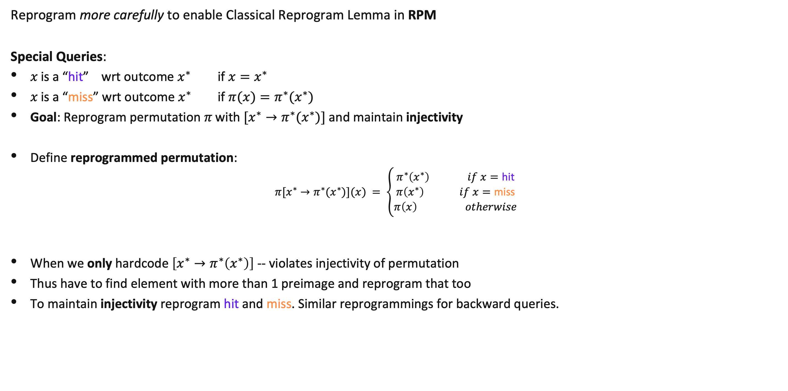
Techniques & Tools:
Classical Lifting in RPM
Reprogram more carefully to enable Classical Reprogram Lemma in RPM
Special Queries:
𝑥 is a “hit” wrt outcome $x^{∗}$ if $x=x^{∗}$
𝑥 is a “miss” wrt outcome $x^{∗}$ if $π(x)=π^{∗}(x^{∗})$
Goal: Reprogram permutation 𝜋 with $[x^{∗}→π^{∗}(x^{∗})]$and maintain injectivity
Define reprogrammed permutation:
$$π[x^{∗}→π^{∗}(x^{∗})](x) = \left\{\begin{aligned}π^{∗}\left(x^{∗}\right) if x=\text{hit} \\ π\left(x^{∗}\right) if x=\text{miss} \\ π\left(x\right) otherwise\end{aligned}\right.$$
When we only hardcode $\left[x^{∗}→π^{∗}\left(x^{∗}\right)\right]$ -- violates injectivity of permutation
Thus have to find element with more than 1 preimage and reprogram that too
To maintain injectivity reprogram hit and miss. Similar reprogrammings for backward queries.
Notes:
Similarly, for backward query to $π^{−1}$ call a query 𝑦 “hit” wrt final outcome $y^{∗}= π^{∗}(x^{∗})$ if $y^{hit}=$ $y^{∗}$
We call a query 𝑦 “miss” (or just 𝑦 𝗆𝗂𝗌𝗌) if $y =π(x^{∗})$as in Figure 1.

Slide 19


Techniques & Tools:
Classical Lifting in RPM
Consider $Sim$ not only guesses index $i^{∗}$ but also if $i^{∗}$-th query is hit or miss query
By defining hit and miss queries, capture first query touching outcome $x^{∗}$
  either by querying miss or hit query
  New Sim establishes reprogram lemma in classical RPM.
$$Sim S$$
  Guess uniform ($i^{∗}, b) ← \left\{1, 2, . . . , q, ⊥\right\} ×\{0,1\}$
  If $i^{∗} = ⊥$, returns what $𝒜^{π}$ returns.
  Else runs 𝒜 with RP $π$ for first $i^{∗}−1$ steps
  For $i^{∗}$-th query:
      If b = 0 (hit query):
          A forward query on input x: compute $y=π^{∗}(x)$and reprogram $π[x→y]$
          A backward query on input y: compute $x={π^{∗}}^{−1}(y)$and reprogram $π[x→y]$
      If b = 1 (miss query):
          A forward query on input x: compute $y =π\left({π^{∗}}^{−1}\left(π\left(x\right)\right)\right)$and reprogram $π[x→y]$
          A backward query on input y: compute $x =π^{−1}\left(π^{∗}\left(π^{−1}\left(y\right)\right)\right)$and reprogram $π[x→y]$
Notes:
Then it runs the rest of 𝒜’s computation under 𝜋[𝑥 → 𝑦] (and its inverse).

Slide 20
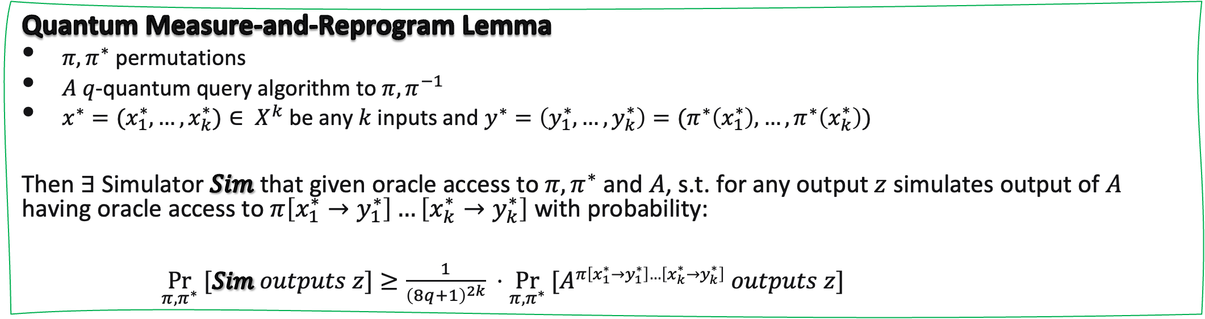

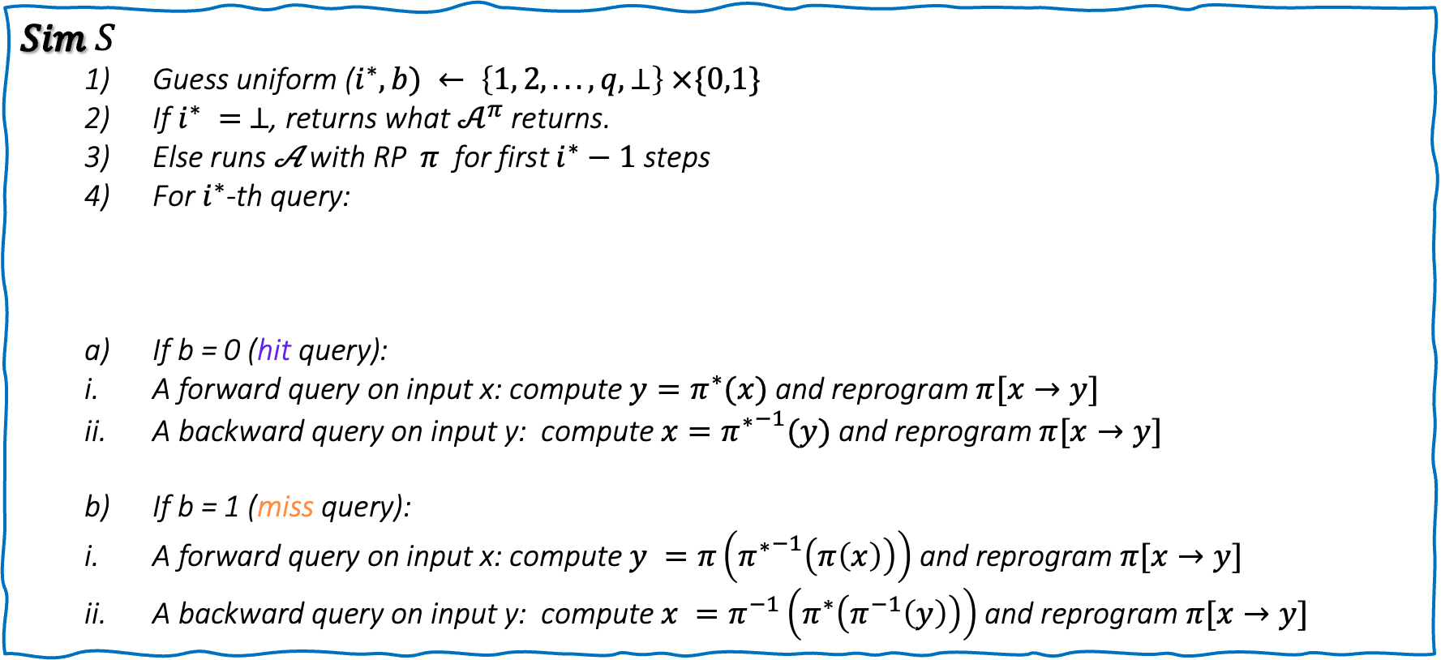
Quantum Measure and Reprogram in QRPM
With idea in classical setting -- generalize to quantum setting and give a lifting theorem for QRPM
$$Sim S$$
  Guess uniform ($i^{∗}, b) ← \left\{1, 2, . . . , q, ⊥\right\} ×\{0,1\}$
  If $i^{∗} = ⊥$, returns what $𝒜^{π}$ returns.
  Else runs 𝒜 with RP $π$ for first $i^{∗}−1$ steps
  For $i^{∗}$-th query:
      If b = 0 (hit query):
          A forward query on input x: compute $y=π^{∗}(x)$and reprogram $π[x→y]$
          A backward query on input y: compute $x={π^{∗}}^{−1}(y)$and reprogram $π[x→y]$
      If b = 1 (miss query):
          A forward query on input x: compute $y =π\left({π^{∗}}^{−1}\left(π\left(x\right)\right)\right)$and reprogram $π[x→y]$
          A backward query on input y: compute $x =π^{−1}\left(π^{∗}\left(π^{−1}\left(y\right)\right)\right)$and reprogram $π[x→y]$
$$c ← \{0,1\}$$
  S measures input register:
  If c = 0 first reprogram then answer all A’s remaining queries using $π[x→y]$
  If c = 1 first answer A’s $i$-th query using $π$and then reprogram
Quantum Measure-and-Reprogram Lemma
$π, π^{∗}$ permutations
$A$ $q$-quantum query algorithm to $π, π^{−1}$
$x^{∗}=(x_{1}^{∗}, …,x_{k}^{∗})∈ X^{k}$ be any $k$ inputs and $y^{∗}=\left(y_{1}^{∗}, …, y_{k}^{∗}\right)=(π^{∗}\left(x_{1}^{∗}\right),…,π^{∗}\left(x_{k}^{∗}\right))$
Then $∃$ Simulator $Sim$ that given oracle access to $π, π^{∗}$ and $A$, s.t. for any output $z$ simulates output of $A$ having oracle access to $π\left[x_{1}^{∗}→y_{1}^{∗}\right]…\left[x_{k}^{∗}→y_{k}^{∗}\right]$ with probability:
$\underset{π, π^{∗}}{Pr} [Sim outputs z]≥\frac{1}{{\left(8q+1\right)}^{2k}} ⋅\underset{π, π^{∗}}{Pr} [A^{π\left[x_{1}^{∗}→y_{1}^{∗}\right]…\left[x_{k}^{∗}→y_{k}^{∗}\right]} outputs z]$
Notes:
We define the following simulator in QRPM
such that the 𝑘-tuple (𝑥 * 1 , 𝑦* 1 ), ...,(𝑥 * 𝑘 , 𝑦* 𝑘 ) are “good” with respect to 𝜋.
Here, we have (8𝑞 + 1) instead of (4𝑞 + 1) because we consider the most general algorithm, which can make superposition queries to 𝜋 and 𝜋 −1 within a single query. To handle this, we decompose each query into two: one querying only 𝜋 and the other querying only 𝜋 −1 . This transformation introduces an additional multiplicative factor of 2.

