Slide 1

Succinct Arguments for BatchQMA and Friends
Rishab Goyal Aditya Jain
Shashwatha Mitra

Slide 2
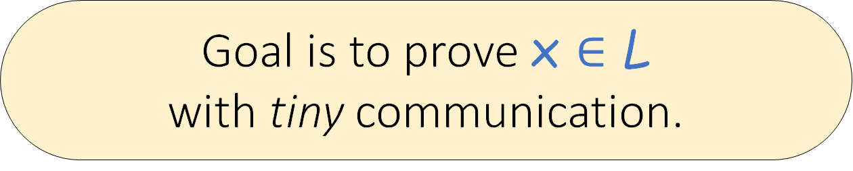
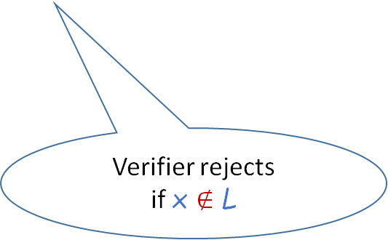
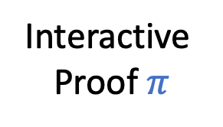

Succinct Arguments [Kilian92, Micali94]
NP Language L
Instance x
Witness w for x $∈$ L
Interactive
Proof $π$
Witness w
…
Succinctness
Soundness
Goal is to prove x $∈$ L
with tiny communication.
Proof size does NOT grow with |w|
Verifier rejects
if x $∉$ L

Slide 3
Succinct Arguments [Kilian92, Micali94]
Seminal work by Kilian → 4-round arguments using CRHFs + PCPs
To make non-interactive:
  Strong barriers under falsifiable assumptions [GW11]
  Fiat-Shamir: Random Oracle heuristic [Mic94]
Large body of work (theory & applied) [Kil92, Mic94, Gro10, BCCT12, BCIOP13, BCCT13, SW14, …]
Numerous applications (blockchain payments, smart contracts, MPC, …)

Slide 4


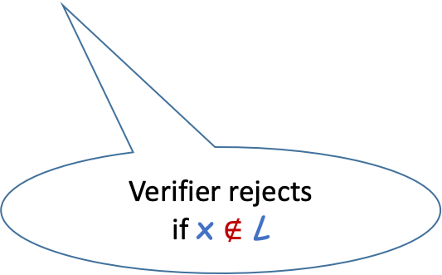
This Work: Succinct Quantum Arguments
[CCY20, BKLMMVVY22, GKNV24, MNZ24]
W/ Classical Verifiers
QMA
NP Language L
Instance x
Proofs could be quantum
Interactive
Proof $π$
Witness w
Q – Can these be classically verified?
Yes!
…
[CCY20, BKLMMVVY22, …]
Succinctness
Last few years, push towards classical verifiers.
Soundness
Proof size does NOT grow with |w|
Verifier rejects
if x $∉$ L
  Near-term projections – available only as quantum cloud service

Slide 5

This Work: Succinct Quantum Arguments
[CCY20, BKLMMVVY22, GKNV24, MNZ24]
W/ Classical Verifiers
Interactive
Proof $π$
  Public-Coin (thus 1-round* via Fiat-Shamir)
Witness w
…
Relies on Quantum Random Oracle heuristic!
Q – Can we do better in the standard model (without QROM)?
Reference | # Rounds | Function Class | Assumption
[Chia-Chung-Yamakawa-20] | 2 + long CRS | QMA | Heuristics + LWE
[Bartusek-Kalai-Lombardi-Ma-Malavolta-Vaikuntanathan-Vidick-Yang-22] | > 8 | QMA/ BatchQMA | iO + LWE/ LWE
[Gunn-Kalai-Natarajan-Villanyi-24] [Metger-Natarajan-Zhang-24] | > 8 | QMA | LWE
*designated-verifier

Slide 6




Minimal Round Complexity without heuristics?
Kilian → 4-round (CRHFs + PCPs)
GOAL: Kilian-style protocol for quantum prover with classical verifier.
No known equivalent!
Hash func $H$
PCP digest $h$
For *any* non-trivial quantum class
PCP queries $Q$
Hash opening $op$
Best we have needs > 8 rounds
Notes:
Broadly, …

Slide 7


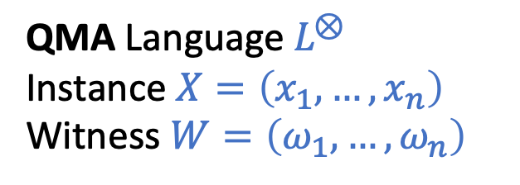

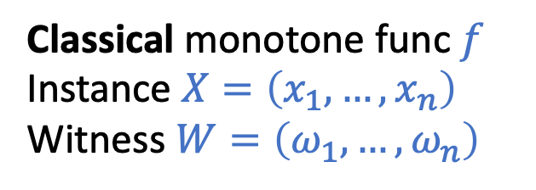

This Work: Results
Need many copies of quantum witness as in all prior works
QMA Language $L^{⊗}$
Instance $X=\left(x_{1},…,x_{n}\right)$
Witness $W=\left(ω_{1},…,ω_{n}\right)$
BatchQMA
  Under LWE + FE, 4-round with optimal comm. complexity
  Under LWE, 4-round with
  long CRS/first-round message
Monotone-batchQMA
  Under LWE, 6-round with optimal comm. complexity
Want: $π$ proves $∧_{i}\left(x_{i}∈L\right)$
Succinctness: $\left|π\right|$ does not grow with $n$
Classical monotone func $f$
Instance $X=\left(x_{1},…,x_{n}\right)$
Witness $W=\left(ω_{1},…,ω_{n}\right)$
Want: $π$ proves $f\left(𝕀_{x_{i}∈L}\right)=1$
Succinctness: $\left|π\right|$ does not grow with $n$

Slide 8
Key Barrier faced by prior works
Rely on a (classical) succinct argument for NP
  Rewind a cheating quantum prover to extract invalid quantum “psuedo”-witnesses
“Rewindable/Extractable” succinct arguments for NP need more rounds
Dilemma – Need more rounds for extraction
– Need extraction for proving soundness

Slide 9


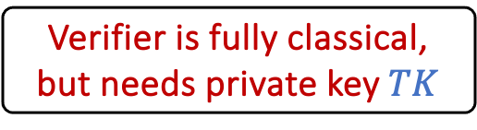




The rewinding barrier in existing blueprints
Tools needed
  FHM protocol for QMA verification with quantum verifier [Fitzsimons-Hajdusek-Morimae-18]
  Mahadev’s measurement protocol [Mahadev-18, Alagic-Childs-Grilo-Hung-20]
    4-round for getting honest measurement from malicious quantum prover
  “State-preserving” Argument of Knowledge for NP
  [Chiesa-Ma-Spooner-Zhandry-21, Lombardi-Ma-Spooner-22]
Witness $ω$
Verifier measures &
does classical computation
$$|π⟩$$
COM key $CK$
COM value $y$
Verifier is fully classical, but needs private key $TK$
challenge $c$
opening $op$
Fully classical

Slide 10
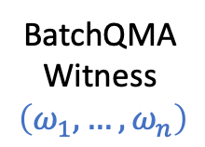








The rewinding barrier in existing blueprints
Private-Coin
Let us focus on BatchQMA – the BKLMMVVY22 blueprint
← Send COM key & Hash function
→ Commit each witness state & hash the COM values
←→ Classical succinct argument for proving knowledge of hash preimage
Send Mahadev challenge
→ Open each commitment & hash the openings
←→ Classical succinct argument for proving knowledge of hash preimage
← Send private key for checking COMs
→ Run FHM + Mahadev verification & prove using classical succinct argument
COM key $CK$, Hash func $H$
$$H(y_{1},…, y_{n})$$
I know ${\left\{y_{i}\right\}}_{i}$
BatchQMA
Witness
$$\left(ω_{1},…,ω_{n}\right)$$
challenge $c$
$$H(z_{1},…, z_{n})$$
I know ${\left\{z_{i}\right\}}_{i}$
Private key $TK$
I know ${\left\{{(y}_{i}, z_{i})\right\}}_{i}$

Slide 11
The rewinding barrier in existing blueprints
Private-Coin
Let us focus on BatchQMA – the BKLMMVVY22 blueprint
COM key $CK$, Hash func $H$
$$H(y_{1},…, y_{n})$$
Adds at least 2 rounds
per block
  What if we can prove soundness without full extraction? .
I know ${\left\{y_{i}\right\}}_{i}$
BatchQMA
Witness
$$\left(ω_{1},…,ω_{n}\right)$$
challenge $c$
$$H(z_{1},…, z_{n})$$
Need to extract from all these for proving soundness
I know ${\left\{z_{i}\right\}}_{i}$
Private key $TK$
I know ${\left\{{(y}_{i}, z_{i})\right\}}_{i}$

Slide 12
Some insights
Full extraction is not necessary
  Rewinding could be bypassed with straight-line partial extraction
Use succinct classical arguments for simpler classes
  E.g., classical batch arguments (BARGs), etc

Slide 13

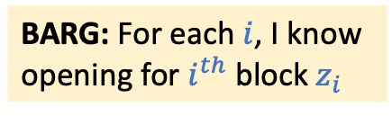
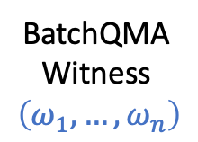
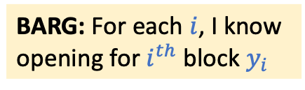






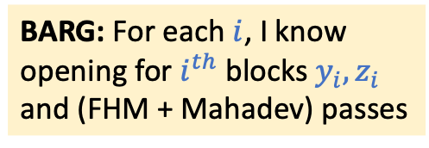
Warmup: Using BARGs instead of AoKs
BARGs are non-interactive succinct argument for batchNP
COM key $CK$, Hash func $H$
$$h_{y}=H(y_{1},…, y_{n})$$
I know ${\left\{y_{i}\right\}}_{i}$
BARG: For each $i$, I know
opening for $i^{th}$ block $y_{i}$
BatchQMA
Witness
$$\left(ω_{1},…,ω_{n}\right)$$
challenge $c$
$$h_{z}=H(z_{1},…, z_{n})$$
I know ${\left\{z_{i}\right\}}_{i}$
BARG: For each $i$, I know
opening for $i^{th}$ block $z_{i}$
Private key $TK$
I know ${\left\{{(y}_{i}, z_{i})\right\}}_{i}$
BARG: For each $i$, I know
opening for $i^{th}$ blocks $y_{i},z_{i}$
and (FHM + Mahadev) passes

Slide 14



Warmup: Using BARGs instead of AoKs
BARGs are non-interactive succinct argument for batchNP
COM key $CK$, Hash func $H$
$$h_{y}=H(y_{1},…, y_{n})$$
BARGs known from LWE [CJJ21]
Give somewhere-extraction
(straight-line; no rewinding needed)
BARG $π_{y}$
BatchQMA
Witness
$$\left(ω_{1},…,ω_{n}\right)$$
challenge $c$
$$h_{z}=H(z_{1},…, z_{n})$$
BARG $π_{z}$
Private key $TK$
Warmup Theorem: Under LWE, 6-round succinct argument for batchQMA
BARG $π_{FHM+}$

Slide 15



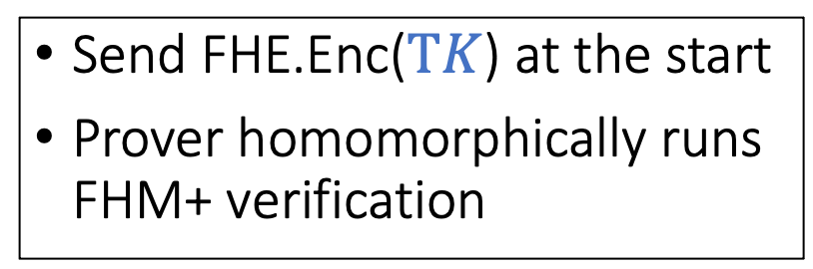
Towards 4 rounds for BatchQMA
Can’t we send $TK$ earlier?
Send FHE.Enc($TK$) at the start
Prover homomorphically runs FHM+ verification
COM key $CK$, Hash func $H$
FHE $CT$
$$h_{y}=H(y_{1},…, y_{n})$$
BARG $π_{y}$
Similar idea used in prior works [CCY20,…] for making public-coin
BatchQMA
Witness
$$\left(ω_{1},…,ω_{n}\right)$$
challenge $c$
$$h_{z}=H(z_{1},…, z_{n})$$
BARG $π_{z}$
P1. How to prove final CT was correctly evaluated using plain BARGs?
FHE $CT′$, BARG $π_{FHM+}$
Private key $TK$
BARG $π_{FHM+}$
  A. Compute CT as an AND-tree of individual FHM+ verifications.
  Can prove correct computation of FHE evaluation of AND-tree using BARGs

Slide 16
Towards 4 rounds for BatchQMA
P2. How to prove soundness?
COM key $CK$, Hash func $H$
FHE $CT$
$$h_{y}=H(y_{1},…, y_{n})$$
Issue is reduction algorithm
must know FHE-key for checking if adversary is successful
BARG $π_{y}$
BatchQMA
Witness
$$\left(ω_{1},…,ω_{n}\right)$$
challenge $c$
Need to go to a hybrid where reduction can use BARG extraction to check instead of decrypting using FHE
$$h_{z}=H(z_{1},…, z_{n})$$
BARG $π_{z}$
FHE $CT′$, BARG $π_{FHM+}$
Issue: Reminiscent of flawed PCP+PIR approach for SNARGs [ABOR00]
as pointed by [DLNNR04]

Slide 17
Approach 1: Bootstrapping FHE keys
Have a separate Mahadev COM-key for each index
FHE Encrypt each COM-key under a fresh FHE-key
Arrange these CTs at the leaves of a binary tree
Sample a fresh FHE-key for each node and encrypt keys for its children
Prover homomorphically runs FHM+ on each key individually and combines the using bootstrapping CTs
Use BARG to prove correctness of bootstrapped CT

Slide 18







Approach 1: Bootstrapping FHE keys
…
Reduction has two ways to verify attacker success
  Given root FHE-SK, or
  BARG trapdoor + FHE-SKs for one path
P2. Why this helps?
FHE $CT_{2}$
COM key $CK$, Hash func $H$
FHE $CT$
FHE $CT_{1}$
$$h_{y}=H(y_{1},…, y_{n})$$
$$FHE_{SK_{2n−1}}({SK}_{2n−2}||SK_{2n−3})$$
BARG $π_{y}$
…
challenge $c$
Bootstrapping FHE-keys
…
$$h_{z}=H(z_{1},…, z_{n})$$
$$FHE_{SK_{n+1}}({SK}_{1}||SK_{2})$$
…
BARG $π_{z}$
FHE $CT′$, BARG $π_{FHM+}$
…
Theorem 1: Under LWE, 4-round succinct argument for batchQMA with long first (reusable) message.
$$FHE_{SK_{1}}(CK_{1})$$
$$FHE_{SK_{2}}(CK_{2})$$
$$FHE_{SK_{n}}(CK_{n})$$
FHE & BARG computation adjusted
Fresh COM-key at leaf

Slide 19
Approach 2: Bootstrapping FHE keys + FE/iO
First message grows with batch size
Q – How to compress it?
A – Another level of delegation
Verifier obfuscates program that outputs ciphertext for each node
Standard puncturing techniques sufficient [SW14]
Theorem 2: Under LWE + FE, 4-round succinct argument for batchQMA.

Slide 20
Beyond BatchQMA?
How hard is to get 4-round protocol for general QMA?
  Need stronger classical succinct proofs (beyond BARGs)
  Rewind in fewer rounds while preserving state
Recent works in the classical setting designed succinct NI-arguments for monotone-batchNP [BBKLP23]
Theorem 3: Under LWE, 6-round succinct argument for
monotone-batchQMA.

Slide 21
Monotone-BatchQMA: Key Ideas
Replace BARG with monotone-BARG
Use stronger predicate hash functions
More subtleties exist; we open up existing monotone-BARG designs and develop new classical techniques.
[See paper for more details]
COM key $CK$, Hash func $H$
$$h_{y}=H(y_{1},…, y_{n})$$
BARG $π_{y}$
Natural idea but is insecure!
BatchQMA
Witness
$$\left(ω_{1},…,ω_{n}\right)$$
challenge $c$
Attacker can use different satisfying sets in different rounds, lead to inconsistent extraction!
$$h_{z}=H(z_{1},…, z_{n})$$
BARG $π_{z}$
Private key $TK$
This issue is due to multiple rounds of interaction.
Such inconsistency attacks do not exist in classical setting since they are 1-round.
BARG $π_{FHM+}$

Slide 22
A few more results …
Getting public verifiability using post-quantum diO
“Fiat-Shamir”-ing gets simpler
Alternate 6-round construction for monotoneQMA

Slide 23
Conclusion & Open Qs
We are inching towards matching Kilian for quantum arguments
We get 4-rounds for batchQMA & 6 for monotone-batchQMA
  OPEN: batchQMA with succinct first message from LWE (without FE/iO)?
  OPEN: 4-rounds monotone-batchQMA and beyond?
  OPEN: Simpler/generic assumptions (a la Kilian)?
Using our classical techniques outside of quantum – MPC etc?
Alternate: “How to prove soundness of succinct quantum arguments w/o rewinding”
Thanks!

