Slide 1
Lattice-Based Post-Quantum iO from
Circular Security with Random Opening Assumption
Yao-Ching Hsieh
UW
Aayush Jain
CMU
Huijia (Rachel) Lin
UW

Slide 2

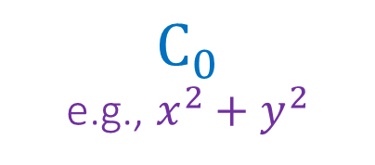


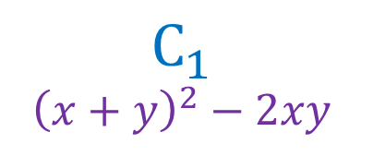

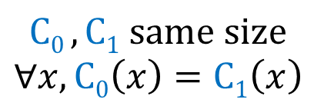
Indistinguishability Obfuscation (iO) [BGIRSVY01]
$$C_{0}$$
e.g., $x^{2}+y^{2}$
iO
$${\tilde{C}}_{0}$$
$$C0 ,C1 same size \\ ∀x,C0\left(x\right)=C1\left(x\right)$$
$$≡$$
$$≈$$
$$C_{1}$$
$${\left(x+y\right)}^{2}−2xy$$
iO
$${\tilde{C}}_{1}$$
Hide implementation difference
iO is an efficient “pseudo-canonicalizer” for circuits!

Slide 3
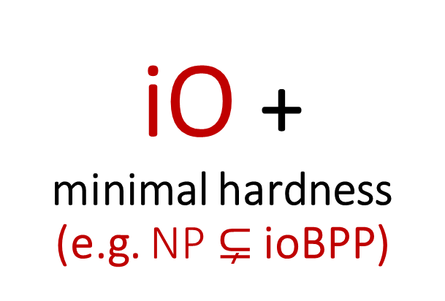
iO + minimal hardness
(e.g. NP$⊊$ ioBPP)
Master Tool
One-Way Functions
Functional Encryption
Public Key Encryption
Witness Encryption
Hardness of Finding Nash
(Doubly) Deniable Encryption
Short Signature
Secret Sharing for NP
Trapdoor Permutation
Correlation Intractable Hash
Identity-Based Encryption
SNARG for NP in the standard model
➔
Attribute-Based Encryption
Multi-Party Non-Interactive Key Exchange
Fully Homomorphic Encryption *
Most
Crypto
OWF with poly hard core bits
Multiparty Computation
Succinct Garbled RAM
PROM Heuristics[JJLW22] + Best-Possible obfuscation [GR07]:
For natural applications, use iO as VBB / ideal obfuscation
(Non-Interactive) Zero-Knowledge
Multilinear Map
Two-Round MPC
Constant Round Concurrent ZK

Slide 4

Better iO
[JLS21, JLS22]: iO exists assuming
LPN + Local PRG + Pairing
[RVV24]: Sparse LPN

Slide 5
Better iO
[JLS21, JLS22]: iO exists assuming
LPN + Local PRG + Pairing
[RVV24]: Sparse LPN
Post-quantum iO?
  Why?
iO is not yet practical
  We’d better aim for “future-proof” constructions.
iO application for quantum crypto
  Obfuscating quantum circuit, Quantum money, Copy protection…
We want different construction method!

Slide 6
Grand Goal: iO from Standard Lattice Assumptions!
So far, candidates based on multilinear maps [GGHRSW13…]
or, candidates inspired by FHE [BDGM20,GP21,BDGM22,WW21,DQVWW21]
Intermediate Goal:
Security based on new, simple-to-state, lattice assumptions
  Circular Shield-Randomness Security [GP21,BDGM22]
  Homomorphic Pseudorandom LWE Samples [WW21]
  Subspace Flooding Assumption [DQVWW21]
  This work - Circular Security with Random Opening
LWE with Hints

Slide 7


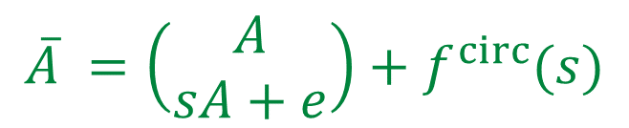
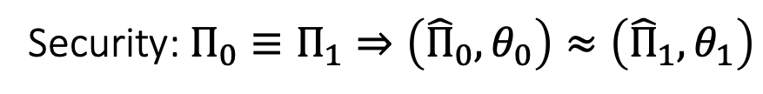




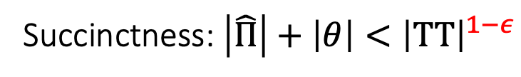
LWE with Hints
x
➔
iO
[LPST16]
(Circular) LWE:
$$CRS =\$\$\$\$\$\$…$$
$$\overline{A} =\left(\begin{matrix}A \\ sA+e\end{matrix}\right)+f^{circ}(s)$$
$$\hat{Π}=Encode\left(Π\right)$$
HEval
$$\hat{TT}=Encode\left(TT\right)$$
Hint:
$$Leak\left(A,s,e\right)$$
$$θ=opening$$
$$TT$$
Succinctness: $\left|\hat{Π}\right|+\left|θ\right|<{\left|TT\right|}^{1−ε}$
Succinctness: $\left|\hat{Π}\right|+\left|θ\right|≪\left|TT\right|$
Challenge:
Security: $Π_{0}≡Π_{1}⇒\left({\hat{Π}}_{0},θ_{0}\right)≈\left({\hat{Π}}_{1},θ_{1}\right)$

Slide 8



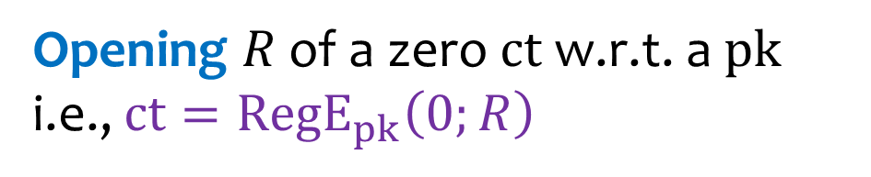
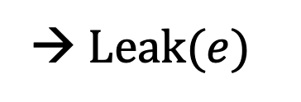
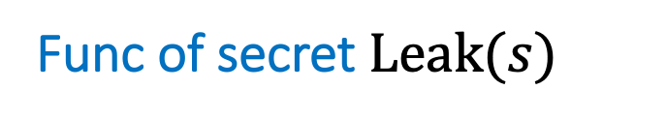

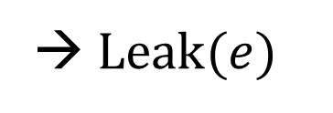
LWE-with-hints
(Circular) LWE:
Func of secret $Leak(s)$
→ $Leak(e)$
$$\overline{A} =\left(\begin{matrix}A \\ sA+e\end{matrix}\right)+f^{circ}(s)$$
[WW21,DQVWW21]
Matrix Preimage $T=B^{−1}\left(P\right)$
→ $Leak(e)$
[BDJMMPV2,AKY24]
Opening $R$ of a zero $ct$ w.r.t. a $pk$
i.e., $ct={RegE}_{pk}\left(0;R\right)$
Hint:
$$Leak\left(A,s,e\right)$$
[GP21,BDGM22]
Cryptanalysis: Structural Vulnerabilities on hints or noise leakage!
[HJL21], [JLLS23], This+[DJMMV25]+[AMYY25]

Slide 9
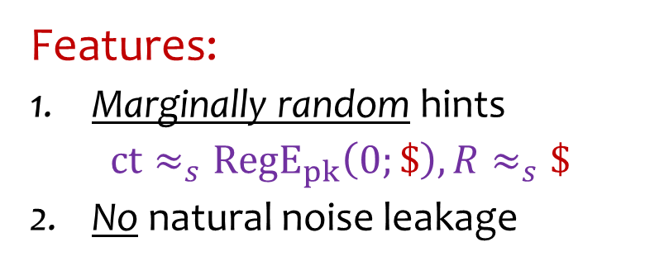
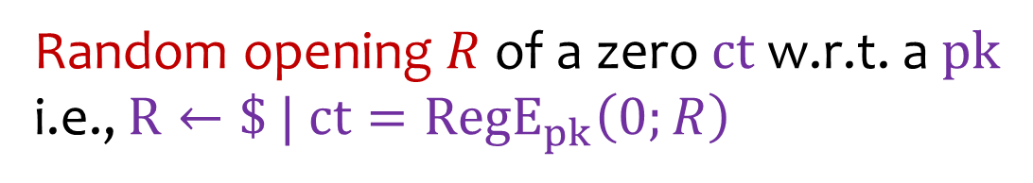

Circular Security w/ Random Opening (CRO)
(Circular) LWE:
Features:
Marginally random hints
$ct≈_{s}{RegE}_{pk}\left(0;\$\right), R≈_{s}\$$
No natural noise leakage
$$\overline{A} =\left(\begin{matrix}A \\ sA+e\end{matrix}\right)+f^{circ}(s)$$
Random opening $R$ of a zero $ct$ w.r.t. a $pk$
i.e., $R←\$ | ct={RegE}_{pk}\left(0;R\right)$
Hint:
$$Leak\left(A,s,e\right)$$
New cryptanalysis target:
  LWE & $R$ Individually sound
  Need non-trivial Combination of LWE & $R$

Slide 10
CRO Assumption

Slide 11
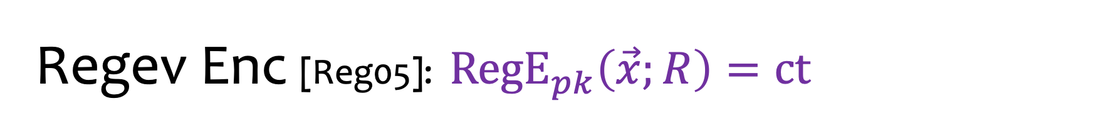
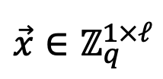
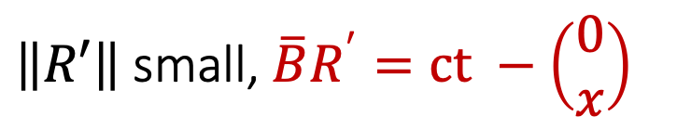

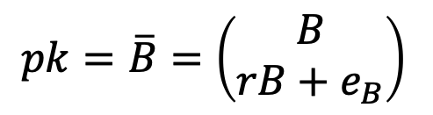

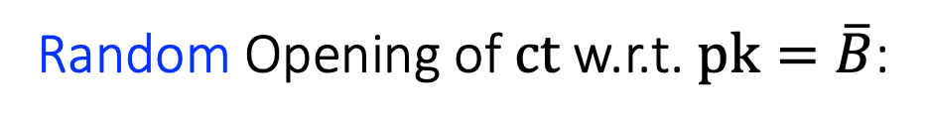

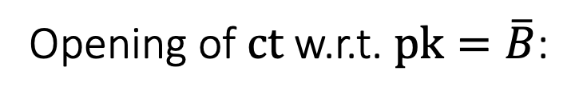

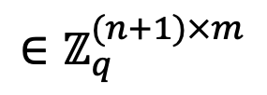

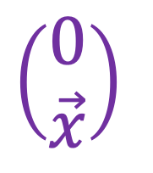
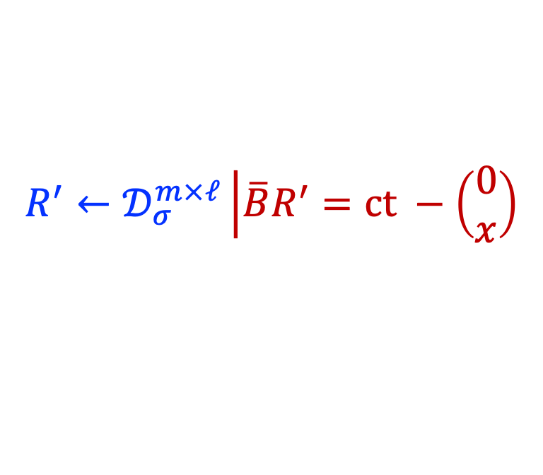


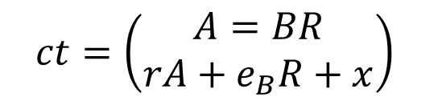
Regev Enc [Reg05]: ${RegE}_{pk}\left(\vec{x};R\right)=ct$
$$pk=\overline{B}=\left(\begin{matrix}B \\ rB+e_{B}\end{matrix}\right)$$
$$∈ℤ_{q}^{(n+1)×m}$$
$$ct=\left(\begin{matrix}A=BR \\ rA+e_{B}R+x\end{matrix}\right)$$
$$\vec{x}∈ℤ_{q}^{1×ℓ}$$
$$R$$
$$\left(\begin{matrix}0 \\ \vec{x}\end{matrix}\right)$$
$$\overline{B}$$
$$×$$
$$+$$
$$=$$
$$ct$$
Zero-ct
$R∈ℤ_{q}^{m×ℓ}, {\left\|R\right\|}_{∞}$ small
$\left\|R′\right\|$small, $\overline{B}R^{′}=ct −\left(\begin{matrix}0 \\ x\end{matrix}\right)$
Opening of $ct$ w.r.t. $pk=\overline{B}$:
$$R^{′}←𝒟_{σ}^{m×ℓ}\left|\overline{B}R^{′}=ct −\left(\begin{matrix}0 \\ x\end{matrix}\right)\right.$$
Random Opening of $ct$ w.r.t. $pk=\overline{B}$:

Slide 12
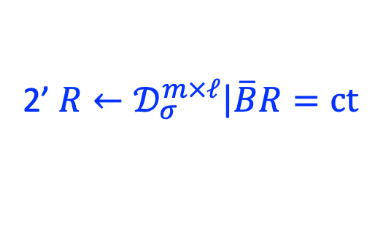

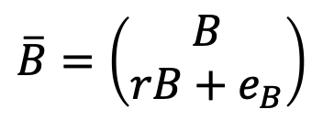



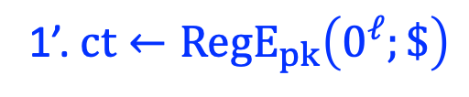

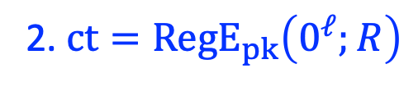



Equivocability
Real
$$\overline{B}=\left(\begin{matrix}B \\ rB+e_{B}\end{matrix}\right)$$
2. $ct={RegE}_{pk}\left(0^{ℓ};R\right)$
$$1. R←𝒟_{σ}^{m×ℓ}$$
1’. $ct←{RegE}_{pk}\left(0^{ℓ};\$\right)$
2’ $R←𝒟_{σ}^{m×ℓ}\left|\overline{B}R=ct \right.$
$$R$$
$$\overline{B}$$
$$×$$
$$=$$
$$ct$$
Ideal
$$\overline{B}←\$$$
2’ $R←𝒟_{σ}^{m×ℓ}\left|\overline{B}R=ct \right.$
1’. $ct= ∗$ (arbitrary)
The ideal world can be efficiently realized by sampling random public key $\overline{B}$ with a trapdoor. [GPV08,MP12]

Slide 13



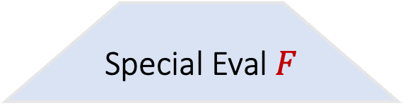



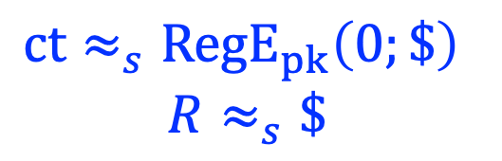

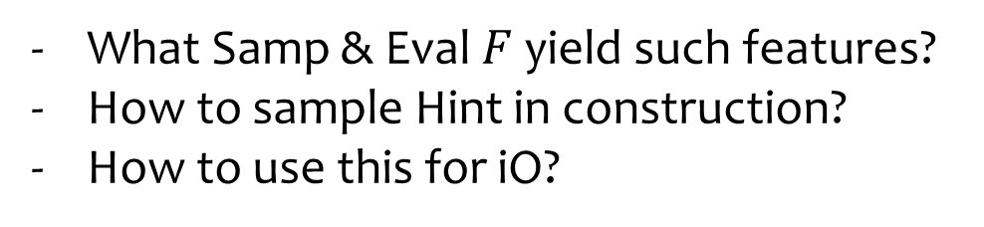

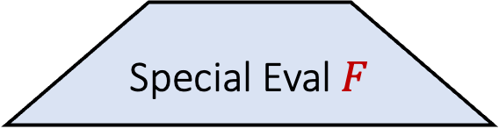

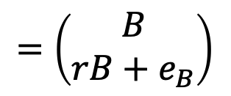
CRO (abstract)
What Samp & Eval $F$ yield such features?
How to sample Hint in construction?
How to use this for iO?
Regev PK
(Circular)-LWE samples
Random PK
Random samples
$$≈$$
$$\overline{B}$$
$$Samp$$
$$\overline{B}←\$$$
$$Samp←\$$$
$$=\left(\begin{matrix}B \\ rB+e_{B}\end{matrix}\right)$$
Special Eval $F$
Special Eval $F$
$$ct∈{RegE}_{pk}\left(0^{ℓ}\right)$$
$$ct=∗$$
Hint $=R←𝒟_{σ}^{m×ℓ}\left|\overline{B}R=ct \right.$
Feature:
$$ct≈_{s}{RegE}_{pk}\left(0;\$\right)$$
$$R≈_{s}\$$$
Feature:
$$ct≈_{c}\$$$
$$R≈_{c} \$$$

Slide 14
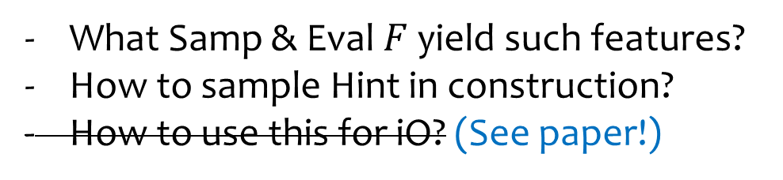
CRO (abstract)
What Samp & Eval $F$ yield such features?
How to sample Hint in construction?
How to use this for iO? (See paper!)
Regev PK
(Circular)-LWE samples
Random PK
Random samples
$$≈$$
$$\overline{B}$$
$$Samp$$
$$\overline{B}←\$$$
$$Samp←\$$$
$$=\left(\begin{matrix}B \\ rB+e_{B}\end{matrix}\right)$$
Special Eval $F$
Special Eval $F$
$$ct∈{RegE}_{pk}\left(0^{ℓ}\right)$$
$$ct=∗$$
Hint $=R←𝒟_{σ}^{m×ℓ}\left|\overline{B}R=ct \right.$
Feature:
$$ct≈_{s}{RegE}_{pk}\left(0;\$\right)$$
$$R≈_{s}\$$$
Feature:
$$ct≈_{c}\$$$
$$R≈_{c} \$$$

Slide 15

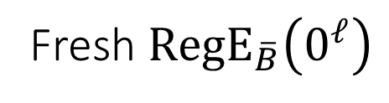
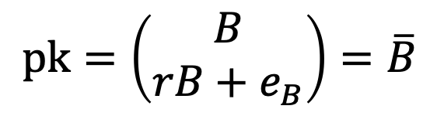


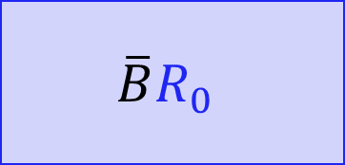

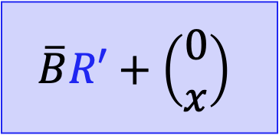

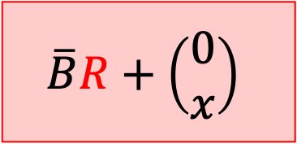
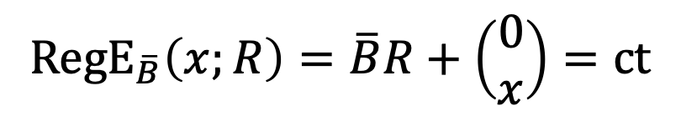

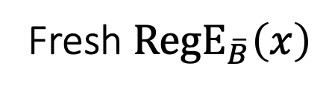
Rerandomizability
$$pk=\left(\begin{matrix}B \\ rB+e_{B}\end{matrix}\right)=\overline{B}$$
$${RegE}_{\overline{B}}\left(x;R\right)=\overline{B}R+\left(\begin{matrix}0 \\ x\end{matrix}\right)=ct$$
Rerandomization:
$${ct}_{x}$$
Fresh ${RegE}_{\overline{B}}\left(0^{ℓ}\right)$
Fresh ${RegE}_{\overline{B}}\left(x\right)$
$$\overline{B}R+\left(\begin{matrix}0 \\ x\end{matrix}\right)$$
$$\overline{B}R_{0}$$
$$\overline{B}R′+\left(\begin{matrix}0 \\ x\end{matrix}\right)$$
$$+$$
$$≈_{s}$$
$$\left( \left\|R\right\|≪σ \right)$$
$$\left( R_{0}←𝒟_{σ} \right)$$
$$\left( R^{′}←𝒟_{σ} \right)$$

Slide 16
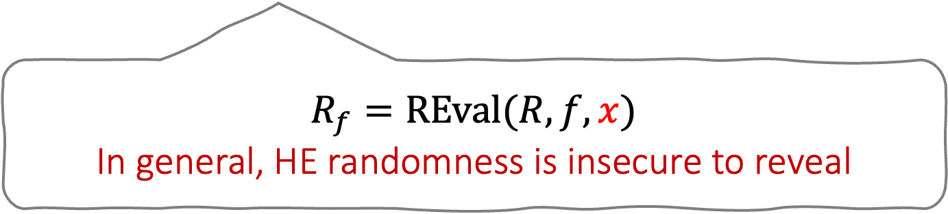

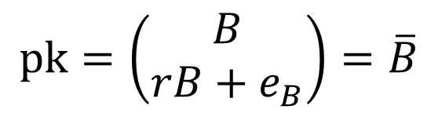

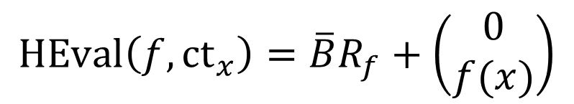

GSW Homomorphism
$$G=I_{n+1}⊗\left[1,2,…,2^{\left\lceil \log{q}\right\rceil }\right]$$
$$pk=\left(\begin{matrix}B \\ rB+e_{B}\end{matrix}\right)=\overline{B}$$
$${GSW}_{\overline{B}}\left(x;R\right)=\overline{B}R+x⊗G={ct}_{x}$$
Homomorphic evaluation for vector-value function $f:{\left\{0,1\right\}}^{\left|x\right|}→ℤ_{q}^{1×ℓ}$
Regev ciphertext
$${RegE}_{pk}\left(f(x);R_{f}\right)$$
$$HEval\left(f, {ct}_{x}\right)=\overline{B}R_{f}+\left(\begin{matrix}0 \\ f(x)\end{matrix}\right)$$
$$R_{f}=REval(R, f, x)$$
In general, HE randomness is insecure to reveal

Slide 17
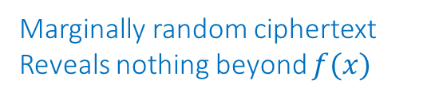


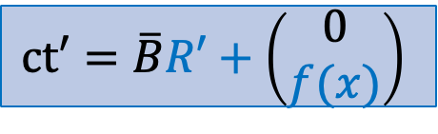
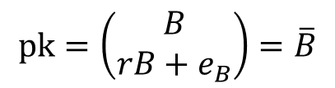
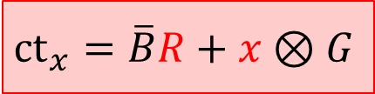

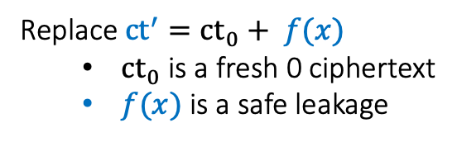
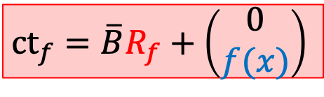





A Warm-up Example
$$CRS =R^{∗}←𝒟^{∗}$$
Honest construction
$$pk=\left(\begin{matrix}B \\ rB+e_{B}\end{matrix}\right)=\overline{B}$$
$${ct}_{CRS}=\overline{B}R^{∗}$$
Marginally random ciphertext
Reveals nothing beyond $f(x)$
$$+$$
$${ct}_{x}=\overline{B}R+x⊗G$$
$${ct}_{f}=\overline{B}R_{f}+\left(\begin{matrix}0 \\ f(x)\end{matrix}\right)$$
$$ct′=\overline{B}R′+\left(\begin{matrix}0 \\ f(x)\end{matrix}\right)$$
$$≈_{s}$$
CRO Real Distribution
$$pk=\left(\begin{matrix}B \\ rB+e_{B}\end{matrix}\right)=\overline{B}$$
Replace ${ct}^{′}={ct}_{0}+ f(x)$
  ${ct}_{0}$ is a fresh 0 ciphertext
  $f(x)$ is a safe leakage
$${ct}_{x}=\overline{B}R+x⊗G$$
$${ct}_{f}=\overline{B}R_{f}+\left(\begin{matrix}0 \\ f(x)\end{matrix}\right)$$
$$ct′=\overline{B}R′+\left(\begin{matrix}0 \\ f(x)\end{matrix}\right)$$

Slide 18



A Warm-up Example
$$CRS =R^{∗}←𝒟^{∗}$$
Honest construction
$$pk=\left(\begin{matrix}B \\ rB+e_{B}\end{matrix}\right)=\overline{B}$$
$${ct}_{CRS}=\overline{B}R^{∗}$$
Marginally random ciphertext
Reveals nothing beyond $f(x)$
$$+$$
$${ct}_{x}=\overline{B}R+x⊗G$$
$${ct}_{f}=\overline{B}R_{f}+\left(\begin{matrix}0 \\ f(x)\end{matrix}\right)$$
$$ct′=\overline{B}R′+\left(\begin{matrix}0 \\ f(x)\end{matrix}\right)$$
$$≈_{s}$$
CRO Real Distribution
$$CRS =R^{∗}←𝒟^{∗}|\overline{B}R^{∗}={ct}_{0}+f\left(x\right)−{ct}_{f}$$
$$pk=\left(\begin{matrix}B \\ rB+e_{B}\end{matrix}\right)=\overline{B}$$
$${ct}_{CRS}=\overline{B}R^{∗}$$
Replace ${ct}^{′}={ct}_{0}+ f(x)$
  ${ct}_{0}$ is a fresh 0 ciphertext
  $f(x)$ is a safe leakage
$${ct}_{x}=\overline{B}R+x⊗G$$
$${ct}_{f}=\overline{B}R_{f}+\left(\begin{matrix}0 \\ f(x)\end{matrix}\right)$$
$$−$$
$$ct′={ct}_{0}+ f(x)$$

Slide 19
A Warm-up Example
CRO Real Distribution
$$CRS =R^{∗}←𝒟^{∗}|\overline{B}R^{∗}={ct}_{0}+f\left(x\right)−{ct}_{f}$$
$$pk=\left(\begin{matrix}B \\ rB+e_{B}\end{matrix}\right)=\overline{B}$$
$${ct}_{CRS}=\overline{B}R^{∗}$$
Replace ${ct}^{′}={ct}_{0}+ f(x)$
  ${ct}_{0}$ is a fresh 0 ciphertext
  $f(x)$ is a safe leakage
$${ct}_{x}=\overline{B}R+x⊗G$$
$${ct}_{f}=\overline{B}R_{f}+\left(\begin{matrix}0 \\ f(x)\end{matrix}\right)$$
$$−$$
$$ct′={ct}_{0}+ f(x)$$

Slide 20












CRO: Real to Ideal
CRO Real Distribution
$$CRS =R^{∗}←𝒟^{∗}|\overline{B}R^{∗}={ct}_{0}+f\left(x\right)−{ct}_{f}$$
$$pk=\left(\begin{matrix}B \\ rB+e_{B}\end{matrix}\right)=\overline{B}$$
$${ct}_{CRS}=\overline{B}R^{∗}$$
Replace ${ct}^{′}={ct}_{0}+ f(x)$
  ${ct}_{0}$ is a fresh 0 ciphertext
  $f(x)$ is a safe leakage
$${ct}_{x}=\overline{B}R+x⊗G$$
$${ct}_{f}=\overline{B}R_{f}+\left(\begin{matrix}0 \\ f(x)\end{matrix}\right)$$
$$−$$
$$ct′={ct}_{0}+ f(x)$$
$$≈_{c}$$
CRO Ideal Distribution
$$CRS =R^{∗}←𝒟^{∗}|\overline{B}R^{∗}={ct}_{0}+f\left(x\right)−{ct}_{f}$$
$$pk=\overline{B}←\$$$
$${ct}_{CRS}=\overline{B}R^{∗}$$
${ct}_{0}←\$$ is random
$f(x)$ is a safe leakage
CRS is efficiently sampleable!
$${ct}_{x}←\$$$
$${ct}_{f}= ∗$$
$$−$$
$$ct′={ct}_{0}+ f(x)$$

Slide 21









CRO LWE Samples
LWE $⇒$ Non-circular CRO.
Circular sample is crucial for iO construction.
Regev PK
Circular-LWE samples
$$≈$$
$$\overline{B}$$
$$Samp$$
$$\overline{B}←\$$$
$$Samp←\$$$
$$=\left(\begin{matrix}B \\ rB+e_{B}\end{matrix}\right)$$
Special Eval $F$
$$ct={ct}_{CRS}∈{RegE}_{pk}\left(0^{ℓ}\right)$$
$Samp$ in Real
Hint $=CRS= R←𝒟_{σ}^{m×ℓ}\left|\overline{B}R=ct \right.$
2-cir-security
$${hct}_{0}=\overline{B}R_{0}$$
$${ct}_{1}=rD+f_{2}^{circ}\left(U, {hct}_{0}\right)+e_{2}$$
$${hct}_{r}=\overline{B}R+r⊗G$$
$${ct}_{2}=UA+f_{1}^{circ}\left(r\right)+E_{1}$$

Slide 22














CRO Special Eval $F$ w.r.t. ($f,\tilde{f})$
$Samp$ in Real
$${hct}_{0}=\overline{B}R_{0}$$
$${ct}_{1}=rD+f_{2}^{circ}\left(U, {hct}_{0}\right)+e_{2}$$
$${hct}_{r}=\overline{B}R+r⊗G$$
$${ct}_{2}=UA+f_{1}^{circ}\left(r\right)+E_{1}$$
Safety Constraint: $f\left(r\right)=\tilde{f}(Samp)$ (w.h.p.)
1
2
$$hct_{f}− hct_{0} −\left(\begin{matrix}0 \\ \tilde{f}\left(samp\right)\end{matrix}\right)$$
$$hct_{f}− hct_{0}$$
3
$$HEval\left(f,hct_{r}\right)$$
$$={hct}_{f}=\overline{B}R_{f}+\left(\begin{matrix}0 \\ f\left(r\right)\end{matrix}\right)$$
$${=hct}_{f}^{′}=\overline{B}R^{′}+\left(\begin{matrix}0 \\ f\left(r\right)\end{matrix}\right)$$
$$=ct=\overline{B}R^{′}$$
Hint $R^{∗}←𝒟_{σ}\left|\overline{B}R^{∗}=ct=\overline{B}R′\right.$
Rerandomization ➔ $\overline{B}R^{′}$ is a random zero-ct $⇒R^{∗}≈_{s}\$$

Slide 23













CRO Ideal Distribution
$Samp$ in Ideal
$${hct}_{0}←\$$$
$${ct}_{1}←\$$$
$${hct}_{r}←\$$$
$${ct}_{2}←\$$$
Safety Constraint: $f\left(r\right)=\tilde{f}(Samp)$ (w.h.p.)
1
2
$$hct_{f}− hct_{0} −\left(\begin{matrix}0 \\ \tilde{f}\left(samp\right)\end{matrix}\right)$$
$$hct_{f}− hct_{0}$$
3
$$HEval\left(f,hct_{r}\right)$$
$$={hct}_{f}=$$
$$∗$$
$${=hct}_{f}^{′}=$$
$$∗$$
$$=ct=$$
$$∗$$
Hint $R^{∗}←𝒟_{σ}\left|\overline{B}R^{∗}=ct=\right.$
$$∗$$
Any ciphertext is equivocatable! Claim: $R^{∗}≈_{c}𝒟_{σ}$

Slide 24








Specification – a Glimpse
$$pk= \overline{B}=\left(\begin{matrix}B \\ b=rB+e_{B}\end{matrix}\right)$$
$$Samp$$
$${hct}_{0,i}=\overline{B}R_{0,i}=\left(\begin{matrix}BR_{0,i} \\ bR_{0,i}\end{matrix}\right)$$
$${ct}_{1,i}=rD_{i}−vec\left(G^{−1}\left(BR_{0,i}\right)\right)UG+e_{1,i}$$
$${hct}_{r}=\overline{B}R+r⊗G$$
$${ct}_{2}=UA+I⊗{\left(rG\right)}^{T}+E_{2}$$
GSW Eval:
Safety Constraint:
$$f_{i}(r)=Δ\left\lfloor \frac{rD_{i}G^{−1}(A)}{Δ}\right\rceil$$
=
$${\tilde{f}}_{i}(Samp)=Δ\left\lfloor \frac{{ct}_{1,i}G^{−1}\left(A\right)+vec\left(G^{−1}\left(BR_{0,i}\right)\right){ct}_{2}−bR_{0,i}}{Δ}\right\rceil$$

Slide 25






New Target
Regev PK
(Circular)-LWE samples
No attack on LWE components,
by circular security
$$\$$$
$$Samp$$
$$\overline{B}$$
$$\$$$
$$=\left(\begin{matrix}B \\ rB+e_{B}\end{matrix}\right)$$
Special Eval
No attack on hint, since it is random
$$ct∈{RegE}_{pk}\left(0^{ℓ}\right)$$
No attack by trivial combination ,
since $\overline{B}R$ is known as $F(samp)$
Hint $=R←𝒟_{σ}^{m×ℓ}\left|\overline{B}R=ct \right.$
Feature:
$R≈_{s}\$$ in real
$R≈_{c}\$$ in ideal
New Target:
Non-trivial ways of combining LWE & opening

Slide 26
Thank You!
eprint.iacr.org/2025/390

