Slide 1
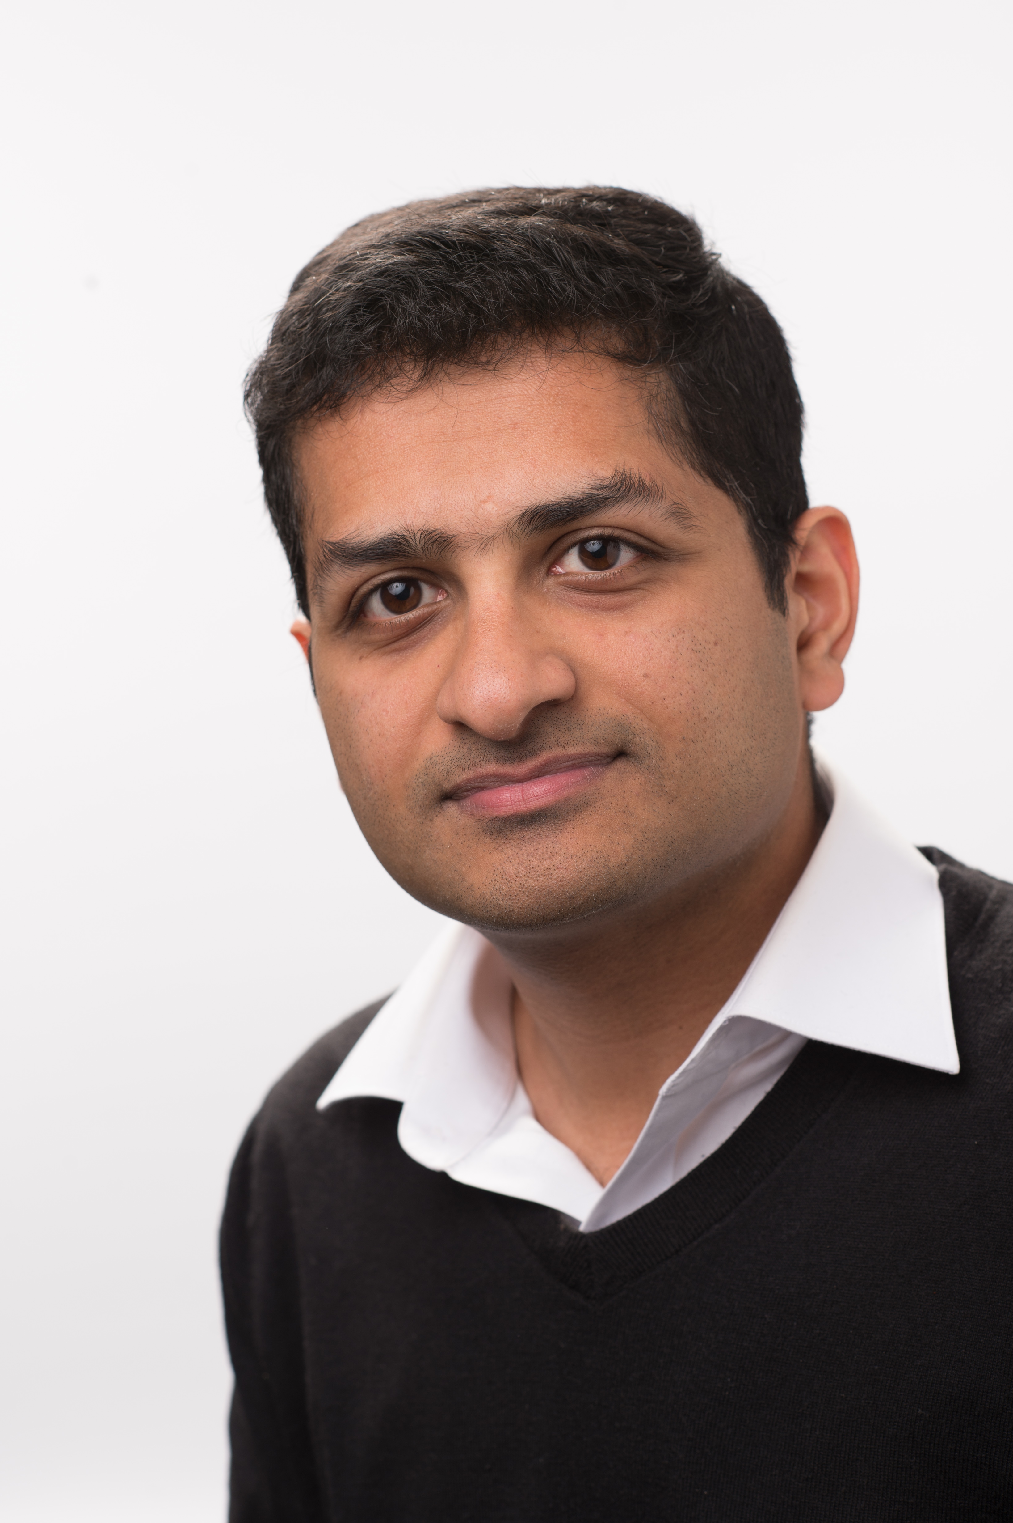
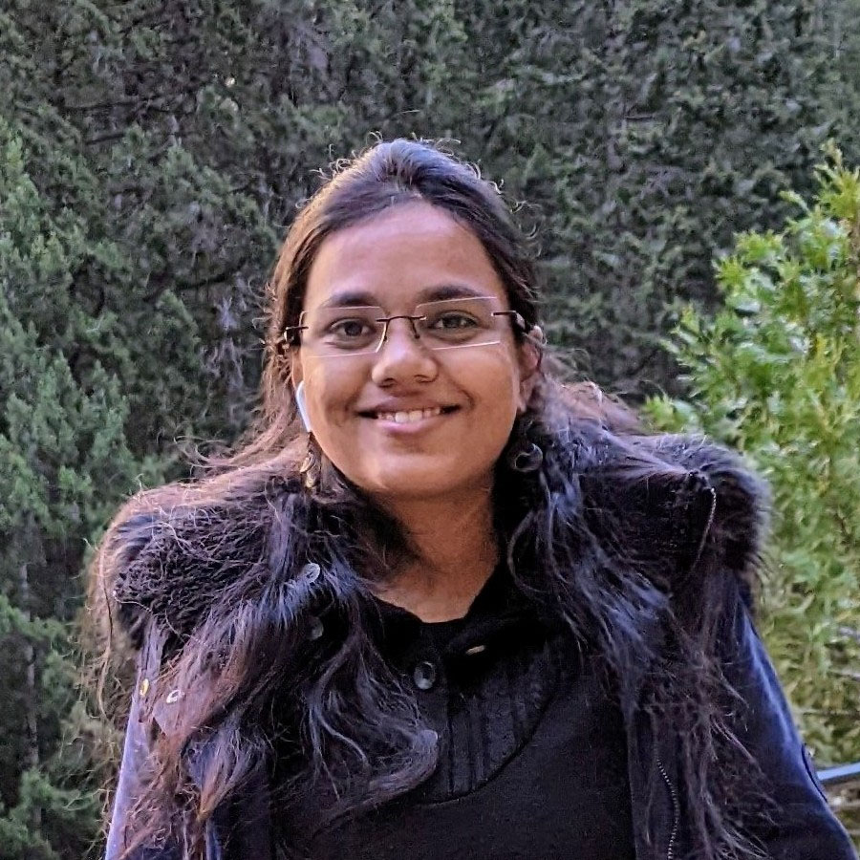



Malicious Security in Collaborative zkSNARKs
Sanjam Garg
UC Berkeley
Aarushi Goel
Purdue University
Abhishek Jain
NTT Research &
Johns Hopkins
Bhaskar Roberts
UC Berkeley
Sruthi Sekar
IIT Bombay

Slide 2
Collaborative zkSNARKs

Slide 3
Collaborative zkSNARKs
Proof Systems
Multiparty Computation
Collaborative zkSNARKs
Notes:
We make non-trivial optimizations for efficiency: MPC in the exponent, avoiding non-black-box use of the hash function.

Slide 4









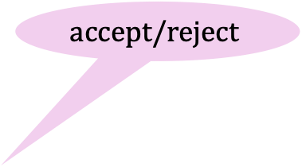




Collaborative zkSNARKs
[Ozdemir & Boneh 2022]
Collaborative
Provers
Verifier
Mallory
$$accept/reject$$
Peggy
$$dabra$$
$$abraca$$
proof
$$π$$
Victor
Pablo
$$boo$$
Ali Baba
$$giligili$$
t-Zero-Knowledge: Against Victor, and against a malicious Mallory who tries to learn the other provers’ secrets.
Notes:
Soundness follows from the underlying zk-SNARK. The tricky part is unsuring privacy of the honest parties’ witness fragments (t-zero-knowledge) against dishonest provers and verifier.

Slide 5

t-Zero-Knowledge (in more detail)
Adversary corrupts any subset of $≤t$ provers
For any such adversary, there exists a simulator such that
t-ZK Simulator
witness
Ver
0/1
Adversary’s view

Slide 6
Our Results
Achieving malicious security requires care
  We give 2 attacks on t-ZK and best practices for mitigation
Malicious security comes essentially for free*
  In the honest majority setting, several semi-honest collaborative zkSNARKs are already maliciously secure (with minor modifications)!
  * We must assume that either the number of corrupted parties is exactly t or that the randomness was shared honestly.

Slide 7
Achieving Malicious Security Requires Care

Slide 8
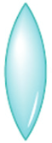
Pitfall: Not verifying the witness before proving
ZK only holds for valid witnesses.
Valid witnesses
Invalid witnesses
Proof system
Proofs
Notes:
Proving t-zero-knowledge is the hardest part of proving security for collaborative zkSNARKs.

Slide 9
Pitfall: Not verifying the witness before proving
t-ZK must hold for invalid witnesses as well.
Valid witnesses
Invalid witnesses
Proof system
Proofs
Common proof systems, such as Groth16, fail to hide invalid witnesses.
Notes:
Proving t-zero-knowledge is the hardest part of proving security for collaborative zkSNARKs.

Slide 10
Pitfall: Not verifying the witness before proving
Best Practice
Verify the witness before generating the proof.
Abort early if the witness is invalid.

Slide 11
Malicious security comes essentially for free
(in the honest-majority setting)

Slide 12


Design Blueprint
zkSNARK.Prove
(w/ semi-honest MPC)
Upgrade
$$π$$
$$π$$
Semi-Honest
Security
Malicious
Security
→

Slide 13


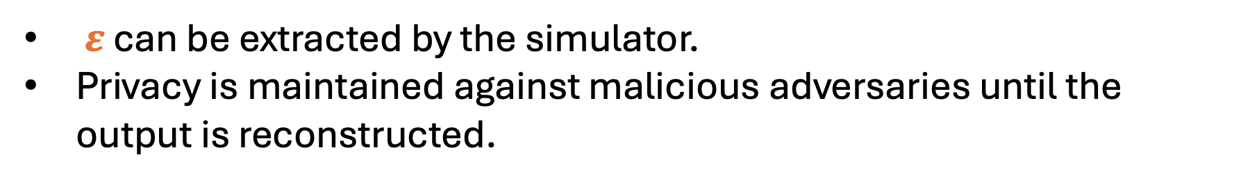

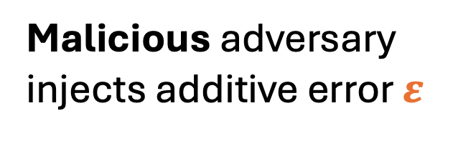



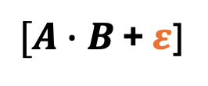
Additive Attack Paradigm [GIPST14]
Run the semi-honest protocol with a malicious adversary
Semi-honest adversary introduces no errors
Malicious adversary injects additive error $ε$
$$[A]$$
Mult
$$[A]$$
Mult
$$[A∙B]$$
$[A∙B$ + $ε$]
$$[B]$$
$$[B]$$
$$ε$$
$ε$ can be extracted by the simulator.
Privacy is maintained against malicious adversaries until the output is reconstructed.
Notes:
Consider an MPC protocol that is secure against semi-honest adversaries, and running the protocol with a fully malicious adversary in the honest-majority setting.
The only possible attacks are additive attacks on multiplication gates.
Adversary cannot break privacy before reconstruction.

Slide 14
Additive Attack Paradigm [GIPST14]
Applies in the honest-majority setting to protocols with a certain linear structure.
$$[A]$$
Mult
$$[A]$$
Mult
$$[A∙B]$$
$[A∙B$ + $ε$]
$$[B]$$
$$[B]$$
$$ε$$
$ε$ can be extracted by the simulator.
Privacy is maintained against malicious adversaries until the output is reconstructed.
Notes:
Consider an MPC protocol that is secure against semi-honest adversaries, and running the protocol with a fully malicious adversary in the honest-majority setting.
The only possible attacks are additive attacks on multiplication gates.
Adversary cannot break privacy before reconstruction.
We must assume that either the number of corrupted parties is exactly t or that the randomness was shared honestly.

Slide 15
How to Handle Additive Errors
Detect additive errors, and abort before opening outputs.
[Damgard-Pastro-Smart-Sarah Zakarias’12]
[Chida-Genkin-Hamada-Ikarashi-Kikuchi-Lindell-Nof’18]
[Genkin-Ishai-Prabhakaran-Sahai-Tromer’14]
[Lindell-Nof’17]
[Nordholt-Veeningen’18]
[Furukawa-Lindell’19]
[Goyal-Song-Zhu’20]
[Boneh-Boyle-Corrigan-Gibbs-Gilboa-Ishai’19]
[Boyle-Gilboa-Ishai-Nof’19]
[Boyle-Gilboa-Ishai-Nof’20]
[Boyle-Gilboa-Ishai-Nof’21]
[Dalskov-Escudero-Nof’24]

Slide 16
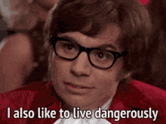

Malicious security comes essentially for free
No need to check for additive errors in Bulletproofs, Groth16, and Plonk (for the most part)
Careful security proofs
Notes:
Dangerous for general functionalities, but not for Bulletproofs

Slide 17


But wait! Additive errors might cause the proof to be invalid.
Not a problem. Proofs can be verified.
Additive errors will not break t-zero-knowledge!

Slide 18
Proving Malicious Security

Slide 19





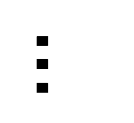





Example 1: Degree-2 Functions
$${[a}_{1}]$$
Mult
${[a}_{1}∙b_{1}$ + $ε_{1}$]
$${[b}_{1}]$$
$$ε_{1}$$
$$…$$
$$Σ$$
$$c$$
$$[a_{n}]$$
Mult
$[a_{n}∙b_{n}$ + $ε_{n}]$
$${[b}_{n}]$$
$$ε_{n}$$

Slide 20


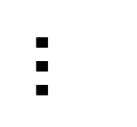




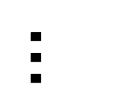





Example 1: Degree-2 Functions
$${[a}_{1}]$$
Mult
${[a}_{1}∙b_{1}$]
$${[b}_{1}]$$
$$…$$
$$Σ$$
$$[a_{n}]$$
Mult
$$[a_{n}∙b_{n}]$$
$$ε_{1}$$
$$Σ$$
$$c$$
$${[b}_{n}]$$
$$…$$
$$ε_{n}$$
Notes:
Privacy is fine even if the erroneous output is reconstructed. Why? explain

Slide 21
t-Zero-Knowledge (in more detail)
Adversary corrupts any subset of $≤t$ provers
For any such adversary, there exists a simulator such that
t-ZK Simulator
witness
Ver
0/1
Adversary’s view

Slide 22



Example 1: Degree-2 Functions
zkSNARK Simulator
Mult
$${\left(l_{3}\right)}_{1}∗{\left(r_{3}\right)}_{1}$$
$$…$$
$$proof$$
$$Σ$$
Mult
$${\left(l_{3}\right)}_{n}∗{\left(r_{3}\right)}_{n}$$
$$ε_{1}$$
$$Σ$$
$$c$$
$$…$$
$$ε_{n}$$

Slide 23



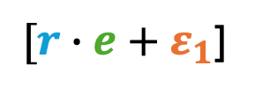
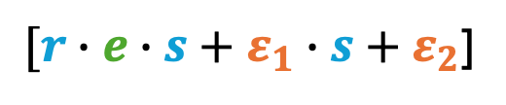


Example 2: Randomized Functions
$$[r]$$
Mult
$[r∙e+ε_{1}$]
Mult
$[r∙e∙s+ε_{1}∙s+ε_{2}$]
$$[e]$$
$$[s]$$
$$ε_{1}$$
$$ε_{2}$$
Output is uniformly random, with or without errors

Slide 24
How to Handle Additive Errors
Detect additive errors, and abort before opening outputs.
Simulate the output with errors
Notes:
Simulate the output with errors.
Additive errors may lead to an invalid proof, but t-ZK is preserved.

Slide 25
How to Handle Additive Errors
Detect additive errors, and abort before opening outputs.
Simulate the output with errors
Sufficient for proving security of collaborative Bulletproofs and Groth16.
Notes:
Simulate the output with errors.
Additive errors may lead to an invalid proof, but t-ZK is preserved.
Idea #2 is sufficient for Bulletproofs and Groth16. Ideas 1 and 2 are required for Plonk.

Slide 26
How to Handle Additive Errors
Detect additive errors, and abort before opening outputs.
Simulate the output with errors
Collaborative Plonk: semi-honest protocol is not maliciously secure.
Detect errors by verifying the proof before reconstruction.
Notes:
Simulate the output with errors.
Additive errors may lead to an invalid proof, but t-ZK is preserved.
Idea #2 is sufficient for Bulletproofs and Groth16. Ideas 1 and 2 are required for Plonk.

Slide 27
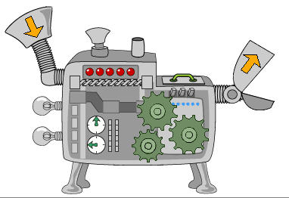
Example 3: Detecting Additive Errors in Plonk
Plonk is a delicate machine.
Random errors lead to a rejecting proof with overwhelming probability.

Slide 28
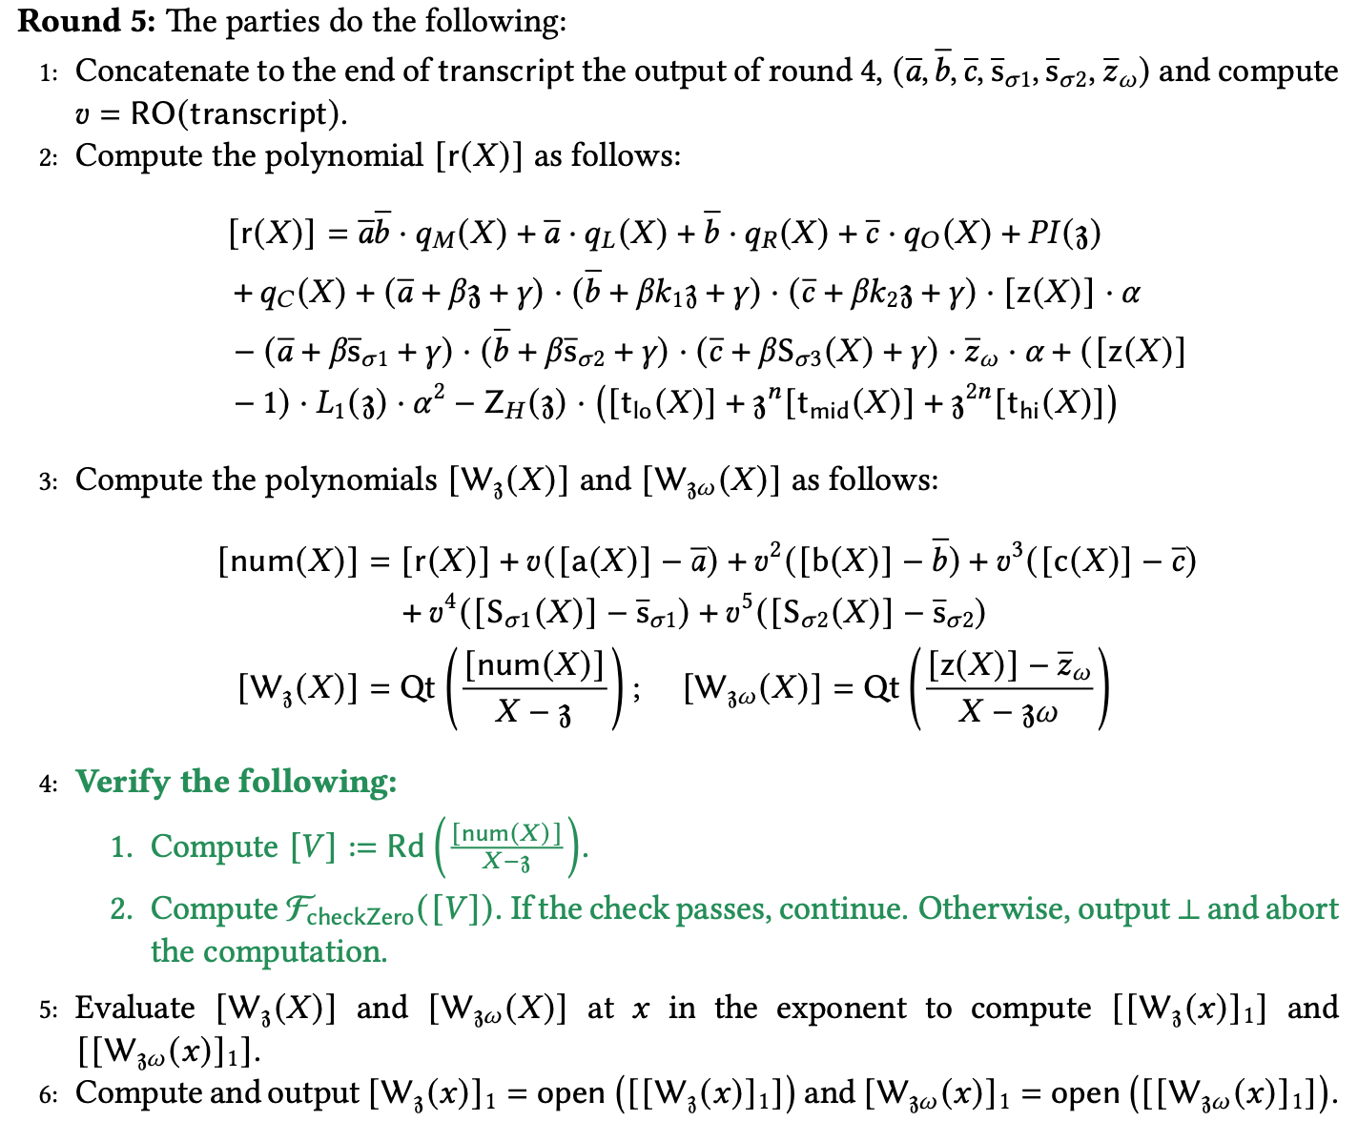
Example 3: Detecting Additive Errors in Plonk
Verify the proof during the final round
Constant amount of extra work

Slide 29
Future Work

Slide 30
Future Work
For what other functions is the semi-honest protocol already maliciously secure?
  Probably many other functions
2. Can this result be extended to the dishonest majority setting?

Slide 31
Our Results
Achieving malicious security requires care
  We give 2 attacks on t-ZK and best practices for mitigation
Malicious security comes essentially for free
  In the honest majority setting, semi-honest collaborative zkSNARKs based on Bulletproofs, Groth16, and Plonk are already maliciously secure (with minor modifications)!

