Slide 1
Hardness Along the Boundary:
Towards OWFs from the Worst-Case Hardness of
Time-Bounded Kolmogorov Complexity
Yanyi Liu
Cornell Tech
Rafael Pass
Cornell Tech, Techion,
and TAU

Slide 2
One-Way Functions (OWF) [Diffie-Hellman’76]
A function f that is
Easy to compute: can be computed in poly time
Hard to invert: no poly-time algorithm can invert it
easy
x
y=f(x)
hard
Ex (factoring): use x to pick 2 random “large primes” p, q, and output y = p* q.

Slide 3
One-Way Functions (OWF) [Diffie-Hellman’76]
A function f that is
Easy to compute: can be computed in poly time
Hard to invert: no poly-time algorithm can invert it
OWF both necessary [IL’89] and sufficient for:
Private-key encryption [GM’84, HILL’99]
Digital signatures [Rompel’90]
Authentication schemes [FS’90]
Pseudorandom generators [Shamir’83, BM’82, Yao’82, GL’80, HILL’99]
Pseudorandom functions [GGM’84]
Commitment schemes [Naor’90]
Coin-tossing [Blum’84]
Zero-knowledge [GMW’86]
…
Not sufficient for:
public-key encryption (PKE) [RSA’83],
obfuscation (iO) [BGI+01]
Whether OWFs exist is the most important open problem in cryptography

Slide 4
OWFs and Kolmogorov Complexity
Can we obtain a simple complexity-theoretic characterization of OWFs?
There are average-case characterizations of OWFs from K^{t} [LP’20, LP’23a].
Central Question: Does Just Worst-Case Hardness of K^{t} Suffice?
Another line of work: Towards the NP hardness of K^{t} [Ila20, ILO20, Ila21, Ila22, LP22b, Hir22, Ila23].
If both hold, would show NP != P => OWFs.
Notes:
say that Kt is a classic problem re finding shortest compression. will introduce later.

Slide 5
Worst-Case Hardness of K^{t}
Prior work: the worst-case hardness of the following problem <=> OWFs. [LP’23b,HN’23]
(Promise) Given that K(x) > n - O(log n) (i.e., Kolmogorov random)
Distinguish between whether K^{t}(x) >= n - 1 or K^{t}(x) < n - 1
However, after adding the promise, it’s unclear how to intuitively interpret the problem.
So it’s a bit artificial.
Technically, the promise is uncomputable.
Notes:
Say that K(x), a quantity, length of shortest program printing x
Kt(x), length of shortest efficient, program printing x;

Slide 6
Our Result in a Nutshell
[Today] The worst-case hardness of the following problem <=> OWFs (under an appropriate derandomization assumption).
(Promise) Given that K^{t2}(x) > n - O(log n)
Distinguish between whether (a) K^{t2}(x) >= n - 1 and (b) K^{t1}(x) < n - 1. (t1 < t2)
Interpretation: deciding whether K^{poly}(x) is “very large” or “intermediate”
Referred to as the boundary version.
Notes:
explain the difference from prior work
explain why we can interpret it this way
explain boundary
explain
In order to explain it in more detail, let’s introduce Kolmogorov complexity

Slide 7
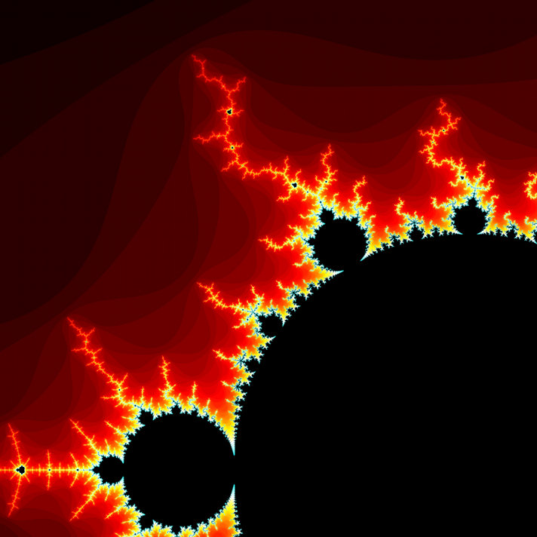
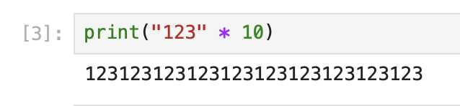
Kolmogorov Complexity [Sol’64,Kol’65,Cha’69]
Which of the following strings/numbers is more “random”:
1231231231231231231
1730544459347394037
K(x) = length of the shortest program that outputs x
Lots of amazing applications (e.g., Godel’s incompleteness theorem, density of primes, ..)
But uncomputable.
Notes:
remove discussion of the examples
say, K is large means lots of randomness, K is short, not so random
a measure of randomness
mandelbrot

Slide 8
Time-Bounded Kolmogorov Complexity
Which of the following strings/numbers is more “random”:
1231231231231231231
1730544459347394037
K(x) = length of the shortest program that outputs x
K^{t}(x) = length of the shortest program that outputs x within time t(|x|)
Can K^{t} be efficiently computed when t is a polynomial?
Studied in the Soviet Union since 60s [Kol’65,T’84]
Whether being NP-hard: a major open problem [ABK+06, ILO20, Ila20a, Ila20b, ACM+21,LP22,Hir22,Ila23…]
Resisting any attacks for over 60 years [MP’24, HIW’24]
Perebor conjecture [60s, T’84]: requires brute-force search
Notes:
therefore Kolmogorov also introduced a time-bounded variant
why is Kt efficient computable? is there an upper bound on K^t?
— perebor: one way to understand it: there’s no structure in the problem that can be used to solve it

Slide 9
The Boundary Version
For poly t1 < t2, define a promise problem boundary-MINK^{t1,t2}
(YES, “intermediate") x $∈$ {0, 1}^{n}, K^{t1}(x) < n - 1 and K^{t2}(x) > n - log(n)
(NO, “large”) x $∈$ {0, 1}^{n}, K^{t2}(x) >= n - 1
In other words, deciding whether x is (a) time-bounded Kolmogorov random, or (b) just “near” time-bounded Kolmogorov random.
We say that boundary-MINK^{poly} $∉$ ioBPP if for all polys t1 < t2, boundary-MINK^{t1,t2} $∉$ ioBPP
Note that if we consider a so-called probabilistic version of K^{t} (i.e., pK^{t}), we also can define the boundary version (boundary-MINpK^{poly}) accordingly.

Slide 10
Main Theorem
[THM 1] Assuming “Derand”, OWFs exist if and only if boundary-MINK^{poly} $∉$ ioBPP
[Note] The “derand” denotes that for all k > 0, E $∉$ ioNTIME[2^{kn}]/2^{0.01n}.
It’s a reasonable strengthening of the assumption that derandomizes AM.
[THM 2] OWFs exist if and only if boundary-MINpK^{poly} $∉$ ioBPP

Slide 11
Is Boundary Hardness WLOG?
Is boundary-MINK^{poly} equivalent to MINK^{poly} ?
If so, would resolve the central question of basing OWFs on worst-case hardness of K^{t}.
The answer is YES, if we consider 3-SAT
Define boundary-3SAT: distinguish between (a) fully satisfiable formulas and (b) unsat formulas with at least n - log n satisfiable clauses.
Reduction: check whether the input formula is SAT using the boundary oracle, with each clause replaced by dummy true clause one by one.
Analysis: SAT will always be SAT, UNSAT will hit (b) at least once.
For most optimization problems, boundary version <=> standard version.
May also hold for MINK^{poly}.
Notes:
therefore Kolmogorov also introduced a time-bounded variant
why is Kt efficient computable? is there an upper bound on K^t?
— perebor: one way to understand it: there’s no structure in the problem that can be used to solve it
It’s not only just a hard problem, but also an important problem

Slide 12
Proof Overview
[THM 1] Assuming Derand, OWFs exist if and only if boundary-MINK^{poly} $∉$ ioBPP
[Today] briefly sketch how to prove the “if” direction (how to obtain a OWF from boundary-MINK).
The only if direction follows from standard techniques.

Slide 13
Earlier Approaches
Starting point [LP’23b]: worst-case hardness of deciding whether K^{t}(x) < n - 1, given that K(x) >= n - log n, implies OWFs.
Their ideas:
Relying on the average-case reduction for K^{t} using an OWF inverter [LP’20].
It fails with small probability over uniform distribution - bad instances are rare.
Thus, fails only when x small K(x) (as they can be enumerated by brute-force).
Key obstacle:
Need to show bad instances have small K^{poly}-complexity
Also known as language compression with efficient decompressor — still open for NP languages (even relative to a OWF inverter).

Slide 14
Compression from Sampling
Step 1:
Showing that if the reduction fails on x, x can be efficiently sampled by a PPT D with probability = pr(x) >= poly(n) / 2^{n}
Step 2:
Proving a so-called “Coding Theorem”, bounding K^{poly}(x) by log 1/pr(x)+|D|.
Main technical contribution: the construction of a new non-black-box PRG, overcoming existing barriers (see the paper).
Taken together, the reduction fails on x only if K^{poly}(x) <= n - O(log(n)) — it will succeed when K^{poly}(x) is “intermediate” or “large”
Notes:
Taken together, Kpoly(x) <= log( n^O(1) / 2^n ) <= n - O(log n)

Slide 15
Sampling Bad Instances
Goal: to show that if the reduction fails on x, x can be efficiently sampled with probability >= poly(n) / 2^{n}. (Let BAD denote the set of such x.)
Hitting BAD through [LP’20] sampling:
    Each x can be sampled w.p. 2^{-n} / O(n), together with its K^{t}-witness.
    BAD will only be sampled w.p. $ϵ$ < 1/poly(n) (due to [Yao’82])
Boosting probabilities through rejection sampling
    Since we have witness, can check whether reduction fails
    If x is not in BAD, repeat
    Each element in BAD has prob 2^{-n} / O(n) / $ϵ$ >= poly(n) / 2^{n}
    Issue: only runs in expected poly-time; Cut-off is needed.

Slide 16
Conclusion
[Today] Assuming Derand, OWFs exist if and only if boundary-MINK^{poly} $∉$ ioBPP
Open Problems:
Dealing with non-uniform attackers.
A search algorithm for BAD?

Slide 17
Thank You!

