Slide 1
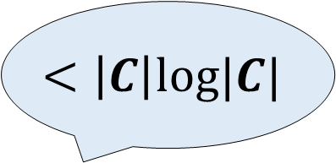
A Unified Framework for Succinct Garbling from Homomorphic Secret Sharing
$$<\left|C\right|log|C|$$
Yuval Ishai
Technion
Hanjun Li
UW
Huijia (Rachel) Lin
UW
Slides made together with Rachel Lin.
Notes:
Hello everyone, I’m Hanjun, and today I’m presenting our recent work that achieves Succinct Boolean garbling, from HSS techniques. It’s a joint work with Yuval and Rachel.
To clarify, here by succinctness we mean the garbling size should be strictly smaller than the circuit description size, C log-C. In particular, we achieve an amortized size of 1-bit per gate or less.

Slide 2
























Garbled Circuits [Yao86,BHR12]
$$Garble\left(C\right) → \hat{C}, {\left\{ℓ_{i0},ℓ_{i1}\right\}}_{i∈[n]}$$
$$y_{1}$$
$$⋯$$
$$y_{i}$$
$⋯$
$$y_{m}$$
$$y_{1}$$
$$⋯$$
$$y_{i}$$
$⋯$
$$y_{m}$$
Boolean
Circuit
$$×$$
$$×$$
$$Garbled Cir \hat{C}$$
$$+$$
$$x_{1}$$
Short labels
$$⋯$$
$$x_{i}$$
$⋯$
$$x_{n}$$
$$⋯$$
$$ℓ_{ix_{i}}$$
$⋯$
$$Eval\left(C,\hat{C},\hat{x}=\{ℓ_{i,x_{i}}\}\right)→C(x)$$
Notes:
First, let me briefly recall the notion of garbled circuits, which consists of a pair of algorithms, garble and Eval. The Garble algorithm takes a Boolean circuit C, and outputs a garbled circuit C-hat, together with n pairs of input labels, l_i_zero and l_i_one, each corresponding to an input wire.
The Eval algorithm takes the circuit C, the garbled circuit C-hat, and one label selected from each pair, according to the bits of input x, and then Eval should output the correct evaluation result C(x). An additional requirement is that the label should be short.

Slide 3
Garbled Circuits [Yao86,BHR12]
$$Garble\left(C\right) → \hat{C}, {\left\{ℓ_{i0},ℓ_{i1}\right\}}_{i∈[n]}$$
$$y_{1}$$
$$⋯$$
$$y_{i}$$
$⋯$
$$y_{m}$$
$$y_{1}$$
$$⋯$$
$$y_{i}$$
$⋯$
$$y_{m}$$
Boolean
Circuit
$$×$$
$$×$$
$$Garbled Cir \hat{C}$$
$$+$$
$$x_{1}$$
Short labels
$$⋯$$
$$x_{i}$$
$⋯$
$$x_{n}$$
$$⋯$$
$$ℓ_{ix_{i}}$$
$⋯$
$$Eval\left(C,\hat{C},\hat{x}=\{ℓ_{i,x_{i}}\}\right)→C(x)$$
This talk: Circuit is public
$$Sim\left(C,C(x)\right) →\hat{C},\hat{x}$$
Notes:
Security of the scheme requires that the garbled circuit C-hat, and the input encoding x-hat, which are the selected set of labels, should be simulatable given only the evaluation result, and the circuit C itself. Intuitively, this means that the garbling material C-hat and x-hat doesn’t leak any information beyond the correct evaluation result.
Here we don’t try to hide the circuit C, and explicitly provide it to the evaluator. Otherwise, the garbled circuit would be at least the description size of C, hence cannot be succinct.

Slide 4
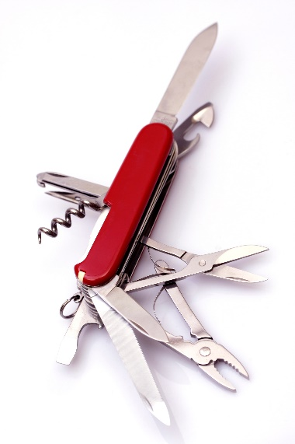
Garbled Circuit
Randomized Encoding
[IK02,AIK04]
Garbled Circuits are everywhere
Verifiable computation
[GGP10,AIK10]
Computing on encrypted data
[SYY99,CCKM00]
Attribute Based
Encryption
[LL20]
Crypto in NC0
[AIK04]
Key Dependent
Message Enc
[BHHI10,App11]
Bounded collusion
Functional Encryption
[SS10,GVW12]
Functional Encryption & indistinguishability obfuscation
[JLS22,JLS23,RVV24]
Great Theory & Practice!
Notes:
Since its introduction, garbling schemes, have found applications to many topics in cryptography, such as verifiable computation, attribute based encryption, functional encryption, and many more. It has also been used in practical multiparty computation systems.

Slide 5












Garbled Circuit Size Matters
Garbler
$$\hat{C} \hat{x}$$
Evaluator
Communication ~ size
Communication matters in interactive protocols e.g., MPC
Garbled circuit is a non-interactive primitive
Saving in Size $×$# recipients
0
0
1
1
2
2
3
$$tx$$
3
$$tx$$
$$tx$$
$$tx$$
$$tx$$
$$tx$$
$$tx$$
$$tx$$
$$\hat{C}$$
$$tx$$
$$tx$$
$$tx$$
$$tx$$
$$tx$$
$$tx$$
…
$$tx$$
…
$$tx$$
$$tx$$
$$tx$$
$$tx$$
$$tx$$
$$tx$$
$$tx$$
$$tx$$
$$tx$$
$$tx$$
$$tx$$
$$tx$$
$$tx$$
$$tx$$
$$tx$$
$$tx$$
$$tx$$
$$tx$$
$$tx$$
$$tx$$
$$tx$$
Only send $\hat{x}$ to many recipients
Notes:
One important objective in designing garbling schemes is to minimize the size of the garbling materials.
For example, in an interactive protocol, minimizing the communication size means reducing latency.
The sizes matter even more in non-interactive settings. For example, a garbler could publish a C-hat on a blockchain, and later reveal a set of input labels to many recipients. Here the savings in size is amplified by the number of recipients.

Slide 6
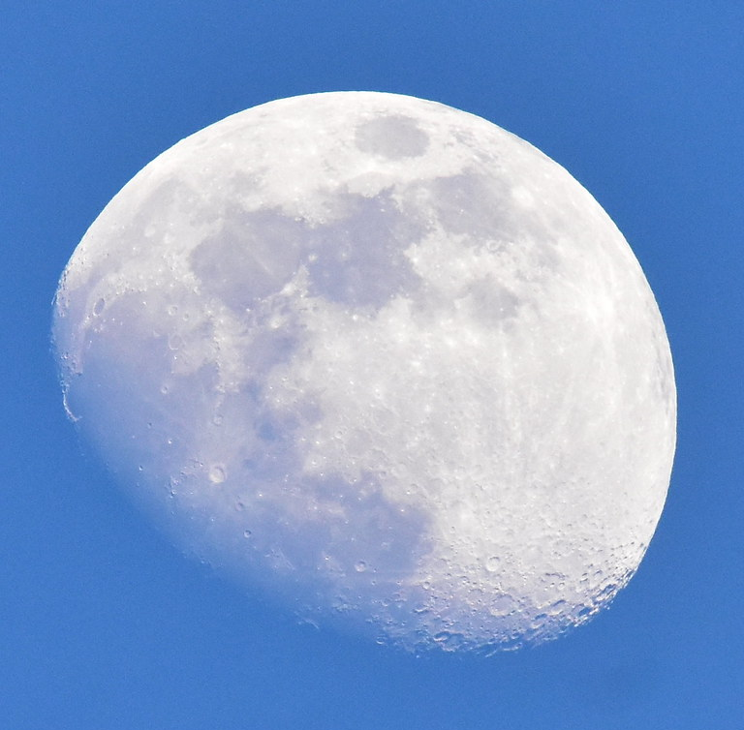




State of the Art (Boolean)
Yao’s GC
Moon-Shot:
Practical Succinct Garb
Fully Succinct
Garbling
$$>|C|λ$$
$$\left(n+m\right)poly(λ)$$
[Yao86] + many optimizations
[GKPVZ13,BGG+24,CHJV15,
BGL+15,KLW15,QWW18,HLL23]
Symmetric Key Crypto
ABE + FHE / iO
Fast
Slow
Comp/gate :
$$O\left(1\right) PRG$$
$$ABE.Eval(FHE.Hmult, {ct}_{1},{ct}_{2})$$
Notes:
Focusing on the metric of garbling sizes, existing works fall in two extremes.
On the left, the original Yao’s GC and many following optimizations achieve garbling sizes roughly lambda-bit per AND gate. These schemes use only symmetric key crypto, and is very fast.
On the right, theoretically optimal garbling size can be achieved, which is independent of the circuit size being garbled. These schemes rely on the heavy tools of attribute based encryption, and fully homomorphic encryption or iO, and is computationally very slow.
The moon shot would be achieving the best of both world, i.e. succinct garbling size and practical computational efficiency.

Slide 7




This Work: A Scheme In Between
Yao’s GC
Partially Succinct
$$\left(<\left|C\right|log\left|C\right|\right)$$
Fully Succinct
Garbling
$$>|C|λ$$
$$\left|C\right|+poly(λ)$$
$$\left(n+m\right)poly(λ)$$
[Yao86] + many optimizations
[GKPVZ13,BGG+24,CHJV15,
BGL+15,KLW15,QWW18,HLL23]
Light(er)-weight
Symmetric Key Crypto
HSS
ABE + FHE / iO
Diverse Algebraic Assumptions
Fast
Slow
Groups & Lattices
Prime order, Paillier/Damgard-Jurik, class groups
Comp/gate :
$$O\left(1\right) PRG$$
$$ABE.Eval(FHE.Hmult, {ct}_{1},{ct}_{2})$$
Notes:
In this talk, I’ll present a scheme lies in-between the two extremes, with a garbling size of one-bit per gate plus an additive term, and relying on relatively lighter-weight tools of homomorphic secret sharing (HSS) instead of the combination of ABE and FHE.
In addition to being lighter-weight, HSS techniques can be based on diverse algebraic assumptions in groups or lattices. In contrast, ABE and FHE are only known from lattice assumptions.

Slide 8
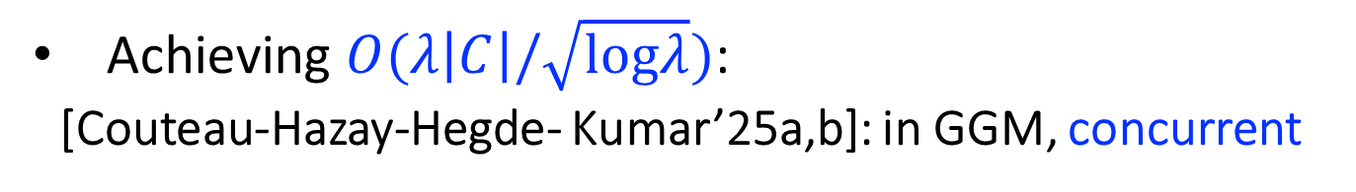
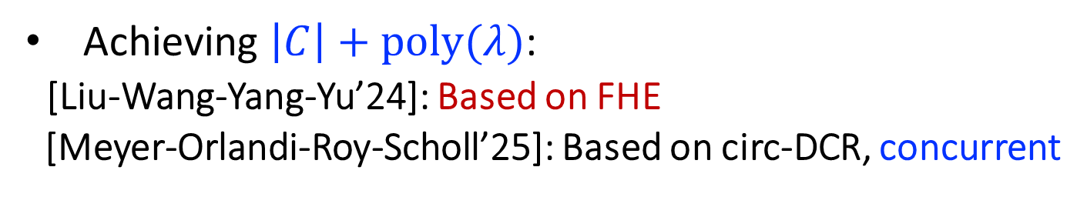
Other Recent Works
Yao’s GC
Partially Succinct
$$\left(<\left|C\right|log\left|C\right|\right)$$
Fully Succinct
Garbling
$$>|C|λ$$
$$\left|C\right|+poly(λ)$$
$$\left(n+m\right)poly(λ)$$
[Yao86] + many optimizations
[GKPVZ13,BGG+24,CHJV15,
BGL+15,KLW15,QWW18,HLL23]
Achieving $\left|C\right|+poly(λ)$:
[Liu-Wang-Yang-Yu’24]: Based on FHE
[Meyer-Orlandi-Roy-Scholl’25]: Based on circ-DCR, concurrent
Light(er)-weight
Symmetric Key Crypto
HSS
ABE + FHE / iO
Diverse Algebraic Assumptions
Achieving $O(λ\left|C\right|/\sqrt{logλ})$:
[Couteau-Hazay-Hegde- Kumar’25a,b]: in GGM, concurrent
Fast
Slow
Groups & Lattices
Prime order, Paillier/Damgard-Jurik, class groups
Comp/gate :
$$O\left(1\right) PRG$$
$$ABE.Eval(FHE.Hmult, {ct}_{1},{ct}_{2})$$
Notes:
I should note that in a recent work by Liu-Wang-Yang and Yu, the authors also achieves amortized 1-bit per gate garbling, based on FHE, in particular avoiding the heavy combination of ABE + FHE. In comparison, our framework based on HSS can be potentially faster, and also has group instantiations.
In a concurrent work by Meyer-Orlandi-Roy and Scholl, also here at crypto, the authors achieve similar results as ours based on a circular variant of DCR assumption.
And in the concurrent works by Couteu-Hazay-Hedge and Kumar, they assume the generic group model to achieve lambda over square-root log lambda bits per gate.

Slide 9

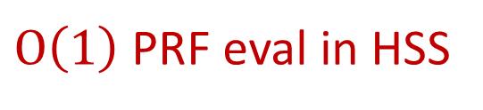
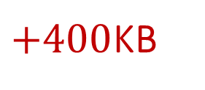
This Work: Concrete Efficiency
Yao’s GC
Partially Succinct
$$\left(<\left|C\right|log\left|C\right|\right)$$
Fully Succinct
Garbling
$$>|C|λ$$
$$\left|C\right|$$
$$\left(n+m\right)poly(λ)$$
[Yao86] + many optimizations
$+400$KB
[GKPVZ13,BGG+24,CHJV15,
BGL+15,KLW15,QWW18,HLL23]
Light(er)-weight
Symmetric Key Crypto
HSS
ABE + FHE / iO
(Paillier Groups)
Fast
Slow
Comp/gate :
$$O\left(1\right) PRG$$
$O\left(1\right)$ PRF eval in HSS
$$ABE.Eval(FHE.Hmult, {ct}_{1},{ct}_{2})$$
Notes:
Concretely, our instantiation based on Paillier groups has 400 kilo bytes plus 1-bit per gate. And the per gate computation consists mainly of a few number of PRF evaluations inside of HSS.

Slide 10
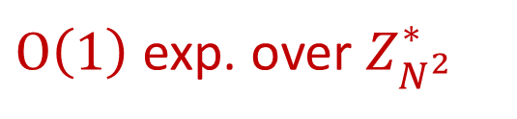
This Work: Concrete Efficiency
Yao’s GC
Partially Succinct
$$\left(<\left|C\right|log\left|C\right|\right)$$
Fully Succinct
Garbling
$$>|C|λ$$
$$\left|C\right|$$
$$\left(n+m\right)poly(λ)$$
[Yao86] + many optimizations
$+400$KB
[GKPVZ13,BGG+24,CHJV15,
BGL+15,KLW15,QWW18,HLL23]
Light(er)-weight
HSS-friendly local PRG
Symmetric Key Crypto
HSS
ABE + FHE / iO
(Paillier Groups)
Fast
Slow
Comp/gate :
$$O\left(1\right) PRG$$
$O\left(1\right)$ exp. over $Z_{N^{2}}^{∗}$
$$ABE.Eval(FHE.Hmult, {ct}_{1},{ct}_{2})$$
Notes:
Using a HSS-friendly local PRG, this computation becomes a constant number of exponentiations in the Paillier group.

Slide 11
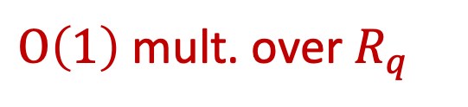
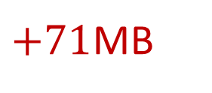
This Work: Concrete Efficiency
Yao’s GC
Partially Succinct
$$\left(<\left|C\right|log\left|C\right|\right)$$
Fully Succinct
Garbling
$$>|C|λ$$
$$\left|C\right|$$
$$\left(n+m\right)poly(λ)$$
[Yao86] + many optimizations
$+71$MB
[GKPVZ13,BGG+24,CHJV15,
BGL+15,KLW15,QWW18,HLL23]
Light(er)-weight
HSS-friendly local PRG
Symmetric Key Crypto
HSS
ABE + FHE / iO
(Lattice)
Fast
Slow
Comp/gate :
$$O\left(1\right) PRG$$
$O\left(1\right)$ mult. over $R_{q}$
$$ABE.Eval(FHE.Hmult, ct_{1},{ct}_{2})$$
Notes:
Alternatively, optimizing for computational efficiency, we also have an instantiation based on lattice assumption. It takes constant number of ring-element multiplications, which are much faster than exponentiation. The garbling size is larger, costing 71 megabytes plus 1 bit per gate.

Slide 12


Overview
Homomorphic Secret Sharing
(HSS)
Algebraic Homomorphic MAC
(aHMAC)
1-bit / gate Garbling
$$+$$
$$⇒$$
[BGI16,BKS19,
OSY21,RS21,ADOS22]
[ILL25b]
HSS Inspired techniques,
from groups or lattices
Notes:
In the remainder of the talk, I will first introduce two technical tools, HSS and an algebraic homomorphic MAC scheme developed in our earlier work. This tool is also based on HSS techniques, hence can be instantiated from groups or lattices similarly to existing HSS schemes.
Then, I will show how to combine them to obtain the claimed 1-bit per gate garbling result.

Slide 13

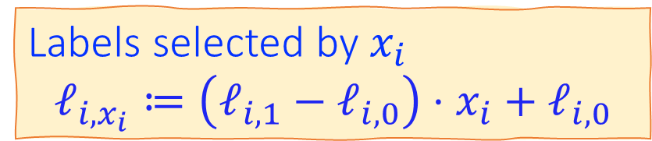


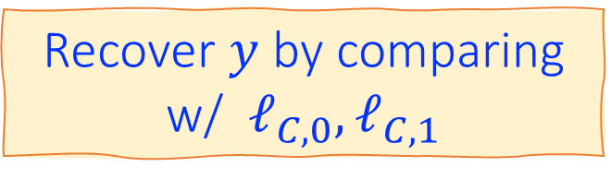






Garbling as 2PC w/ One-Way Communication
Garbler
Evaluator
Labels selected by $x_{i}$
$$ℓ_{i,x_{i}}≔\left(ℓ_{i,1}−ℓ_{i,0}\right)⋅x_{i}+ℓ_{i,0}$$
$$\{ℓ_{i,0},ℓ_{i,1}\}$$
$$←\$$$
$${\{ℓ}_{i,x_{i}}\}$$
$$\hat{C}$$
$${Garb}_{C}$$
$${Eval}_{C}$$
$$ℓ_{C,0},ℓ_{C,1}$$
$$ℓ_{C,y}$$
$$ℓ_{C,0},ℓ_{C,1}$$
Recover $y$ by comparing w/ $ℓ_{C,0},ℓ_{C,1}$
Notes:
As background, let me first recall the classical Yao’s garbling, but viewing it as a 2PC protocol between a garbler and an evaluator.
In the setup phase, the garbler samples a pair of random labels for each input wire, and the evaluator should have the labels corresponding to some input x.
Then, during the evaluation phase, the Garb algorithm derives a garbled circuit C-hat, which consists of encrypted truth-tables, and send it to the evaluator. On the other side, the Eval algorithm derives a label for the final output wire.
For the evaluator to learn the output y, it suffices for the garbler to reveal both labels on the output wire.

Slide 14
Garbling as 2PC w/ One-Way Communication
Garbler
Evaluator
Labels selected by $x_{i}$
$$ℓ_{i,x_{i}}≔\left(ℓ_{i,1}−ℓ_{i,0}\right)⋅x_{i}+ℓ_{i,0}$$
$$\{ℓ_{i,0},ℓ_{i,1}\}$$
$$←\$$$
$${\{ℓ}_{i,x_{i}}\}$$
IND
of x
One-Way
Comm
$$\hat{C}$$
$${Garb}_{C}$$
$${Eval}_{C}$$
$$ℓ_{C,0},ℓ_{C,1}$$
$$ℓ_{C,y}$$
$$ℓ_{C,0},ℓ_{C,1}$$
Recover $y$ by comparing w/ $ℓ_{C,0},ℓ_{C,1}$
Notes:
We note two things : first, there is only one-way communication from the garbler to the evaluator; second, the garbler’s computation is independent of the input x. In fact any such 2PC satisfying these two properties can be re-written as a garbling scheme.

Slide 15



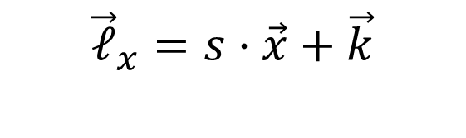
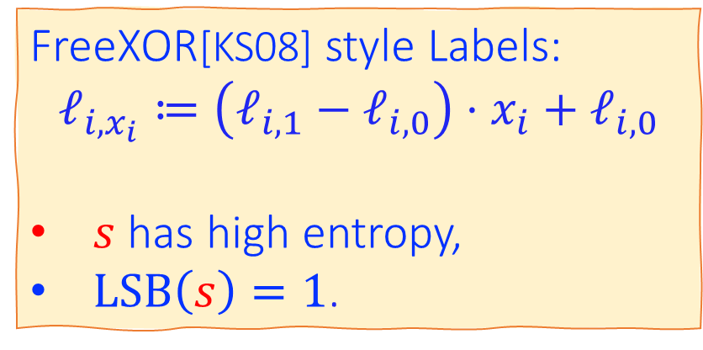




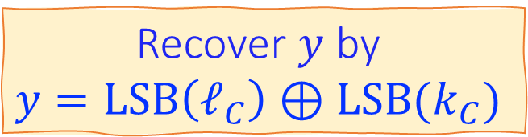


Garbling w/ FreeXOR style Labels
Garbler
Evaluator
FreeXOR[KS08] style Labels:
$$ℓ_{i,x_{i}}≔\left(ℓ_{i,1}−ℓ_{i,0}\right)⋅x_{i}+ℓ_{i,0}$$
$s$ has high entropy,
$LSB\left(s\right)=1$.
$$\left\langle s⋅\vec{x} \right\rangle$$
$$\vec{k}$$
$${\vec{ℓ}}_{x}=s⋅\vec{x}+\vec{k}$$
$$←\$$$
Set to global $s$
$$≡k_{i}$$
$$\hat{C}$$
$${Garb}_{C}$$
$${Eval}_{C}$$
$$\left\langle s⋅y \right\rangle$$
$$ℓ_{C}=s⋅y+k_{C}$$
$$k_{C}$$
$$k_{C}$$
Recover $y$ by
$$y=LSB\left(ℓ_{C}\right)⊕LSB(k_{C})$$
Notes:
This picture looks slightly different when we incorporate the free-xor style labels. Basically, the format requires a global secret offset S between every pair of labels on each wire.
So in this picture, the garbler only needs to prepare 1 random label k on each input wire, and the evaluator gets either k itself, or S plus K, depending on the input x. That is, the garbler and evaluator holds an additive secret sharing of the values s times x. And after evaluation, the they derive additive share of s times y.

Slide 16






Garbling vs. HSS
[BGI16,BKS19,OSY21,RS21,ADOS22]
HSS
Garbler
Evaluator
Alice
Bob
$$\left\langle s⋅\vec{x} \right\rangle$$
$$\left\langle s⋅\vec{x} \right\rangle$$
$$\vec{k}$$
$${\vec{ℓ}}_{x}=s⋅\vec{x}+\vec{k}$$
$$\vec{k},ct_{s}\left(x\right)$$
$${\vec{ℓ}}_{x},ct_{s}\left(x\right)$$
IND
of x
One-Way
Comm
Depend
on x
No
Comm
$$\hat{C}$$
$${Garb}_{C}$$
$${Eval}_{C}$$
$${AEval}_{C}$$
$${BEval}_{C}$$
$$\left\langle s⋅y \right\rangle$$
$$ℓ_{C}=s⋅y+k_{C}$$
$$k_{C}$$
$$\left\langle s⋅y \right\rangle$$
$$k_{C}$$
$$ℓ_{C}$$
Branching
Programs
Circuits
Notes:
Under this view, we can now explain what common HSS schemes achieve, by comparing it against a garbling scheme.
So in the setting of HSS, two parties Alice and Bob initially hold an additive share of values s time the input x, plus, they both hold an encryption of the input x. In the end the two parties derive an additive share of s times y. This is pretty similar to the setting of garbling, and better, there is no communication required in the HSS evaluations.
But a crucial difference is that in HSS both parties’ computation depends on the input x, through the ciphertext of x. This violates the garbling requirement. And in garbling we know how to evaluate circuits, while current HSS techniques are limited to low depth computation such as branching programs.

Slide 17




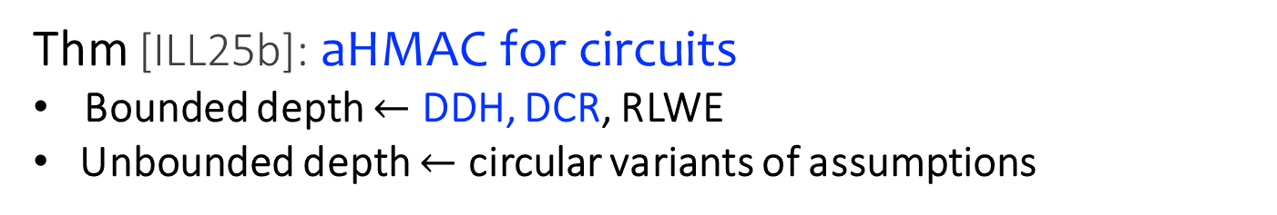
Garbling vs. aHMAC
[ILL25b]
aHMAC
Garbler
Evaluator
Alice
Bob
$$\left\langle s⋅\vec{x} \right\rangle$$
$$\left\langle s⋅\vec{x} \right\rangle$$
$$\vec{k}$$
$${\vec{ℓ}}_{x}=s⋅\vec{x}+\vec{k}$$
$$\vec{k},{PD}_{s}$$
$${\vec{ℓ}}_{x},{PD}_{s},\vec{x}$$
IND
of x
One-Way
Comm
Privacy
for x
IND
of x
No
Comm
No Priv.
for x
$$\hat{C}$$
$${Garb}_{C}$$
$${Eval}_{C}$$
$${AEval}_{C}$$
$${BEval}_{C}$$
$$\left\langle s⋅y \right\rangle$$
$$ℓ_{C}=s⋅y+k_{C}$$
$$k_{C}$$
$$\left\langle s⋅y \right\rangle$$
$$k_{C}$$
$$ℓ_{C},y$$
Thm [ILL25b]: aHMAC for circuits
Bounded depth $←$ DDH, DCR, RLWE
Unbounded depth $←$ circular variants of assumptions
Circuits
Circuits
Notes:
Next we have the new primitive introduced in our earlier work, named algebraic homomorphic MAC. It’s inspired by HSS techniques, but with the tweak that we avoid giving encryptions of x to both parties. Instead, they are given some public data independent of x, and additionally Bob knows x in the clear.
Still there is no communication during evaluation, and now Alice’s computation is independent of x, as required by the garbling setting. But on the other hand, since Bob knows the input x in the clear, there is no privacy for x. So aHMAC directly implies a privacy-free variant of garbling. And in ILL25b, we construct aHMAC for circuits from circular variants of DDH, DCR or RLWE assumptions.

Slide 18
Overview
Homomorphic Secret Sharing
(HSS)
Algebraic Homomorphic MAC
(aHMAC)
1-bit / gate Garbling
$$+$$
$$⇒$$
[BGI16,BKS19,
OSY21,RS21,ADOS22]
[ILL25b]
Notes:
Next, I’ll explain how we combine the two primitives.

Slide 19



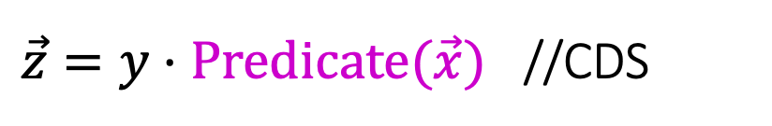

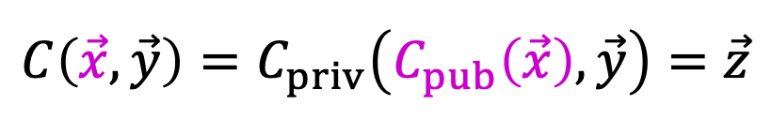



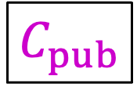






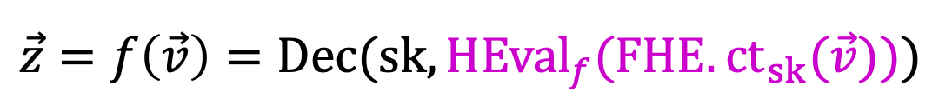
Partial Garbling [IW14]
$$z_{1}$$
$$⋯$$
$$z_{i}$$
$⋯$
$$z_{m}$$
$$C_{priv}$$
Partially Public Computation
Partial Garbling:
$$×$$
$$×$$
$$C\left(\vec{x},\vec{y}\right)=C_{priv}\left(C_{pub}\left(\vec{x}\right),\vec{y}\right)=\vec{z}$$
$$C_{pub}$$
$$+$$
E.g.
$\vec{z}=y⋅Predicate(\vec{x})$ //CDS
$$\vec{x}$$
$$\vec{y}$$
$$\vec{z}=f\left(\vec{v}\right)=Dec(sk, HEval_{f}(FHE.ct_{sk}(\vec{v})))$$
$$Eval\left(C,\hat{C},\vec{x},\hat{x},\hat{y} \right) →\vec{z}$$
$$Sim\left(C,\vec{x},\vec{z}\right) →\hat{C}, \hat{x},\hat{y}$$

Slide 20
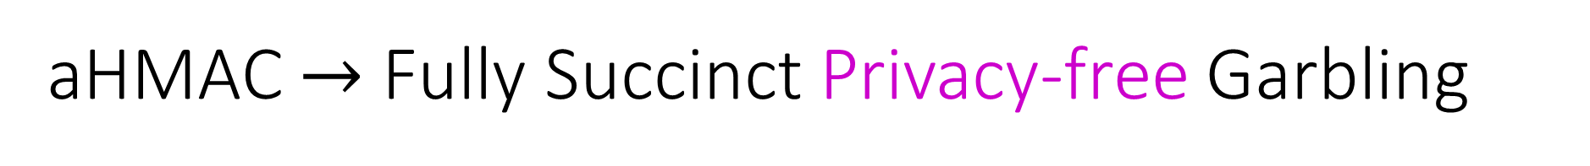

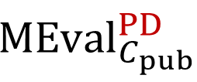
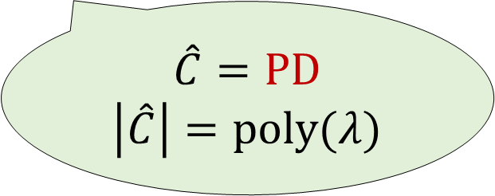


aHMAC $→$ Fully Succinct Privacy-free Garbling
[FNO15]
$$C_{pub}\left(\vec{x}\right)$$
Garbler
Evaluator
$$\left\langle s⋅\vec{x}\right\rangle ,\vec{x}$$
$${MEval}_{C_{pub}}^{PD}$$
$$\left\langle s⋅C_{pub}\left(\vec{x}\right)\right\rangle ,C_{pub}(\vec{x})$$
$$\hat{C}=PD$$
$$\left|\hat{C}\right|=poly(λ)$$
Notes:
Just to recap what I said about aHMAC, we can directly obtain a privacy-free variant of garbling as illustrated in this picture. Here the box represents aHMAC evaluation.
And the entire garbling size is just public data in aHMAC, which has fixed poly-lambda size, doesn’t depend on the circuit size of C_pub.

Slide 21



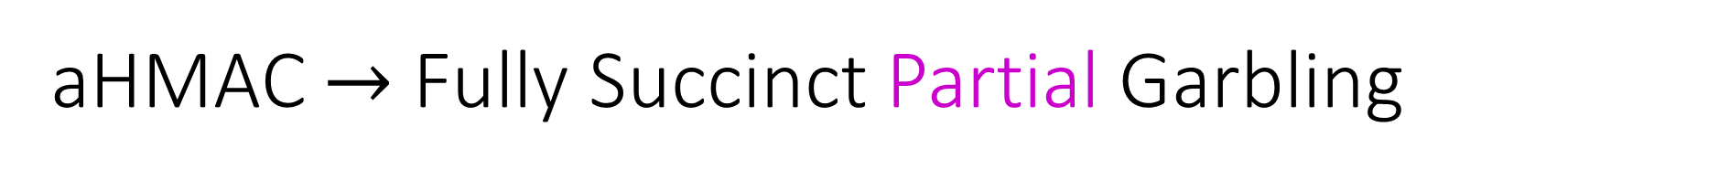

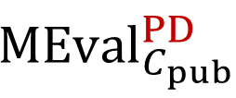

aHMAC $→$ Fully Succinct Partial Garbling
[IW14]
$$C\left(\vec{x},\vec{y}\right)=C_{priv}\left(C_{pub}\left(\vec{x}\right),\vec{y}\right)=\vec{z}$$
Garbler
Evaluator
$$\left\langle s⋅\vec{x}\right\rangle ,\vec{x}$$
$${MEval}_{C_{pub}}^{PD}$$
$$\left\langle s⋅C_{pub}\left(\vec{x}\right)\right\rangle ,C_{pub}(\vec{x})$$
$$C_{priv}(⋆,\vec{y})$$
$$\left\langle s⋅z\right\rangle$$
Notes:
As a next step, we can also obtain fully succinct partial garbling, which considers circuits with a privacy-free subcircuit, C_pub, but requires privacy for the rest of the wires in the circuit.
As before, we will use aHMAC to garble the privacy-free subcircuit C_pub, and then connect its output shares to a standard garbling scheme to handle the remaining private computation.

Slide 22

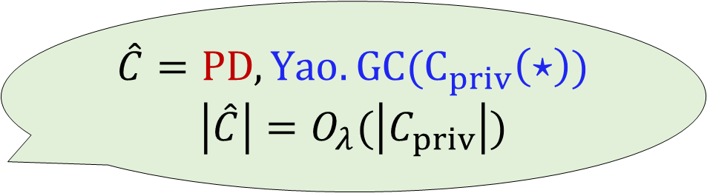





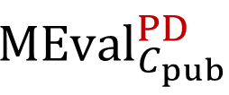

aHMAC $→$ Fully Succinct Partial Garbling
[IW14]
$$C\left(\vec{x},\vec{y}\right)=C_{priv}\left(C_{pub}\left(\vec{x}\right),\vec{y}\right)=\vec{z}$$
$$\hat{C}=PD, Yao.GC(C_{priv}\left(⋆\right))$$
$$\left|\hat{C}\right|=O_{λ}(\left|C_{priv}\right|)$$
Garbler
Evaluator
$$\left\langle s⋅\vec{x}\right\rangle ,\vec{x}$$
$${MEval}_{C_{pub}}^{PD}$$
$$\vec{ℓ}=s⋅C_{pub}\left(\vec{x}\right)+\vec{k}, \vec{ℓ^{′}}=s⋅\vec{y}+\vec{k′}$$
$$\left\langle s⋅C_{pub}\left(\vec{x}\right)\right\rangle ,C_{pub}(\vec{x})$$
$$C_{priv}(⋆,\vec{y})$$
$$Yao.GC(C_{priv}\left(⋆\right))$$
$$\left\langle s⋅z\right\rangle$$
$$ℓ^{′′}=s⋅z+k′′$$
Notes:
In more detail, the evaluator’s share of s time C_pub x act as input labels to a Yao’s garbling. This requires Yao’s garbling also with free-XOR style format.
So in this construction, the garbling of the privacy-free part doesn’t cost any communication. The overall garbling size is only Yao’s garbling of the private computation.

Slide 23

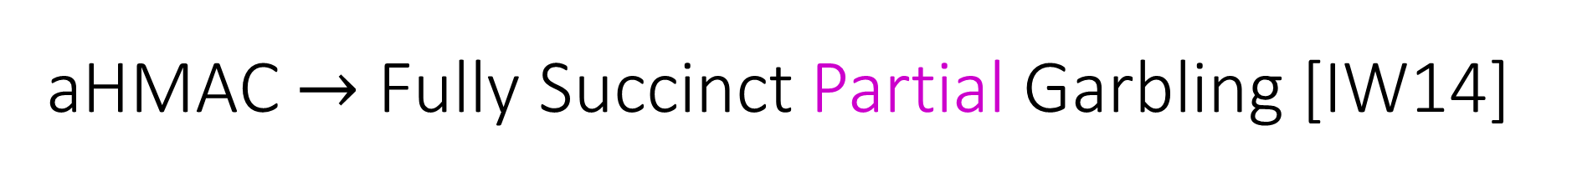



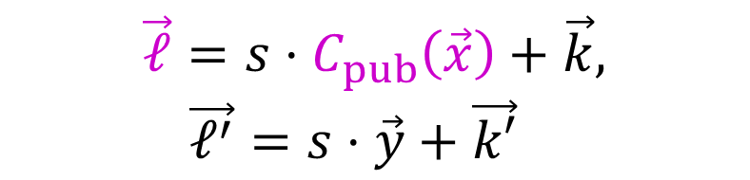

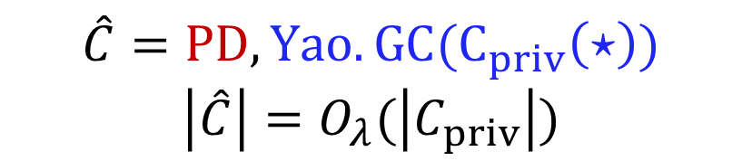
aHMAC $→$ Fully Succinct Partial Garbling [IW14]
$$\hat{C}=PD, Yao.GC(C_{priv}\left(⋆\right))$$
$$\left|\hat{C}\right|=O_{λ}(\left|C_{priv}\right|)$$
$$C\left(\vec{x},\vec{y}\right)=C_{priv}\left(C_{pub}\left(\vec{x}\right),\vec{y}\right)=\vec{z}$$
Garbler
Evaluator
$$\left\langle s⋅\vec{x}\right\rangle ,\vec{x}$$
$$\vec{ℓ}=s⋅C_{pub}\left(\vec{x}\right)+\vec{k}, \vec{ℓ^{′}}=s⋅\vec{y}+\vec{k′}$$
$${MEval}_{C_{pub}}^{PD}$$
$$\left\langle s⋅C_{pub}\left(\vec{x}\right)\right\rangle ,C_{pub}(\vec{x})$$
$$Yao.GC(C_{priv}\left(⋆\right))$$
$$C_{priv}(⋆,\vec{y})$$
$$ℓ^{′′}=s⋅z+k′′$$
$$\left\langle s⋅z\right\rangle$$

Slide 24
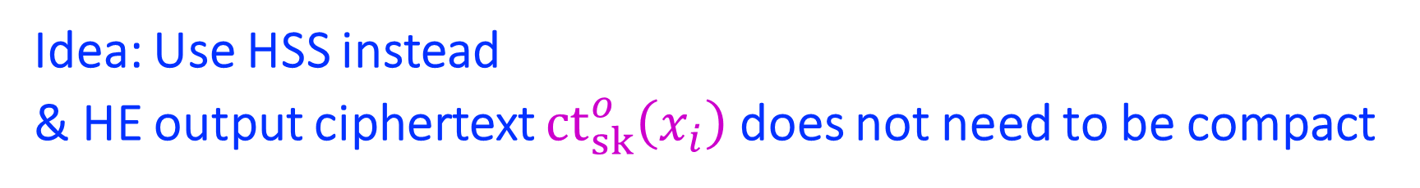





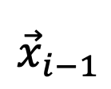



Paradigm for Standard Garbling
$$w$$
$$\left\langle s⋅HE.{ct}_{sk}\left({\vec{x}}_{i−1}\right)\right\rangle ,HE.{ct}_{sk}({\vec{x}}_{i−1})$$
$${\vec{x}}_{i}$$
$${MEval}_{HEval}^{PD}$$
$$d$$
$$f_{i}$$
$$\left\langle s⋅HE.ct_{sk}^{o}\left({\vec{x}}_{i}\right)\right\rangle ,HE.ct_{sk}^{o}\left({\vec{x}}_{i}\right)$$
$${\vec{x}}_{i−1}$$
Problem: Yao’s GC too large
$$ReEnc(sk,⋆)$$
$$\left\langle s⋅HE.{ct}_{sk}\left({\vec{x}}_{i}\right)\right\rangle ,HE.{ct}_{sk}\left({\vec{x}}_{i}\right)$$
Idea: Use HSS instead
& HE output ciphertext $ct_{sk}^{o}\left(x_{i}\right)$does not need to be compact
Notes:
Finally, to go from garbling without privacy to full privacy, our starting point is the common idea of encrypting the input with a homomorphic encryption, and homomorphically evaluate over them inside our aHMAC scheme.
If we use FHE, then we do get a succinct standard garbling, but it would be too computationally heavy. So the natural thought is to use a less powerful homomorphic encryption to only evaluated a low depth chunk of the circuit, and then re-fresh the evaluated ciphertext inside a private Yao’s garbling.
But this thought again runs into trouble, because this re-encryption circuit via Yao’s garbling takes too much communication. So our final idea is to instead use HSS to implement this private garbling of re-encryption. And since there is no communication in HSS, even if these homomorphically evaluated ciphertext have are not compact, this would only mean more computation, but not communication.

Slide 25





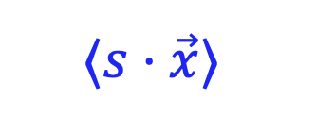

HSS for Simple Re-Encryption
Imagine very simple $Re\text{Enc}\text{:}$
HSS
$$sk$$
$$=$$
$$⟨s⋅\vec{x}⟩$$
$${\text{ct}}_{s}(\vec{x})$$
$${\text{HssE}\text{val}}_{f}$$
$$⟨s⋅f\left(\vec{x}\right)⟩$$
Notes:
To apply HSS, we recall the main computation of HSS requires both parties to have a ciphertext of the input. So it can only handle computation that doesn’t depend on any wire values. In our use case, these input would be the secret key for re-encryption.

Slide 26


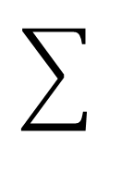






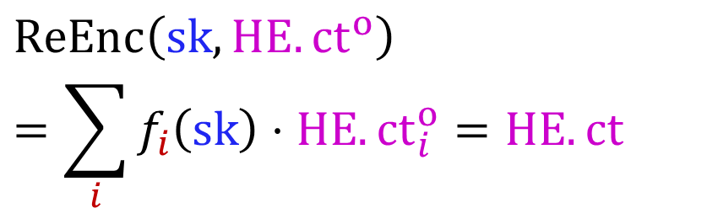







HSS for Simple Re-Encryption
Imagine very simple $Re\text{Enc}\text{:}$
HSS
$$sk$$
$$HE.{ct}^{o}$$
$$i$$
$$=$$
$$=$$
$$ReEnc\left(sk,HE.{ct}^{o}\right)$$
$$=\sum_{i}{f_{i}\left(sk\right)⋅HE.{ct}_{i}^{o}}=HE.ct$$
$$⟨s⋅\vec{x}⟩$$
$$⟨s⋅a ⟩$$
$$i$$
$$(over Z)$$
$${\text{ct}}_{s}(\vec{x})$$
$${\text{HssE}\text{val}}_{f}$$
$$⟨s⋅f\left(\vec{x}\right)⋅a ⟩$$
$$i$$
$$i$$
$$=$$
$$⟨s⋅HE.ct⟩$$
Notes:
Additionally common HSS schemes can actually be slightly extended to handle one more input a, that doesn’t have associated ciphertexts. This would be our homomorphic ciphertext waiting for re-encryption. With the extended interface, we can evaluate any branching program on the secret key, but then only a simple inner product with the additional input.
So for our paradigm to work, we need a very simple Re-encryption circuit that fits this interface.

Slide 27







Paradigm for Standard Garbling
$$w$$
$$\left\langle s⋅HE.{ct}_{sk}\left({\vec{x}}_{i−1}\right)\right\rangle ,HE.{ct}_{sk}({\vec{x}}_{i−1})$$
$${\vec{x}}_{i}$$
$${MEval}_{HEval}^{PD}$$
$$d$$
$$f_{i}$$
$$\left\langle s⋅HE.ct_{sk}^{o}\left({\vec{x}}_{i}\right)\right\rangle ,HE.ct_{sk}^{o}\left({\vec{x}}_{i}\right)$$
$${\vec{x}}_{i−1}$$
$${\text{ct}}_{s}(sk)$$
$$HSS(ReEnc)$$
$$\left\langle s⋅HE.{ct}_{sk}\left({\vec{x}}_{i}\right)\right\rangle$$
1-way Comm.
$$\left\langle s⋅HE.{ct}_{sk}\left({\vec{x}}_{i}\right)\right\rangle ,HE.{ct}_{sk}\left({\vec{x}}_{i}\right)$$
Notes:
In summary, our paradigm with HSS looks like the following, where HSS handles private garbling for a simple re-encryption.
Note that to continue with aHMAC evaluation for the next layer, we need to also reveal the refreshed ciphertext to the evaluator. This can be done by some 1-way communication, which would be then only communication in our scheme.

Slide 28




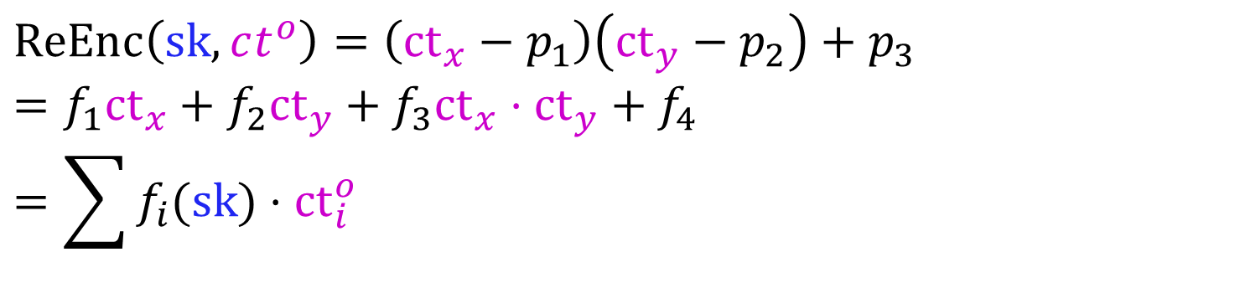
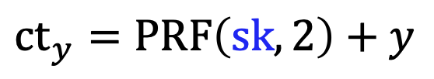
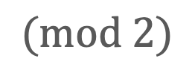


One-time Pad has Simple Re-Encryption!
$$p_{1}$$
$$p_{2}$$
$${ct}_{x}=PRF\left(sk,1\right)+x$$
$${ct}_{y}=PRF\left(sk,2\right)+y$$
$$(mod 2)$$
$${ct}^{o}=HMult\left({ct}_{x}, {ct}_{y}\right)={ct}_{x}, {ct}_{y},{ct}_{x}⋅ct_{y}$$
$$(mod 2)$$
$$ReEnc\left(sk,ct^{o}\right)=\left({ct}_{x}−p_{1}\right)\left({ct}_{y}−p_{2}\right)+p_{3}$$
$$={f_{1}{ct}_{x}+f_{2}{ct}_{y}+f}_{3}{ct}_{x}⋅ct_{y}+f_{4}$$
$$=\sum{f_{i}(sk)}⋅{ct}_{i}^{o}$$
$$(mod 2)$$
$$(over Z)$$
$$(over Z)$$
Notes:
It remains the specify what’s the homomorphic encryption we use that satisfy simple re-encryption. And we realize simple one-time pad is enough. The quote unquote homomorphic evaluation is just keeping both ct-x and ct-y, and additionally compute ct-x times ct-y.
Re-encryption indeed satisfy our requirement, which I will skip the equations here.

Slide 29
















Paradigm for Standard Garbling
$$C$$
$$\left\langle s⋅OTP.{ct}_{sk}\left({\vec{x}}_{i−1}\right)\right\rangle ,OTP.{ct}_{sk}({\vec{x}}_{i−1})$$
$$gate$$
$$gate$$
$$gate$$
$${MEval}_{HEval}^{PD}$$
$$gate$$
$$gate$$
$$\left\langle s⋅OTP.ct_{sk}^{o}\left(x_{i}\right)\right\rangle ,OTP.ct_{sk}^{o}\left(x_{i}\right)$$
$$gate$$
$${\text{ct}}_{s}(sk)$$
$$HSS(ReEnc)$$
For layered circuits,
$O(\frac{1}{loglogλ})$ bits per gate
$$…$$
$$gate$$
$$\left\langle s⋅OTP.{ct}_{sk}\left(x_{i}\right)\right\rangle$$
$$gate$$
$$gate$$
1-bit Comm. per gate!
1-way Comm.
$$\left\langle s⋅OTP.{ct}_{sk}\left(x_{i}\right)\right\rangle ,OTP.{ct}_{sk}\left(x_{i}\right)$$
Notes:
So back to our picture, what we do is we apply re-encryption for every gate, and everytime we re-encrypt we pay 1-bit of communication to reveal the new one-time-padded wire values.
This technique is extended slightly in our paper to obtain layered Boolean garbling scheme, with 1/loglog lambda bits per gate, and also to obtain constant rate arithmetic garbling for any modulus.

Slide 30
Thank you!

